Slide 1
Modernizing Medical License and Credentialing Applications
[your name and credentials]
in collaboration with the American College of Physicians
Well-Being and Professional Fulfillment Initiative
Notes:
I am here today to speak about an urgent issue for our physician workforce and a possible fix: the problem of medical license and credentialing applications and how they deter physicians from seeking mental health care
These slides will include screenshots of articles so that we can have a shared understanding of the why and how to modernize medical license and credentialing applications.
Consider an anecdote that is a ‘hook’ that can personalize why this topic that is important, such as if you know a peer or learner who is a great physician but who did not seek mental health care because they were afraid of how it would affect their ability to get or keep a job

Slide 2
Notes:
QR codes will be available throughout these slides so that you can scan them and read the primary resources at your leisure.
It’s widely reported that physician burnout is widespread, with wide-reaching and long-lasting effects on the workforce through recruitment and retention. But often when we are discussing physician burnout it is used interchangeably with depression – but they are different entities. This paper in JAMA Network Open helps highlight why it is important that we understand they are different.
It is a cross sectional study that examined self reported medical errors, suicidal ideation, burnout, and depression.

Slide 3
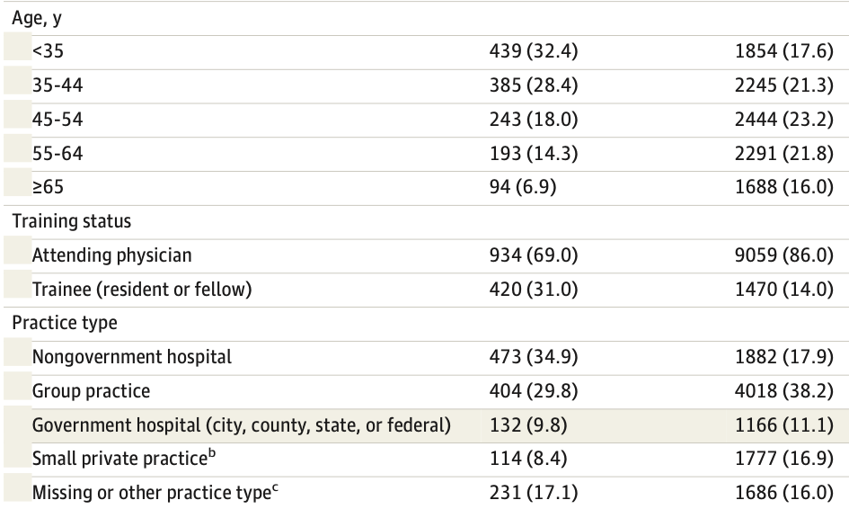
Notes:
There were over 10000 participants, and they reflected all ages, all genders, and all practice types – so we should feel safe thinking about the implications of these findings within our own team/clinic/community/hospital/system

Slide 4
Notes:
The authors found that:
Depression was associated with suicidal ideation but not self-reported medical errors.
Burnout was associated with medical errors but not suicidal ideation.
So we should be targeting both burnout and depression, while always knowing they are different entities. And that burnout appeared to affect patient care, but depression did not.

Slide 5
Notes:
Having established that depression and burnout are different, and have different consequences, we’re going to come back to medical license applications.
Medical license applications have long asked about physician mental and physical health. For the last several years, this practice has fallen under scrutiny.
This is a paper from 2017 where the authors surveyed physicians about their reluctance to seek mental health care and corresponded respondents’ answers to whether they lived in a state that asked about mental health on their state’s medical license application. (For the purposes of the data analysis, they examined if the medical license application questions on mental health were consistent or inconsistent with recommendations from the Federation of State Medical Boards [who recommends against asking questions that deter help seeking])

Slide 6
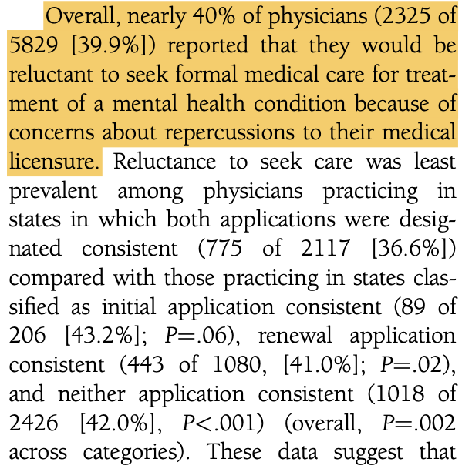
Notes:
In this nationwide sample of more than 5800 physicians, nearly 40% of respondents reported reluctance to seek treatment for a mental health diagnosis due to concerns about the possible effects on their medical licensure.

Slide 7
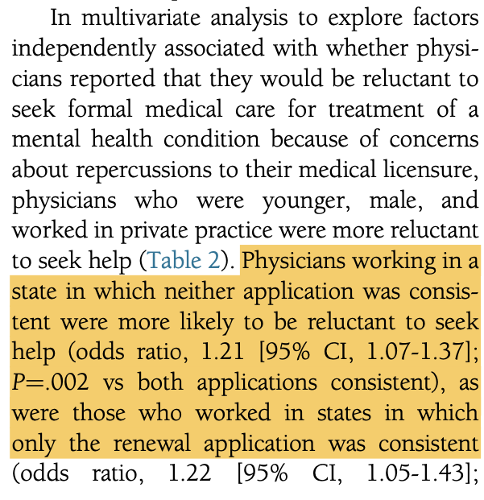
Notes:
Furthermore, one of the predictors of physician reluctance to seek mental health care was if their state asked questions on their license application about mental health diagnoses or mental health care

Slide 8
Notes:
The last paper was from 2017, and it’s natural to wonder if things have changed since then as there has been increasing attention paid to physician mental health.
In this JAMA research letter published in 2021, recommendations for medical license applications from the Federation of State Medical Boards were reviewed and compared to a compendium of initial license applications. Specifically, recommendations for how physician mental health is addressed by the license application were reviewed for each state.

Slide 9
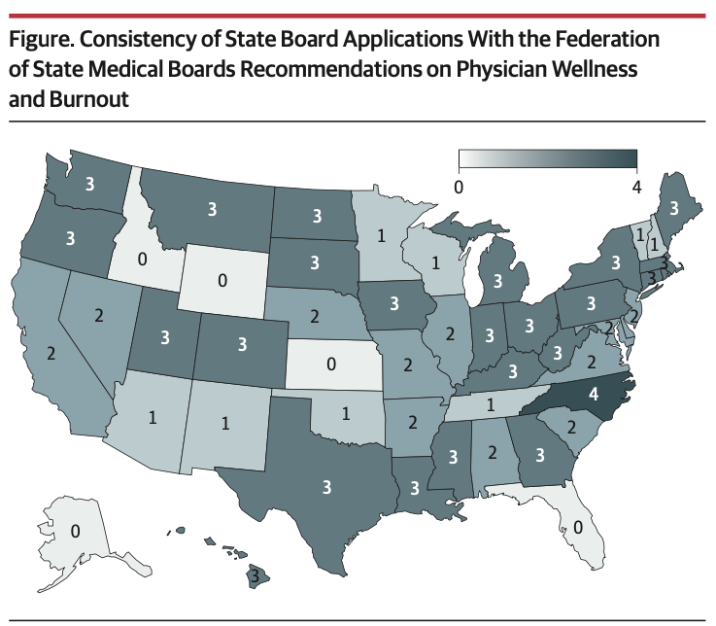
Notes:
The authors found there was widespread heterogeneity in how consistent state board applications were with recommendations from the FSMB, with only one state following all 4 measurable recommendations. A vast majority of states were following at least one recommendation, however.
(Here the darker the blue color, the more consistent license applications were with FSMB recommendations.
Also, although this may seem disappointing, several states have revised how they address physician mental health since this paper was published.

Slide 10
Notes:
We’ve discussed in the first JAMA Network Open paper presented that physician’s having depression is common and is not shown to be tied to medical error, in the second article that medical license applications asking about mental health deter physicians from seeking mental health care, and also that mental health questions are still common on license applications.
This paper highlights an additional problem with medical license applications on mental illness: they may not be compliant with the ADA.
In this paper, the authors used a compendium of medical license applications to examine for compliance with the ADA.

Slide 11
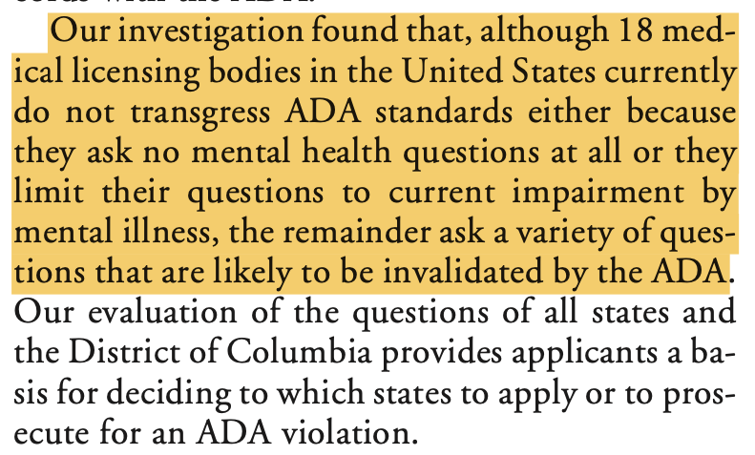
Notes:
The authors found that multiple states asked questions that are likely inconsistent with requirements of the ADA.
The papers presented highlight a pervasive problem facing physicians, but other papers provide some solutions.

Slide 12
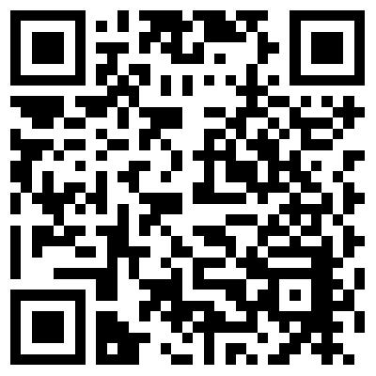
Notes:
This ACP paper notes that physicians may be reluctant to access mental health care because of stigma, and physician concerns about lack of confidentiality and licensure requirements. The medical community must act to change its culture around mental health issues of its members and counter barriers that prevent physicians from seeking care.

Slide 13
Notes:
This is a paper from early 2020 describing how one state modernized their state license application’s approach to physician mental health.
In it, the authors describe the why, who, what, and how of working with the medical board.
Instead of asking questions about diagnoses or possible diagnoses, either past or present, this paper recommends that if medical boards must ask about physician health that they focus on the effect on their ability practice, such as by asking:
Do you currently have any condition that adversely affects your ability to practice medicine in a safe, competent, ethical and professional manner?

Slide 14
Adding language that supports help-seeking is also important:
It is common for licensees to feel overwhelmed from time to time and to seek help when appropriate. The Board emphasizes the importance of well-being and appropriate treatment and support for all health conditions.
Notes:
Because it is so common for physicians and other healthcare workers to have their mental health affected by their work, it’s also recommended that boards (and credentialing applications) specifically endorse help-seeking, such as by including language like:
It is common for licensees to feel overwhelmed from time to time and to seek help when appropriate. The Board emphasizes the importance of well-being and appropriate treatment and support for all health conditions.

Slide 15
Notes:
This paper was published in the fall of 2021, and in addition to calling for removal of questions on mental health care from license applications, also calls for removing them from credentialing applications.
Specifically, it calls for institutions and organizations to: ‘update credentialing and employment applications to remove unnecessary questions about mental and physical health diagnoses that may deter care-seeking, violate the Americans With Disabilities Act, and stigmatize clinicians’

Slide 16
In summary
Clinician mental health is essential for patient health and the health of the workforce
License and credentialing applications play a prominent role in deterring clinicians from seeking mental healthcare
These questions can (and should) be changed to no longer serve as a barrier to physician’s seeking care

