Slide 1
Presenter Instructions
These adaptable slides contain a menu of activities that can be used to present at Chapter meetings, wellness committee meetings, or other areas of your institution.
These materials should not be used for anything other than individual, non-commercial purposes
To cite an ACP adaptable presentation on your CV, list your name, title of the presentation, date of presentation, and the presentation location (unless virtual).
Doe, J. Feelings and needs. Presented at: ACP Florida Chapter Scientific Meeting; December 4, 2020.
Smith, M. Enhance personal well-being and professional satisfaction. Presented at: ACP Michigan Chapter Scientific Meeting; October 11, 2019. Grand Rapids, MI.
Change any red text, delete, and re-order the slides throughout the presentation as needed so that it is customized to your presentation.
See the notes section below each slide for additional information.

Slide 2

Title of Happy Hour/Community Get Together
Presenter Name
Notes:
Replace with the title of your happy hour/wellness experience

Slide 3
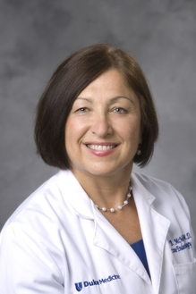
Meet Our Host
Diana McNeill, MD, MACP​
Professor of Medicine at Duke University Medical Center ​
Inaugural Director, Duke AHEAD​
Well-being Champion, North Carolina Chapter​
​
Kristin Dickerson​
Duke AHEAD Coordinator
Notes:
Replace with your headshot and name/credentials

Slide 4
Agenda
Welcome
Well-being moment and icebreaker
Rethinking the happy hour
Our present state (how are we feeling right now) and our hopes for the future
Enhancing personal well-being activities – Select 2 or 3 as time allows
Balancing competing priorities
Living in the circle of influence
Engaging in reflection
Limiting screen time
Expressing gratitude
Thriving together
Wrap Up
Notes:
Adapt and shorten the activities listed here to fit your needs and interests.

Slide 5

Welcome to the Happy Hour
Use your chat function to respond to questions.
Show your face on video.
This is an informal gathering. Feel free to mute your mic and turn off your camera if you need to step away.
Notes:
Add or remove any other rules/guidelines for your event.

Slide 6
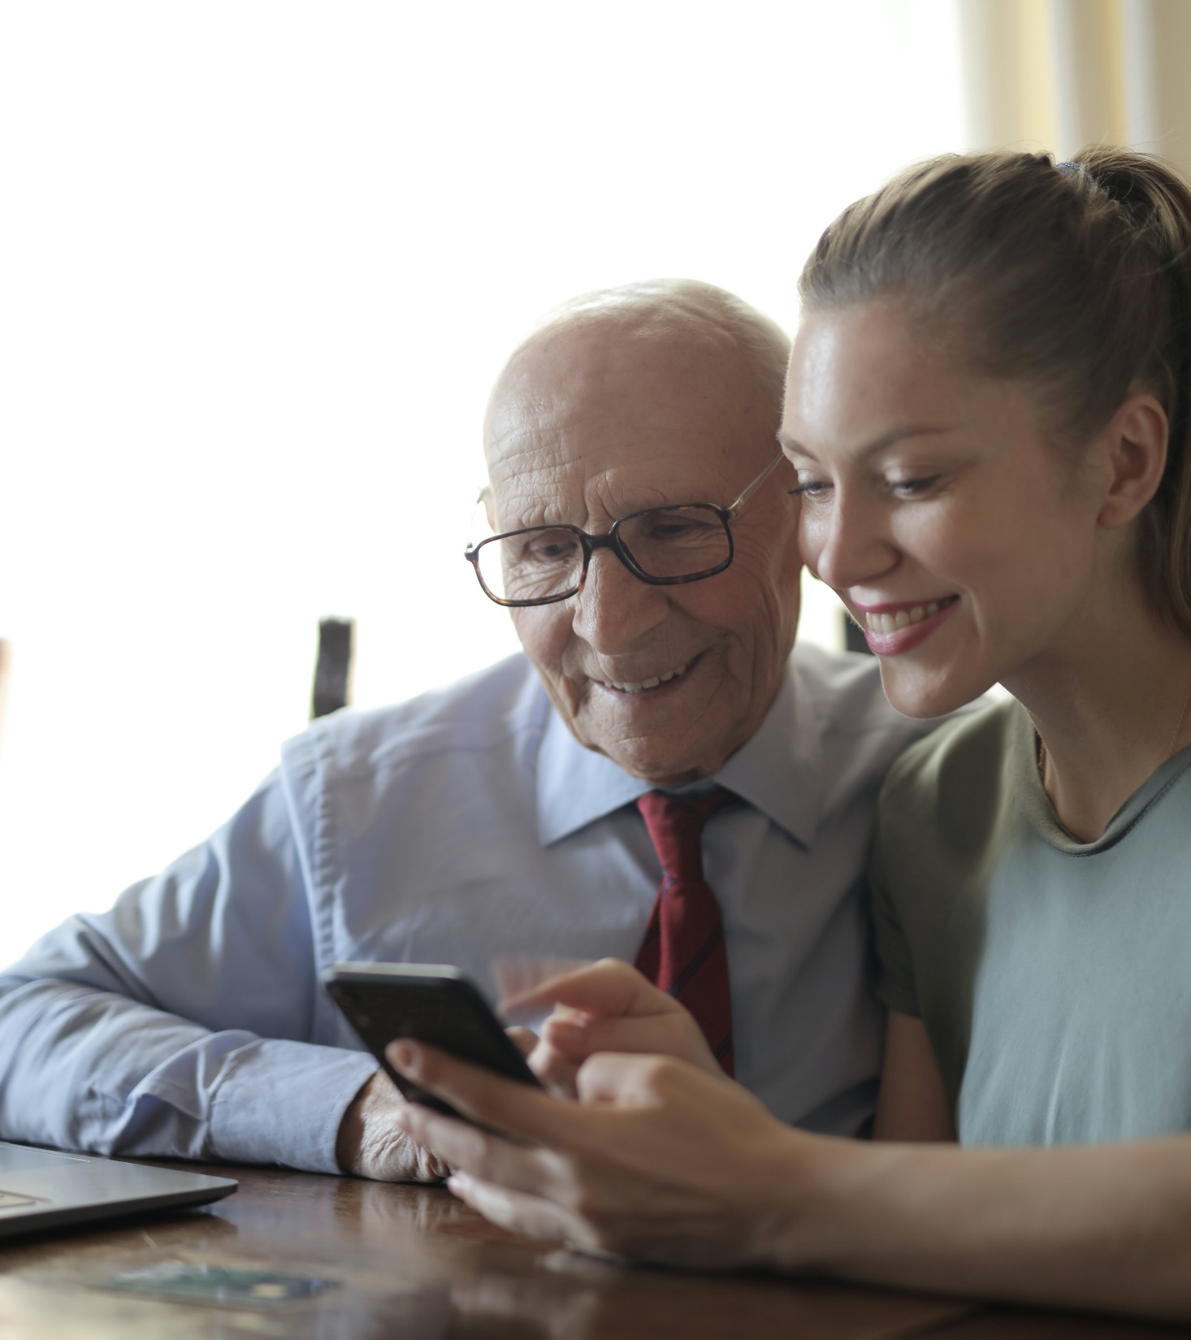
Well-being Moment
Spend 1 minute thinking about a person you are grateful for and make a plan to reach out to this person after this happy hour!

Slide 7

Icebreaker: 3 Things in Common
I will pair you with another participant in a breakout room OR in the chat.
You will have 5 minutes to chat and discover 3 things you have in common.
After 5 minutes, we will get back together and share what we’ve learned with the larger group.
Notes:
If you don’t want to use breakout rooms (or if your platform doesn’t support it,) have your participants partner using the chat box.

Slide 8

Where can you spend a happy hour?
Notes:
When we traditionally think of happy hours, we may think of cocktails or networking, but we can reframe the term happy hour to mean time for ourselves to focus on joy and reflection.
Replace this picture with one meaningful to you, and use it to spark conversation: Where is a place that invokes a sense of calm and relaxation? Where you can spend a “happy hour?”

Slide 9
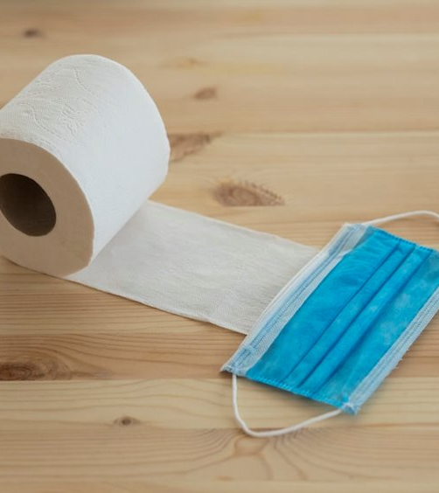
How does this picture make you feel?
Notes:
Invite participants to share one word about how this picture makes them feel in the chat, then paste some words you see into the text box. (Must be out of presentation mode.)

Slide 10

Share a wish you have for the future.
Notes:
Planning for the future can help inform a sense of optimism. Ask participants to share a wish they have for the future in the chat. (Post-COVID or more generally.) Paste selected responses in the text box. (Must be out of presentation mode.)

Slide 11


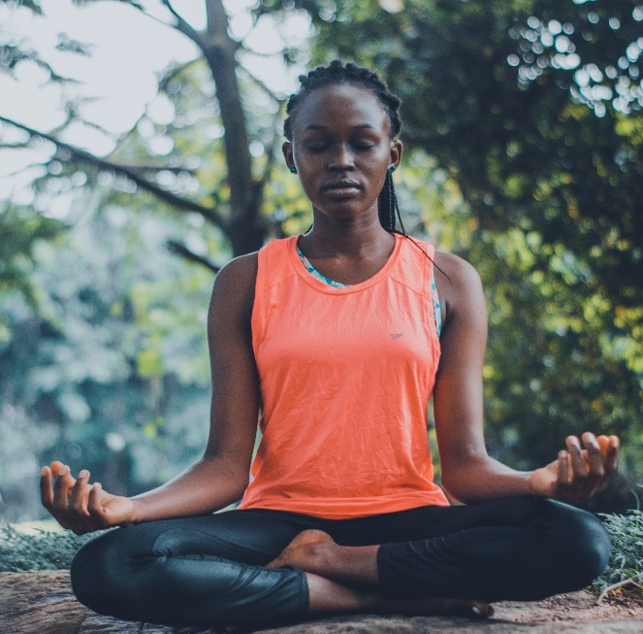
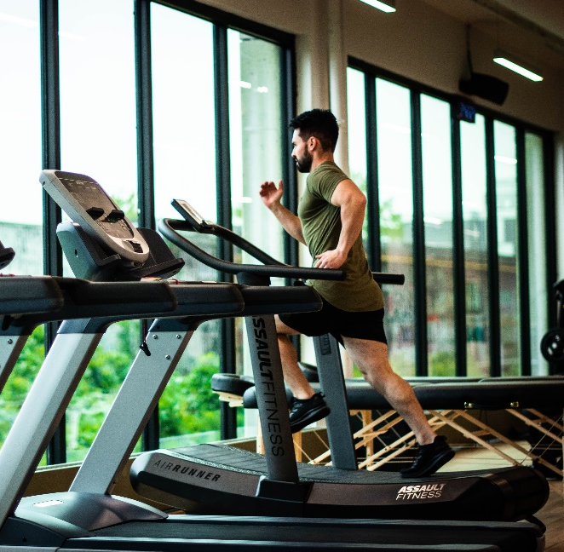
Balancing Priorities
How do you balance competing priorities?
Tell us about a recent success or setback.
Share your best tips or lifehacks.
What do you do to rejuvenate?
Does your daily to-do list align with your priorities?
What is one thing you’d like to do to improve your quality of life?
Photo by Andrea Piacquadio from Pexels
Photo by Ketut Subiyanto from Pexels
Photo by Oluremi Adebayo from Pexels
Photo by William Choquette from Pexels
Notes:
Ask participants to share ways they find alignment between their competing priorities at work and home. Encourage them to engage in daily priority setting.

Slide 12
What are things you can embrace or let go of moving forward?
 | Say YES to… | Say NO to…
Family/Friends
Health
Personal Interests
Spirit
Work
Notes:
What are things you can embrace or let go of to better balance your competing priorities?
Ask participants to respond in the chat, then record their responses in the text boxes. (Must be out of presentation mode.)

Slide 13
Living in the Circle of Influence
What is something in your circle of influence?
What is something outside of it that causes you concern?
What can you let go?
Circle of Concern
Circle of Influence
Notes:
When feeling stressed, it may be helpful to stop and identify those things that are not under our control, and those things that are under our control. Encourage participants to make their own circle of concern/influence. Participants can identity what in their lives they have control over, what they have influence over, and what they cannot control. Most of us spend our time in the circle of concern. Remind participants to spend most of their time focused on that circle of influence.

Slide 14

How do you engage in reflection?
Notes:
Ask participants how they engage in reflection. Paste selected responses from the chat in the text box. (Must be out of presentation mode.)
Emphasize the importance of regular reflection on personal well-being and suggest different ways of doing that (e.g. mindfulness meditation, gratitude journal, three good things).

Slide 15
Making Technology Work for You
How can you use technology in ways that enhance flexibility and allow you to fulfill both personal and professional responsibilities?
How can you promote the right balance between your work and your personal life?
What are some strategies you can use to limit screen time and set boundaries on technology?
Notes:
In this virtual world, we are all feeling exhausted by technology. Encourage participants to take a few minutes every day to unplug from the phone, laptop, etc. Ask participants for strategies they use to limit their own screen time, or for ways to make technology work better for them.

Slide 16

Gratitude
What are some creative ways to express gratitude towards others around you?
This Photo by Unknown Author is licensed under CC BY
Notes:
Expressing gratitude increases both your well-being, and the well-being of the person being thanked. Ask participants to share some creative ways that they express gratitude towards those around them (colleagues, family, caregivers, etc.).

Slide 17
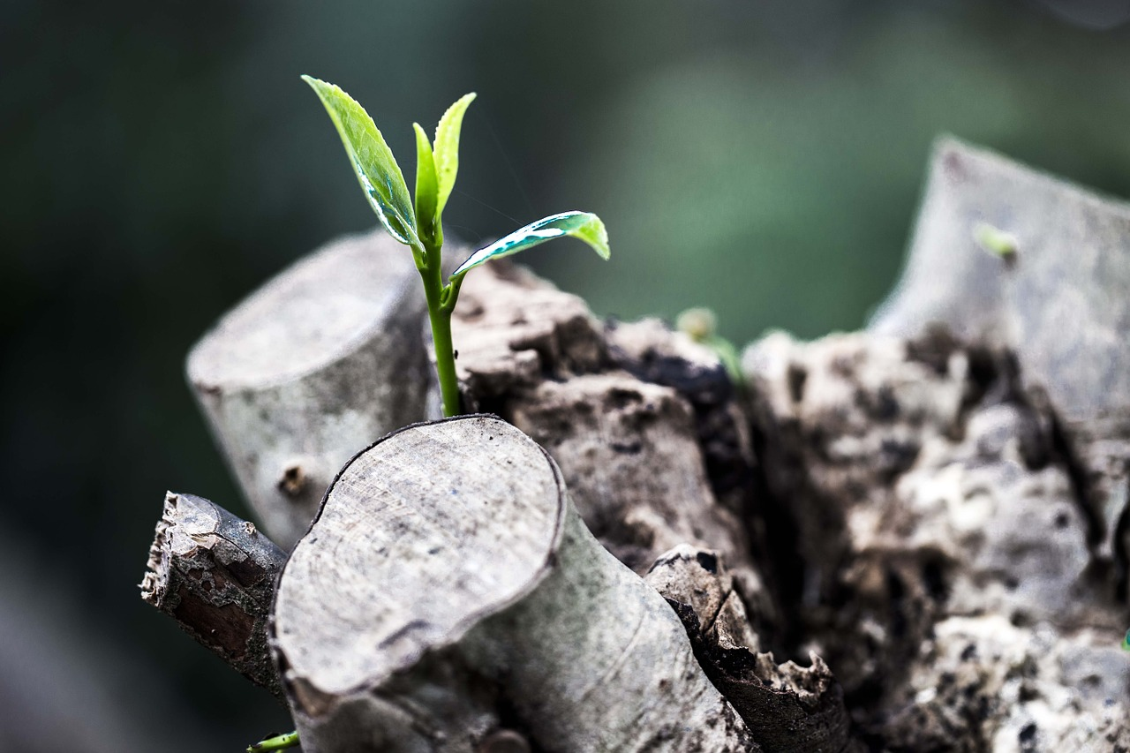
To thrive during these present challenges, we will…
Notes:
End on a message of hope. Ask participants to share ways they can thrive personally and within their organization during times of challenge.

Slide 18

Thank you for joining us!
Add additional info here (your e-mail, social media, links to happy hour sign up sheet, other well-being resources, etc.)

