Slide 1
Technology to reduce administrative burdens
Priya Radhakrishnan, MD, FACP, FAMWA,
Chief Academic Officer, VP, HonorHealth,
Vice Dean of Clinical Affairs & GME- ASU John Shufeldt School of Medicine & Advanced Medical Engineering
Ankita Sagar, MD, MPH, FACP, FAMWA,
System Vice President, Clinical Transformation and Well-Being, CommonSpirit Health

Slide 2
Begin with the end in sight
Technology, Medical Education and the Future

Slide 3
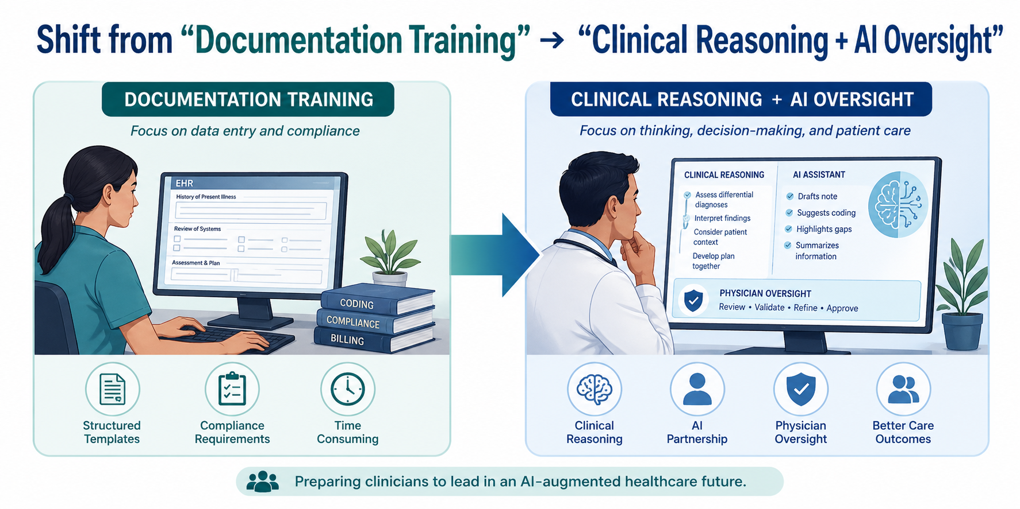
Integration into Medical Education

Slide 4
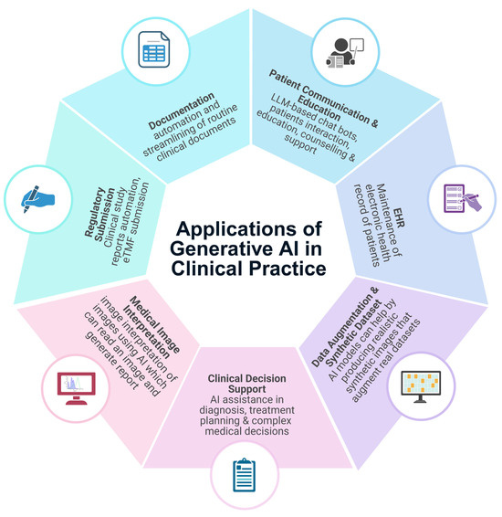
Curriculum
Teach:
  AI-assisted documentation validation
  Digital workflow management
  Data interpretation vs data entry
Clinical informatics
AI literacy
Systems-based practice
Rabbani SA, El-Tanani M, Sharma S, Rabbani SS, El-Tanani Y, Kumar R, Saini M. Generative Artificial Intelligence in Healthcare: Applications, Implementation Challenges, and Future Directions. BioMedInformatics. 2025; 5(3):37. https://doi.org/10.3390/biomedinformatics5030037

Slide 5
Medical Education- Training Transformation
New Competencies
Supervising AI outputs
Leading team-based digital care
Quality improvement using real-time data
Upskilling Faculty
GME reimbursement & payment rules

Slide 6
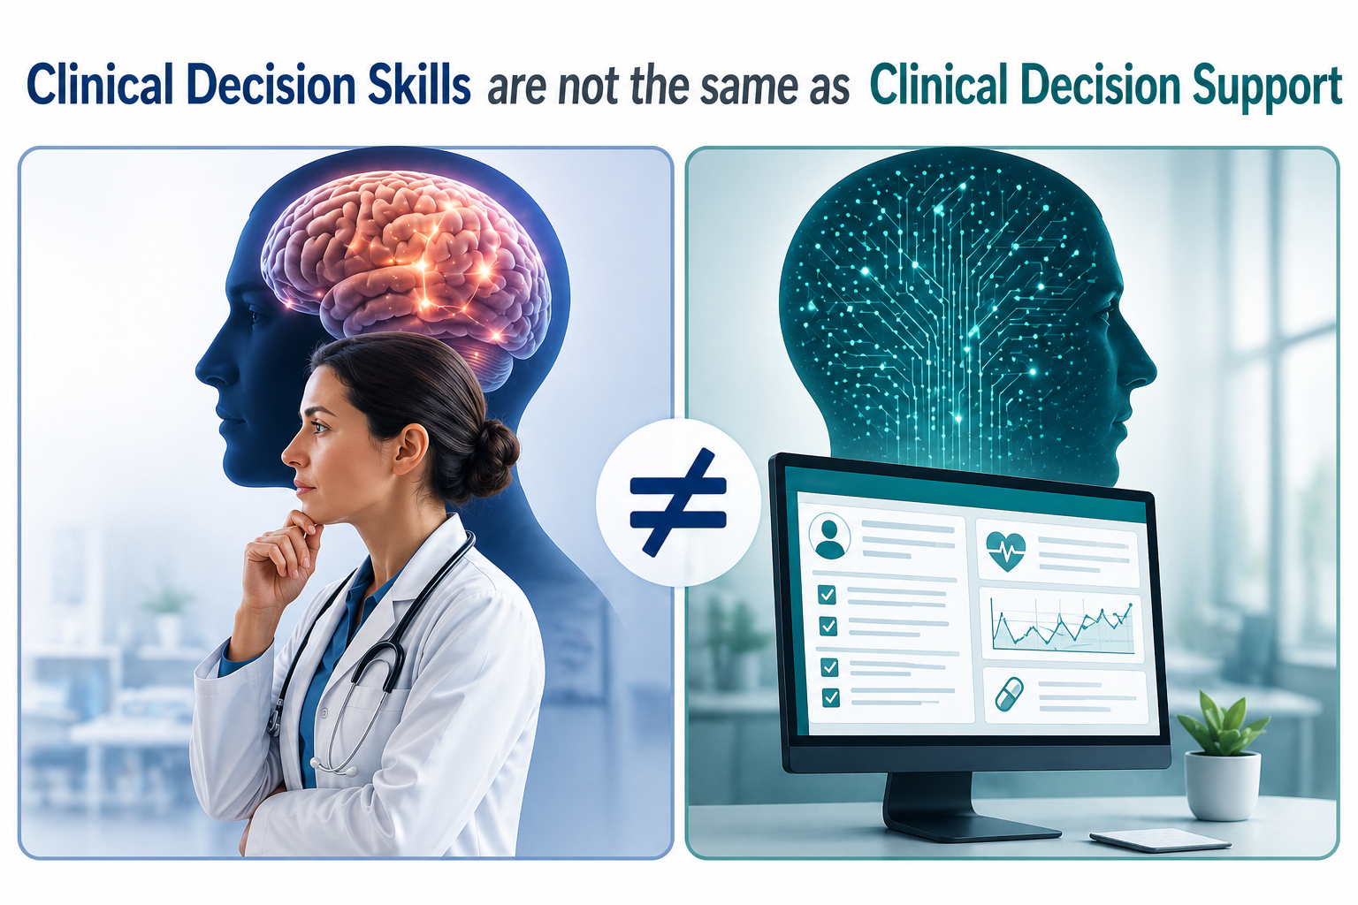

Slide 7

Rural & Underserved Settings
Unique Challenges
  Workforce shortages
  Limited specialty access
  Infrastructure gaps
Technology Levers
  Tele-primary care augmentation
  AI-supported diagnostics
  Centralized virtual inbox teams

Slide 8
Equity Considerations
Address Digital divide exacerbation
Ensure:
  Broadband access
  Language-inclusive AI tools
  Bias monitoring in algorithms
Opportunity:
Technology can reduce disparities if implemented intentionally

Slide 9
Building the Primary Care Workforce For Trainees
Increased attractiveness of primary care careers
Better alignment with digital-native expectations

Slide 10
Financial & Operational Model
Upfront investment:
  AI tools
  Workflow redesign
ROI:
  Increased panel size capacity
  Reduced turnover costs
  Improved billing capture

Slide 11
Knowing this, how should we think about technology?

Slide 12
Technology must fundamentally improve the experience of practicing medicine, not merely optimize existing processes.

Slide 13
Medicine is a calling.
Non-compensated work: notes, inbox, orders
Invisible labor: nights/weekends/pajama time
Cognitive overload: constant task switching
Moral injury: right care is hardest to delivery in the system
Loss of continuity: fragmented, inbox-driven care
Loss of mastery: less thinking, more processing = widgets
Notes:
We are overpaying for low-value physician work
And underutilizing their highest skills

Slide 14
Medicine is a calling.
The question we must ask:
What is the problem we need to address?
Notes:
We are overpaying for low-value physician work
And underutilizing their highest skills

Slide 15
Medicine is a calling.
The work no longer matches the calling.
This is not an interest (or resilience) problem
It’s a flawed work design problem.
Notes:
We are overpaying for low-value physician work
And underutilizing their highest skills

Slide 16
Expectations of Tech
Physician Time Returned
Physician Time Returned
  Reduce after-hours work
  Restore cognitive bandwidth
  Create space for thinking, teaching, living
Top-of-License Care Redesign
  Upskill workforce (APPs, RNs, digital tools)
  Triage needs so physicians can focus on: complex decisions, and diagnostic & therapeutic reasoning
  Result in increased engagement & effectiveness
Scalability to move from Innovation to Adoption
  Adoption is prioritized over innovation novelty
  Integrate into real workflows (no added steps)
  Build trust by showing visible, immediate relief
  Align with payment and incentive structures
Levers that Redesign the Practice of Internal Medicine
Scalability
Top of License Care

Slide 17
Tech focuses on:
Efficiency
Click reduction
Burnout mitigation
The question we must ask:
Does this tech make Internal Medicine a career people choose, survive, and thrive?
Bottom line:
If it doesn’t improve how it feels to practice, it won’t change workforce trends.

Slide 18
Technology must fundamentally improve the experience of practicing medicine, not merely optimize existing processes.

Slide 19
AI in Clinical Settings
Foundational / Infrastructure
Medical Research Assistance
Revenue Cycle & Utilization
Workflow Automation & Care Coordination
Clinical Documentation & Ambient AI
Patient Communication & Engagement
Clinical Decision Support & AI
Co-Pilots
EHR-integrated AI platforms
Interoperabiliy and data aggregation layers
Clinical data models and APIs
Enterprise AI infrastructure (secure, compliant LLM layers)
Conducting literature review
Analyzing research data
Recording research processes
Managing research enrollment
Automated coding and billing
Documentation-to- revenue optimization
Prior authorization support
Utilization + compliance tools
Inbox triage
Task routing across care teams
Scheduling + follow-up automation
Ambient scribes
Note generation
Clinical summarization
Coding support (CPT/ICD)
Messaging automation
Patient instructions + education
Virtual agents (calls, scheduling, follow-ups)
Diagnostic support tools
Treatment recommendation engines
Order/referral automation
Chart summarization + clinical reasoning assistants
AI "copilots" embedded in EHR workflows
Ex. Connection between external imaging and Primary Care, Gen AI for emails or documents etc
Ex. Statistically analyze the data, randomize enrollees
Ex. Revenue optimization for missing codes, CDI AI for missing details
Ex. Triage summary for call center, smart scheduling, Patient tracking in ED/hospital
Ex. Ambient listening or coding companions
Ex. Virtual AI agent for triage inboxes, automated responses in inbox,
Ex. AI assisted colonoscopy, AI assisted liver embolization simulation, RPA for cancer screening
Adapted from: Bedi, S., Cui, H., Fuentes, M. et al. Holistic evaluation of large language models for medical tasks with MedHELM. Nat Med 32, 943–951 (2026). https://doi.org/10.1038/s41591-025-04151-2

Slide 20
Priority Matrix for Clinical AI
 |  | Effort
 |  | High Effort | Low Effort
Impact | High Impact | Strategic enablers Virtual RN triage models Centralized inbox or call management Pre-visit planning at scale AI clinical decision support | Near Term bets/ Quick Wins Ambient / generative documentation Inbox triage rules + protocols Basic RPA for refills, forms, scheduling, patient risk stratification
 | Low Impact | Foundational Bets/Ecosystem Cross-payer PA automation Interoperable data exchange Payment models that reward cognitive work | Incremental Optimizers Minor EHR workflow tweaks (templates, order sets) Single-step click reductions Small improvements without role redesign Narrow automation that saves seconds, not hours One-off specialty tools with limited spread

Slide 21
Call to Action
Integrate technology into training environments first
Align incentives with burden reduction
Prioritize rural and vulnerable populations
Treat admin reduction as a core workforce strategy
Ask for explicit data showing how tech improves the experience of working in medicine, not just a surrogate marker.

