Slide 1
Democratizing Specialty Access through Collaboration with Primary Care
Brian Brady, MD
Clinical Associate Professor of Medicine
Stanford University School of Medicine, Division of Nephrology
On Behalf of the Stanford Medicine CKD Population Health Team

Slide 2





Slide 3
Acceleration of Kidney-Focused Therapeutics
Budesonide
Sparsentan
Finerenone
Tolvaptan
Empagliflozin
Dapagliflozin
Irbesartan
Losartan
Eculizumab
Ramipril
Semaglutide
Canagliflozin
1980
1990
2000
2010
2020
2030
Epoetin α
Sevelamer
Cinacalcet
CKD Guideline Directed Medical Therapy
Notes:
This slide is meant to convey the explosion in kidney focused therapeutics over the last decade and paint a stark contrast to the 20 years between 1990’s and 2010’s when all that was approved to treat CKD were RAAS inhibitors

Slide 4
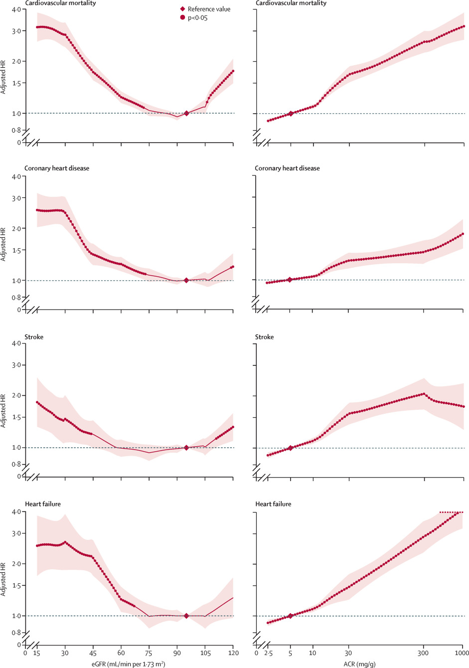
Matsushita et al
Lancet Diab Endo 2015

Slide 5
Albuminuria is a Bad Actor
Death
Stroke
Heart Attack
Hospitalization
Albuminuria
Vascular Disease
Arrythmia
Heart Failure
Kidney Failure

Slide 6







Our opportunity
Low Awareness
Patient Engagement
UACR?
CKD and CVD
Limited Nephrology Access
Kidney Disease
Limited Rx
Rx Revolution
Limited Nephrology Access

Slide 7
Extending Specialty Care Through Teams
PCP
Nephrologist
PCC
PharmD
RD
APP
High-Value Care Innovation
Fee-for-Service Tradition
Notes:
This slide is used to discuss the importance of finding innovative care models to deal with a constrained supply of specialists and major access to care issues which exist across the US. Finding a way to scale specialty care (we propose through building teams based in primary care) holds the potential to extend the reach of specialists beyond the 1:1 office visits which serve as the current model. In the nephrology example, nephrologists serve as content experts and educators to teach primary care physicians and other team members how to start and titrate guideline directed treatment early on in patients’ CKD course to slow disease progression and reduce CVD risk for patients with moderate to advanced CKD.

Slide 8
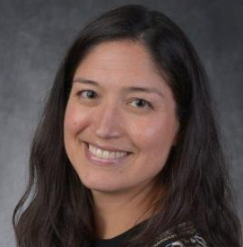
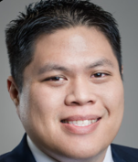



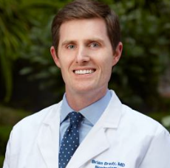

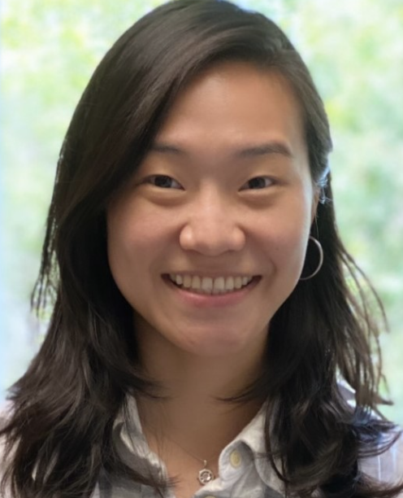
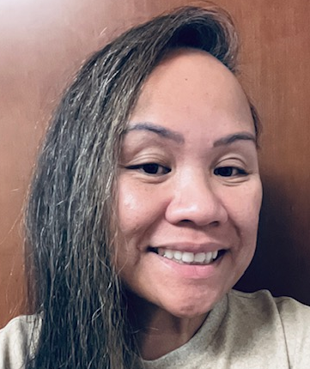

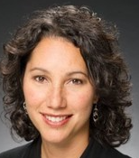
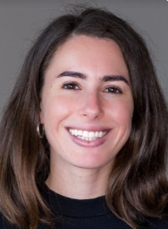
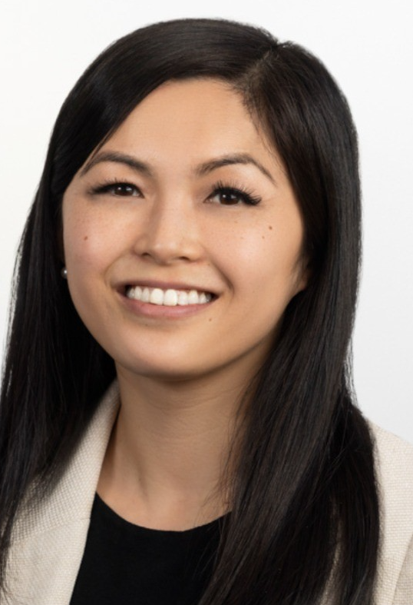
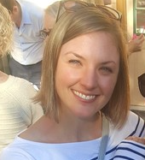
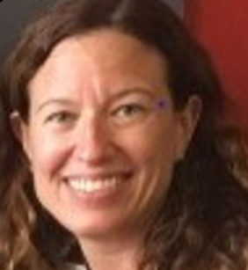
Stanford Medicine CKD Team
Dr. Jo-Anne Suffoletto
Primary Care Physician Lead
Jimmy Dang
Sr. Mgr, Accountable Care & Population Health
Riti Gupta
Ambulatory Care Clinical Pharmacist
Anna Simos
Mgr, Diabetes Care & Prevention
Andrea Wolf
Clinical Dietitian
Dr. Brian Brady
Nephrology Physician Lead
Kate Britton
Mgr, Accountable Care & Population Health
Judy Lin
Ambulatory Care Clinical Pharmacist
Alma Medina
Patient Care Coordinator
Alex Weaver
Spvr, Outpatient Clinical Nutrition
Michelle Gabriel
Sr. Mgr, Primary Care Clinical Programs
Maddy Frank
Sr. Quality Consultant
Carmen Lu
Mgr, Ambulatory Care Pharmacy Services
Dania Saarony
Spvr, Outpatient Clinical Nutrition
Michelle Stroebe
Clinical Dietitian

