Slide 1


Anne Cioletti, MD, FACP
University of Utah
Co-Chair
Lauren Block, MD, MPH, FACP
Northwell Health
Co-Chair
Kelly Graham, MD, MPH
Beth Israel Deaconess Medical Center
Lead, Investigation
Jennifer Shiroky-Kochavi, MD, MPH
Lead, Clinical
University of South Florida
Notes:
I am really excited to be here to share the work of our growing group.
Nod to Kelly

Slide 2
Objectives
Highlight outpatient recommendations that could lead to a meaningful foundation.
Describe opportunities to enhance primary care career choices in residents from individual, clinical/learning environment, and structural approaches.
Notes:
My goal is two fold in this 20 minutes.

Slide 3
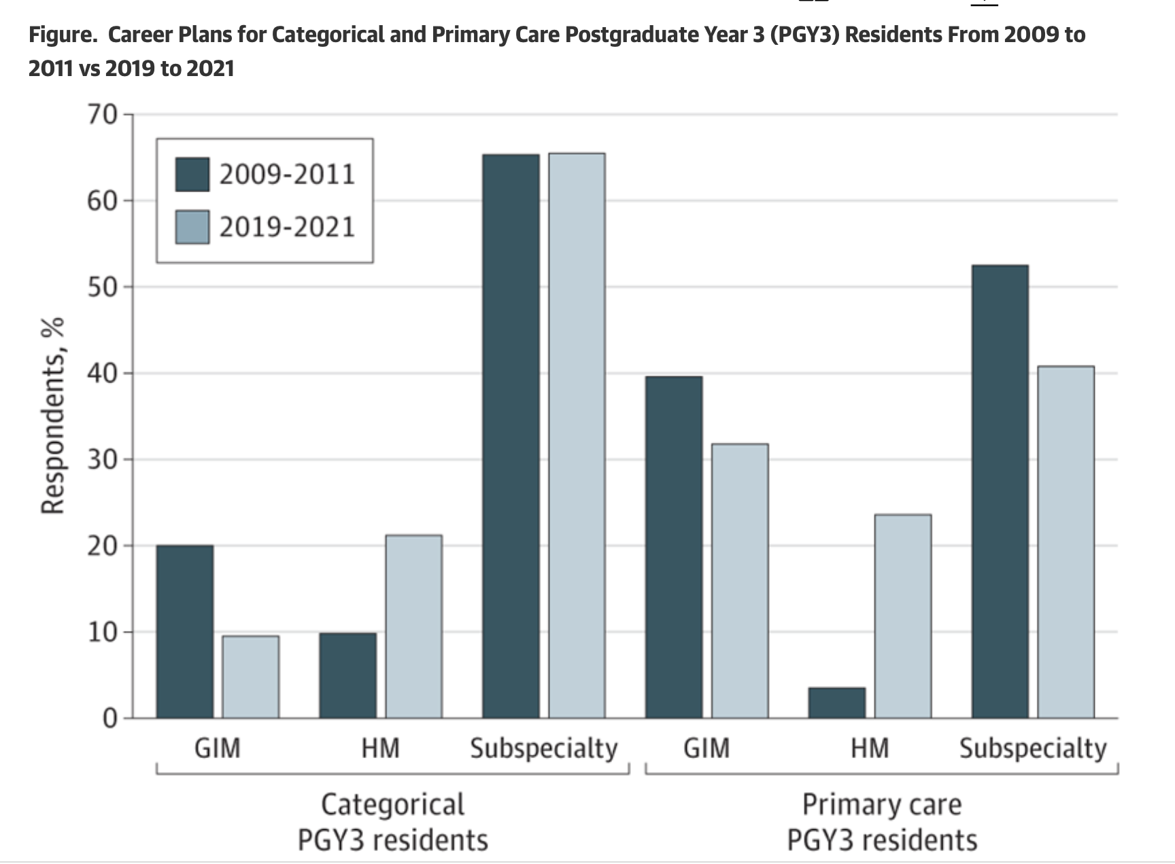
The Problem: Primary care shortage
70K PCP shortage
1,500 patients per PCP
105 million Americans with no PCP
HRSA 2025
Paralkar N, Block L. JAMA Intern Med. 2023.
Notes:
Obligatory background slide as it is hard to leave it out.
By 2038 predicting 70,610
May be higher due to the decreasing rates our internal medicine graduates are entering into primary care.
https://bhw.hrsa.gov/sites/default/files/bureau-health-workforce/data-research/State-of-the-Primary-Care-Workforce-2025.pdf

Slide 4
Declining Pipeline Begins in the Training Environment for IM
Notes:
Declining most sharply during residency
HRSA 80K
Lauren’s paper 9% is categorical IM PC rates
Students: https://students-residents.aamc.org/premed-navigator/get-know-medical-school-class-2025

Slide 5
Association of Chiefs and Leaders in General Internal Medicine
Hess Initiative 2023
Primary care recruitment and retention
Clinical Environment
Compensation
Learner experience
Notes:
Our group initially formed out of the Hess Initiative, which is a leadership precourse of chiefs and leaders in GIM before the annual Society of GIM met in 2023. After recognizing all of the opportunities, these were the 3 topics that persisted.

Slide 6
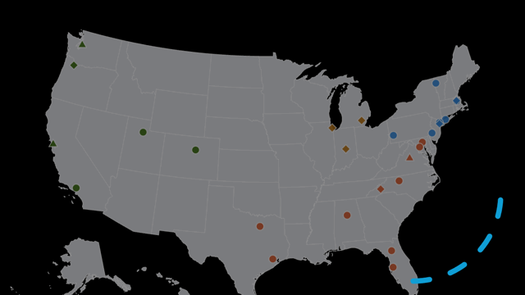
Who are we?
75 Internal Medicine Residency Programs
Academic and Community Representation
All US census regions
Supported by SGIM & ACLGIM
Notes:
Over the last 3 years,, our group has expanded to include over 75 members across the country with representation from both academic and community programs

Slide 7
What is our Mission and Vision?
Create an undergraduate and graduate medical education experience that prioritizes the needs of our patients and our learners above other forces in the healthcare system
Optimize learner experience in outpatient internal medicine
Increase the pipeline of internal medicine-trained primary care physicians to meet the workforce needs of the public
Pillars: Continuity of care, Team-based care and population health

Slide 8
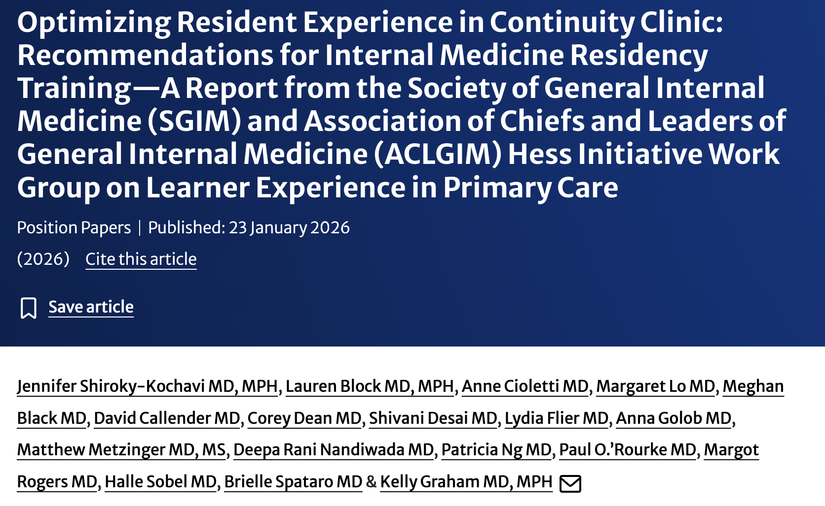


Notes:
Work to date has culminated into a list of recommendations broken down by ACGME Core competencies with evidence to support it.
We believe this is the FOUNDATION – what all resident clinics need to provide a strong working environment for residents to work.
https://link.springer.com/epdf/10.1007/s11606-025-10157-w?sharing_token=aGfLcVnF7wBVQlPzdVy7ePe4RwlQNchNByi7wbcMAY7XTSye6HptZ_KdmhGzaPXKZmu4asUKPuwT_L3VHYPjfaRPGWd6O1bAubOy34_z7_aSBwgH-YPA6ViujgBd5GuX_aKPzHEesKBCzoHRXB0H2H3OHGizprMh48CrN7H_Tho%3D

Slide 9
Looking Ahead
Primary Care
Notes:
As we see this as foundational work – helping ensure all programs can meet a common set of expectations, I would now like to share where we see this moving.
This peacock looking graphic is to highlight that if it were one path to success, we would have done it. But it is not. We are going to

Slide 10
Next Steps for Primary Care Learner Experience
Individual factors:
Defining who is choosing primary care
Survey to track the workforce
Recognize and overcome the hidden (and overt) messaging
Clinical and Learning Environment:
Factors affecting trainee choice for primary care
Focus groups identifying factors associated with retention (and attrition) in primary care
Qualitative review on programs that are successful
Structural and Policy Factors:
Supporting the value of primary care
GME Funding Structure
Reframing support for primary care
Notes:
I am thinking of this as the overview slide to talk through solutions.

Slide 11
Individual Workforce: Defining who is Choosing Primary Care
Tracking the workforce as graduates should match public health needs
  Track fellowship matches, but more challenging to identify generalist paths
  Precedent in Family Medicine with question on certification exam
  Measures how we are meeting the needs of the public
Optimize the messaging
Notes:
https://www.acponline.org/advocacy/where-we-stand/2025-acp-priorities/strengthening-the-internal-medicine-and-primary-care-physician-workforce

Slide 12
Messaging to Trainees
“You’re too smart to do general medicine”
“General medicine is less prestigious than other fields”
“You won’t make any money in general medicine”
“You’ll be drowning in paperwork in GIM”
“You’ll be replaced by an APC”
Notes:
Comments on intelligence, prestigue; on the salary parity or administrative burden – even the future of physician in primary care.
Problems exist in medicine, not always unique to primary care.
Make clinical experience less terrible

Slide 13
Rebrand the Mission: Patient and Learners
The only specialized care that keeps you out of special care.
Primary care is principal care
Captain of the Ship (or conductor or quarterback or pilot)
The first line of defense, the last line of support.
We are the only ones who know what “normal” looks like for you.
Cure sometimes, treat often, comfort always.
If your doctor’s last name is Google, it’s time to get a second opinion.
Notes:
Partner with other specialties to amplify value of primary care messaging instead of disparage it
How to rebrand the work we do – these are some sayings that popped up on the AI overview of my google search.
Not unique to primary care but my favorite that I am sure we can all relate to:…

Slide 14
Clinical and Learning Environment:
Factors Impacting Trainee Choice
Trainee exposure time needs to reset
  Increase confidence in outpatient care
    Training time is opposite of needs (both patient and workforce)
    Inpatient focus creates discomfort in outpatient care
    Resident clinics often are not high functioning clinics
  Visibility often matches dwell time
  Value follows the finances
Rebalance learner experience
  Support the clinics with the right resources (staff and team)
  Balance the clinical time with opportunities to overcome the administrative work
IM Workforce
30% Outpatient
70% Inpatient
80% Outpatient
20% Inpatient
Training Time
Notes:
Limited clarity and a changing landscape

Slide 15
Selected Work Group Recommendations, Evidence, and Implementation
Recommendation | Certainty | Implemented
SBP: Residents should have timely access to interprofessional, team-based care including behavioral health, pharmacy, social work, care management, and robust interpreter services available remotely or on-site. | High Certainty | 75%
PBL: The residency practice director should work closely with population health teams and/or operational leadership to develop capacity to obtain basic metrics for each resident’s panel such as panel size, patient demographics, continuity and core population health measures. | High Certainty | 65%
PC: Residents should complete at least 140 half-day sessions within their primary care continuity clinic distributed over three years. | Moderate Certainty | 62%
PC: Residency programs should assess resident panel sizes annually with a goal of 50-100 patients per panel and at least 50% patient- and resident- facing continuity by the end of PGY-2 year and at least 60% patient- and resident-facing continuity by the end of PGY-3 year with a structured process to transition a graduating senior’s panel to an incoming intern (or another physician). | High Certainty | Panel size 54%; continuity 30%
Notes:
As promised, here is a selection of the recommendations.
Not on do we need to have a minimum time they clearly spend in primary care continuity clinic, the clinics also need to be well supported with team-based care.
On the right side of the screen we show the certainty based on evidence of thewse recommendations as well as the number of programs surveyed managing to accomplish this. While team-based care in some form or fashion is reaching ¾, continuity only is being tracked in less than a third.

Slide 16
Clinical and Learning Environment:
What Makes Learners Choose Primary Care?
Determine residency programmatic factors that are associated with attrition and retention in IM-Primary Care programs
Qualitative review on programs who achieve success
Develop standardized method to track career retention in primary care from different residency programs and tracks in the US.

Slide 17
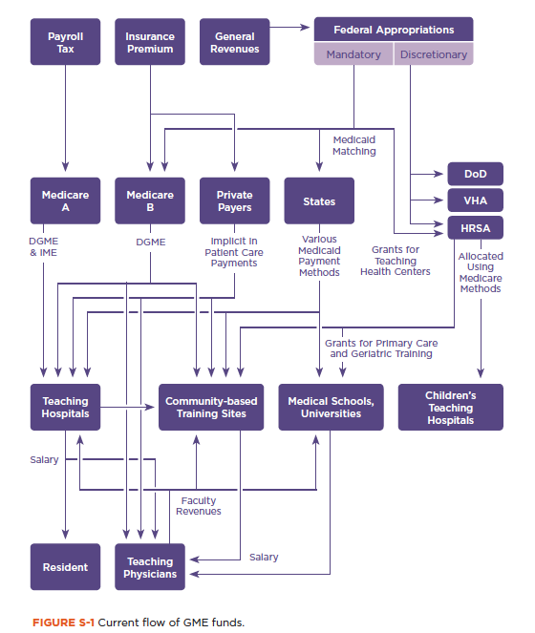
Structural and Policy Factors:
Supporting the Value of Primary Care
Current: GME funding is tied to HOSPITAL-based care
Future:
Balance CMS funding separate from location
Reframes conversation about where residents (should) spend their time
Coupled with recommendations, will allow
  Increased confidence in and visibility for primary care
  Support for high functioning primary care clinics
Notes:
A quick note on structural and policy factors as our residents are clever and aim to follow the money.
Redistributing the money allows for high functioning primary care clinics to thrive – including having an interdisciplinary team, a means to pull metrics and perform QI projects to improve the experience.
This is a figure the attempts to map the flow of GME funds int he US, it is a confusing picture with a lot of arrow, but I want to draw your attention to left side of it here (ANIMATE) because this line represents about 90% of the funding, which flows from taxpayers through the centers for Medicare and Medicaid services, and then directly to teaching hospitals.
This system has been largely unchanged since the 1960s, when the majority of patient care occurred within the walls of the teaching hospital, and made a lot of sense at the time, however, today we practice in systems where the majority of care occurs in the outpatient setting, and our funding structures have not yet adapted to these emerging trends.

Slide 18
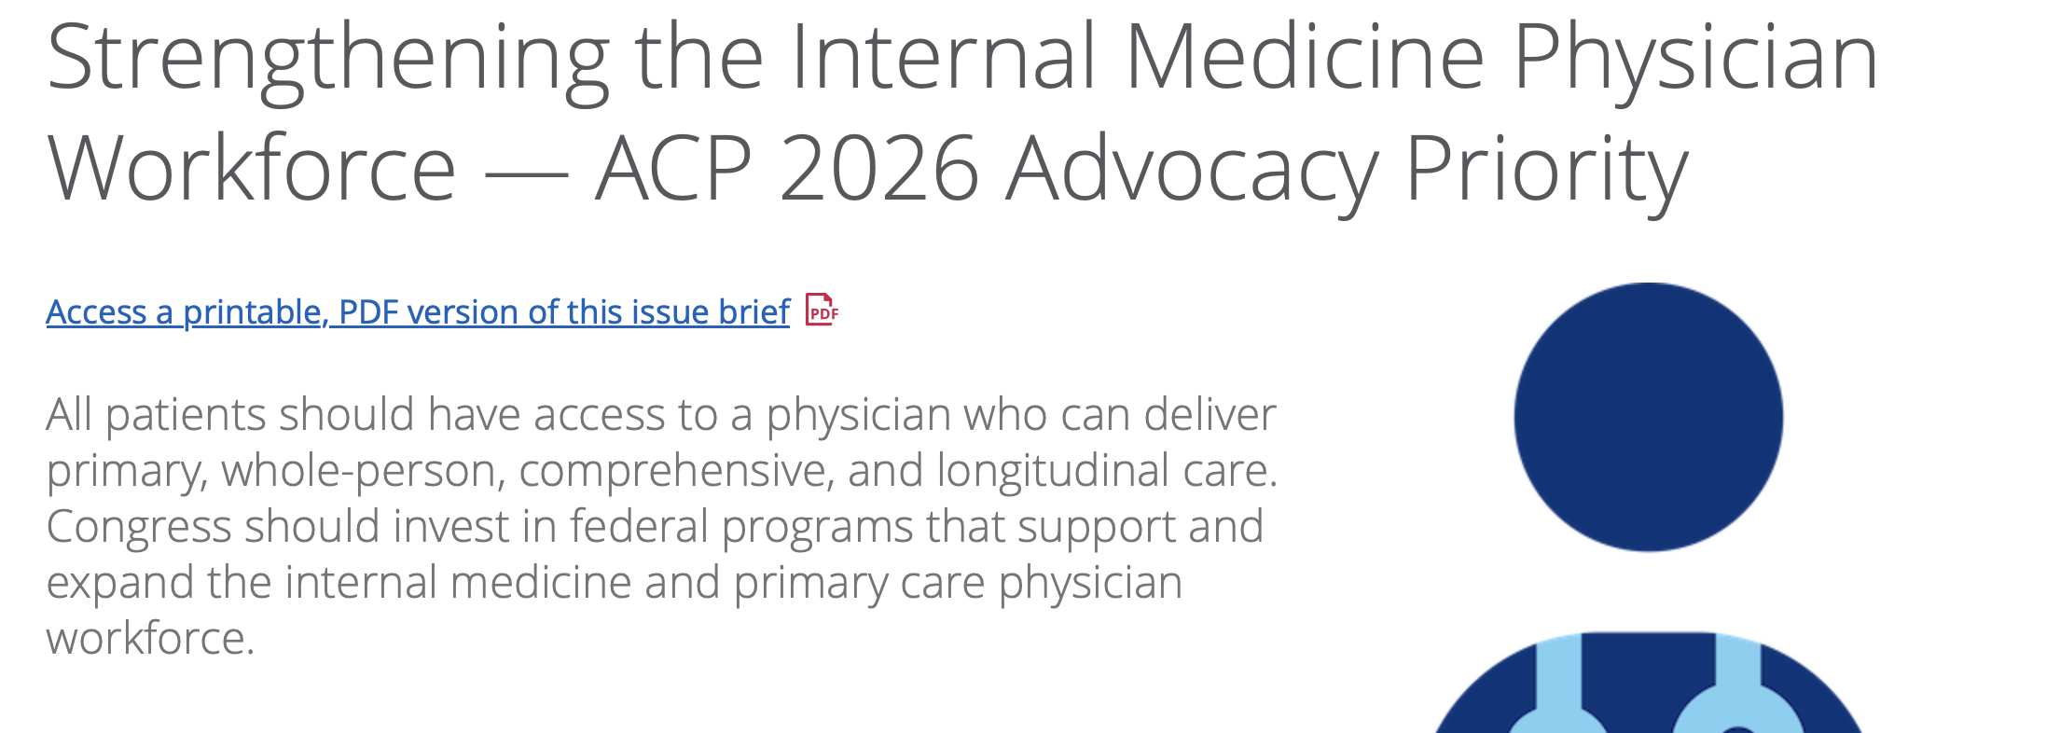
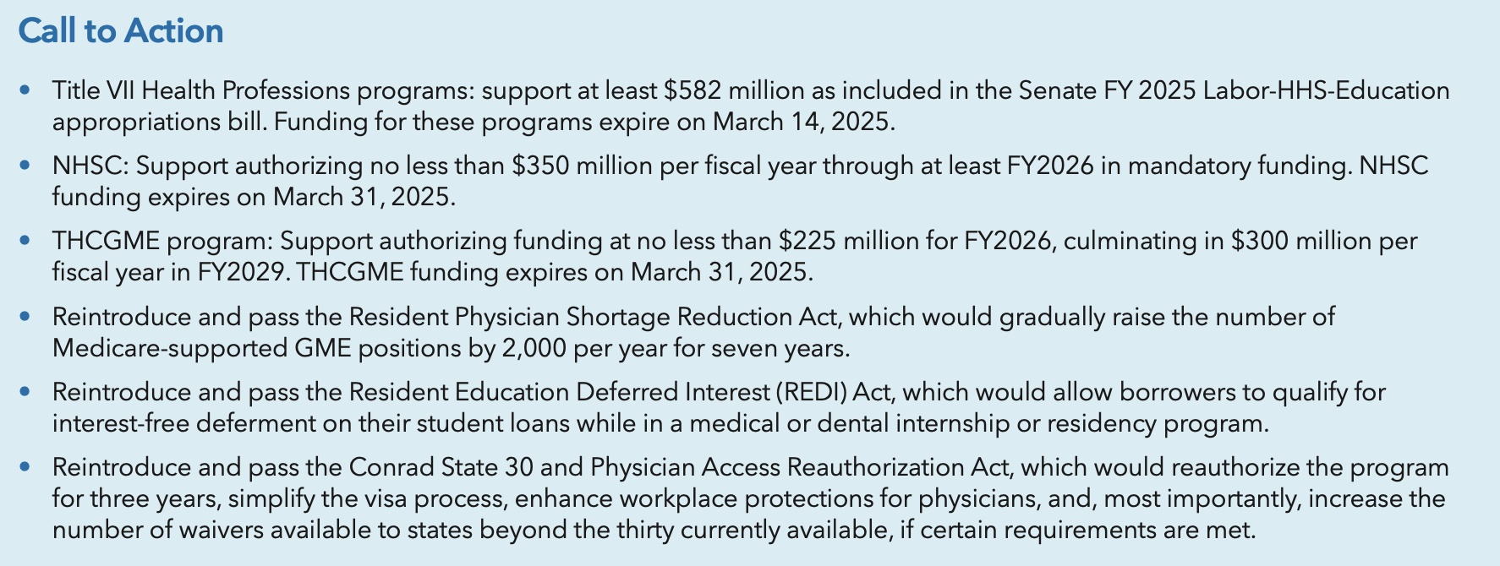
The Big Picture
Strengthening the Primary Care Workforce
Potential means to strengthen the primary care workforce
  Expand offerings of support
  Unified advocacy across professional organizations
Notes:
ACP has strengthening primary care as a priority, which is amazing and shows that this is clearly a focus. Recommendations include support for medical school and loan forgiveness.
How do we progress these conversations to broaden what it means to strengthen the primary care workforce.
We would love to continue to work on these efforts to optimize a means to where we can see more trainnees choosing primary care as a sustainable field.

Slide 19
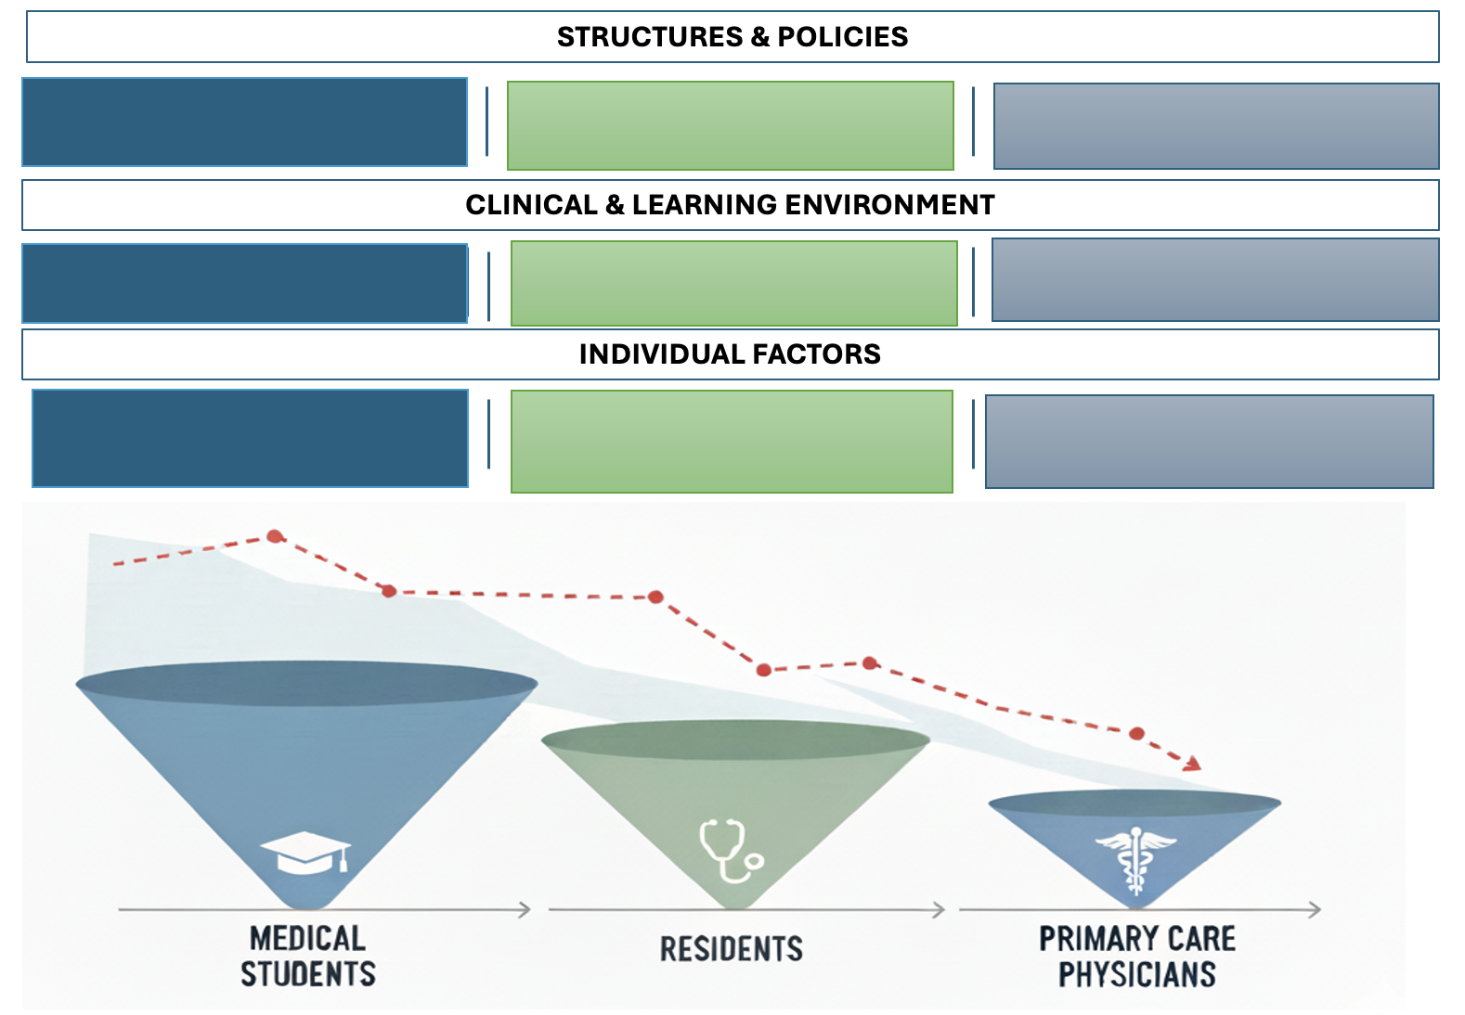
Goal: Partnership Towards Change

Slide 20
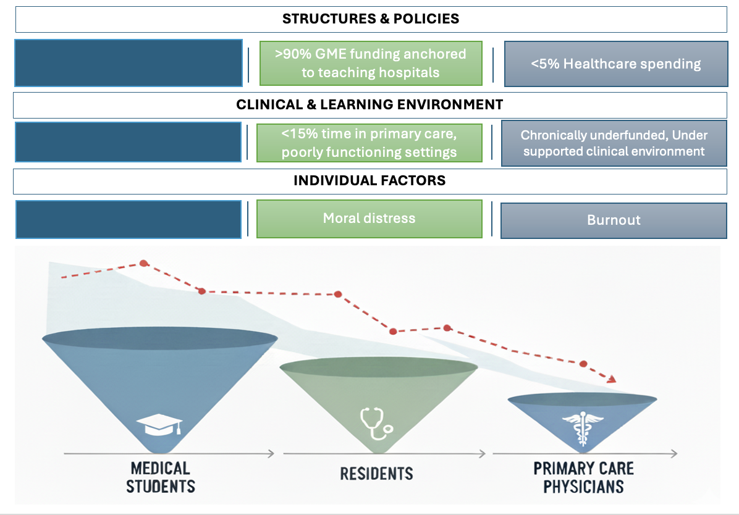
The Current

Slide 21
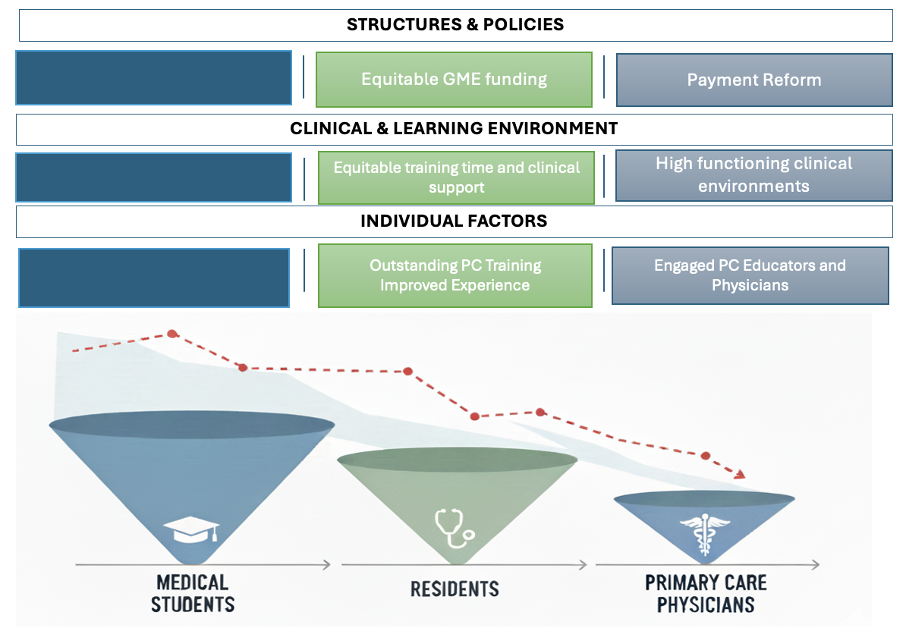
Overview

Slide 22
Acknowledgements
Jillian Gann, Director of Leadership and Mentoring Programs, Society of General Internal Medicine
Eric Bass, MD, CEO, Society of General Internal Medicine
Mitch Feldman, MD, and Leadership of Association of Chiefs and Leaders in General Internal Medicine
Kelly Graham MD, Investigation Lead, HI-FIVE PC

Slide 23
Thank you!
Questions?
Anne.Cioletti@hsc.Utah.edu
"As we learn to do things well we love to do them, and after doing a few things that are quite hard to do we become very fond of doing hard things." — Sara E. Wiltse
Notes:
"As we learn to do things well we love to do them, and after doing a few things that are quite hard to do we become very fond of doing hard things." — Sara E. Wiltse

