Slide 1
Project ECHO Model for Subspecialty Care
Susan R. Kirsh, MD, MPH, CMQ
May 15, 2026

Slide 2
Project ECHO: Expanding Subspecialty Care Through Virtual Education
Bridging Specialist Gaps
  Project ECHO connects specialists with frontline clinicians through virtual education to overcome geographic barriers.
Empowering Frontline Clinicians
  The program provides mentorship and specialist support to enhance clinicians’ skills and improve patient care outcomes.
Evidence-Based Validation
  Project ECHO is grounded in published research demonstrating its effectiveness within the Veterans Health Administration.

Slide 3
Who are our Veterans
9 million Veterans who served in the military and were honorably discharged and often with service-related conditions
170 VA Medical Centers
25% with Diabetes
30% with Mental Health Diagnosis
30% living in Rural Area
Over 1000 sites of care with approximately 370,000 employees
Lower Socioeconomic Status

Slide 4
A National Gap in Subspecialty Access
VA's Subspecialty Access Challenge
  The VA faces a significant shortfall in subspecialty access despite serving over nine million Veterans nationwide.
Limited Cancer Rehabilitation Workforce
  Only eleven cancer physiatry fellowships exist in the U.S. and Canada, limiting trained rehabilitation specialists.
Impact on Veteran Care
  Limited subspecialty training and low awareness result in underreferral and reduced quality of life for Veterans.
Rural and Underserved Disparities
  Veterans in rural or underserved areas face disproportionate barriers to accessing specialized cancer rehabilitation.

Slide 5

Telementorship Model
  Project ECHO connects specialists with frontline clinicians using real-time, case-based telelearning sessions.
Improving Access for Veterans
  VA adopted ECHO in 2011 to improve specialty care access for veterans in rural and underserved areas.
Free Inclusive Participation
  All VA healthcare professionals can join free sessions, removing financial and logistical barriers.
Community of Practice
  ECHO fosters a national multidisciplinary community that promotes innovation and improves patient care.
Extension of Community Healthcare

Slide 6
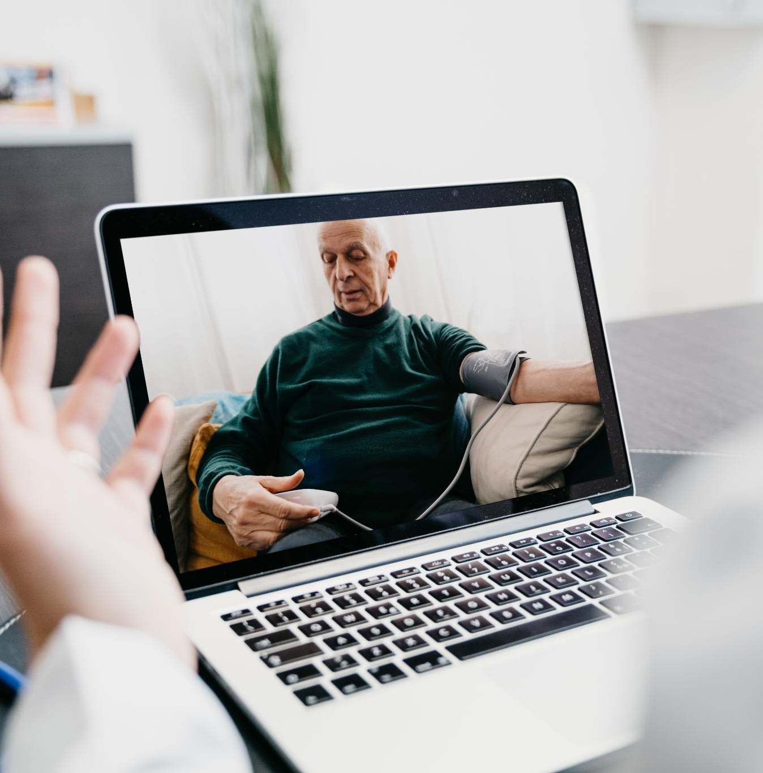
Cancer Rehabilitation VA‑ECHO Case Study
Monthly Webinar Series
  The program offers 60-minute monthly webinars promoting consistent learning in cancer rehabilitation principles over time.
Annual Rehabilitation Bootcamp
  A two-day intensive bootcamp provides deep learning and skill refinement through 16 high-yield cancer rehabilitation modules.
Program Accessibility and Accreditation
  All sessions are recorded, archived, accessible to VA staff, and accredited by multiple organizations, ensuring wide reach and credibility.

Slide 7
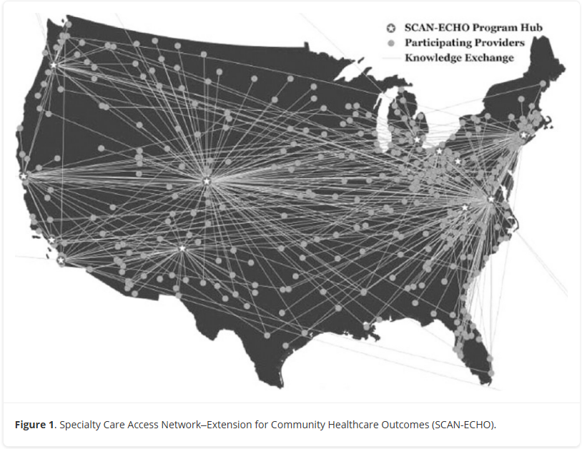
Program Scale and Reach
Participant Engagement
  The program attracted 923 unique participants, with steady monthly attendance averaging 71 clinicians.
Intensive Learning Opportunities
  Annual bootcamps averaged 203 participants, indicating strong demand for in-depth structured learning.
Geographic Diversity
  Participants represented 222 care sites across 48 states, Washington D.C., and Puerto Rico, showing wide program reach.
Commitment to Growth
  34 percent of participants attended five or more sessions, showing strong ongoing professional commitment.

Slide 8

Interprofessional Participation
Diverse Professional Representation
  35 disciplines participated, reflecting the multidisciplinary nature of cancer rehabilitation work.
Top Participating Roles
  Physical therapists (22.2%), occupational therapists (15.5%), and nurses (13.4%) were the largest participant groups.
Broad Clinical and Nonclinical Engagement
  Program included physicians, psychologists, social workers, pharmacists, and administrative staff showing wide relevance.
Geographic and Organizational Reach
  Participants from rural and urban facilities across VA networks highlight bridging of professional and geographic divides.

Slide 9

Program Evaluation Outcomes
High Topic Relevance
  The program received a 4.6 out of 5 rating for clinical relevance, showing alignment with real-world clinical needs.
Knowledge Improvement
  Participants rated knowledge improvement at 4.5, indicating effective enhancement of cancer rehabilitation principles.
Practice Change Impact
  Clinicians reported a 4.3 score for anticipated changes in clinical practice, reflecting meaningful influence on patient care.
Strong Participation Rates
  Response rates of over 50% demonstrate strong engagement in voluntary professional education programs.

Slide 10
Advantages of Virtual Subspecialty Education
National Community of Practice
  Virtual education fosters a collaborative national community connecting clinicians from diverse regions and specialties.
Efficient Expert Knowledge Sharing
  Virtual platforms enable scarce experts to share specialized knowledge directly with frontline clinicians efficiently and equitably.
Asynchronous Learning Resources
  Recorded sessions create reusable educational materials accessible anytime, allowing flexible clinician learning.
Cost-Effective and Accessible
  Virtual education reduces costs and boosts access by eliminating travel and enabling continuing education during work hours.

Slide 11

Scalability Across Subspecialties
Adaptability to Multiple Specialties
  Project ECHO’s framework is flexible and scalable to subspecialties facing shortages or geographic challenges.
Democratizing Specialist Expertise
  ECHO enables frontline clinicians everywhere to access specialist insights regardless of location.
Building Sustainable Education
  The model fosters continuous learning through mentorship, peer support, and shared knowledge.
Supporting Patient Care Equity
  Scalability is key to ensuring high-quality specialty care for patients regardless of geography.

Slide 12
Questions

