Slide 1
Health systems innovations: reshaping how we work
Anna Flattau, MD, MSc, MS, FAAFP
Alumni Professor & Chair, Family and Community Medicine
System Chief, Jefferson Primary Care

Slide 2
Conceptualizing our health system

Slide 3
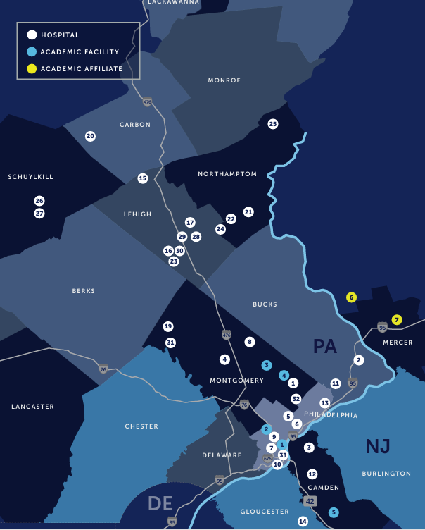
Two ways of looking at a health system
View 1
View 2
Communities of diverse types
A million primary care patients
(150 sites + virtual + home)
Medical and surgical subspecialists
32 hospitals for acute care needs
Health plans
(70% value-based contracts; provider-owned plan, employee plan)
We are a million-person primary care and population health system, supported by 32 hospitals and 700 sites of care.

Slide 4
Whence the revolution?
“Organizations are tools for shaping the world
as one wishes it to be shaped.”
-- Charles Perrow, Complex Organizations (2014)
Clinical sites
Home
Virtual
Let’s reimagine us:
We design creatively and freely to deliver on individual, household, community, and public health needs.
We commit to deeply understanding the various mechanisms of health care financing, recognizing that these are the building materials out of which we will construct our patient-centered programs.

Slide 5
Examples of care model & workforce innovation

Slide 6
18-month Timeline of Program Launches
August
2024
September
2024
October
2024
February
2025
July
2025
September
2025
January
2026
Virtual Primary Care
Clinical Risk Assessments
Age-Friendly Nurse
Visits
Medical Weight Management
Home-Based Primary Care
Transitions of
Care
Lifestyle
Medicine
Notes:
Anna

Slide 7
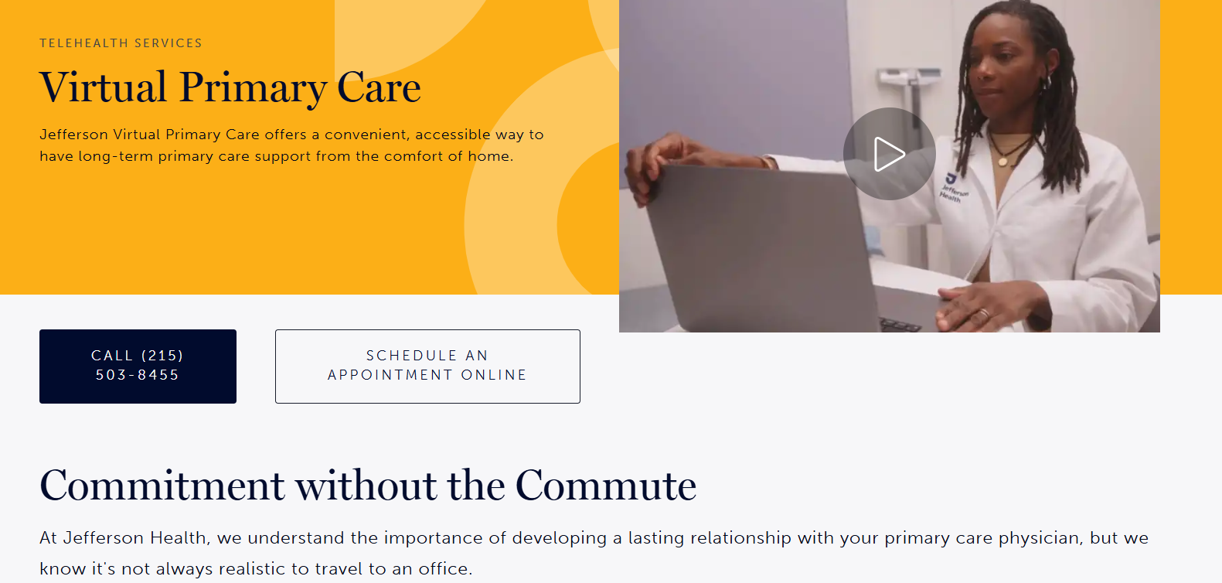

Slide 8
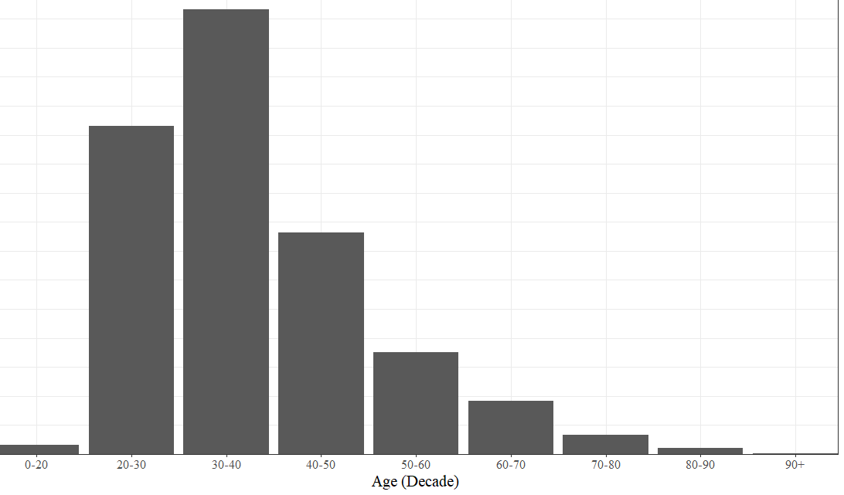
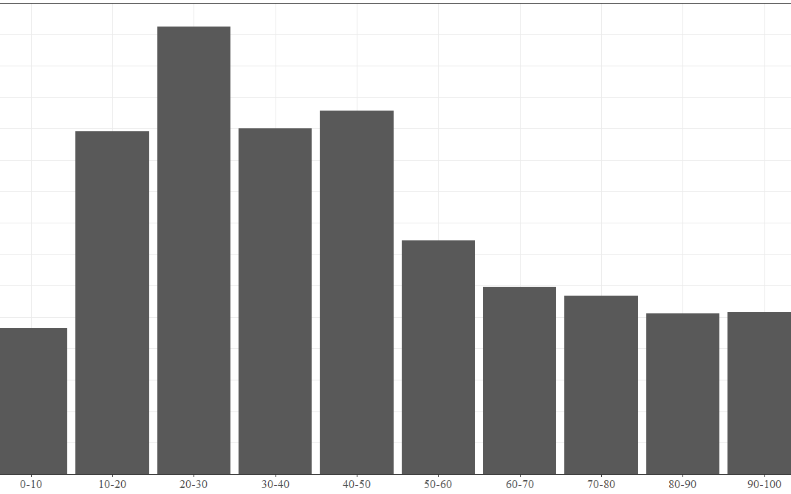
Real primary care, virtual-only practice
All new patients are offered a choice of virtual vs traditional primary care
Primary care clinicians are recruited for commitment to values of relationship-based, comprehensive, longitudinal care
When stratified by age, VPC patients have similar or higher rates of chronic disease than traditional patients
Schedules are >95% filled, while maintaining same-week availability for new patients
We can scale up without limit – continually hiring new PCPs
Age (by decade)
Area Deprivation Index- national deciles

Slide 9
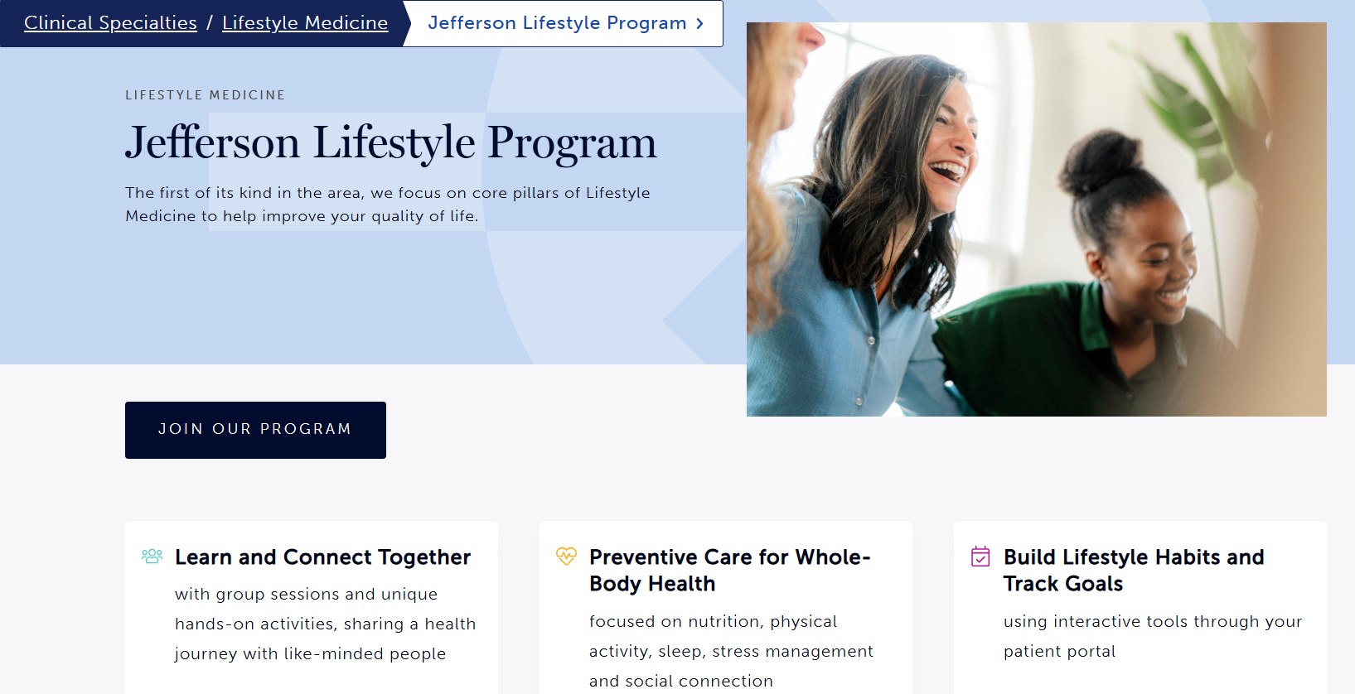
Lifestyle Medicine: scaling health through a social and relational care model
Physician and RD oversight of program, which is delivered by RDs and APCs
Structured assessments, referrals, and outcomes tracking; focus on self-empowerment and meaningful incremental change in group model
Within first four months, 2,016 people referred and 757 people enrolled

Slide 10
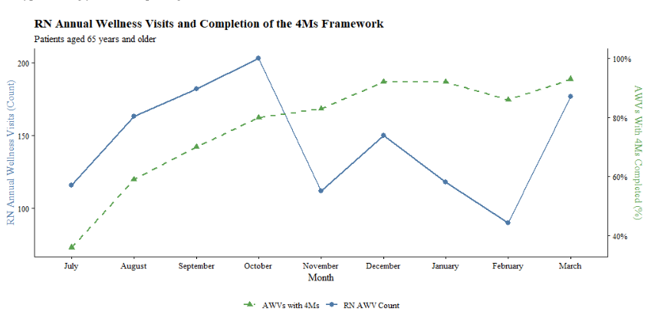
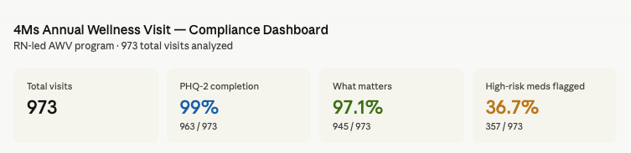
Age-Friendly Care at system scale
How will we provide Age-Friendly Care at scale?
A million primary care patients; 1/3 are age 65+
120,315 Medicare hospitalizations each year (57% of total)
Across our whole system, we have 17 geriatricians, 8 geriatric APCs, and 4 fellows.

Slide 11
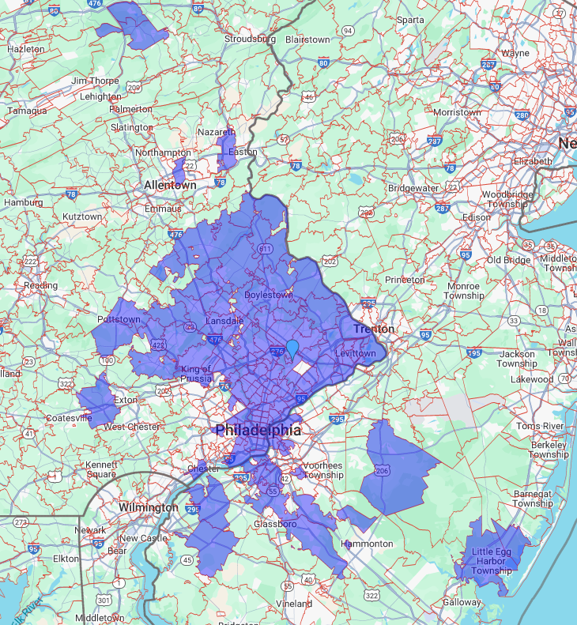
Home-Based Primary Care
Vision
Home-based care for high-risk, homebound patients
Improve quality of care while reducing hospitalizations
Create availability across Jefferson geographic footprint
Optimize cost-efficiency through interprofessional teams and telehealth supports
Completed Home Visits:
current geographic reach
When can home care supplement traditional or virtual primary care?
Transitions of care support
Complex patients
Patients who are not improving with usual care
Clinical Risk Assessments
Notes:
ME

Slide 12
Medical Weight Management (employee health plan)
97%
‘Likelihood to Recommend’ Press Ganey score
Expert-Led Care
Telehealth-First Model
Personalized, Streamlined Care
Culture of Respect
Integrated Care Coordination
Connected to Health System Experts
92%
sustained member engagement
Hims & Hers: 75%
Weight Watchers: 40%
136k
total weight loss
Accompanied by care management services to support effective program management
Implementation Project Manager
Data Analytics
Specialty Pharmacy Support
Prioritized Scheduling
16%
average change in members’ weight
58%
members with improved cholesterol levels
91%
members have controlled BP

Slide 13
Physician workforce in new care models

Slide 14
Redesigning how we work together across specialties
There are well-established tools that transform the primary care/ specialist interface
  E-consults
  Project ECHO
  Virtual consultations
Extended care teams are essential to meeting patient and community needs
  Integrated behavioral health models
A setting, a complex care population, or a transitional period of time can be a ‘specialty’
Technological solutions that synergize, organize, and present information will imminently drive further transformation
The “Phony Issues” of G. Gayle Stephens:
“None of these [ways of defining specialties] represent primary epistemological categories. All of medicine is derivative, secondary, and applied…. All medical vocations are constantly shifting their territories, and there are many local variations on a theme.”
- Intellectual Basis of Family Practice, 1975

Slide 15
Aligning workforce development and health services innovation
Care model innovation | Key point/ key consideration
Virtual primary care | Hew closely to core professional values, while changing delivery model
Lifestyle Medicine | Shift from transactional to relational interactions
Age-Friendly Primary Care | Training interprofessional colleagues elevates all of our work, including in ‘shortage’ area
Home-Based Primary Care | The setting is the specialty
Medical Weight Management | By acting flexibly, non-profit health systems can bring in-house models that are often driven by private companies and start-ups
Cross-cutting hypothesis:
Physicians are highly-trained professionals with deep knowledge and flexible skill sets. We are rate-limited by the operational systems in which we work.
Workforce solutions often live in the redesign of those operational systems, and we will train or retrain for, and thrive in, those patient- and community-centered models.

Slide 16
JeffersonHealth.org

