Slide 1
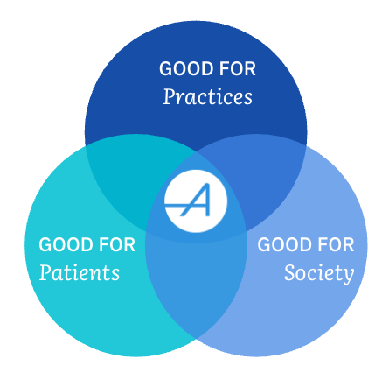
Primary Care ACOs and Technology
Value Based Care can revitalize Primary Care
Dr. Catherine Smitas, FACP
Senior Medical Director, Aledade

Slide 2
My Population Health, Value Based Care Journey
1
2
3
4
5
2007-2008
PCMH
2011
Meaningful Use
2012
CPC
(CMMI)
2017
CPC+
2020
VBC payments & Capitation = financial security during COVID
Early Regional Payer VBC pilots
“Triple aim”
VBC contract for nearly all payers

Slide 3

Prior to Focusing on Population Health and Value Based Care
Afraid to spend money
“We can’t afford an RN”
Reluctant to delegate
Shouldering the burden of running the practice and caring for patients alone

Slide 4

Reactive → Proactive
Solo → Team Player
Invested staff with more diverse and rewarding responsibilities, including pre-visit planning
Larger care team to share the work/emotional burden of caring for patients – RN, pharmacist, social worker
Everyone is happier - patients, staff and doctors
Ongoing challenge….data

Slide 5
Momentum for shift to value-based care through CMS MSSP
In 2012, CMS introduced the Medicare Shared Savings Program (MSSP) to cut down on unnecessary healthcare spending and improve care quality in the U.S.
Future
In 2024
2012
Additional
opportunities to deliver cost-effective care
11M
MSSP beneficiaries
3.2M
MSSP beneficiaries
$4.1B
Shared Savings
$315M
Shared Savings
CMS Shared Savings Program Fast Facts - As of January 1, 2026

Slide 6
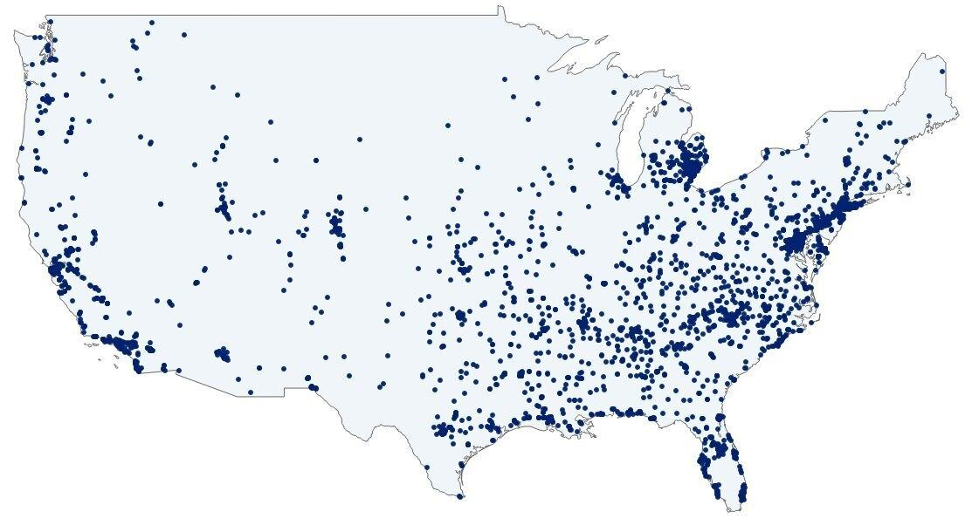
Aledade is the largest physician-led primary care network in the country, focused exclusively on value-based care.
3M+
patients
3K+
primary care organizations
Serving over 3 million patients across
more than 3,000 primary care organizations, our accountable care organizations (ACOs) help practices and health centers improve patient outcomes and generate sustainable revenue.
Map shows primary locations for 2026 partner practices
Notes:
Main point: Aledade has huge scale, huge growth, and enormous momentum
Transition point: That momentum is driven by our 2 flywheels

Slide 7
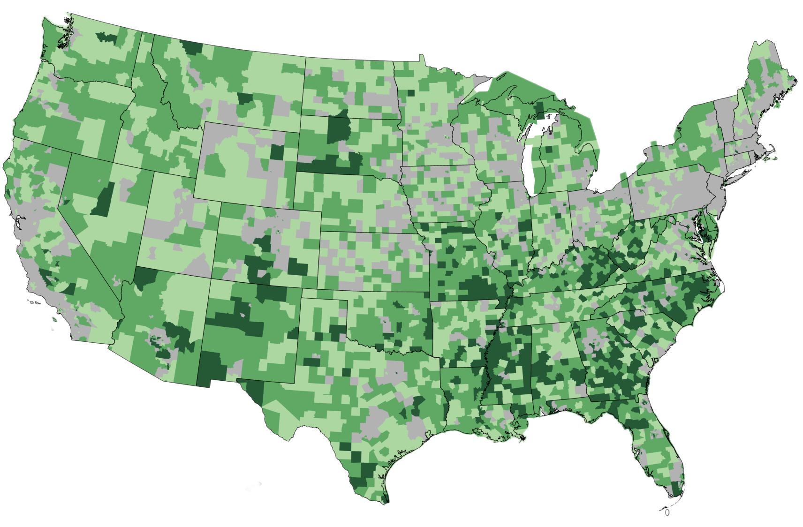

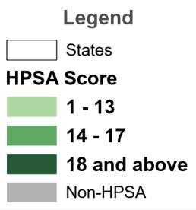
Aledade supports all communities through value-based care
>60%
of Aledade partners are in Primary Care Health Professional Shortage Areas
Health Professional
Shortage Areas (HPSA)
Health Professional Shortage Areas (HPSA)
As of May 2025 internal analysis of data; HPSA

Slide 8
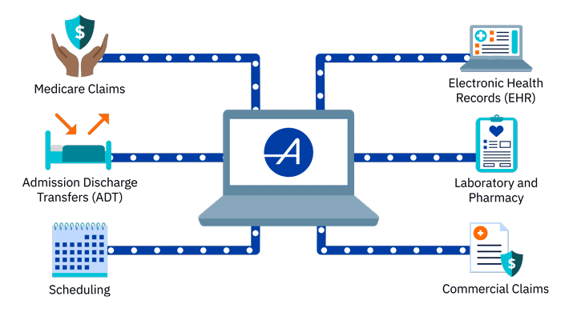
Data Sources

Slide 9
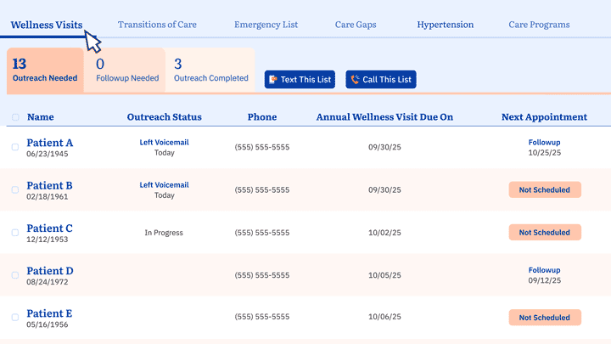
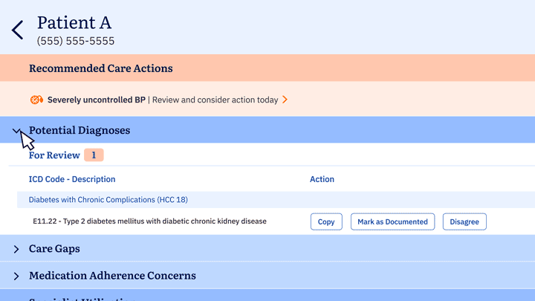
How our technology drives results
Insights at the point of care
Potential diagnoses, care gaps, risk indicators and more available during patient encounters.
Patient data all in one place
Hospital, lab, pharmacy and claims data sourced from across the healthcare landscape.
Prioritized patient worklists
Targeted lists that identify patients eligible for timely care and outreach opportunities.

Slide 10
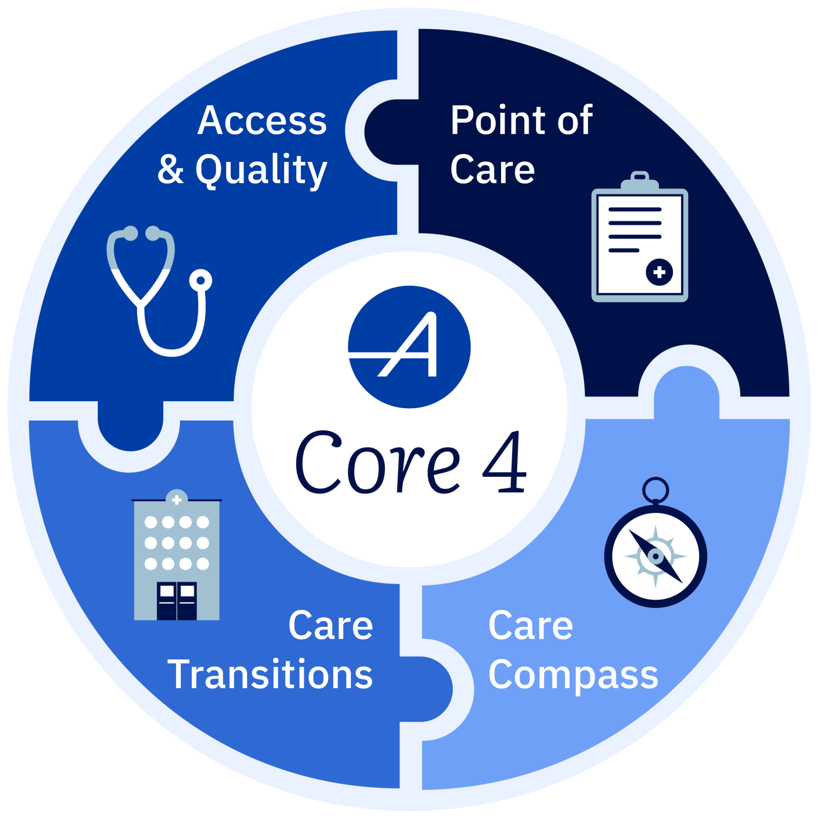
Aledade Core 4
Helping primary care organizations deliver quality care more efficiently, with proven solutions.
Access & Quality
Identify which patients
need to be seen and services needed to close care gaps
Point of Care
Act on valuable insights
for the patients seen today
Care Transitions
Engage patients when they leave the hospital, ED or skilled nursing facility
Care Compass
Connect patients to clinical services tailored to their needs

Slide 11
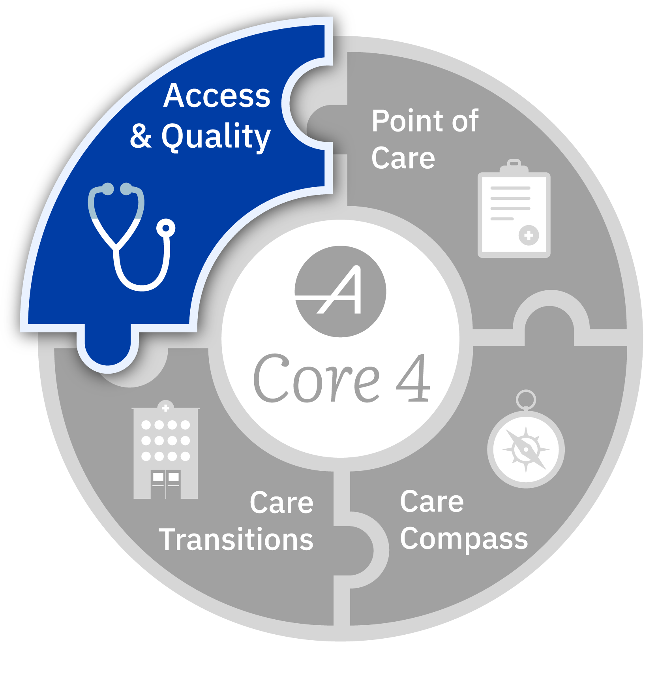
Executing on the Core 4 leads to better patient care and experience
Know when high-need patients haven’t been seen and need more active engagement
See what services patients may require
Manage care gaps and preventive care

Slide 12
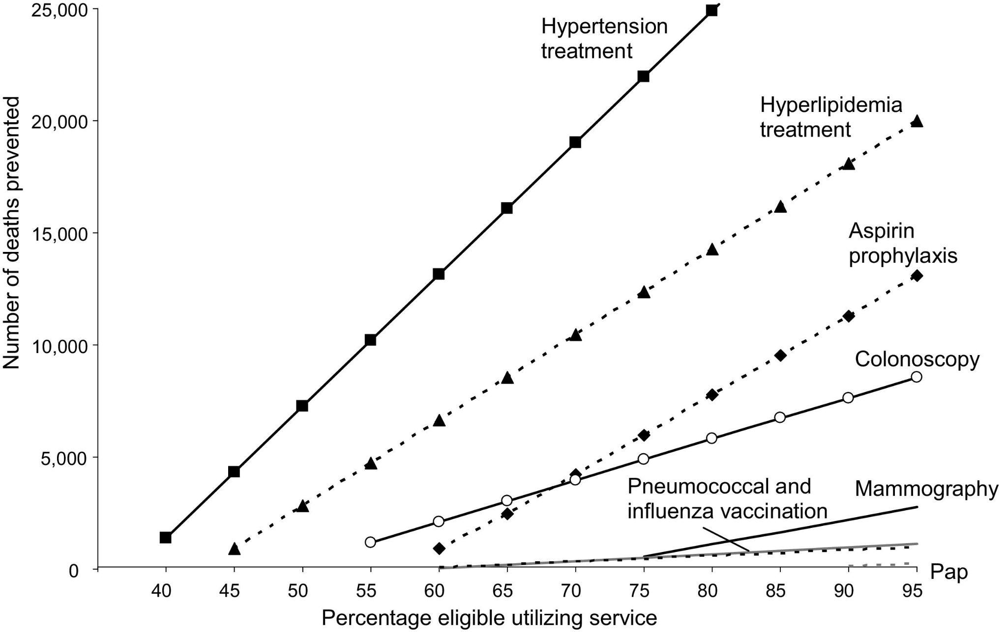
Controlling Hypertension Saves Lives and reduces morbidity
In total, costs associated with HTN amount to over $130 Billion each year in the U.S.
BP control rate for patients in ACOs is 71.21% vs. 67.82% among comparable MIPS groups
¹ Farley TA, Dalal MA, Mostashari F, Frieden TR. Deaths preventable in the U.S. by improvements in use of clinical preventive services. Am J Prev Med. 2010 Jun;38(6):600-9. doi: 10.1016/j.amepre.2010.02.016. PMID: 20494236.
² Per ROIPA Pathfinder analyses conducted in 4Q24.
Health and Economic Benefits of High Blood Pressure Interventions

Slide 13
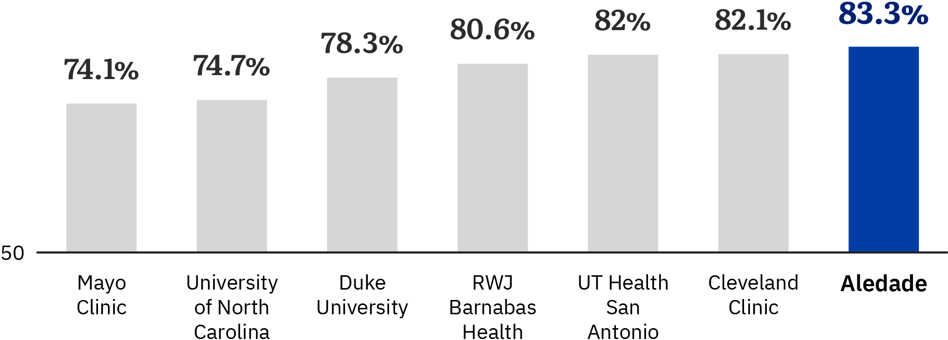
Controlling blood pressure saves lives
Aledade leverages data and innovation to help primary care clinicians outperform national blood pressure control averages and some of the largest medical systems, saving lives by effectively addressing hypertension.
2024 MSSP weighted averages for hypertension control
90
Aledade partners recognized for Blood Pressure Control Excellence by the American Heart Association and American Medical Association for achieving hypertension control rates of 70% or more
Aledade’s network of organizations participating in MSSP two years or longer, outperforming some of the largest medical systems around the nation.
Data is reflective of 2024 PY2+ ACOs only. National comparisons utilize the 2024 CMS Public Use File results for MSSP only. For enablers with multiple ACOs, the rates above are weighted averages, using total beneficiaries. The individual performance of ACOs may be better or worse than the weighted average shown above.

Slide 14
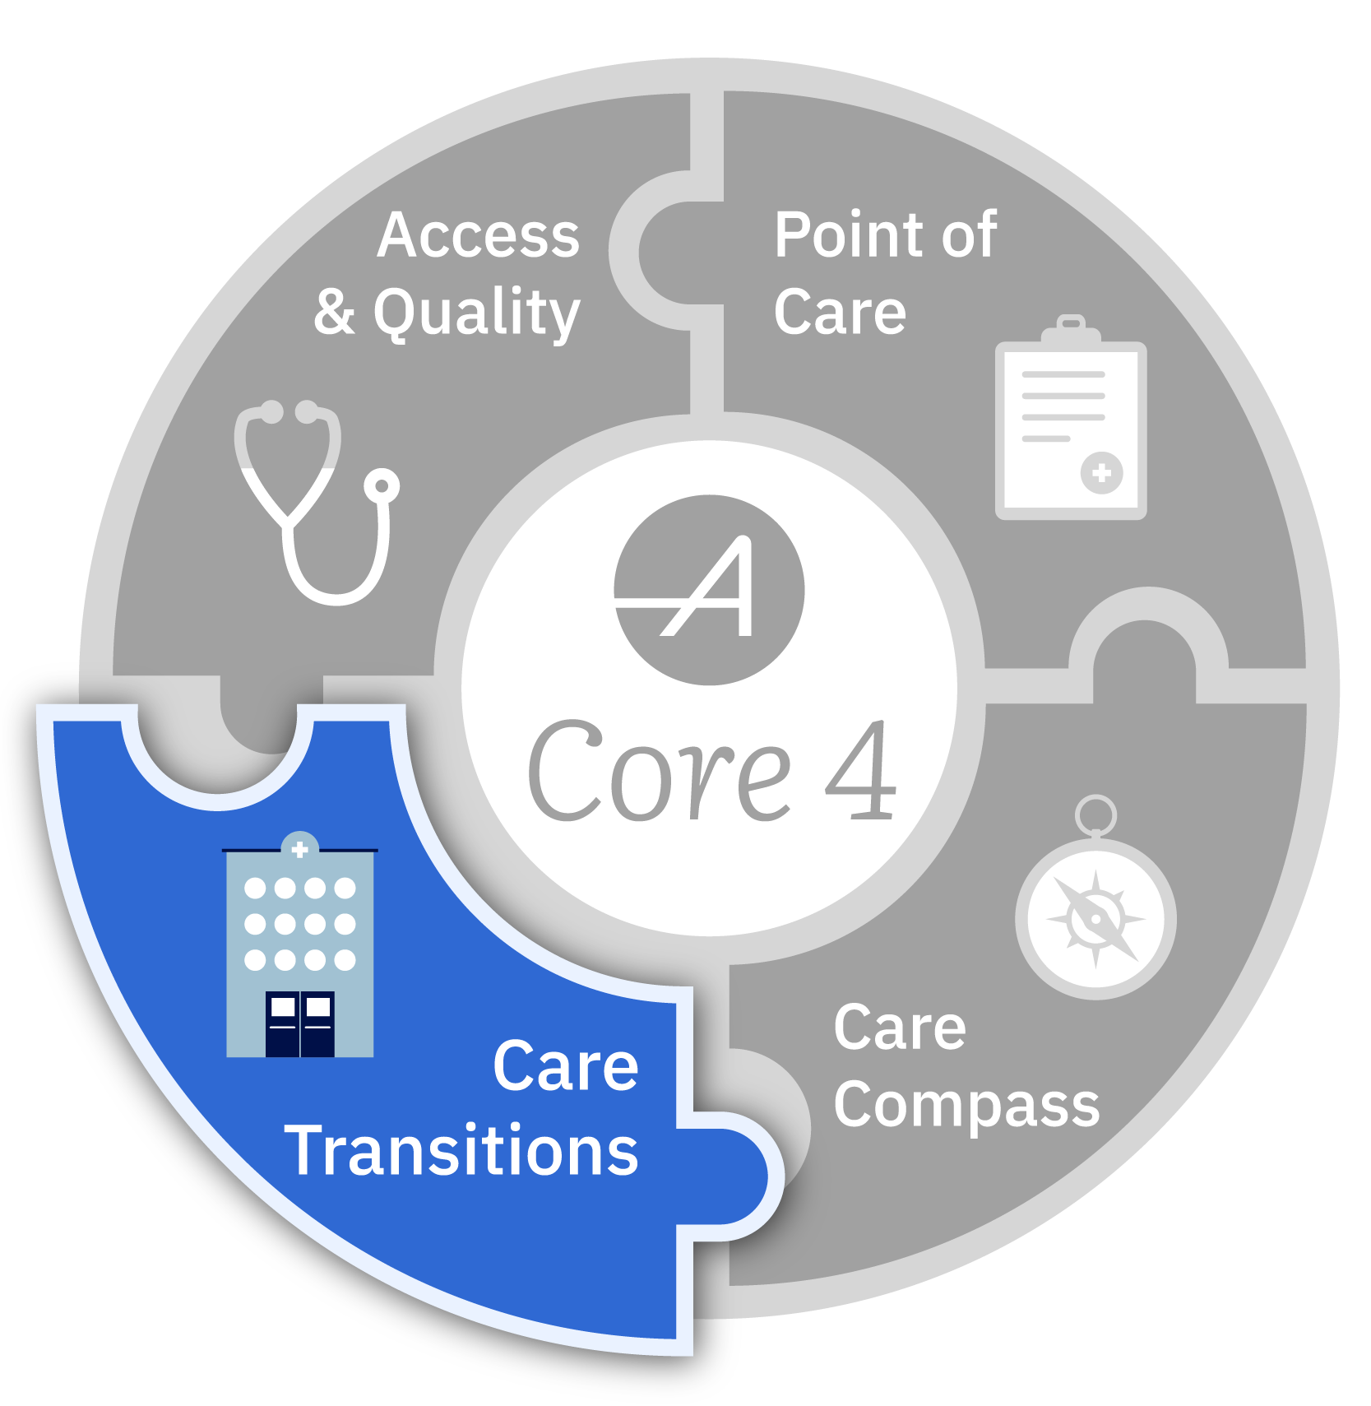
Executing on the Core 4 leads to better patient care and experience
Know when patients transition out of high-acute settings
Use targeted workflows to support patients during this transition

Slide 15



Hospital Readmission Rates
1 in 5
Medicare patients discharged from the hospital are readmitted within 30 days
2.6M
Seniors readmitted
$26B
Annual Cost of Readmissions
Community-Based Care Transitions Program Fact Sheet (2011-2015)

Slide 16

Transitions of Care Management (TCMs) Prevent Hospitalizations
1 in 15
TCMs prevents
an unnecessary hospital visit
Aledade estimations, based on practice 2016-2019 data

Slide 17




53K+
TCMs provided to patients by Aledade practices in 2024
WE ARE
impacting
society
96K
Unnecessary hospitalizations avoided in 2024
167K
Unnecessary emergency
department visits avoided in 2024
Aledade estimations, based on practice 2024 LUM

Slide 18


Additional Primary Care Practice Resources
Aledade FIRST
Training the next generation of primary care physicians in value-based care. Placing trained residents in Aledade partner practices.
Group Purchasing Organization (GPO)
Provides access to discounted savings from manufacturers, distributors, and other vendors
Turnkey
Management Service Organization (MSO) model that supports physicians in setting up and operating their own independent primary care practice.

Slide 19
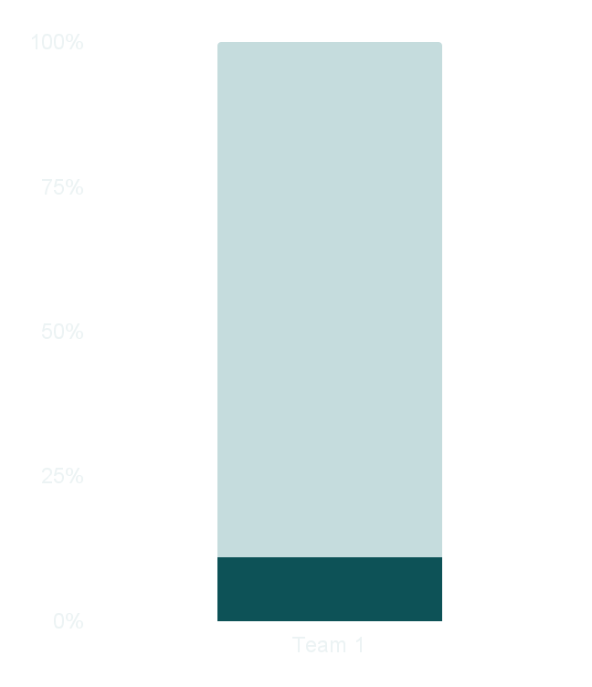
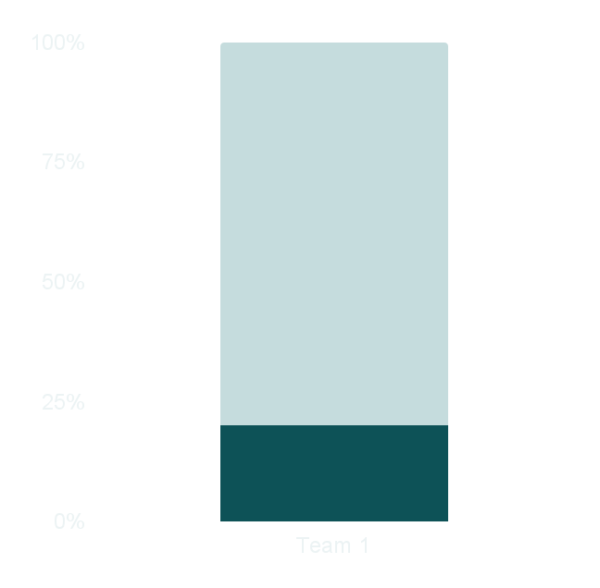
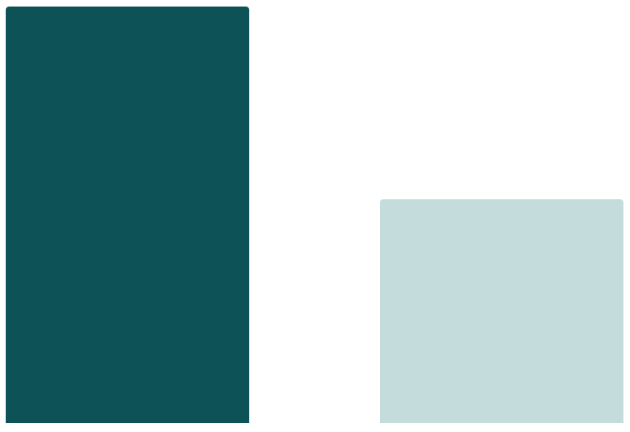

Aledade ACOs perform well across all lines of business, with greatest history and largest share of lives in MSSP¹
$1B+
Record MSSP savings generated by Aledade practices in 2024
For PY2024, Aledade represented:
Average savings
per beneficiary
93%
of Aledade ACO’s earned shared savings
vs <73% for non- Aledade participants ²
$665
11%
20%
$359
of the lives in MSSP
of the savings generated
Aledade
ACOs
Non-Aledade
ACOs
¹ All data relates to performance year 2024, the latest period for which data is available. Aledade analysis of CMS Public Use File available at https://data.cms.gov/medicare-shared-savings-program.
²The individual performance of non-Aledade ACOs may be better or worse than the average.

Slide 20
Value Based Care can revitalize Primary Care
Primary Care Physicians are compensated for their cognitive work - improving health outcomes by keeping patients out of the ER and hospital and judicially ordering testing and referrals
-Longitudinal relationships focused on prevention and control of chronic disease are rewarding professionally and are rewarded financially by these models
-Teams working at the top of their licenses reduce burnout, improve job satisfaction and result in better patient outcomes
-Focusing on population health with insights from data and tech result in a healthier society

