Slide 1
Payer perspective on Primary Care
May 2026

Slide 2
Unprecedented Cost and Regulatory Pressures are changing the Payer Landscape
Rising medical costs – hospital consolidation, pharmaceuticals, labor costs, etc.
Risk adjustment and v28
Exiting unprofitable markets
Reducing benefits for consumers and increased cost sharing
Increased focus on global risk value-based care contracts

Slide 3
Full risk value-based care remains a critical strategy
Primary care clinicians are at the heart of this strategy

Slide 4
“The most effective tool we have to ensure better outcomes and lower total cost of care for a patient is to make sure they have a good value-based PCP”
Health Insurance Executive, 2022

Slide 5
Strategies to support Value-based primary care
Financial support to invest in resources to drive higher value care
Usable analytic insights to identify opportunities to drive high value care and reduce low value care (e.g. specialist referrals, preferred lab/radiology partners)
Must be enabled within the clinical workflow in the EMR
Directly align financial incentives with clinical outcomes – meaningfully
Enable clinicians with AI tools to substantially reduce administrative and cognitive burden

Slide 6
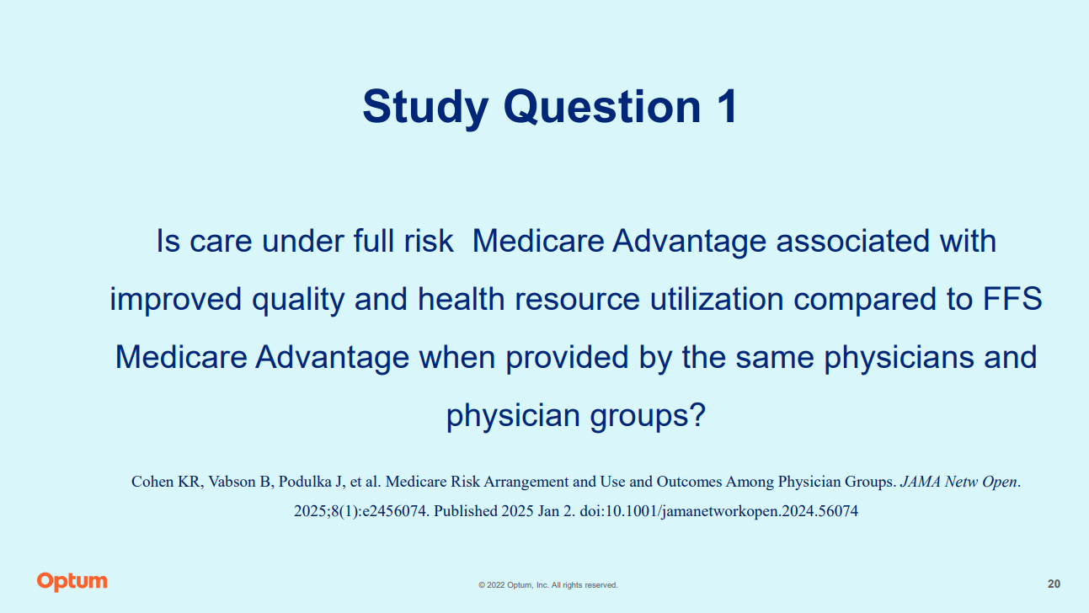

Slide 7
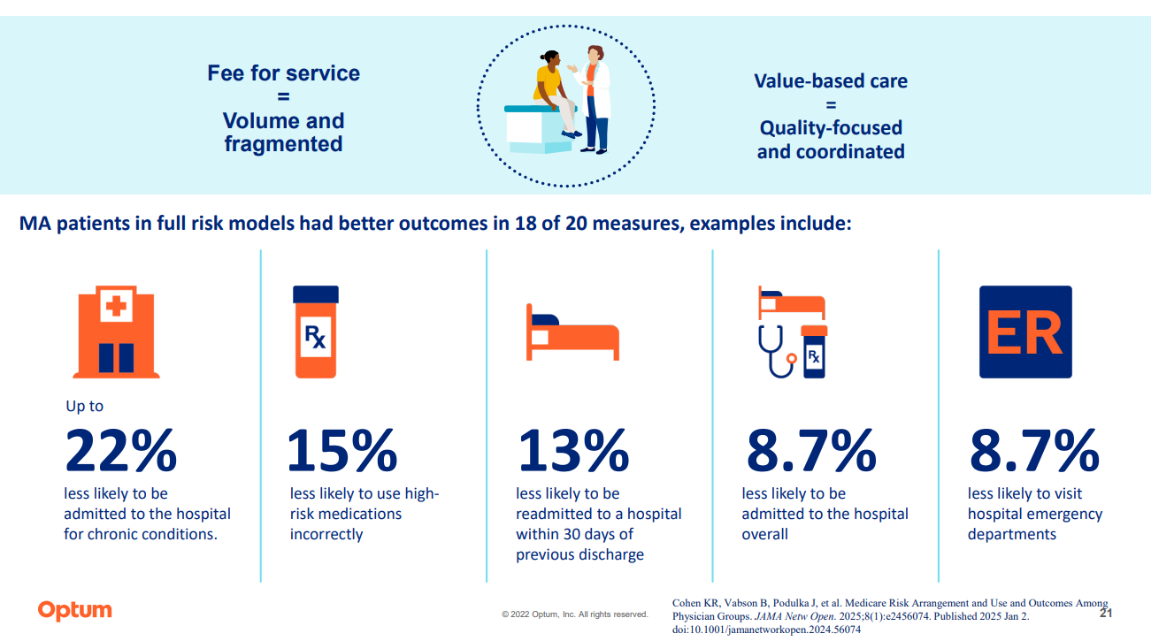

Slide 8


Slide 9
