Slide 1


5 Opportunities for Internal Medicine to Meet the Health Care Needs of the Future
Asaf Bitton, MD, MPH
Executive Director, Ariadne Labs
Brigham & Women’s Hospital | Harvard School of Public Health | Harvard Medical School
ACP Workforce Summit
May 15th, 2026
Notes:
This is another cover slide treatment - drag your image into the gray image placeholder area

Slide 2
Disclosures
I am a part-time senior advisor (since 2012) at the Center for Medicare and Medicaid Innovation (CMMI).
However, I am speaking today as a practicing primary care physician and health policy practitioner/researcher.
My views do not represent any official position of CMMI or CMS.
I am a member of the NASEM Standing Committee on Primary Care.
I am a board member (unpaid) of NCQA.
I have no other potential conflicts of interest to report.

Slide 3
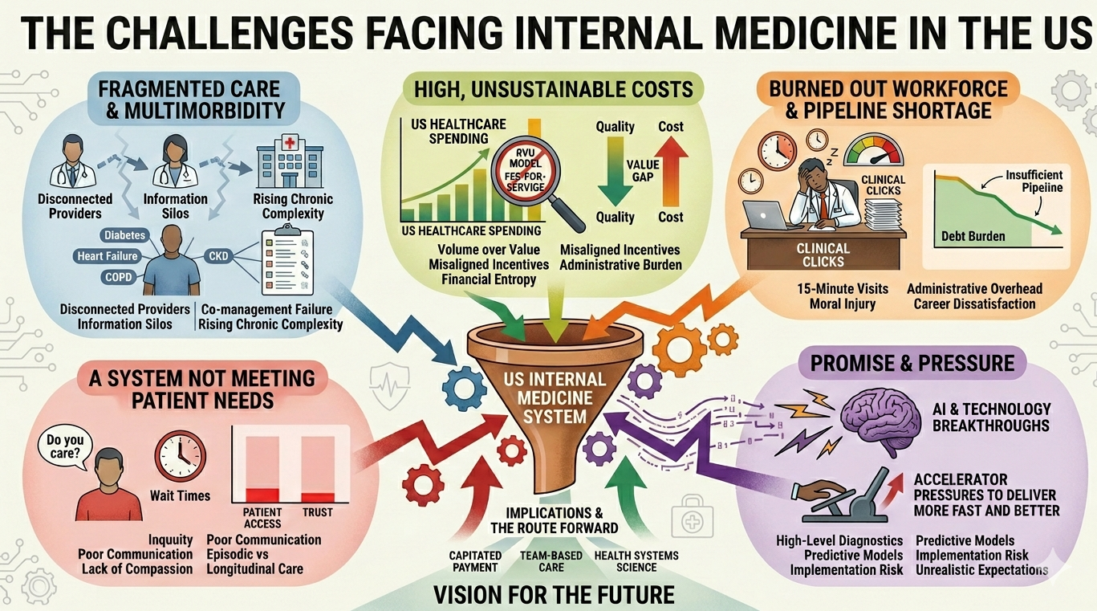
Summary

Slide 4
The Core Premise
We will need to continue to change meaningfully the ways we pay, train, and organize our internal medicine workforce in order to support more systems-oriented, whole-person, and technologically-enabled care.

Slide 5
5 Opportunities for the Future of Internal Medicine
1. Position Internal Medicine at the fulcrum between discovery, system redesign, and implementation science
2. Build care delivery innovation pathways – new technology, tools, specialty integration, and relational approaches to care
3. Innovate and change sites of care
4. Fundamentally evolve Internal Medicine training toward new and emerging capacities needed in the future
5. Revitalize primary care through payment reform and workforce growth

Slide 6
Internal Medicine Roles of the Future
*Compassionate Effective Physician
Systems Implementation Architect
Digital Steward
Integrated Specialist
Deep Generalist

Slide 7


Opportunity 1:
Position Internal Medicine at the fulcrum between discovery, system redesign, and implementation science
Notes:
Recommendation 2: Using the data sources and methodologies in Recommendation 1, the Centers for Medicare & Medicaid Services should consider the full range of value-enhancing primary care activities and services that are required for high-quality primary care in its valuation process. This includes the efforts of the full interprofessional primary care team and non encounter-based activities.

Slide 8

ARIADNE LABS
The Power of Breakthrough Innovation
A century of scientific research
has driven transformative breakthroughs in medicine
and public health.

Slide 9
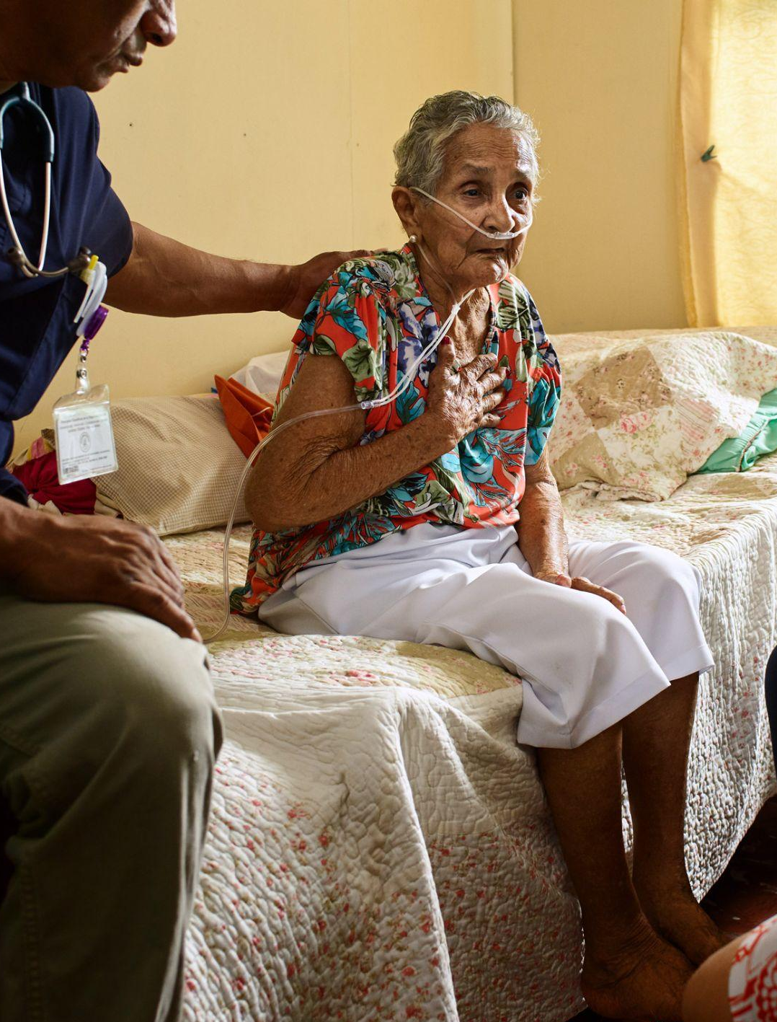
ARIADNE LABS
Where Systems Fall Short
Yet millions around the US face unnecessary suffering due to failures in care systems, which cost too much to deliver too little.

Slide 10
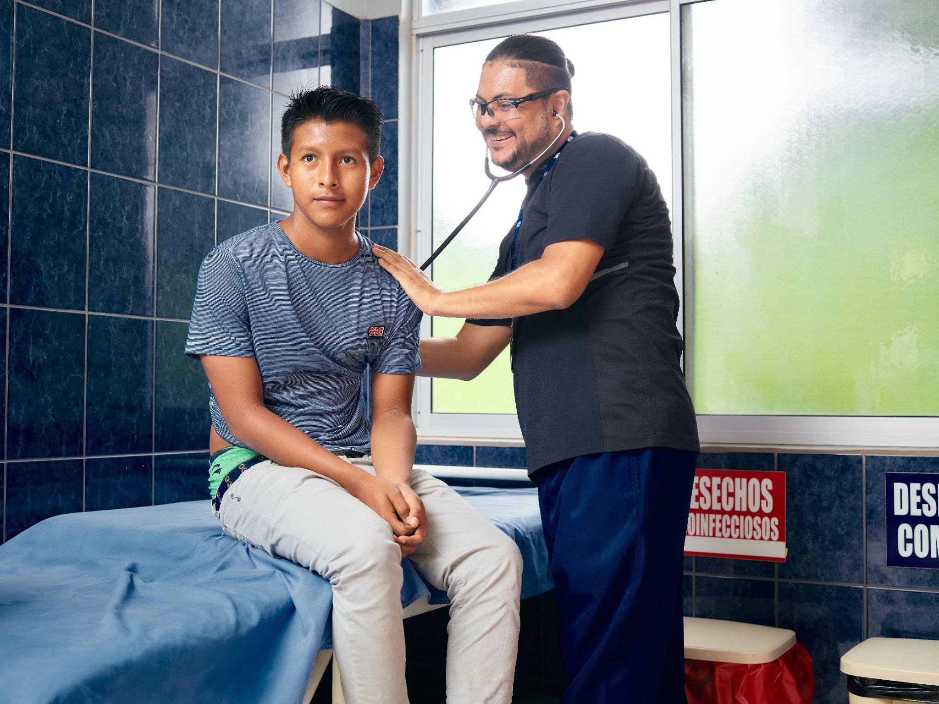
ARIADNE LABS
From Breakthrough
to Follow-Through
To save lives and reduce suffering, we need follow-through innovations that build systems to ensure every breakthrough reaches every patient, everywhere.
Internal Medicine can lead the way.

Slide 11
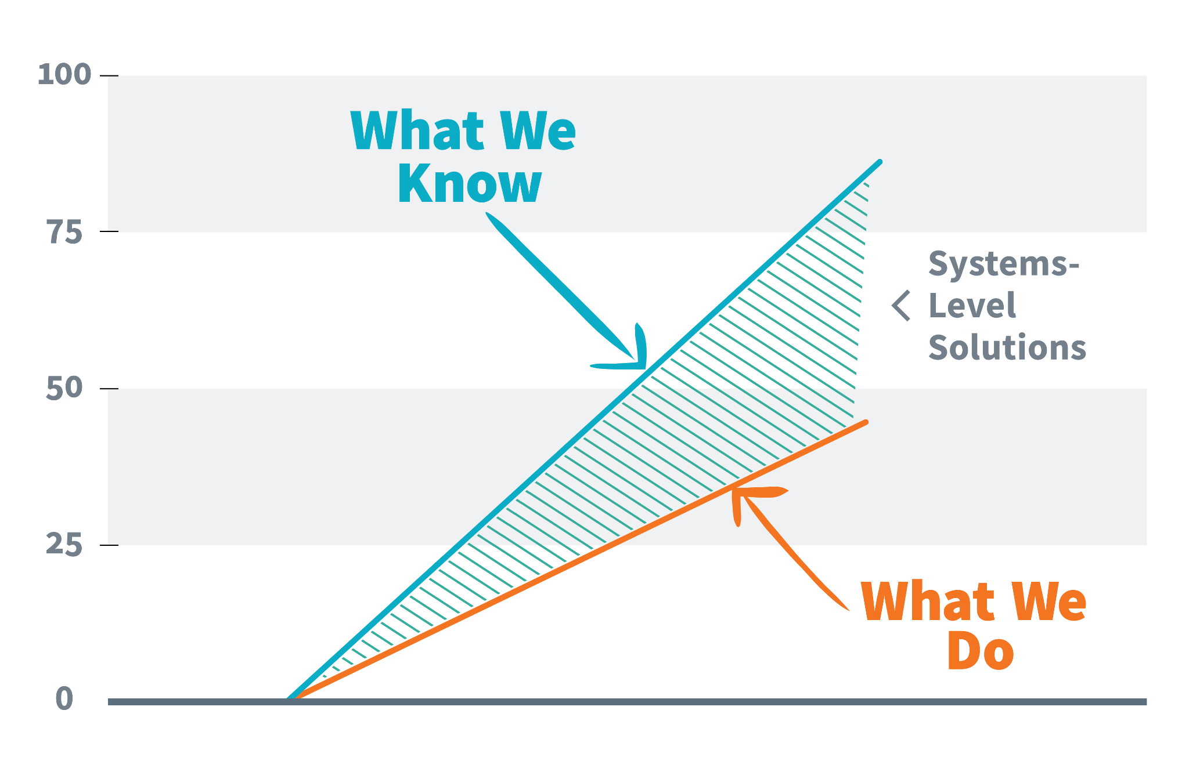
Closing
Know-Do Gaps
Through scalable,
systems-level solutions,
we must aim to close the gaps between what we know should happen in health care and what actually happens.

Slide 12

Guiding
Principles
Innovation is doing something differently that brings clear value to the end user
Innovations must be widely implemented to measurably reduce suffering in the real world of health care.

Slide 13
Implementation Science and Research
“The study of methods to promote the integration of
research findings and evidence into healthcare policy
and practice…. It seeks to understand the behavior of healthcare professionals and other stakeholders as a
key variable in the sustainable uptake, adoption, and implementation of evidence-based interventions.”
— NIH Conference on the Science of Dissemination and Implementation. NLM.NIH.gov

Slide 14
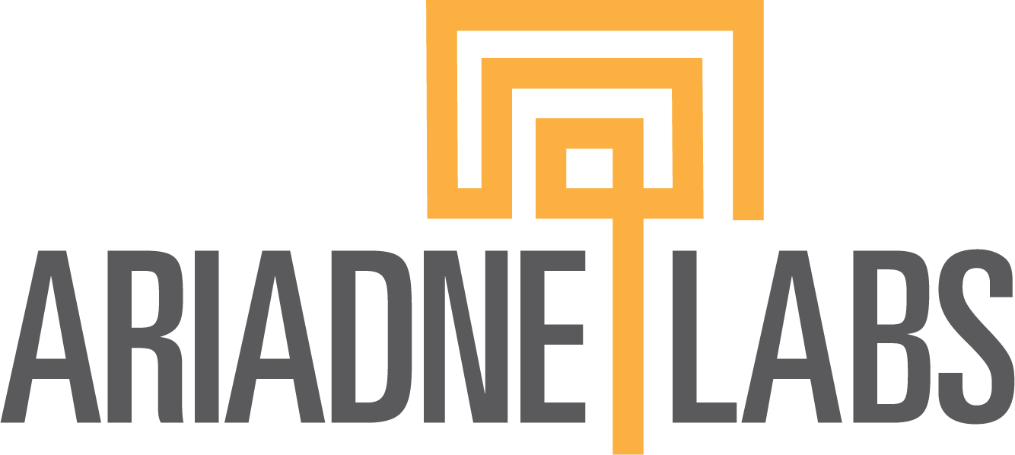
Implementation Matters
Weekly support, pre-selected sites
(NEJM trial, -47%)
Mandate/regular feedback
(Scotland -26%, France -35%, Norway RCT -43%)
Checklist adoption/ Mortality reduction
Voluntary, light touch support
(S Carolina -22% in hospitals completing adoption program)
Mandate/team-training
(Veterans Administration Hospitals -18%)
Mandate alone (Ontario -0%)
Implementation readiness/intensity
Notes:
This is an example of the implementation of the Surgical Safety Checklist. The impact of the checklist is dramatically different depending on how well it is implemented. In a review of a number of large scale studies of checklist implementation we can see a close correction between the intensity of the implementation strategy as demonstrated on the x axis here, and the reduction in mortality seen on the Y axis. So if we want the checklist to work, we need to do more than just hand it to surgical teams.

Slide 15






Generalizable
Implementation Science starts here
Adapt to local contexts
Generalize for other contexts
Quality Improvement starts here
Setting specific
Notes:
How is IS different from QI? QI = Design for us- then pull out general lessons. IS = design for everyone and then adapt locally

Slide 16
How We Work
Scalable Solutions
Tool “WHAT” Simple(r), evidenced based intervention that is clear, concise, and easy to use
Tool “WHAT”
Implementation Strategies “HOW”
SCALABLE SOLUTION
Implementation Strategies “HOW” Plans or methods that ensure a new tool is effectively applied and integrated within an organization, system or community.

Slide 17
Opportunity 2:
Build care delivery innovation pathways for Internal Medicine –
new technology, tools, specialty integration, and relational approaches to care
Notes:
Recommendation 2: Using the data sources and methodologies in Recommendation 1, the Centers for Medicare & Medicaid Services should consider the full range of value-enhancing primary care activities and services that are required for high-quality primary care in its valuation process. This includes the efforts of the full interprofessional primary care team and non encounter-based activities.

Slide 18

AI Functions - IM
Automated documentation
Data & chart summary
Diagnostic & treatment guidance
Patient engagement & self-care
Care gap identification & closure
Risk prediction & stratification
QI & continuous feedback
Language translation & interpretation
New Tools and Technology
AI: Potential Promise & Peril for Internal Medicine
The Challenge:
Bias & Trust Issues
Potential Widening of Digital Divide
Need for Real-World Evidence of Effect
Implementation, Usability & Scalability
The Opportunity:
Internal Medicine as a key Digital Steward
Build systems co-designed & implemented with patients & frontline workers to meet their diverse needs inside/outside the clinic, attuned to risks, and oriented toward fair outcomes for all

Slide 19
AI Functions - IM
Automated documentation
Data & chart summary
Diagnostic & treatment guidance
Patient engagement & self-care
Care gap identification & closure
Risk prediction & stratification
QI & continuous feedback
Language translation & interpretation
New Tools and Technology
AI: How Will We Know It “Works”?
What is the clear problem the application is trying to solve?
Is the model/app/solution/technology:
- appropriate?
- valid?
- reliable?
- safe?
- fair?
3. Does it meaningfully:
- improve care?
- for everyone?
- at a cost we can afford?
- in a sustainable way for the workforce?
- with identified unintended consequences?

Slide 20

Opportunity to use new genetic tools in a broader way
If precision medicine is to be fully integrated into population health and the day-to-day practice of medicine at scale, significant health system innovations and implementation at scale will be required.
Internal Medicine can lead the way.

Slide 21


Key Milestones - Ariadne
Corewell Health primary care patients screening for 167 actionable genetic markers in a pilot study
Launched first-ever preventive genetic screening program for an Alaskan Native population with Southcentral Foundation
ICoNS conference has grown to more than 500 members from 50 countries
New Tools and Technologies
Precision Population Health
Ushering in the era of medical prevention and personalized care
The Challenge
Breakthroughs in genomics have transformed diagnosis and treatment in specialty care, but there is untapped potential in applying genomics to population health
Genetic markers of risk can help clinicians effectively treat and prevent disease
Genetic screening only reaches a small fraction of people who could benefit
Our Solutions
Implementation Pathways: Developing clinical tools and implementation support to help primary care practices introduce genetic screening.
International Consortium on Newborn Sequencing: Founding members of a consortium of world-class experts in newborn genetic sequencing working to accelerate progress toward broader adoption of screenings that can save lives, led by BEACONS-NBS program in 7 states
www.ariadnelabs.org/precision-population-health

Slide 22
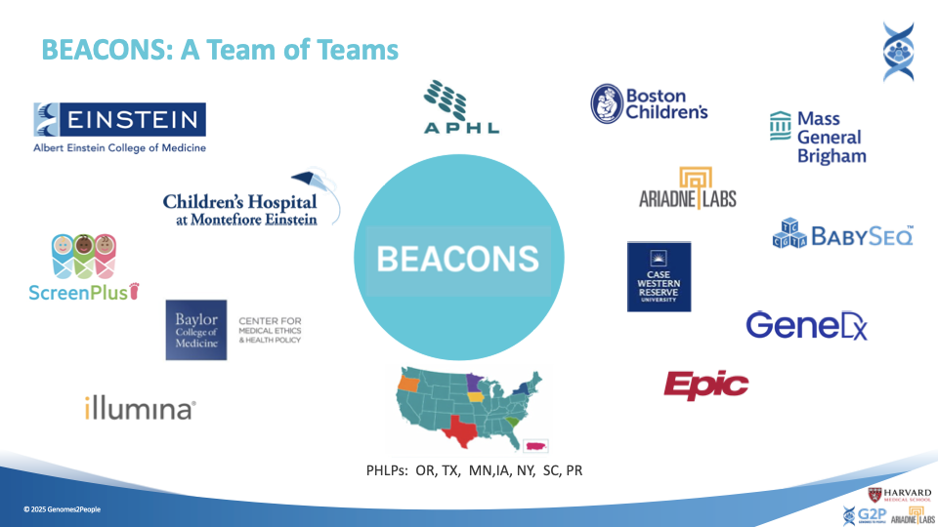

Slide 23
More broad adoption of value-based care

Slide 24

eConsults Can Add Value
https://www.healthsystemtracker.org/brief/can-econsults-reduce-commercial-health-spending-learnings-from-an-arkansas-pilot-study/
Notes:
Recommendation 3: The Centers for Medicare & Medicaid Services (CMS) should invite other expert and technical advisory organizations beyond the Relative Value Scale Update Committee to contribute to the annual valuation process. This could entail CMS establishing a separate internal or external expert group or involving contractors or researchers to conduct independent analyses.

Slide 25
New Approaches to Relational Care
The Serious Illness Care Program
Our Impact
7 million patient lives touched
300,000 clinicians trained
50% lower rates of anxiety and depression for patients
70% increase in clinician satisfaction
Evidence-based, system-level intervention to enable care centered on what matters most to patients.
“You can almost see [the patient] recognize that yes, this is the most important thing to me, and no I actually don't want to go through all of this suffering.”
-A clinician, on having Serious Illness Conversations when weighing goals for quality of life versus treatment options

Slide 26
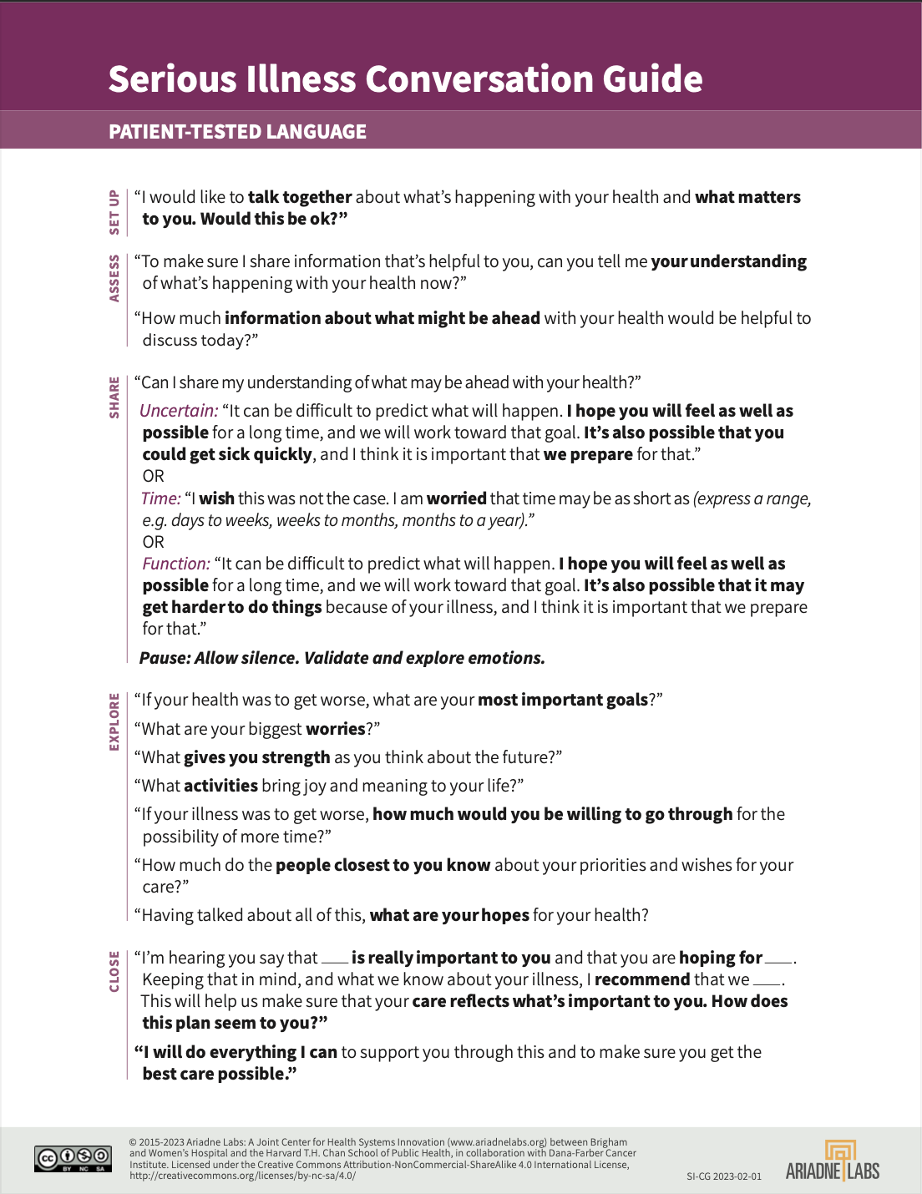
New Approaches to Relational Care
The Serious Illness Care Program
Grounded in the Serious Illness Conversation Guide
Provides systems with tools, clinician trainings, and system resources to deliver care centered on what’s most important to the patient
“If it's done skillfully, patients want to share with you who they are as human beings. They want to feel like somebody cares.”
- A clinician trained in the Serious Illness Care Program

Slide 27
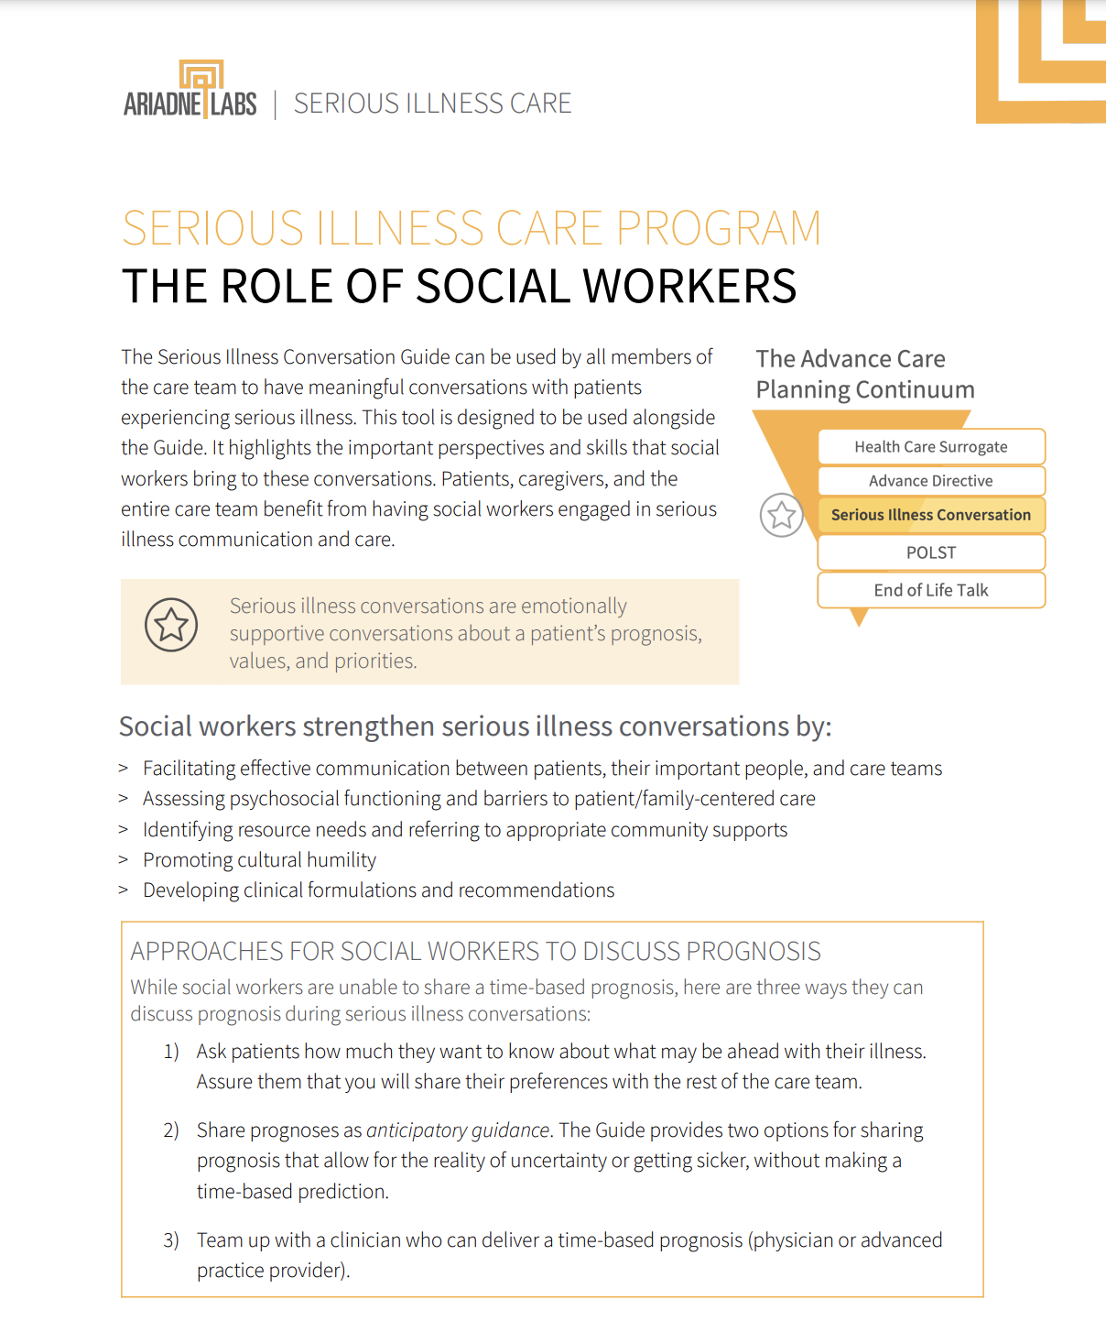
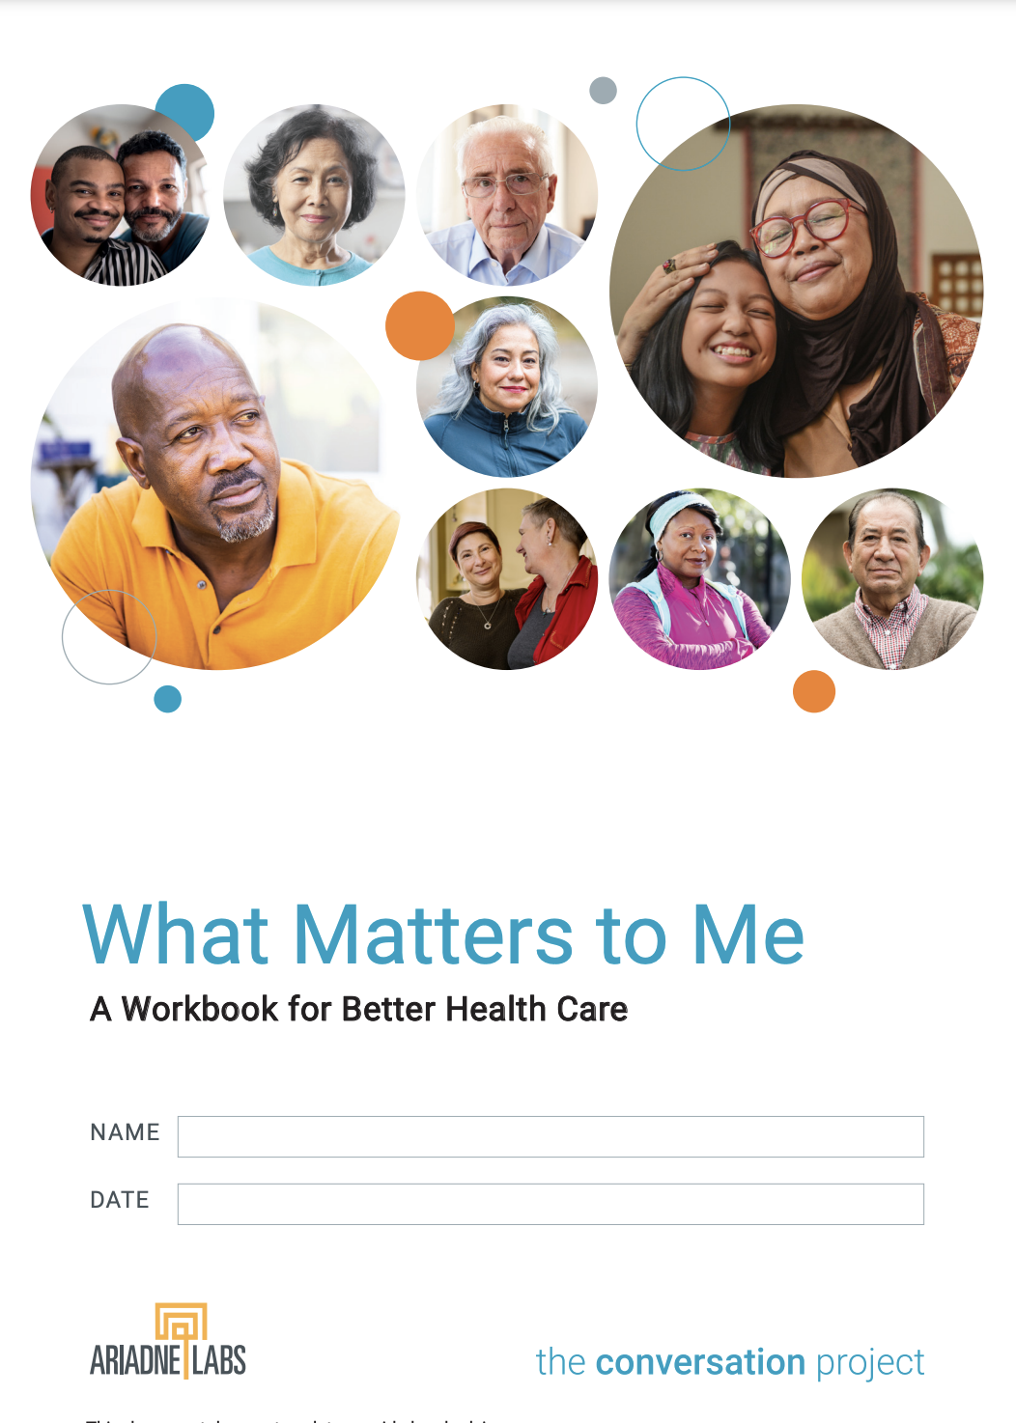
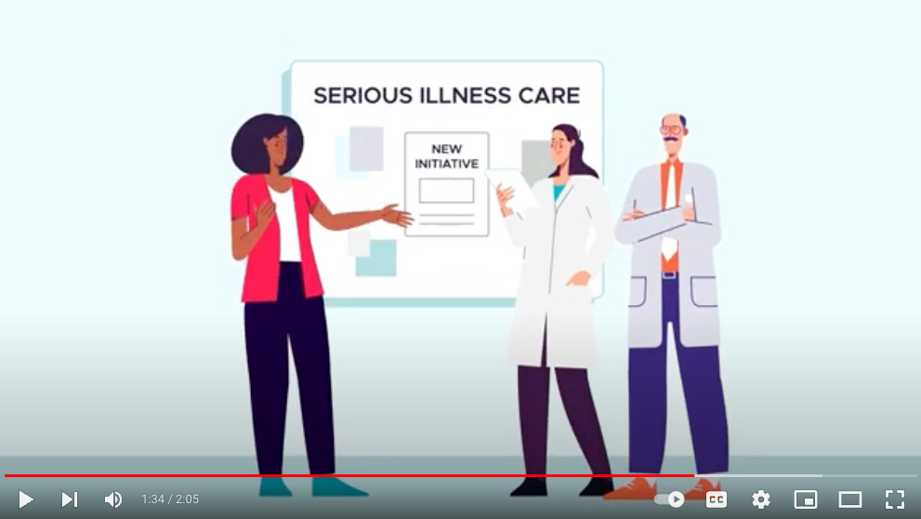
New Approaches to Training
Continuous Innovation
The Serious Illness Care Program
As we’ve scaled, we’ve continued to learn from the work. Our learnings have inspired the design, test, and spread of new tools to foster patient-centered care.
Digital, avatar-based training
Tools for interdisciplinary teams
Patient-facing tools
Notes:
Add screenshot of DGT?

Slide 28
Opportunity 3:
Innovate the sites of care

Slide 29
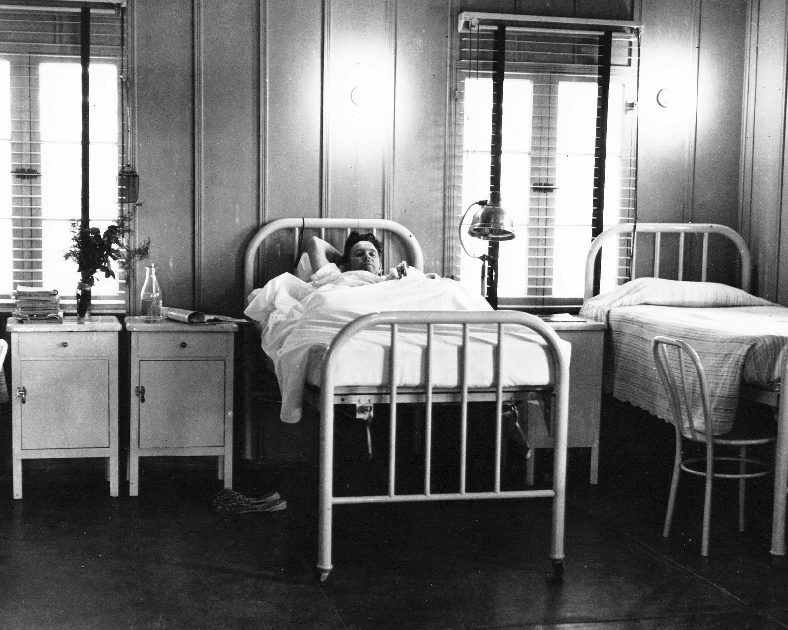
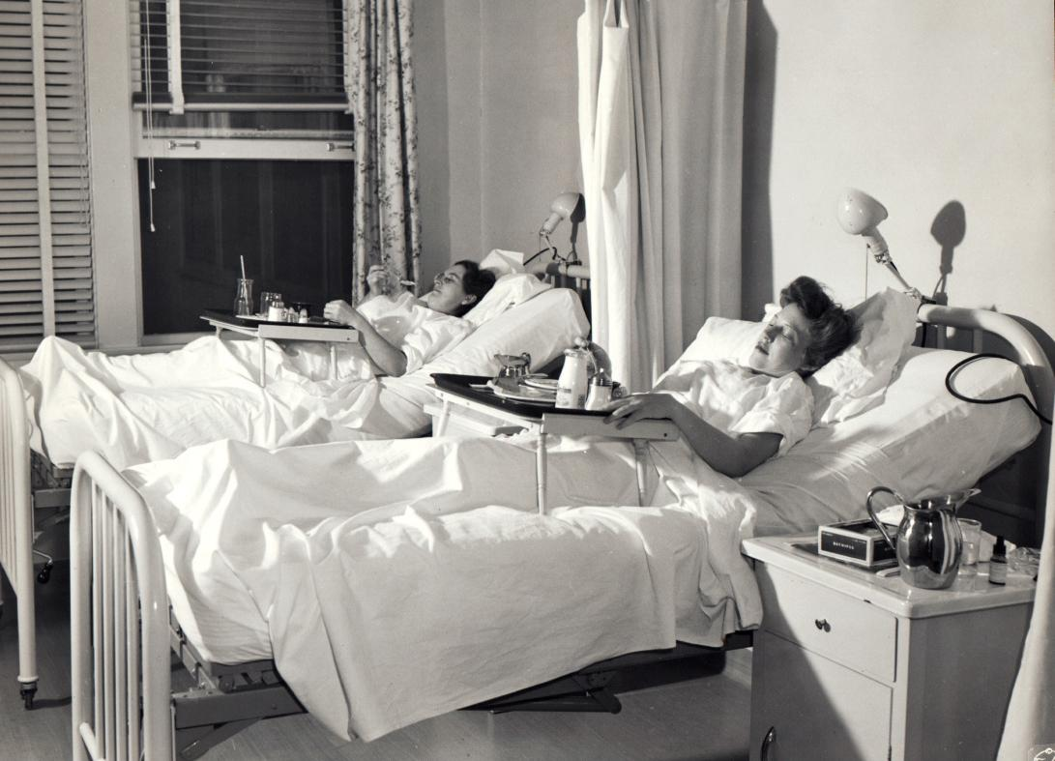
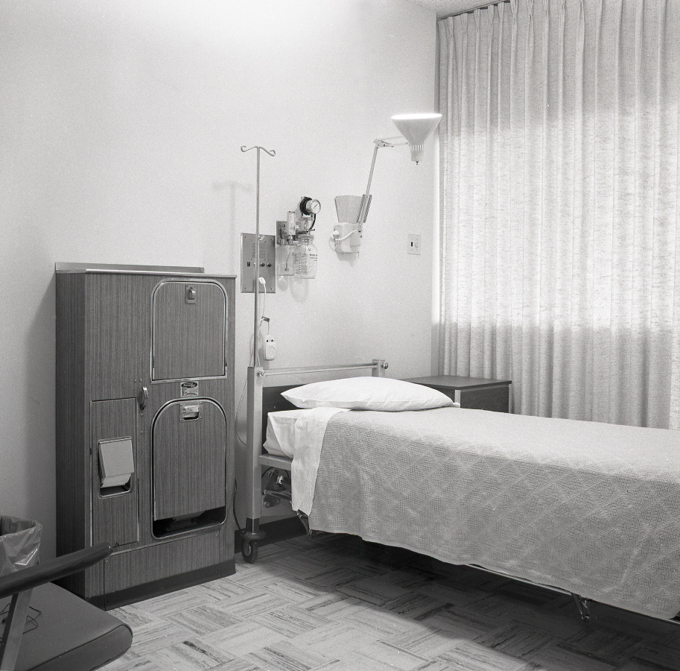
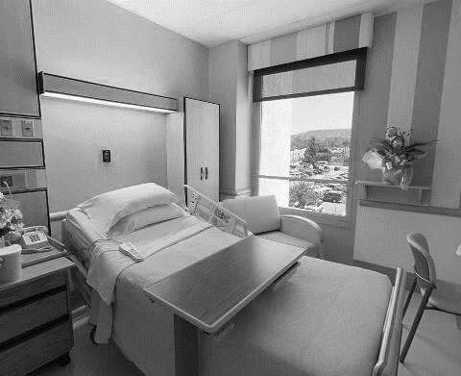
1933
1944
The structure and delivery of hospital care has persisted for almost 100 years
1960
2026
29
Notes:
We have come a long way in medicine in many areas. Despite important incremental improvements in our hospitals, the structure and care delivered is still very reminiscent of hospitals 50 years ago. Some hospital structures have persisted for over 100 years.
Garfield's Contractors General Hospital at Desert Center, circa 1933
The Southern Permanente Hospital (Fontana), 1944
Kaiser Permanente hospital room setting, circa 1960.
2011 – Kaiser Permanente Hospital
http://kaiserpermanentehistory.org/latest/race-gender-and-infection-the-case-for-private-hospital-rooms

Slide 30
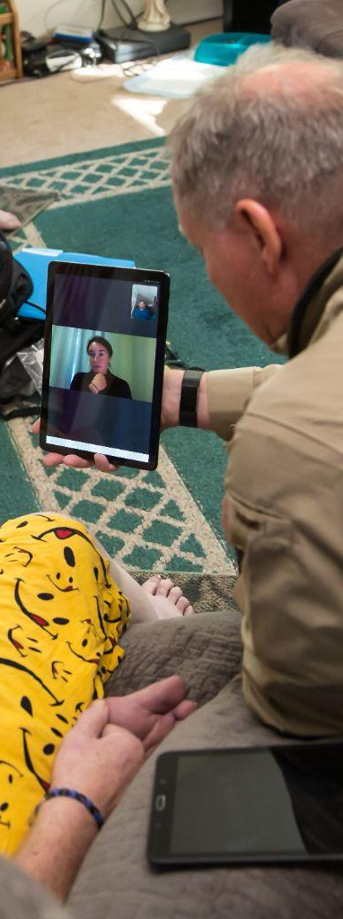
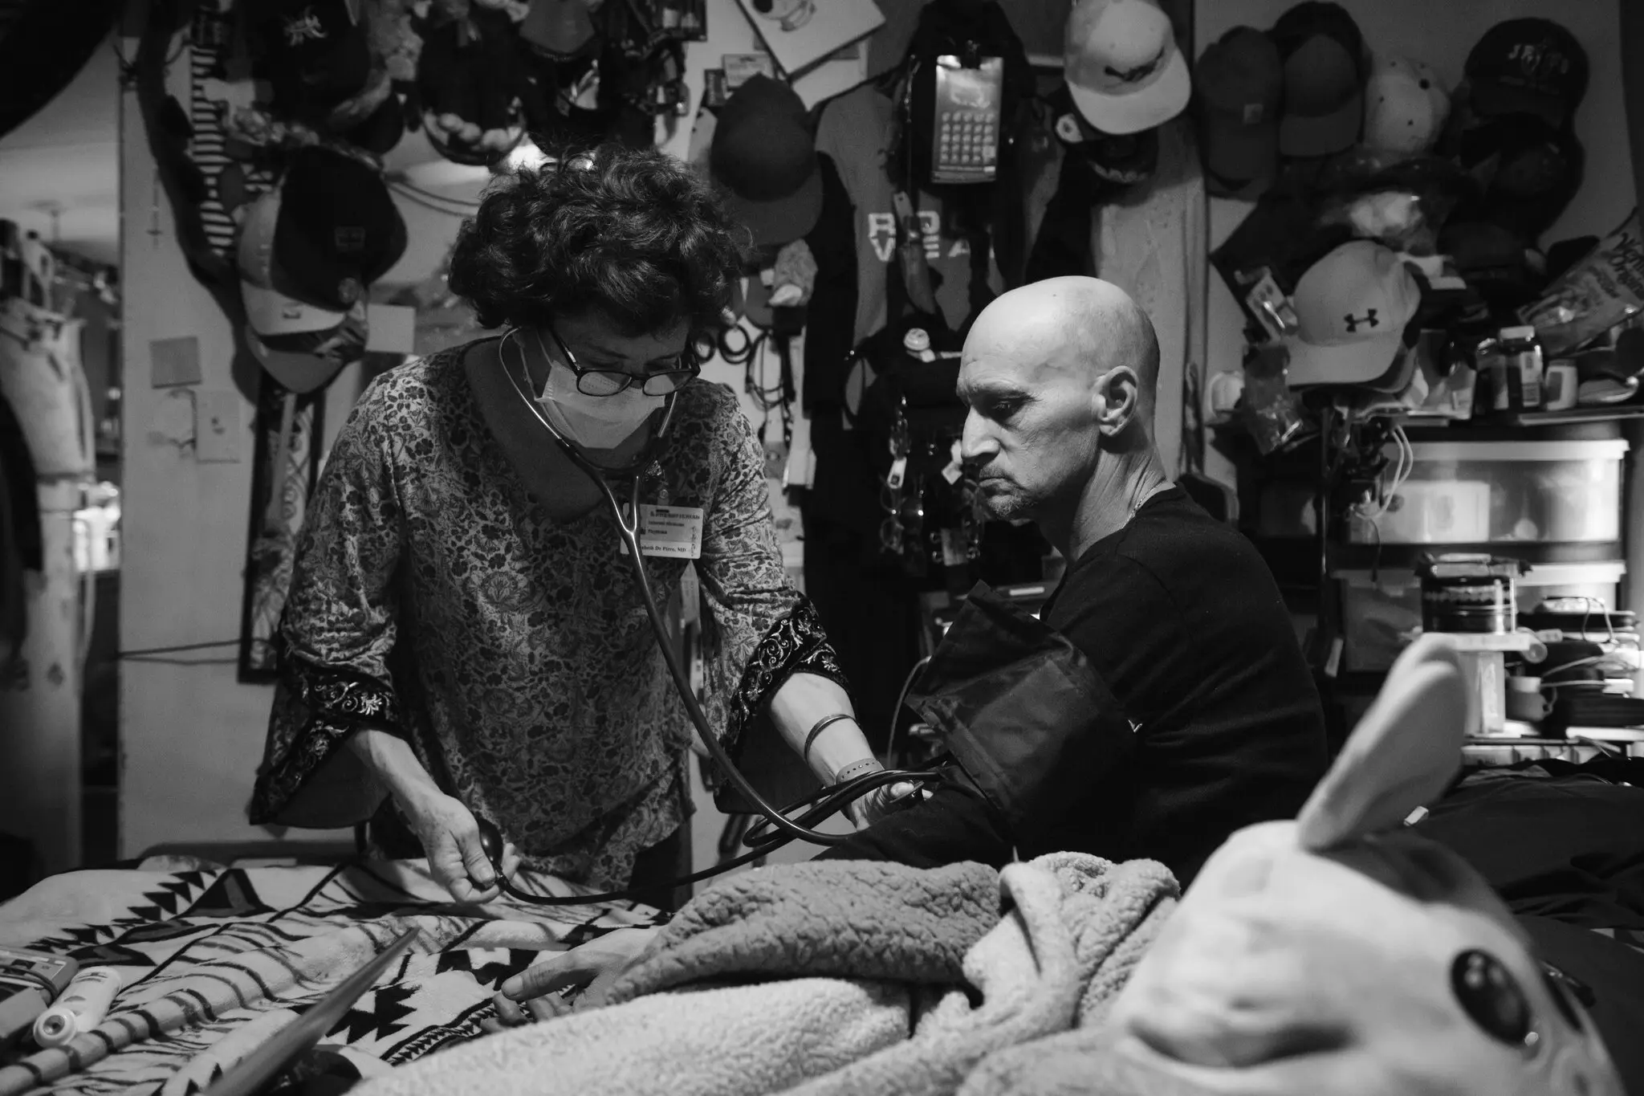
Home Hospital Care Model
2 Daily RN/CP Visits
24/7 Availability
1 Daily remote or in-person MD Visit
Home Hospital Care
Diagnostic Testing
IV Medications
If needed: specialist consultation, home health aide, social work, physical/occupational therapy,
food delivery
Remote Monitoring Vital Signs
30

Slide 31
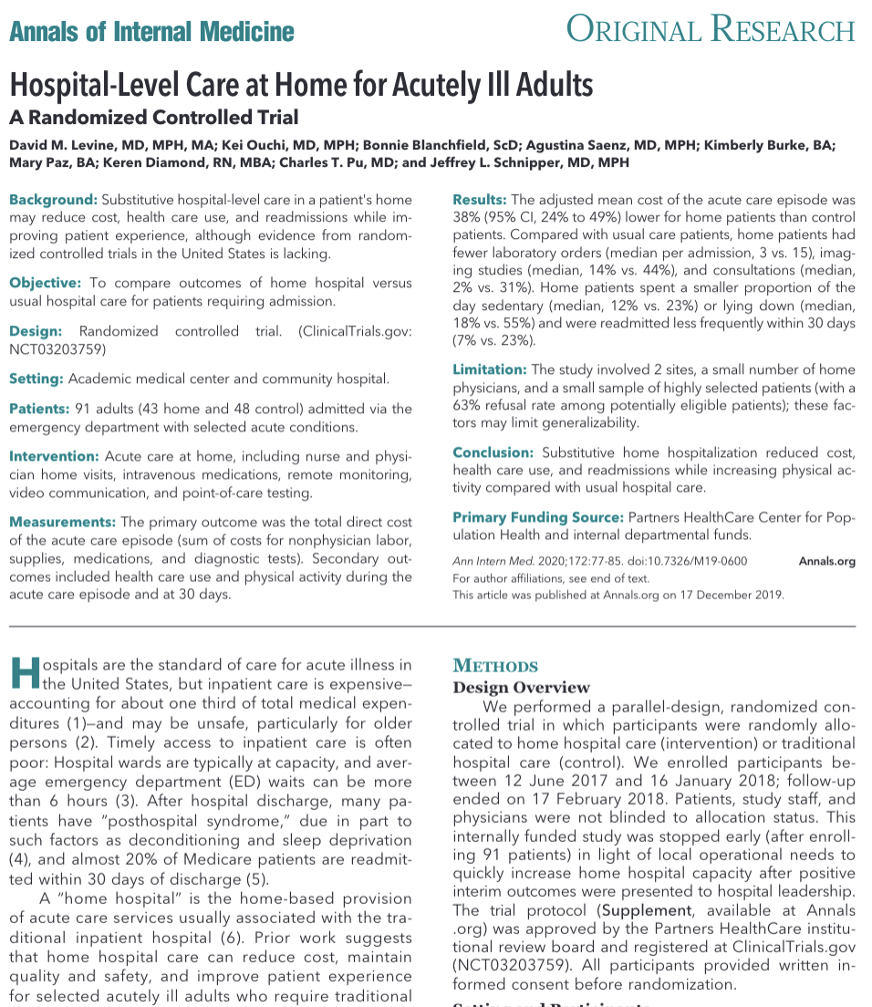
Urban home hospital model produced strong evidence in December 2019
REDUCED COST 35% | REDUCED UTILIZATION Labs 5% vs 15% Imaging 14% vs 44% Consults 2% vs 31%
REDUCED READMISSIONS 7% vs 23% | INCREASED PHYSICAL ACTIVITY Sedentary 15% vs 22% Lying down 32% vs 66%
31
Notes:
Sarah
Our overall aim was to compare the experiences of RHH patients with the usual care that adults receive when they’re admitted to the hospital
Primary aim
Reduction in cost by 10%
Secondary aims
Improves days at home*
Improves physical activity
Improves readmission rate - lower readmission rate 30 days post-discharge
Overall synthesize the lessons learned so that it can inform future RHH and HH initiatives
Clarify with David
Intro the study

Slide 32

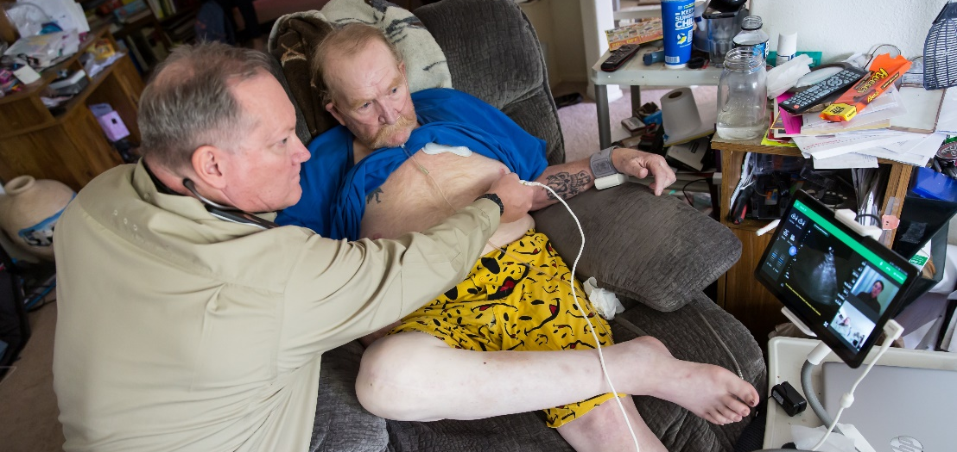
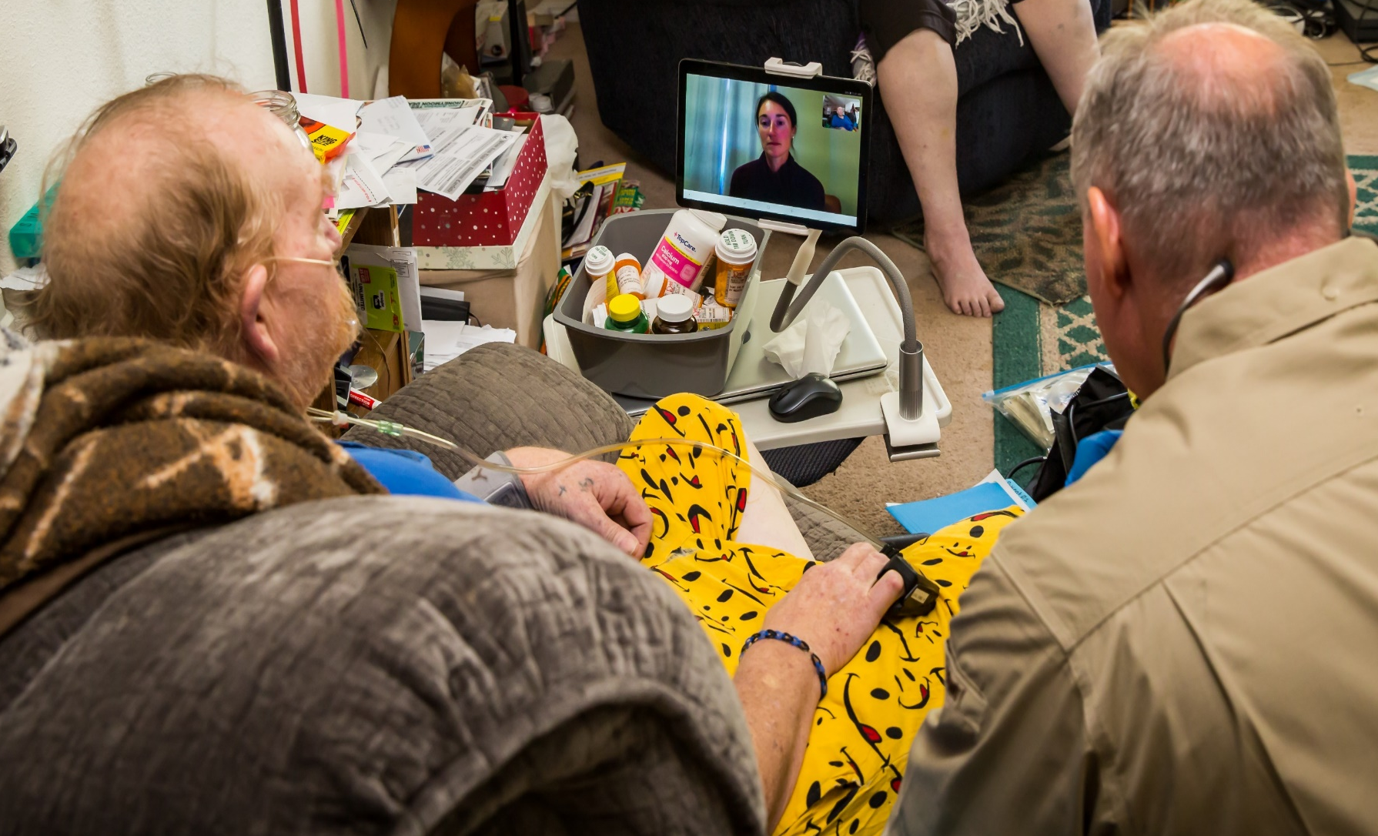
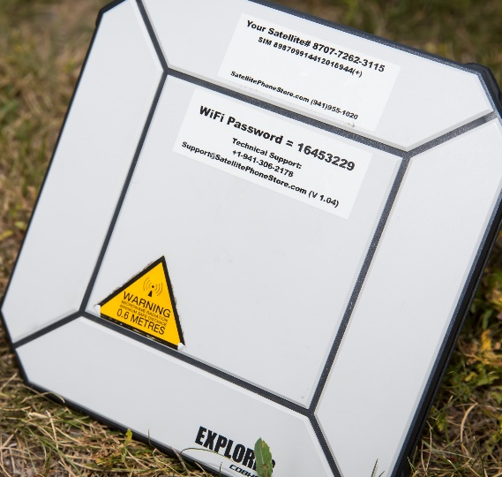
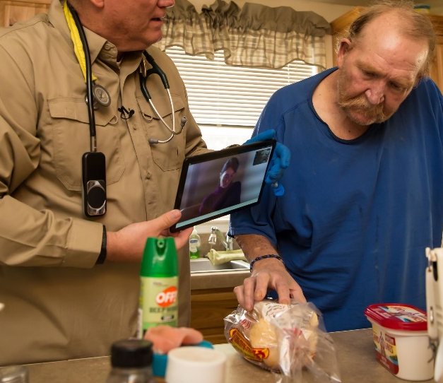
A Rural Home Hospital Model in Action
Pilot components at rural home hospital site – Vernal, Utah
Portable ultrasound & IV meds with real-time delivery
Treatment, counseling & education through tele-medicine or in-person physician
Portable satellite broadband
In-person nurse or paramedic
Notes:
Rural sites -> 2. communication -> 3. gather and transmit data to MD -> 4. Facilitate MD interaction -> 5. Educate

Slide 33
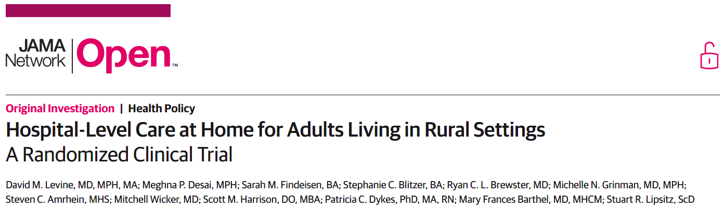
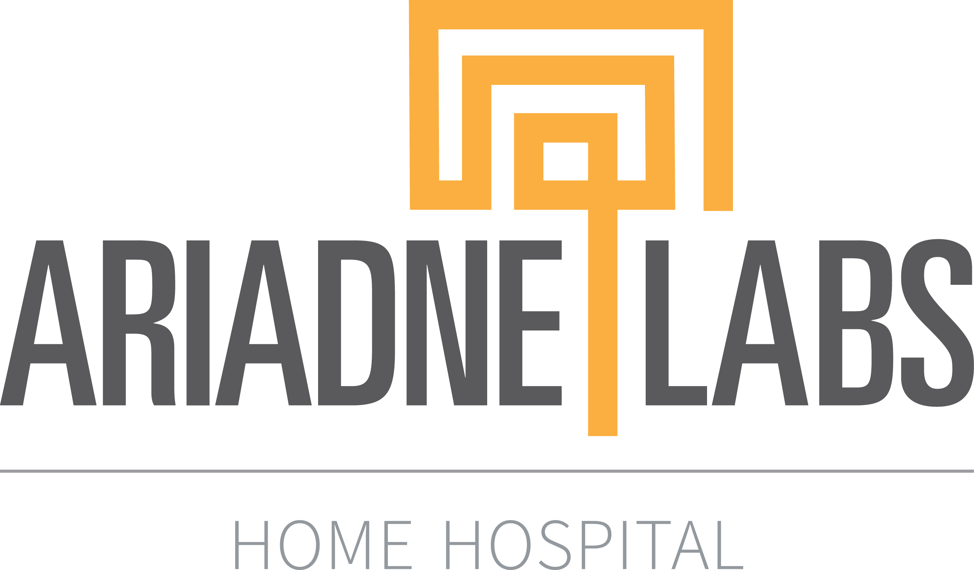






Rural RCT findings
RURAL HEALTH
Similar safety and use of necessary care
Significant improvement in physical activity and experience
No difference in cost in primary analysis;
lower cost if transferred early
Rural home hospital is a viable model
Levine DM. JAMA Netw Open. 2025.

Slide 34
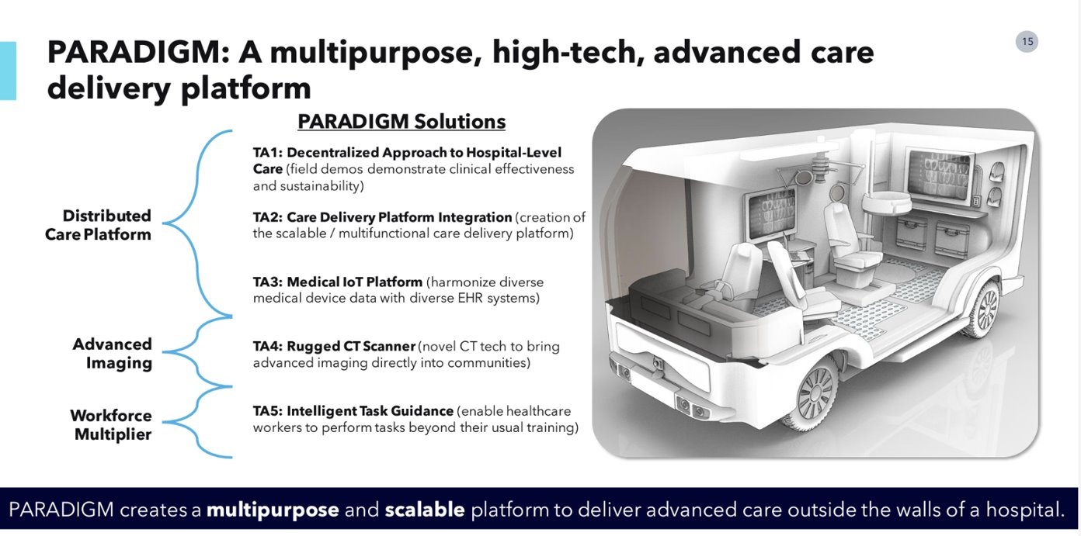
What if we could deliver advanced hospital-level care to every rural county in America?

Slide 35
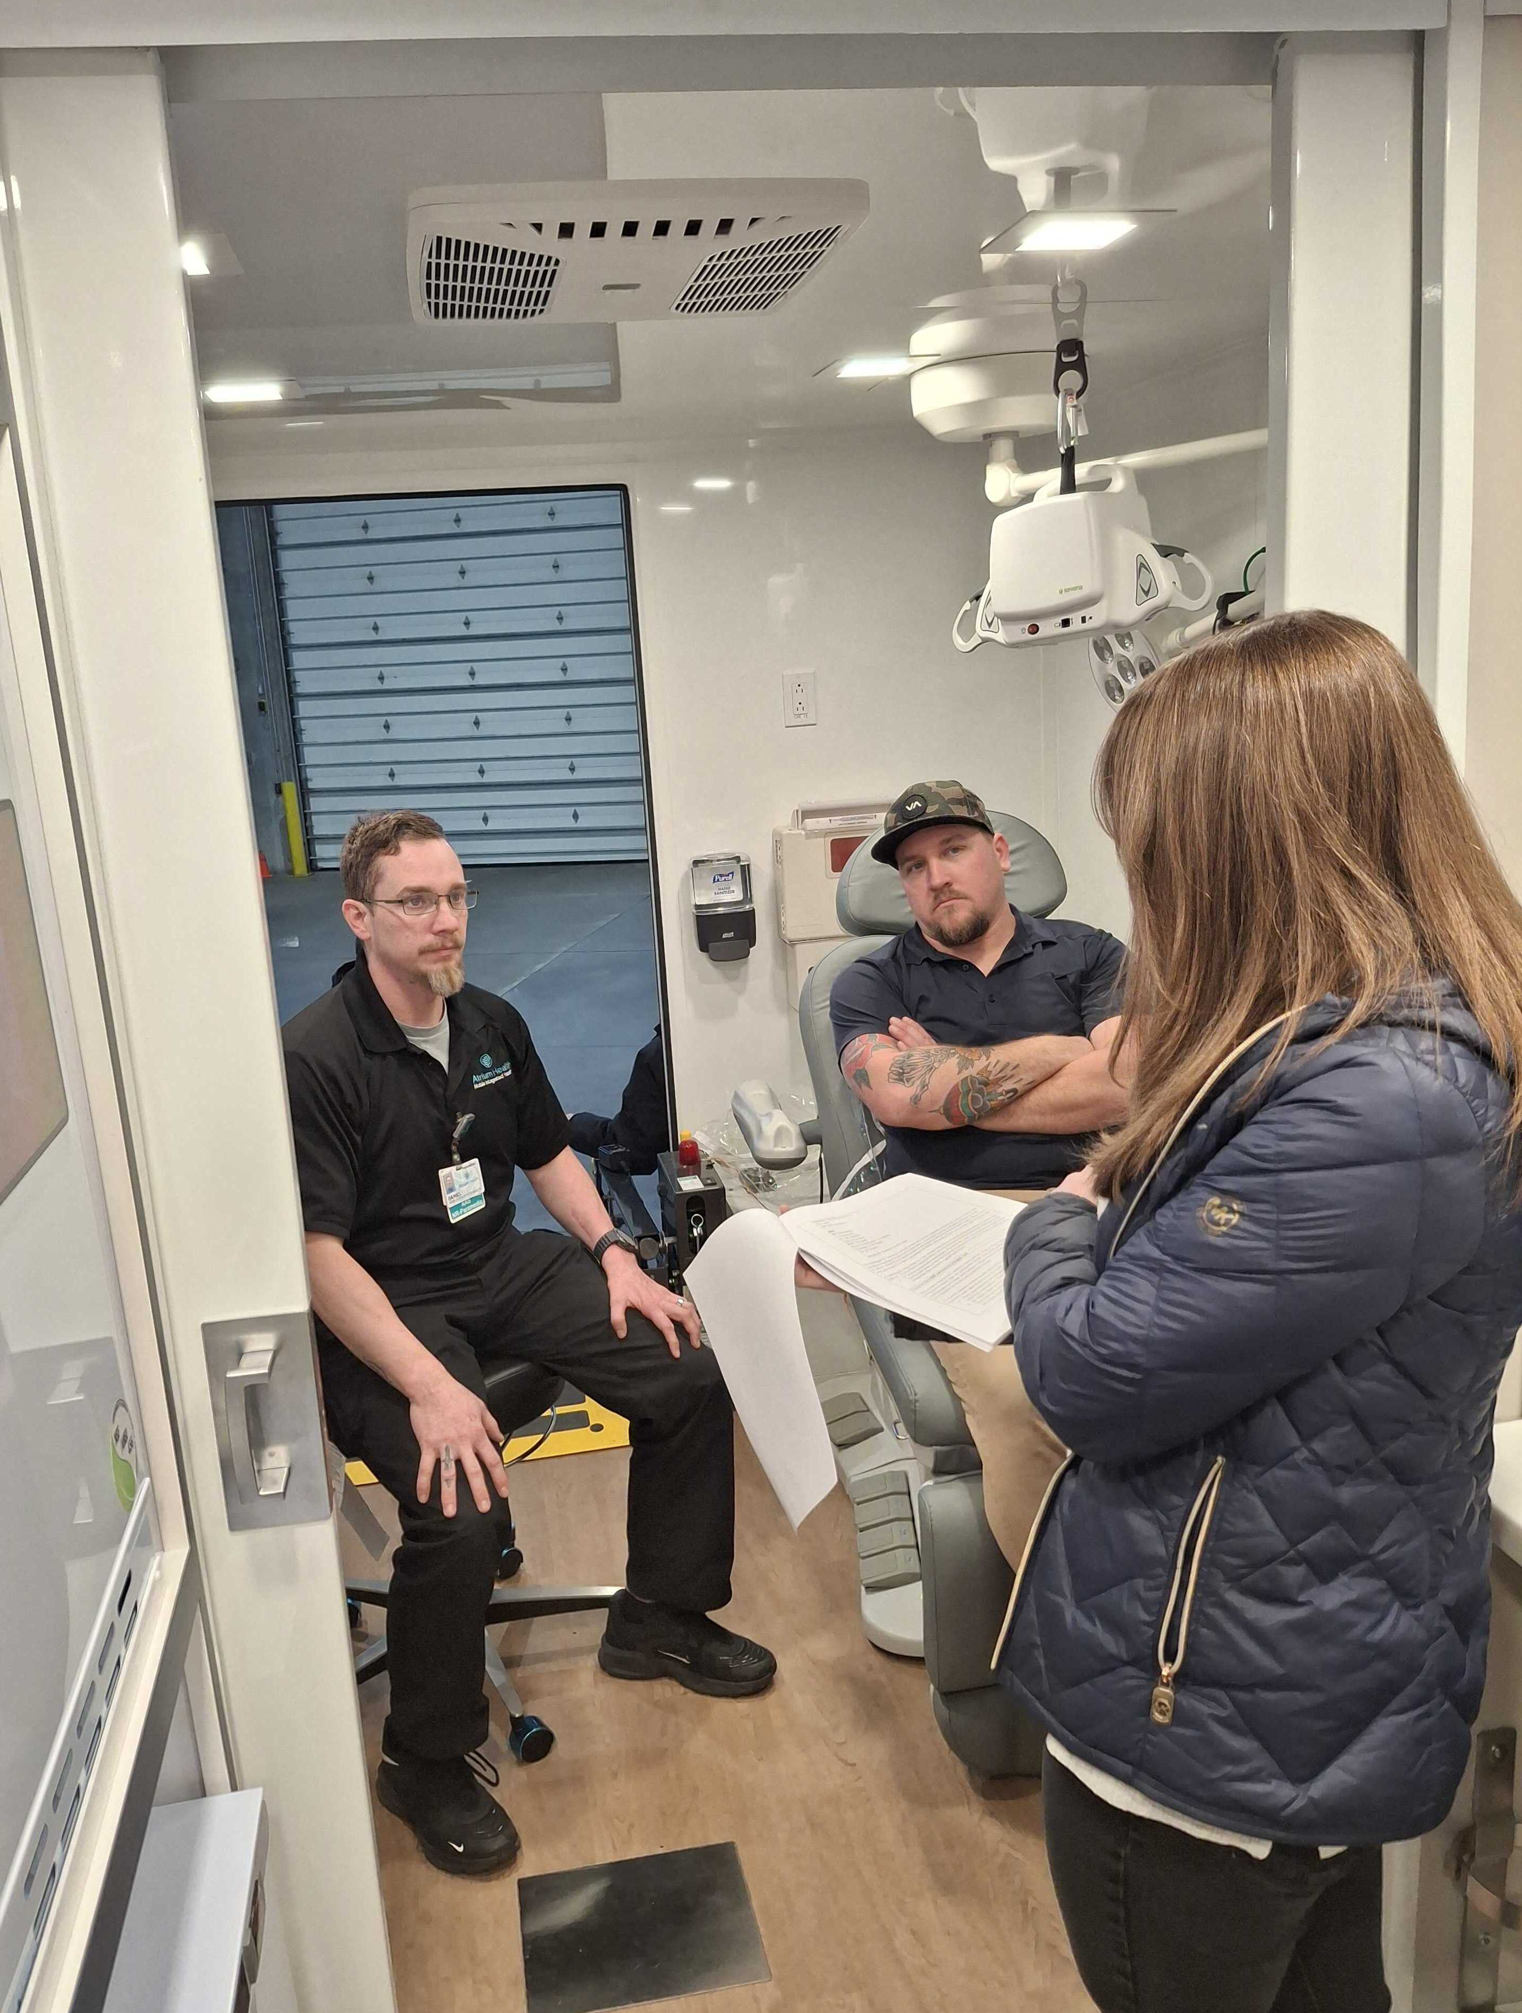
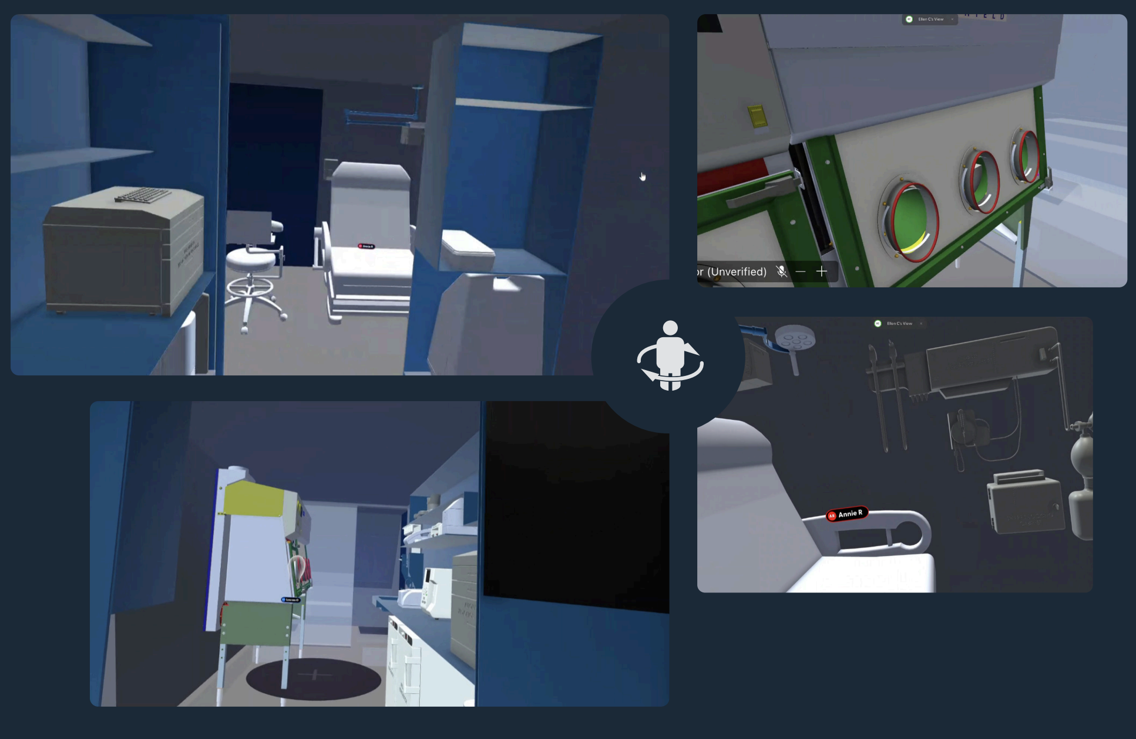
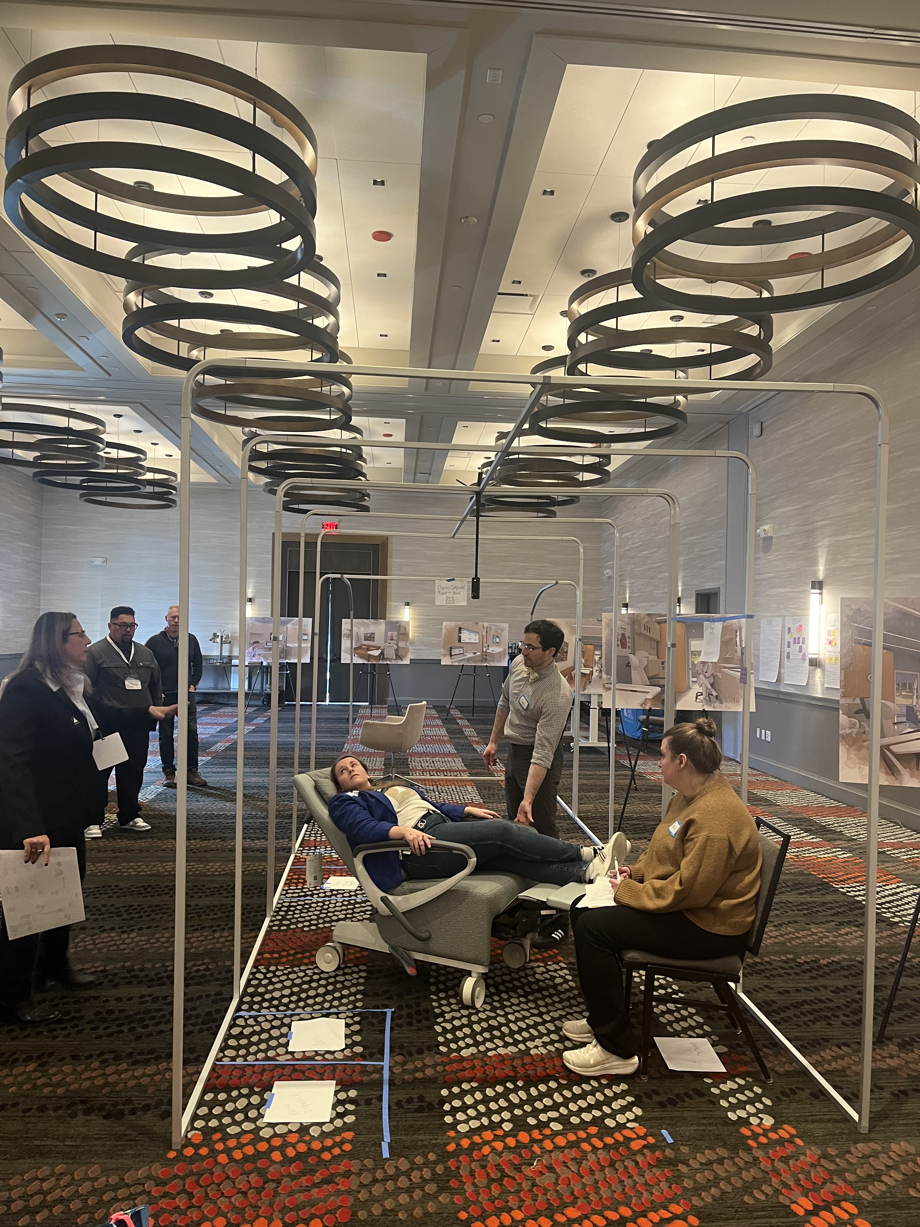
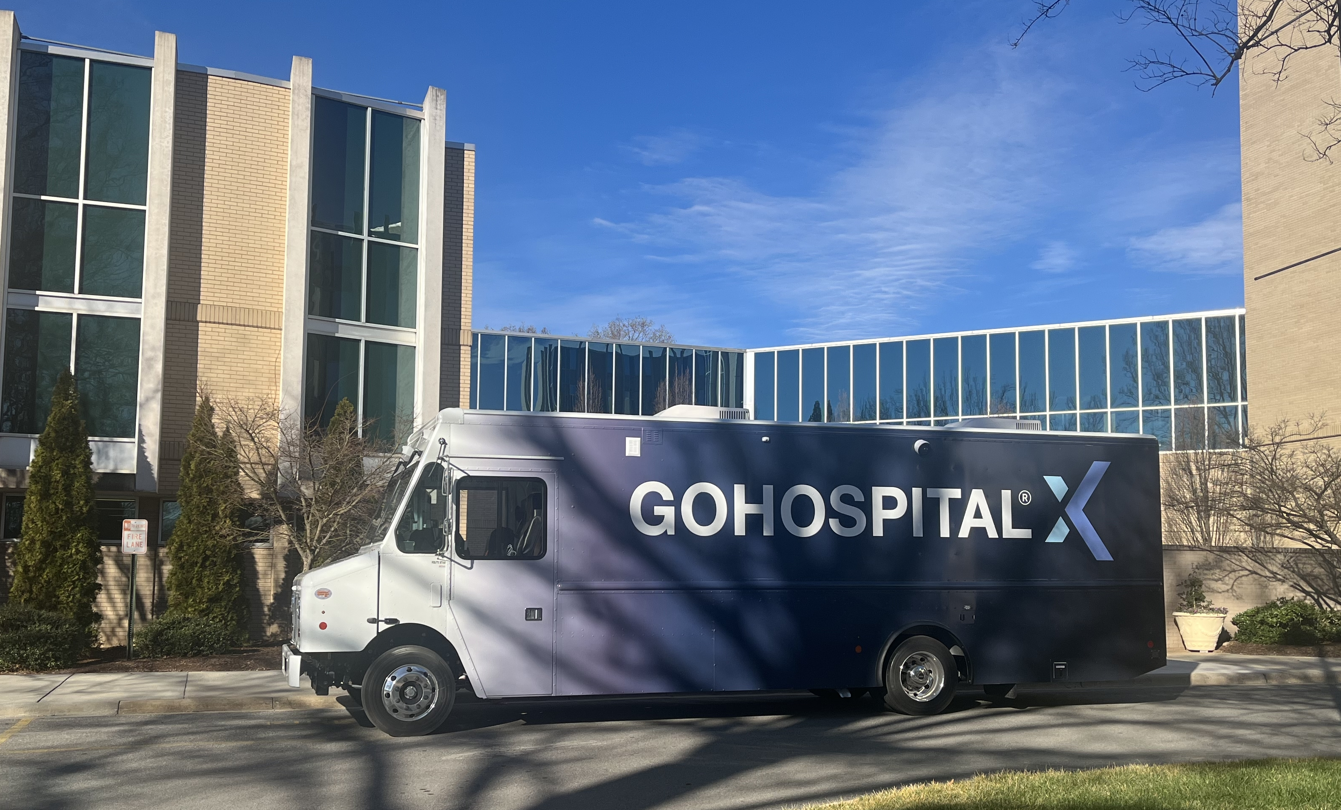
Rural Health
Designing a Clinical Delivery Platform
for Rural Areas
Confidential - Do Not Distribute

Slide 36




History
Behavioral Health Home Hospital
Year 1
Design BHH
Year 2
Simulate & Iterate
Year 3
Test & Refine
Mission: To provide an innovative solution to a nationwide psychiatric bed shortage by bringing hospital-level care to behavioral health patients at home and improving their access to high-quality, necessary and timely treatment.​

Slide 37








Program Overview
Care Model: A Day in the Life
Psychiatrist psychologist, RN, & MHS huddle
RN visit
(in person)
Milieu Therapy
Individual Therapy
Group Therapy
Activities
RN visit
(in person)
RN reviews plan of care
MD visit (remote)
SW PRN
Psychologist visit (remote) PRN
Daily care will include the following as needed:
Additional in-person care
Urgent response care (MIH)
Daily care includes:
Medication management
Remote continuous patient monitoring and MHS checks
Behavioral health life skills practice in the real-world environment
Caregiver education and support

Slide 38
Opportunity 3:
Fundamentally evolve Internal Medicine training

Slide 39
Internal Medicine Roles of the Future
*Compassionate Effective Physician
Systems Implementation Architect
Digital Steward
Integrated Specialist
Deep Generalist

Slide 40
The Value of Generalism and the
Generalist Paradox

Slide 41

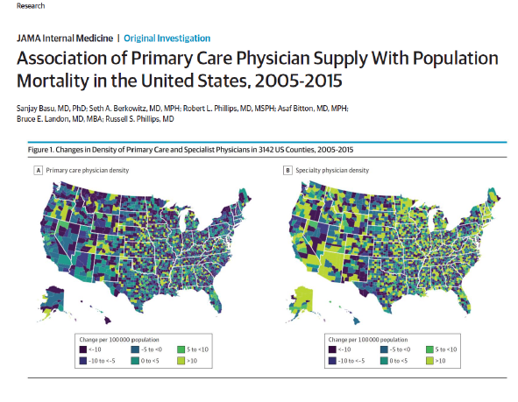
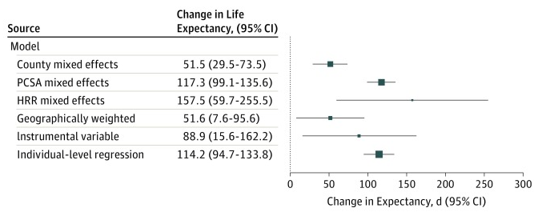
Community Health Conference and Expo 2025
Generalist Paradox at a Population Level - US
Changes in Life Expectancy Associated with an Increase of 10 Primary Care Physicians per 100,000 Population:
Basu S, Berkowitz SA, Phillips RL, Bitton A, Landon BE, Phillips RS. Association of Primary Care Physician Supply With Population Mortality in the United States, 2005-2015. JAMA Intern Med. 2019 Apr 1;179(4):506-514

Slide 42
Core Domains of Future Internal Medicine Training

Slide 43
Future Internal Medicine Management Capacities
Multidisciplinary Team
Technology Asset
Data
Relationship
Clinical oversight
Training
Backup for complexity
Diagnostic
Wearables
Genomics
Imaging
Clinical quality synthesis
Multiple streams
User & consumer
Individuals
Community
Profession-Society
Notes:
Recommendation 1: When valuing physician services and activities for the Physician Fee Schedule, the Centers for Medicare & Medicaid Servicesshould consider a range of data sources that are directly observed (e.g., electronic health record audit log data or time-motion studies) or reported (e.g., high-quality surveys) and that are analyzed using complementary approaches such as time-driven activity-based costing and large language modeling.

Slide 44
What Could a Deep Generalist Future Look Like?

Slide 45
Opportunity 4:
Revitalize Primary Care as a bedrock of system improvement through payment reform and workforce enhancement
Notes:
Recommendation 2: Using the data sources and methodologies in Recommendation 1, the Centers for Medicare & Medicaid Services should consider the full range of value-enhancing primary care activities and services that are required for high-quality primary care in its valuation process. This includes the efforts of the full interprofessional primary care team and non encounter-based activities.

Slide 46
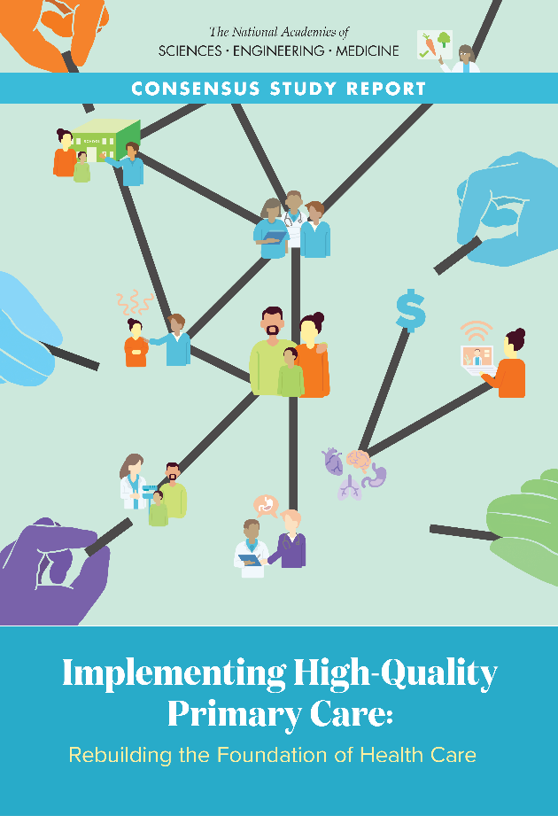

NASEM 2021 Primary Care Study
Primary care is the only part of health care system in which investments routinely result in longer lives and more equity
        Primary care is weakening in the U.S. when it is needed most

Slide 47
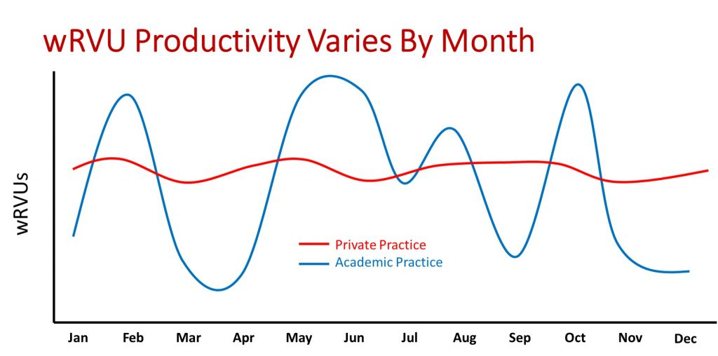


Primary Care Faces a Broken Production Model
20th Century Payment
21st Century Health Care

Slide 48
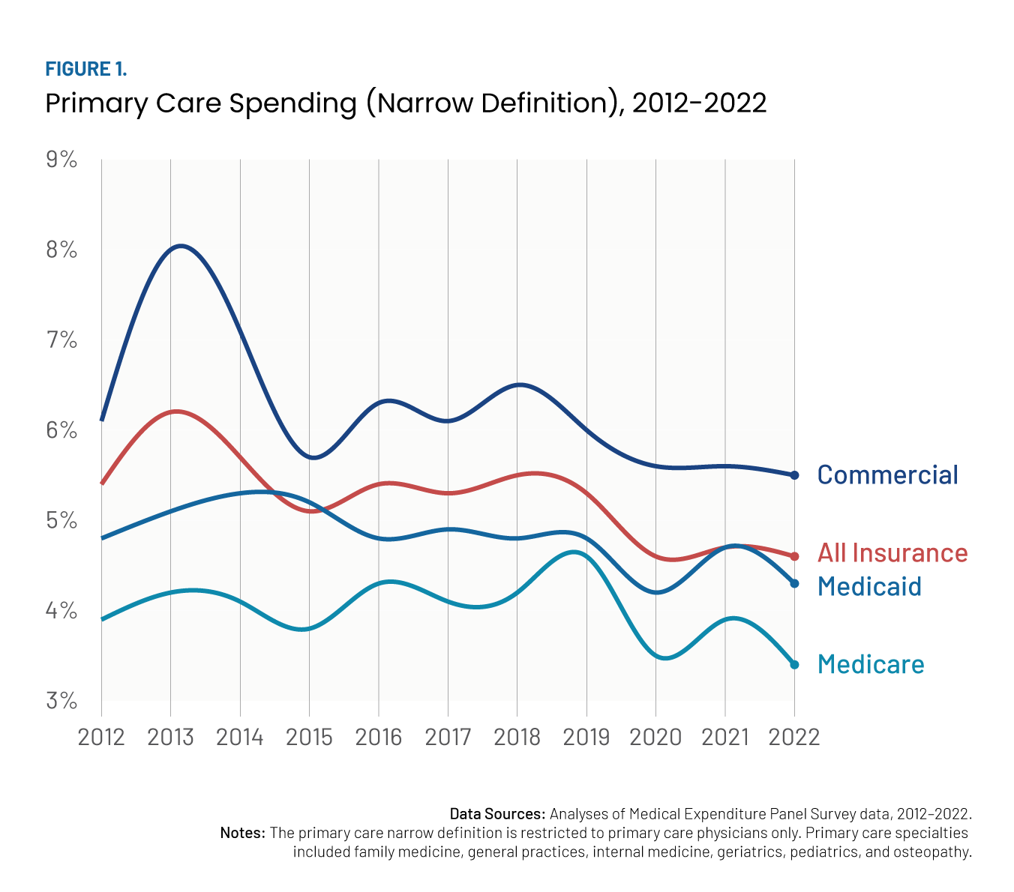
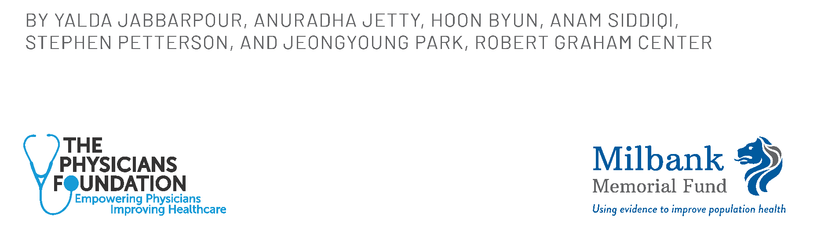
Money Matters: Primary Care Only
3-6% of Total Spend, and is Falling

Slide 49
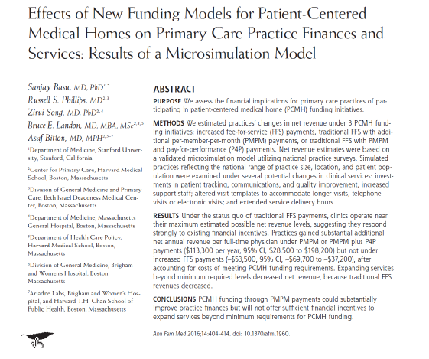
Doing the Math
You can’t run an
Advanced Primary Care Practice on a Fee For
Service Chassis

Slide 50
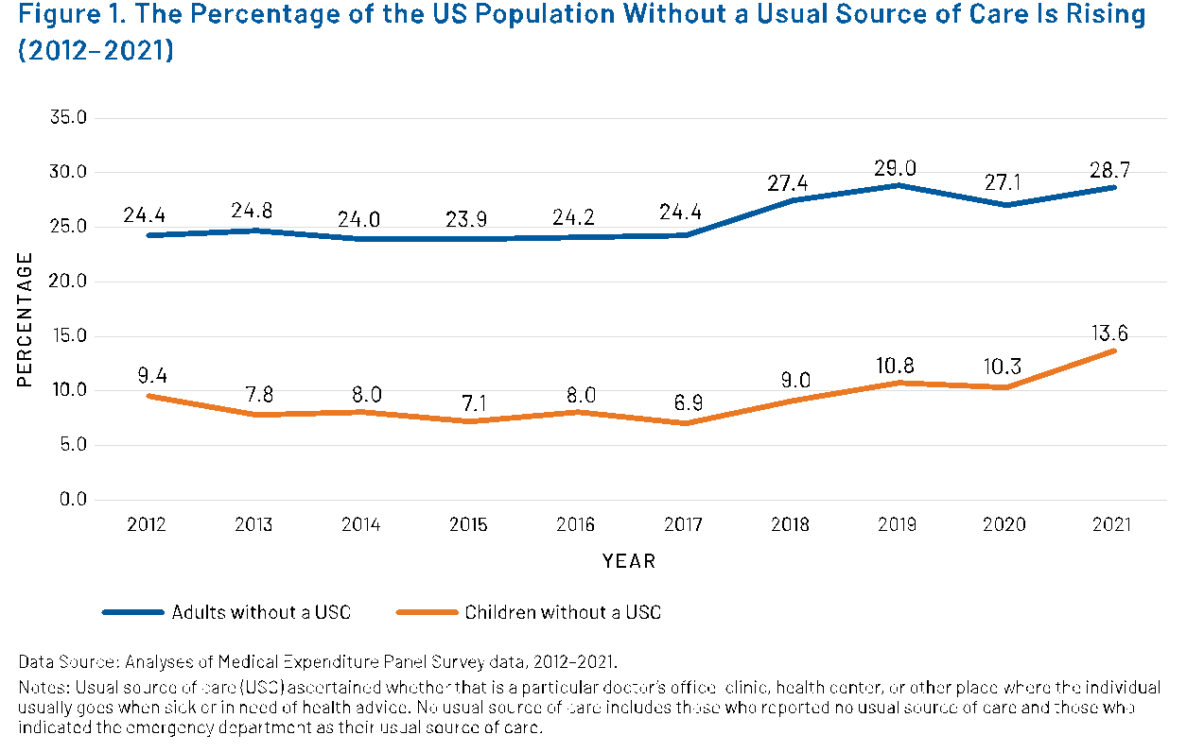
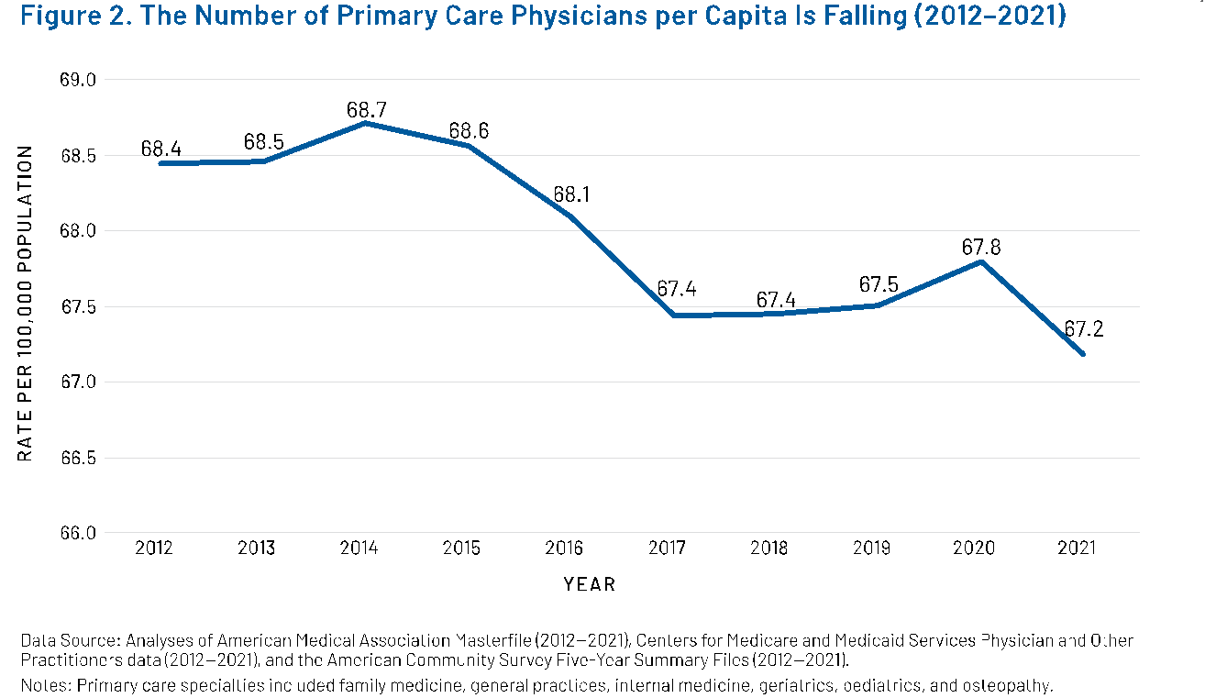
People Without Usual Care Rising, and PCP per Capita Falling
THE HEALTH OF US PRIMARY CARE: 2024 SCORECARD REPORT

Slide 51
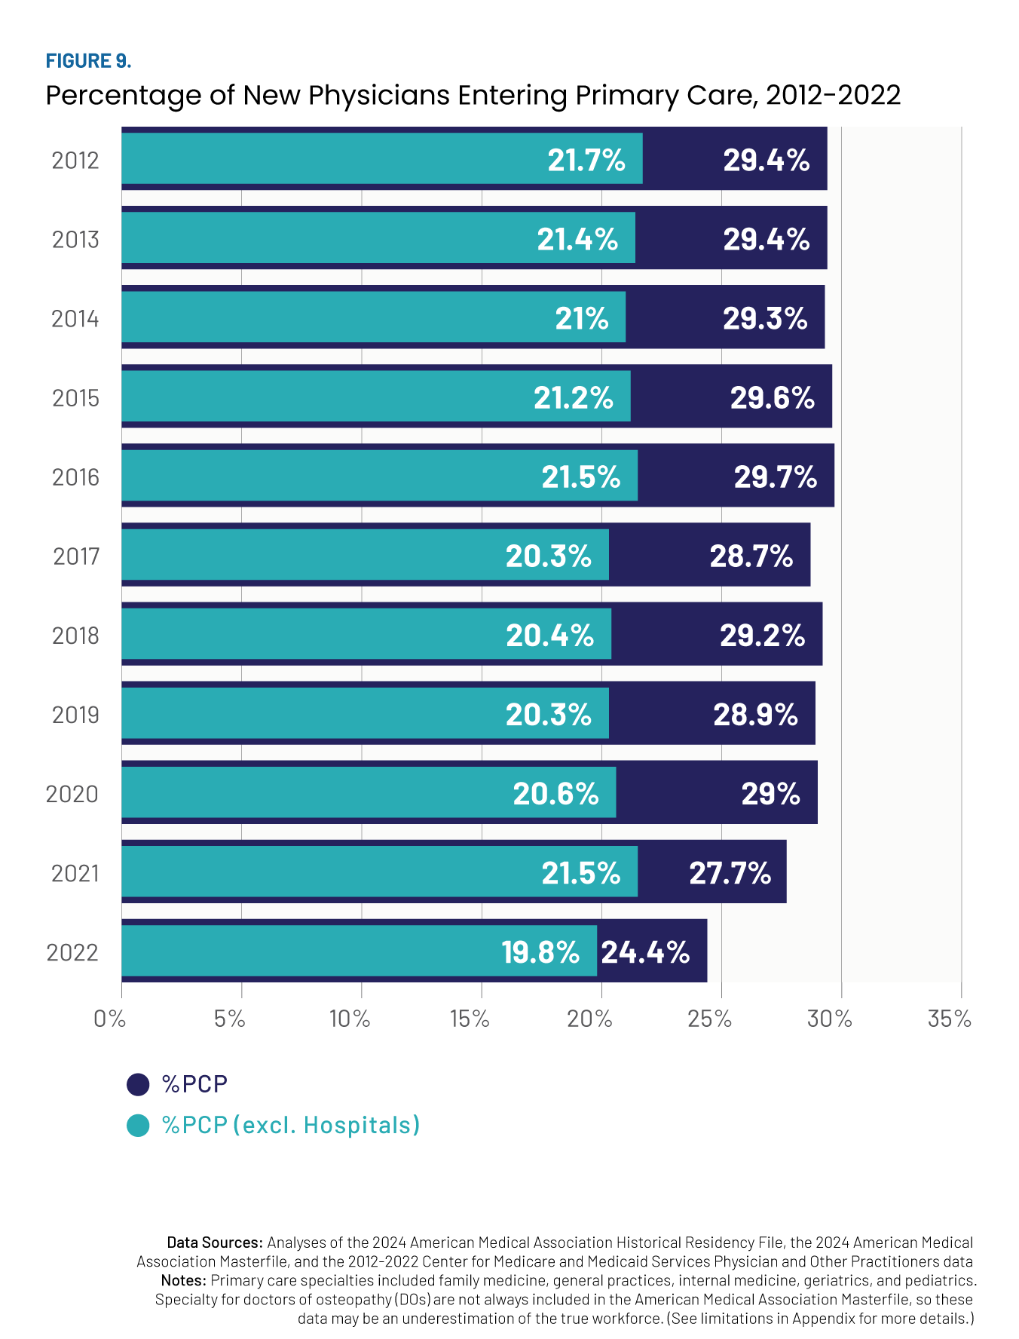
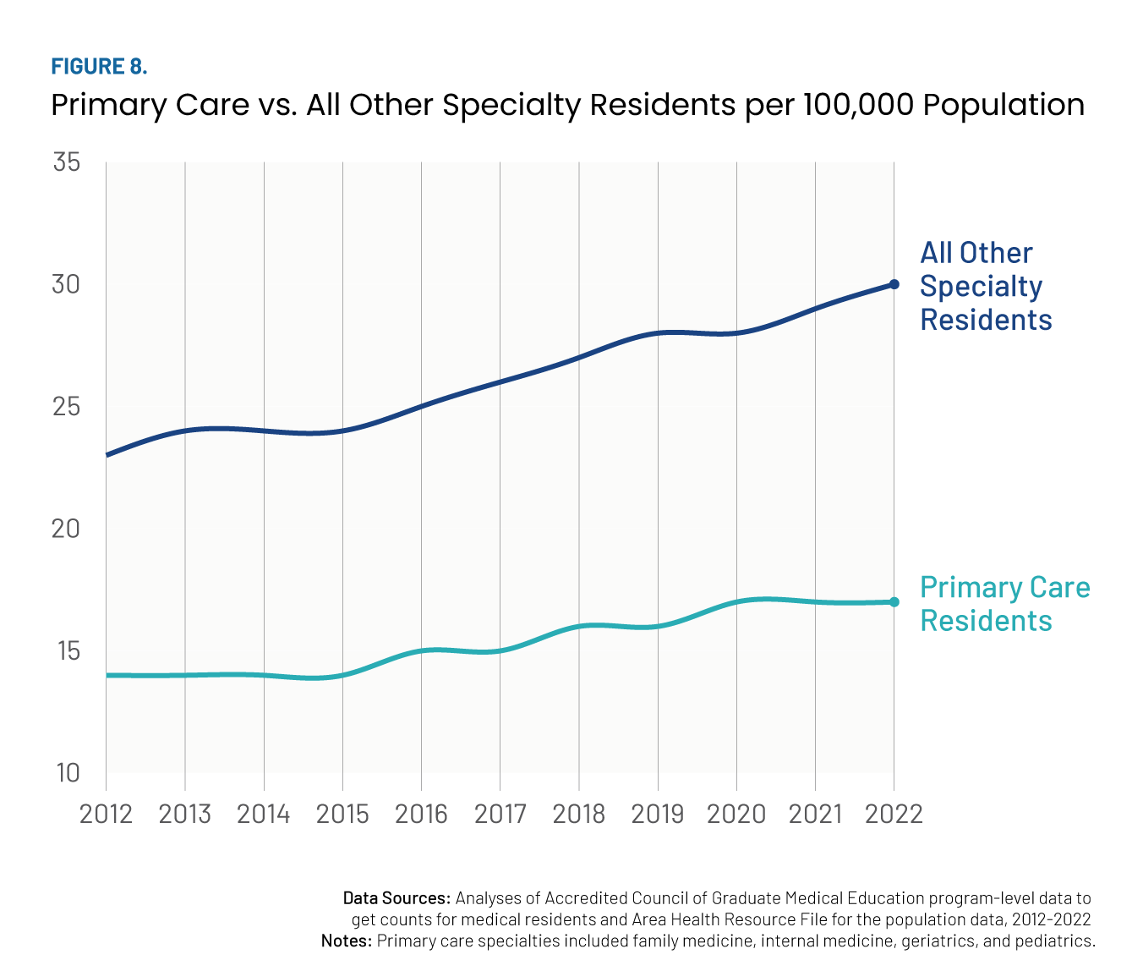
Triple Double
Primary Care Physician Pipeline is Limited; Getting More Narrow

Slide 52
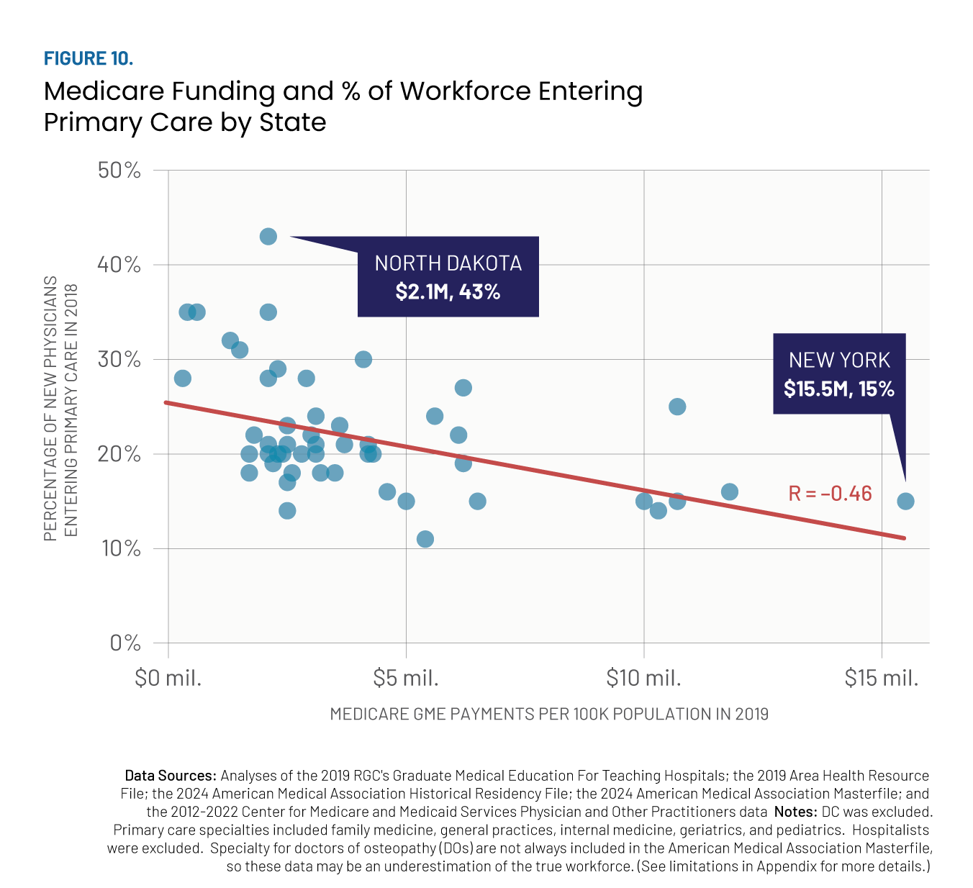
GME Funding and Primary Care:
Not Getting What We Are Paying
(A LOT) For

Slide 53
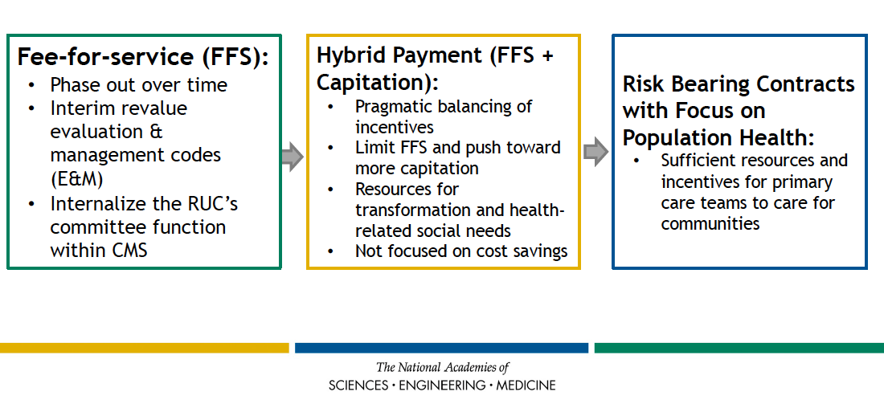
A Way Forward for Payment

Slide 54
Community Health Conference and Expo 2025
Three Care Delivery Focus Areas for Improving Primary Care
More Team-Based Primary Care with a Population View | Better Primary-Specialty Care Integration | Improved Community Engagement/Navigation/ Integration
e.g. Risk-Stratified Panels, Access Focus, Workforce Support, & Better IT (w/ AI)) | e.g. eConsults, Care Pathways, Shared Risk and Quality Models | e.g. CHWs, Behavioral Health Integration, Effective Social Needs Referrals, Thoughtful Use of AI
**Requires different/adequate FORM, LEVEL, & FLOW of primary care payment**

Slide 55

What is a Triple Double?
The Triple Double in Basketball:
Double Digits in at least 3 of 5 categories:
  Points
  Rebounds
  Assists
  Blocks
  Steals
Rare and Impressive Feat:
Only Occurs in about 1 in 20 games
Team with Triple Double Wins ~75% of the Time

Slide 56
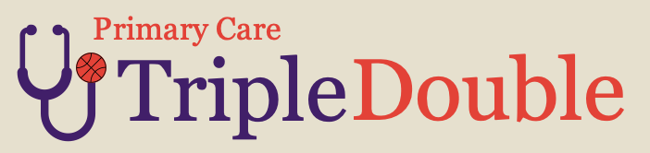
A Primary Care Triple Double by 2030:
5% →
10%
Double the investment in primary care
Not just the level — but also the form and the flow of spending
10% → 20%
Double the reach of primary care, starting with CHCs
Ensuring more patients have a usual source of trusted primary care
20% → 40%
Double the next generation primary care workforce
Training and retaining primary care clinicians in community-based settings

Slide 57
Internal Medicine Roles of the Future
*Compassionate Effective Physician
Systems Implementation Architect
Digital Steward
Integrated Specialist
Deep Generalist

Slide 58
5 Opportunities for the Future of Internal Medicine
1. Position Internal Medicine at the fulcrum between discovery, system redesign, and implementation science
2. Build care delivery innovation pathways – new technology, tools, specialty integration, and relational approaches to care
3. Innovate and change sites of care
4. Fundamentally evolve Internal Medicine training toward new and emerging capacities needed in the future
5. Revitalize primary care through payment reform and workforce growth

