Slide 1

Health Center Community Based Training: Meeting Workforce Needs at the Local Level.
ACP Workforce Summit:
Internal Medicine for the Future of Healthcare
Dr. Luis Padilla
Chief Health Officer, NACHC
May 15, 2026

Slide 2







Community Health Centers
America's Largest Primary Care System
52M
1,512
17K+
Patients Served
1 in 7
Community Health Centers
Service Sites Nationwide
Americans (1 in 3 Rural)
$60B*
326K
$261.7B
Total Cost to Run CHCs
*1% of total healthcare spend
Health Care Workers
in Economic Output
Notes:
52 M Served Source: Masselli & Shin (2025), Moses/Weitzman Health System & NACHC

Slide 3
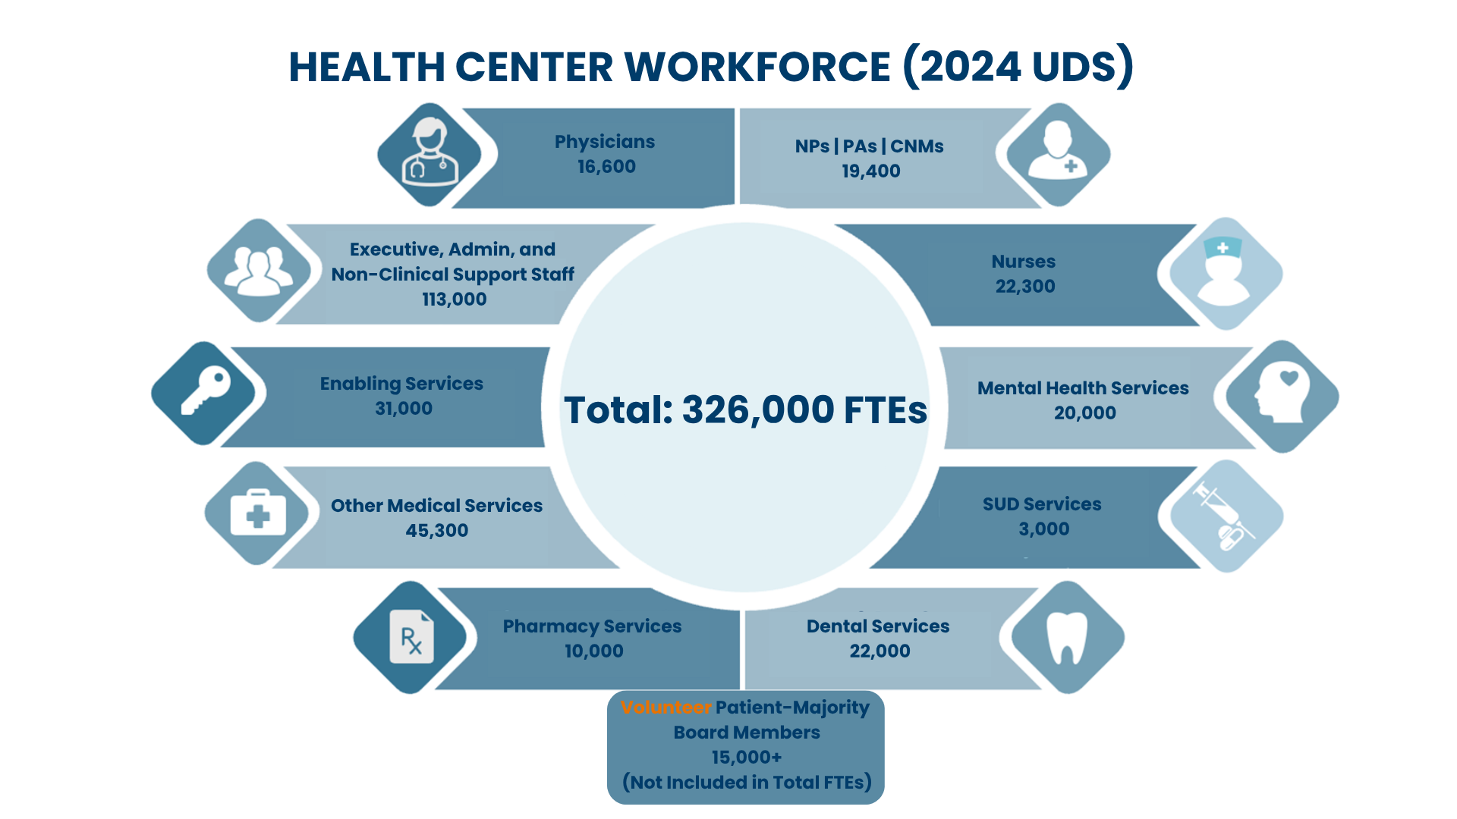
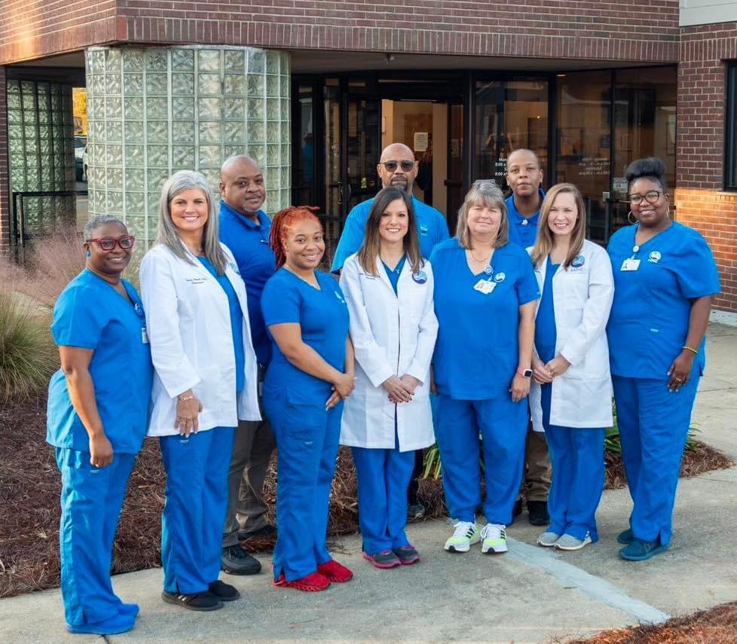
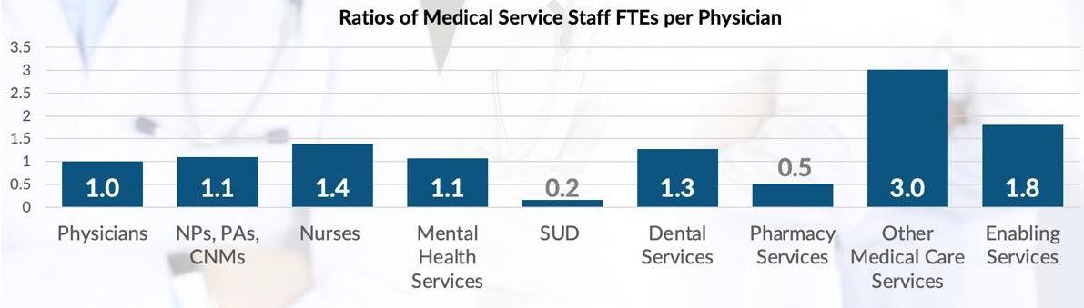
60 Years of Affordable, Comprehensive, Effective Primary Care
Albany Area Primary Health Care
Notes:
Source of Ratios of Medical Service Staff FTEs per Physician: 2022 Uniform Data System. Bureau of Primary Health Care, HRSA, DHHS

Slide 4
HRSA National Center for Health Workforce Analysis
Workforce shortages predicted by 2038
  39,060 family physicians
  20,660 internists
  9,320 pediatricians
  1,570 geriatricians
  44,000 psychiatrists
  19,860 dentists
  Nonmetro areas will have a 39% shortage of primary care physicians
  The dentist shortage reaches 46% in nonmetro areas in 2038
Notes:
https://bhw.hrsa.gov/data-research/projecting-health-workforce-supply-demand

Slide 5


70,610
Defining the
Access Gap
Projected shortage of Primary Care Physicians by 2038
100 million Americans lack reliable access to primary care.
92 M
8,467
1 in 3
adults lack a regular source of care
Live in Health Professional Shortage Areas (HPSAs)
Health Professional Shortage Areas (HPSAs)
Rising chronic disease rates make primary care investment more critical than ever.
Notes:
8,467 and 92 million taken from HRSA Q1 FY2026 Data
https://data.hrsa.gov/default/generatehpsaquarterlyreport
70,610 taken from HRSA Health Workforce Projections
https://bhw.hrsa.gov/data-research/projecting-health-workforce-supply-demand
100M Access Gap: Health Landscape (AAFP). Analysis cited in: NACHC Health Center Funding Policy Paper (2024). hcadvocacy.org

Slide 6




Defining the Problem
What's Causing the Primary Care Gap?
Physicians
Nurse Practitioners
Physician Assistants
29% of NPs work in primary care
Only 24% of PAs work in primary care
Only 26% of all physicians work in primary care
22% of new physicians entered primary care in 2023
30% of NP graduates entering primary care
Only 22% of PA graduates entering primary care
The current GME model is simply not producing enough primary care clinicians to close the gap.
Notes:
2026 Primary Care Scorecard Shows Continued Underinvestment, Workforce Strain | Milbank Memorial Fu…
Source on NP and PA graduates: https://doi.org/10.7759/cureus.73216
NP Specific Source: https://storage.aanp.org/www/documents/research/NP_Student_Snapshot_PC_AC_PMH_2015-2024.pdf

Slide 7
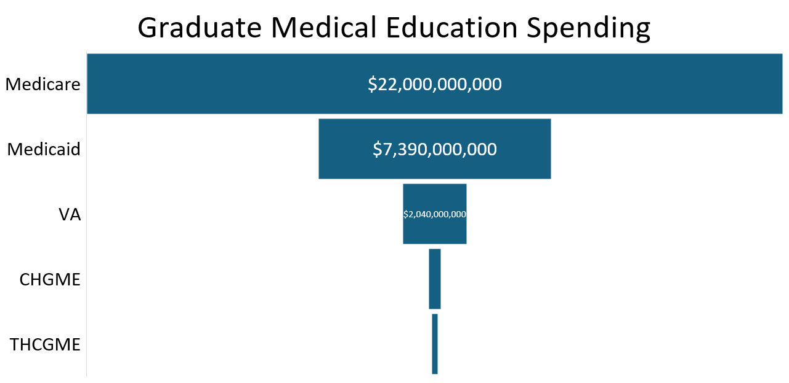
$2,040,000,000
(Veterans Affairs)
$395,000,000
(Children’s Hospital
GME)
$225,000,000
(Teaching Health
Centers)
Notes:
There were 163,000 residents in training in 2023-24. Less than 50% may be considered primary care. THCGME funds <2% of these.
Federal Support for Graduate Medical Education. (2025, September 5). https://www.congress.gov/crs-product/R48636
H.R.7148 - 119th Congress (2025-2026): Consolidated Appropriations Act, 2026. (2026, February 3). https://www.congress.gov/bill/119th-congress/house-bill/7148/

Slide 8
THCGME Funding History & Future
ARP
Notes:
HRSA Justification of Estimates for Appropriations Committees, FY2012 through 2025 and Consolidated Appropriations Act, 2026
Patient Protection and Affordable Care Act, Medicare Access and CHIP Reauthorization Act of 2015, Balanced Budget Act of 2018, Coronavirus Aid, Relief, and Economic Security Act, Consolidated Appropriations Act 2021, American Rescue Plan Act of 2021, Consolidated Appropriations Act 2024, Full-Year Continuing Appropriations and Extensions Act 2025, Continuing Appropriations and Extensions Act 2026.

Slide 9
Proven Success
of THCGME
3,000+
Graduates trained at a THC since 2011
Impact Reduction in Primary Care Shortages
85%
Work in communities with limited access to health care
4.6%
3.3%
13%
Working in rural areas
2.1%
$225M→$300M
Congressional funding FY26–FY29
Overall
Primary Care
Family
Medicine
Internal
Medicine
$1.8B
Estimated savings to Medicare & Medicaid by THCGME over 5 years
Notes:
Sources:
https://bhw.hrsa.gov/funding/apply-grant/teaching-health-center-graduate-medical-education
https://bhw.hrsa.gov/sites/default/files/bureau-health-workforce/data-research/tchgme-brief-24-25.pdf
https://bhw.hrsa.gov/sites/default/files/bureau-health-workforce/data-research/thcgme-eval-nchwa.pdf
https://www.cbo.gov/publication/59945
https://bhw.hrsa.gov/sites/default/files/bureau-health-workforce/data-research/thcgme-eval-nchwa.pdf
https://collections.nlm.nih.gov/catalog/nlm:nlmuid-101755893-pdf

Slide 10
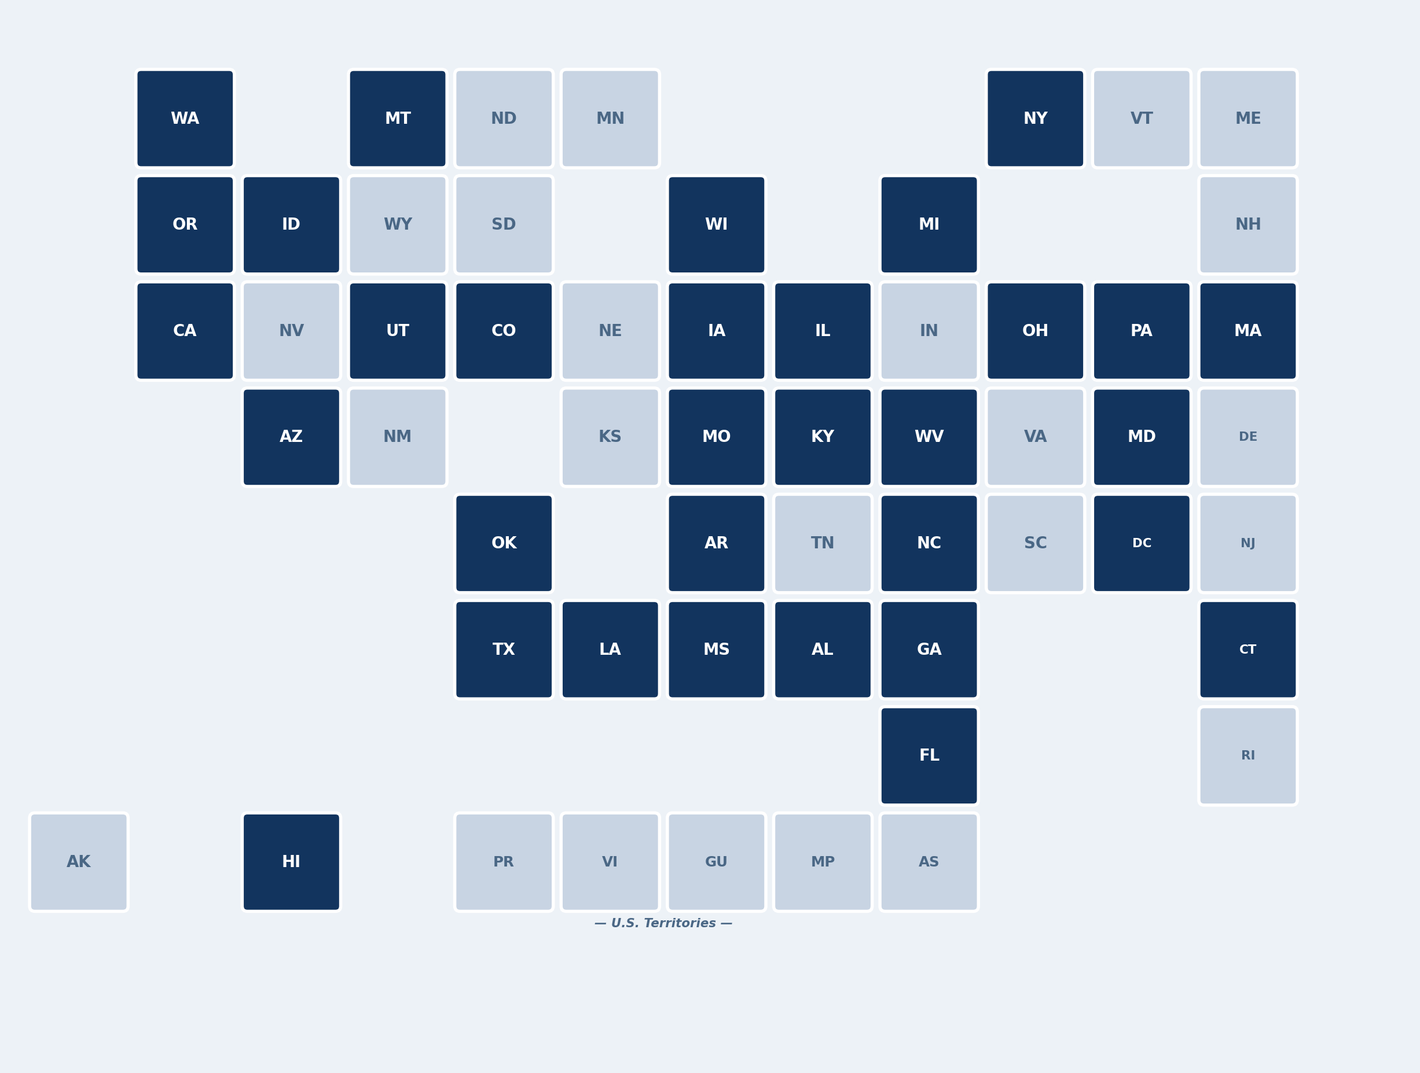
THCGME PROGRAMS
Current THCGME Grantee States
Expanding
Teaching Health
Centers Nationwide
Teaching Health Center Graduate Medical Education programs currently span 31 states and the District of Columbia — but we need to reach every corner of America and the territories.
88
1,254
1M+
THCGME
Programs
Residents
Currently in Training
Patient Visits
Annually
31 states + DC with active THCGME grantees
States & territories without current grantees
Notes:
Source: https://bhw.hrsa.gov/funding/apply-grant/teaching-health-center-graduate-medical-education

Slide 11
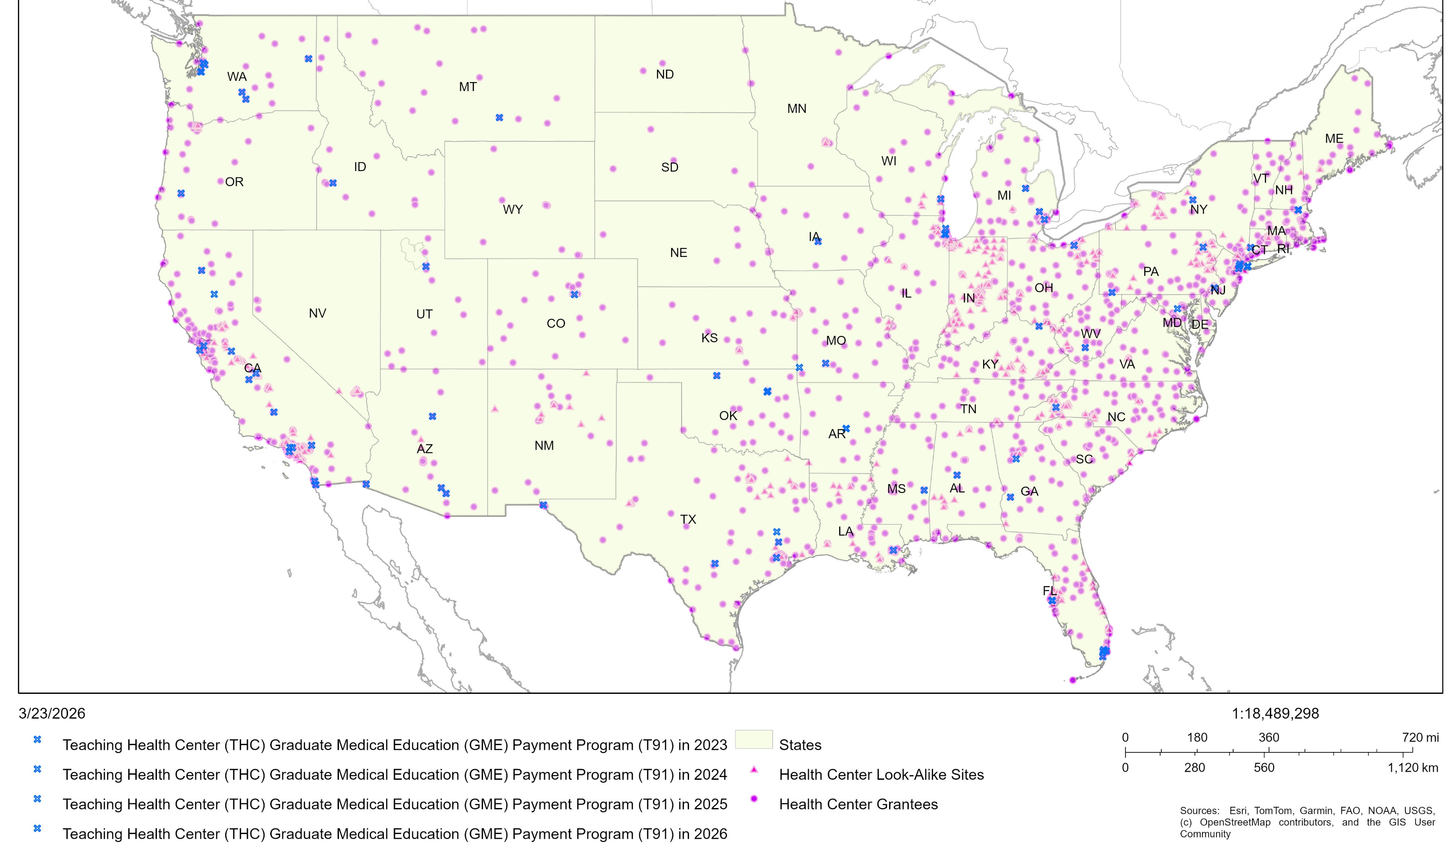

Teaching Health Centers and Community Health Centers Mapped

Slide 12


Proposing the TRUST Solution
Five Bold Asks to Transform Primary Care

Slide 13

THCGME at Scale—
The Proof of Concept
01
THCGME is the most effective and efficient program for training primary care physicians — yet it's significantly underfunded.
With current funding, HRSA projects the THCGME program will support 1,550 FTEs in 2029.
We need to grow THCGME so that all CHCs (who want to be) can become THCs.
Bold Ask 1
57 CHCs
Have THCGME programs
All CHCs
Should have the opportunity to become THCs
$1.5B
Leverage 5% GME spend to the
THCGME Program
Notes:
HRSA projects the THCGME program will support 1,550 FTE in 2029
Some 57 CHCs host active Teaching Health Center residency programs, some have multiple residency programs)
About 15 unfunded CHC-based residency programs which may be ready to train up to 86 residents on July 1, 2026
Another 50 CHC-based residency programs in development, which may be capable of training up to 262 residents on July 1, 2027

Slide 14
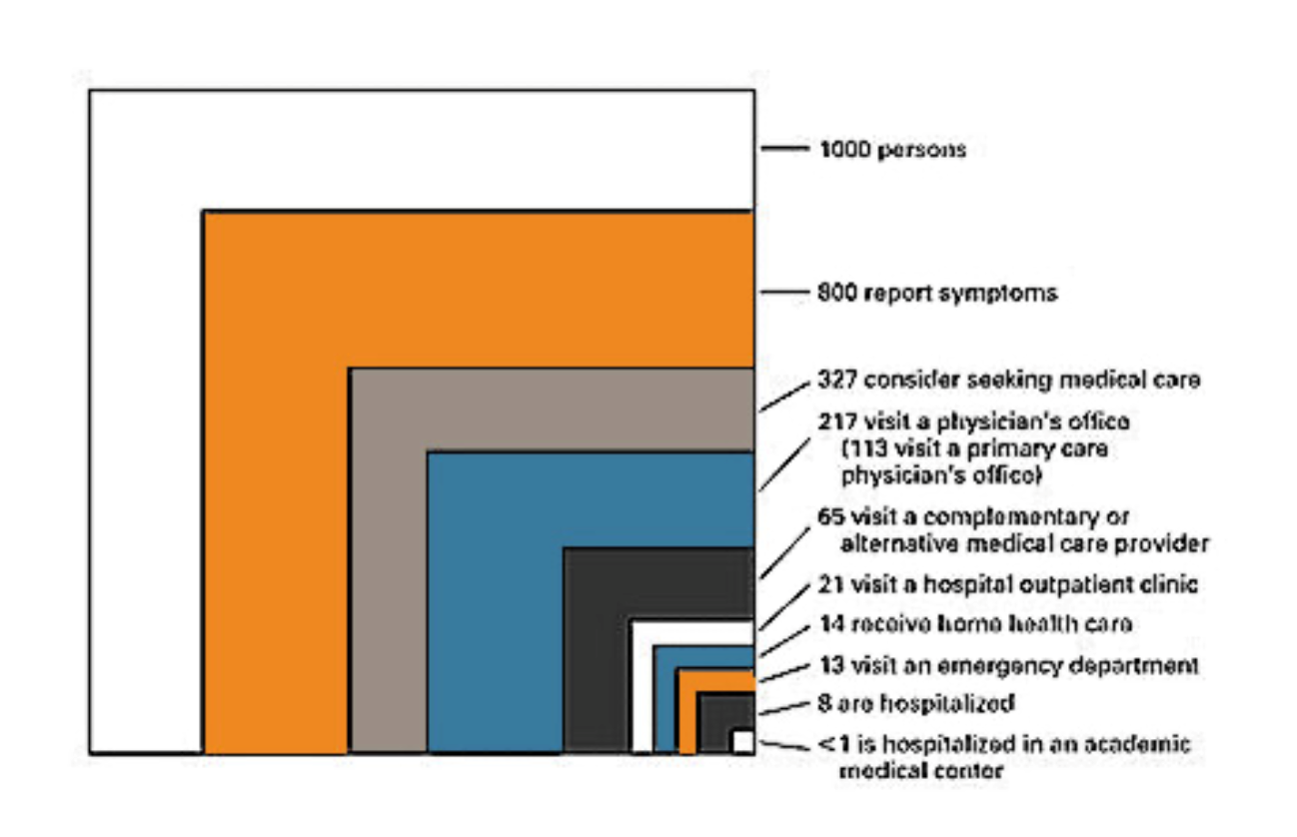
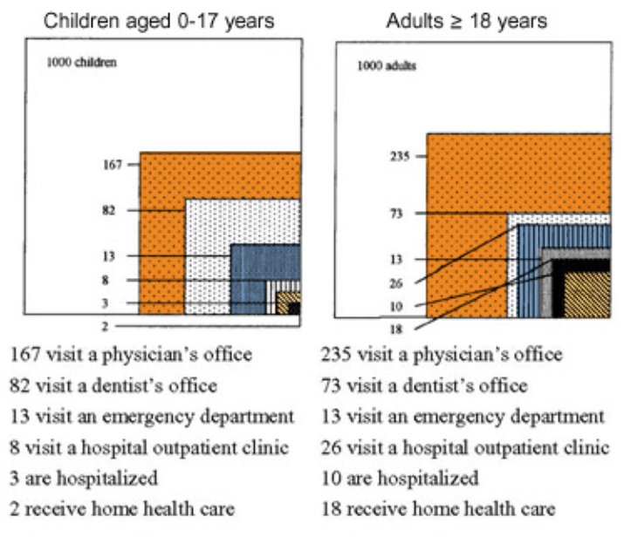
In a Typical Month per 1,000 People:
THE OPPORTUNITY
Ecology of
Medical Care
We're focusing on building and training the workforce of tomorrow at academic medical centers. We need to train the workforce locally in communities where primary care and prevention is delivered.
"We can’t build the primary care workforce of tomorrow if we’re too focused on the 1% who are hospitalized or the <0.1% who go to academic medical centers."
Train upstream → Retain and Recruit in Community

Slide 15

REFORM GME to
Incentivize Primary Care
02
Reform GME funding to incentivize all GME programs (e.g., consider Robert Graham Center GME-IQ) to increase the percentage of graduates entering the primary care workforce with our national target of 40%.
Medicare spends $21.2B annually on GME with no requirement to produce the primary care workforce we need.
Bold Ask 2
$21.2B
Medicare GME spending annually
26%
Physicians working in primary care in 2023
22%
New physicians who entered the
primary care workforce in 2023
Notes:
2026 Primary Care Scorecard Shows Continued Underinvestment, Workforce Strain | Milbank Memorial Fu…

Slide 16

UNITE GME Funding
to CHC Partnerships
03
Bold Ask 3
We know that community-based training gives the best return on investment for primary care.
We must incentivize all primary care GME programs to partner with their local CHCs — leverage 5% of federal GME funding (~$1.5B) to create those financial incentives.
5X
Family medicine residents who train in rural settings are 5X more likely to practice rural
5%
Of federal GME funding should be reserved
for CHC incentives
$1.5B
Potential incentive pool to advance GME
and local CHC partnerships
Notes:
https://jgme.kglmeridian.com/view/journals/jgme/14/4/article-p441.xml

Slide 17

SCHOLARSHIPS for Primary Care
04
The costs and debt of medical school is a major driver of physician choice.
We can address this by expanding and providing National Health Service Corps Scholarships for all medical students ($280k per student) who commit to primary care and 2–4 years of service in primary care gap communities.
Bold Ask 4
30,000
Medical graduates annually and need to influence their residency decision
6,000 to 12,000
20% now and need to move to 40% as soon as possible to close the primary care gap
$3.36B/yr
Cost of tuition reimbursement for 12,000 primary care grads
Notes:
12K X $280k = $3.36 billion

Slide 18

Triple Double Investment in Primary Care
05
The pay gap between primary care and specialists is a major driver of choice. We must reform payment to reimburse primary care at a fair and sustainable rate to reduce costs, improve outcomes, and assure health for all.
Primary care physician spending makes up just 5% of total health care spend; this needs to double to 10%. Our nation’s largest primary care provider CHCs currently deliver care to 14% of the population for only 1% of health care spending — a preview of what a primary care-centered system delivers at scale.
Bold Ask 5
5%
Share of total health care spending on primary care in 2023
1%
Share of total health care spending on CHCs
14%
Share of the U.S. population served by CHCs
Notes:
2026 Primary Care Scorecard Shows Continued Underinvestment, Workforce Strain | Milbank Memorial Fu…

Slide 19





Proposing the TRUST Solution
Five Bold Asks to Transform Primary Care
1
THCGME: Grow the THCGME program so that all CHCs (who want to be) can become Teaching Health Centers
2
Reform GME: Incentivize all GME programs to increase the percentage of graduates entering primary care
3
Unite: Incentivize all GME programs to partner with local Community Health Centers
4
Scholarships: Provide Scholarships for all medical students who commit to primary care and serve underserved communities
5
Triple Double: Reform payment to reimburse primary care providers at a fair and sustainable rate
THCs and CHCs are proof of models that work.
Together, we can measurably meet the workforce needs of the future.

Slide 20
Nurse Practitioner Residency Program Outcomes
Access
99% NP Residents received training in Medically Underserved Communities and Primary Care settings
Supply
Over 135 NP Residents and 84 preceptors in year 1
Distribution
Quality
NP residents participated in trainings related to COVID-19 (93%), opioid use treatment (91%), telehealth (84%), behavioral health integration
At least 63% of the ANE-NPR Program first year graduates are currently employed in FQHCs or Look-Alikes and Rural Health Clinics.

Slide 21
Health Care Workforce Innovation Act
H.R.935 – Reps. Andrew Garbarino (R-NY) & Kim Schrier (D-WA)
S.2454 – Sen. Ron Wyden (D-OR) & Marsha Blackburn (R-TN)
Partnerships between CHCs, high schools, community colleges.
Supports apprenticeship, career laddering, preceptorship programs.
Focused on medical assistants, dental hygienists, pharmacy technicians, community health workers, peer support specialists.
Workforce development for these allied health roles, while essential, currently receives no dedicated federal funding

Slide 22
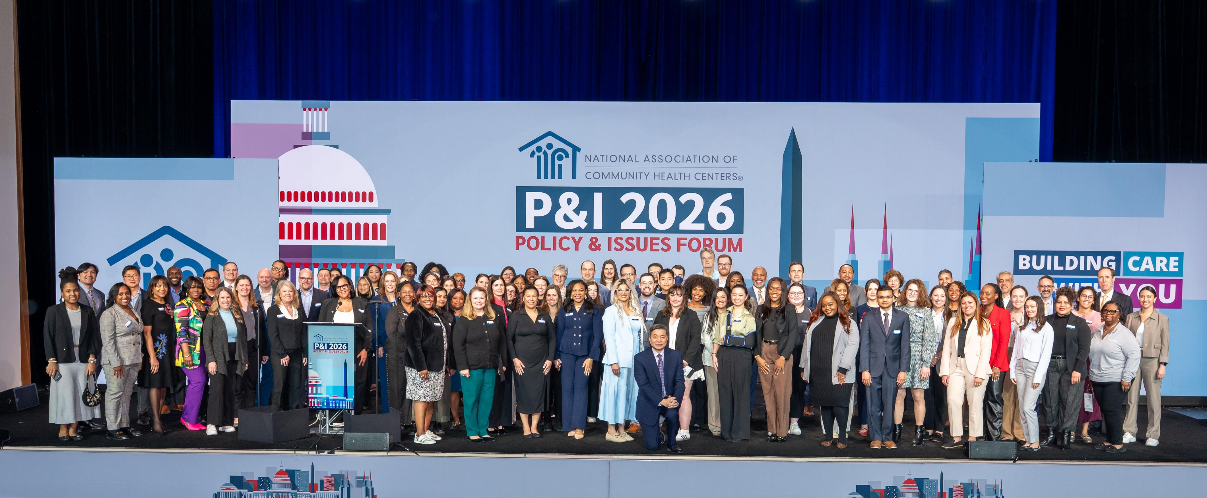
THANK YOU FROM NACHC!

