Slide 1
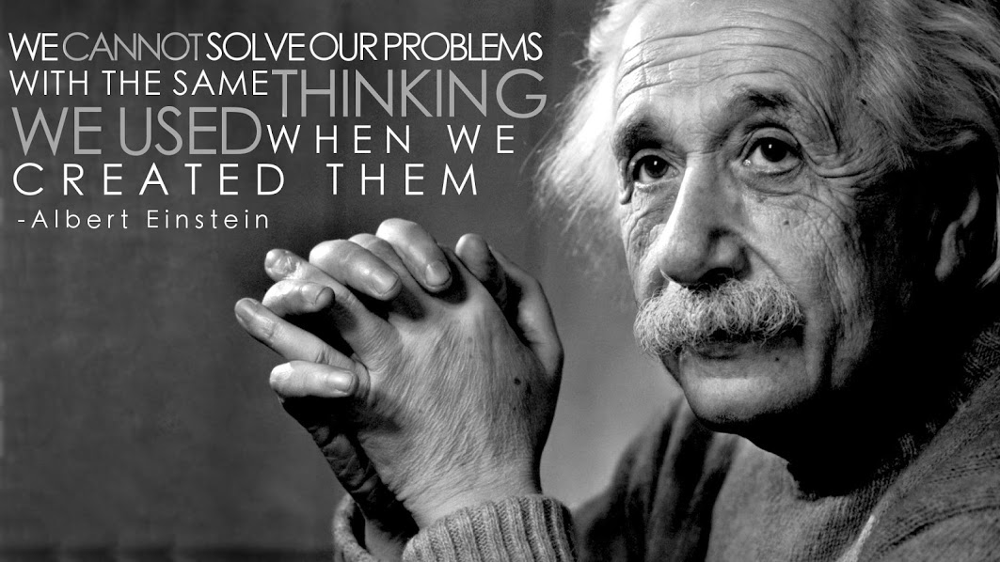

Slide 2
What is Health Literacy?
The degree to which individuals have the capacity to obtain, process, and understand basic health information and services needed to make appropriate health decisions.
Health Literacy: A Prescription to End Confusion.
Institute of Medicine. 2004
Notes:
THE CURRENT DESIGN OF HEALTH CARE SYSTEMS REQUIRES PATIENTS TO POSSESS AND DEMONSTRATE MULTIPLE SKILLS, INCLUDING UNDERSTANDING AND GIVING CONSENT, INTERACTING WITH HEALTH PROFESSIONALS, AND APPLYING HEALTH INFORMATION TO DIFFERENT SITUATIONS IN A VARIETY OF LIFE EVENTS. FOR EVERY TASK, PATIENTS MUST EMPLOY THE MAJOR COMPONENTS OF HEALTH LITERACY; PRINT LITERACY (WRITING AND READING), ORAL LITERACY (LISTENING AND SPEAKING), AND NUMERACY (USING AND UNDERSTANDING NUMBERS SUCH AS MEDICATION DOSES)

Slide 3
Why is Health Literacy Important?
Institute of Medicine’s To Err is Human: Building a Safer Health System (2000)
IOM’s Crossing the Quality Chasm: A new Health System for the 21st Century (2001)
  Recommended systematic identification of priority areas for quality improvement
Committee charged with generating a list of 15-20 candidate areas
http://www.ahrq.gov/qual/iompriorities.htm
Notes:
IN THE ONLY POPULATION LEVEL STUDY OF HEALTH LITERACY SKILLS CONDUCTED TO DATE, THE DEPT OF EDUCATION’S NATIONAL ASSESSMENT OF ADULT LITERACY DOCUMENTED THAT ONLY 12% OF US ADULTS ARE PROFICIENT ENOUGH IN HEALTH LITERACY TO UNDERSTAND AND USE HEALTH INFORMATION EFFECTIVELY…THEY MAY FAIL TO UNDERSTAND CRITICALLY IMPORTANT WARNINGS ON THE LABEL OF OVER THE COUNTER MEDICATIONS, FIND IT DIFFICULT TO DEFINE A MEDICAL TERM, FORM A COMPLEX DOCUMENT ABOUT AN UNFAMILIAR TOPIC….AND 24 MILLION AMERICANS (8.7%) ARE NOT PROFICIENT IN ENGLISH.

Slide 4
Institute of Medicine Priorities Areas for National Action: Transforming Health Care Quality
Self-management/
Health Literacy
Care Coordination
Notes:
BEYOND A DISEASE BASED APPROACH….ALL NOT POSSIBLE IN THE ABSENCE OF A HEALTH LITERATE POPULATION
Care Coordination (cross-cutting)
Self-management/health literacy (cross-cutting)
Asthma—appropriate treatment for persons with mild/moderate persistent asthma
Cancer screening that is evidence-based—focus on colorectal and cervical cancer
Children with special health care needs
Diabetes—focus on appropriate management of early disease
End of life with advanced organ system failure—focus on congestive heart failure and chronic obstructive pulmonary disease
Frailty associated with older age—preventing falls and pressure ulcers, maximizing function, and developing advanced care plans
Hypertension—focus on appropriate management of early disease
Immunization—children and adults
Ischemic heart disease—prevention, reduction of recurring events, and optimization of functional capacity
Major depression—screening and treatment
Medication management—preventing medication errors and overuse of antibiotics
Nosocomial infections-prevention and surveillance
Pain control in advanced cancer
Pregnancy and childbirth—appropriate prenatal and intrapartum care
Severe and persistent mental illness—focus on treatment in the public sector
Stroke—early intervention and rehabilitation
Tobacco dependence treatment in adults
Obesity (emerging area)

Slide 5
The Cycle of Crisis Care: A Patient’s Experience
Sick patient seeks medical help
Patient is discharged, and no one follows up with patient
Staff at doctor’s office ask patient to complete complex, confusing forms
Hospital staff give patient a new treatment plan, referrals, and prescriptions; staff do not confirm patient’s understanding
Doctor explains patient’s condition and treatment plan using medical jargon
Patient’s condition gets worse, and patient goes to the emergency department
Doctor writes multiple prescriptions and referrals for tests
Patient takes medicines incorrectly and does not follow up on appointments
Doctor does not confirm patient’s understanding
No one follows up with patient
Staff send patient home with a complicated set of written instructions
Direct action by doctor
Direct action by office or hospital staff
Effect on patient
SOURCE Authors’ analysis.

Slide 6
Health-Literate Care: A Patient’s Experience
Sick patient seeks medical help
Patient’s condition is being well managed
Scheduler reminds patient about what to bring to office visit
Staff at doctor’s office follow up regularly with patient
Patient is not feeling well
Staff at doctor’s office give patient simple forms and offer to help with filling them out
Nurse gives patient a simple handout and basic tools to use in complying with treatment; staff help plan appointments
As part of assessment, doctor listens to patient describe symptoms
Doctor and patient agree on treatment plan
Doctor describes patient’s condition using easy-to-understand terms
Doctor and patient agree on treatment plan
Doctor discusses treatment options with patient and solicits questions
Direct action by doctor
Direct action by office or hospital staff
Effect on patient
SOURCE Authors’ analysis.

Slide 7
NATIONAL ACTION PLAN TO IMPROVE HEALTH LITERACY: UNIFIED HEALTH LITERACY GOALS AND STRATEGIES
TWO PRINCIPLES:
1. ALL PEOPLE HAVE THE RIGHT TO HEALTH INFORMATION THAT HELPS THEM MAKE INFORMED DECISIONS;
2. HEALTH SERVICES SHOULD BE DELIVERED IN WAYS THAT ARE UNDERSTANDABLE AND LEAD TO HEALTH, LONGEVITY AND GOOD QUALITY OF LIFE.
PLAIN WRITING ACT OF 2010
REQUIRES FEDERAL AGENCIES TO WRITE DOCUMENTS CLEARLY SO THAT THE PUBLIC CAN UNDERSTAND AND USE THEM.
Notes:
IN ADDITION TO THE ABOVE HITECH PROMOTES THE ADOPTION OF EHRs TO PROVIDE HEALTH INFO THAT IS MEANINGFUL AND USEFUL TO CONSUMERS, INCLUDING AFTER VISIT SUMMARIES, DISCHARGE INSTRUCTIONS, PATIENT REMINDERS AND PATIENT SPECIFIC INFORMATION. NQS INCLUDES A BROAD ARRAY OF ACTIONS SUCH AS UPDATING THE STANDARDS ON CULTURALLY AND LINGUISTICALLY APPROPRIATE SERVICES… AND HEALTHY PEOPLE 2020 INCLUDES OBJECTIVES RELATED TO HEALTH LITERACY….TEACH BACK METHOD, SHARED DECISION MAKING AND POPULATIONWIDE ACCESS TO PERSONALIZED E HEALTH TOOLS

Slide 8
Notes:
THIS WILL ENABLE AN ENVIRONMENT OF RAPID CYCLE LEARNING AND KNOWLEDGE DISSEMINATION IN WHICH RESEARCH IS CONTINUOUSLY TRANSLATED INTO PRACTICE AND PRACTICE INTO RESEARCH..A PROVEN APPROACH FOR DRIVING IMPROVEMENT THAT DOES NOT NECESSARILY OCCUR NATURALLY IN HEALTH CARE TODAY.

Slide 10
Notes:
CURRENT “LORE” STATES THAT IT TAKES APPROX 17 YEARS FROM DISCOVERY TO IMPLEMENTATION OF NEW IDEAS, ETC….”CHANGE IS DIFFICULT”..WOULD IT NOT BE NICE TO MAKE THIS 17 HOURS!!

Slide 12



Health Literate Care Model
A Universal Precautions Approach
Health Literate Systems
Community Partners
Organization of Health Care
Resources and Policies
Delivery System Design
Health Information Systems
Self-Management Support
Shared
Decision-making
Apply
Improvement methods
Strategies for
Health Literate Organizations
Link to
supportive systems
Improve verbal interaction
Engage patients as partners in care and improvement efforts
Improve written communication
Informed, Health Literate, Activated Patient and Family
Prepared, Proactive, Health Literate, Health Care Team
Productive Interactions
Improved Outcomes
Notes:
NICE MODEL HOW IS THIS ALL TO WORK?? OUTCOMES???

Slide 13
Questions?

