Slide 1
Welcome!
Thank you for joining the American College of Physicians’ Quality Connect Adult Immunization Learning Series Webinar!
We will start in a few minutes.
Today’s webinar is focused on vaccine storage and handling and ordering for your practice.
Please keep your phone on mute, when not asking questions, we are recording this webinar.
Feel free to ask questions in the chat feature of WebEx.
ACP will share the slides and recorded webinar on MedConcert.

Slide 2
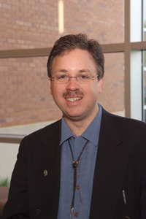

Today’s Speakers
John H. O’Neill, DO, FACP
Chair, Immunization Technical Advisory Committee, ACP
Level One Faculty, Christiana Care Health System, Newark, DE
Charles Michael Soppet, MD, FACP
Primary Care General Internist
ACP Medical Practice and Quality Committee

Slide 3
Webinar Overview: Objectives
Learn strategies to improve your vaccine ordering for different practice sizes
Learn tips on how to store and handle your vaccine stock
How to work with your staff to streamline this process

Slide 4
Managing Your Vaccine Stock: Tips to Improve Ordering, Storage and Handling of Vaccines John H. O’Neill, DO, FACP C. Michael Soppet, MD, FACP June 21, 2016 Adult Immunization Learning Series Webinar

Slide 5
Disclosure
Dr. John O’Neill has received a stipend from ACP to assist in the development of educational programs and tools to promote adult immunization,
and otherwise has NO financial relationships with any entity producing, marketing, re-selling, or distributing health care goods or services, consumed by, or used on, patients.

Slide 6
“The Big Five” for Adults
Influenza
PCV13 (pneumococcal conjugate)
PPSV23 (pneumococcal polysaccharide)
Tdap/Td
Zoster (VZV)

Slide 7
“The Other Seven” for Adults (Depending on Individual Patient Circumstances)
9vHPV/4vHPV/2vHPV
Meningococcal (MenACWY, MPSV4, MenB)
Hepatitis B
Hepatitis A
MMR
Varicella
Hib: Hemophilus Influenza B

Slide 8
Immunization and the Small Practice
Ordering Vaccine: How much to Order and When?
Influenza Vaccine: Indicated for everyone > 6mo
National rates: 43% >19 y/o, 68% > 65 y/o
Assume, of # of patients that see you each year:
1/3 will not get flu vaccine
1/3 will get it thru your practice
1/3 will get it elsewhere
Other vaccines: depends on need of your patients

Slide 9
Immunization and the Small Practice
PCV13, PPSV23, Tdap (frequent flyers)
Keep these in the fridge at all times
Start with one box of 10 doses of each and track use, order accordingly
MenACWY: One box of 5 doses in June
Hep B: Keep 6 doses on hand
Schedule the follow-up doses
9vHPV: Keep 6 doses on hand
Schedule follow-up doses

Slide 10
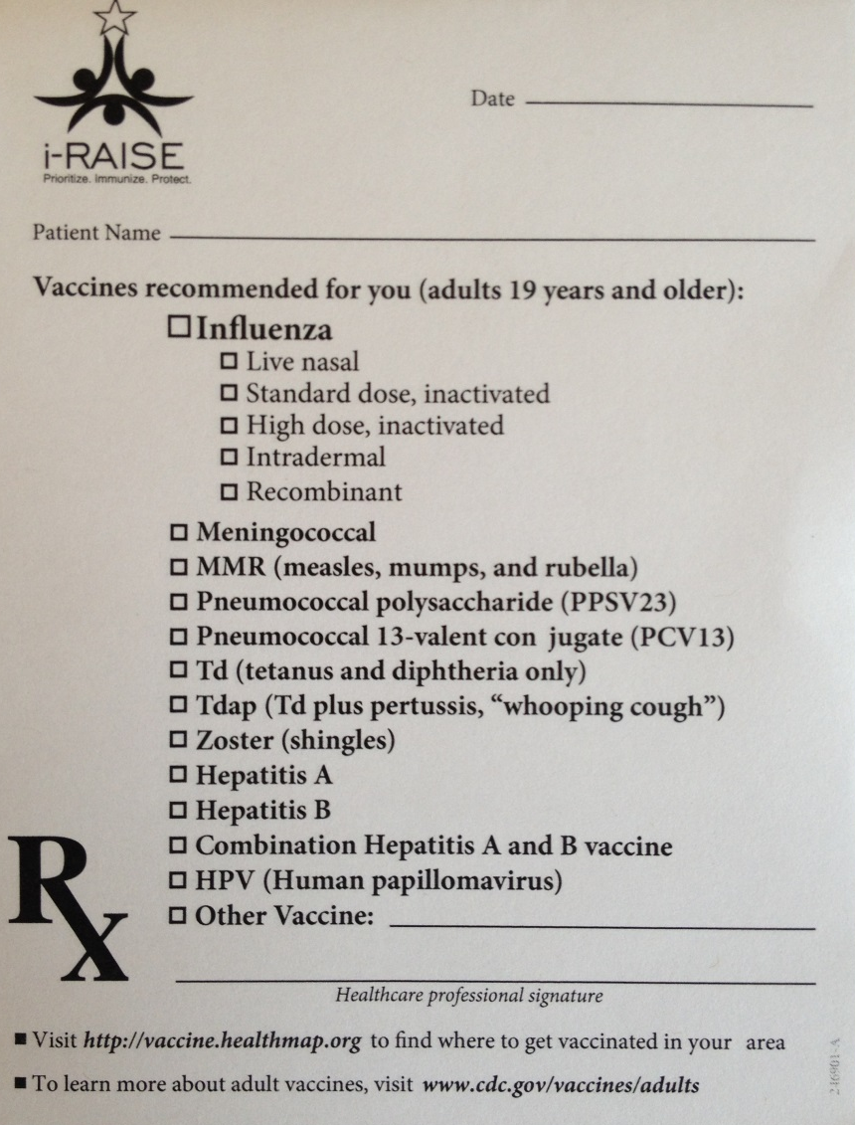
Vaccinate or Refer for Vaccination
ACP Center for Quality:
“I Raise the Rates”

Slide 11
Ordering Vaccines
Most of the vaccine suppliers have incentive programs: e.g.. Sanofi, Merck, Pfizer
Vaccine Discount Suppliers: (examples)
Atlantic Health Partners
Vaxserve
National Discount Vaccine Alliance
Vaccine purchasing groups: talk to local pediatricians

Slide 12
Log the vaccines as they come in
Vaccine | Date Rec’d | # of doses | Lot # | NDC # | Exp. date
Hi dose Flu
Quadrivalent Flu
PCV13
PPSV23
Tdap
Hep B
MenACWY
9vHPV

Slide 13
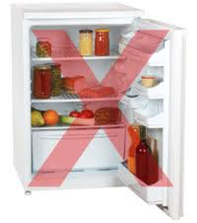
Storage of Vaccines
CDC: Vaccine Storage and Handling Toolkit
Maintain the chain of cold
36 – 45 degrees F (aim for 40)
Zoster, Measles, Varicella: -58 to +5 degrees
Store in separate freezer
No dorm style refrigerators!
Vaccine Fridge Czar

Slide 14
Refrigerators for Vaccines
No food or drink in the Vaccine Fridge!
No vaccine on the top shelf or in the crisper drawer
Line the door with water bottles labeled: “Do Not Drink”
Also line the crisper box, and along top shelf
Size: At least 4.5 cubic feet under counter fridge
Examples: LABRepCo, American Biotech Supply, Aegis Scientific
Back-up plan for power failure and temp out-of-range

Slide 15
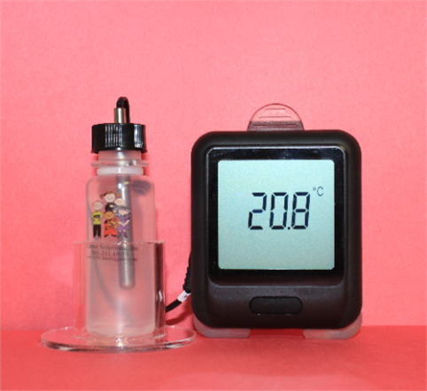
Data-logging Thermometers
Record temperature of vaccine fridge every minute
Data stored digitally in device, USB port for uploading to computer/spreadsheet
Thermometer probe in glycerol for temp stability
Out of range alerts: local alarm at fridge, text message, email alerts
Examples: VFCdataloggers.com, Southern Labware, and LABRepCo

Slide 16
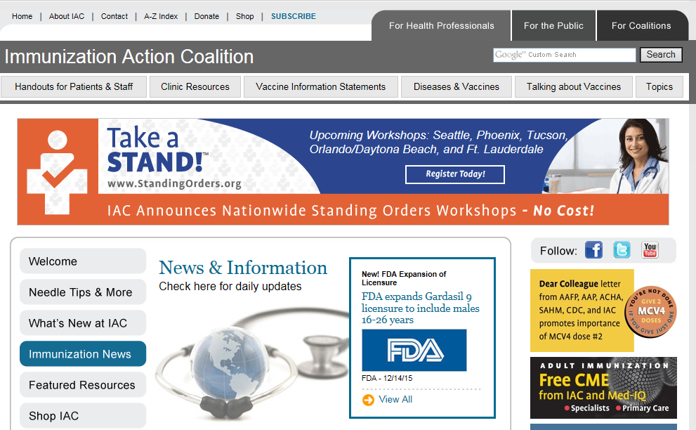
Helpful Resources
http://www.immunize.org/

Slide 17
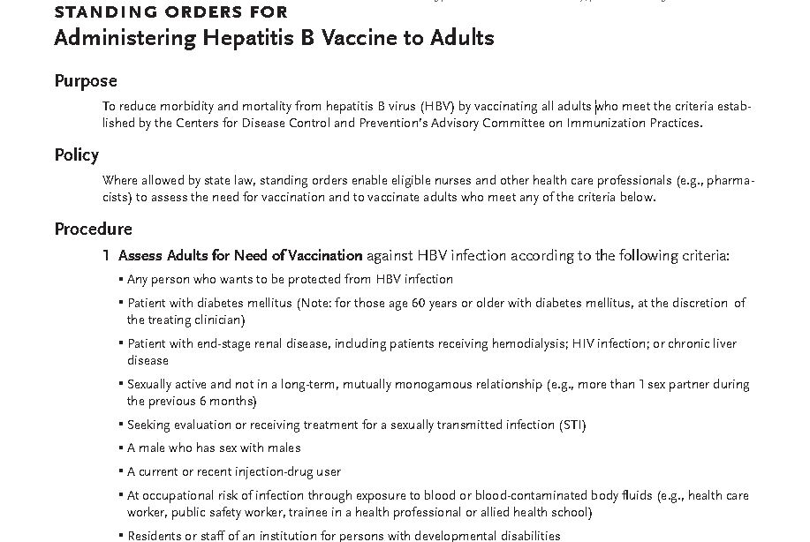
Standing Order Example
http://www.immunize.org/standing-orders/

Slide 18
Vaccine Ordering: How Much Do I Need? Initial Order Parameters

Slide 19
What size is your patient population?
If you don’t know your vaccination rates for your patient population, use the CDC default estimates:
The Big Five and the unvaccinated population
47% of patients remain unvaccinated for flu
80% of eligible remain unvaccinated for pneumococcal vaccine
70% of eligible for Tdap remain unvaccinated
80% of eligible for Zoster remain unvaccinated

Slide 20
Did You Know?
For each 1000 patients in the average internal medicine practice:
9% are older than 85 years of age
90 Patients out of 1000
64% are older than 65 years of age (640 patients)
75% are older than 60 years of age (750 patients)
88% are older than 50 years of age (880 patients)
Only 12% are 49 years of age or younger

Slide 21
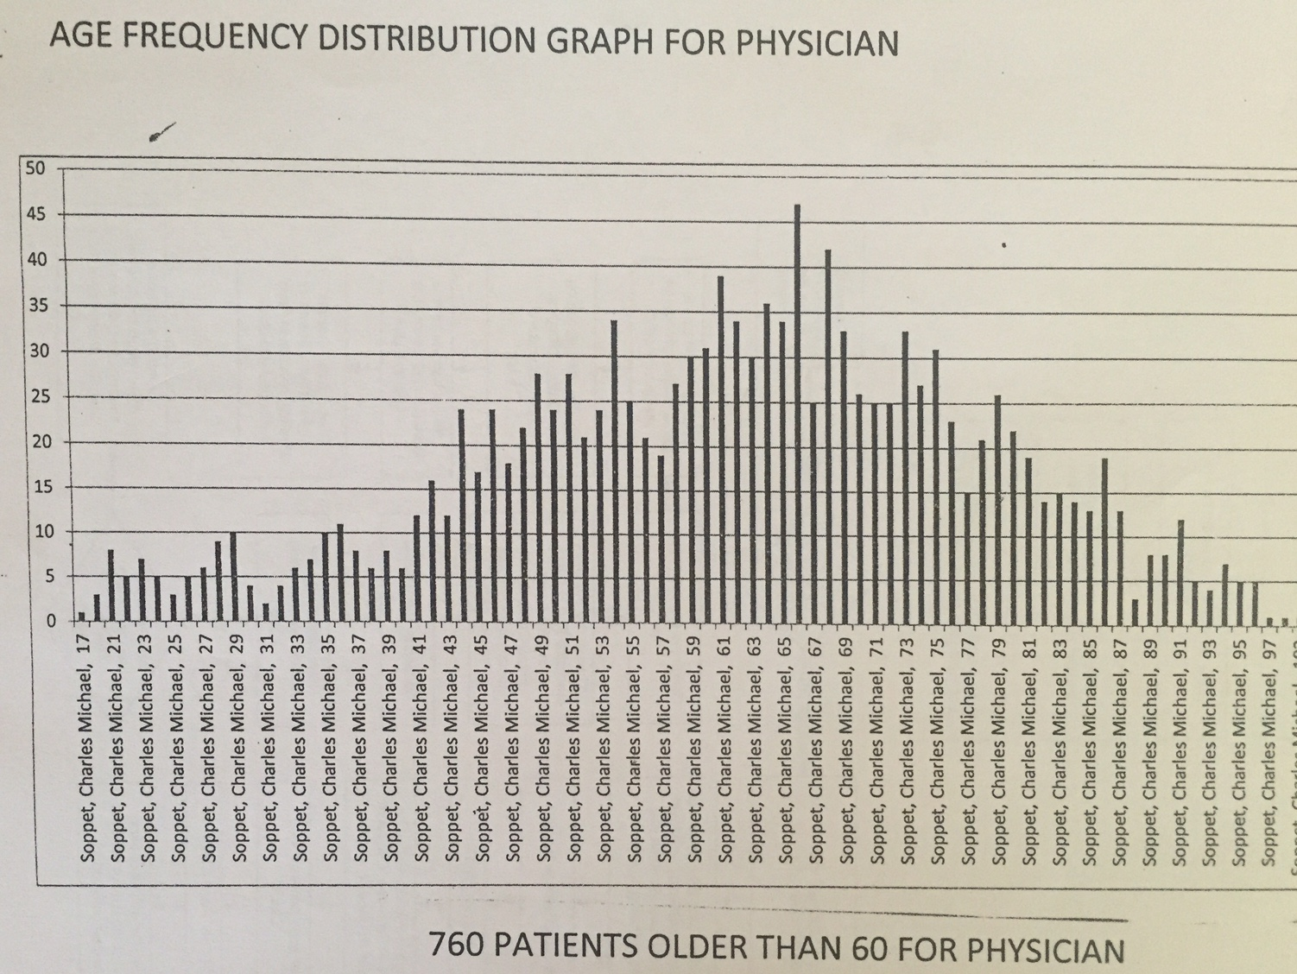

Slide 22
Predictive Analytics for Flu Orders
All 1000 need flu vaccine
CDC estimates that 47% get vaccinated
Let’s aim higher!
Order based upon last years experience plus 5%
Be proactive and aim higher for your practice
494 doses which equals CDC estimates plus 5% increase

Slide 23
Prediction Analysis for Pneumococcal
At least 640/1000 patients need some form of pneumococcal protection
“13 before 23” is the way to go
However, give them something if not high risk
PPSV23 is cheaper ($60) to buy than PCV13 ($150)
You can immunize lower risk patients with PPSV23 than PCV13 – so do it!
High risk patients need PCV13 before PPSV23
Ballpark your orders at 75% PCV13 and 25% PPSV23

Slide 24
Prediction Analysis for Zoster
750/1000 need Zoster
134 are between 60 – 65 years old and eligible for commercial coverage
Identify those 60 – 65 and vaccinate them ASAP before Medicare D coverage starts
616/1000 are older than 65 and are covered under Part D

Slide 25
Prediction Analysis for Tdap
Can be more difficult to predict
Cost about $35 – 40 a dose
Medicare Part D coverage for specific indications
Injuries
Order lower numbers due to uncertain need
Consider the “cocoon” strategy for your patients who are parents or grandparents

Slide 26
Inventory Management
Now I know the number of vaccines I need for my practice
When do I order them?
How many do I keep on hand?

Slide 27
Ordering: Plan One
Flu: 500 doses/1000 patients delivered in August for usage in September – January
Acquisition cost at $9.50 each = $4,750 for an August delivery
PCV13: 40 doses per month of at $150 = $6,000
PPSV23: 13 doses per month at $60 = $800
Zoster: Aim for 10 doses per month at $180 = $1,800
Concentrate on the 60 – 64 commercial insured age group
Tdap: Keep 10 doses on hand and try cocooning

Slide 28
Plan One: Total Monthly Outlay
$8,950 per month from January – December
Plus an additional $800 monthly for September – January

Slide 29
Ordering: Plan Two
Flu: 500 doses/1000 patients delivered in August for usage in September – January
Acquisition cost at $9.50 each = $4,750 for August delivery
PCV13: 10 doses per month of at $150 = $1,500
PPSV23: 50 doses per month at $60 = $3,000
Zoster: Aim for 10 doses per month at $180 = $1,800
Concentrate on the 60 – 64 commercial insured age group
Tdap: Keep 10 doses on hand and try cocooning

Slide 30
Plan Two: Total Monthly Outlay
$7,050 per month from January – December
Plus an additional $800 monthly for September – January

Slide 31
Too Costly for Cash Flow?
If you are worried about the cash flow….
Pick one vaccine to concentrate upon each month of the year and stock up for that vaccine
September: Flu month
January: Pneumonia month
February: Zoster (Shingles) month

Slide 32
Discussion and Questions
Questions?
Contact Information
Dr. John O’Neill: drjho7@verizon.net
Dr. Mike Soppet: msoppet@Comcast.net

