Slide 1

I Raise the Rates: Initiative to Raise the Adult Immunization Rates in Primary Care
An ACP Quality Connect Program
Laura Lee Hall, PhD, Director, Center for Quality

Slide 2
Introductory Comments
Why and What of I Raise the Rates
Who Are the Champions
Champion Training Overview

Slide 3
Acknowledgements
Support for this program has been from Pfizer, Inc.
Thanks to ACP staff – especially Rebecca and Dawn - and all of the faculty and chapter staff and leaders who have worked so hard on this program.

Slide 4
Remember…
Videos
Golf carts

Slide 5
So Low, So Little Change

Slide 6
What About 2014 Data?
“Overall, increases in adult vaccination coverage are needed. Although modest gains occurred in Tdap vaccination coverage among adults aged ≥19 years and herpes zoster vaccination coverage among adults aged ≥60 years, coverage for other vaccines and risk groups did not improve, and racial/ethnic disparities persisted for routinely recommended adult vaccines.”
Williams WW, Lu P, O’Halloran A, et al. Surveillance of Vaccination Coverage Among Adult Populations — United States, 2014. MMWR Surveill Summ 2016;65:1–36. DOI: http://dx.doi.org/10.15585/mmwr.ss6501a1

Slide 7

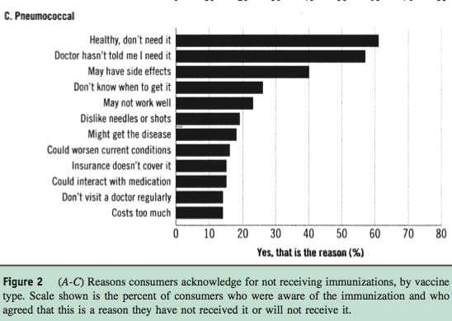

Slide 8
ACP Quality Connect Mission
To create and sustain a learning community of empowered physicians and other health care professionals, patients and caregivers, to improve health, care delivery and outcomes.
  Create QI network of internists and other physicians and their health care teams
  Partner with state chapters and health care systems
  Highlight patient engagement as part of health care team
  Add value and joy to clinicians in everyday practice
Value = MOC, VBP/APM, MU, revenue, efficiency (team-based care), professional development
Joy = Reduced administrative burden, collaborating with colleagues and peers and…taking care of your patients!
Notes:
It was 2 years ago this month that a wonderful advisory group, including some of you and your peers helped create the vision for the Center for Quality – that is Connecting health teams to work on improving care with an eye towards helping physicians and practices complete reporting requirements (such as MOC and PQRS) while promoting joy – that is pursuing your vocation of doing good medicine for patients. Partnering with the states was in the vision from the start.

Slide 9
Improvement Tools
Champion Training
Performance Monitor and Learning Platform
Practice Coaching Calls
Webinars
Focus on Topics Important to Practices (costs, team-based approaches, referral tools, recommendation)
PDSA Library
Resident Training Modules

Slide 10
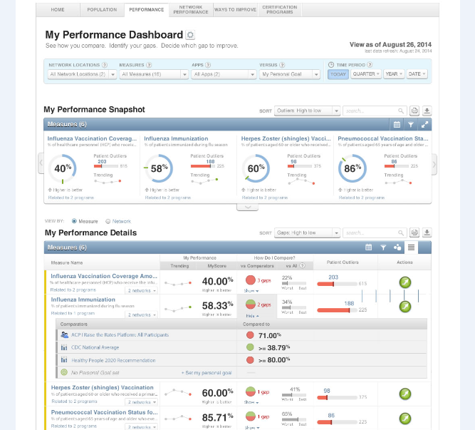
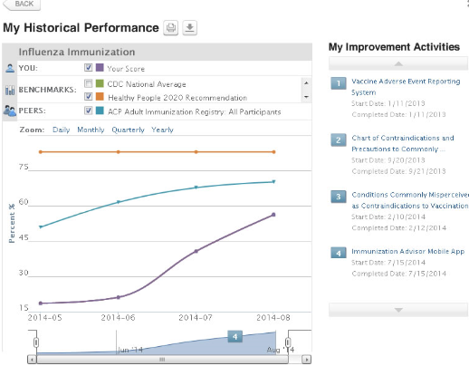
Medconcert: Performance Monitoring Dashboard
View your performance based on vaccine measure and against established benchmarks and peer comparators.

Slide 11
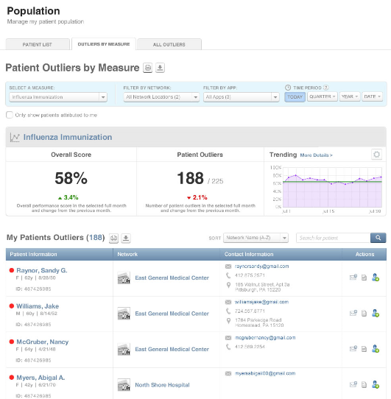
Medconcert: Patient Population Management/Outliers
View your patient population and your patient outliers to see where gaps may be.

Slide 12
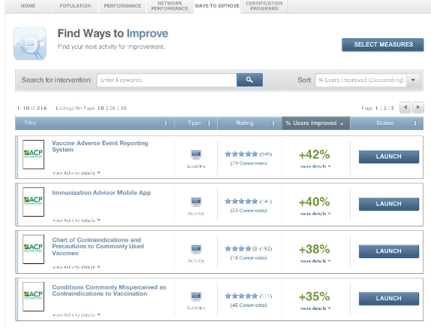
Medconcert: Improvement Tools
Access to improvement tools and educational resources for patients and staff.
Resources specific to each vaccine measure and focusing on the adult immunization practice standards.

Slide 13
This Approach Can Make a Difference
 | Baseline (%) | Follow-up (%) | Improvement (%)
Herpes Zoster (shingles) Vaccination | 51.92 | 66.18 | 14.26
High Risk Pneumococcal Vaccination | 69.13 | 92.65 | 23.52
Influenza Immunization | 79.34 | 97.64 | 18.3
Influenza Vaccination Coverage Among Healthcare Personnel | 75 | 100 | 25
Pneumococcal Vaccination Status for Older Adults | 96.12 | 99.01 | 2.89
Tdap Vaccination | 76.56 | 91.23 | 14.67

Slide 14
And You Can Make a Profit
Decision points:
Which vaccines to stock
Storage and handling
Purchasing method
Optimal coding
Standing orders/team-based care
Vaccine | MCR Margin | Non-MCR Margin | Estimated Net Profit 9/12-8/13
influenza | 29.07 | 20.61 | 13,106.16
PPSV23 | 38.70 | 21.54 | 1,794.06
Tdap | 49.05 | 30.45 | 11,985.90
Zostavax |  | 20.54 | 123.24
HPV4 |  | 50.00 | 600.00
PCV13 | 35.52 | 14.89 | 50.41
Other Vax: |  | 20.00 est | 100.00
TOTAL: |  |  | $27,759.77

Slide 15
Welcome Champions

Slide 16
Who Are You?

Slide 17
Introducing the Florida Champions
Azzam Adhal | Kenji Kaye
Steven Attermann | John Langdon
Carmel Barrau | Albert Lopez
Josee Barrau | Benjamin Mena
Daniel Bendetowicz | Cynthia Miller
Martin Derrow | Naresh Pathak
Jason Goldman | Michelle Rossi
Lucy Guerra | Kaley Tash
Kristen Hager | Rick Waks
Stuart Himmelstein

Slide 18
Introducing the NJ Champions
Theresa Barrett Diane Carroll Claudia Casas Mike Cestare Aparna Daley Laurie Dickerson George DiFerdinando, Jr., Doantrang Du Margaret H. Eng Donna Fitzpatrick | Susan Gonzalez Anne Lefferts Christina Lusk-Cáceres Steven Peskin Ralph Pothel Sandi Selzer Olga Tarasova Sara Wallach

Slide 19
Who Are You?
Practice Setting | Florida | New Jersey | Total
Solo private practice | 3 | 0 | 3
Small IM private practice (<10 docs) | 1 | 0 | 1
Large IM private practice (>10 docs) | 1 | 1 | 2
Multi-specialty practice (>15 docs) | 1 | 0 | 1
Academic center | 3 | 1 | 4
Community health center | 0 | 5 | 5
Government run facility | 1 | 0 | 1
Hospital | 0 | 2 | 2
NA | 1 | 3 | 4

Slide 20
More About You
66% physicians; 12% nurses/nurse practitioners; 16% residents
25% self-employed; 16% academic medical center; 50% from CHC/health system/hospital/VA
85% some kind of EHRs; 62% 1+ years (62% attesting to MU)
34% - PCMH; 38% - ACO (20-25% unsure of either)

Slide 21
QI Experience: My Practice…

Slide 22
Barriers to QI
Skill and engagement= 22%
Time and money = 70%

Slide 23
Your QI Priorities
Enhancing team-based care (68%)
QI training/implementation (39%)
Increased SDM and patient engagement (32%)
Performance reporting programs (29% - MU, ACO, state law/reimbursement requirements, licensure, hospital credentialing/privileges)
Care coordination (23%)

Slide 24
Immunization Importance
How important is improving adult vaccination coverage rates in your patients?
  75% say EXTREMELY IMPORTANT
How ready is your practice to increase immunizations?
  75% say READY TO CHANGE NOW
  If not ready to change now, note lack of knowledge of how to do so or the complexity of getting data on vaccine status of your patients
How confident are you that you can increase immunizations?
  58% say EXTREMELY CONFIDENT

Slide 25
During a typical week, estimate the % of your patients who are up-to-date with all recommended vaccines
Less than 10% | 6.5%
10% to 50% | 19.4%
51% to 75% | 41.9%
76% to 100% | 9.7%
Unsure | 22.6%

Slide 26
ASSESS: Please rate how consistently your practice performs the following: Our practice...

Slide 27
ASSESS: Please rate how consistently your practice monitors the percentage of your patients who are eligible to receive:

Slide 28
RECOMMEND: Our practice consistently…

Slide 29
ADMINISTER AND REFER: Please rate how consistently your practice performs the following: Our practice...

Slide 30
DOCUMENT: Our practice consistently…

Slide 31
What are your top vaccine priorities?
77% - Increase vaccination in my practice
39% - Implement team-based/SOP in my practice to administer vaccines
38% - Educate my patients about vaccines

Slide 32
What Does a Champion Do?
Lead their practice setting in QI project aimed at increasing immunizations in their patients
Engage peers in promoting the importance of immunizations
Teach colleagues about strategies that can promote immunizations
Promote immunizations in your organization or community

Slide 33
Program Overview
Friday night: Overview of recommended immunizations; general discussion
Saturday: Communicating with patients and peers about immunization; implementing immunizations in your practice
Sunday: The business of immunizations; interdisciplinary and training program roles
Walk out with: communication plan, QI template, and overall action plan – FOR YOU AND YOUR PRACTICE/WORK SETTING

Slide 34
THANK YOU!!

Slide 35


Slide 36
Small Group Discussion: Developing an Improvement Plan
Laura Lee Hall, PhD
February 26 – 28, 2016
I Raise the Rates Champion Training

Slide 37
Overview
Worksheet is located in Day Two tab 3
Notes:
I used this format to develop community talking points during H1N1 for the community, healthcare professionals, and EMS.

Slide 38
Things to Consider
Work on a plan today that is for YOUR practice, using your data and interests
BE SPECIFIC: set numerical goal and set timeframe
BE REALISTIC: set realistic goals
Start small
Integrate into practice workflow
Use your run charts to analyze and share progress
Use ACP resources: practice coaches, on-site support, webinars, print resources

Slide 39
Elements of Worksheet
Plan: What do you want to focus on (e.g., increasing pneumococcal vaccination in high risk patients through patient education)?
Goal: What is your aim (e.g., increase pneumococcal vaccine awareness among all our patients over the next year)?
Prediction: What will your intervention yield (e.g., 20% increase in pneumococcal immunization rates among high risk patients)?
Team Leaders: Who is going to spearhead the project (e.g., champion(s) trained here plus a nurse and front desk administrative staff person)?

Slide 40
Elements of Worksheet, continued
Tool/Resources: ACP platform; patient education posters for waiting and exam rooms; patient hand-outs
Steps: Finalize plan in detail; communicate project to practice in meeting and in poster in staff room; place posters and begin hand-out of patient materials at check-out; review data monthly and share results with the practice in meetings and postings in staff room)
What do you observe? No change in first month.
Study: Did you meet your goal (e.g., no)? What did you learn? (e.g., discussion shows that the patient materials were distributed at check-out – so not an implementation problem)
Act: What did you conclude (e.g., may be better to distribute the materials at check-in)?

