Slide 1
Welcome!
Thank you for joining the American College of Physicians’ Quality Connect Adult Immunization Learning Series Webinar!
We will start in a few minutes.
Today’s webinar is focused on cultural outreach and communication towards minority and ethnic groups.
Please keep your phone on mute, when not asking questions, we are recording this webinar.
Feel free to ask questions in the chat feature of WebEx.
ACP will share the slides and recorded webinar on MedConcert.

Slide 2
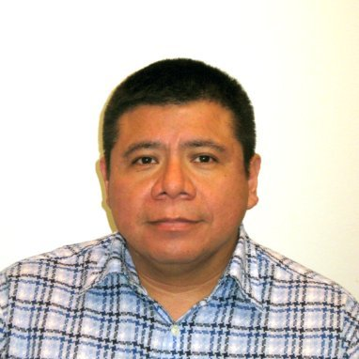
Today’s Speakers
Jennifer Dillaha, MD
Medical Director for Immunizations; Medical Advisor for Health Literacy and Communication at the Arkansas Department of Health
Carlos Velazquez
President of HMA Associates, Inc.

Slide 3
Webinar Overview
Focused on cultural outreach and communication towards minority and ethnic groups
Learn about provider resources to support efforts
Understand new patient tools and resources to reinforce the importance of immunizations

Slide 4
Cultural Competency – How to Apply Outreach and Understanding in Your Practice Jennifer Dillaha, MD Carlos Velazquez January 12, 2016 Adult Immunization Learning Series Webinar

Slide 5
Cultural Competency
Jennifer Dillaha, MD
Medical Director, Immunizations
Medical Advisory, Health Literacy and Communication
Arkansas Department of Health

Slide 6
Overview
Define cultural competency
Briefly discuss impact on preventive services and immunization coverage rates
Keys for developing culturally appropriate immunization messages and practices
Training, resources, and tools

Slide 7
Cultural Competence
The ability of providers and organizations to effectively deliver healthcare services that meet the social, cultural, and linguistic needs of patients.
Betancourt, J. R., Green, A. R., & Carrillo, J. E. 2002. Cultural competence in health care: Emerging frameworks and practical approaches. New York: The Commonwealth Fund.
Notes:
It is NOT a fixed endpoint, but a journey toward achieving attitudes, knowledge, and skills.

Slide 8
Rationale for Cultural Competence in Primary Care
To respond to demographic changes in the U.S.
To eliminate disparities in the health status of people of diverse racial, ethnic and cultural backgrounds.
To improve the quality of services and health outcomes.
To meet legislative, regulatory and accreditation mandates.
To gain a competitive edge in the market place.
To decrease the likelihood of liability/malpractice claims.
National Center for Cultural Competence
http://nccc.georgetown.edu/resources/cultural5.html

Slide 9
Office of Minority Health Center for Linguistic and Cultural Competency in Healthcare
Department of Health and Human Services (HHS), Office of Minority Health (OMH)
National CLAS Standards
Think Cultural Health Website: https://www.thinkculturalhealth.hhs.gov/
Continuing Education
http://minorityhealth.hhs.gov/omh/browse.aspx?lvl=2&lvlid=34
Notes:
Become a member of the Center for Linguistic and Cultural Competency in Health Care.
By joining, you will gain access to exclusive resources and be the first to hear about the latest initiatives from OMH and Think Cultural Health team.

Slide 10
National CLAS Standards
Culturally and Linguistically Appropriate Services in health and healthcare
A framework for organizations to serve the nation's increasingly diverse communities
Principal Standard: Provide effective, equitable, understandable and respectful quality care and services that are responsive to:
Diverse cultural health beliefs and practices
Preferred languages
Health literacy and other communication needs
HHS Office of Minority Health
http://minorityhealth.hhs.gov/omh/browse.aspx?lvl=2&lvlid=53

Slide 11
Immunization Action Coalition Skills Checklist for Immunization
Competency
Patient/Parent Education
Clinical skills, techniques, and procedures
Accommodates language and literacy barriers and special needs of patient/parents to help make them feel comfortable and informed about the procedure.
http://www.immunize.org/catg.d/p7010.pdf

Slide 12
Training from the CDC
Five online health literacy courses for health professionals
Health Literacy for Public Health Professionals (free CE)
Writing for the Public
Using Numbers and Explaining Risk
Creating Easier to Understand Lists, Charts, and Graphs
Speaking with the Public
Centers for Disease Control and Prevention
http://www.cdc.gov/healthliteracy/gettraining.html
Notes:
printable completion certificate on four without CE

Slide 13
Other Trainings
A Physician's Practical Guide to Culturally Competent Care
HHS, Office of Minority Health
Free, self-directed course for physicians and other healthcare professionals with a specific interest in cultural competency in the provision of care
9.0 AMA PRA Category 1 credits
9.0 contact hours for nurse practitioners
http://www.cdc.gov/healthliteracy/gettraining.html
Notes:
Identify at least five areas related to cultural and linguistic competency in medical practice.
Identify at least three strategies to promote self-awareness about attitudes, beliefs, biases, and behaviors that may influence clinical care.
Devise strategies to enhance skills toward the provision of care in a culturally competent clinical practice.
Demonstrate the advantages of the adoption of the National CLAS Standards in clinical practice.

Slide 14
Other Trainings (cont.)
Culturally Competent Nursing Care: A Cornerstone of Caring
HHS, Office of Minority Health
Free course that discusses the behaviors, attitudes, and skills that enable nurses to work effectively in cross-cultural situations
9.0 contact hours for nurses
http://www.cdc.gov/healthliteracy/gettraining.html
Notes:
How do we become culturally competent?
Attitude – Steps: Self-Reflection (of cultural differences) → Self-Assessment (of Cultural Competence)
2. Knowledge – of culture, impact of class/ethnicity on behavior, help-seeking behaviors, communication, and resources
3. Skills – Techniques for learning; Good communication; Ability to assess based on cultural influence, Interviewing skills
-Understand pt's explanatory model of illness (key to appropriate Tx plan = asking the right questions!)

Slide 15
LHD Organizational and Administrative Factors Related to Immunization Rates
Key Factor: Local health department perspectives on its community
Challenges:
Limited cultural competency and cultural humility of staff
Limited infrastructure for staff development and growth in cultural humility and cultural competency
Limited activities focused on health equity
Success:
Cultural competency integrated into staff training
Immunization efforts considered to be part of the agency’s health equity efforts
Ransom J, Schaff K, Kan L. J Health Hum Serv Adm, 2012 Spring, 34 (4): 418-55.
Notes:
Ethnocentrism: “The view that one’s own cultural orientation is the correct view of reality.”
Personal and professional cultures can bring about ethnocentrism!

Slide 16
National Library of Medicine (NLM): Multi-Cultural Resources for Health Information
Cultural competency
Dictionaries, glossaries, and online translation tools
Health literacy
Health resources in multiple languages
Interpreting in healthcare
Law, policy, and standards
http://sis.nlm.nih.gov/outreach/multicultural.html#a0

Slide 17
National Library of Medicine (NLM): MedlinePlus Resources
Immunization http://www.nlm.nih.gov/medlineplus/immunization.html
Adult Immunization https://www.nlm.nih.gov/medlineplus/spanish/immunization.html#cat23
Spanish-mirror site
Information in other languages: Chinese, Farsi
https://healthreach.nlm.nih.gov/

Slide 18
Immunization Action Coalition (IAC) Adult Vaccine Resources
Vaccines and Adults: A Lifetime of Health Booklet
27 page booklet for adults in English and Spanish
Vaccinations for Adults – You are never too old to get immunized
One-page sheet describes vaccinations that adults need, in multiple languages
Vaccinations for Adults with Lung Disease
English and Spanish
Vaccinations for Adults with Diabetes
English and Spanish
Vaccinations for Adults with Heart Disease
English and Spanish
http://www.vaccineinformation.org/adults/resources.asp

Slide 19
Vaccine Information Statements from IAC
Use the vaccine information statements (VIS) in your conversations with patients
IAC has the VIS in multiple languages http://www.immunize.org/vis/?f=9

Slide 20
Communicating Risk Applied to Immunization
Make sure you understand what the numbers mean so you can explain them.
Use visuals if possible.
Helen Osborne’s Health Literacy Out Loud Podcast with Dr. Zikmund-Fisher
FDA’s Communicating Risks and Benefits: An Evidence-Based User’s Guide
http://www.healthliteracyoutloud.com/2013/08/27/when-communicating-risk-consider-what-patients-need-and-want-to-know-hlol-102/
http://www.fda.gov/downloads/AboutFDA/ReportsManualsForms/Reports/UCM268069.pdf
Notes:
People don’t often know how to weigh risks and benefits.

Slide 21
Key Cultural Perspectives on Vaccination
Individual rights and public health stances toward vaccination
Various religious standpoints and vaccine objections
Suspicion and mistrust of vaccines among different U.S. and global cultures and communities
Divergent cultural perspectives and opinions toward vaccination, including libertarian and religious objections and vaccine suspicions, signal the need for continued communication and collaboration between medical and public health officials and the public regarding acceptable and effective immunization policies
The College of Physicians of Philadelphia
http://www.historyofvaccines.org/content/articles/cultural-perspectives-vaccination

Slide 22
Emory Interfaith Health Program
Model Practices to Increase Influenza Prevention Among Hard-to-Reach Populations
Strategies to identify and engage faith-based organizations as partners in community health promotion and disease prevention outreach
http://ihpemory.org/2014/03/10/public-health-and-faith-community-partnerships-2/

Slide 23
Resources on Religion and Vaccines
Johns Hopkins Bloomberg School of Public Health http://www.vaccinesafety.edu/Religion.htm
Porcine-derived components
Aborted fetuses
Links to relevant articles

Slide 24
Vaccine Literacy
“It is often said that doing the right thing is rarely easy, but doing the easy thing is rarely right. In the case of vaccines, we owe it to the future of health — to do the right thing — and develop a vaccine literacy.”
Scott Ratzan, Vaccine Literacy, a Crucial Healthcare Innovation, Harvard Business Review
https://hbr.org/2011/02/vaccine-literacy-a-crucial-hea/
Notes:
Scott Ratzan, MD, MPA is Vice President of Global Health, Government Affairs & Policy for Johnson & Johnson and the Editor-in-Chief of the Journal of Health Communication: International Perspectives. Dr. Ratzan holds faculty appointments at Yale University.

Slide 25
Mobile Gaming Strategies to Engage Hispanic and African American Young Mothers for Flu Vaccination Uptake
Carlos Velazquez, MA, President, HMA Associates

Slide 26
Overview
Target audience
Purpose of communications intervention
Digital and gaming strategy
Flight results
Lessons learned

Slide 27
Messaging
Cultural competency is an important factor in creating messages that resonate with a target audience
Messaging platform is equally as important in reaching segmented audiences

Slide 28
Target Audience
For the 2014-2015 flu season vaccination coverage rates were lower Hispanic (44.3%) and African American (43.8%) adults than that for non-Hispanic whites (48.5%)
Ethnic and racial minority groups are disproportionately impacted by chronic diseases/conditions
Hispanic and African American women 18 – 34 years old, parents of young children
Notes:
The increasing use of mobile devices rather than computers for online activity magnifies the importance and relevance of a mobile campaign for this audience. In a recent study by the Pew Research Center, 6 in 10 Americans own a smartphone (64%), and 2 in 10 Americans now access the Internet primarily through their mobile phone (25%).
http://www.digitalgov.gov/2015/04/07/trends-on-tuesday-40-of-americans-use-smartphones-to-find-government-information/

Slide 29
Purpose
To assist the CDC in campaign aimed at increasing awareness about the importance of annual flu vaccination among underserved communities
Promote influenza immunization in a targeted and cost-effective manner, using mobile technology on three large mobile-accessible platforms:
MocoSpace (mobile and game platform)
Moasis (mobile and game platform)
Batanga Network (free subscription music player, Spanish only)
Notes:
Educate target audiences about the risk of flu for themselves, their families, and ultimately encourage them to get vaccinated
Reach captive target audience on smart phones
Increase traffic to CDC’s flu website by directing mobile banners to:
http://www.cdc.gov/flu/ (English banners)
http://espanol.cdc.gov/enes/flu/ (Spanish banners)

Slide 30
Goals
Reinforce benefits of flu vaccination through digital channels that target audience(s) frequent
Promote a call-to-action to drive the target audiences to the www.cdc.gov/flu website
Maximize the outreach impact by leveraging donated and earned media

Slide 31
Mobile Platform Strategy

Slide 32
Capabilities
35 million members in the US
Exclusive gaming partner for Univision Mobile
Targeting capabilities by:
Age
Gender
Ethnicity
Location
Demographic
*The Top Grossing category is to indicate which apps have the highest total spent on them.
Notes:
Custom in-banner mobile game strategy
Mobile banner strategy
#4 Grossing App* in the Android Google Play Store in the Social category
Ranked #9 in Google Trends Social Media Sites Trending Chart
Comscore top Hispanic Ad Source: More time spent on MocoSpace than all other leading Hispanic ad sources combined

Slide 33
Mobile Game
Timed-memory game
Word match-related message after pairing words
Concluding overall flu message once all matches are identified
Call to action to visit www.cdc.gov/flu or http://espanol.cdc.gov/enes/flu/
http://www.mocospace.com/html/game/cdc/demo.jsp?view=full&platform=desktop

Slide 34
Mobile Banner

Slide 35
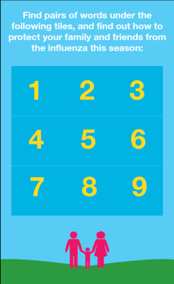
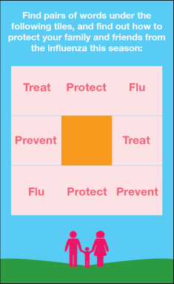
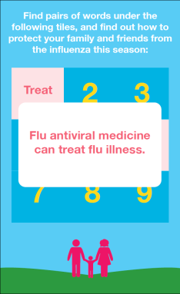
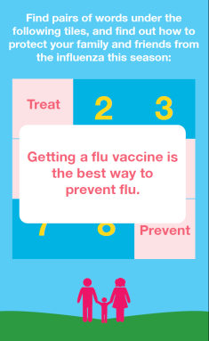
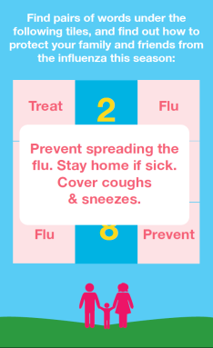
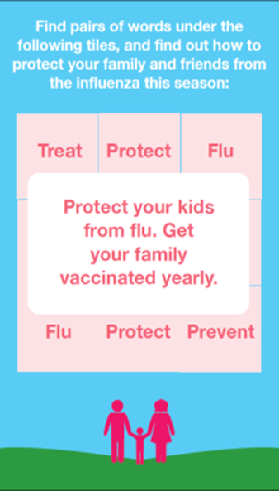
Mobile Game

Slide 36
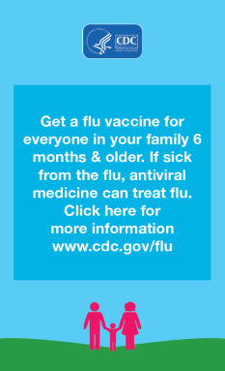
Mobile Game

Slide 37
Capabilities
Moasis uses GPS positioning to reach target audiences
Banner ads are placed as a tactic
Can target specific demographics at or around target locations (e.g., Hispanics at pharmacies and/or doctor offices)
120 billion location enabled monthly impressions
175 million monthly unique users
Used through 60,000+ apps and mobile sites

Slide 38
Mobile Banners
Visually engaging mobile banners with flu vaccination facts
Banners placed between game levels
Geo-targeted by gender, age, and ethnicity
Notes:
Different size options that will automatically resize if viewed from a mobile device or a tablet
Activity will be tracked to determine users response, and continue to run those with higher CTR
Banners will be linked to www.cdc.gov/flu (English) and http://espanol.cdc.gov/enes/flu/ (Spanish)

Slide 39
Mobile Banner
Notes:
There will be three flights scheduled during the base year, the table below provides detailed information on type of unit to be run, number of impressions, Cost Per Mille (CPM), and net cost.
Target: Hispanic and AI/AN women 18-34 years old; parents of young children

Slide 40
Capabilities
Largest US Hispanic-focused digital audience
26.3 million US Hispanic free subscribers reached every month
Average listening time is 43 minutes per session
Notes:
Targeting capabilities: geographic, content, demographic, age, behavior
Mobile/Audio banner strategy, existing CDC :30 PSA with a banner

Slide 41
Mobile Audio
The 30 second audio placement runs as a background image
Audio continues to play*regardless of user closing out of banner
Link to CDC 30 second PSA in Spanish: “Flu Vaccine for Big Kids”
Reference source: http://www.cdc.gov/flu/freeresources/media-psa.htm
* Audio PSAs play in average every 4-6 songs

Slide 42
Media Buy Flights (ad runs)
Three flights scheduled during the early flu season (September-October)
Media Outreach
To complement the media buy, minority media outlets were engaged

Slide 43
Online Publishers and Mommy Bloggers for Interviews
Key online publishers reaching English and Spanish-speaking audiences
Subject matter experts conducted media interviews during National Influenza Vaccination Week and beyond
Notes:
interviews are not only conducted during NIVW each year

Slide 44
Evaluation
Performance tracking on mobile game and audio banners:
Click through rate (CTR)
Impressions
Clicks
Internal proprietary tracking system for earned media and subject matter experts engagements:
Impressions
Media outlets
Estimated donated value

Slide 45
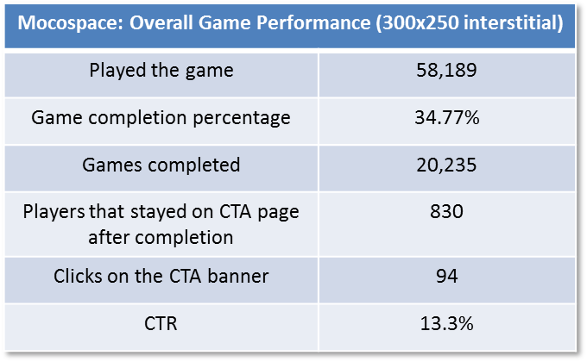
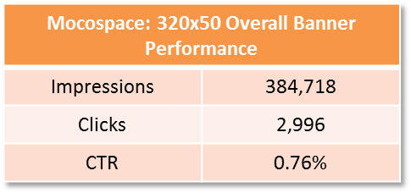
Media Buy Results

Slide 46
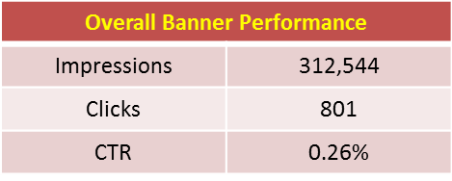
Media Buy Results
Batanga: Overall Spanish Banner Performance
Impressions | 1,258,702
Clicks | 9,458
CTR | 0.70%

Slide 47
Media Outreach Results
Hispanic audiences
Eight placements
2,785,588 impressions
$73,435 publicity value
Award Winning Strategy
Notes:
Examples of placements would be helpful here

Slide 48
Lessons Learned
Engaging Latina and African American young women through mobile platforms is a cost/effective strategy
Messaging must be adapted to the target audience
Repetition is key through donated media strategy
Hispanics consistently engage at higher rate with English content

Slide 49
Discussion and Questions
Questions?
Contact Information
Jennifer.Dillaha@Arkansas.gov, 501-661-2864
cvelazquez@hmaassociates.com, 202-342-0676, @jclatino

