Slide 1
Welcome!
Thank you for joining the American College of Physicians’ Quality Connect Adult Immunization Learning Series Webinar!
We will start in a few minutes.
Today’s webinar is focused on influenza, vaccinating patients 65+, and clarification on the LAIV change.
Please keep your phone on mute, when not asking questions, we are recording this webinar.
Feel free to ask questions in the chat feature of WebEx.
ACP will share the slides and recorded webinar on MedConcert.

Slide 2
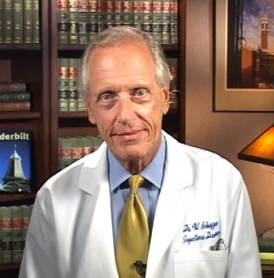
Today’s Speaker
William Schaffner, MD, MACP
Professor of Preventive Medicine and Infectious Diseases
Vanderbilt University Medical Center

Slide 3
Webinar Overview
Focused on the 2016 – 2017 influenza season
Learn tips on reaching your 65+ year old patients and what vaccines to use
Understand and learn information on the LAIV vaccine change

Slide 4
Preventing Influenza – Reaching Your Patients 65+ and Feeling Confident for the Upcoming 2016-2016 season William Schaffner, MD August 9, 2016 Adult Immunization Learning Series Webinar

Slide 5
Potential Conflicts of Interest
Merck: Member, Data Safety Monitoring Board
Pfizer: Member, Data Safety Monitoring Board
Dynavax: Consultant
Novavax: Consultant
Genentech: Lecture

Slide 6
AGENDA
Influenza background
Influenza vaccines, 2016
Influenza vaccines for persons age 65+
Why recommendation not to use
nasal spray vaccine
What about egg allergy?

Slide 7
INFLUENZA – BURDEN OF DISEASE

Slide 8
Variability in Season Onset
Percentage of Visits for Influenza-like Illness (ILI) Reported to CDC ILINet For Selected Previous Seasons from all US States
CDC. FluView Interactive. http://gis.cdc.gov/GRASP/Fluview

Slide 9
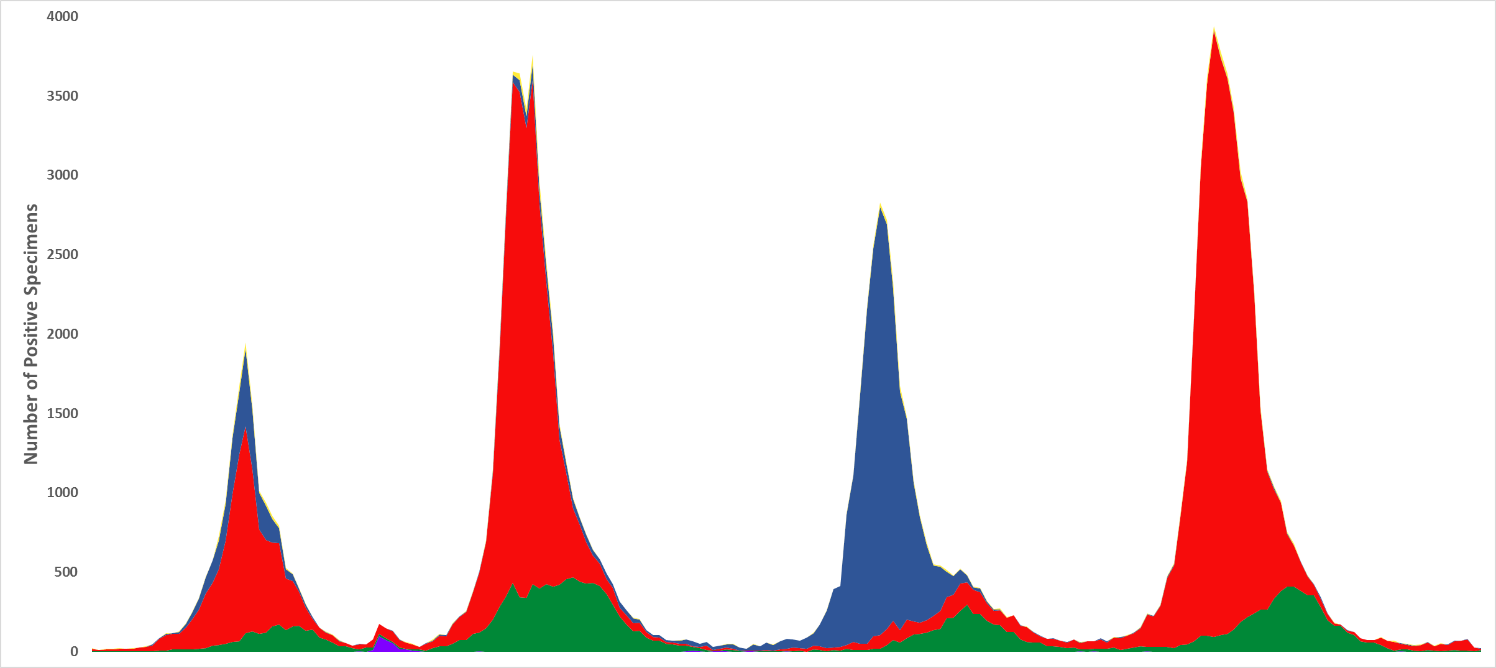
Influenza Virus Surveillance 2011-2015 US Public Health Laboratories
A(H3N2)
A(H1N1) pandemic
B/Yam & B/Vic
2012
2013
2014
2015

Slide 10
Annual Influenza Impact Varies by Season
Reed et al. PLOS One 10(3):e0118369 http://www.cdc.gov/flu/about/disease/2014-15.htm

Slide 11
Annual Influenza Impact Varies by Age Group
2010-11
2011-12
2012-13
2013-14
2014-15
Cases
Hospitalizations
Reed et al. PLOS One 10(3):e0118369
Foppa et al. Vaccine 33 (2015) 3003–3009

Slide 12
Annual Influenza Impact by Age Group
2010-11
2011-12
2012-13
2013-14
2014-15
Cases
2014-15 H3N2 Drift Season:
974,206 Hospitalizations
40,435,474 Cases
Hospitalizations
Reed et al. PLOS One 10(3):e0118369 http://www.cdc.gov/flu/about/disease/2014-15.htm

Slide 13
INFLUENZA VACCINE

Slide 14
INFLUENZA VACCINES
VACCINE | COMMENT
Trivalent IM Intradermal Recombinant | Standard Age 18 - 64 No egg
High Dose | 65+
Adjuvant | 65+
Quadrivalent IM Cell culture LAIV | Added B strain Minimal egg Do not use this season

Slide 15
VACCINE Effectiveness
Our patients (and we) want:
Side effects = 0
Effectiveness = 100%
Effectiveness varies by year, age,
underlying illness, each viral strain
Age 15 - 64 62 - 76%
Age 65+ 26 - 52%
Prevention: hospitalization, ICU, death
transmission to others

Slide 16
Influenza Deaths Averted
Foppa et al. Vaccine 33 (2015) 3003–3009

Slide 17
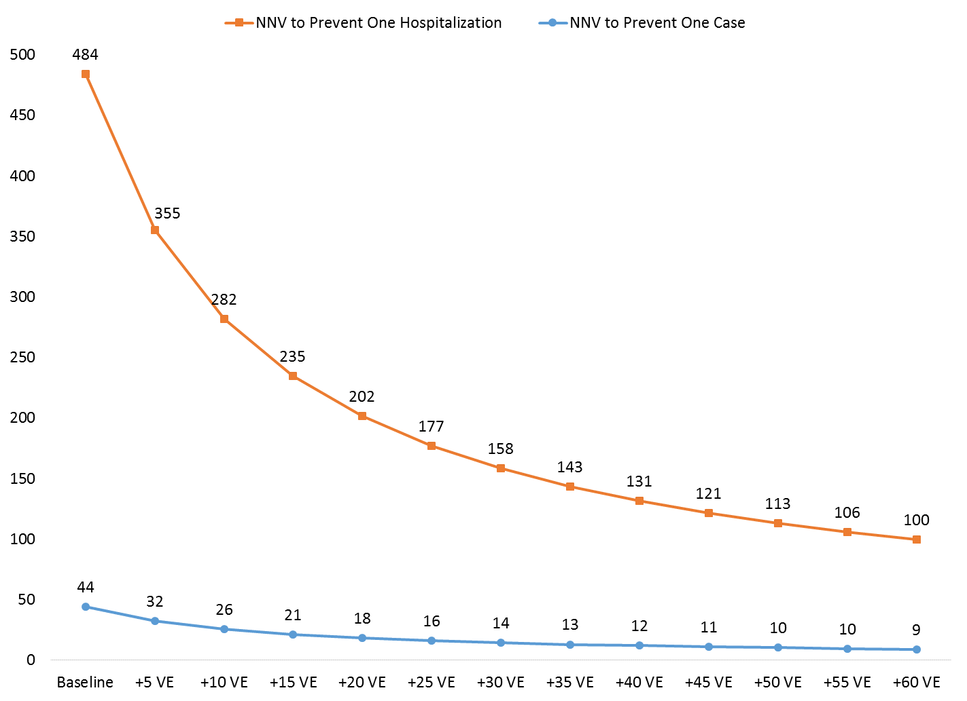
Number Needed to Vaccinate
Number Needed to Vaccinate to Prevent One Influenza
Hospitalization or Case with Increasing Vaccine Effectiveness,
US 2014-15 Influenza Season
Number Vaccinated
Biggerstaff et al. CDC unpublished data. 2016

Slide 18
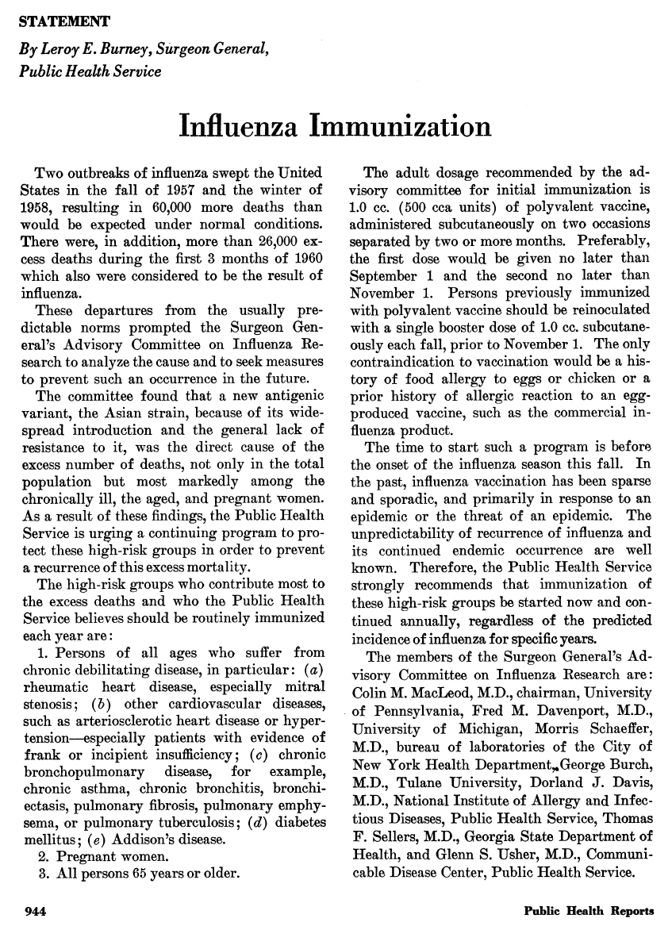
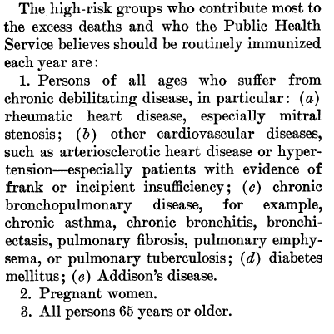
Recommendation for Vaccinating 65+
First Influenza Vaccine Recommendation
By Surgeon General Burney in:
Public Health Rep. 1960 Oct;75(10):944.

Slide 19
Percent of Population 65+ Projected
Administration on Aging. http://www.aoa.acl.gov/Aging_Statistics/future_growth/future_growth.aspx#age

Slide 20
High-Dose Influenza Vaccine (Fluzone-HD, Sanofi-Pasteur)
4X the HA content (60 mcg) of standard vaccine (15 mcg) of each strain
Trivalent
During 2015 - 16 season, about 50% of immunized seniors

Slide 21
High-Dose Influenza Vaccine Post-licensure Efficacy Trial
Relative efficacy vs standard
Overall + 24.2%
Age 65 - 74 + 19.7%
75+ + 32.0%
Hospitalization (all cause) + 6.9%
Serious cardio-resp events + 17.7%
Pneumonia (30 days) + 39.8%
CHF + 24.0%
Cerebrovascular events + 6.5%

Slide 22
High-Dose Influenza Vaccine Post-licensure Efficacy Trial
Relative efficacy vs standard
No frailty condition 34%
1 frailty condition 27.5%
2 frailty conditions 23.9%
3+ frailty conditions 16%

Slide 23
Adjuvanted Influenza Vaccine (Fluad, Seqirus)
Oil-in-water adjuvant (MF59)
Squalene – biodegradable intermediate precursor cholesterol biosynthetic pathway
Worldwide - licensed in 30+ countries
100 million+ doses

Slide 24
Adjuvanted Influenza Vaccine
Relative immunogenicity
Adjuvanted vs standard vaccine (16 RCT)
Viral strain
H1N1 + 9.5%
H3N2 + 10.5%
B + 12.7%

Slide 25
Adjuvanted Influenza Vaccine
Open, comparative, observational study (Italy)
25% reduction in hospitalizations
Prospective, community, case-control (Canada)
Overall enhanced effectiveness: 35%

Slide 26
Decision Not to Recommend the Use of Live, Attenuated Nasal Spray Influenza Vaccine this Season

Slide 27
US Flu VE Network, Ages 2-17 Any influenza A or B
 | 2010-11 Mixed | 2011-12 H3N2 | 2012-13 H3N2 | 2013-14 H1N1 | 2014-15 H3N2 | 2015-16 H1N1
LAIV | 71 | 67 | 46 | -1 | 3 | 3
IIV | 71 | 55 | 45 | 60 | 15 | 63
LAIV 3
LAIV 4
IIV3
IIV 3/4

Slide 28
2015-2016: Summary of US Data
US Flu VE: No LAIV effectiveness vs H1N1
DOD: No LAIV effectiveness vs H1N1
AstraZeneca: LAIV effectiveness vs H1N1 not significant
Significant VE for IIV
All studies reported higher VE for IIV than LAIV

Slide 29
Hypotheses
Suboptimal performance of the H1N1 component
Possible interference among viruses in quadrivalent vaccine
Reduced immunogenicity of LAIV because
children now more highly vaccinated

Slide 30
ACIP VOTE
For the 2016-2017 influenza vaccination season, LAIV is not recommended.

Slide 31
EGG ALLERGY
Numerous studies (over 5,000 pts)
US and European Allergy Societies
“Egg allergy does NOT impart increased risk of
anaphylactic reaction to immunization with
either IIV or LAIV”

Slide 32
EGG ALLERGY
Eats eggs OK HIVES often after eggs Severe reaction after eggs Previous severe reaction to vaccine | Vaccinate as usual RIV or Vaccinate as usual and observe for 30 minutes RIV or vaccinate as usual and observe for 30 minutes; experienced physician Contraindication to vaccine

Slide 33
Discussion and Questions
Questions?
Contact Information
William.Schaffner@Vanderbilt.edu

