Slide 1
Welcome!
Thank you for joining the American College of Physicians’ Quality Connect Adult Immunization Learning Series Webinar!
We will start in a few minutes.
Today’s webinar is focused on standing orders.
Please keep your phone on mute, when not asking questions, we are recording this webinar.
Feel free to ask questions in the chat feature of WebEx.
ACP will share the slides and recorded webinar on MedConcert.

Slide 2


Today’s Speakers
Dr. Robert H. Hopkins, Jr., MD, FACP
Internal Medicine Division Director, from the University of Arkansas for Medical Sciences
L.J. Tan, PhD
Chief Strategy Officer at the Immunization Action Coalition and is Co-Chair, National Adult and Influenza Immunization Summit

Slide 3
Standing Orders – A Model to Fit Your Practice
Robert Hopkins Jr. MD, FACP
LJ Tan, PhD
November 20, 2015
Adult Immunization Learning Series Webinar

Slide 4
Standing Orders: An Overview
LJ Tan, PhD

Slide 5
Outline
What are standing orders?
What are the components of a standing orders protocol?
Do standing orders improve vaccination rates?
How do standing orders benefit medical practices?

Slide 6
The Problem
Adult immunization rates are appallingly low
Patients aren’t receiving their recommended vaccinations during office visits
Clinicians must address acute and chronic medical issues first; results in lack time for vaccinations and other preventive health issues
Missed immunization opportunities abound
Patients are not protected from vaccine-preventable diseases

Slide 7
Standing Orders – A Solution
The goal of using standing orders is to increase vaccination coverage by:
Reducing missed opportunities in your practice
Routinizing vaccination by making it a program rather than relying on an individual clinician’s
order for each dose of vaccine
Empowering nurses (or other legally qualified individuals) to manage your vaccination program
Freeing up clinician time

Slide 8
What are standing orders?

Slide 9
Standing Orders – What Are They?
Written protocols, approved by a physician or other authorized practitioner, that authorize nurses, pharmacists, or other healthcare personnel (where allowed by state law) to:
  Assess a patient’s need for vaccination
  Administer the vaccine without a clinician’s direct involvement with the individual patient at the time of the interaction

Slide 10
Who Recommends Use of Standing Orders?
The Community Preventive Services Task Force recommends standing orders to increase vaccination coverage among adults and children on the basis of strong evidence of effectiveness.
Applicable to patients in both inpatient and outpatient settings where improvements in coverage are needed.
The Advisory Committee on Immunization Practices (ACIP) recommends standing orders for influenza, pneumococcal vaccinations, and several other adult vaccines.

Slide 11
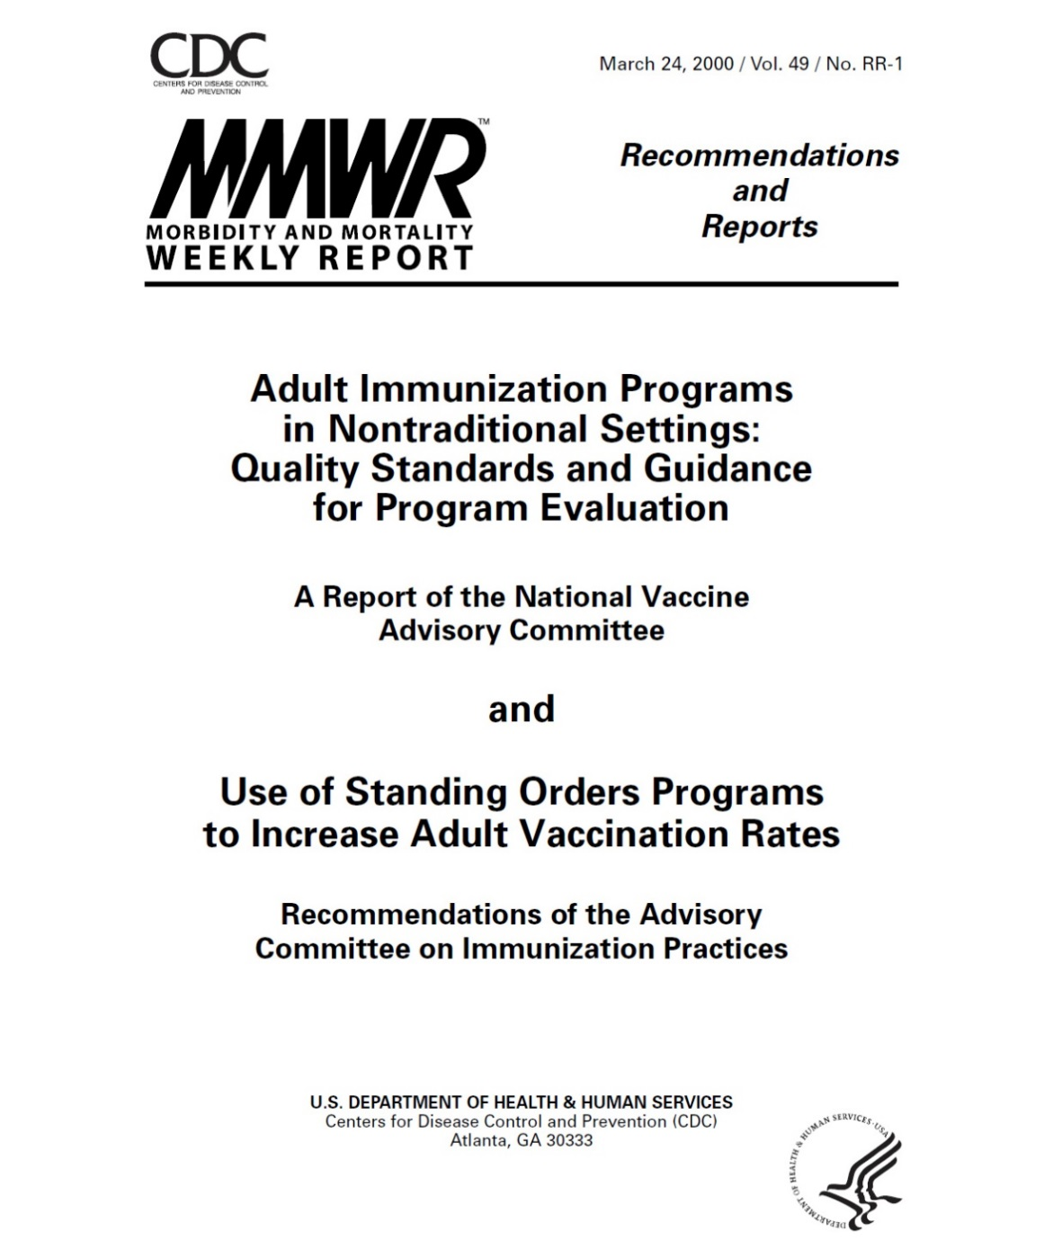
Notes:
ACIP has recommended standing orders since 2000.

Slide 12
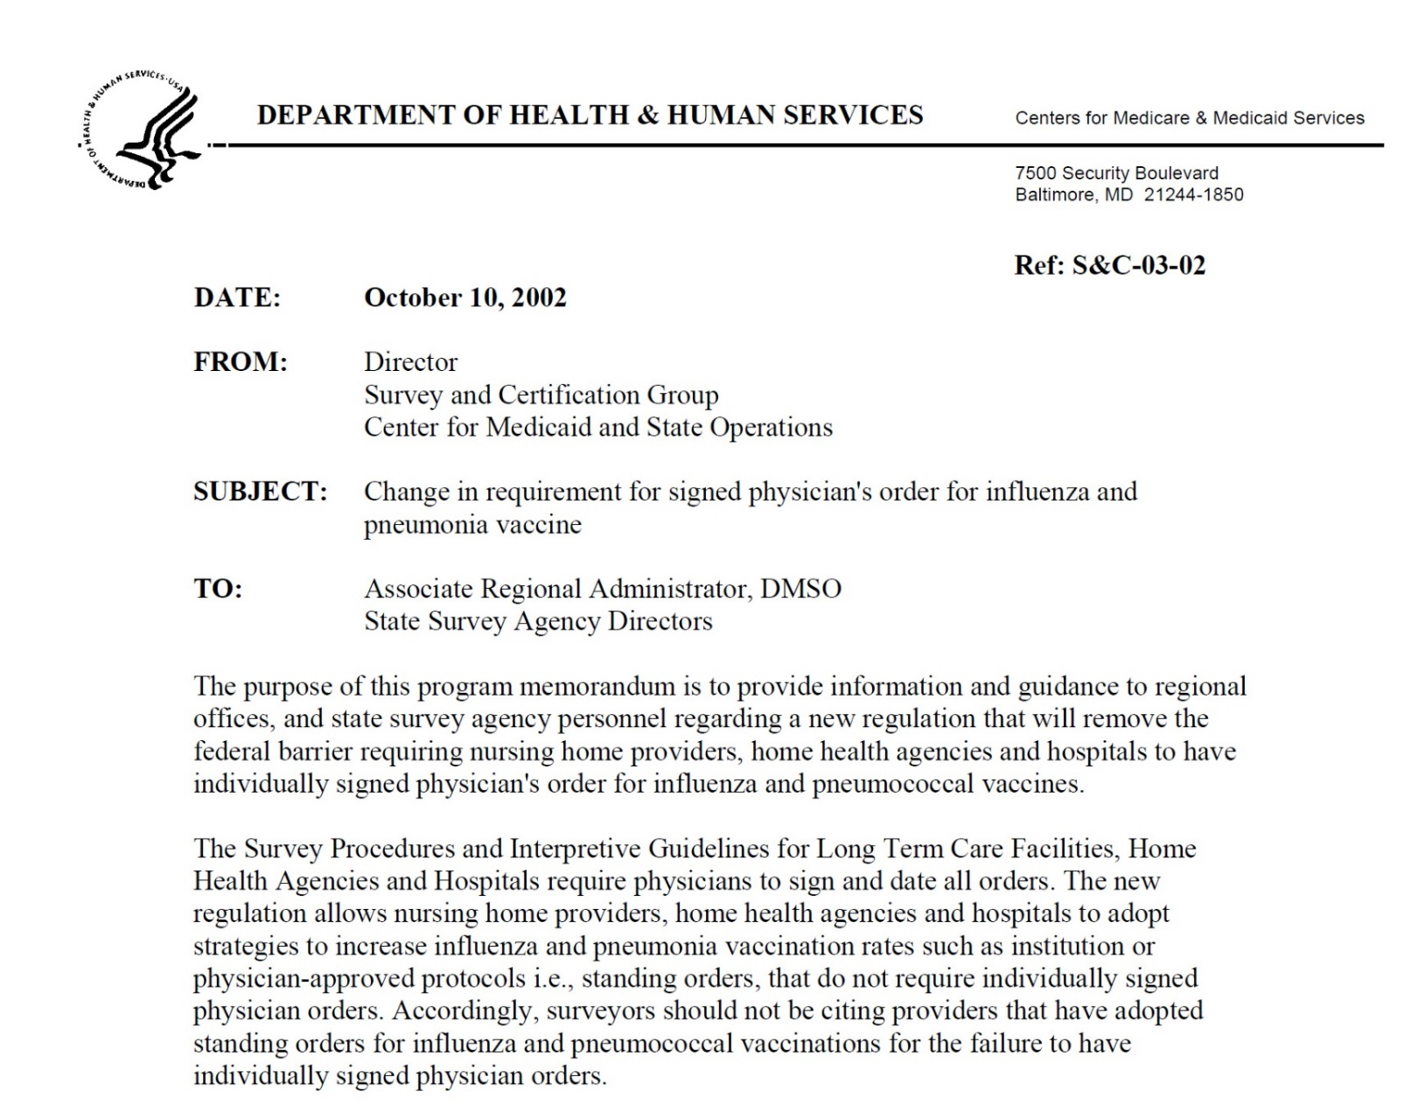
Notes:
CMS prohibited SOs for all medications until 2002 when this memorandum allowed SOs for influenza and pneumococcal polysaccharide vaccines

Slide 13
Use of Standing Orders
In 2009, only 42% of physicians reported using standing orders for adult influenza vaccination
Only 23% reported consistently using standing orders for both influenza vaccine and pneumococcal polysaccharide vaccine
Zimmerman et al. Am J Prev Med 2011; 40(2):144-8

Slide 14
Use of Standing Orders
Lack of standing orders implementation may be due to:
Weak or no organizational support
Small size of the clinical support staff relative to providers
Concerns about legal ramifications of standing orders

Slide 15
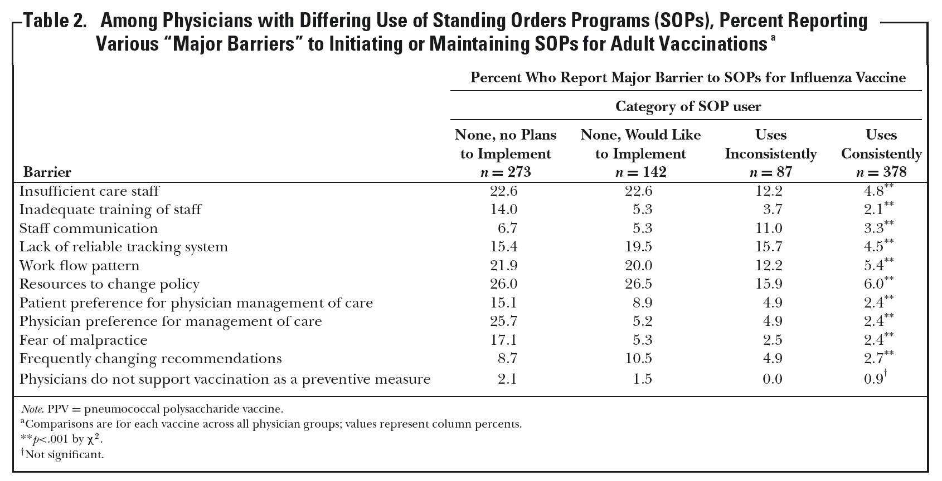
Barriers to the Use of Standing Orders
Yonas et al. J Healthcare Quality 2012;34:34-42

Slide 16
Vaccine Injury Compensation Program
Established by National Childhood Vaccine
Injury Act (1986)
Provides no-fault compensation for specified injuries that are temporally related to specified vaccinations
Program has greatly reduced the risk of litigation for both providers and vaccine manufacturers
Covers all routinely recommended childhood vaccines, including those administered to adults

Slide 17
What are the components of a standing orders protocol?

Slide 18
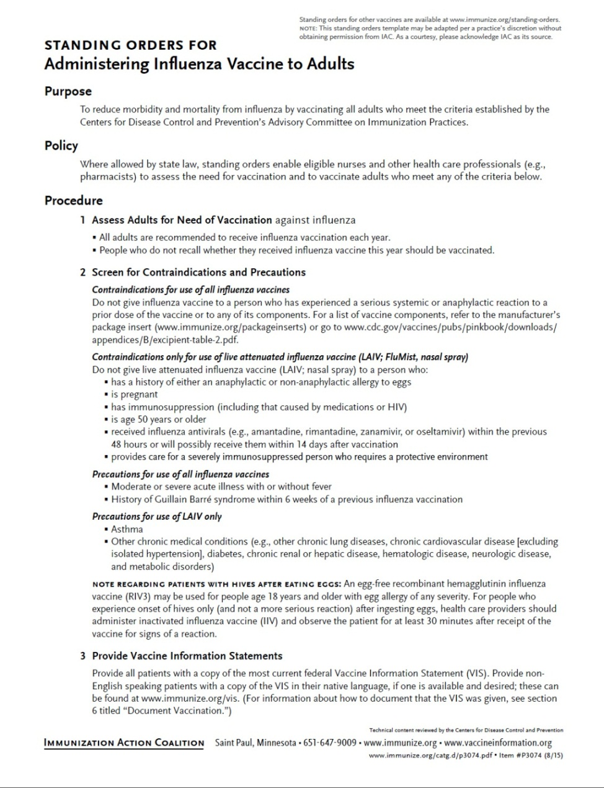
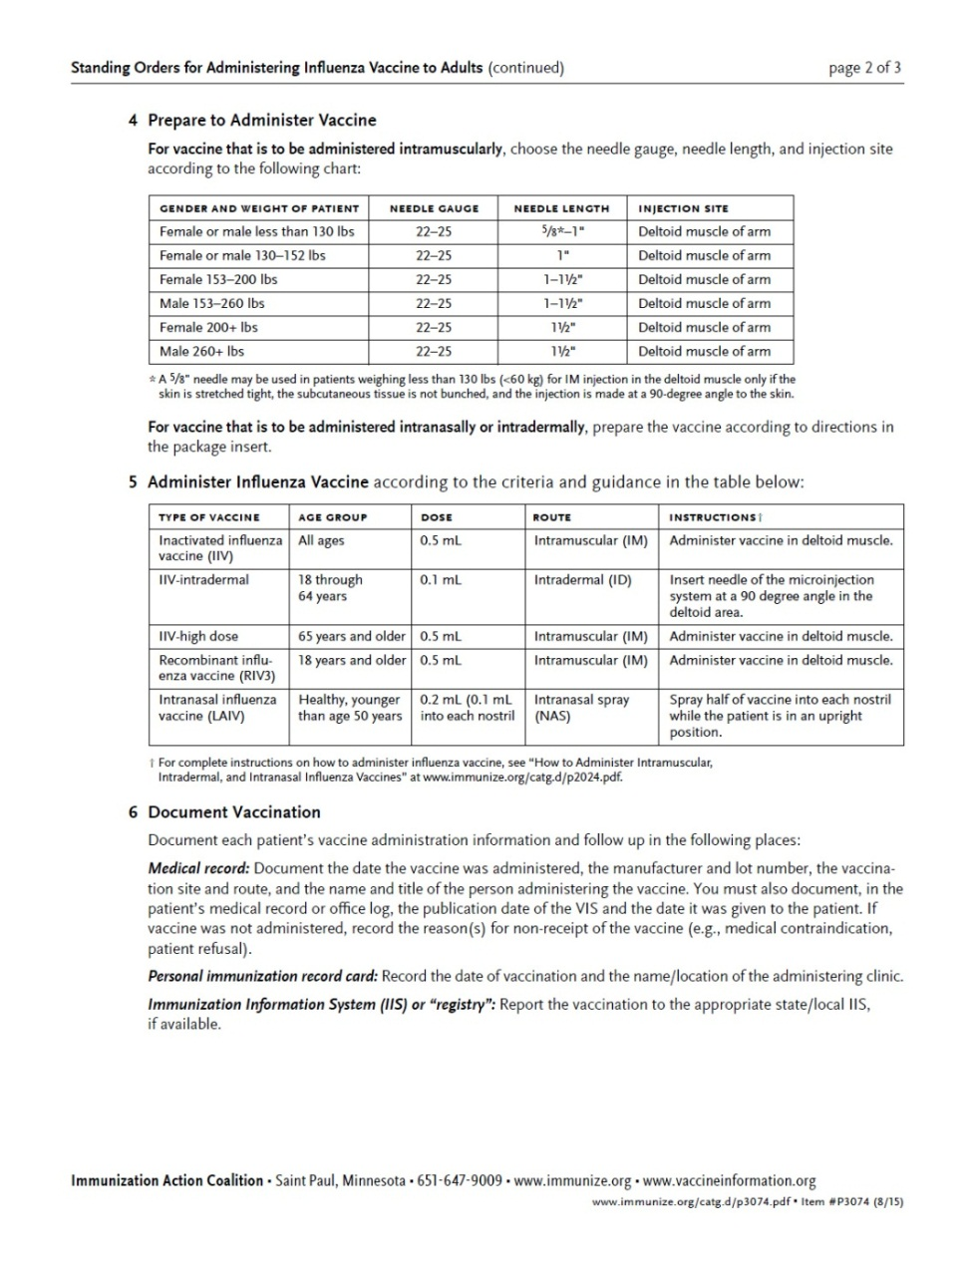
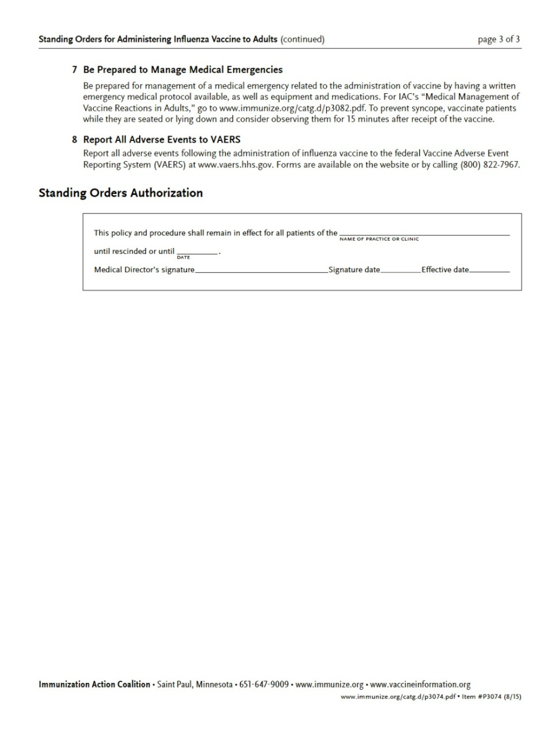
Notes:
Example of a standing orders template, in this case for influenza vaccine

Slide 19
Components of a Standing Orders Protocol
A comprehensive standing order should include these elements:
  Who is targeted to receive the vaccine
  How to determine if a patient needs or should receive a particular vaccination (e.g., indications, contraindications, and precautions)
  Provision of any federally required information (e.g., Vaccine Information Statement)
  Procedures for preparing and administering the vaccine (e.g., vaccine name, schedule for vaccination, appropriate needle size, vaccine dosage, route of administration)

Slide 20
Components of a Standing Orders Protocol
A comprehensive standing order should include these elements:
  How to document vaccination in the patient record
  A protocol for the management of any medical emergency related to the administration of the vaccine
  How to report possible adverse events occurring after vaccination
  Authorization by a physician or other authorized practitioner

Slide 21
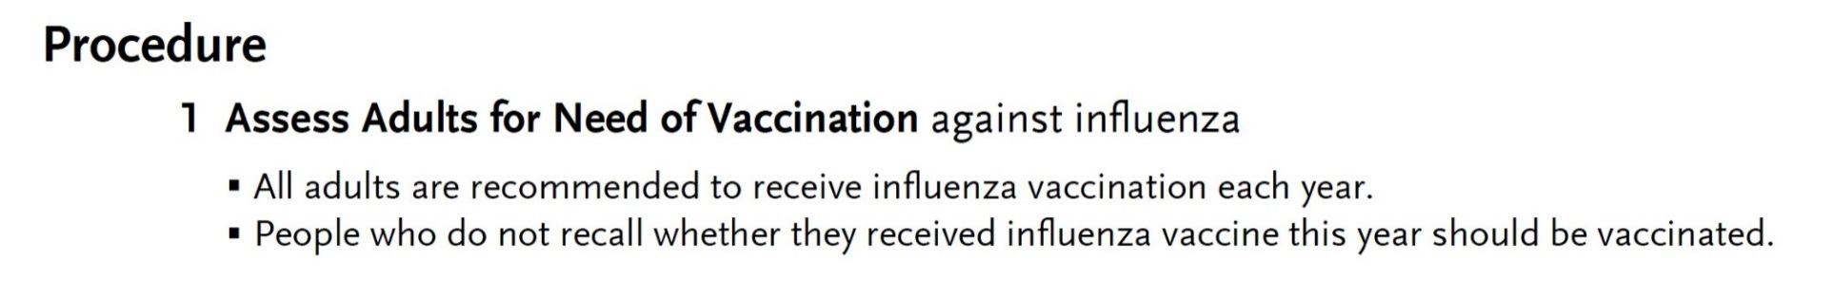
Components of a Standing Orders:
Protocol (1)
Who is targeted to receive the vaccine – assessing the need

Slide 22
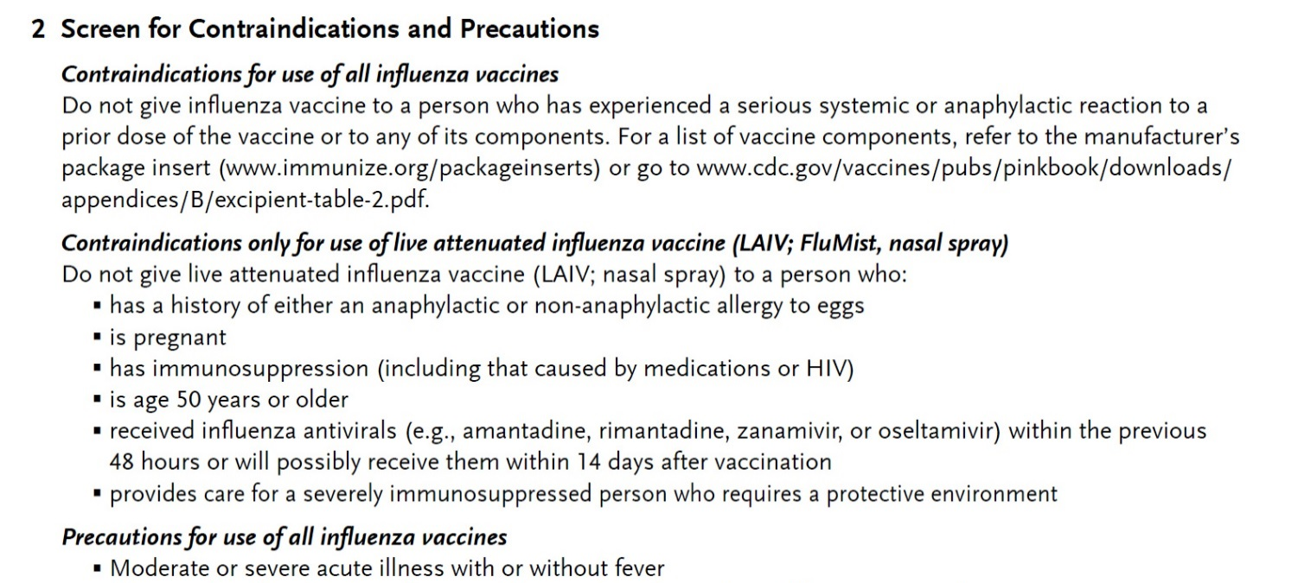
Components of a Standing Orders:
Protocol (2)
How to determine if the patient can receive a certain vaccination (e.g., screen for contraindications and precautions)

Slide 23
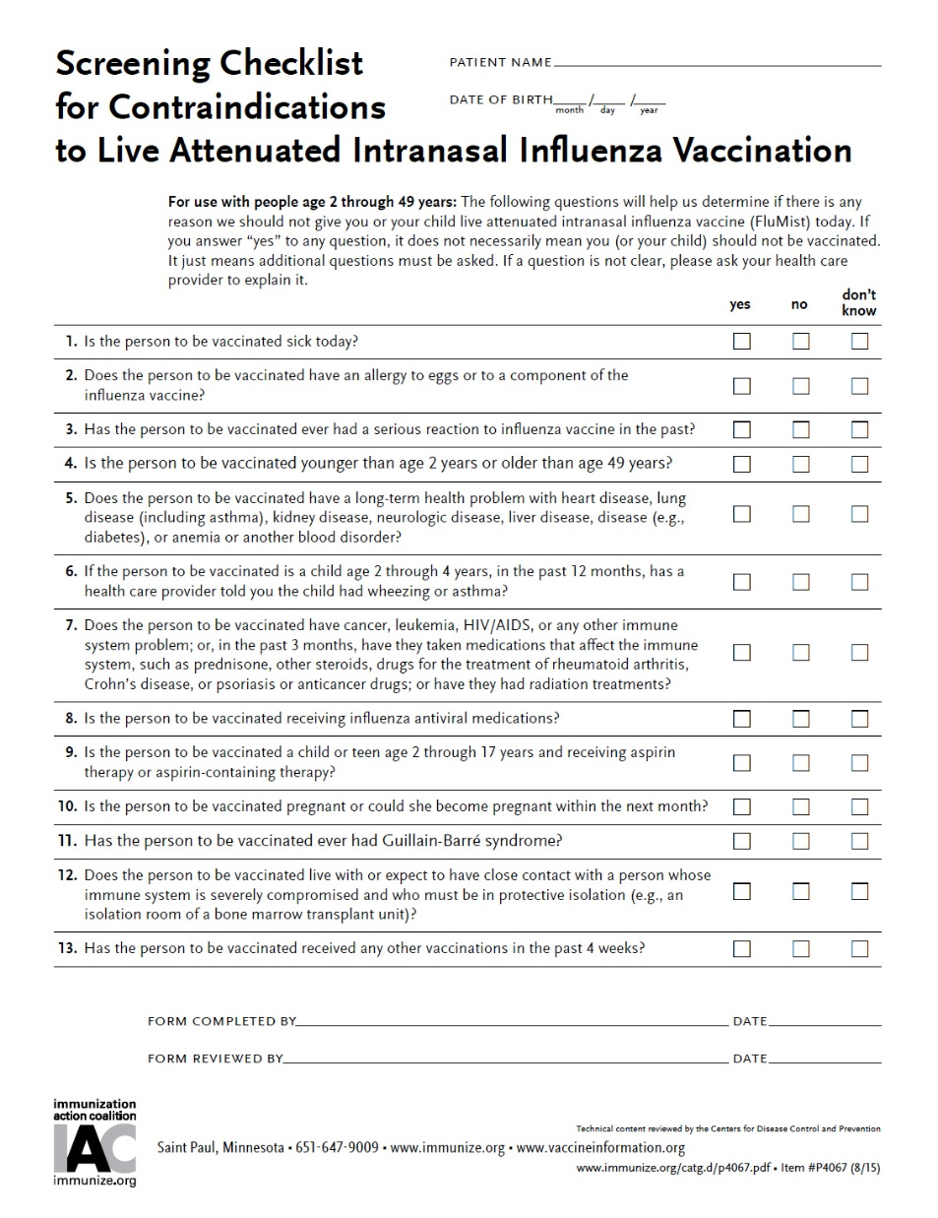
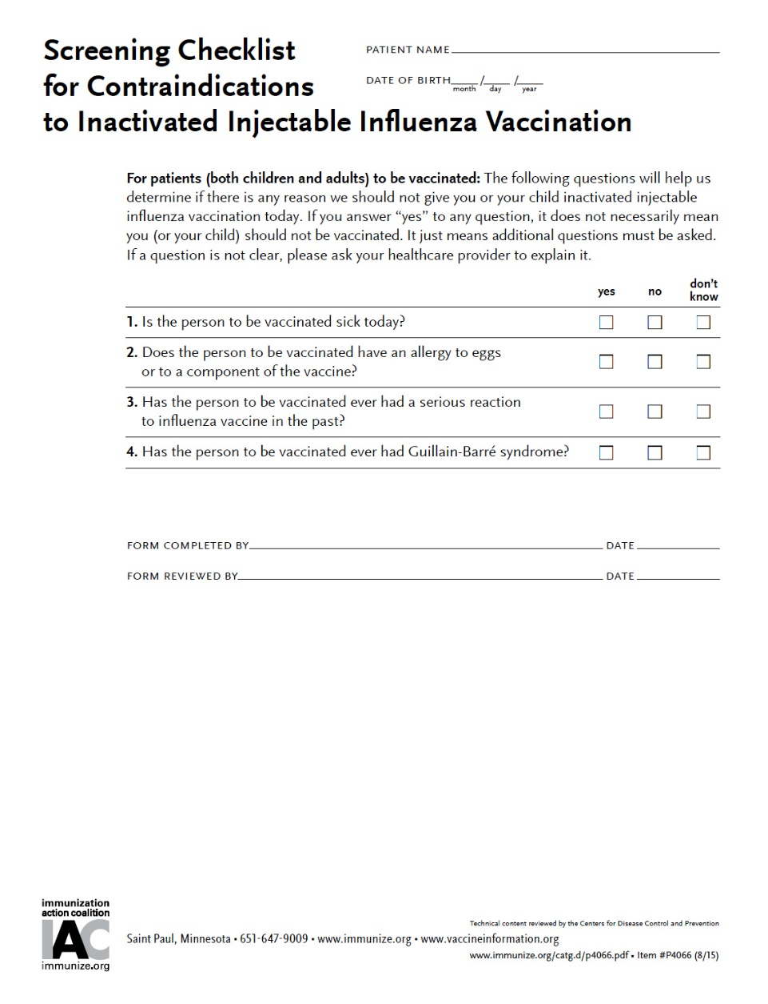
Notes:
Screening for contraindications and precautions to influenza vaccine is easy with IAC’s screening checklists, available on the IAC website.

Slide 24
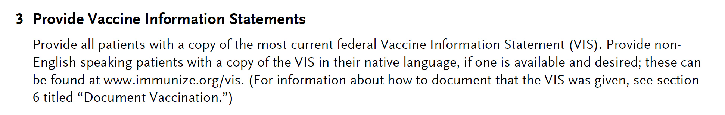
Components of a Standing Orders:
Protocol (3)
Provision of federally required information:
  The Vaccine Information Statement (VIS)

Slide 25
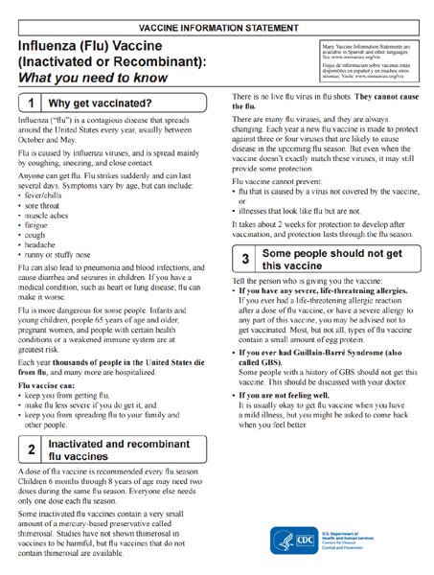
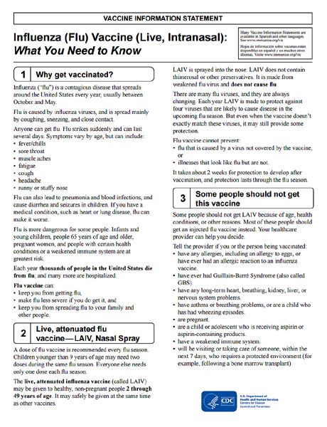
Notes:
In the past a new VIS was developed each year. Beginning in the 2015-2016 influenza season the VISs are no longer specific to one season and may be used indefinitely (at least until a change in recommendation requires a revision of the wording on the document).

Slide 26
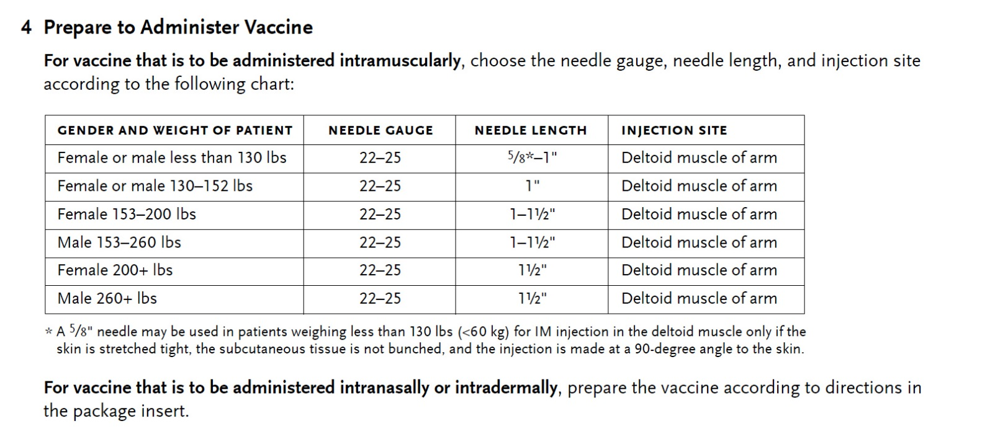
Components of a Standing Orders:
Protocol (4)
Prepare to administer the vaccine (e.g., by choosing appropriate vaccine product, needle size, and route of administration)

Slide 27
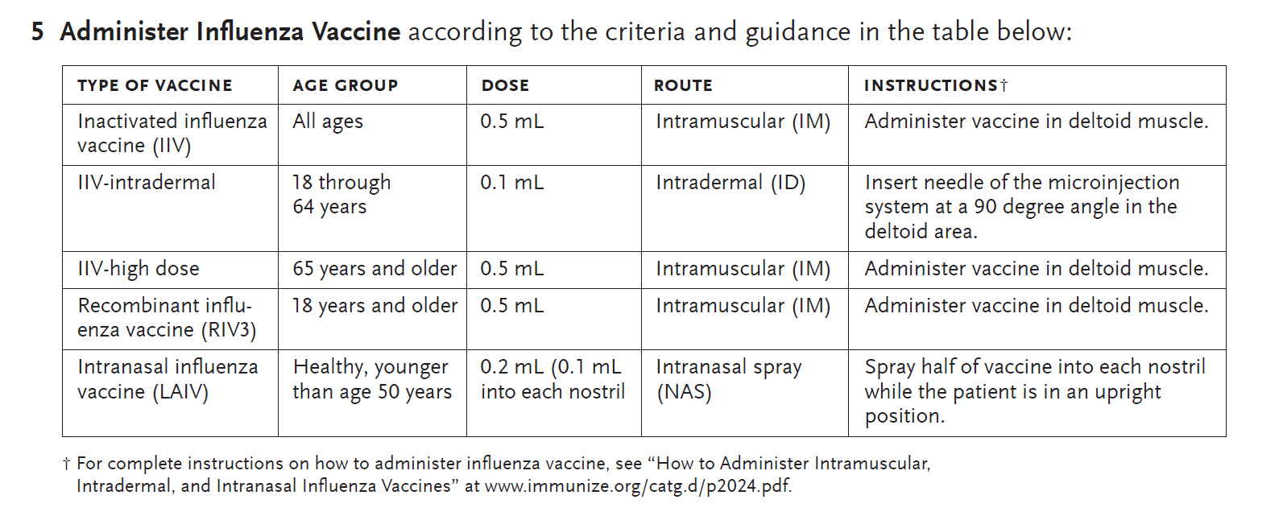
Components of a Standing Orders:
Protocol (5)
Specific guidance for administration of the vaccine (e.g., right patient, right vaccine, right age group, right dose, right route, and right site)

Slide 28
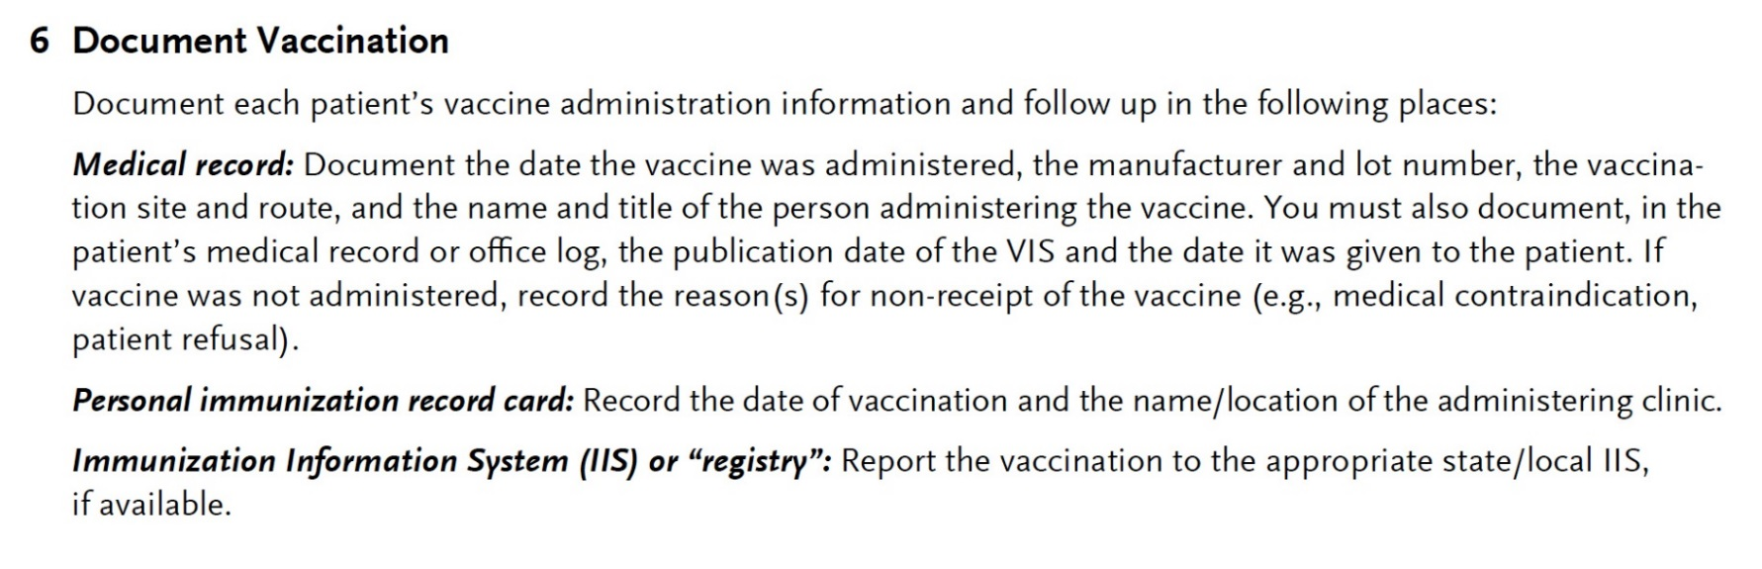
Components of a Standing Orders:
Protocol (6)
How to document vaccination in the patient record

Slide 29
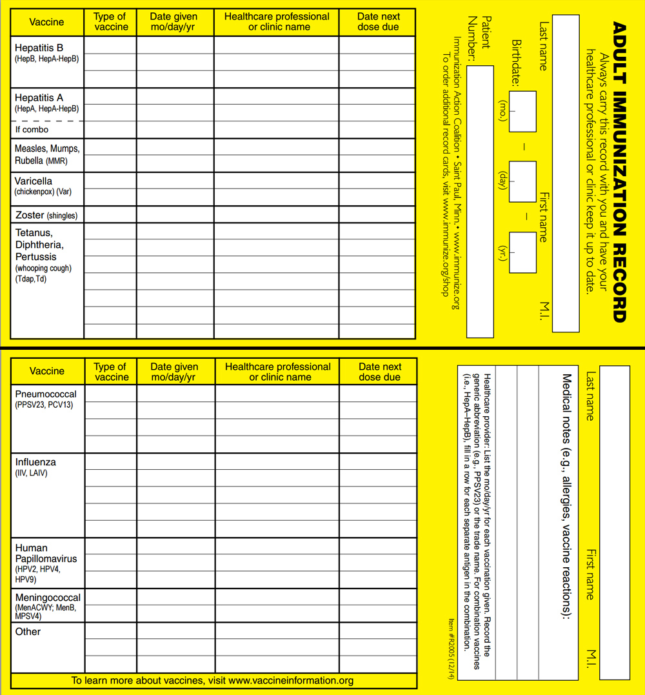
Notes:
Every adult should have a personally-held record of vaccination. Record cards are available from IAC.

Slide 30
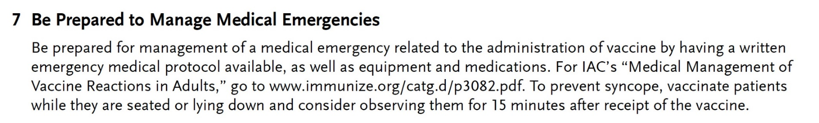
Components of a Standing Orders:
Protocol (7)
A protocol for the management of any medical emergency related to the administration of the vaccine

Slide 31
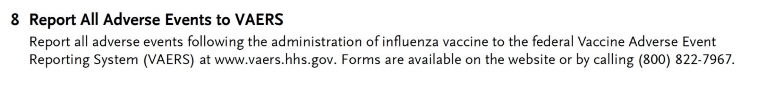
Components of a Standing Orders:
Protocol (8)
How to report possible adverse events occurring after vaccination

Slide 32

www.vaers.hhs.gov
Notes:
Providers should familiarize themselves with the VAERS website and how to report a reaction should one be suspected.

Slide 33
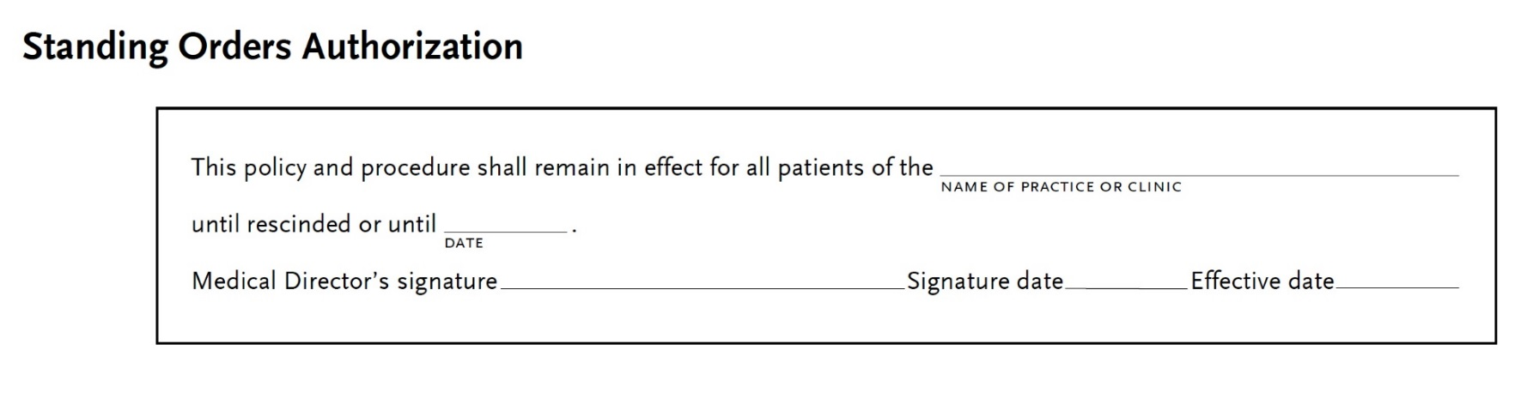
Components of a Standing Orders:
Protocol (9)
Authorization: In general, standing orders are approved by an institution, physician, or authorized practitioner. State law or a regulatory agency might authorize other healthcare professionals to sign standing orders

Slide 34
Do standing orders improve vaccination rates?

Slide 35
Are Standing Orders Effective?
Based on a review of 29 studies (1997 – 2009) that examined standing orders either alone or combined with other activities, the Community Prevention Services Task Force found:
  used alone, standing orders increased adult vaccination coverage by a median of 17 percentage points (range, 13% to 30%)
  used in combination with other interventions,* standing orders increased adult vaccination coverage by a median of 31 percentage points (range, 13% to 43%)
* Such as expanding access in healthcare settings, client reminder and recall systems, clinic-based education, provider education, provider reminder and recall systems, or provider assessment plus feedback
www.thecommunityguide.org/vaccines/standingorders.html

Slide 36
Are Standing Orders Effective? (cont.)
Based on a review of 29 studies (1997 – 2009) that examined standing orders either alone or combined with other activities, the Community Prevention Services Task Force found:
  Standing orders were effective in increasing vaccination rates when implemented in a range of clinical settings, among various providers and patient populations
  Standing orders were effective for vaccine delivery to children (universally recommended vaccinations) and adults (influenza and pneumococcal)
www.thecommunityguide.org/vaccines/standingorders.html

Slide 37
Example 1: Use of Standing Orders for Influenza Vaccine in an Ambulatory Care Setting
Percentage of Patients Vaccinated With and Without a Standing Order
Goebel LJ et al. J Am Geriatr Soc 2005;53:1008-10
Notes:
The study was conducted to determine whether standing orders for influenza vaccine increase its usage in an ambulatory setting in patients 65 years and lder.
Overall, 912 elderly patients of two physicians who issued standing orders and 884 elderly patients of two physicians who did not do so constituted the study group. Rates of influenza vaccination of patients whose physicians used standing orders were compared with those of physicians who did not use standing orders.
RESULTS: Five hundred seventy-six (63%) patients of physicians who used standing orders received influenza vaccine, compared with 332 (38%) patients of physicians who did not use them (P<.001). Standing orders accounted for a significantly higher rate of influenza vaccination in each study year. Moreover, in 2001, when influenza vaccine delivery was delayed, physicians who used standing orders maintained their same rate of usage, but physicians who did not had rates of about one-half their usage of the other 3 years.
CONCLUSION: More Medicare recipients received influenza vaccine when their physicians used standing orders for its administration than when their physicians did not. Influenza vaccine represents an important prevention modality that demands widespread implementation, and standing orders can increase its usage.

Slide 38
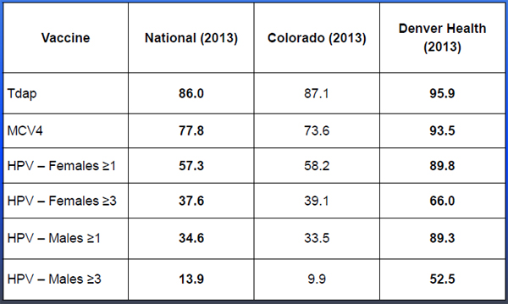
Example 2: Impact of Standing Orders on Adolescent Vaccination Rates, Denver Health, 2013
Notes:
Denver Health began using Standing Orders to deliver vaccines to adolescents in 2011. By 2013 the coverage for all adolescent vaccines in for the Denver Health system were significantly higher than both national and overall Colorado coverage levels. Data presented by Dr. A. Kempe at the National Foundation for Infectious Diseases Clinical Vaccinology Course, March 2015.

Slide 39
Standing Orders in Clinical Practice
Efficiency
    Clinician time is not required to assess vaccination needs and issue verbal or written orders to vaccinate
    Nurses (or others) take charge of vaccination program
Increased number of patients seen = increased income stream
Patient safety
    Improved vaccine coverage, less vaccine-preventable disease

Slide 40
Summary: Standing Orders Protocols
Standing orders can improve vaccine coverage
levels among adults in a variety of settings
Use of standing orders is endorsed by major
vaccine policy-making institutions
Standing orders are not difficult to implement but
require the “buy in” of everyone in the office
Use of standing orders is facilitated by having an Immunization Champion on the staff

Slide 41

Summary: Standing Orders Protocols
Take A Stand™: First of its kind national initiative to assist practices to implement vaccination standing orders: www.standingorders.org

Slide 42
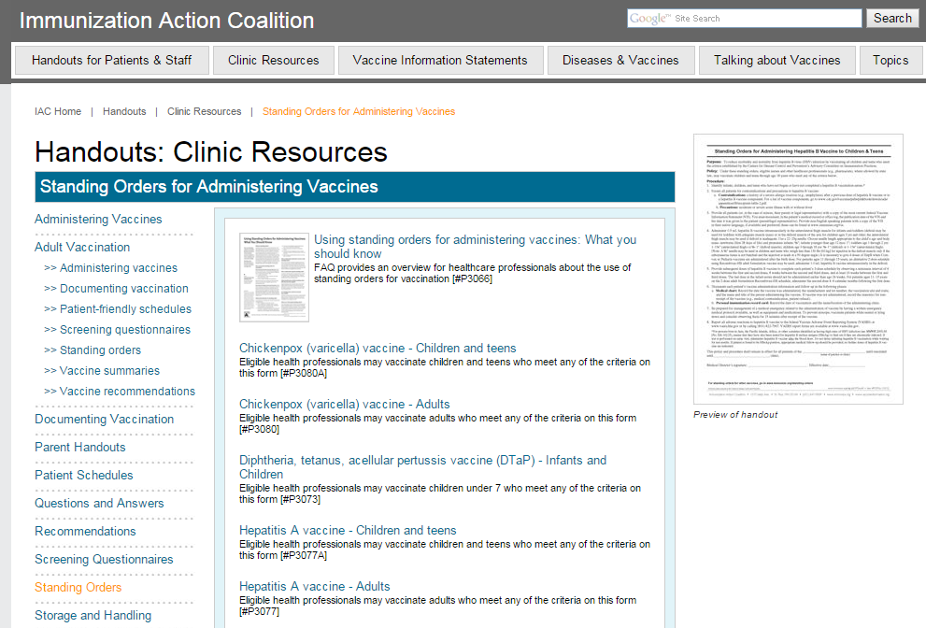
Standing orders for all routine vaccines are available on the IAC website

Slide 43
Resources
Take A Stand™
  www.standingorders.org
Immunization Action Coalition
  www.immunize.org
IAC Weekly Updates Via Email
  www.immunize.org/subscribe
Standing Orders Protocol Templates
  www.immunize.org/standing-orders

Slide 44
Standing Orders in Practice:
The UAMS Experience
Robert Hopkins Jr. MD, FACP

Slide 45
University of Arkansas for Medical Sciences (UAMS)
Tertiary Care Referral Center
  Inpatient Units
  Outpatient Clinics
    On Campus
    Off Campus
  Centers
    Aging
    Cancer
    Spine

Slide 46
Standing Orders at UAMS
Have been in place for a variety of uses since 2005
  Immunization [Flu] first used
  Pneumococcal developed around 2005
Broad use of standing orders in Emergency Department, Pre-op, clinics, other settings to improve workflow
  Recent CMS guidance that standing orders should not be used except in places where urgent intervention could place patient at risk and immunization
    Has led to a great deal of consternation and revision in work flows

Slide 47
Current UAMS Vaccine Standing Orders
Influenza
Pneumococcal
  PCV13
  PPSV23
Tdap
UAMS Medical Staff By-Laws and Compliance Office
  Require annual review/approval of standing orders
  Require MD/DO/APN signature [may be post-hoc]
Approval is campus wide
  Activation requires medical director sign-off

Slide 48
Influenza Standing Orders

Slide 49
Standing Orders in Practice
Approved by CMS for Immunization in 2002
Goal: Improve vaccination rates using whole healthcare team
Challenges come with opportunity
  Tradition: Doctor is captain, must steer ship!
  Activation/Buy in
  Specificity: Simple for Flu, Tdap… more challenging for vaccines with specific risk groups
  Work flow
  Wrap up

Slide 50
Inpatient
Standing orders: Influenza and Pneumococcal
Utilization: Influenza
  No 2015 – 16 season rate available
    RAW: 403 doses dispensed [data 11/10]
  Medicare 2014 – 15 season: 73% Goal: 90%
Utilization: Pneumococcal
  No 2015 – 16 season rate available [PM inactive]
    RAW:
      PCV13: 104 doses dispensed [1/1/15 – 11/10/15]
      PPSV23: 388 doses dispensed [1/1/15 – 11/10/15]

Slide 51
Emergency Department
Standing orders: Tdap
Utilization:
  No hard data on which to base assessment
  Anecdotes: ‘Routine’ with injury or trauma
  RAW: 1247 doses dispensed [1/1/15 – 11/10/15]

Slide 52
Outpatient
Standing orders in place: Tdap, Pneumococcal, Influenza
  Utilization is variable
Primary Care: Most use
  Medical Specialties: Variable Use
  Other Specialties: Rarely Use

Slide 53
Internal Medicine Experience
Success of standing orders depends on Champion
  Higher rates when MD or LPN Champion is on duty
  Use in context of a broader Immunization QI plan
  May be more controllable and routine in a smaller system or with more ‘closed staff model’

Slide 54
Vaccination Clinics
Standing order is basis for highly-effective annual employee campaign
  Mandatory employee flu vaccination since 2012
[New] Patient-focused vaccine clinic opened 10/1/15
  Primary emphasis: Flu
  Secondary emphasis: Pneumococcal
  Considering additional vaccines in future iterations

Slide 55
Ambulatory Vaccine Clinic 2015
Co-located with outpatient laboratory
  Brief registration
  LPN vaccination based on standing orders
  [Retroactive] signature by attending MD

Slide 56
Outpatient Results
Influenza
  4331 doses dispensed [8/1/15 – 11/10/15]
  2014: 4830 doses dispensed [8/1/14 – 4/1/2015]
Tdap
  2756 doses dispensed [1/1/15 – 11/10/15]
  1740 doses dispensed in CY 2014
Pneumococcal
  PCV13 [Prevnar] 3020 doses dispensed [1/1/15 – 11/10/15]
  PPSV23 [Pneumovax] 700 doses dispensed [1/1/15 – 11/10/15]
  2014: PCV13 = 70; PPSV23 = 610

Slide 57
Discussion and Questions
Questions?
The next Adult Immunization Learning Series Webinar will be in January 2015!
  Focused on cultural outreach and communication towards minority and ethnic groups

