Slide 1
Welcome!
Thank you for joining the American College of Physicians’ Quality Connect Adult Immunization Learning Series Webinar!
We will start in a few minutes.
Today’s webinar is focused on the communication.
Please keep your phone on mute, when not asking questions, we are recording this webinar.
Feel free to ask questions in the chat feature of WebEx.
ACP will share the slides and recorded webinar on MedConcert.

Slide 2
Adult Immunizations: Crucial Conversations
Marie Brown, MD, FACP
Rupel Dedhia, MD, FACP
October 22, 2015
Adult Immunization Learning Series Webinar

Slide 3
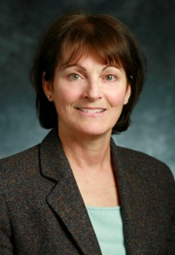

Today’s Speakers
Marie Brown, MD, FACP
Governor
American College of Physicians
Associate Professor
Rush University Medical Center
Chicago, Illinois
Rupel Dedhia, MD, FACP
Assistant Professor
Rush University Medical Center
Chicago, Illinois

Slide 4
Impact of Vaccines During the Past 70 Years
Disease | Reported Cases (year) | Reported Cases (2012) | % Decrease in Reported Cases
Diphtheria | 5796 (1950) | 0 | 100%
Tetanus | 486(1950) | 36 | 93%
Pertussis¹ | 120,718(1950) | 41880 | 65%
Measles | 319,124 (1950) | 55 | >99%
Mumps | 152,209 (1968) | 199 | >99%
Rubella | 46,975 (1966) | 8 | >99%
Hepatitis A* | 32,859 (1966) | 1402 | 96%
Hepatitis B* | 26,611 (1985) | 2950 | 89%
Polio | 33,300(1950) | 0 | 100%
*Underreporting estimated at a factor of 4.3 for hepatitis A and 2.8 for hepatitis B thus actual number of cases likely substantially higher than reported numbers of cases. CDC. Epidemiology and Prevention of Vaccine-Preventable Diseases: The Pink Book; 2011. MMWR December 29, 2012 Table 1 Provisional Cases Infrequently Reported Notifiable Diseases http://wonder.cdc.gov/mmwr/mmwr_reps.asp?mmwr_year=2012&mmwr_week=52&mmwr_table=1&request=Submit
¹2009, 16858 reported cases
Notes:
According to the Centers for Disease Control and Prevention, reported cases of many vaccine-preventable diseases (VPDs) decreased dramatically during the 20th century.
This decrease in reported cases highlights one of the most important public health achievements of the last century—immunizations.
As can be seen in this slide, the decrease in the number of reported cases of the VPDs shown ranges from 86% for pertussis to 100% for diphtheria and polio.
Vaccinations are, indeed, a major public health achievement.
**If you notice these disease were prominent in 1950- so anyone with a memory of the impact of these is not in their 70- 80’s. I have one patient left in my practice who contracted polio and if you have patients who survived polio, talk with them, maybe get them on video or tell their story.

Slide 5
Adult Vaccination Rates = POOR!
Vaccine | 2011 Vaccine Coverage
Influenza | 41.8%
[All] 50-64 years | 42.2%
> 65 years | 68.8%
HCW [19-64 years] | 66.9 %
Pneumococcal
High risk 19-49 years | 20.1 %
> 65 years | 62.3%
Pertussis | 12.5%
Tetanus | 64.5 %
Zoster | 15.8%
Hepatitis B Vaccine [High risk 19-49 years] | 35.9 %
HPV Vaccine [women 19-26 years] | 29.5 %
MMWR Feb 1, 2013 http://www.cdc.gov/mmwr/preview/mmwrhtml/mm6204a2.htm?s_cid=mm6204a2_w

Slide 6
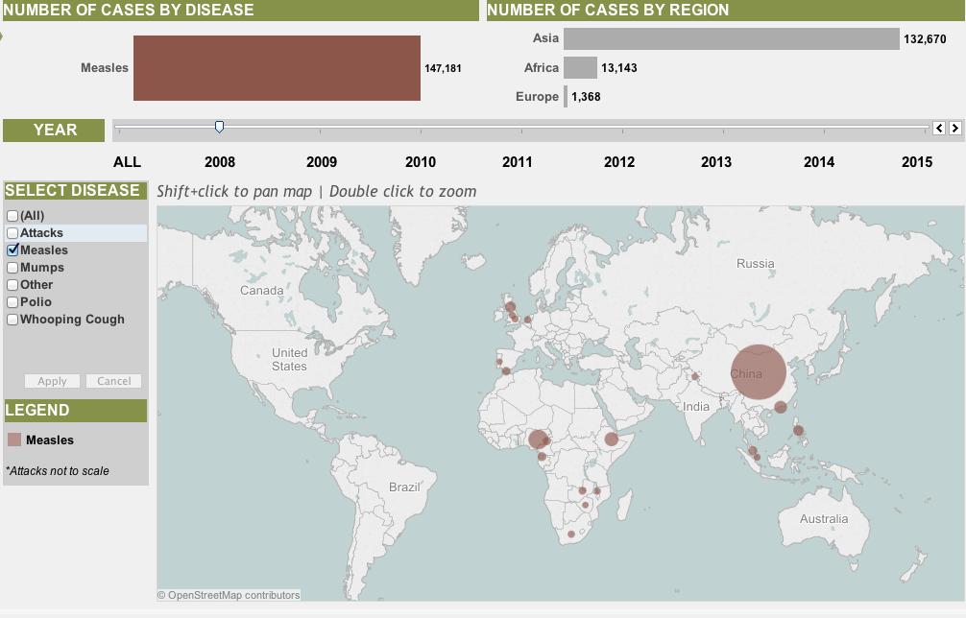
Council on Foreign Relations, Vaccine Preventable Disease - Measles

Slide 7
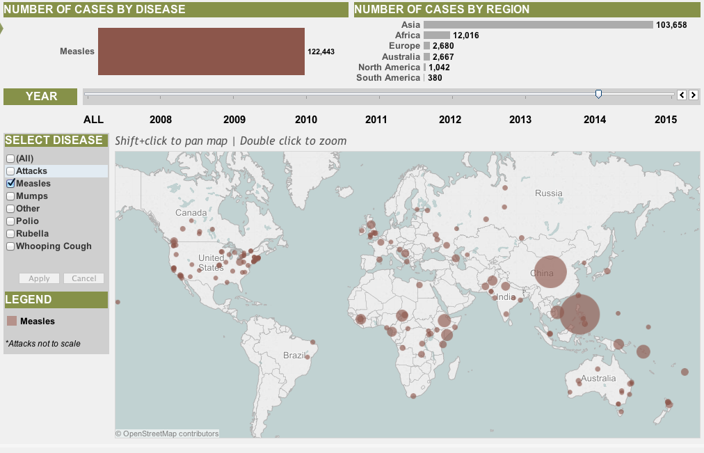
Council on Foreign Relations, Vaccine Preventable Disease - Measles

Slide 8
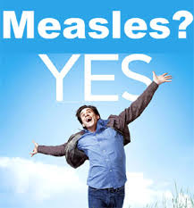
Reaction To Vaccination
Recommendations
Indifference
Anti-vaccine opinions
Hesitancy
Human Vaccines 7:12,1261-1270; Dec 2011

Slide 9
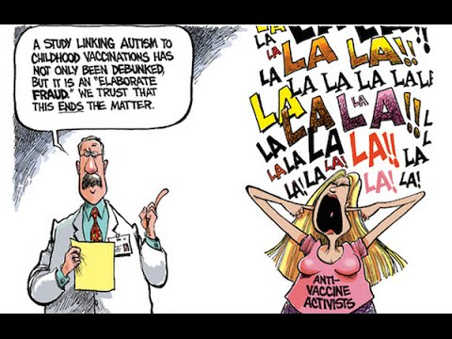
Reasons for Anti-Vaccine Opinions
Strong Personal Beliefs
Religious Convictions – The remedy to infectious disease should be brought by spiritual salvation
Philosophical Arguments – Vaccination is against the rules of the religion
Libertarian Ideologists – The state has no rights to make decisions regarding vaccinations
Their influence is increasing.
Belief is not the beginning but the end of all knowledge
Goethe, 1749–1832)
Notes:
Intentional
Long term vs. short term benefits crying, pain ,cost
2 beliefs that predict faitlur to vx
unsafe
long-term side effects

Slide 10
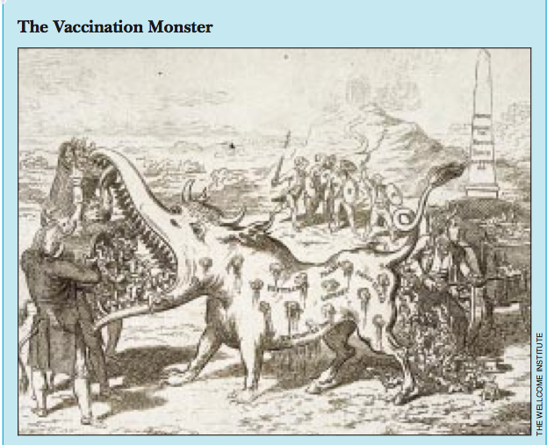
Notes:
Bmj volume 325 24 august 2002

Slide 11

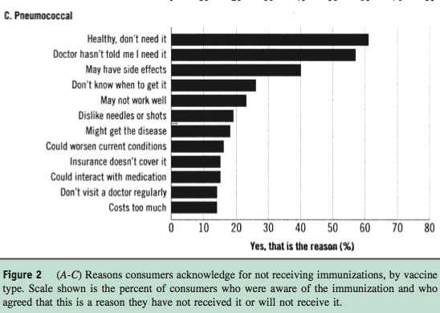
Notes:
Providers indicated that patients dislike of needles, fear of adverse effects and lack of knowledge were frequently responsible for missed immunizations
Most patients (79-85%) indicated that they were likely to receive vaccine if their provider recommended it.
However ….

Slide 12
'Those who cannot remember the past…
….. are condemned to repeat it.’
George Santayana Life of Reason 1905

Slide 13
Who Most Influences Adults’ Decisions to Get Immunized?
 | All Adults
Personal physician | 69%
Family member | 19%
Celebrity physician, public figure, other | 7%
None of the above | 4%
No answer | 1%
Almost 90% !
NFID. 2009 National Adult Immunization Consumer Survey: Fact Sheet.
Available at: http://www.adultvaccination.com/doc/Survey_Fact_Sheet.pdf. Accessed June 15, 2011.
AMA. American Medical News. Physicians asked to persuade adults to get immunized.
Available at: http://www.ama-assn.org/amednews/2009/08/03/prsc0803.htm. Accessed June 13, 2011.
Notes:
Results from a 2009 telephone survey of 1001 adults (500 men and 501 women conducted during February 2009) by the National Foundation for Infectious Diseases (NFID) shows the most important influencers of adults’ decisions to get immunized. Overall, physician recommendation was most often cited as the main reason that adults were vaccinated. However, responses varied somewhat by age group. For example, among young adults, while physician recommendation was most often cited at 47%, a family member was cited as a main reason by 33%. (Speculation—does this reflect the role of a parent among college-aged adults?) In contrast, among older adults, physician recommendation was cited as the main reason 82% of the time. All in all, these findings certainly highlight the importance of physician recommendation for getting adults vaccinated—a finding seen in other studies as well.
Physician recommendation yes- 87% are very or someone likely to get vaccinated
55% would not get vaccine less recommended by doctor
CDC. Adult immunization coverage information from CDC’s National Immunization Survey.
Available at: http://www.nfid.org/pdf/pressconfs/adultimm08/cdcsurvey.pdf. Accessed June 15, 2011

Slide 14

What We Communicate….Matters

Slide 15

How We Communicate…Matters
As clinicians steeped in statistics, it can be difficult to respect irrational fears. It is tempting to shake our heads, sigh deeply and bemoan a paranoid, uninformed public.
Inevitably, an unemotional and unsociable-looking scientist in a dark suit tells the interviewer that the best experts in the field have declared the public’s fears unfounded.
Stay on message…. The risk is very low.
Given recent outbreaks, we are not doing a good job of helping patients understand the risks and benefits.
We complain, roll our eyes, and throw our hands up in the air or we can remember that everyone of us is an irrational, emotional human being.
Don’t
worry
Adapted from Fear, Numbers, and Measles
Turnbull,A Health Communications 26:775-776,2011
Dept. of Epidemiology Johns Hopkins
Notes:
Turnbull, Allison

Slide 16
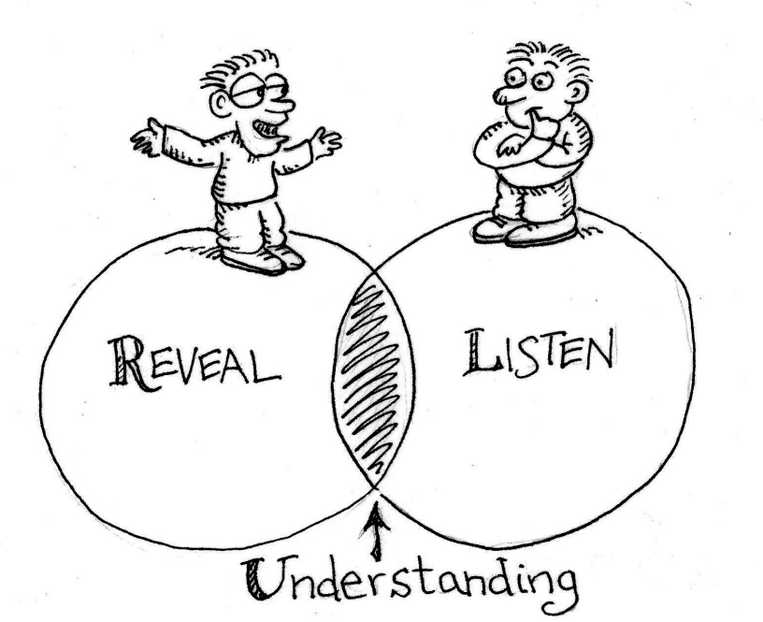
Motivational Interviewing
Express Empathy: Build Rapport
Develop Discrepancy: Elicit Pros and Cons
Roll with Resistance: Respect patient autonomy
Support Self-efficacy: Communicate that patient is capable of change

Slide 17

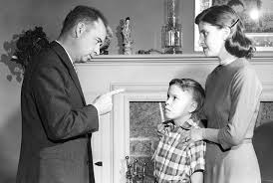
Motivational Interviewing (MI)
MI SPIRIT
Opposite of MI Spirit
Collaboration: Patient is the expert and the Physician creates an atmosphere that is conducive rather than coercive and built on partnership
Evocation: Patient has resources and motivation to change within and the physician must evoke this from the patient
Autonomy: Patient has right and capacity for self direction and the physician respects and affirms this
Confrontation: Patient is seen as impaired, unable to understand the situation and the Physician imposes reality of the situation
Education: Patient is assumed to lack knowledge necessary for changes to occur and MD enlightens patient by forcing education
Authority: Patient is assumed to lack capacity for self direction and MD tells patient what he/she must do

Slide 18

Tools
Open-ended questions
Affirming and Supporting
Reflective Listening
Summarize
Notes:
Open-ended questions: allows patient to express own views while MD follows patient’s perspective
Affirming and supporting: actively listening to patients strengths, values, aspirations, positive qualities; reflect those to client in affirming manner
Reflective Listening: mirrors what patient says in non-threatening manner
Collaborative and nonjudgmental
Deepens the conversation
Helps patients understand themselves
Avoid over or understanding
Use language of patient or similar language
Summary: reinforce patient’s motivation to change if present; highlight any realizations and identify transitions or progress of themes

Slide 19
Address
Patient Barriers
“I don’t want chemicals injected into my body.”
“I always get the flu when I get the flu shot.”
“I’m healthy, I don’t need it”
Notes:
Question to stimulate learner input:
In your experience, what is the most important patient factor for not getting vaccinated?
I’ll get sick from them
Not aware of need
Not recommended by HCP
Financial
Forgot
Ineffective
Something else

Slide 20

I don’t want chemicals injected into my body!!!
Example 1

Slide 21

Example 1A: Less Effective Communication

Slide 22
What went wrong?
Failure to acknowledge and respect the patient's concern
  Use of "refuse" instead of "decline" may set a negative tone
Created Relational Resistance: Lost "face" with the patient by talking "to" the patient instead of speaking "with" the patient
  "Trust me, I'm the doctor"
  "The chemicals as you call them"
Lack of affirmation and support
  "I'm disappointed to hear this"

Slide 23
CASE Framework
Corroborate: Acknowledge the patient's concern and identify a talking point on which you can agree. Set the tone for a respectful, successful talk
About Me: Describe what you have done to build your knowledge base and expertise
Science: Describe what the science says
Explain/Advice: Give your advice based on the science
CASE Framework for Communicating Science created by Autism Science Foundation

Slide 24

Example 1B: Effective Communication

Slide 25
What worked?
Acknowledged the patient's concern and identified a talking point
Asked open-ended questions
Conclusion: reinforced and clarified any "change talk (talk that involves a change in patient's reasoning)"
  Patient now considering vaccination, but requesting additional materials

Slide 26
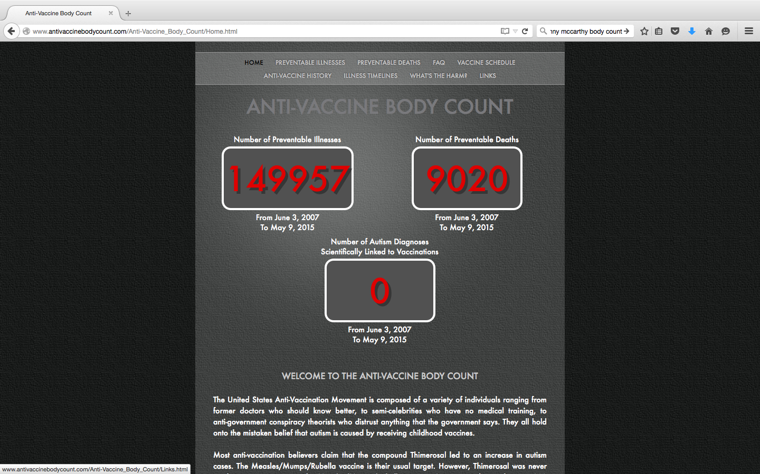
Jenny McCarthy Body Count
http://www.antivaccinebodycount.com/Anti-Vaccine_Body_Count/Home.html

Slide 27
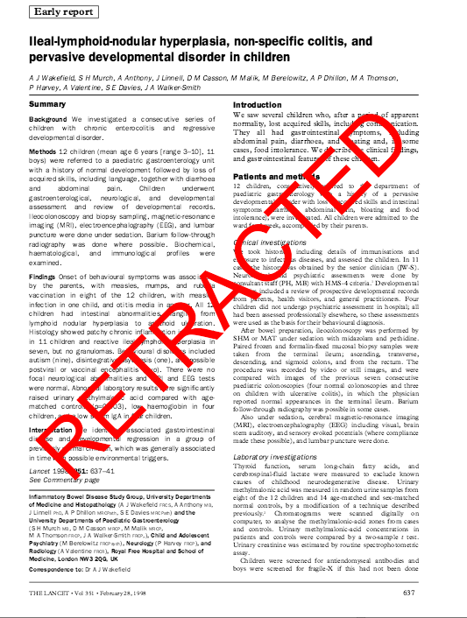
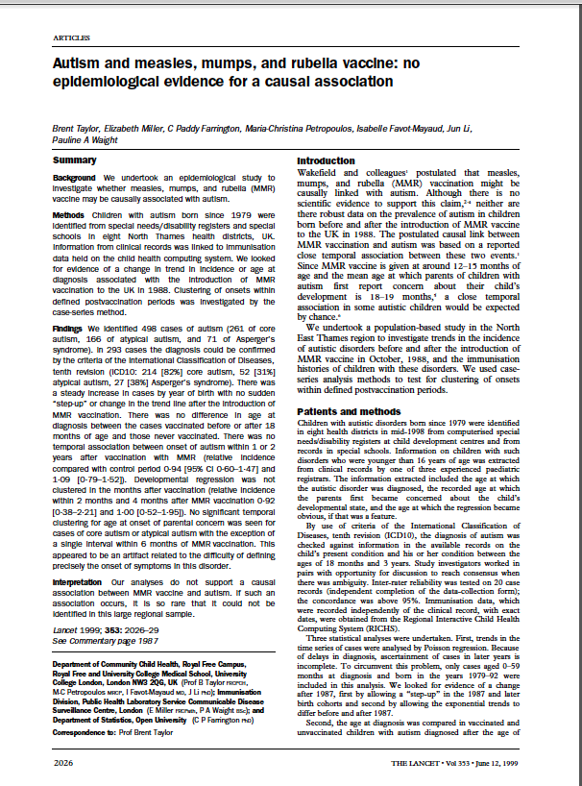
Lancet Publications

Slide 28

Example 2
I’m healthy and I don’t‘ need it!

Slide 29
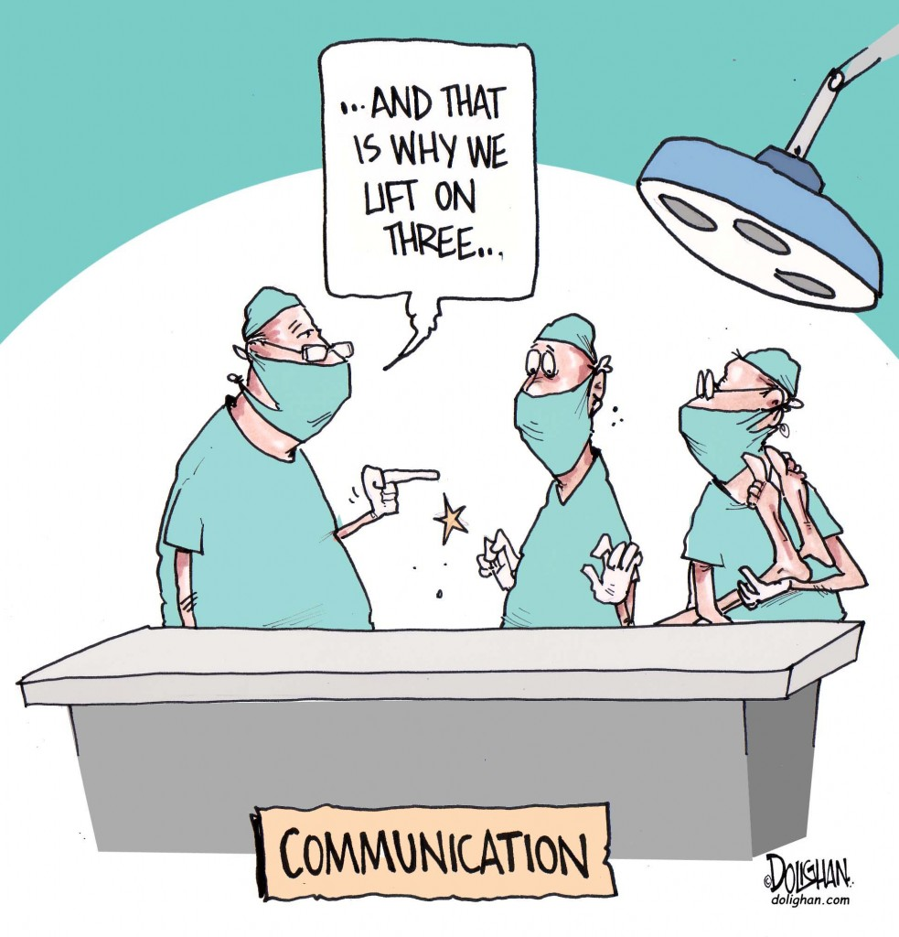
Example 2A: Less Effective Communication

Slide 30
What went wrong?
Lack of respect for patient's autonomy
  Physician “forced” their agenda of vaccination on the patient
Confrontational
  Physician imposes reality of situation
Forcing “education” as physician assumes they need to “enlighten” the patient

Slide 31

Example 2B: Effective Communication

Slide 32
What worked?
Collaborative: patient is seen as the expert and the physician creates a conducive instead of coercive atmosphere
Reflective Listening-mirrored patient’s concern in a non-threatening manner (affirmation of rash followed by pain from shingles)
Summarized: interim summaries throughout the encounter
  Ended with strategic collaborative summary reinforcing patient’s decision to change (In this situation-receive vaccination)

Slide 33

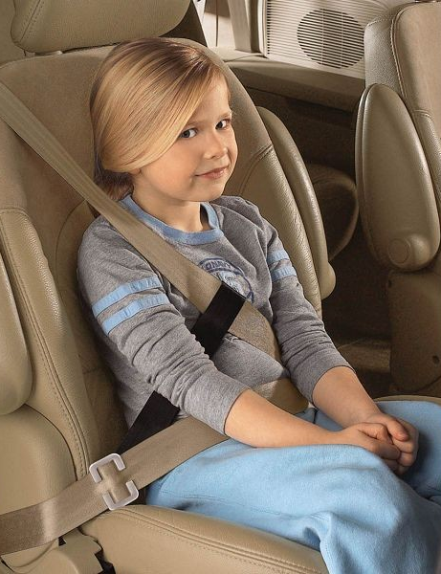
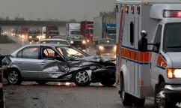
Comparison Example
You are very safe driver, and if you were on the road driving all by yourself and no other cars were around you might not feel you needed your seat belt.
You wear it because someone else might crash into you.
So if you weren’t wearing your seatbelt (or be immunized) that person with the disease could crash into you and your family and you would be unprotected.
Notes:
Herd immunity:
When most members in a community are immune, even if one person gets sick, the disease will not spread- because it has nowhere to spread and it
will die out.
NYT ‘Many doctors view the so called ‘exempter’ as parasites, of a sort, benefiting from the otherwise inoculated majority.”
Measles vaccine is 95% effective.
Those choosing the ‘personal exemption make >75,000 $ and are well educated

Slide 34
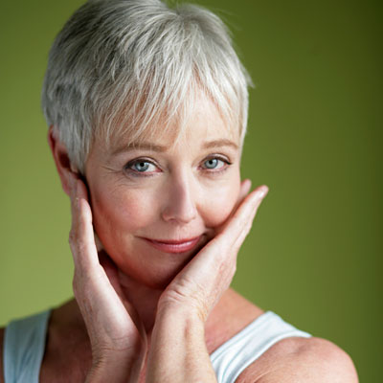
Example 3
I always get the flu when I get the flu shot!
Health.com

Slide 35
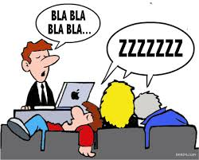
Example 3A: Less Effective Communication

Slide 36
What went wrong?
Lack of empathy or support for patient’s concerns which led to low likelihood of “change talk”
Used Authority as a means of “motivational interviewing”
  Actually this has the opposite effect as it assumes the patient lacks any decisional making skills (“You need to get the flu shot”)

Slide 37
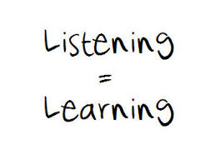
Example 3B: Effective Communication

Slide 38
What worked?
Use of open-ended questions
  Allows patient to express their own views while the physician follows the patient’s perspective
Affirmed patient’s values and strength to increase likelihood they will follow through with the plan (decision to obtain the vaccine on Friday)

Slide 39




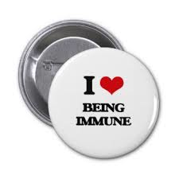


Slide 40
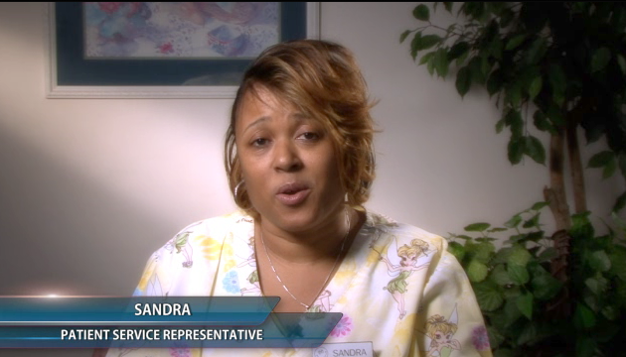
Solutions
Sandra suggested the intervention that increased our immunization rates

Slide 41
General Resources
CDC’s National Immunization Program
  www.cdc.gov/vaccines
Immunization Action Coalition
  www.immunize.org
National Foundation for Infectious Diseases
  www.nfid.org
CMS
  www.cms.gov/AdultImmunizations/
State health departments

Slide 42
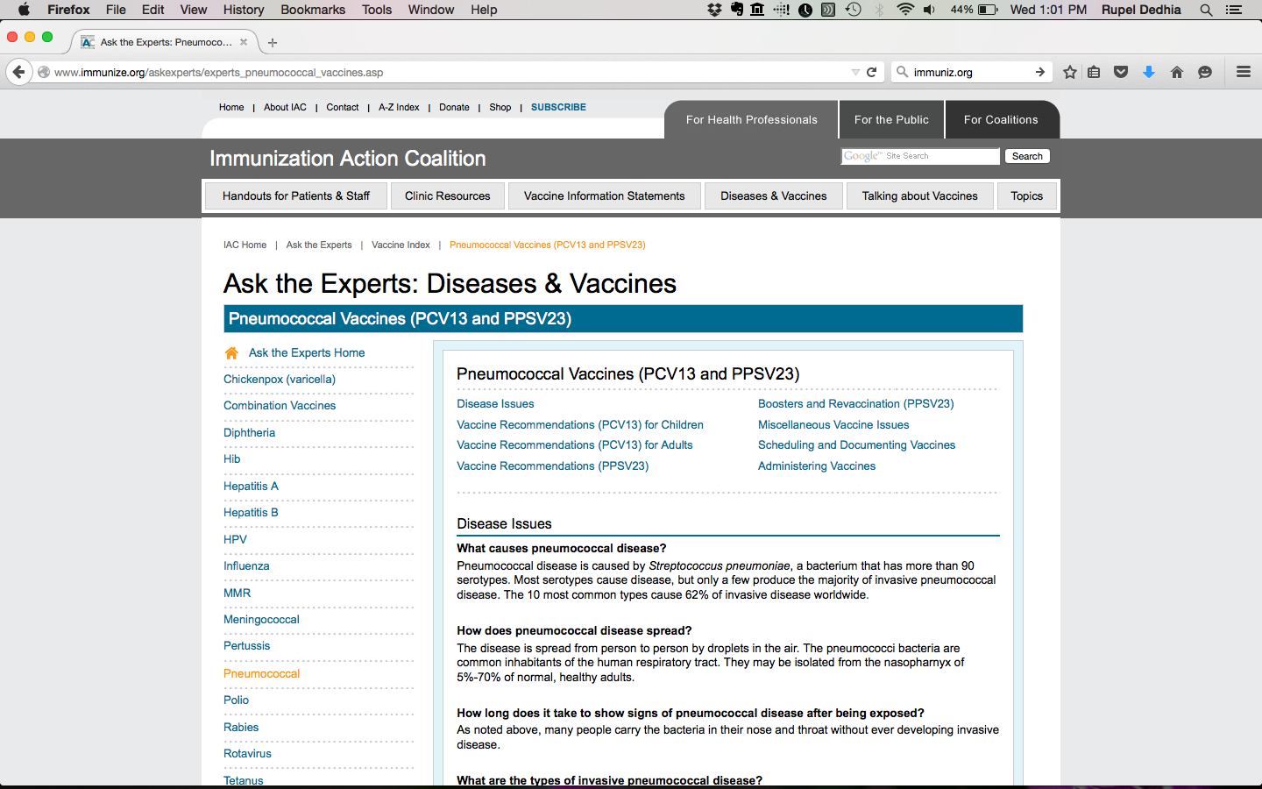
Immunization Action Coalition (IAC)
http://www.immunize.org/

Slide 43
ACP Resources and Videos
Adult Immunization Resident Training Program
  https://www.acponline.org/running_practice/quality_improvement/projects/residents_immunization.htm
Link to Adult Immunization: Challenges and Solutions
  http://www.acponline.org/multimedia/?bclid=782543304001&bctid=2402409433001
Adult Immunizations Webinar 2012
  http://www.acponline.org/clinical_information/resources/adult_immunization/webinars.htm
Medication Adherence Videos
  http://vimeo.com/42194365 (21 minute version)
  http://vimeo.com/42144406 (5 minute version)

Slide 44
Summary
Patients have thoughtful and valid reasons for not
following the advice of physicians
For patients, misconceptions about vaccines and lack of provider recommendation are important factors in not being immunized
There is a reason they call it ‘the art of conversation’
Motivational Interviewing is an effective strategy to communicate importance of vaccination
Respect the patient's autonomy
Avoid "Talking to" and start "Speaking with" the patient

Slide 45
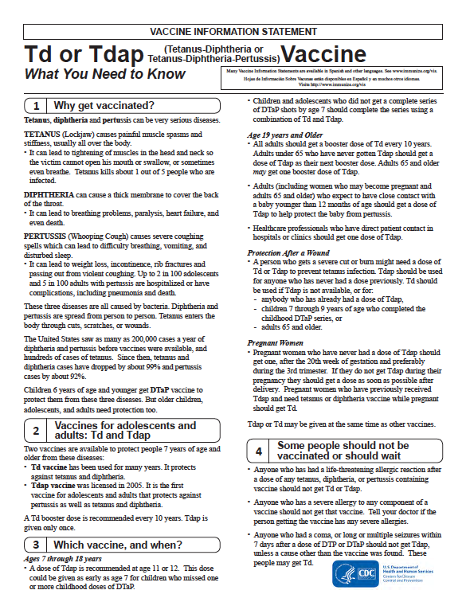
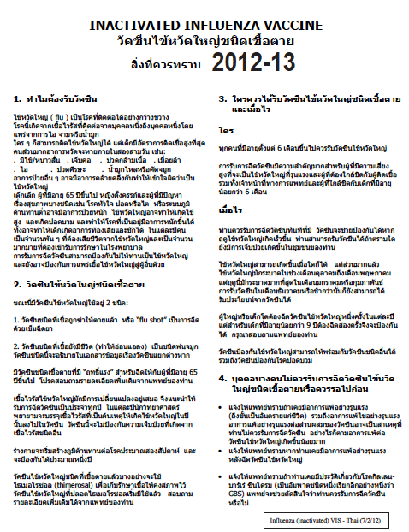
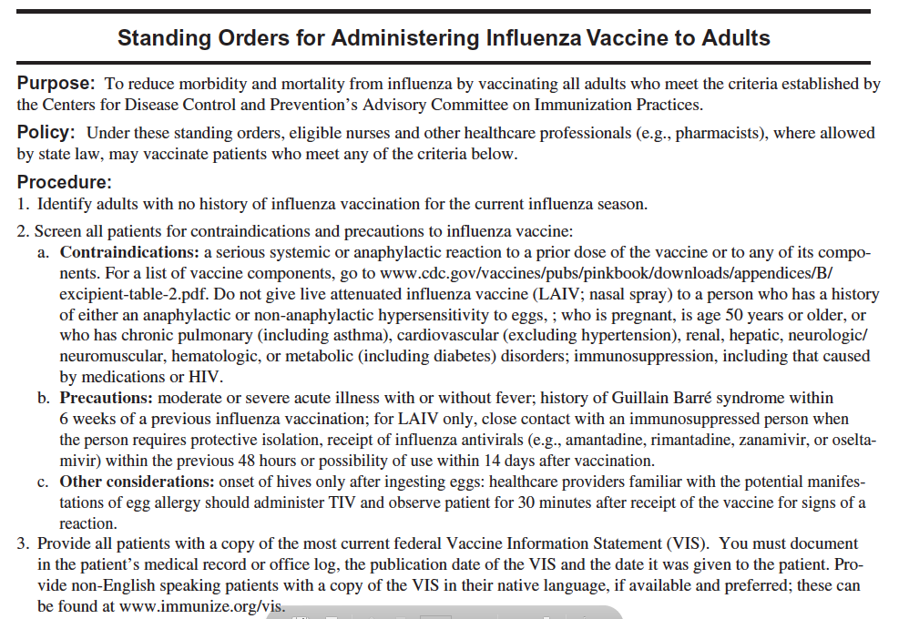
Helpful Tools

Slide 46
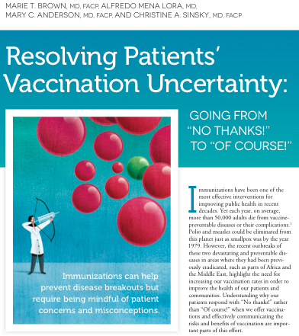
Brown M, Sinsky C
Family Practice Management March/April 2014

Slide 47
Questions
Contact Information:
  Marie Brown, MD, FACP: mbrown@mbrownmd.net
  Rupel Dedhia, MD, FACP: Rupel_Dedhia@rush.edu
  Rebecca Gehring, MPH: rgehring@acponline.org
Register for the next webinar: Standing Orders – A Model to Fit Your Practice
  November 20, 2015 at 1 PM ET/12 PM CT
  Register here: http://bit.ly/IRaiseStandingOrders

