Slide 1





I Raise the Rates through the Promotion of Equity: Initiative to Raise Adult Immunization Rates through the Promotion of Racial and Ethnic Equity in Primary Care

Slide 2
Welcome
Welcome to ACP’s I Raise the Rates through the Promotion of Equity Virtual Training Webinar!
House-keeping items:
We are recording today’s webinar.
Please keep your phone on mute when not speaking.
Please hold your questions until the end of the presentation. You can press *6 to unmute your line.
Feel free to use the chat feature on the right side of your screen to ask questions.

Slide 3
Webinar Agenda
Time | Agenda Item | Faculty
10:00 am | Welcome and Introductions | Wendy Nickel, MPH
10:05 am | I Raise the Rates through the Promotion of Equity Program Overview | Melat Aklilu, MPH Selam Wubu, MPH
10:20 am | NMQF/SHC Overview and Presentation of Vaccine Index | Laura Lee Hall, PhD
10:35 am | Clinical Overview of Adult Vaccine Recommendations QI Strategies for Increasing Immunization Rates | Bob Hopkins, MD, MACP, FAAP Mike Soppet, MD, FACP
11:15 am | Racial/Ethnic Disparities in Immunizations and Effective Strategies for the Promotion of Health Equity | Tamara Coyne-Beasley, MD, MPH, FAAP, FSAHM
11:45 am | Q&A
11:55 am | Next Steps | Melat Aklilu, MPH
12:00 pm | Adjourn

Slide 4
Today’s Presenters
Faculty
Tamera Coyne-Beasley, MD, MPH, FAAP, FSAHM
Bob Hopkins, MD, MACP, FAAP
Mike Soppet, MD, FACP
ACP
Wendy Nickel, MPH
Selam Wubu, MPH
Melat Aklilu, MPH
SHC
Laura Lee Hall, PHD

Slide 5

I Raise the Rates through the Promotion of Equity Program Overview
Melat Aklilu, MPH
Selam Wubu, MPH

Slide 6
Program Objectives
Create a proprietary national map, using Medicare reimbursement data, to localize majority minority populations by ZIP code with low AI rates
Identify ACP members and FQHCs serving patients in those ZIP codes; conduct qualitative interviews and survey
Identify, review, and when necessary, develop patient- and provider-facing tools to promote AI using best practices for health and literacy and cultural competence
Support practice transformation in identified practices to facilitate improvements in AI

Slide 7
Evaluation of Super and Low-immunizers
Goal: Identify potential patient-, provider-, and organization-level barriers and facilitators to providing adult immunizations among majority-minority serving physicians
Conduct in-depth interviews with low immunizing providers and high immunizing providers (~ 20-30 providers in each group)
Question providers about factors influencing immunization:
Organizational policies
Personal perceptions and practices
Reasons that individuals cite for denying immunization

Slide 8
I Raise the Rates through the Promotion of Equity – The Quality Connect Approach

Slide 9
Quality Connect Framework
Program Launch
Practice Assessment
Champion Training
Data Collection
Education and Resources
Ongoing Facilitation
Dissemination

Slide 10
Quality Connect Program Elements
Practice Assessment Survey
QI Champion Training
October 2017 virtual champion training
Practice Coaching
Follow-up call post-QI Champion training
Bi-weekly coaching calls
QI activities
Two PDSA cycles
Data Collection
Performance measures (I Raise the Rates Registry on MedConcert)
Practice assessment survey
Educational programs
Webinars
Live programs
Resources
PDSA resources
Recorded Webinars & QI videos
Patient education materials

Slide 11
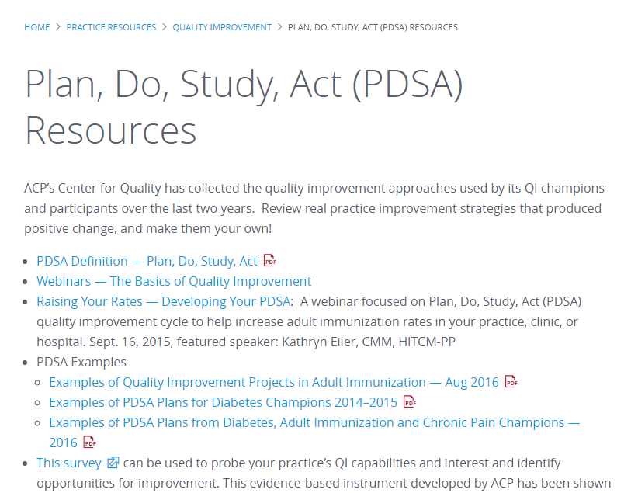
PDSA Resources Online

Slide 12
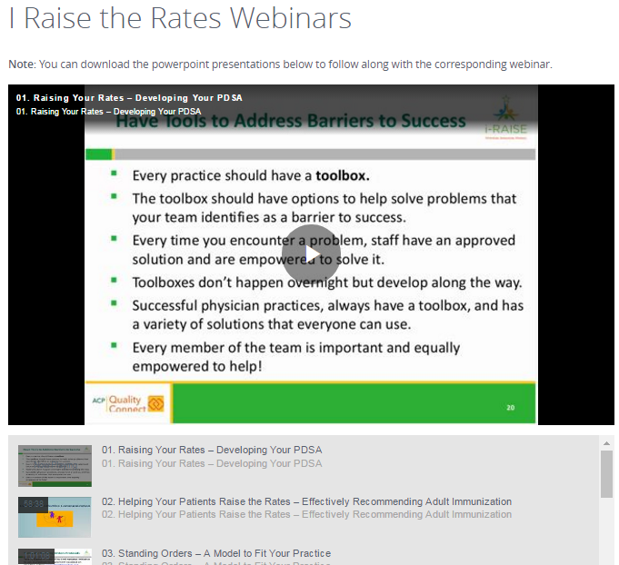
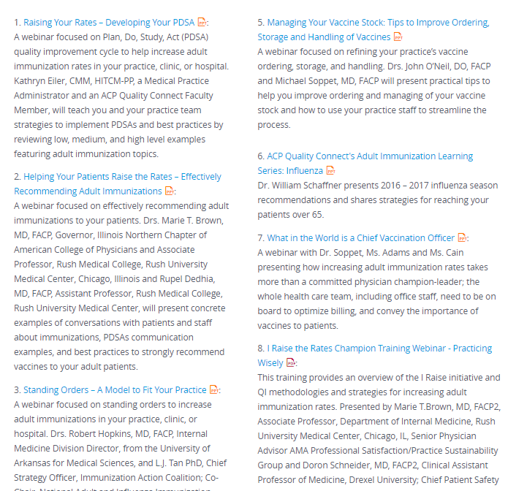

Slide 13
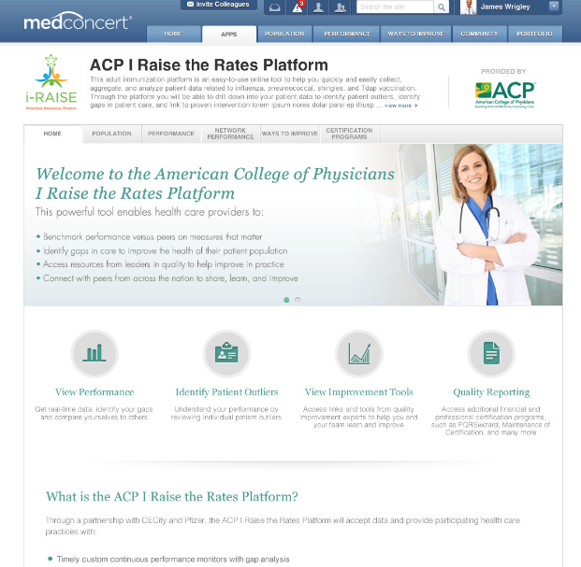
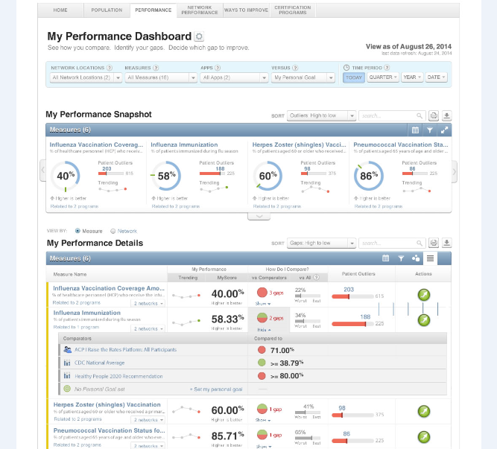
I Raise the Rates Registry

Slide 14
Measure Definitions
Measure Title | Description | Denominator Description | Numerator Description
Influenza Vaccination | Percentage of patients aged 6 months or older seen during a visit between October 1 and March 31 who received an influenza vaccination OR who reported previous receipt of an influenza vaccination. | Patients aged 6 months or older seen for a visit between October 1 and March 31 with a valid patient encounter code. | Patients who received an influenza vaccination OR reported previous receipt of an influenza vaccination.
Pneumonia Vaccination Status for Older Adults | Percentage of patients aged 65 or older who ever received a pneumococcal vaccination. | Patients aged 65 or older with a valid patient encounter code. | Patients who have ever received a pneumococcal vaccination.
High Risk Pneumococcal Vaccination | The percentage of patients aged 19 through 64 with a high risk condition, who either received a pneumococcal vaccination (reported separately) OR had a contraindication to pneumococcal vaccination (reported separately). | Patient aged 19 through 64 with a high risk condition (e.g., diabetes, heart failure, COPD, end-stage kidney disease, nephritic syndrome, chronic kidney disease, chronic dialysis, asplenia, malignancy, solid organ transplant, on immunosuppressive medications, HIV) and a valid patient encounter code. | 1. Patients who received a pneumococcal vaccination OR 2. Patients who have a contraindication to pneumococcal vaccination.
Herpes Zoster (Shingles) Vaccination | Percentage of patients aged 60 or older who received a herpes zoster vaccination OR who reported previous receipt of a herpes zoster vaccination. | Patients aged 60 or older with a valid patient encounter code. | Patients who received a herpes zoster vaccination OR who reported previous receipt of herpes zoster vaccination.
Tdap (Tetanus, Diphtheria, Acellular Pertussis) Vaccination | Percentage of patients aged 19 or older who received a primary vaccine series of tetanus/diphtheria/acellular pertussis (tdap) vaccine OR who reported previous receipt of Tdap vaccination. | Patients aged 19 or older with a valid patient encounter code. | Patients who received Tdap vaccination OR who reported previous receipt of Tdap vaccination.

Slide 15
Champion Role
Lead your practice setting in QI project aimed at increasing immunizations rates for your diverse patient population
Engage peers in promoting the importance of immunizations
Teach colleagues about strategies that can promote immunizations
Promote immunizations in your organization or community

Slide 16
Champion Responsibilities
Complete pre-intervention practice assessment
Attend today’s webinar and review online resources
Collect and submit baseline data
Complete 2 PDSA cycles
Attend 2 check-in calls
Attend at least 2 coaching calls
Collect and submit follow-up data
Complete post-intervention practice assessment

Slide 17
Example Success Stories – GA FQHC
72% average increase from April 2016 to February 2017- if clinical champion
23% average increase from April 2016 to February 2017- if NO clinical champion

Slide 18
43% average increase per clinic from April 2016 to February 2017

Slide 19
IL Champion Results
Academic Medical Center
3 clinics (primary care, infectious disease & peds, general medicine)
QI focus area: influenza
Interventions:
MAs trained to identify patients and recommend flu shot
Visual display of run chart in public area
Email reports to residents and individual clinicians with their immunization rates
Results
Baseline: 37.4% (September 2015 – February 2016)
5592 unique patients seen
2096 flu vaccines
Follow-up: 53% (September 2016- February 2017)
7688 unique patients seen
4074 flu vaccines

Slide 20



Introduction to NMQF and SHC: Promoting Adult Immunization on the Map and in Underserved Communities Laura Lee Hall, PhD Chief Operating Officer and Executive Vice President Sustainable Healthy Communities

Slide 21

National Minority Quality Forum (NMQF)
Founded in 1998, NMQF is a non-profit Washington, D.C.-based, health care research and education organization whose mission is to strengthen the ability of communities and policy-makers to eliminate the disproportionate burden of premature death and preventable illness in special populations through the use of evidence-based, data-driven initiatives.

Slide 22
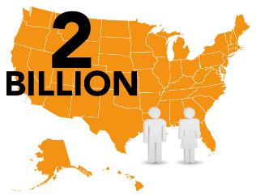

The National Minority Quality Forum Data Warehouse
The Forum has developed a comprehensive database comprised of over 2 billion patient records, which it uses to define disease prevalence, costs and outcomes for demographic subpopulations at the zip code level

Slide 23
Sustainable Healthy Communities, LLC
Wholly-owned subsidiary of NMQF, founded November 2016
SHC’s vision statement is: Sustainable healthy communities in every zip code.
SHC’s mission is to promote sustainable healthy communities, especially those with diverse and underserved populations, through the provision of actionable data, research, and engagement/training of clinicians and community leaders.

Slide 24


Slide 26
NMQF SHC
Calculating disparities
Promoting Health Equity

Slide 27

Patient/Family Education
Community Engagement and Support
Clinical Trial Support
Research
Clinician QIE
SHC: Expanding the Reach and Impact of NMQF

Slide 28
Health Indices and Maps Developed to Date
Acromegaly
ACS
Afib
Alzheimer’s
Asthma
CVD
Childhood obesity
Chronic kidney disease
Cancers
Diabetes
Elevated cholesterol
Heart failure
Hemophilia A
Hepatitis C
Hip/knee replacement
HIV/AIDS
Hypertension
Lead risk
Lung cancer
MRSA
MS
OAB
PAD
Stroke
Vaccines

Slide 29
Data Elements
Patient identification (permits linking to other datasets and tracking over time at the patient level)
Provider identification and visits (physician, pharmacy, ED, hospital, LTC facility)
Diagnoses (ICD codes and common co-morbidities in summary file)
Treatment, including specific medications, where they were filled, and adherence rates
Location of care
Patient demographic characteristics
Formulary, health plan, total costs, costs per type of care, and out of pocket-costs
Social factors (income, education, environmental quality, community resources such as hospitals, pharmacy, Y’s, etc.)

Slide 30
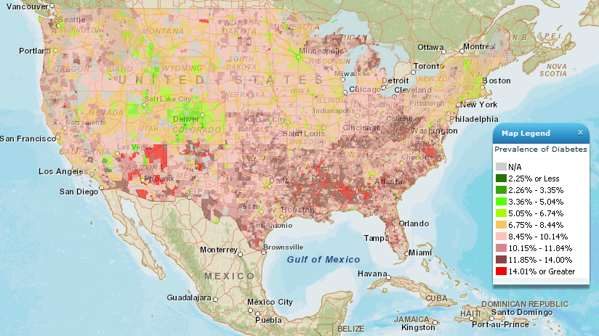
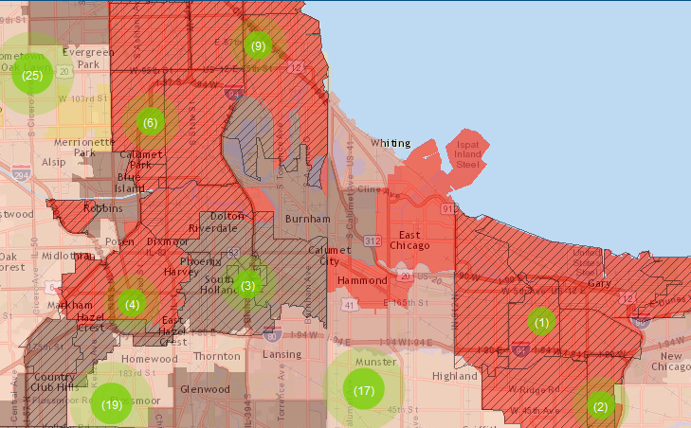
GIS-based Data Visualization
Mapping helps clarify data
AND
Geography matters
Where to put resources
Understanding factors contributing to health
Working with clinicians and communities
Recruiting for clinical trials

Slide 31
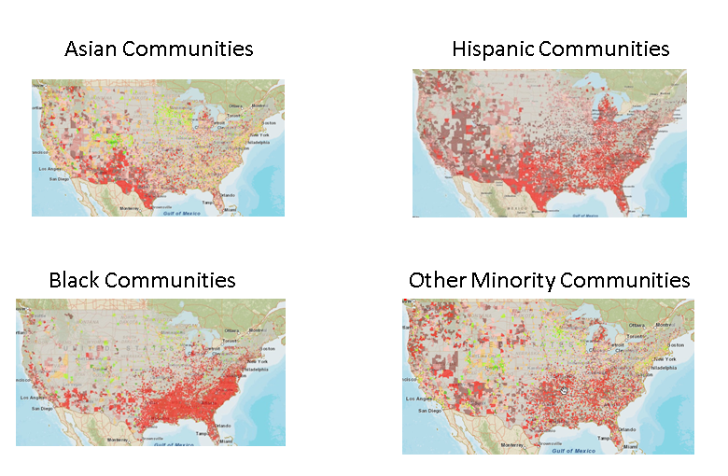
Americans Live in 38,000 Zip Codes Most Minorities Live in 7,500
50%of Asian Live in 1,500 Zip Codes
70%of Hispanics Live in 2,500 Zip Codes
70%of Blacks Live in 2,500 Zip Codes
70%of Other Minorities Live in 1,000 Zip Codes

Slide 32
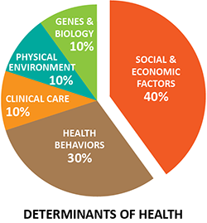
Determinants of Health

Slide 33
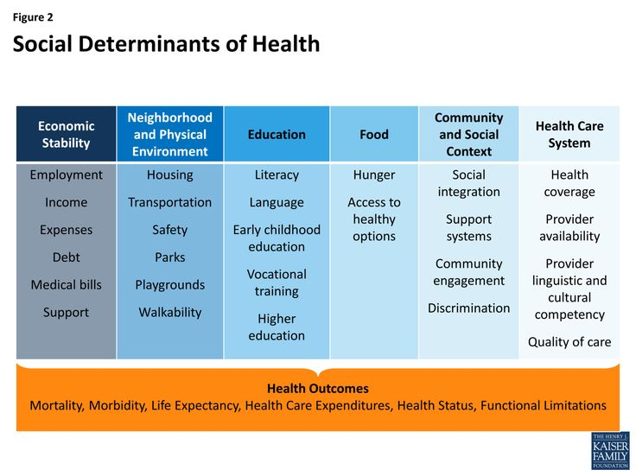

Slide 34
Programmatic Focus
Working Groups and major clinical foci to date:
Cancer
Diabetes
Heart failure
Adult immunization
Sickle Cell Disease
Programs promoting diversity in clinical trials and treatment through research, education, quality improvement support, and community and patient education

Slide 35
Adult Immunization

Slide 36


Slide 37
ACP members in Practices of 3-5 Serving Majority Black, Low Income Populations: 10% of Practices Provided 70% of Pneumococcal Vaccines
Notes:
In Cluster 13 areas,
73 practices (11-20) provided 616 pneumococcal vaccines to the Medicare population

Slide 38
Data Sources Utilized to Date
Medicare FFS Claim data, 2014-15
Adult-serving PCPs in ambulatory setting
Part B for influenza and pneumococcal vaccines
Part D for herpes zoster vaccine
Data reflect vaccines billed for in ambulatory setting
Patient-level data

Slide 39
PCPs in the United States
Adult serving include general internists, family practice, physician assistants, osteopaths, and nurse practitioners
296,500 PCPs billed Medicare FFS in 2014

Slide 40
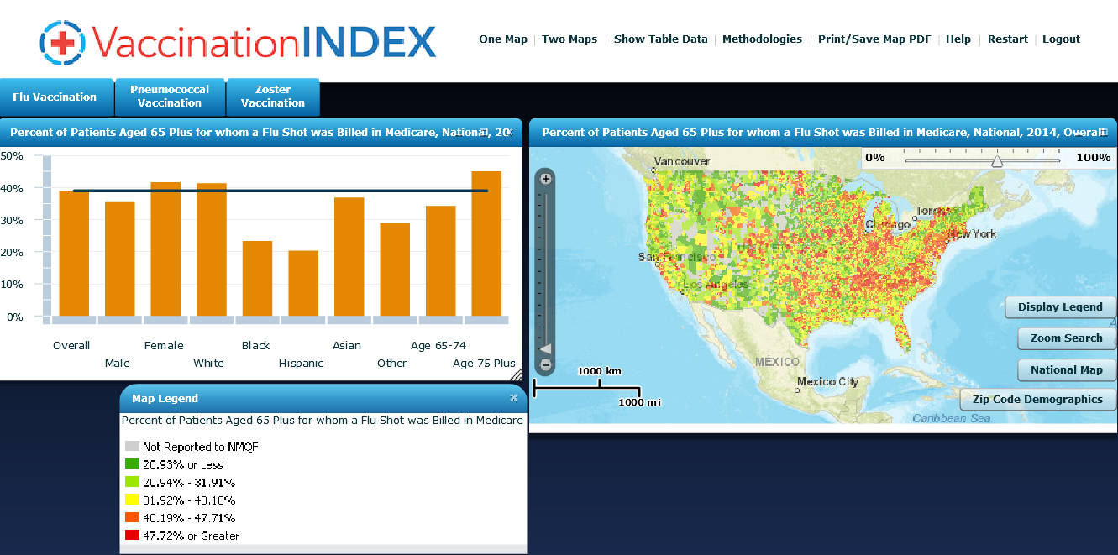
Percent of Patients 65+ for Whom a Flu Shot was Billed in Medicare, 2014

Slide 41
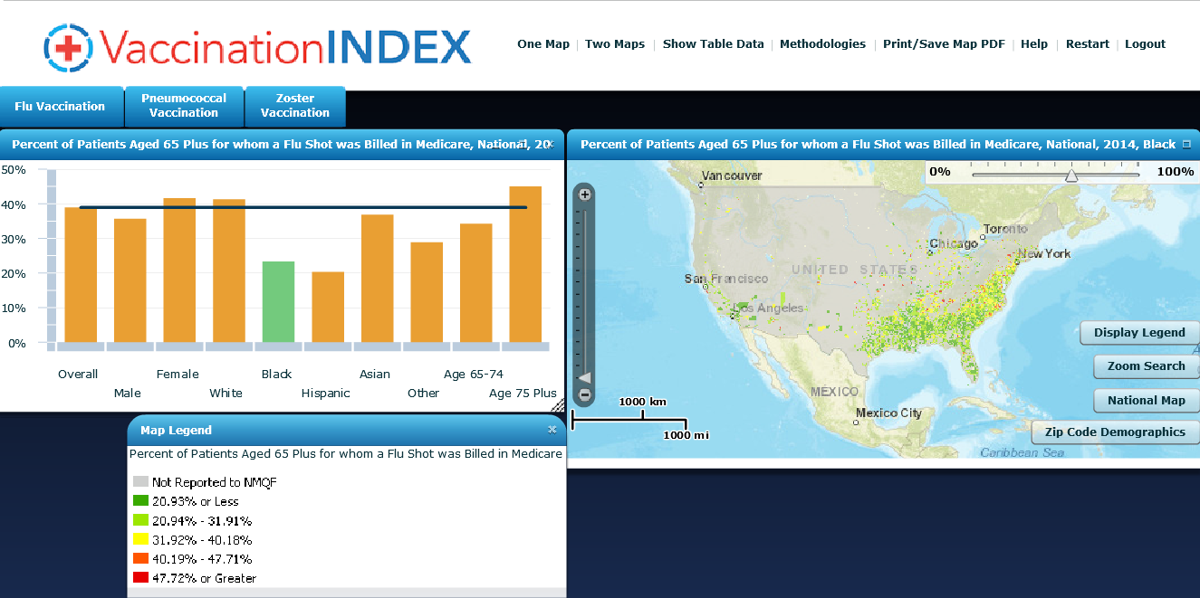
Percent of Black Patients 65+ for Whom a Flu Shot was Billed in Medicare, 2014

Slide 42
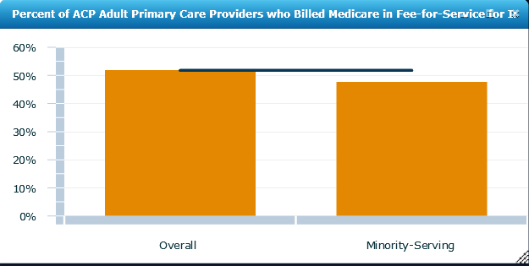
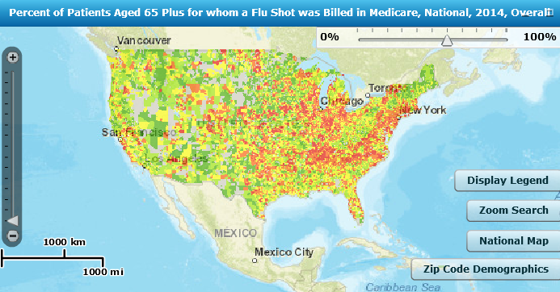
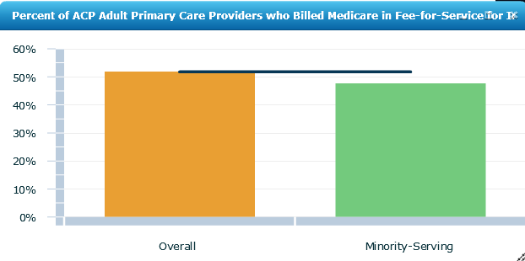
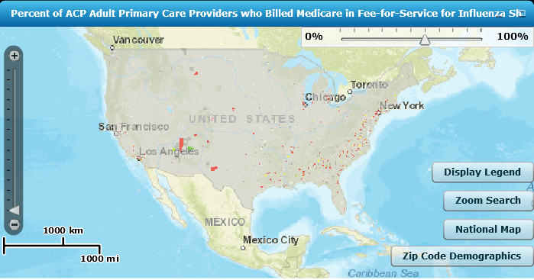
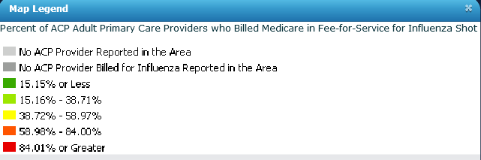
ACP PCP 2014 Billing for Flu Shots in 2014: 52% vs 47% of all PCPs versus Minority-Serving PCPs, respectively

Slide 43
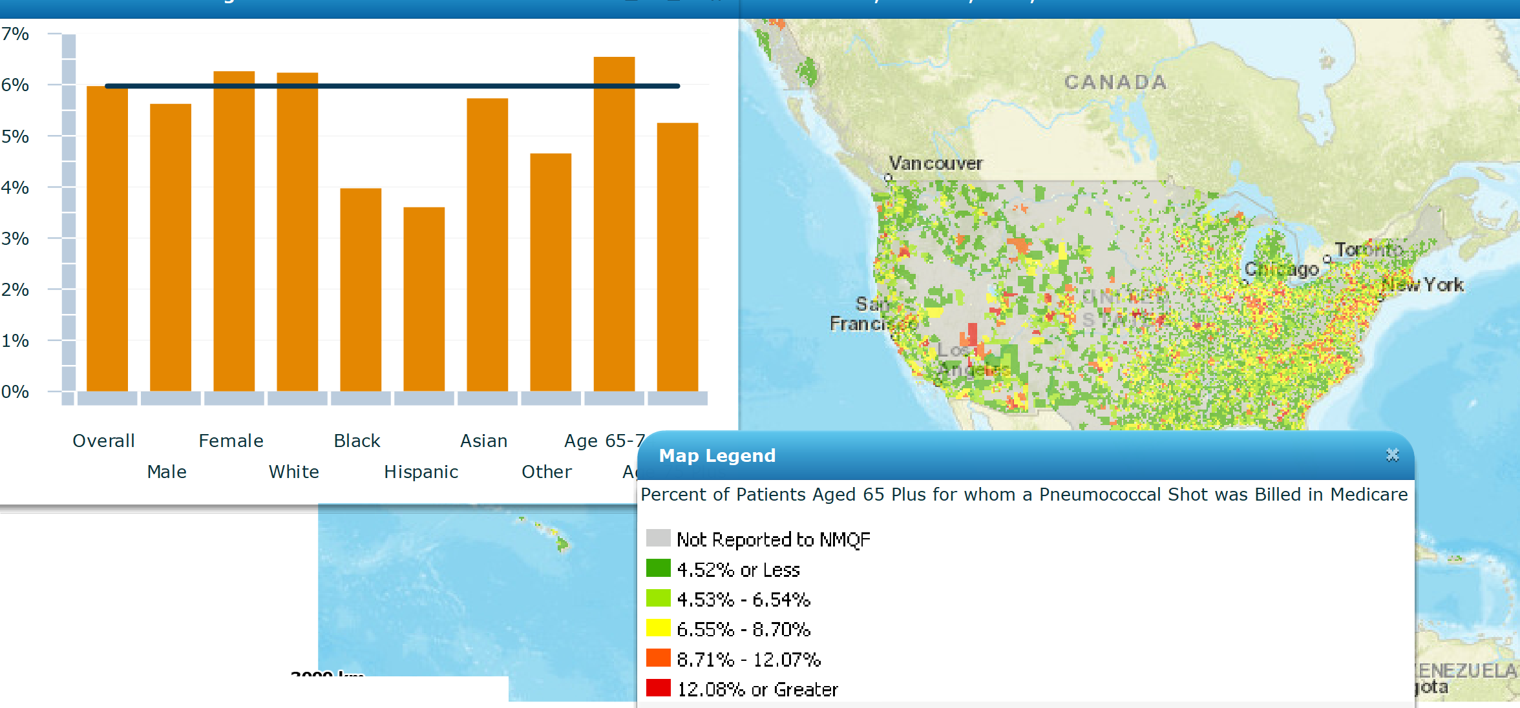
% of Patients for Whom a Pneumococcal Vaccine Was Billed

Slide 44
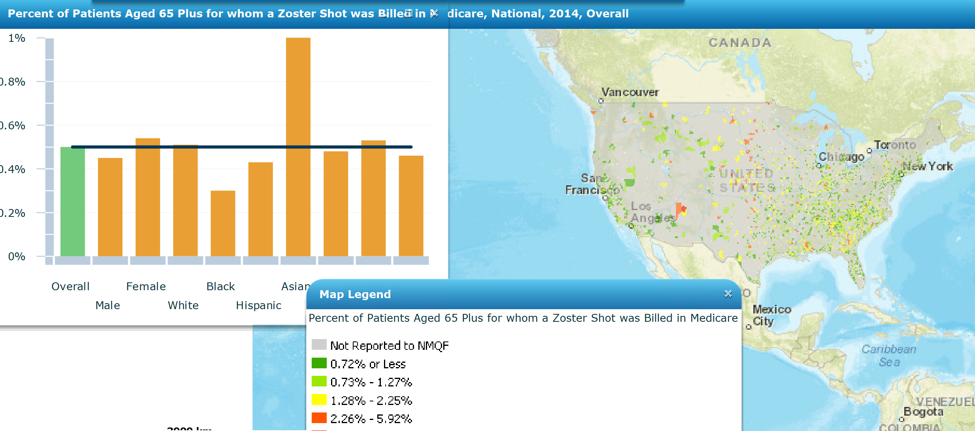
% of Patients for Whom Zoster Was Billed

Slide 45
Thanks! Questions? lhall@shcllc.info

Slide 46
Tools for Immunization Improvement: Case Based Approach to Increasing Immunization in Your Practice
Bob Hopkins, MD, MACP, FAAP
Mike Soppet, MD, FACP

Slide 47
Disclosures
I have no financial conflicts of interest
I have MAJOR nonfinancial conflicts
I am a firm believer in adult immunization
I am disturbed by our poor performance in this area
I am confident that we can improve with better
Knowledge
Skills
Determination
Tools

Slide 48
Outline
Brief survey of current AI recommendations, rates
Case based review of Adult Immunization
Identify challenges associated with specific vaccines
Plant seeds in you:
Because you are ‘fertile soil’ to grow improved adult immunization practice!!!
Provider Recommendation & Patient Communication
Reminder – Recall
Chart/Provider Reminders
Standing Orders
Immunization Information Systems

Slide 51
Adult Vaccination Rates = POOR!
Data: NHIS 2014-2016
Vaccine [Population]
Influenza | 2013 | 2014--15 | 2015-16
Influenza – All Adults | 39.7 % | 43.2 % | 44.8%
[All] 19 – 49 years | 30.6 % | 31.5 % | 32.5%
[All] 50 – 64 years | 43.7 % | 47.7 % | 48.7%
> 65 years | 61.3 % | 71.5 % | 73.5%
HCW [19 – 64 years] | 65.4 % | 65.4 % | 68.6%
PPS23 & PCV13 | 2013 | 2014 | 2015
High risk 19 – 49 years | 21.2 % | 20.3 % | 23.0%
> 65 years | 59.7 % | 61.3 % | 63.6%
Tetanus [19 – 49 years, received < 10 years] | 62.9 % | 62.6 % | 62.1%
Tetanus/Pertussis [19+, received < yrs] | 17.2 % | 20.1 % | 23.1%
Shingles [Zoster] age 60+ | 24.2 % | 27.9 % | 30.6%
Hepatitis B Vaccine [High risk 19 – 49 years] | 32.6 % | 32.2 % | 32.0%
HPV Vaccine [W 19-26, M 19-21, >1 dose] | 36.9 %, 8.0 % | 40.2 %, 8.2 % | 41.6%, 10.1%
https://www.cdc.gov/mmwr/volumes/66/ss/ss6611a1.htm
Notes:
NHIS – National Interview Survey
NIS – National Flu Survey

Slide 52
Disparities and Adult Vaccination Rates
Data: NHIS 2016
Vaccine [Population] | Rate
Pneumococcal [>65 years]
All Adults | 63.6 %
Hispanic | 41.7 %
White | 68.1 %
Black | 50.2 %
Asian | 49.0 %
“…and, unfortunately, there are similar disparities for most adult vaccines. This is absolutely unacceptable in the United States in 2015!!”
-RHH, MD 2/15/2015
https://www.cdc.gov/mmwr/volumes/66/ss/ss6611a1.htm
Notes:
Unlike childhood vaccination rates, we see large ethnic and racial disparities in adult vaccination rates.

Slide 53
Provider Recommendation: Standards for Adult Immunization Practice
ALL providers should incorporate immunization needs assessment and strong recommendation into every clinical encounter!
ASSESS immunization status
STRONGLY RECOMMEND vaccines indicated
ADMINISTER needed vaccines or REFER patients to a vaccine provider
4. DOCUMENT received vaccines
http://www.cdc.gov/vaccines/hcp/patient-ed/adults/for-practice/standards/index.html

Slide 54
CASE 1: Jane Smith
42 year-old high school teacher with asthma since childhood presents for follow up. Is using her controller and needs reliever about once a month in fall, winter and spring. Nurse ‘flagged chart’ because she refused recommended vaccines— ‘I don’t need them, those are for sick people…’
How do you respond to Jane’s comment??
What vaccines would you recommend?

Slide 55
Jane Smith: Answers
STRONG recommendation to vaccinate
Recommend:
Influenza Asthma is high-risk condition
PPSV23 Asthma is intermediate-risk
Tdap Routine adult, once*, then resume Td
*In pregnant women recommend Tdap every pregnancy @ 27-36 weeks→ for infant protection

Slide 56
Provider Recommendation
NONCONFRONTATIONAL
Recognize and turn motivations to positives
Avoid pejorative/emotional reaction
SUPPORTIVE
Data not highly effective in leading to behavior change
Personal anecdotes, stories can be useful
Conviction without judging is critical

Slide 57
Provider recommendation 1: Anti-Vaccine 5-Point Response
RISK REDUCTION
High risk patients may not understand this
VALUE to INDIVIDUAL
Cost of illness in work loss/effectiveness
Cost of treatment of illness
VALUE to FAMILY/Community
Not there -or not at best- to care for family
LOW COST
ACA Mandated first dollar coverage [Not M’Care, MCD]
SAFETY of vaccines

Slide 58
Provider recommendation 2: SHARE More Information (If Needed)
Share reasons why the recommended vaccines are right for the patient
given age, health status, lifestyle, job, or other risk factors.
Highlight your own experiences with vaccination to reinforce benefits
Address patient questions and any concerns about vaccines,
include side effects, safety, effectiveness in plain, understandable language
Remind patients many vaccine-preventable diseases are common in the U.S. and can be serious for them.
Explain the potential costs of getting VPDs, including serious health effects, time lost (e.g. missing work or family obligations), and financial costs.

Slide 59
Provider Recommendation Translates Into Higher Vaccination Rates
(Even for Patients With Negative Attitudes)
Vaccination Rate (%)
*High-risk patients were those ages 65 and older or those having heart disease, lung disease, diabetes, or other serious illness.
Nichol KL, et al. J Gen Intern Med. 1996;11(11):673-677.

Slide 60

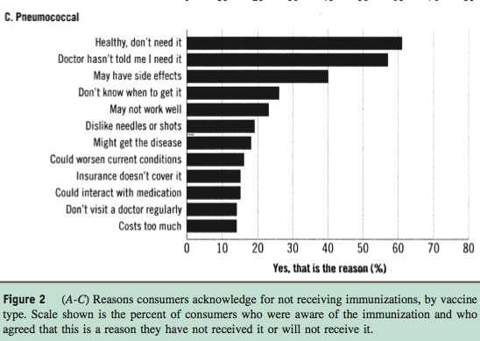

Slide 61
Provider recommendation 3: Patients Who Aren’t Ready to Decide…
Emphasize the ‘benefits of getting vaccinated today’
Provide education
Materials
Trusted websites
Community partners [Pharmacy, Health Department, AARP,…]
Document the conversation in the record
Set a plan for deferred vaccines
And send reminders about needed vaccines
Continue the conversation at the next visit.
For those who choose not to [be vaccinated]…

Slide 62
Reminder – Recall
Strategy to remind patients that vaccines are due (reminder) or late (recall)
Can be delivered via various methods (telephone, letter, email, text) and include educational materials
Usually targeted by patient demographics
Disease: asthmatic, diabetes, cancer, HIV/AIDS,…
Risk Factors: smokers
Age group: 18-19/College, 65+
Increase vaccination coverage ~ 12 – 20%
Guide to Community Preventive Services http://www.thecommunityguide.org/vaccines/clientreminder.html
Notes:
Here are some possible questions you may receive from the audience:
What time of year do you start projects like these?
What staff makes the patient lists for the QI project?
What are the EHR considerations such as basic reporting functions of patient records?

Slide 63
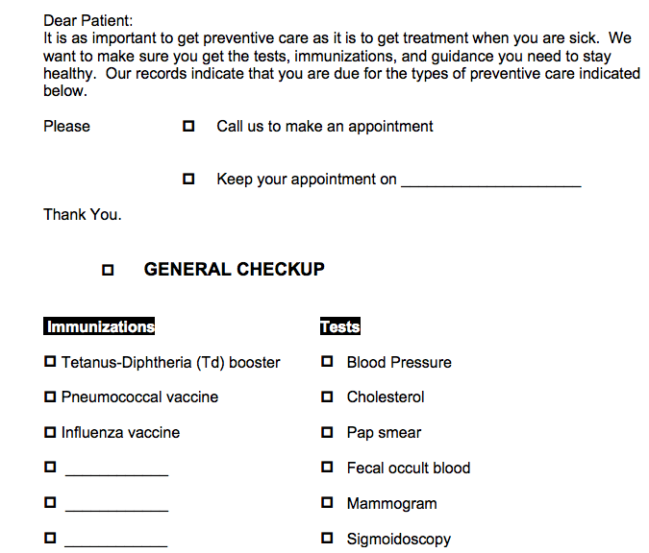
NO EMR: Sample Reminder Notice
Notes:
This is an example reminder notice and if you use this strategy, modify to meet your practice/patient needs.

Slide 64
Patient Reminder/Questionnaires: Assess Status, Patient Reminder… In clinic or send out via patient portal.
UAMS Adult immunization Clinic Screening Questionnaire NAME ____________________ Birthdate ___/___/19___ PCP _________________
Please complete this questionnaire to help our staff help better protect you and all of our patients from vaccine-preventable diseases!
-UAMS Center for Primary Care Staff
1. Do you have an allergy to any vaccine, to eggs or to gelatin? O No O Yes
2. If you need additional vaccines, would you be willing to receive them today with your flu vaccination? O No O Yes
If no, may we forward this questionnaire to your PCP? O No O Yes
3. Do you have any chronic health conditions, including any previous tissue or organ transplants? O No O Yes
If yes, please list here:______________________________________________________________________________________
4. Are you taking any medication [now or within the last month] which lowers the function of your immune system? O No O Yes
Examples would include: Chemotherapy, prednisone, medications to treat lupus or rheumatoid arthritis, medications to prevent transplant
rejection, medications to treat colitis or Crohns. If yes, please list here:_______________________________________________
5. Have you had [or are your doctors planning] surgery to remove your spleen? O No O Yes
6. Have you had any of the following: brain or spine surgery with placement of a shunt, brain or spine surgery which has resulted in a
spinal fluid leak, or cochlear implant surgery? O No O Yes
7. Have you ever had an adult tetanus and whooping cough (pertussis) vaccination? O No O Yes
8. Was your last tetanus vaccination given within the last 10 years? O No O Yes
If yes, what year was this given? __________
9. Have you received a 'pneumonia [or Pneumococcal] vaccine’ in your adult life? O No O Yes
If yes, what year was this given? __________
10. Have you ever had any of the following diseases or vaccinations against these diseases?
Chicken Pox: O No O Yes
Measles: O No O Yes
Mumps: O No O Yes
11. Have you ever had a Shingles (Zoster) vaccine? O No O Yes
12. Have you ever had Hepatitis B or Hepatitis A vaccination [or both]? O No O Yes Hepatitis B O Yes Hepatitis A
13. Did you receive an influenza vaccine last year? O No O Yes
If yes, where did you receive this immunization? ________________________
RHH, MD AI Screening Questionnaire 2014
NOTE: For this to be most useful, support with additional tools for patients, registration and vaccinating staff [e.g. guideline, standing order, access]

Slide 65
CASE 2: Bill Jones
54 year old man with diabetes and severe chronic kidney disease [CKD5] here for follow up. He has been adherent to medications and has lost a few # since last visit. On kidney transplant list for severe CKD. He received influenza vaccine and Tdap from health department this past fall. Nurse ‘flagged chart’- he Zoster vaccine [and will consider others] but nurse concerned - he does not qualify based on standing order…
Resources used for improvement?
What vaccines do you recommend?
What about the Zoster question?

Slide 66
Bill Jones: Answers
Resources:
TOOLS TEAMWORK REMINDER STANDING ORDERS
Recommend:
PCV13 ESRD is highest-risk condition
Followed by PPSV23 in 8+ weeks
HBV DM < 60 yrs. is high-risk condition
ESRD is high-risk condition [High Dose vax]
[Likely NO] Zoster recommended by ACIP at 60+
FDA approved at 50+
Can give, ‘one shot’ vax, likely this will require $$ out of pocket as not ACIP indicated..

Slide 67
Chart/Provider Reminders
Alert providers that patient(s) are due for vaccines
Methods:
EMR Alerts
Pre-visit chart review
Engage team in use of reminders in concert with SO
Expect results!
Shown to increase vaccination 12 – 16% overall
EHR based: can result in up to 50% increase in flu and pneumococcal vaccinations
http://archinte.jamanetwork.com/article.aspx?articleid=1105941
http://www.thecommunityguide.org/vaccines/providerreminder.html
Notes:
If there are questions on who will remind the provider, explain it could be the medical assistant, nurse, or a reminder in the EHR depending on clinic workflow.

Slide 68
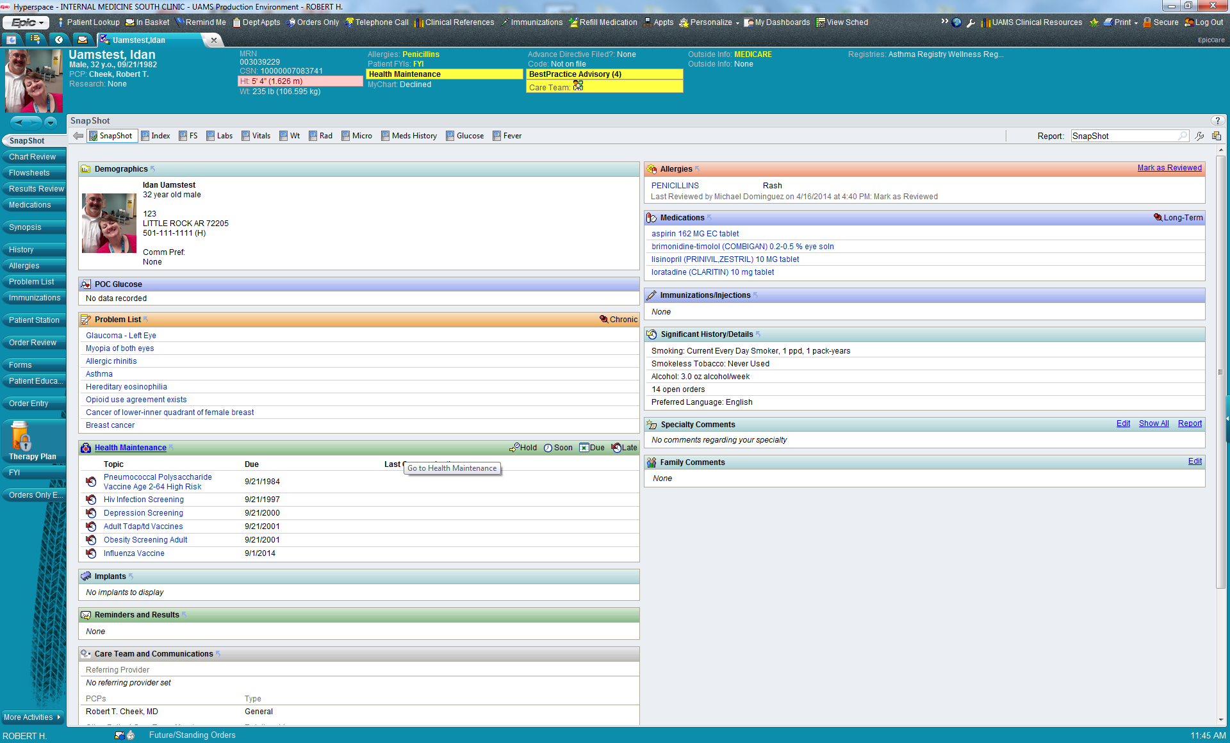
Provider Reminder: Vax Indications
Mr. Test has not received [none doc. in EMR] any immunizations!!
He is deficient in many ‘Health Maintenance’ elements, including no vaccinations

Slide 69
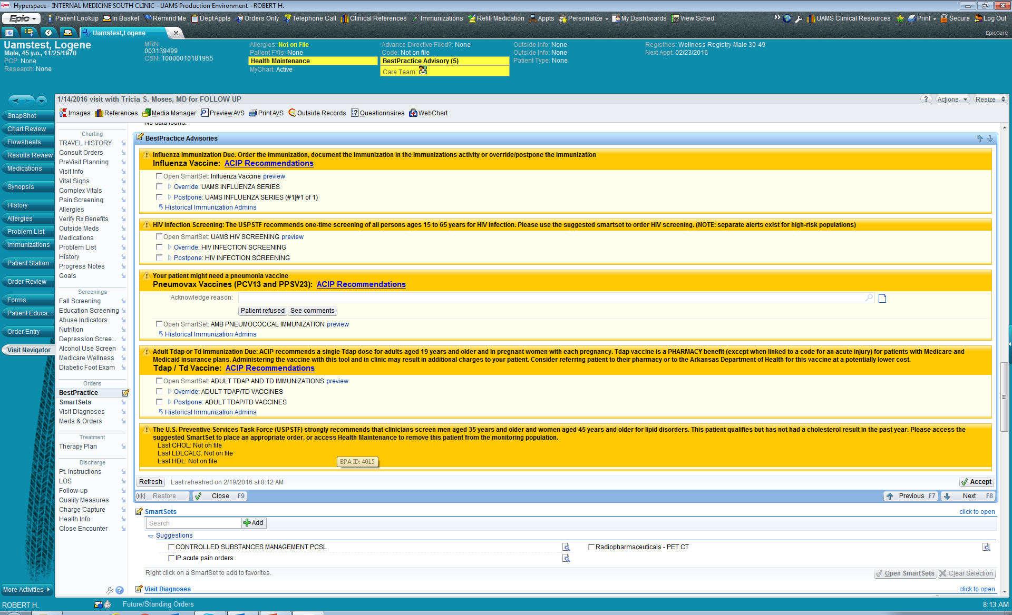
2
2
1
2
3

Slide 70
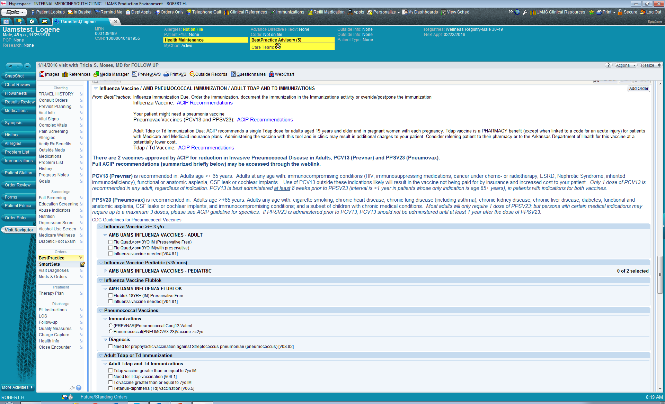
Select vaccines you wish to order [EMR associates with Preventive imm codes]
Click ‘sign’ button to activate

Slide 71
Standing Orders Protocol (SOPs)
Strategy to avoid missed opportunities in vaccination by allowing non – physician providers to administer vaccines without direct physician involvement
Recommended by many groups, including:
Advisory Committee on Immunization Practices (ACIP)
U.S. Community Preventive Services Task Force
Endorsed by CMS for vaccines since 2002
Resources:
http://www.standingorders.org/
http://www.immunize.org/standing-orders/

Slide 72
SOP Procedure
Recommend vaccination
“Your doctor strongly recommends [flu] vaccine and wants you to have it – may I give it to you?”
Screen for contraindications and precautions
Provide appropriate Vaccine Information Statement (VIS)
Vaccine administration procedure
Vaccine documentation procedure

Slide 73
Standing Order Example: Influenza UAMS
UAMS Standing Order: Tdap. AU: RHH, MD. 10/2014. Accessed 2/18/2015

Slide 74
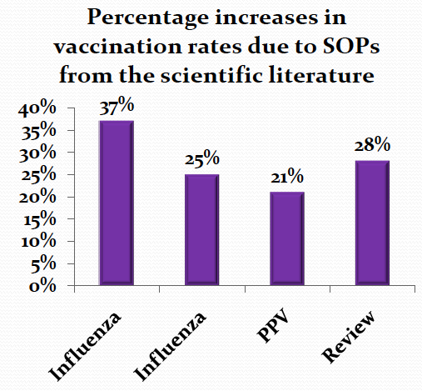
Standing Orders Protocols Effectiveness
Pharmacotherapy2007;27:729-733
Journal of American Geriatric Society2005;53:1008-1010
American Journal of Kidney Diseases2009;54:6-9
American Journal of Preventive Medicine2000;18(1S):92-6

Slide 75
CASE 3: Johnny Boudreaux
76 year-old man transferred today from the regional trauma center to the rehab center for which you are the Medical Director following severe ortho injuries in MVA.
On intake assessment you note Influenza vaccination documented in transfer summary but there is no record of any other immunizations… He does not know what vaccines he has received.
How might you obtain this information?
What vaccines would you recommend for Mr. B today?

Slide 76
Johnny Boudreaux: Answers
Information:
Family? PCP? Pharmacy? State Registry?
Immunizations Today:
PCV13 Single dose in all adults 65+
PPSV23 DELAY: Recommend IN 12 months [CMS]
Zoster Adults 60+
Tdap Would be surprising to not get this in
trauma care but stranger things have happened..

Slide 77
Immunization Information Systems (IIS): State Lifespan Registries
IIS (registries) are confidential, population-based, computerized databases that record all immunization doses administered by participating providers in a given area
IISs have robust vaccinations records for children, but remain underdeveloped or used for adults
Due to the mobility of the U.S. population, IISs will be critical to easily access complete vaccine histories
Multiple vaccine providers and locations for adults
Interoperability and data sharing between state IISs are needed
http://www.cdc.gov/vaccines/programs/iis/contacts-registry-staff.html
Notes:
The CDC has a contact list of state IIS staff: http://www.cdc.gov/vaccines/programs/iis/contacts-registry-staff.html

Slide 78
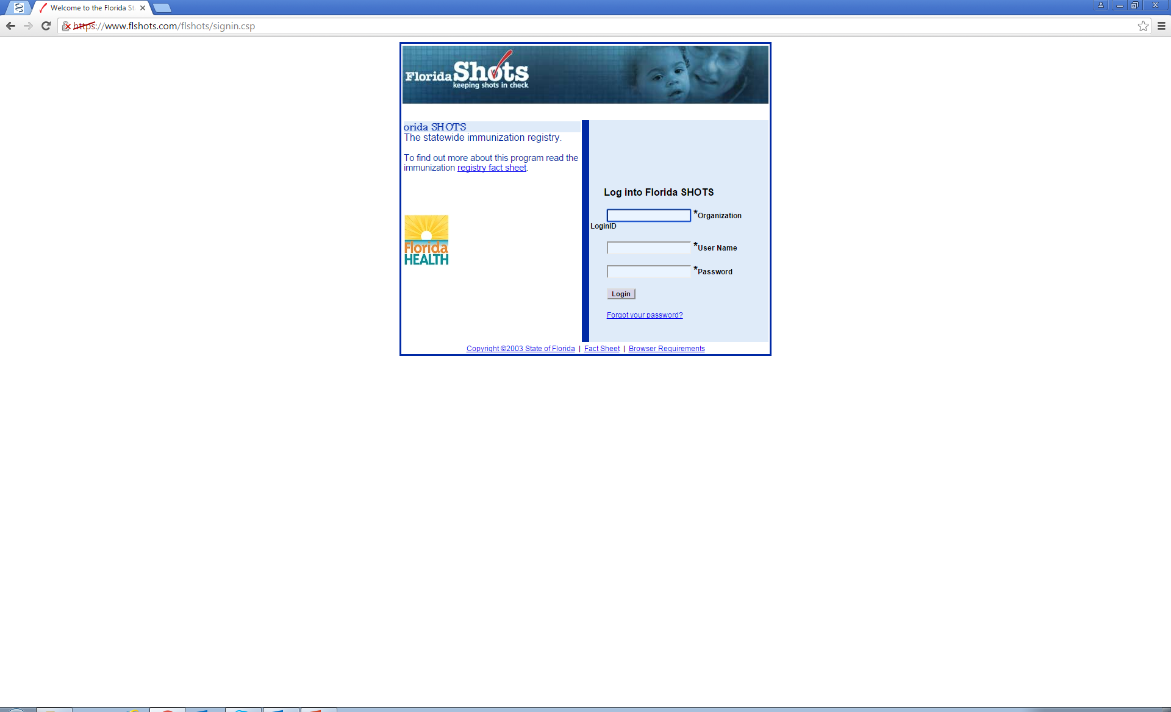
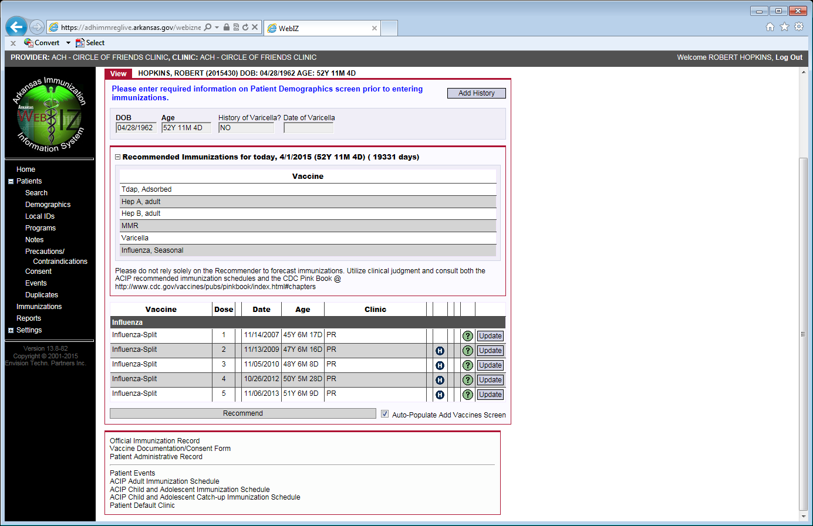
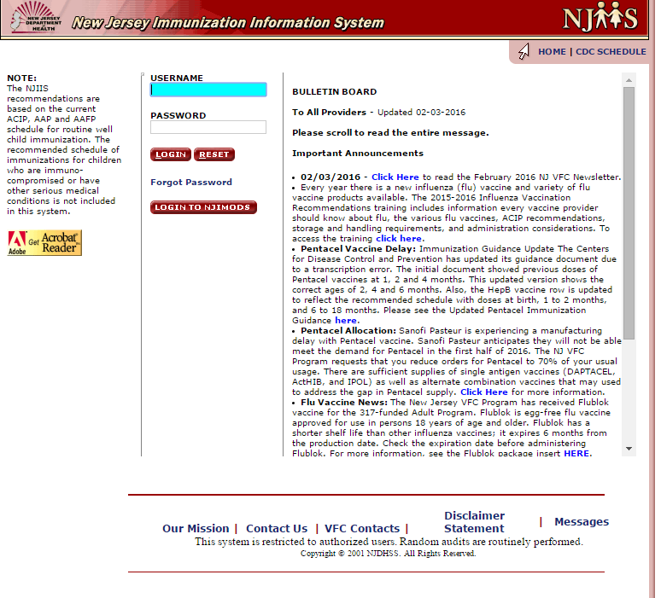
State Registry Snapshots: AR WebIZ, Florida Shots, and NJIS

Slide 79
IIS and Meaningful Use
Stage 2: Core Measure 16 – Submit electronic data to immunization registries
Objective: Capability to submit electronic data to immunization registries or immunization information systems […]
Measure: Successful ongoing submission of electronic immunization data from certified EMR to immunization registry or immunization information system for the entire EHR reporting period.
Unidirectional feed is required from your EMR
Bidirectional better but more problematic…
http://www.cms.gov/Regulations-and-Guidance/Legislation/EHRIncentivePrograms/downloads/Stage2_EPCore_16_ImmunizationRegistriesDataSubmission.pdf

Slide 80
CASE 4: Systems, QI Starter
You have done a quick audit of 30 randomly selected patient charts in your clinic panel and see that only 40% of your patients received influenza vaccine and had it documented in the EMR in the 2014 – 15 season.
What elements can you identify that might play into this low vaccination rate?
What simple intervention could be implemented to address this issue?
What other team members do you want to engage in this project to improve your likelihood of success?

Slide 81
QI Starter: Some Potential Answers
Problems:
Is there a systematic vaccination process in place?
Is vaccination ‘ad lib’ or actively encouraged?
Process to document vaccines elsewhere, refusal?
Are all vaccine doses being recorded?
Is the team knowledgeable and engaged?
Intervention: Education, Process, Outreach
App, In-service, Post schedule/reminders
Team: 1= Identify Champion
Clinic admin/leaders, all providers must at least agree
Registration, Nurses, MA, others?

Slide 82
QI: PDSA Cycling
Plan
Design a process change: Identify gap in care, champions and stakeholders, process for change (with measurable outcome and timeframe)
Do
Put the process change into place
Study
Review the data
Act
Abandon, adapt, adopt, or repeat again

Slide 83
Where to start with Immunization QIP?
Identify a champion
Choose a specific focus/target:
One vaccine
One age group
One disease state
Assess the status of that target
Rate in a sample population
Impact on the practice
Assess the knowledge and concerns of your team

Slide 84
Example QI Projects
Strategy Utilized | Vaccine | Population | Details
Patient Communication | Hepatitis B | Diabetics | Generate list of all diabetic patients and at next visit, recommend vaccination against Hepatitis B
Reminder – Recall | Influenza | All adults | At the start of flu season, send patient communication to remind patients to receive vaccine. After 2 months, identify patients not yet vaccinated and resend reminder
Chart Reminder | HPV | Female patients 19 – 26 & Male patients 19 – 21 | Query EHR to identify eligible patients who have not received HPV vaccine. Program an alert in patient charts to discuss and administer vaccine at next visit
Standing Orders | Tdap | Pregnant women, 27 – 36 weeks gestation | For each pregnant patient, have nursing staff offer and administer vaccine with appropriate documentation
Immunization Information Systems | Pneumo | Patients over 65 | For each visit with elderly patients, transmit pneumo vaccination status to IIS

Slide 85
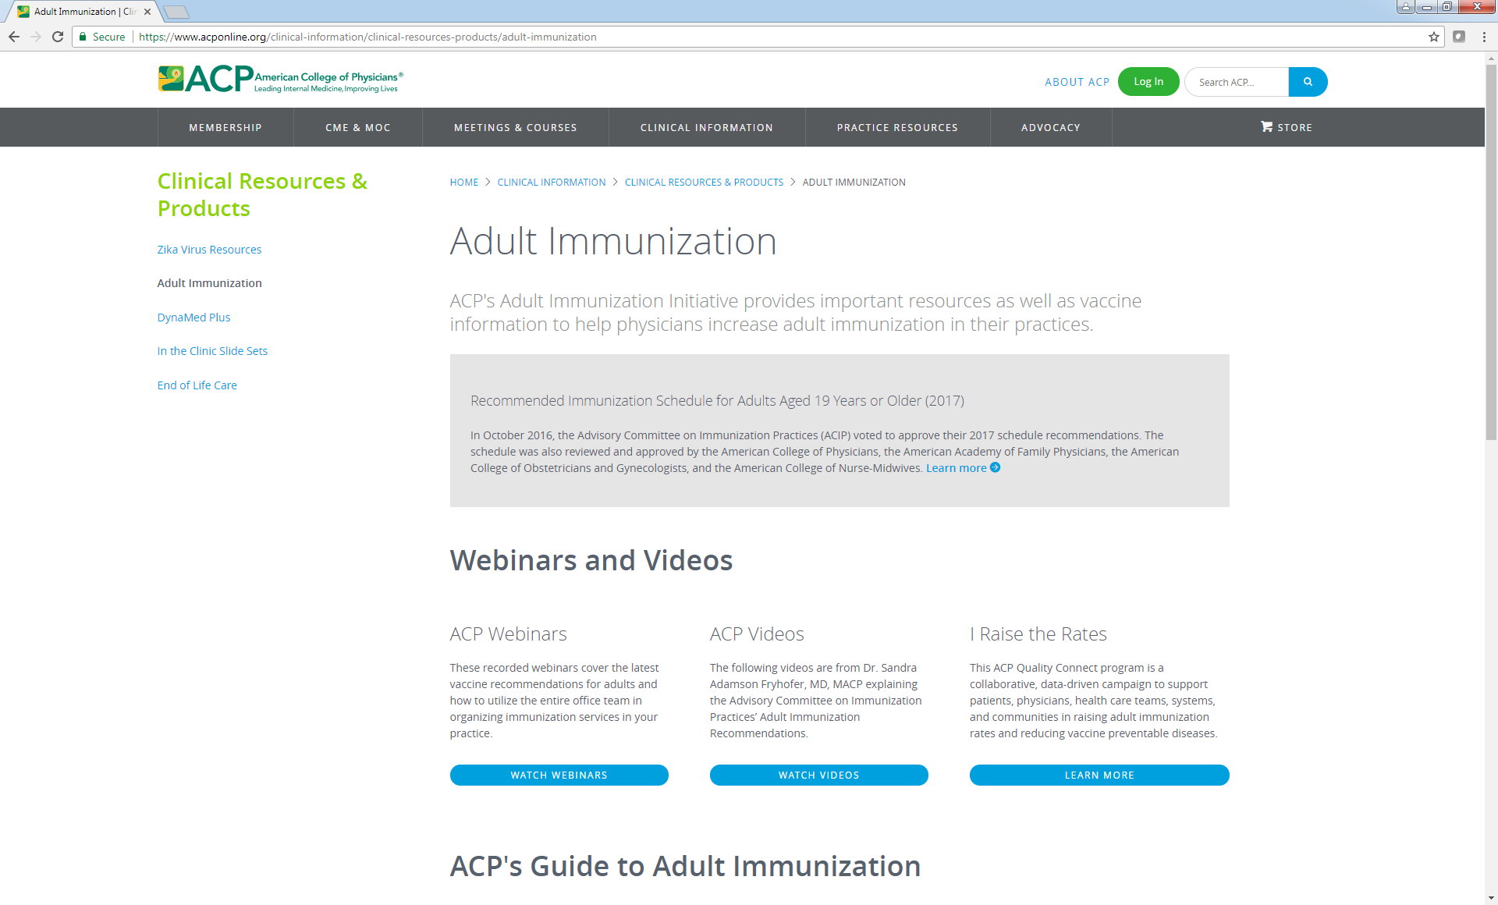
https://www.acponline.org/clinical-information/clinical-resources-products/adult-immunization

Slide 86
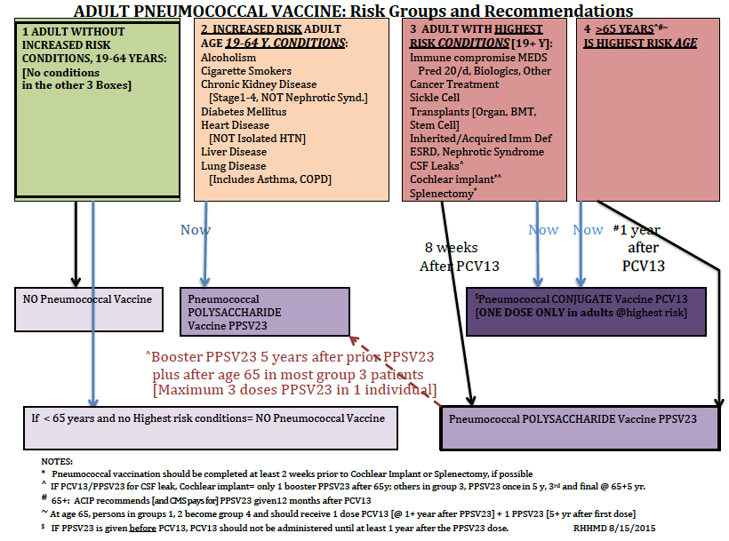
Pneumococcal Flow Sheet: ACIP Indications

Slide 87
Tdap QIP 1
Is there a problem?
Analyze the problem
Look for solutions
Quick wins
PDSA Candidates
Build a team
Start P-D-S-A
Assess results
Next cycle(s)
Same problem
Move to a new issue

Slide 88
Tdap QIP 2

Slide 89
Tdap QIP 3
And multiple other cycles could/should follow until rates are sustained at goal!
Then we turn the team’s attention to the next target!

Slide 90
Flu QIP: Starter Set

Slide 91
Additional Resources
ACP Guide to Adult Immunization
https://www.acponline.org/clinical-information/clinical-resources-products/adult-immunization
CDC Patient Education Materials
https://www.cdc.gov/vaccines/ed/patient-ed.html
Adult Vaccinations Resource Library
http://www.immunize.org/adult-vaccination/
What Works to Increase Adult Vaccination Rates
https://www.cdc.gov/vaccines/hcp/adults/for-practice/increasing-vacc-rates.html
Quick Guide to Adult Vaccine Messaging
https://www.izsummitpartners.org/content/uploads/2014/05/AdultVaccineMessaging2.pdf

Slide 92
Adult Immunization Disparities
Tamera Coyne-Beasley, MD, MPH, FAAP, FSAHM
Professor of Pediatrics and Internal Medicine
University of North Carolina-Chapel Hill

Slide 93

Definition of health disparity
Healthy People 2020 defines a health disparity as “a particular type of health difference that is closely linked with social, economic, and/or environmental disadvantage”
If a health outcome is seen to a greater or lesser extent between populations, there is disparity
U.S. Department of Health and Human Services. The Secretary’s Advisory Committee on National Health Promotion and Disease Prevention Objectives for 2020. Phase I report: Recommendations for the framework and format of Healthy People 2020 [Internet]. Section IV: Advisory Committee findings and recommendations.

Slide 94
Key Facts about Adult Immunization Disparities
Racial Disparities Among Older People: Whites aged ≥ 60 years had higher shingles vaccination coverage (27%) compared with blacks (10.7%), Hispanics (9.5%) and Asians (22.6%).
Racial Disparities in Young Adult Women: Among women aged 19-26: Non-Hispanic blacks (30.6%), Hispanics (30.3%) and non-Hispanic Asians (19.8%) each had lower coverage than non-Hispanic whites (41.7%).
Racial Disparities in Vaccination Rates of Adult Healthcare Personnel: During 2005-2013, Tdap vaccination of healthcare personnel (HCP) aged ≥ 19 was 37.3%. White HCP had higher Tdap coverage (39.9%) compared with black HCP (32.2%) and Hispanic HCP (29.5%).
Spotlight on Adult Immunization Disparities. National Adult and Influenza Immunization Summit, 2015.

Slide 95

Adult Vaccination Coverage by Nativity
Vaccination coverage among U.S. born respondents was higher than that of foreign-born respondents with few exceptions:
Influenza vaccination, aged 19-49 years and aged 50-64 years
HepA vaccination, aged >19 years
HepB vaccination, persons with diabetes, or chronic liver disease
2015 NHIS

Slide 96

Adult Vaccination Coverage by Years Living in the United States and Citizenship
Coverage varied for foreign-born persons living in the United States >10 years compared with those living in the United States <10 years
Coverage among foreign-born adults who were U.S. citizens was generally higher than that for foreign-born respondents who were not U.S. citizens
2015 NHIS

Slide 97
Adult Disparities Associated with Lack of Health Insurance
Uninsured people have lower vaccination rates than insured people
For influenza, PPSV, shingles, and HPV vaccination, coverage was two to three times higher among those with health insurance versus those without insurance
Generally, adults with a usual place for health care were more likely to report having received recommended vaccinations than those who did not
Coverage was generally higher among those reporting private vs. public insurance
Lu PJ, O’Halloran A, Williams WW. Impact of health insurance status on vaccination coverage among adult populations. Am J Prev Med 2015;48:647–61
Spotlight on Adult Immunization Disparities. National Adult and Influenza Immunization Summit, 2015.
Notes:
Adult Disparities Associated with Lack of Health Insurance: Uninsured people have lower vaccination rates than insured people. The Affordable Care Act holds the promise of eliminating lack of insurance as a barrier to immunization. However, whether these newly-insured adults will receive their recommended vaccines remains to be seen.
Influenza vaccination coverage among adults aged ≥18 years without or with health insurance was 14.4% versus 44.3%
For influenza, PPSV, shingles, and HPV vaccination, coverage was two to three times higher among those with health insurance versus those without insurance

Slide 98
Childhood Immunization Disparities: Good News
The Vaccine for Children (VFC) program was created to provide vaccines for eligible children at no cost 20 years ago
The VFC program has protected millions of children from disease and has helped to virtually eliminate disparities in childhood vaccine rates
Several vaccination disparities between racial/ethnic populations and white children have been non-existent since 2007
Elimination of Health Disparities. National Prevention Strategy, 2014.

Slide 99
Adult Immunization Disparities: Persisting, May Be Widening
Racial/ethnic gaps in immunization coverage have been shown for 7 major vaccines:
Pneumococcal, hepatitis A, hepatitis B, herpes zoster (shingles), influenza, human papillomavirus (HPV), and the tetanus/pertussis/diphtheria vaccines
There were vaccination disparities for most other groups, even after adjusting for demographic and access-to-care characteristics
Results suggest other factors that are associated with vaccination disparities are not measured by the NHIS and could also contribute to the differences in coverage
Disparities might be getting worse for Tdap and herpes zoster vaccination
Adult immunization disparities are systemic, avoidable and unfair
Elimination of Health Disparities. National Prevention Strategy, 2014.

Slide 100
INFLUENZA VACCINATION COVERAGE

Slide 101
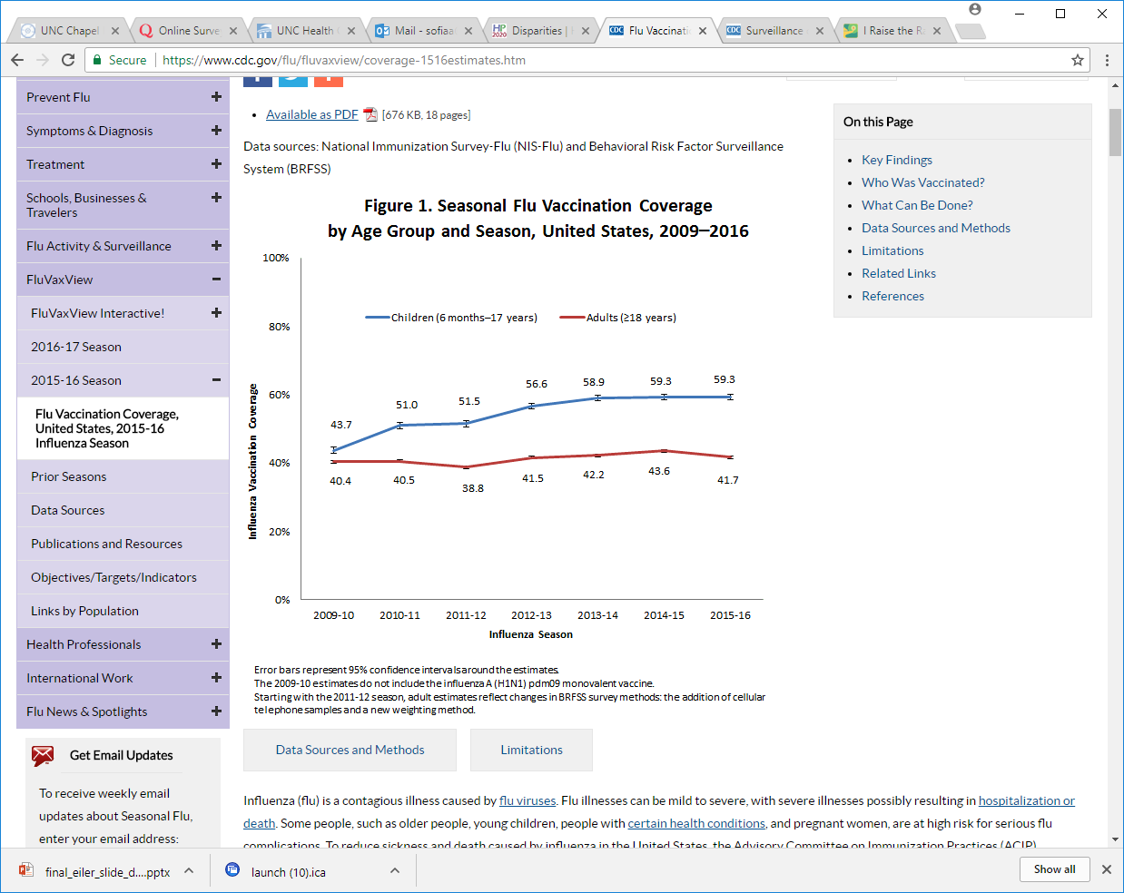
CDC. Flu vaccination coverage, United States, 2015–16 influenza season. Atlanta, GA: US Department of Health and Human Services, CDC; 2015.

Slide 102
Flu Vaccination Coverage by Race/Ethnicity, Adults 18 Years and Older, United States, 2016-17 Season
CDC. Flu vaccination coverage, United States, 2015–16 influenza season. Atlanta, GA: US Department of Health and Human Services, CDC; 2015.
Notes:
Influenza coverage among whites aged ≥19 years was higher (48.5%) than that for blacks (37.7%) and Hispanics (33.0%).
Asians had the highest coverage (47.1%)
^{Other‡‡} Includes Native Hawaiian or other Pacific Islander, multiracial, and other races.

Slide 103

PERCENT OF PATIENTS AGED 65 PLUS FOR WHOM A FLU SHOT WAS BILLED IN MEDICARE (2014)

Slide 104
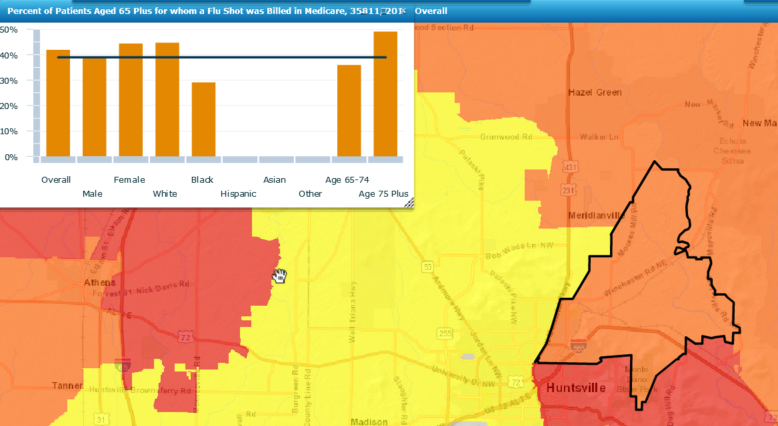
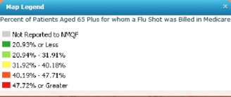
Alabama 35812

Slide 105
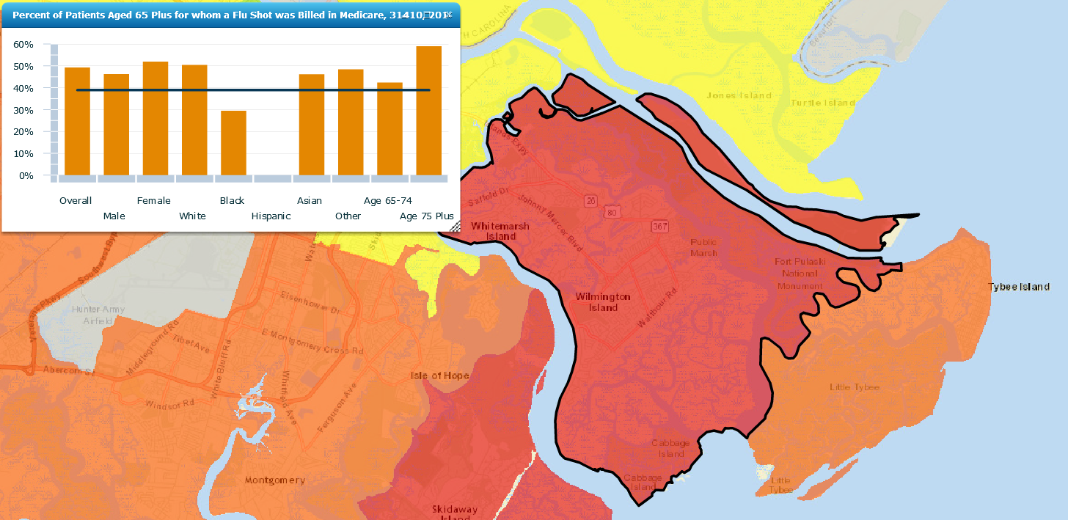
Savannah GA: 31410

Slide 106
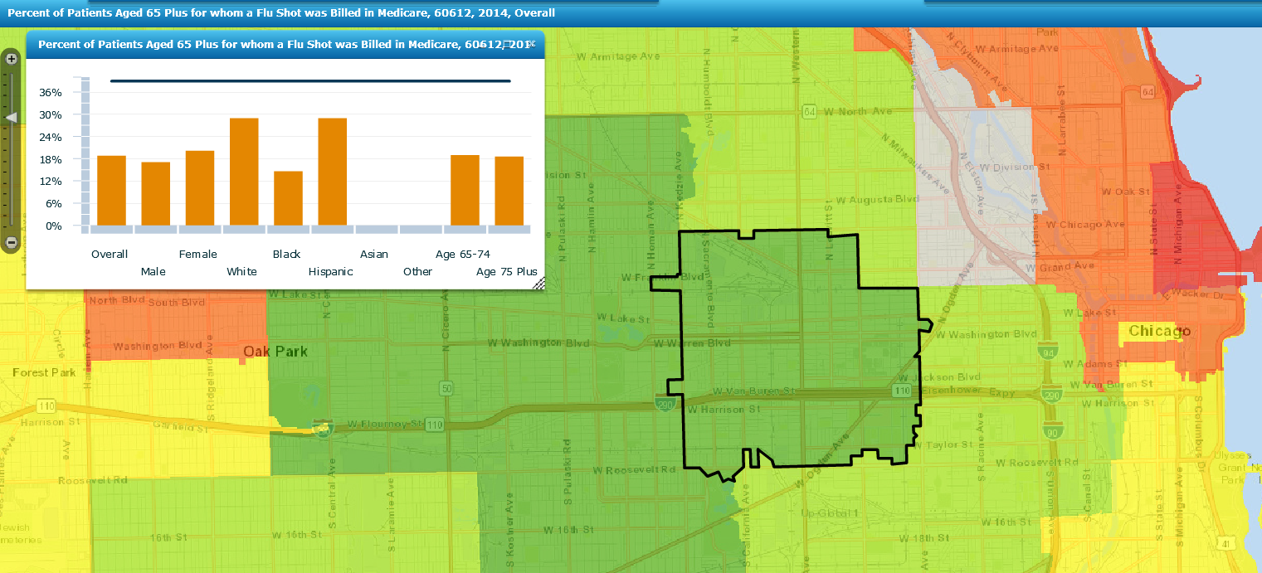
Chicago, IL: 60612

Slide 107
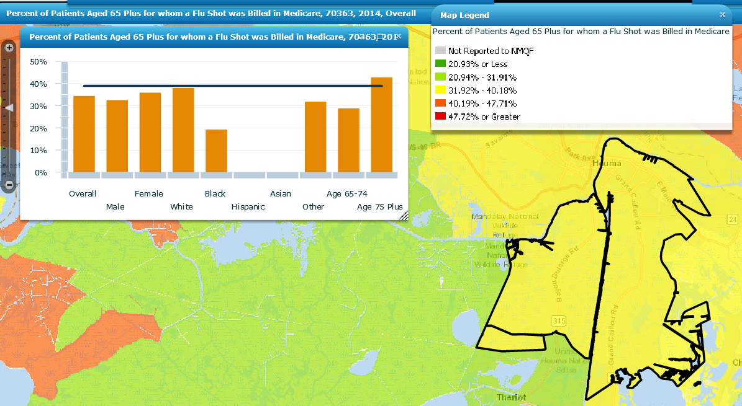
Houma, LA: 70363

Slide 108
PNEUMOCOCCAL VACCINATION COVERAGE

Slide 109
Estimated proportion of High Risk adults aged 19-64 years who received Pneumococcal vaccination by Race/Ethnicity
Williams WW, Lu P, O’Halloran A, et al. Surveillance of Vaccination Coverage among Adult Populations — United States, 2015. MMWR Surveill Summ 2017;66(No. SS-11):1–28. DOI: http://dx.doi.org/10.15585/mmwr.ss6611a1.
Notes:
Pneumococcal coverage among whites aged 19–64 years at increased risk was higher (24.0%) compared with Hispanics (19.4%) but did not differ for other racial/ethnic groups compared with whites. Coverage among whites aged ≥65 years (68.1%) was higher compared with blacks (50.2%), Hispanics (41.7%), and Asians (49.0%).

Slide 110
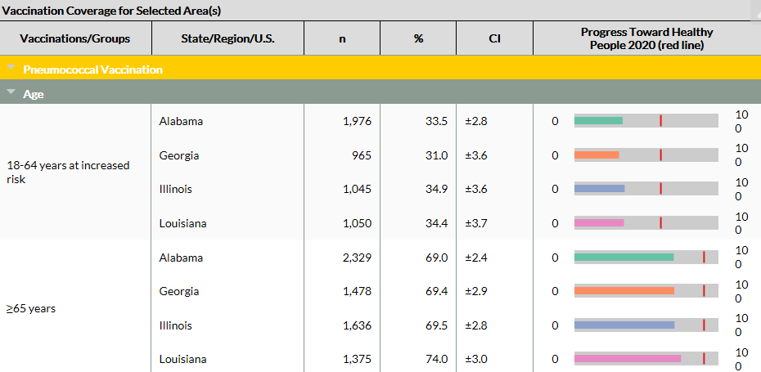
Progress Toward Healthy People 2020 for Pneumococcal Vaccine
Notes:
Goal: 90%

Slide 111
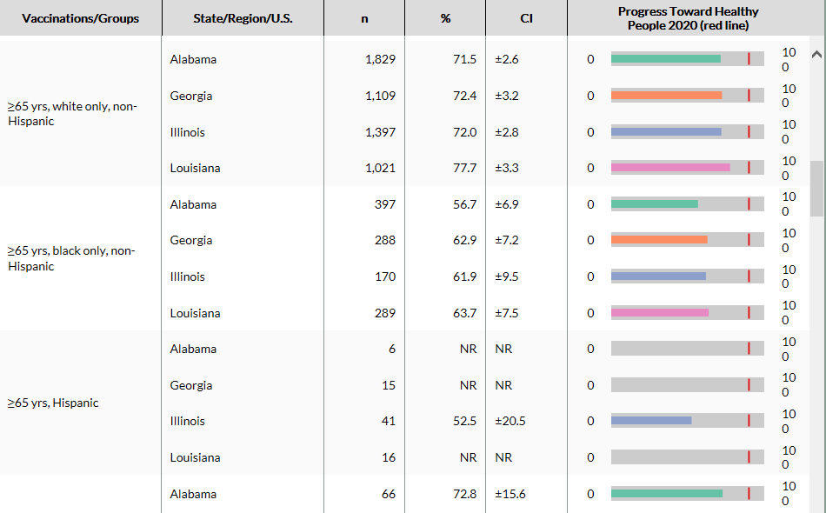
Progress Toward Healthy People 2020 for Pneumococcal Vaccine

Slide 112
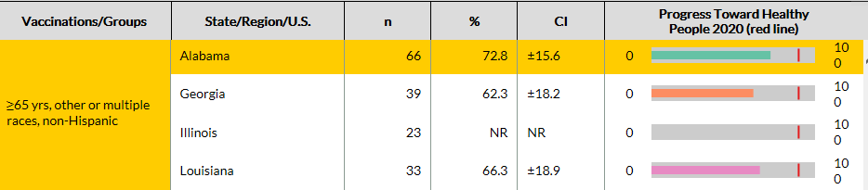
Progress Toward Healthy People 2020 for Pneumococcal Vaccine

Slide 113

PERCENT OF PATIENTS AGED 65 PLUS FOR WHOM A PNEUMOCOCCAL SHOT WAS BILLED IN MEDICARE (2014)

Slide 114
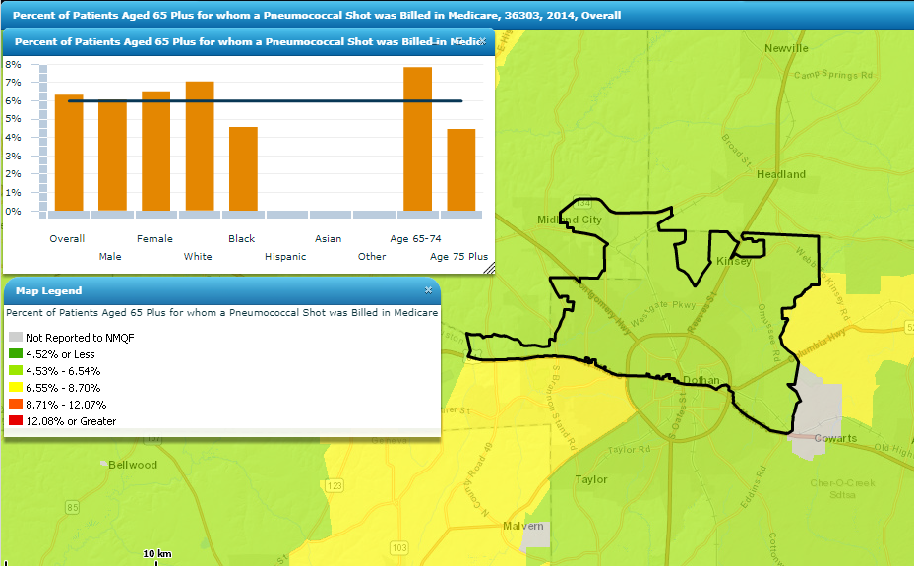
Alabama: 36303

Slide 115
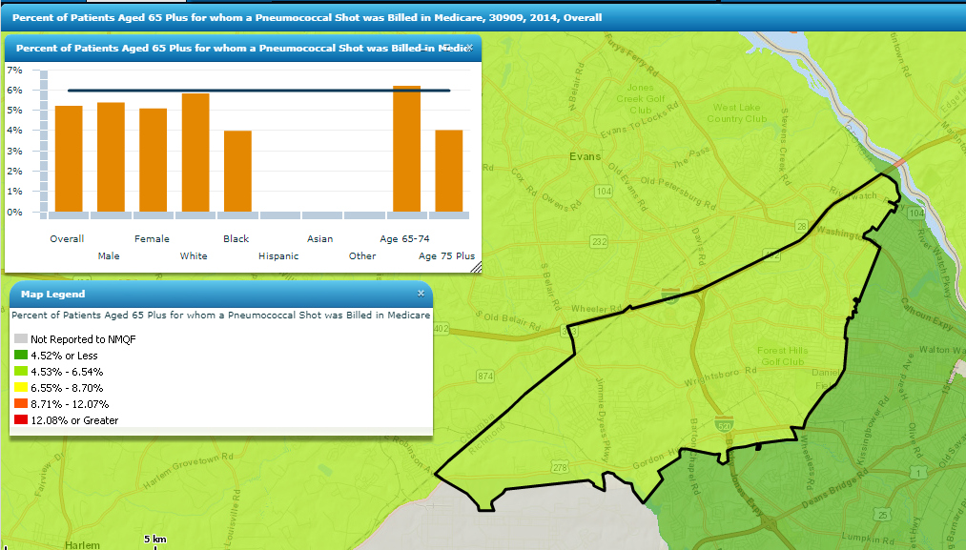
Augusta GA: 30909

Slide 116
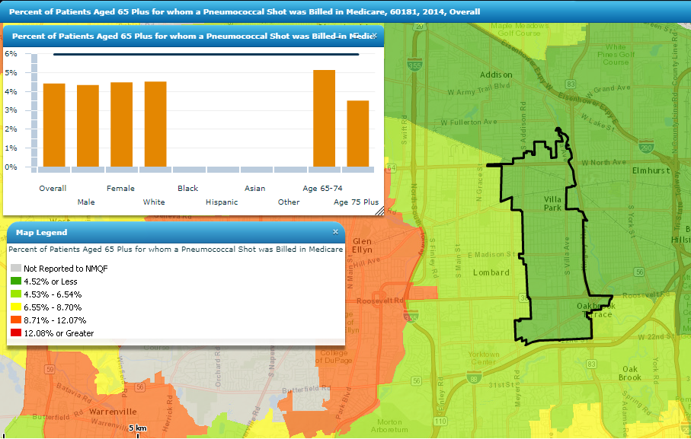
Oakbrook Terrace, IL: 60181

Slide 117
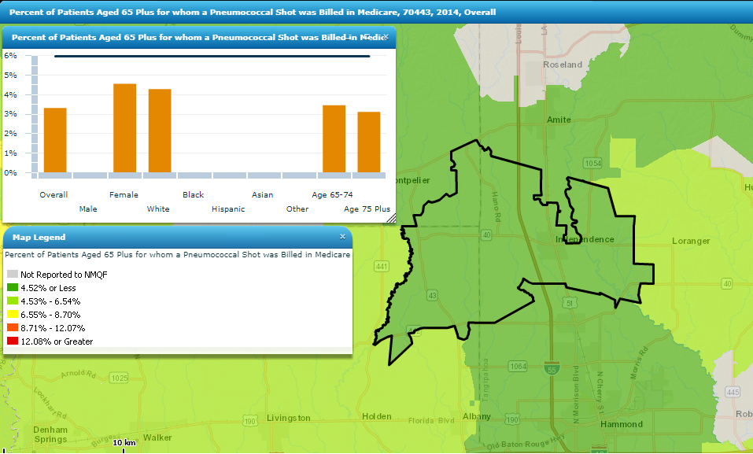
Independence, LA: 70443

Slide 118
HERPES ZOSTER VACCINATION COVERAGE

Slide 119
Estimated proportion of adults ≥60 years who received Herpes zoster vaccination, by age group and race/ethnicity
Williams WW, Lu P, O’Halloran A, et al. Surveillance of Vaccination Coverage among Adult Populations — United States, 2015. MMWR Surveill Summ 2017;66(No. SS-11):1–28. DOI: http://dx.doi.org/10.15585/mmwr.ss6611a1.
Notes:
Whites aged ≥65 years had higher herpes zoster vaccination coverage (38.3%) compared with blacks (14.1%), Hispanics (19.2%), and Asians (30.6%).
Herpes zoster vaccination coverage in 2015 met the Healthy People 2020 target of 30%.

Slide 120

PERCENT OF PATIENTS AGED 65 PLUS FOR WHOM A ZOSTER SHOT WAS BILLED IN MEDICARE (2014)

Slide 121
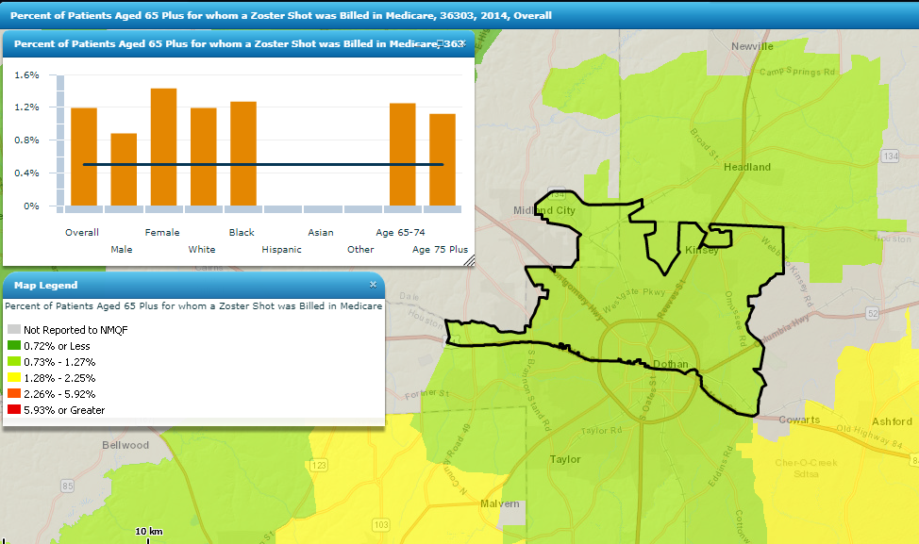
Alabama: 36303

Slide 122
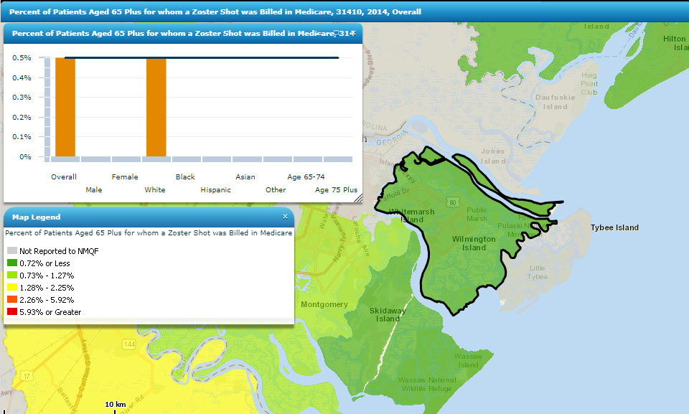
Savannah GA: 31410

Slide 123
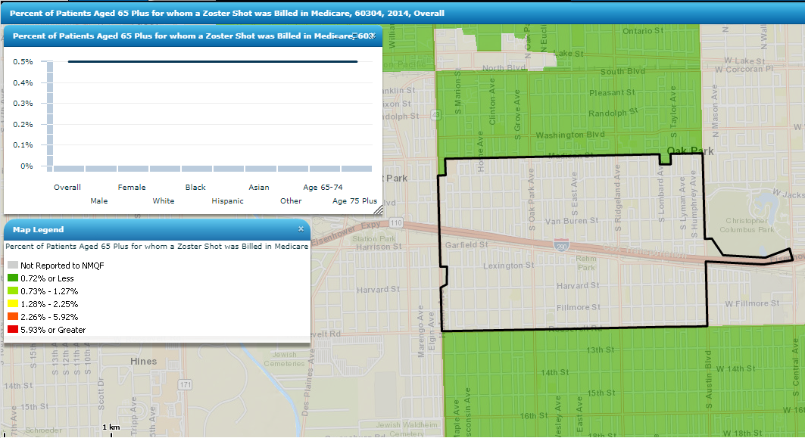
Oak Park, IL: 60304

Slide 124
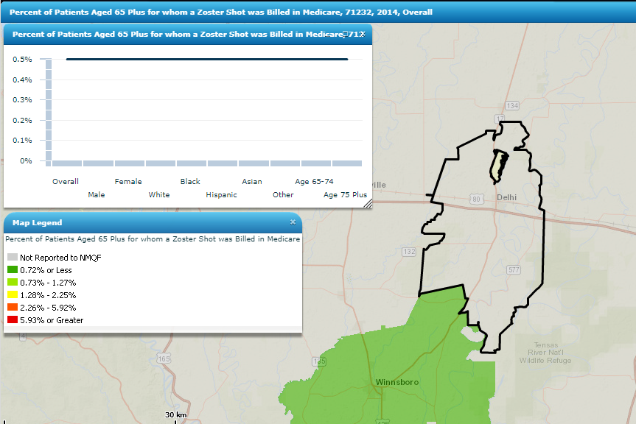
Delhi, LA: 71232

Slide 125
HPV VACCINATION COVERAGE

Slide 126
Estimated proportion of adults 19-26 years who received HPV vaccination, by age group and race/ethnicity
Williams WW, Lu P, O’Halloran A, et al. Surveillance of Vaccination Coverage among Adult Populations — United States, 2015. MMWR Surveill Summ 2017;66(No. SS-11):1–28. DOI: http://dx.doi.org/10.15585/mmwr.ss6611a1.
Notes:
HPV vaccination coverage for adults aged 19-26 was higher for Other race/ethnic groups(45.5%) followed by Whites(44.7%).

Slide 127
TETANUS VACCINATION, INCLUDING PERTUSSIS VACCINE COVERAGE

Slide 128
Estimated proportion of adults ≥19 years who received tetanus vaccination, including pertussis (Tdap) vaccine, by race/ethnicity
Williams WW, Lu P, O’Halloran A, et al. Surveillance of Vaccination Coverage among Adult Populations — United States, 2015. MMWR Surveill Summ 2017;66(No. SS-11):1–28. DOI: http://dx.doi.org/10.15585/mmwr.ss6611a1.
Notes:
Tdap coverage for black (15.1%), Hispanic (14.3%), and Asian (19.9%) adults aged ≥19 years was lower compared with whites (27.0%) and other (29.7%).

Slide 129
Estimated proportion of health care personnel who received Tdap vaccinations, by race/ethnicity
Williams WW, Lu P, O’Halloran A, et al. Surveillance of Vaccination Coverage among Adult Populations — United States, 2015. MMWR Surveill Summ 2017;66(No. SS-11):1–28. DOI: http://dx.doi.org/10.15585/mmwr.ss6611a1.
Notes:
Tdap coverage for black (28.3%)and Hispanic (38.7%) health care personnel was lower compared with Asians(49.4%), whites (49.2%) and other (56.8%).

Slide 130
Health Care Personnel Race and Ethnic Group Vaccination Differences
Among HCP with direct patient care, influenza coverage among white HCP was higher (72.8%) than that for black (53.8) and Hispanic (59.8%) HCP
Among all HCP, white HCP had higher Tdap coverage (49.2%) compared with black HCP (28.3%) and Hispanic HCP (38.7%)
White HCP generally having higher vaccination coverage compared with black and Hispanic HCP
Williams WW, Lu P, O’Halloran A, et al. Surveillance of Vaccination Coverage among Adult Populations — United States, 2015. MMWR Surveill Summ 2017;66(No. SS-11):1–28. DOI: http://dx.doi.org/10.15585/mmwr.ss6611a1.

Slide 131
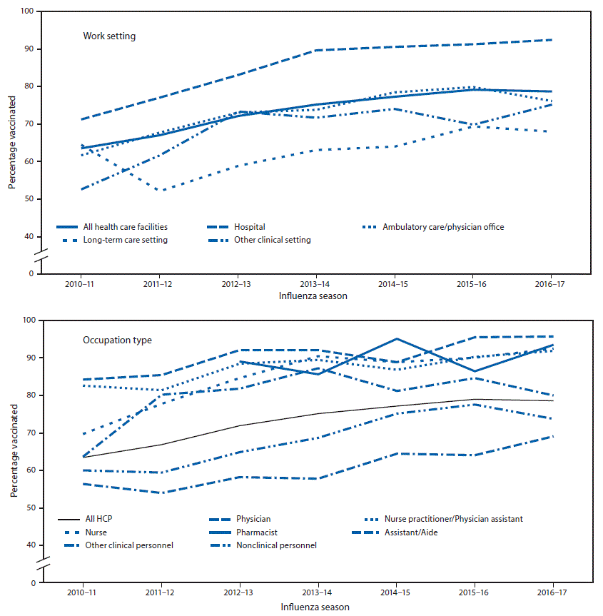
Percentage of health care personnel (HCP) who reported receiving influenza vaccination, by work setting and occupation type— Internet panel surveys, United States, 2010–11 through 2016–17 influenza seasons
Black CL, Yue X, et al. Influenza Vaccination Coverage Among Health Care Personnel — United States, 2016–17 Influenza Season. MMWR Morb Mortal Wkly Rep 2017;66:1009–1015. DOI: http://dx.doi.org/10.15585/mmwr.mm6638a1.

Slide 132
WHAT CAN BE DONE TO REDUCE ADULT IMMUNIZATION DISPARITIES?

Slide 133
What Can Be Done to Reduce Adult Immunization Disparities?
There is No Single Intervention
The causes of health disparities must be addressed with the involvement of many individuals and organizations with a cross-disciplinary approach that leverages housing, transportation, education and employment
Immunization disparities, like other healthcare disparities, are rooted in the social determinants of health
Know the Numbers
Improvement requires good surveillance
Identifying and monitoring disparities over time is a necessary first step toward the development and evaluation of evidence-based interventions that can reduce disparities
Elimination of Health Disparities. National Prevention Strategy, 2014.
Notes:
There is No Single Intervention
There is a need for broad collaborative attention and efforts sustained over time. The causes of health disparities must be addressed with the involvement of many individuals and organizations with a cross-disciplinary approach that leverages housing, transportation, education and employment. Immunization disparities, like other healthcare disparities, are rooted in the social determinants of health.
Know the Numbers
Improvement requires good surveillance. Identifying and monitoring disparities over time is a necessary first step toward the development and evaluation of evidence-based interventions that can reduce disparities.

Slide 134
What Can Be Done to Reduce Adult Immunization Disparities?
Evidence-based Interventions
Targeted at reaching populations with disparities are needed to eliminate disparities
Healthcare Reform
Offers the greatest opportunity to improve health equity and reduce disparities
Reducing financial barriers to access and improving quality to its many race, ethnicity and language specific provisions
Elimination of Health Disparities. National Prevention Strategy, 2014.
Notes:
Evidence-based Interventions
CDC Office of Minority Health states that the use of evidence-based interventions targeted at reaching minority populations are needed to eliminate these disparities. A recent study by Maurer et al states that “routine offering of influenza vaccine to amenable patient in office-based setting has the potential to increase the uptake of influenza vaccine among all adults and cut racial/ethnic disparities by one half.”
The Promise of Healthcare Reform
Health care reform offers the greatest opportunity in at least a generation to improve health equity and reduce disparities. From reducing financial barriers to access and improving quality to its many race, ethnicity and language specific provisions, the new law target s longstanding problems that have frustrated progress in improving patient outcomes and population health. At the same time, ACA is not a “disparities panacea”.

Slide 135
Healthcare Providers Can Prompt Action
Reduce disparities in their own practices
Perform standardized routine assessment, recommendation and offering of vaccines for ALL of their adult patients
Find out what disparities exist in their own patients
surveying and tracking differences in immunization rates
Elimination of Health Disparities. National Prevention Strategy, 2014.
Notes:
READ
Health care providers have a unique voice with the power to prompt action. They are positioned to collaborate with others on broad-based solutions and can find ways to reduce disparities in their own practices or clinics.
Perform standardized routine assessment, recommendation and offering of vaccines for ALL of their adult patients.
Find out what disparities exist in their own patients. Assess baseline date on the immunization rates among patients in clinics, hospitals, or other settings and identify disparities they want to reduce. Differential vaccination rates can exist across categories other than race/ethnic groups. A necessary step to reducing disparities in any setting is surveying and tracking differences in immunization rates, whether in a single practice, or on a bigger level.

Slide 136
Healthcare Providers Can Prompt Action
Continue being an energetic immunization champion
Carry out quality improvement projects as part of their “Maintenance of Certification” process or residency training
Build a diversified workforce of healthcare providers in their workplace
Target the newly insured patient for vaccination
Utilize patient education materials in foreign languages, when appropriate. (www.immunize.org/adult-vaccination/resources.asp) (www.cdc.gov/vaccines/hcp/patient-ed/adults/index.html)
Elimination of Health Disparities. National Prevention Strategy, 2014.
Notes:
Become an energetic immunization champion, a common characteristic of successful immunization programs. Beyond every successful effort is passionate human leadership. When healthcare providers identify disparities in their community or state that they want to address, working with other like-minded persons is a good course of action.
Carry out quality improvement projects as part of their “Maintenance of Certification” process or residency training. This is a concrete commitment to reducing disparities with the providers’ sphere of influence.
Build a diversified workforce of healthcare providers in their clinic, hospital or workplace.
Target the newly insured patient for vaccination
Utilize patient education materials in foreign languages, when appropriate. (www.immunize.org/adult-vaccination/resources.asp) (www.cdc.gov/vaccines/hcp/patient-ed/adults/index.html)

Slide 137
National Prevention Strategy Recommendations
Reduce disparities in access to quality health care
Support research to identify effective strategies to eliminate health disparities with a focus on communities at greatest risk
Support and expand cross-sector activities to enhance access to high-quality education, jobs, economic opportunities and opportunities for healthy living
Elimination of Health Disparities. National Prevention Strategy, 2014.

Slide 138
Actions At The Community and Federal Level
Identify and map high-need areas that experience health disparities and align existing resources to meet these needs
Support policies to reduce exposure to environmental and occupational hazards, especially among those at greatest risk
Support health center service delivery sites in medically underserved areas and place primary care providers in communities with shortages
Elimination of Health Disparities. National Prevention Strategy, 2014.

Slide 139
Actions Partners Can Take
Use community resources to improve ability to read, understand and use health information
Help ensure prevention strategies are culturally, linguistically and age appropriate, and that they match people’s health literacy skills
Provide internet access and skill-building courses to help residents find reliable health information and services
Elimination of Health Disparities. National Prevention Strategy, 2014.

Slide 140
Actions Partners Can Take
Increase the cultural and communication competence of health care providers
Train and hire more qualified staff from underrepresented racial and ethnic minorities and people with disabilities
Provide opportunities for workplace prevention activities, including preventive screenings
Improve coordination, collaboration, and opportunities for engaging community leaders and members in prevention to ensure health needs are identified and barriers addressed
Elimination of Health Disparities. National Prevention Strategy, 2014.

Slide 141
References
Black CL, Yue X, et al. Influenza Vaccination Coverage Among Health Care Personnel — United States, 2016–17 Influenza Season. MMWR Morb Mortal Wkly Rep 2017;66:1009–1015. DOI: http://dx.doi.org/10.15585/mmwr.mm6638a1.
CDC. Flu vaccination coverage, United States, 2015–16 influenza season. Atlanta, GA: US Department of Health and Human Services, CDC; 2015.
Elimination of Health Disparities. National Prevention Strategy, 2014.
Lu PJ, O’Halloran A, Williams WW. Impact of health insurance status on vaccination coverage among adult populations. Am J Prev Med 2015;48:647–61
Spotlight on Adult Immunization Disparities. National Adult and Influenza Immunization Summit, 2015.
U.S. Department of Health and Human Services. The Secretary’s Advisory Committee on National Health Promotion and Disease Prevention Objectives for 2020. Phase I report: Recommendations for the framework and format of Healthy People 2020 [Internet]. Section IV: Advisory Committee findings and recommendations.
Williams WW, Lu P, O’Halloran A, et al. Surveillance of Vaccination Coverage among Adult Populations — United States, 2015. MMWR Surveill Summ 2017;66(No. SS-11):1–28. DOI: http://dx.doi.org/10.15585/mmwr.ss6611a1.
2015 NHIS

Slide 142
Q&A

Slide 143
Next Steps
Melat Aklilu, MPH

Slide 144
Following Today’s Webinar
Review ACP Adult Immunization resources (link)
Complete PDSA worksheet (link)
Sign-up for coaching call with today’s faculty (link)
Monday, Nov. 13, 2017, 10-11AM (EST), 9-10AM (CST)—Faculty: Dr. Bob Hopkins
Tuesday, Nov. 28, 2017, 6-7PM (EST), 5-6PM(CST)— Faculty: Dr. Mike Soppet
Friday, Dec. 15, 2017, 3-4PM (EST), 2-3PM (CST)—Faculty: Dr. Tamera Coyne-Beasley
Begin collecting pre-intervention data

