Slide 1
WHAT IN THE WORLD IS A CHIEF VACCINATION OFFICER ?
--And Why would you need one or want to be one ?
Notes:
In the next 90 minutes we will try to tell a story, a story of a journey which began about 6 or 7 years ago, and which is not yet completed. This is the story of the origin of the concept of the CVO and evolution of our small clinical practice.

Slide 2
On the Webinar today
Carla Adams, LPN (CVO)
Emily Cain, LPN (CVO)
Charles M. Soppet MD, FACP
Notes:
These are the team members who are on the call today.

Slide 3

Our Team
EMILY, GLENDA, AND CARLA
LPN’S
(LICENSED
PROACTIVE NURSES)
Notes:
So that you can better understand our physical setup from an architectural and organizational standpoint, our building consists of two wings. Each wing contains two pods per wing with two teams per pod. Each team consisted of two LPN’s and one M.D. per team. One scheduler and one CRNP per wing with one additional LPN or MA. These are the key members of the team who have made the journey with me. My partners in this endeavor--our scheduling assistant, Glenda (in the middle) and two LPN’s, Emily on the left and Carla on the right. Glenda is not on the call today. Ladies, say “hello”

Slide 4
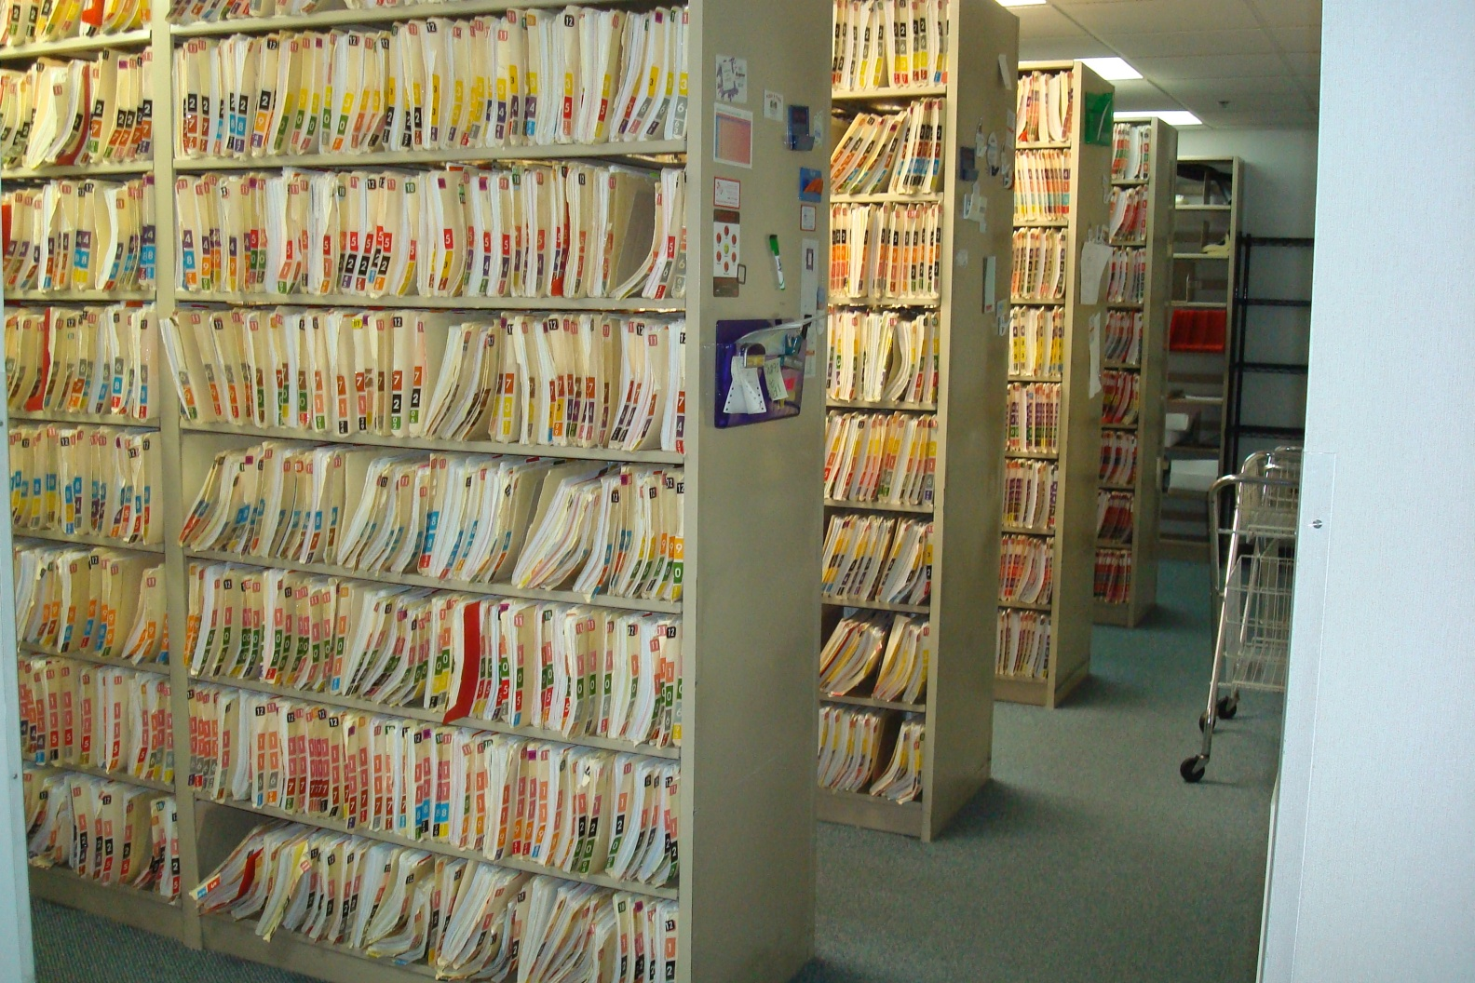
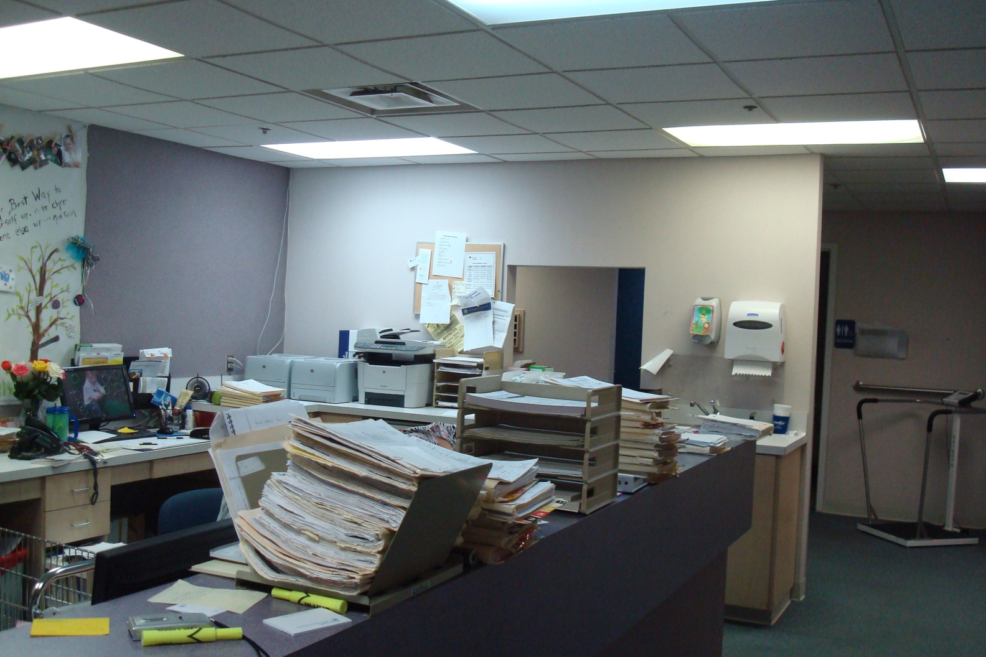
“The Good Old Days”
Notes:
This was our life before 2010. This all seems like a dream to me now. Is this a dream or a nightmare?

Slide 5
Clear Electronic Health Record Advantage
Central Repository of Adult Immunization Information
  Initial labor input is intensive
  Labor decreases exponentially with time
  However:
  Interoperability with state immunization information systems problematic
  Interconnectivity with third party registries costly and problematic
Notes:
Beginning in that year, we transitioned from paper charts to an Electronic Health Record. There have been clear benefits. The E.H.R. has enforced some degree of standardization among documentation by practitioners, which is a little appreciated benefit, and the “chart room at each workstation” has reduced time in accessing records at the drop of a hat. Additionally, for some, it has created a problem list discipline which was previously lacking. Clearly the electronic health record has made it easier and faster to do pre-visit planning for and track immunizations. The information is located in one place in the chart and there is no time consuming chart retrieval and then searching meticulously through pages in the chart to find each prior immunization, which may have been located either in the individual note, on the face sheet, or in a separate immunization sheet.

Slide 6
Realities of Modern Practice
1) Electronic Health Records have increased physician workload
2) Electronic Health Records have reduced physician productivity/availability
3) Electronic Health Records have increased practice costs and therefore new revenue streams are needed
Notes:
These are some of the realities of the new system which are not so advantageous. Increasingly, the electronic record has worsened the bottleneck which occurs at the point of decision. More decisions flow to physicians and more clerical work “must” be done by the physician per government decree in order to provide “Meaningful use” of the electronic record. Practice costs have increased each year the electronic medical record has been in place and are projected to increase each year in the future.
They are familiar to you and we won’t belabor them. They have fundamentally changed the way we must practice.

Slide 7
Challenges of Adult Immunizations
  Immunization combines areas of clinical practice with areas of retail sales
  We have made little headway in Immunization uptake in 40 years
  The “Immunizing Event” is Complicated
    Patient Attitudes and refusal rates lend uncertainty
    Cost Issues for patients and physicians
      Each patient has different payment requirements
    Billing and collections are different from retail
      No one size fits all payment
Notes:
Since mass immunization was first proposed as a health and wellness strategy by the Surgeon General in 1976, we have made little headway. Still less than half of our population receives annual influenza immunization and the rates for other adult immunizations are similarly low. Why is this the case with all our new tools?

Slide 8
The process of office immunization
Step one: order vaccine
Step Two: receive and reconcile vaccine quantity against order
Step Three: store the vaccine safely and securely
Step Four: distribute vaccine to the intermediate user (vaccinator)
Step Five: identify and administer vaccine to end user (patient)-pre-visit planning
Step Six: document vaccinating event in the medical record and State Registry
Step Seven: enter a charge in the practice management system
Step Eight: bill for both the administration fee and the vaccine charge
Step Nine: generate an insurance claim and collect copayment (Part D only)
Step Ten: reconcile all charges with collections
Step Eleven: Reconcile inventory (doses @ begin day - vaccine doses given = vaccine doses remaining @ end of day)
Step Twelve: Produce Cash flow (Income and Expense) statement
Notes:
In trying to answer that question, we have identified some so-called “barriers to immunization”. Some of those include:
1) decision control in large practices,
2) belief system of physicians and patients—Stephen Hawking has referred to this as Model Dependent Realism
3) availability of vaccines at the time of patient encounters
4) types and variety of vaccines available
5) economic risk to the physician or practice.
One barrier that has not been discussed much is that this is a surprisingly complicated process. Each immunizing event individually has all the elements of a project.

Slide 9
The Immunizing Event along a Process Continuum
Inventory Control
(Steps 1-4)
Vaccine Administration and Documentation
(Steps 5-7)
Claims and Revenue Collections
(Steps 8-10)
Auditing and Report Generation
(Steps 11-12)
Phase I
Phase II
Phase III
Phase IV
Phase V= Retail Possibilities
Notes:
So we can think of this complicated immunizing event as a continuous process which necessarily proceeds along an organized path. In order to be successful, each step must occur. In order for it to be optimum, each phase must be completed in its entirety. In some practices, physicians participate in or control “i.e. become the bottleneck in” all phases. The ultimate purpose of the Chief Vaccination Officer is to remove all unnecessary bottlenecks and to relieve the physician of as much of this detail as possible.
The path to becoming a Chief Vaccination Officer usually begins in Steps 5-7. This is the clinical knowledge phase. Physicians certainly have an important role to play in initially imparting this knowledge to the “vaccinator” but once imparted, this can be reinforced by the use of the Standing Orders Protocol. Repetition and consistency are necessary to inculcate this as a routine part of practice. Every patient, Every Visit, Every Time should be the Mantra you follow.

Slide 10
Work Shared is half the work—Fun Divided is twice the Fun
Notes:
If there is such a thing as a central idea of the CVO concept, this is that central idea. For anyone who has ever been part of an interdependent team, you have experienced the joy of that experience. If you have not, you are missing out on at least half of the joy in practice.

Slide 11
IDEA: Multiply the fun
Empower through Knowledge, Authority, and Responsibility
Reward through Education, Credit, and Incentives
Celebrate through Success
Notes:
We build teams through knowledge, authority, training and education and we maintain and improve them through empowerment, rewards, and celebrations

Slide 12

CVO as Leader of a Team
Notes:
The Concept of Servant Leadership. Leadership involves both Education (the imparting of Knowledge) and the Acquisition of Skills. The skills necessary begin with the clinical knowledge of how to do the job and are augmented through skills gained in conflict management, listening, organization, division of labor, and how to conduct effective meetings. Specifically, the job of a team Leader is to keep others accountable by providing the tools and resources they require to do their particular part of the job, providing clear goals and a plan to meet those goals, and then keeping track of the progress or lack of progress towards the goal. They do this by way of a continuous Quality Improvement Plan which is accomplished on a daily basis by utilizing consecutive Plan-Do-Study-Act cycles to achieve these goals of doing the job better each time we do it.

Slide 13
A Conversation
Notes:
So, we would like to pause now in our didactic portion of the webinar for a conversation about the process. I want to bring Emily and Carla back in. Hello, ladies! Would you say I have summarized the concept of our team? So, Carla, let me begin with you, since you were there in the beginning. If you don’t mind, please tell us a little about your professional background and experience. I have my own perspective, but I am interested in hearing from your perspective how you and I came to form this partnership? Emily, same question to you. Would you like to chime in?

Slide 14

CVO as Project Manager
Notes:
Project management involves education in how to manage a project. Education is Knowledge which can be imparted, that is transferred from one person to another.

Slide 15
The Immunizing Event along a Process Continuum
Inventory Control
(Steps 1-4)
Vaccine Administration and Documentation
(Steps 5-7)
Claims and Revenue Collections
(Steps 8-10)
Auditing and Report Generation
(Steps 11-12)
Phase I
Phase II
Phase III
Phase IV
Phase V= Retail Possibilities
Notes:
As I was preparing to retire from practice at age 65, Carla was going to be out of a job. My plan was to transition her to become the CVO for our entire practice. After all, as she has stated, she was already knowledgeable in Phase I from her experience in a previous practice. She was very knowledgeable and facile in Phase II. The plan was to expand the immunization services into the other six clinical teams within the practice. Phase III would still be handled largely by our in-house insurance and billing department, though the plan was to introduce Carla to this important issue and to teach her how to speak the insurance language so that she could act in an auditing capacity. Phase IV would have been a new responsibility and in this capacity she would work as a liasan between the Claims/Revenue department, our accountant, and the practice manager. She would serve as our Immunization Quality Control officer and general quality and financial reports for the partners and the business manager. As you become better at immunization and more of your patients are “fully immunized” or up to date on their immunizations, there is a natural plateau which occurs in immunization volume during your practice. This then allows you to open up your immunizing arm to become a community wide immunizer for your community.

Slide 16
Phase I: (Steps 1-4)
INVENTORY CONTROL:
Clerk with organizing talents and aptitude
(Maranda)

Slide 17
Phase II: (STEPS 5-7)
VACCINE ADMINISTRATION AND DOCUMENTATION:
  LPN, RN, OR MEDICAL ASSISTANT (Carla and Emily)
(DEPENDS UPON STATE LICENSING REQUIREMENTS FOR ADMINISTRATION OF INJECTIONS)
Notes:
These steps also include Patient Vaccine Education, including providing patient with Vaccine Information Sheets, discussion of side effects and benefits, preparing and giving the vaccine, accounting for the vaccine dose, and documenting the administration in the electronic health record and the state immunization information system and all clinical registries. It also now includes querying the state immunization information system and downloading/uploading the vaccinations needed an given to the state IIS.

Slide 18
Phase III: (STEPS 8-10)
CLAIMS AND COLLECTIONS:
  Billing Clerk/Insurance Clerk
    (Sue/Kathy)

Slide 19
Phase IV: (STEPS 11-12)
AUDITING AND REPORTING:
  Practice Manager/Business OfficeManager or CVO
  (Danny)

Slide 20
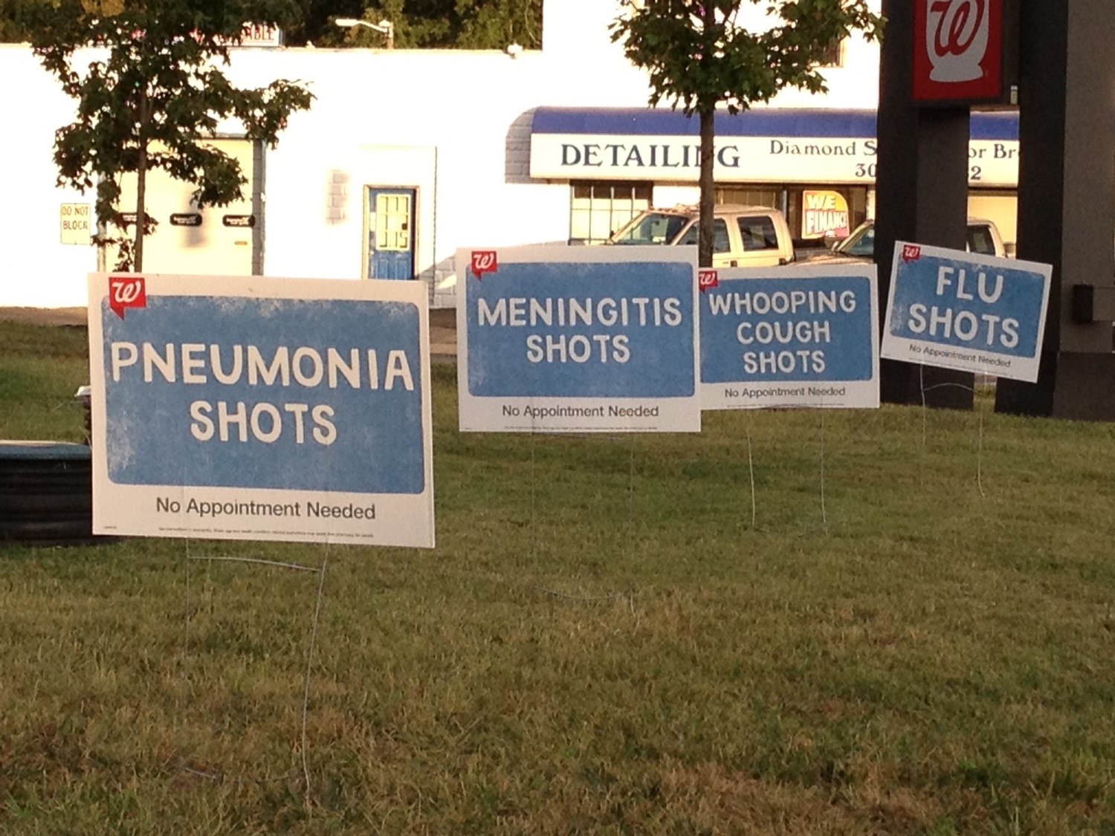
Phase V: Explore the Retail Possibilities

Slide 21
The Immunizing Event along a Process Continuum
Inventory Control
(Steps 1-4)
Vaccine Administration and Documentation
(Steps 5-7)
Claims and Revenue Collections
(Steps 8-10)
Auditing and Report Generation
(Steps 11-12)
Phase I
Phase II
Phase III
Phase IV
Phase V= Retail Possibilities
Notes:
So lets again re-orient ourselves. Most of the individuals on this webinar are probably approaching this idea from a clinical standpoint, so we are going to begin your journey in the clinical phase, Phase II. We will present some tips and tools which you can use to begin your journey.

Slide 22
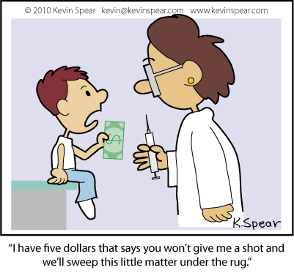
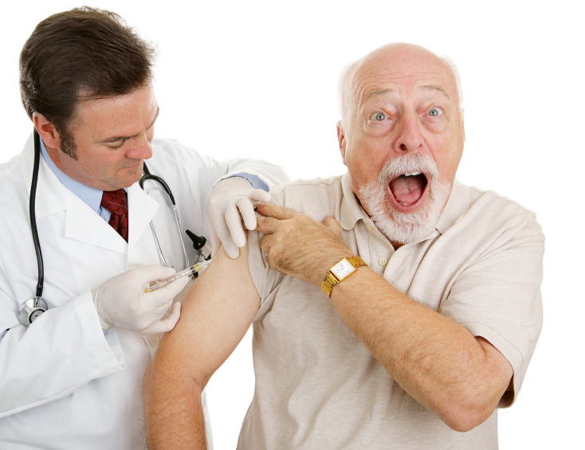
Phase II: Vaccine Administration and Documentation

Slide 23
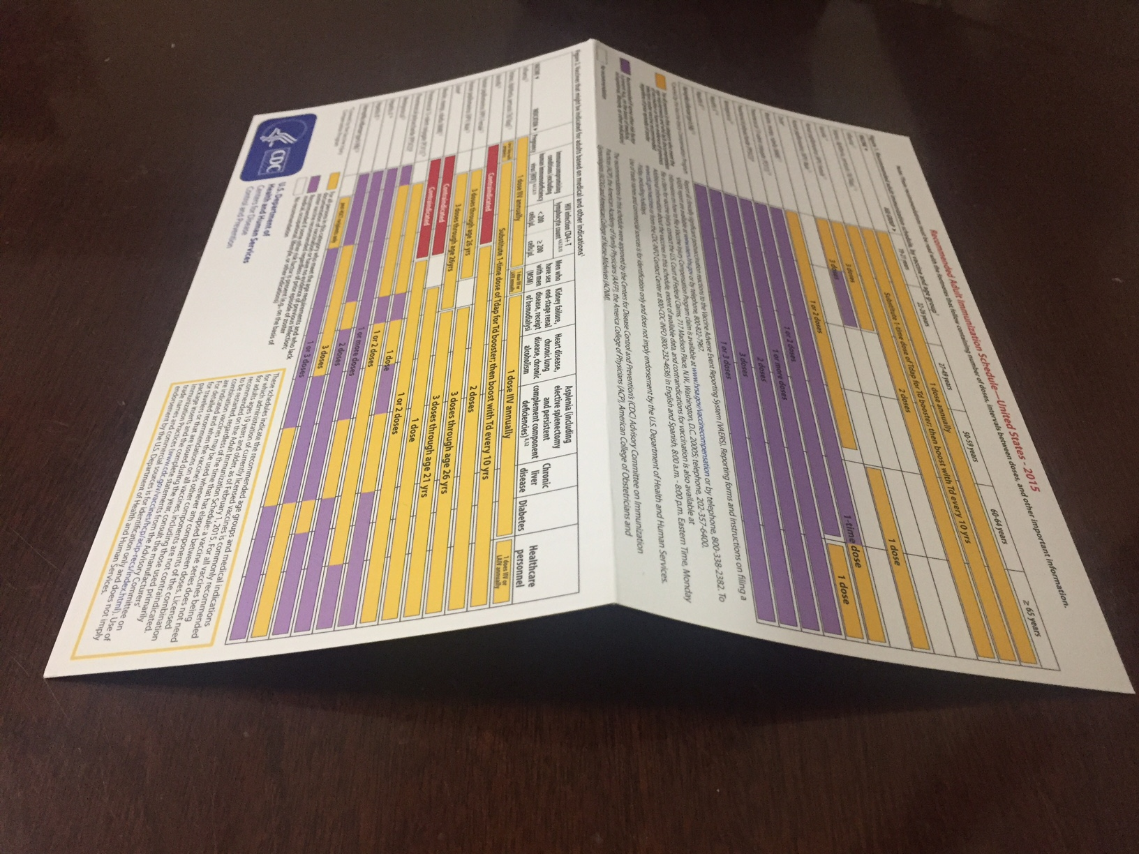
Starting with Steps 5-7:
Vaccine Administration and Documentation:
http://www.cdc.gov/vaccines/hcp/adults/for-practice/standards/index.html
When folded, 8 inches x 4.5 inches
Fits easily in pocket of scrubs or coat
Notes:
Here is the “I hope” familiar CDC color card on Adult Immunizations. It is available from the CDC as a folding card or you can print off their website and make your own on some card stock. You can laminate it and make it foldable. The top half is for Adult Immunizations by age and the bottom half for special populations. The reverse side has all kinds of footnotes of explanation in case you need more information. Most fledgling CVO’s will feel most comfortable with this part of the job, but we can all improve our knowledge base. So start here by improving skills and knowledge.

Slide 24
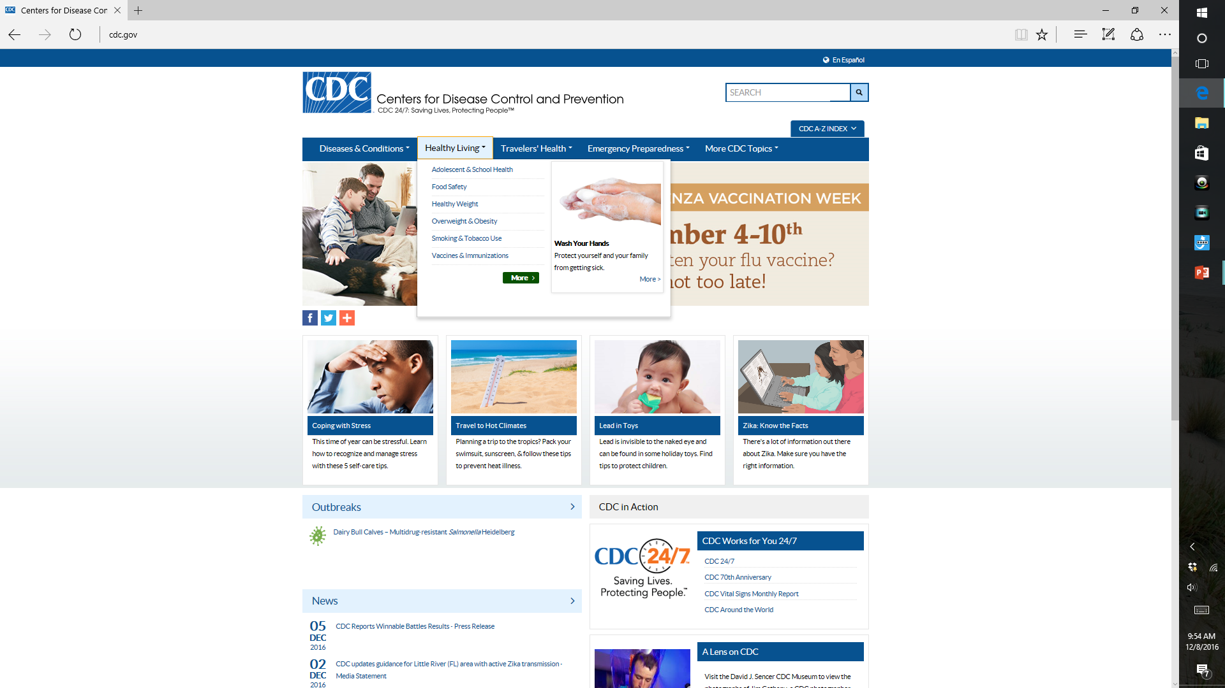
www.CDC.gov
First Click here
And then
Click here
Notes:
After printing and using the adult immunization card, a great place to start in beginning to educate yourself or your team about the process of immunizing adults is at the CDC website.

Slide 25
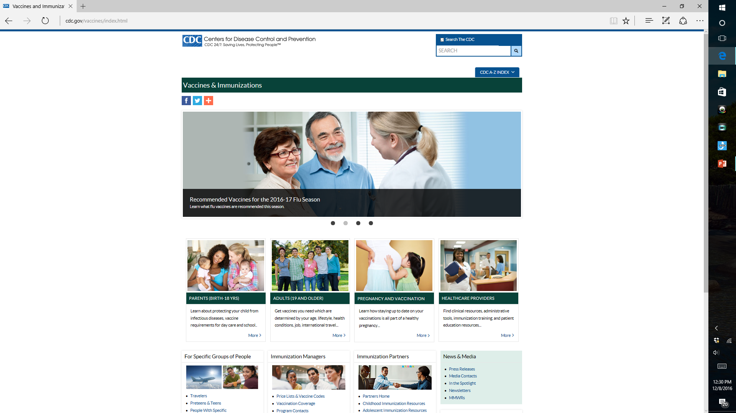
This Brings you to the Immunization Master Page
Information for
CVO’s
Information
For Patients
Notes:
After clicking in those two places, the immunization master page will appear. It contains both information for patients which you can print or distribute, and information for health care professionals. The healthcare professionals information is available in two places—the “healthcare professionals” area and the “immunizing managers” area. A CVO is both.

Slide 26
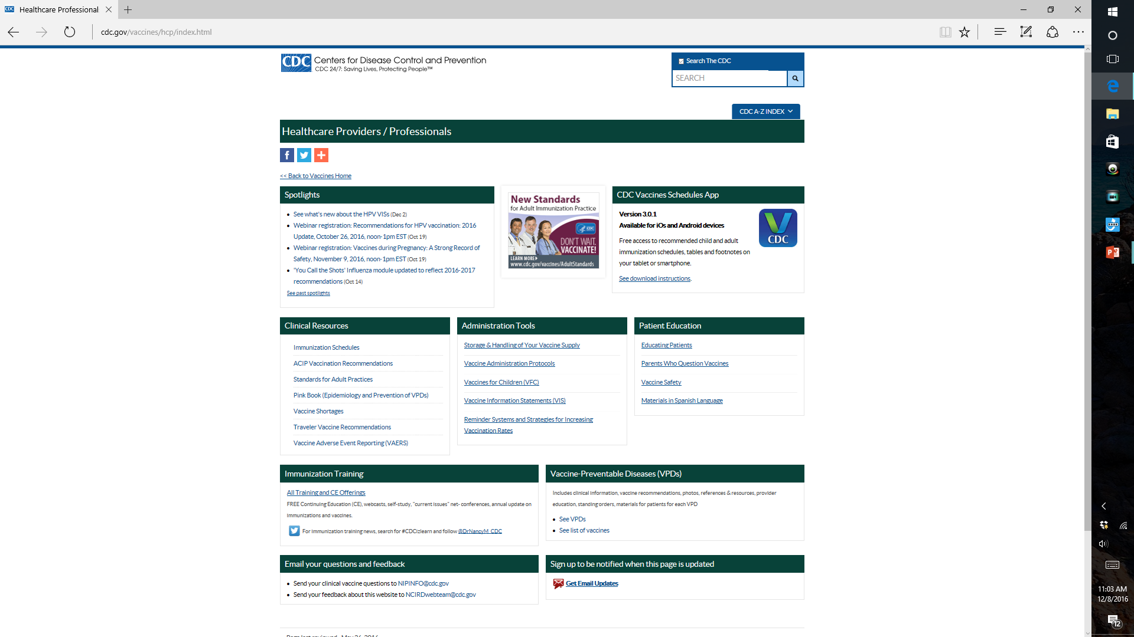
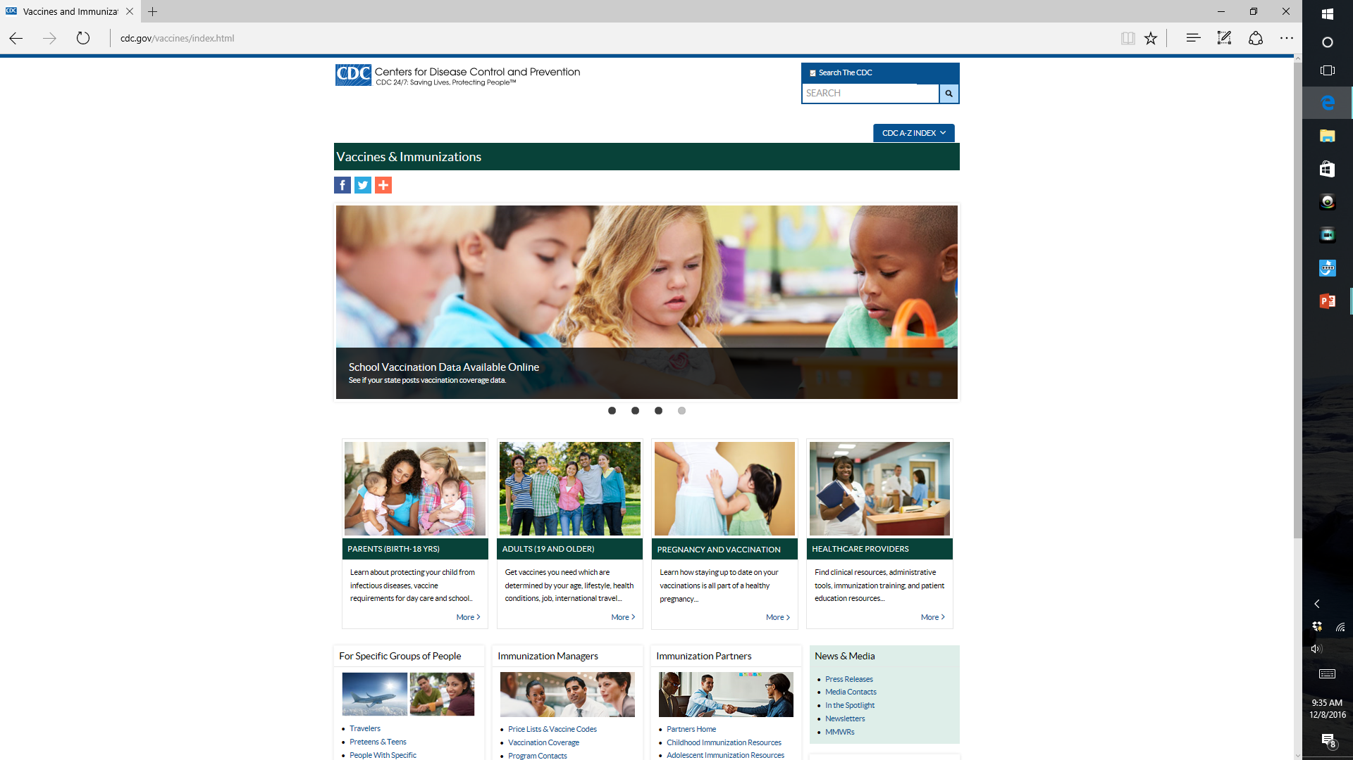
Adult Immunization
Schedules
Adult Immunization
Standards
Adult Immunization
standing orders and
other great tools !!
Information for CVO’s
Step #2
Adult Immunization
Information for patients
Step #1
Notes:
If you click on the Healthcare professionals “more” tab from the immunization master page, you will come to the Healthcare Professionals master page. Here you will find a wealth of tools which you may print to form your own “Immunization Policies and Procedures” manual. Not only are up-to-date immunization schedules available, but there is a great page on State of the Art Adult immunization Standards for your policy book and a terrific collection of “Adult Immunization Standing Orders”. Print these and have your physicians vote to adopt them and you have a ready made Policy and Procedure Manual for Adult Immunization in your practice. Avoid reinventing the wheel wherever possible. We want to make this easier, not harder for you.

Slide 27
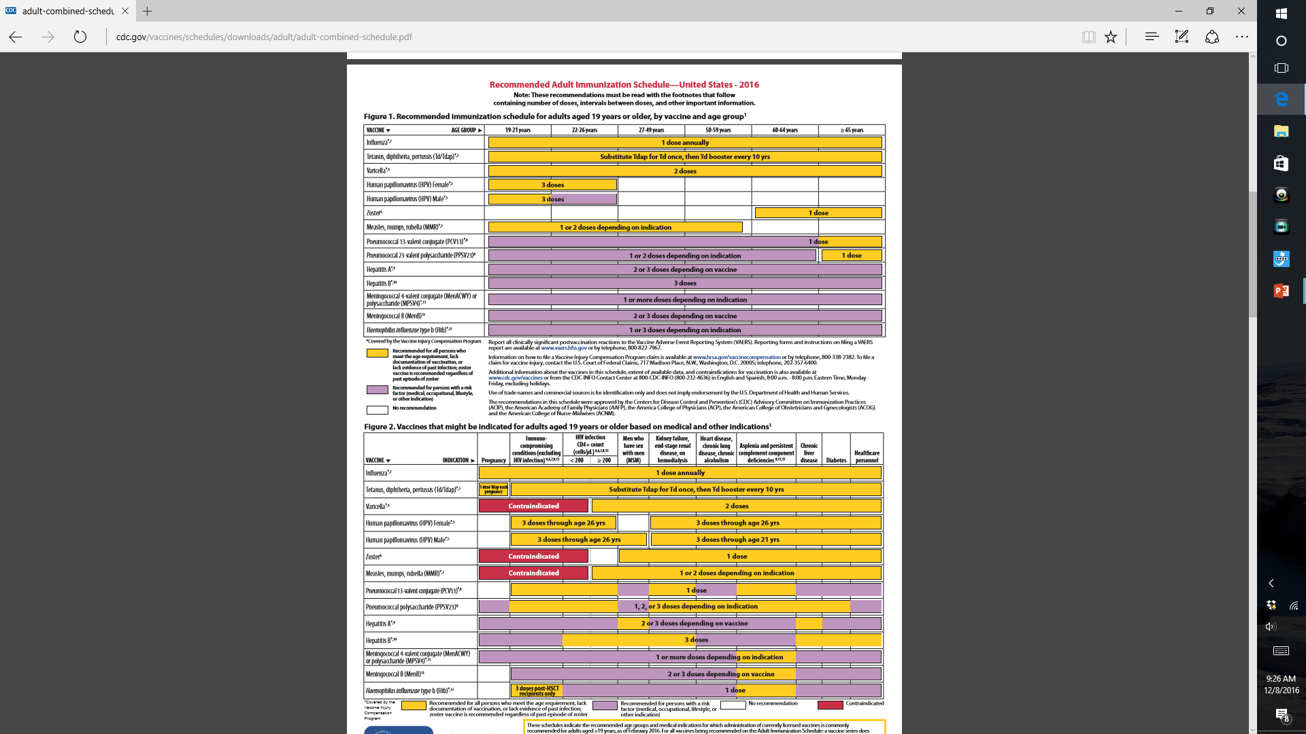
2016 Adult Vaccination Schedule
Notes:
So after clicking on immunization schedules tab on the healthcare professionals master page you will find the latest information. It is also available in an easy to read format which can be used by healthcare professionals or patients. Showing patients this in the easy-to-read format often allows them to verify for themselves the vaccines that are recommended just for them. This allows them to, as Emily mentioned, “take ownership” of their own vaccination status. It too is printable if they need time at home to think about it.

Slide 28
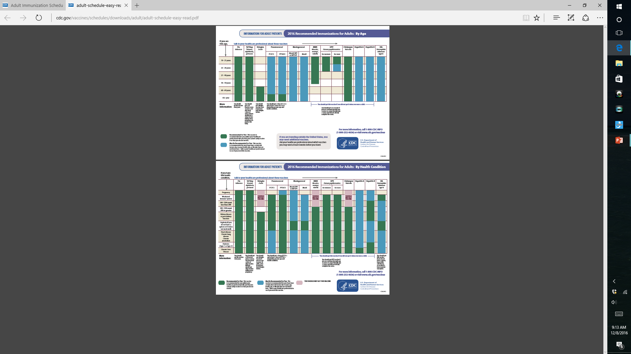
http://www.cdc.gov/vaccines/schedules/downloads/adult/adult-schedule-easy-read.pdf
Your Choice-
old style or new “easy to read for everybody”
Notes:
Here is the direct link to the immunization schedule so you don’t have to go through the master pages to get there. So now you know two ways to get to the pages. Good idea to keep these web addresses in your policy and procedure manual.

Slide 29
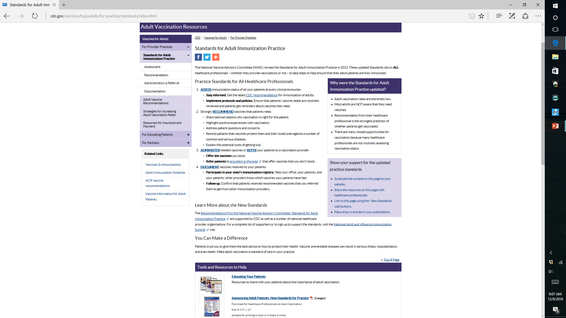
Step #1
Notes:
Again, from the Healthcare Professionals Master Page, clicking on the Adult Immunization Standards tab brings up this page. There are hyperlinks in blue which direct you to helpful pages of explanation and examples.

Slide 30
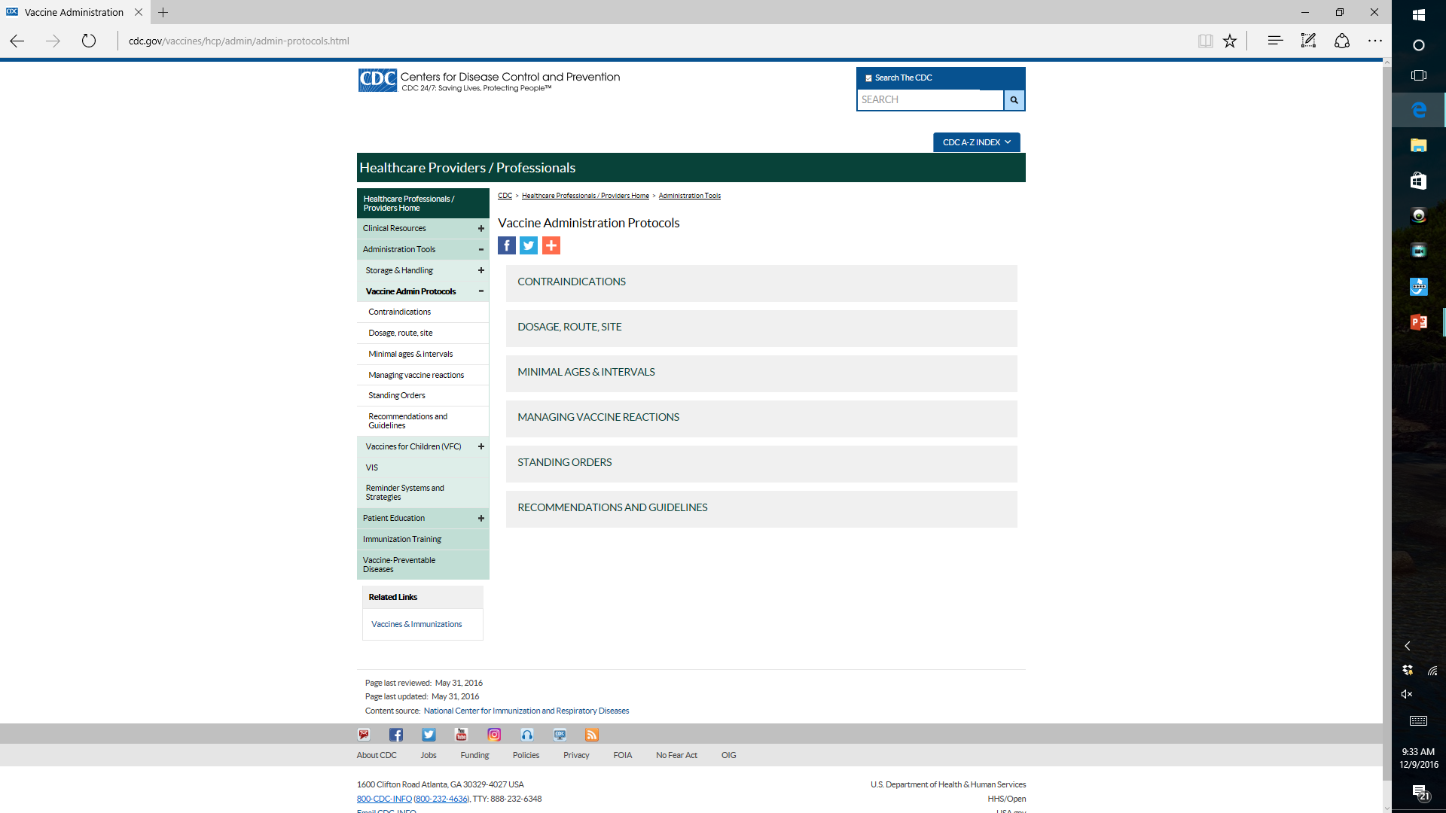
Tools for Vaccine Administration
(Standing Orders etc)
Everything you
Need to Know
In one Place !!
Notes:
From the Healthcare Professionals Master page click on the “Administration Tools” button brings you to this page. Click on the “Standing orders” tab. This page contains everything you need to know and include in your policy and procedures manual for Vaccine Administration. Don’t re-invent the wheel.

Slide 31
This Brings you to the Immunization Master Page
Information for
CVO’s
Information
For Patients
Notes:
If we go back to the immunization master page and click on the “Adults 19 and older tab” shown here, we will come to patient level information.

Slide 32
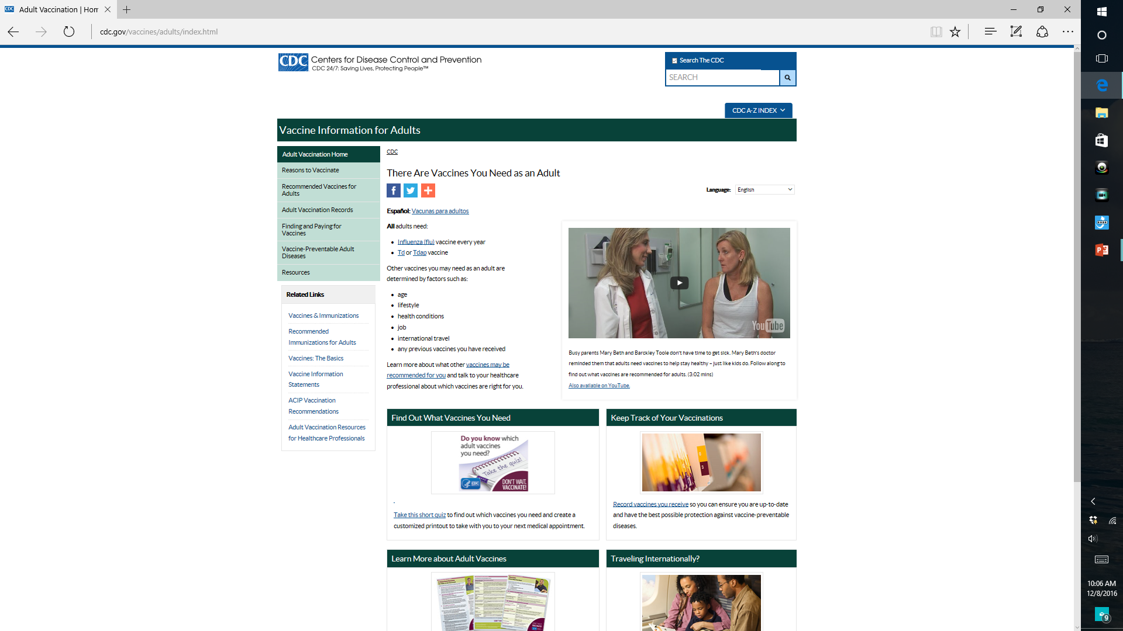
Click Here to View and Print out Vaccine Information
Statements
Information for
patients
Notes:
This patient page appears will all kinds of information. Again, patient level vaccine information statements are available for view or print for your policy and procedure manual.

Slide 33
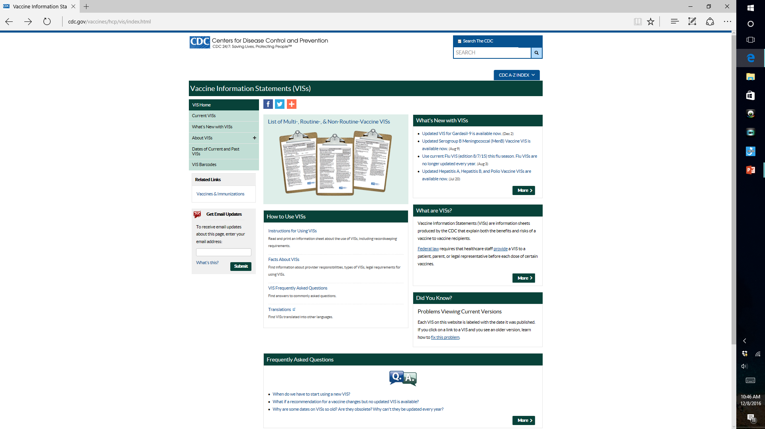
Click Here to
View and Print Vaccine Information
Statements
Notes:
VIC localities for printing and how to use these. Don’t reinvent the wheel !

Slide 34
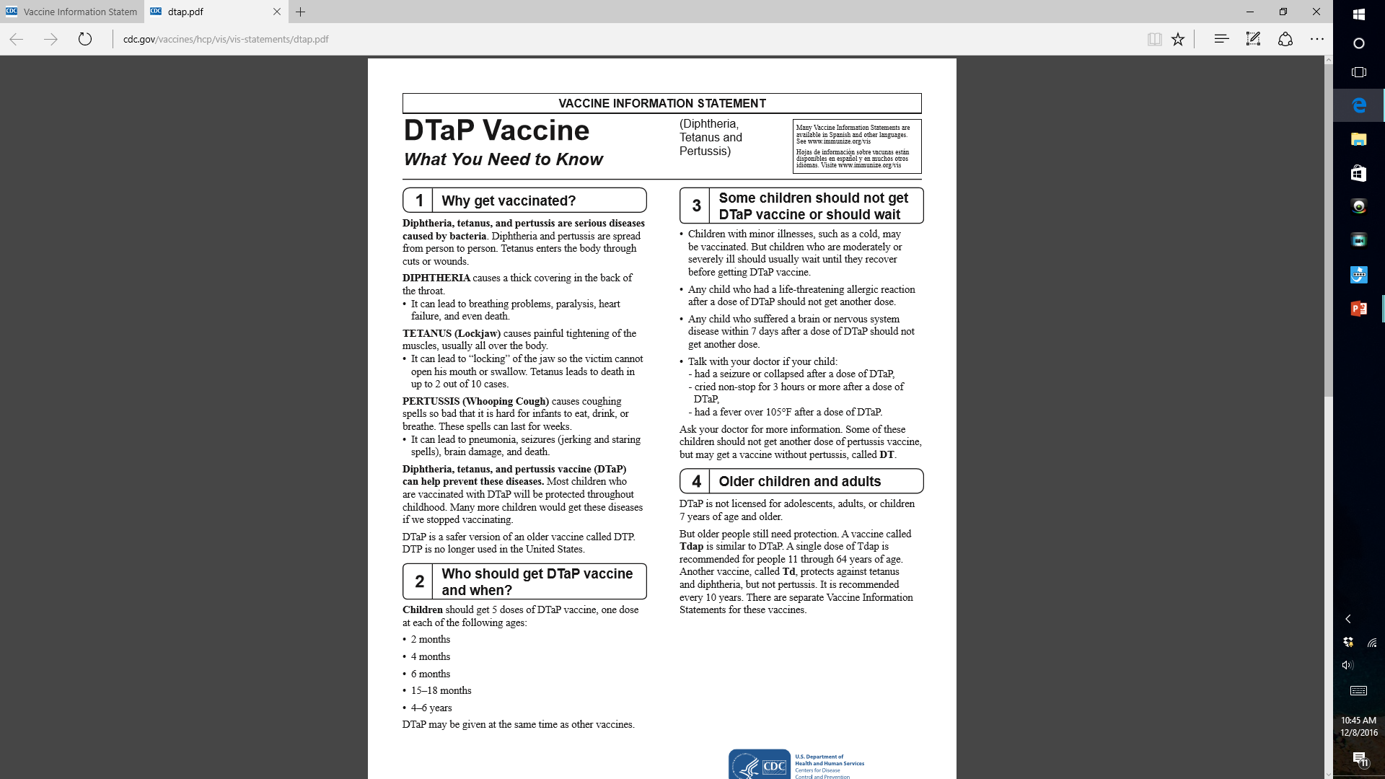
Print on Demand
OR
2) Print in Advance
Notes:
You may print on demand as needed. For this purpose, having a printer in each exam room or each sets of rooms helps to speed up the process. Of course, you can print these in advance for the day also and stock them in the exam rooms or the weighing station before rooming the patient.

Slide 35
NEW RESPONSIBILITIES
Step Five: identify and administer vaccine to end user (patient)
Step Six: document vaccinating event in the medical record and State Registry
Step Seven: Enter a charge for the vaccine and the administration fee into the billing system.
Notes:
Responsibilities highlighted in orange have traditionally been responsibilities of the MA or the Nurse
We are adding two new responsibilities as a Fledgling CVO and that is to begin to learn how to identify for yourself the needed vaccines and to utilize the State Immunization Information System Registry. Additionally, we are going to learn how to charge for those vaccines

Slide 36
Identify: Pre-Visit Planning for Adult Immunizations
Access the Immunization record in the Chart
Access the State Immunization Information System
Access the problem list in the chart and look at current patient age
Access the Adult Vaccination Schedule for age and medical problems
Fill out the daily PDSA Run Sheet
Notes:
These are the steps in pre-visit immunization planning. Steps 1,3,4 are the steps Emily and Carla were used to doing. I was doing number 5 and number 2 is a new responsibility. A CVO can improve his or her value by taking over all these responsibilities. The more responsibility you can take away from your physician the greater your value.

Slide 37
Patient: John Doe
Date of query: October 1, 2016
Patient Immunization - All Dates
Immunizations Td Tdap | Recent | Dates of prior immunizations |  |  | Dates of prior doses
 |  | 04/29/14
Influenza, seasonal, injectable PCV (Prevnar) Hep A, adult Zoster Vaccine, Live | Ordered 10/1/16 | 09/10/15 11/14/14 06/02/16 04/30/13 | 09/03/14 08/13/15 | 09/11/13 | 08/28/12 | 10/03/11
Hep B PCV (Pneumovax 23) |  | 08/26/08 05/22/07 | 01/09/08 | 11/21/07
DTP Smallpox |  | 01/03/55 01/03/52 | 06/03/52 | 1/03/52 | 9/3/1951 | 8/3/1951
Notes:
The Pre-visit Plan. This is an actual patient’s Electronic Health Record Immunization Sheet.

Slide 38
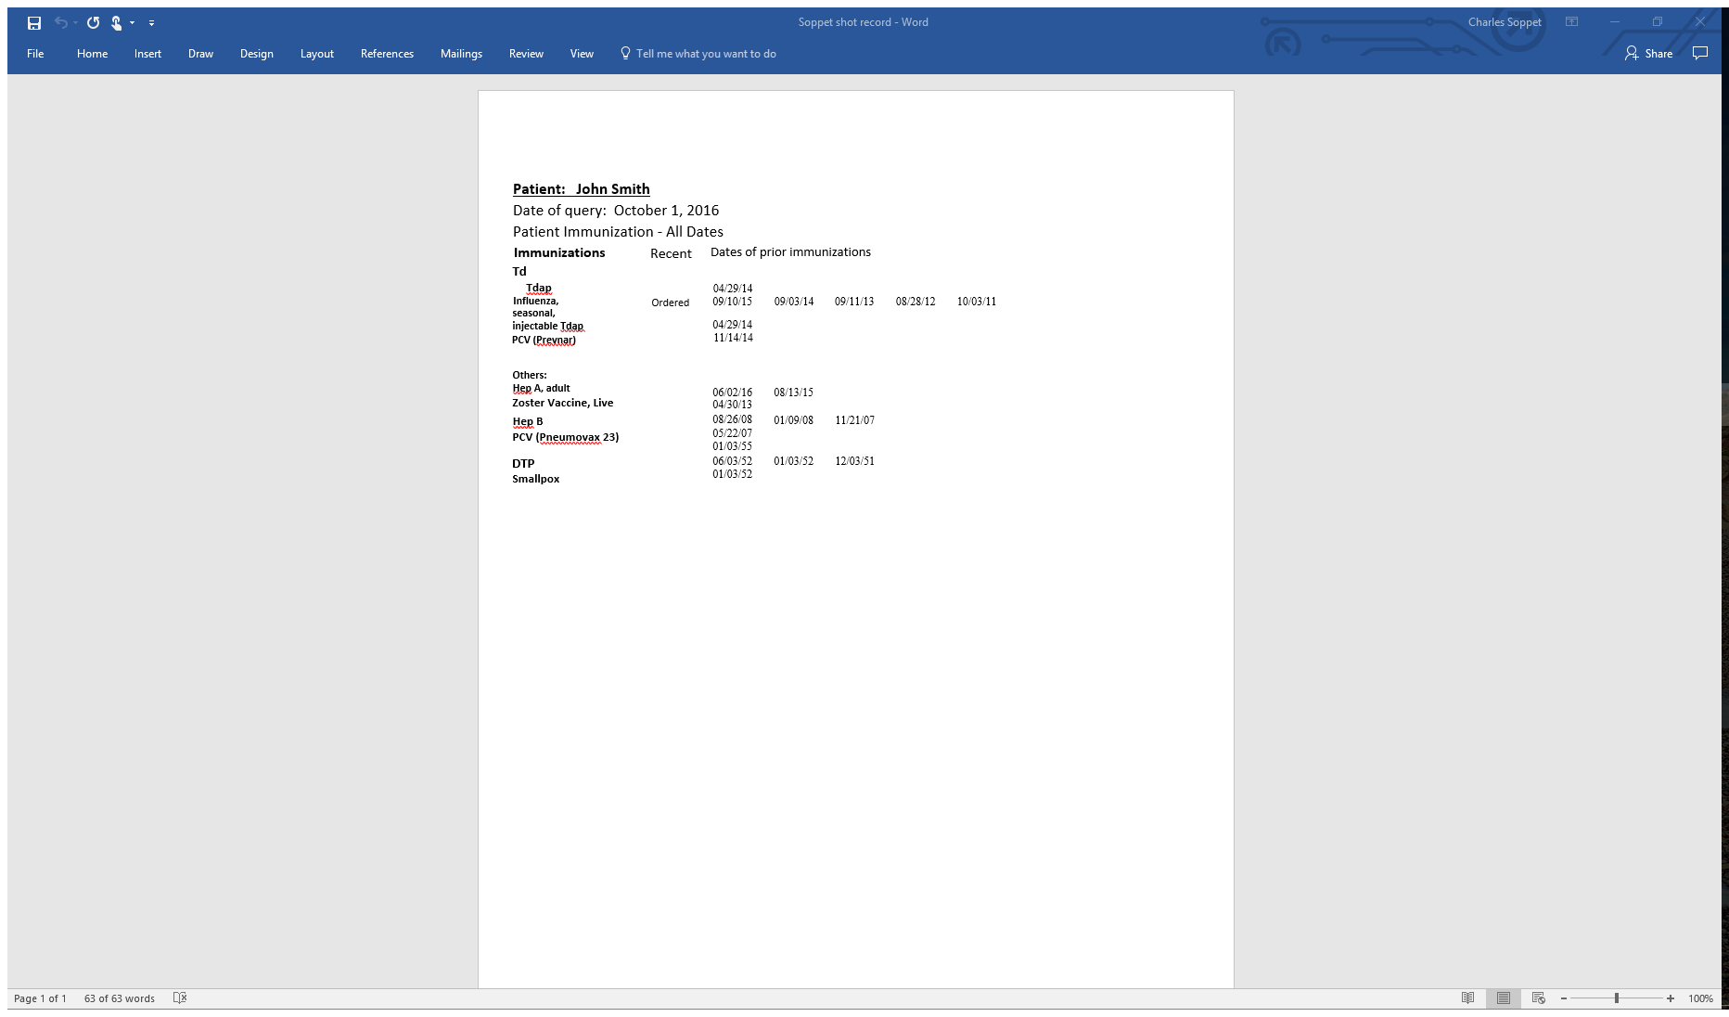
Notes:
This is the sheet as it appears when we print it for the patient at the end of the visit. In this case, the nurse had not yet clicked the “Administered” button so it shows up as having been “ordered” for the influenza vaccine.

Slide 39
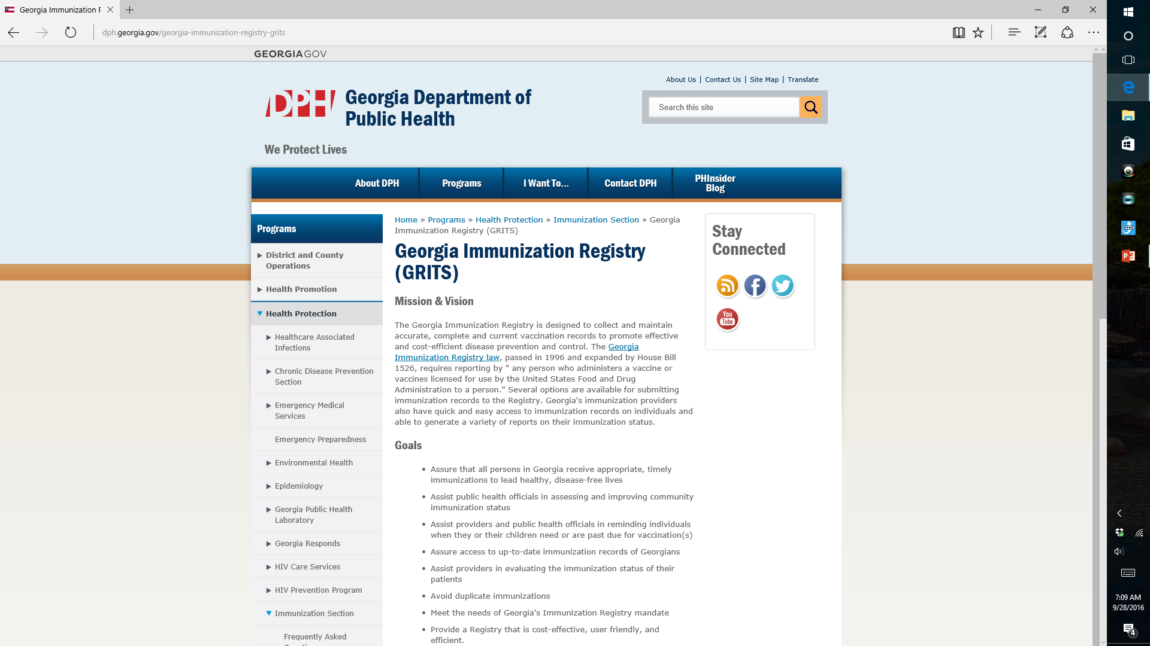
Notes:
This is GRITS, the Georgia State Immunization Registry. A CVO can be responsible for query and uploading of your immunization information into the IIS Registry in your state.

Slide 40
PDSA DAILY WORKSHEET FOR VACCINES
DAILY PLANNING WORKSHEET AND RECONCILIATION SHEET FOR IMMUNIZATION PDSA
6-Mar-16 | Monday
DATE | WEEKDAY
 |  |  | VACCINE TYPE
 | Influenza | PPS-23 | PCV-13 | Tdap | Td | Zostavax | Hep B | HPV | Hep A | Hib | Meningococcal
Mary Smith | ? | x | ? | x | n/a | x | x | n/a | n/a | n/a | n/a
John Doe
George Will
Babe Ruth
Ty Cobb
 |  |  |  |  |  |  |  |  |  |  | LEGEND
 |  |  |  |  |  |  |  |  |  |  | n/a=Not needed
 |  |  |  |  |  |  |  |  |  |  | x=previously given
 |  |  |  |  |  |  |  |  |  |  | ?= ask them today
 |  |  |  |  |  |  |  |  |  |  | D=declined today
 |  |  |  |  |  |  |  |  |  |  | checkmark=given today
Notes:
This is our low tech PDSA daily run sheet. Using the legend highlighted in yellow, this is where you document your pre visit planning for immunizations. You see demonstrated the pre-visit plan for Mary Smith. This patient has received PPS-23 in the past as well as Zostavax, Hepatits B and Tdap so these are noted with an “X”. We aren’t certain if this patient has received influenza or is yet eligible for Prevnar-13. (She received her PPS-23 in another locale so we need to ask her if she remembers the year she received it before we can decide if PCV-13 is appropriate yet). The other listed vaccines are not appropriate for her so they receive an “n/a” notation.

Slide 41


Completed PDSA daily run sheet
DAILY PLANNING WORKSHEET AND RECONCILIATION SHEET FOR IMMUNIZATION PDSA
20-Jan-17 | Friday
DATE | WEEKDAY
 | Influenza (iiv3) | PPS-23 | PCV-13 | TdaP | Td | Zostavax | Hep B | HPV | Hep A | Hib | Meningococcal
1) John Sartre | x | X (2005) | ? ✓ | x | x | x | x | n/a | n/a | n/a | n/a
2) F. Nietzsche | ?✓ | ?✓ | x (2014) | ? ✓ | ? n/a | x | n/a | n/a | n/a | n/a | n/a
3) Albert Camus | ?✓ | x | n/a | x (2012) | n/a | ? D | n/a | n/a | n/a | n/a | n/a
4) George Will | ? ✓ | x (2010) | x (2015) | x(2015) | n/a | ? ✓ | n/a | n/a | n/a | n/a | n/a
5) Mary Barnes | x | x (2000) |  | ? D | x | x | n/a | n/a | n/a | n/a | n/a
6) John Doe | x | x | ? | x (2010) | n/a | x | n/a | n/a | n/a | n/a | n/a
7) Ty Cobb | ? D | ? D | ? D | ? D | ? D | ? | ? D | n/a | ? D | ? n/a | ? n/a
8) Babe Ruth | x | ? | ?✓ | ? ✓ | x | x | x | n/a | n/a | n/a | n/a
9) A. C. Doyle | ? ✓ | x (2013) | x(2012) | x2012 | n/a | n/a | n/a | x | n/a | x (2012) | x(2012)
10) James Smith | ? ✓ | ?x (2010) | ?✓ | x (2013) | n/a | ? ✓ | n/a | n/a | n/a | n/a | n/a
Vaccine cost | $9.80 | $75.00 | $157 | $32 | $29 | $181 | $41 | $148 |  |  | $99/$98
Vaccine payment | $17.71 | $89.95 | $181.06 | $31.07 | $24.19 | varies by plan | $61.48 | n/a | $50.85 | n/a | LEGEND
Administration fee | $25.42 | $25.42 | $25.42 | $25.42 | $25.42 | $25.42 | $25.42 | n/a | $25.42 | n/a | n/a=Not needed
 |  |  |  |  |  |  |  |  |  |  | x=previously given
 |  |  |  |  |  |  |  |  |  |  | ?= ask them today
 |  |  |  |  |  |  |  |  |  |  | D=declined today
 |  |  |  |  |  |  |  |  |  |  | Checkmark ☑=given today
 |  |  |  |  |  |  |  |  |  |  | Prescription given=
Notes:
Here is an example of a completed “PDSA” run sheet at the end of a day for ten patients. (Typically you will have one of these sheets for morning session and one for afternoon session.) They are placed in your three ring binder as part of your QI program. For your patient “Ty Cobb” you will note that you have some work to do. You began by giving him a prescription for Zostavax to take to his pharmacy since he said he would “think about it”. You have reservations about whether he will receive that vaccine based upon his refusal to take other vaccines. In your next PDSA cycle you should amend your plan to include additional efforts to educate and influence patients like “Ty Cobb” to reconsider their choices in the face of new information and a new approach. Simply repeating the same approach over and over is not amending the plan, it is adopting the same plan for the next cycle. For “Ty Cobb” who is a retired marine, consider using a “culturally appropriate” explanatory sheet which would better allow him to understand the process and aim of immunization.
Note Traditional Medicare payment information at the bottom of the sheet. This reinforces to the staff that there are actual costs and potential revenues associated with each of these vaccines.

Slide 42
So, Ready to begin the Journey?
Step One: Educate yourself and your team using the CDC website
  Keep a copy of the adult immunization sheet with you at all times
Step Two: Previsit Planning for Immunizations
  Use the PDSA daily runsheet all the time
Step Three: Become familiar with the State Immunization Information system
  Practice accessing it every day as part of your pre-visit planning
Notes:
Ready Plan.

Slide 43
Tools You Need to Get Started
A supply of Vaccines
Adult Immunization Schedule Card in your pocket at all times
A stack of Blank PDSA Daily Run Sheets
A Three Ring Binder to hold the blank and completed PDSA daily run sheets
A Red pen, green pen, and black pen with you at all times
A supply of blank patient personal immunization wallet cards (obtainable for free from the Immunization Action Coalition)
A blank vaccination prescription pad (available from ACP)
Vaccine Information Sheets to Give to Patients
Internet Access to the CDC website and state Immunization Registry
Enthusiasm and an interest in learning
Notes:
Here we are at the holidays. Those of us who celebrate are all familiar with the warning to parents on the children’s gifts we give: “Some Assembly required.” Fortunately, while some assembly is required, the tools and effort necessary are minimal. Don’t re-invent the wheel. However, be prepared when you come to work. Have your colored pens, adult immunization card, and PDSA run sheet with your pre-visit plan with you at all times during the day. Don’t waste effort!

Slide 44
One, Two, Three
Vaccinate !
Notes:
So let’s get started !

Slide 45
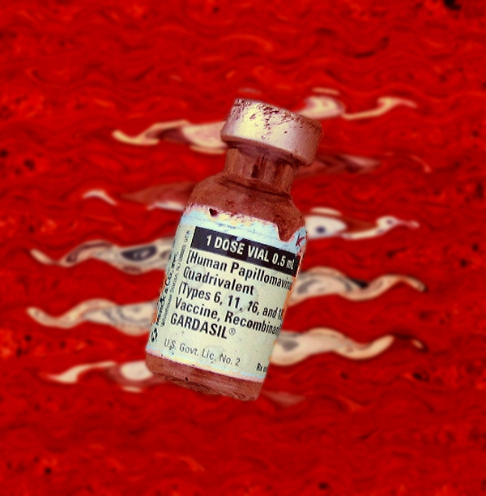
Phase I: Vaccine Inventory Management

Slide 46
The Immunizing Event along a Process Continuum
Inventory Control
(Steps 1-4)
Vaccine Administration and Documentation
(Steps 5-7)
Claims and Revenue Collections
(Steps 8-10)
Auditing and Report Generation
(Steps 11-12)
Phase I
Phase II
Phase III
Phase IV
Phase V= Retail Possibilities
Notes:
So lets again re-orient ourselves. Most of the individuals on this webinar are probably approaching this idea from a clinical standpoint, so we are going to begin your journey in the clinical phase, Phase II. We will present some tips and tools which you can use to begin your journey.

Slide 47
Completed PDSA daily run sheet
DAILY PLANNING WORKSHEET AND RECONCILIATION SHEET FOR IMMUNIZATION PDSA
20-Jan-17 | Friday
DATE | WEEKDAY
 | Influenza (iiv3) | PPS-23 | PCV-13 | TdaP | Td | Zostavax | Hep B | HPV | Hep A | Hib | Meningococcal
1) John Sartre | x | X (2005) | ? ✓ | x | x | x | x | n/a | n/a | n/a | n/a
2) F. Nietzsche | ?✓ | ?✓ | x (2014) | ? ✓ | ? n/a | x | n/a | n/a | n/a | n/a | n/a
3) Albert Camus | ?✓ | x | n/a | x (2012) | n/a | ? D | n/a | n/a | n/a | n/a | n/a
4) George Will | ? ✓ | x (2010) | x (2015) | x(2015) | n/a | ? ✓ | n/a | n/a | n/a | n/a | n/a
5) Mary Barnes | x | x (2000) |  | ? D | x | x | n/a | n/a | n/a | n/a | n/a
6) John Doe | x | x | ? | x (2010) | n/a | x | n/a | n/a | n/a | n/a | n/a
7) Ty Cobb | ? D | ? D | ? D | ? D | ? D | ? | ? D | n/a | ? D | ? n/a | ? n/a
8) Babe Ruth | x | ? | ?✓ | ? ✓ | x | x | x | n/a | n/a | n/a | n/a
9) A. C. Doyle | ? ✓ | x (2013) | x(2012) | x2012 | n/a | n/a | n/a | x | n/a | x (2012) | x(2012)
10) James Smith | ? ✓ | ?x (2010) | ?✓ | x (2013) | n/a | ? ✓ | n/a | n/a | n/a | n/a | n/a
Vaccine cost | $9.80 | $75.00 | $157 | $32 | $29 | $181 | $41 | $148 |  |  | $99/$98
Vaccine payment | $17.71 | $89.95 | $181.06 | $31.07 | $24.19 | varies by plan | $61.48 | n/a | $50.85 | n/a | LEGEND
Administration fee | $25.42 | $25.42 | $25.42 | $25.42 | $25.42 | $25.42 | $25.42 | n/a | $25.42 | n/a | n/a=Not needed
 |  |  |  |  |  |  |  |  |  |  | x=previously given
 |  |  |  |  |  |  |  |  |  |  | ?= ask them today
 |  |  |  |  |  |  |  |  |  |  | D=declined today
 |  |  |  |  |  |  |  |  |  |  | Checkmark ☑=given today
 |  |  |  |  |  |  |  |  |  |  | Prescription given=
Notes:
Here is an example of a completed “PDSA” run sheet at the end of a day for ten patients. (Typically you will have one of these sheets for morning session and one for afternoon session.) They are placed in your three ring binder as part of your QI program. For your patient “Ty Cobb” you will note that you have some work to do. You began by giving him a prescription for Zostavax to take to his pharmacy since he said he would “think about it”. You have reservations about whether he will receive that vaccine based upon his refusal to take other vaccines. In your next PDSA cycle you should amend your plan to include additional efforts to educate and influence patients like “Ty Cobb” to reconsider their choices in the face of new information and a new approach. Simply repeating the same approach over and over is not amending the plan, it is adopting the same plan for the next cycle. For “Ty Cobb” who is a retired marine, consider using a “culturally appropriate” explanatory sheet which would better allow him to understand the process and aim of immunization.
Note Traditional Medicare payment information at the bottom of the sheet. This reinforces to the staff that there are actual costs and potential revenues associated with each of these vaccines.

Slide 48
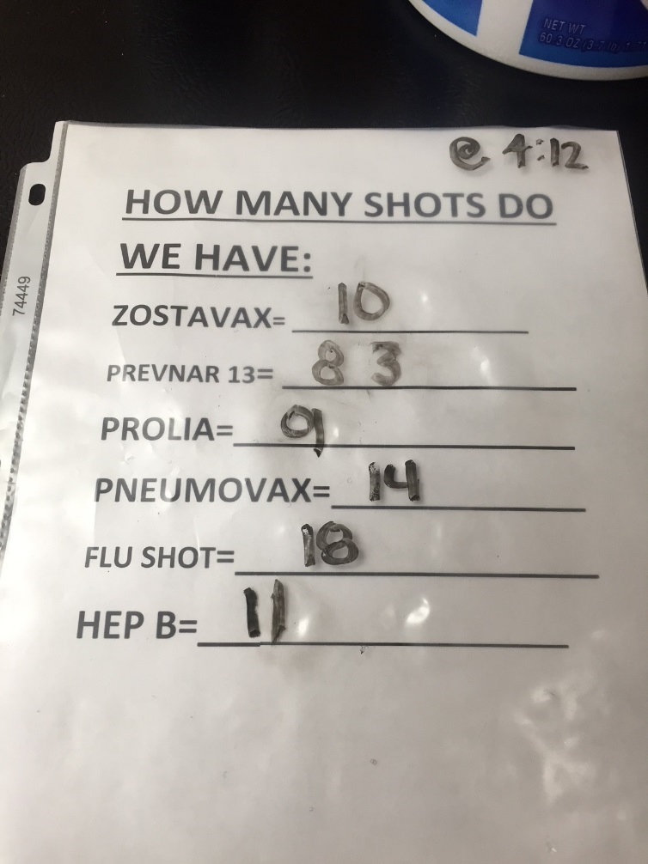
LOW TECH INVENTORY CONTROL
Updated Each day at both
Start and close of day
Notes:
Maranda’s low tech inventory control. She does these at least twice per day (first thing in am and last thing in pm) and as she has time through the day. She reconciles vaccine doses administered and documented with those checked out daily. That is, she balances her vaccine drawer in her refrigerator, maintains proper temperatures etc. This is just a printed sheet contained in a plastic holder that she writes upon with a sharpie !

Slide 49
Storage of Vaccines
CDC: Vaccine Storage and Handling Toolkit
Maintain the chain of cold
36 – 45 degrees F (aim for 40)
Zoster, Measles, Varicella: -58 to +5 degrees
  Store in separate Freezer
No dorm style refrigerators!
Vaccine Fridge Czar

Slide 50
Vax Refrigeration/Storage
Vaccine Refrigerator Manufacturers to Consider:
Panasonic Biomedical www.sanyobiomedical.com
Follett: www.follettice.com
Helmer: www.helmerinc.com
Thermo Scientific: www.thermo.com
Lab Research Products: www.labresprod.com
Gem Scientific: www.gemref.com
Fisher Scientific: www.fishersci.com
Sun Frost (efficient): www.sunfrost.com
Source: (fridges)
public.health.oregon.gov
(Oregon VFC guide)
Re: Digital Logging Thermometers -
See: http://www.vfcdataloggers.com/
Notes:
Where do you store your vaccine? Here are some websites to look for vaccine refrigerators and digital logging thermometers with pricing. We have a Zostavax freezer and a separate vaccine refrigerator for all other vaccines plus a small refrigerator at the two nurses stations for the daily allotment of each nurses vaccine. The nurses “check-out” their vaccines at the beginning of each day. Larger practices could use a Pyxis system.

Slide 51
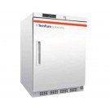

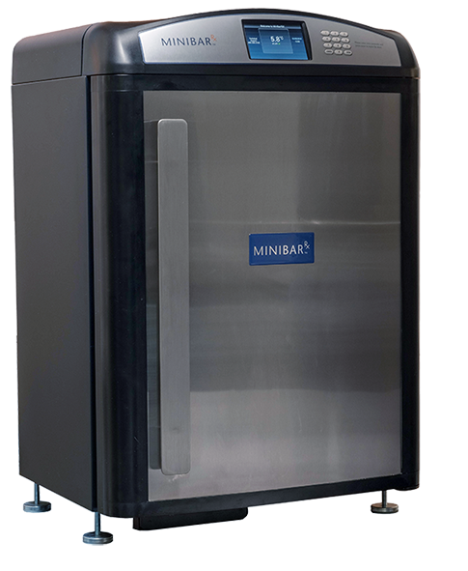
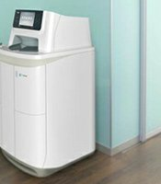
Other Vaccine Refrigeration Options
Undercounter Vaccine
Freezer only
Vaccine
Refrigerator
only
Minibar Rx™
(combination)
TruMed AccuVax™
(combination robotic)

Slide 52
Ordering Vaccines: Online

Slide 53
Maximum you should be paying for purchase of vaccines
Influenza Trivalent $9.80
Influenza Quadrivalent $17.00
Influenza High Dose $37.00
Pneumococcal Polysaccharide 23 $75.00
Pneumococcal Conjugate 13 $157.00
HPV-9 $148.00
Zostavax® $181.00
Hepatitis B $41.00
TdaP $32.00
Tetanus Toxoid $29.00
Neisseria Meningitides A, C, Y, W $99.00
Trumemba® (Neisseria group B) $98.00
Notes:
As you could see from our PPS 23 ROAI example, the most important of your variable costs is vaccine purchase amount. So it is important to buy as efficiently as possible. The lower the cost the higher the ROAI. These are current maximum prices you should be paying.

Slide 54
Purchasing Vaccines
Most of the vaccine suppliers have incentive programs: e.g. Sanofi, Merck, Pfizer
Vaccine Discount Suppliers: (examples)
  Atlantic Health Partners https://www.empireblue.com/wps/portal/ehpprovider?content_path=provider/noapplication/f1/s0/t0/pw_ad088435.htm&label=Atlantic%20Health%20Partners%20Vaccine%20purchasing%20program
  VAXserve www.Vaxserve.com/
  National Discount Vaccine Alliance http://www.nationaldiscountvaccinealliance.com/
Vaccine purchasing groups: (examples)
  MPPG (Medical Practice Purchasing Group) http://www.mppg.net/
  Pediatric Federation LLC https://pediafed.com/
Notes:
Return on investment depends entirely on the investment itself ! You must purchase wisely, take advantage of all discounts, and pay promptly to realize those discounts. Generally speaking, GPO’s or so called “Group Purchasing Organizations” are offering the best pricing. The last was featured in a recent Medical Economics article and guarantees level pricing for three years at a time.

Slide 55
Logging Vaccines: Simple Procedure
Maintain a vaccine inventory log that is used to document the following:
a. Vaccine name and # of doses rec’d
b. Date we received the vaccine
c. Condition of vaccine when received
d. Vaccine manufacturer, lot number
e. Vaccine expiration date
f. Dates administered
Source:
Immunization Action Coalition (IAC)
Immunize.org
Notes:
Inventory control is key as I will show you with an example later. Who Does this? Our telephone operator Maranda. In fact, she keeps track of inventories, maintains an adequate stock on hand, and orders all vaccines directly

Slide 56

Phase IV: Quality Improvement and Financial Reporting
Notes:
Why do quality control? One reason—It is interesting and fun to improve.

Slide 57
The Immunizing Event along a Process Continuum
Inventory Control
(Steps 1-4)
Vaccine Administration and Documentation
(Steps 5-7)
Claims and Revenue Collections
(Steps 8-10)
Auditing and Report Generation
(Steps 11-12)
Phase I
Phase II
Phase III
Phase IV
Phase V= Retail Possibilities
Notes:
So lets again re-orient ourselves. Most of the individuals on this webinar are probably approaching this idea from a clinical standpoint, so we are going to begin your journey in the clinical phase, Phase II. We will present some tips and tools which you can use to begin your journey.

Slide 58
Completed PDSA daily run sheet
DAILY PLANNING WORKSHEET AND RECONCILIATION SHEET FOR IMMUNIZATION PDSA
20-Jan-17 | Friday
DATE | WEEKDAY
 | Influenza (iiv3) | PPS-23 | PCV-13 | TdaP | Td | Zostavax | Hep B | HPV | Hep A | Hib | Meningococcal
1) John Sartre | x | X (2005) | ? ✓ | x | x | x | x | n/a | n/a | n/a | n/a
2) F. Nietzsche | ?✓ | ?✓ | x (2014) | ? ✓ | ? n/a | x | n/a | n/a | n/a | n/a | n/a
3) Albert Camus | ?✓ | x | n/a | x (2012) | n/a | ? D | n/a | n/a | n/a | n/a | n/a
4) George Will | ? ✓ | x (2010) | x (2015) | x(2015) | n/a | ? ✓ | n/a | n/a | n/a | n/a | n/a
5) Mary Barnes | x | x (2000) |  | ? D | x | x | n/a | n/a | n/a | n/a | n/a
6) John Doe | x | x | ? | x (2010) | n/a | x | n/a | n/a | n/a | n/a | n/a
7) Ty Cobb | ? D | ? D | ? D | ? D | ? D | ? | ? D | n/a | ? D | ? n/a | ? n/a
8) Babe Ruth | x | ? | ?✓ | ? ✓ | x | x | x | n/a | n/a | n/a | n/a
9) A. C. Doyle | ? ✓ | x (2013) | x(2012) | x2012 | n/a | n/a | n/a | x | n/a | x (2012) | x(2012)
10) James Smith | ? ✓ | ?x (2010) | ?✓ | x (2013) | n/a | ? ✓ | n/a | n/a | n/a | n/a | n/a
Vaccine cost | $9.80 | $75.00 | $157 | $32 | $29 | $181 | $41 | $148 |  |  | $99/$98
Vaccine payment | $17.71 | $89.95 | $181.06 | $31.07 | $24.19 | varies by plan | $61.48 | n/a | $50.85 | n/a | LEGEND
Administration fee | $25.42 | $25.42 | $25.42 | $25.42 | $25.42 | $25.42 | $25.42 | n/a | $25.42 | n/a | n/a=Not needed
 |  |  |  |  |  |  |  |  |  |  | x=previously given
 |  |  |  |  |  |  |  |  |  |  | ?= ask them today
 |  |  |  |  |  |  |  |  |  |  | D=declined today
 |  |  |  |  |  |  |  |  |  |  | Checkmark ☑=given today
 |  |  |  |  |  |  |  |  |  |  | Prescription given=
Notes:
Here is an example of a completed “PDSA” run sheet at the end of a day for ten patients. (Typically you will have one of these sheets for morning session and one for afternoon session.) They are placed in your three ring binder as part of your QI program. For your patient “Ty Cobb” you will note that you have some work to do. You began by giving him a prescription for Zostavax to take to his pharmacy since he said he would “think about it”. You have reservations about whether he will receive that vaccine based upon his refusal to take other vaccines. In your next PDSA cycle you should amend your plan to include additional efforts to educate and influence patients like “Ty Cobb” to reconsider their choices in the face of new information and a new approach. Simply repeating the same approach over and over is not amending the plan, it is adopting the same plan for the next cycle. For “Ty Cobb” who is a retired marine, consider using a “culturally appropriate” explanatory sheet which would better allow him to understand the process and aim of immunization.
Note Traditional Medicare payment information at the bottom of the sheet. This reinforces to the staff that there are actual costs and potential revenues associated with each of these vaccines.

Slide 59
Clinical Registries:
QCDR’S= Qualified Clinical Data Registries
MedConcert™
Genesis™
GRITS™

Slide 60
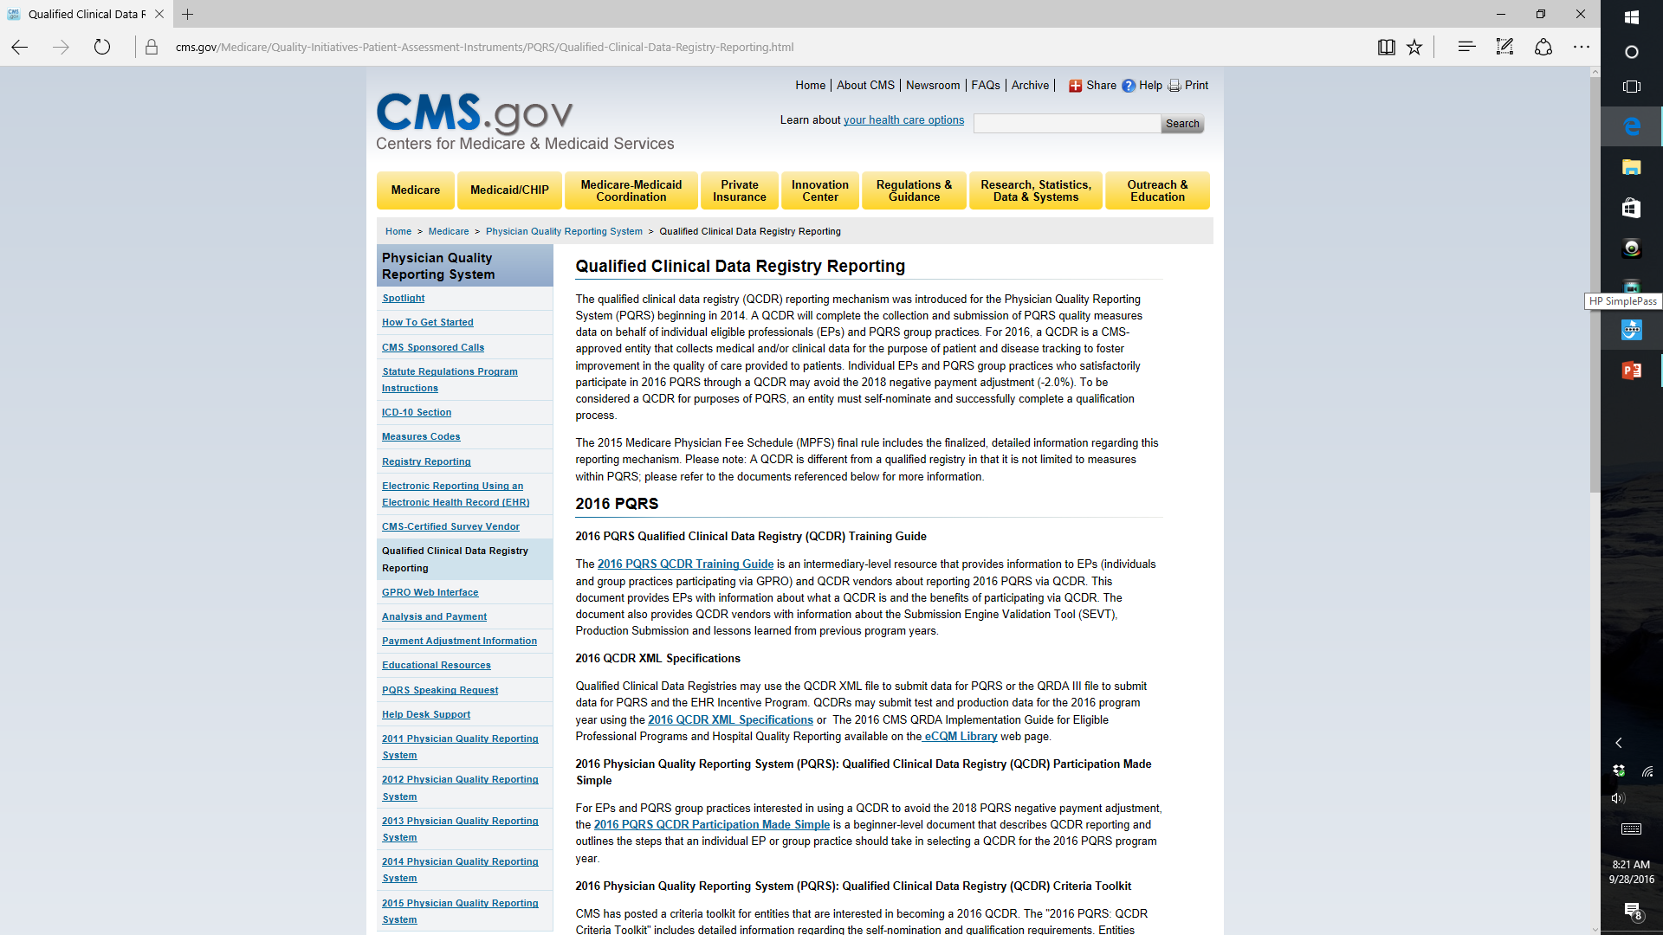
Getting Started With QCDR’s

Slide 61
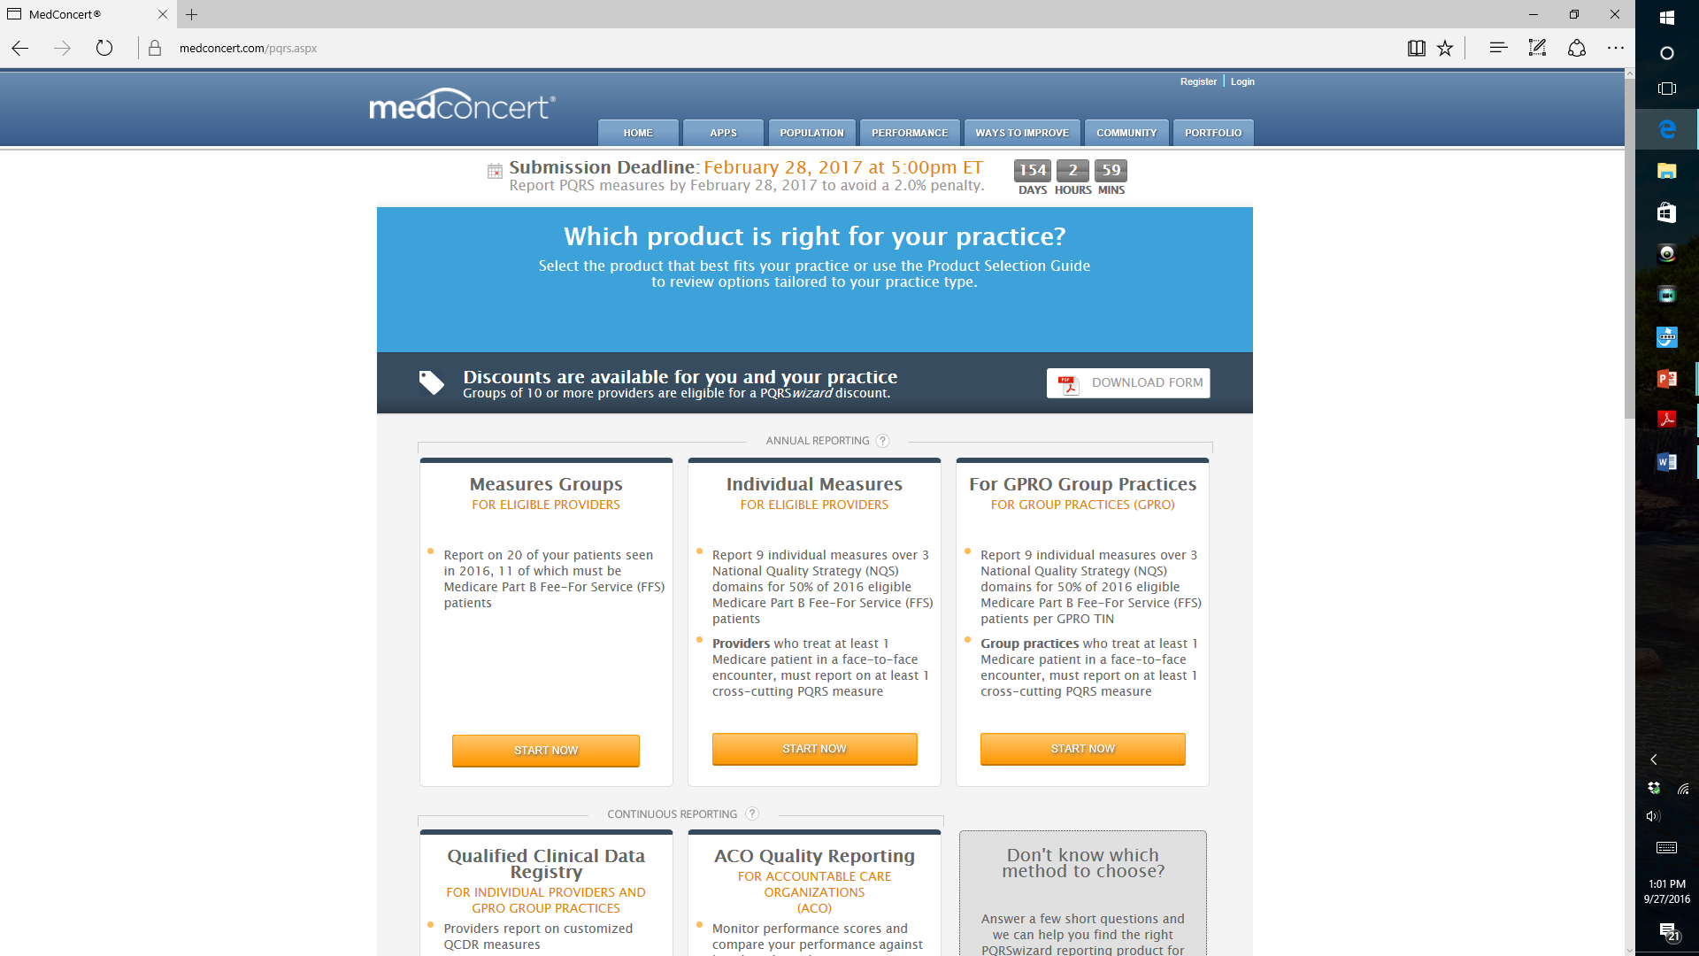
Notes:
MedConcert™ Platform for PQRS (Qualified Certified Data Registry-QCDR)

Slide 62
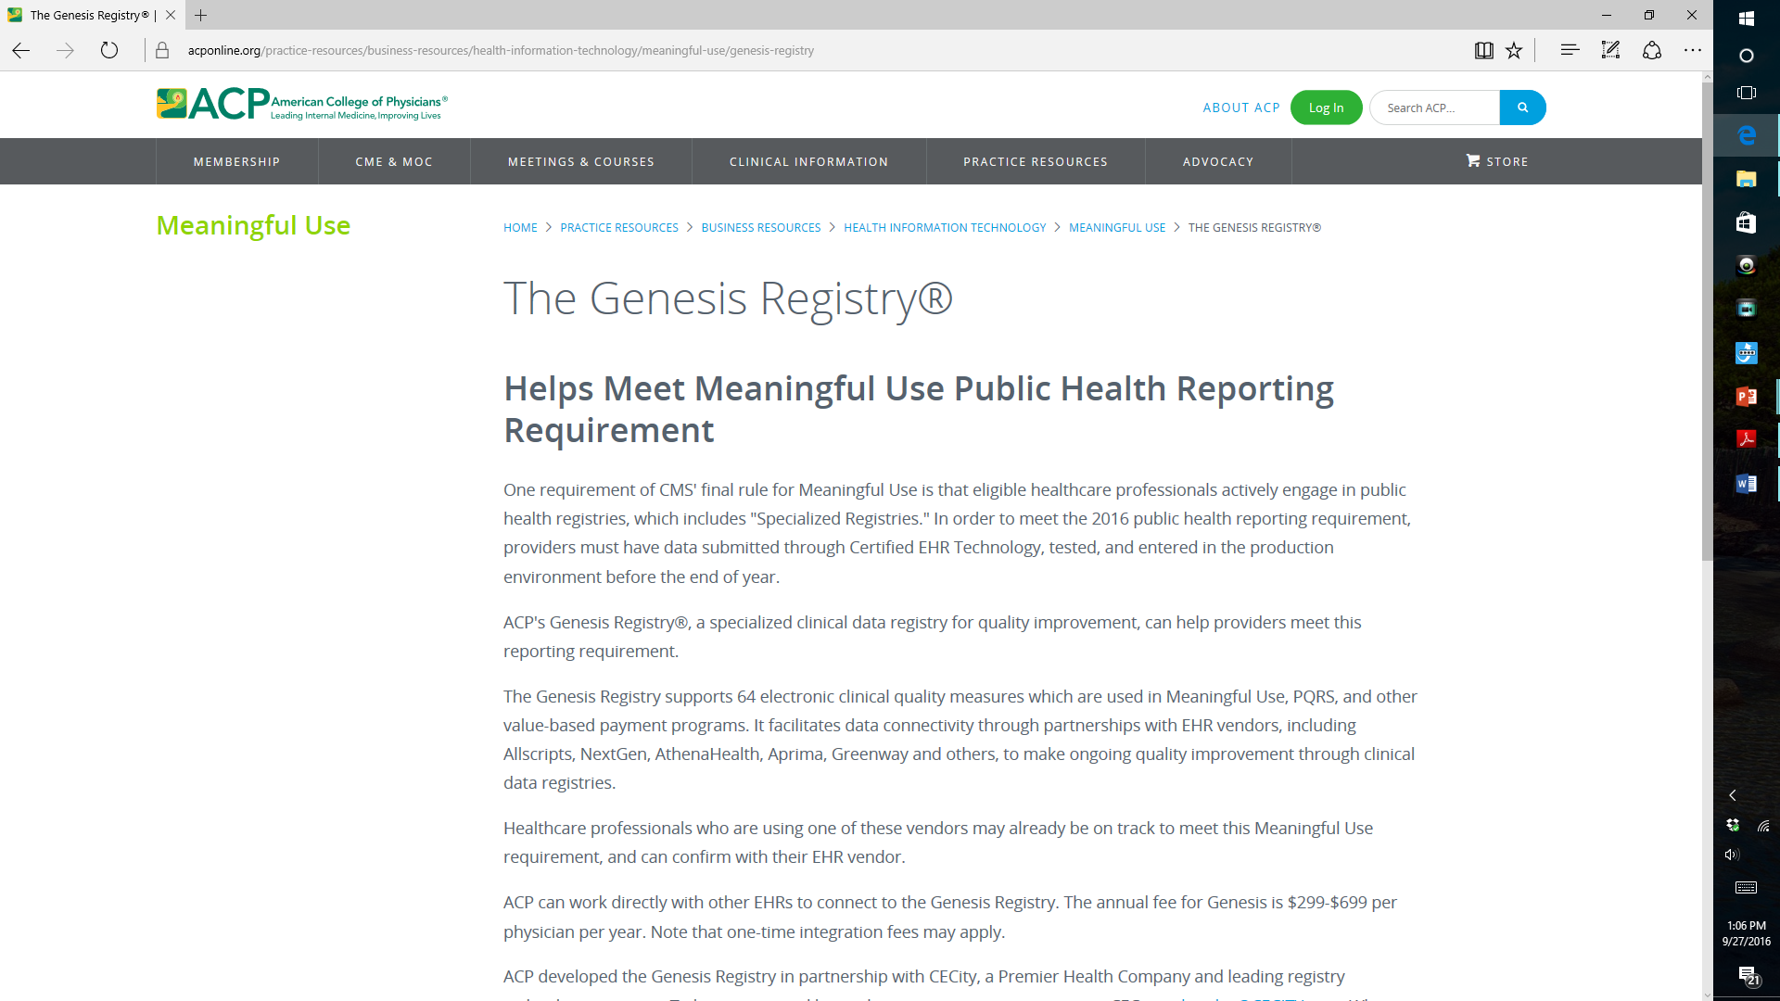
Notes:
This is ACP’s registry.

