Slide 1
WHAT IN THE WORLD IS A CHIEF VACCINATION OFFICER ?
--And Why would you need one or want to be one ?
Notes:
Welcome to the third in our four-part survey on the Chief Vaccination Officer. If you have been attending, some of what we have to begin with will be a review. Bear with me for a few slides until we catch up anyone who was not with us on the previous two webinars. For your review also, ACP has made available the recordings and slide sets from the previous two webinars for your availability.

Slide 2
On the Webinar today:
Charles M. Soppet MD, FACP
msoppet@Comcast.net
Notes:
My email address for anyone who wants to ask a specific question offline about their practice or a particular practice problem.

Slide 3
We Still Have Work To Do
The Big Five and the unvaccinated population
47% of patients remain unvaccinated for flu
80% of eligible remain unvaccinated for both pneumococcal vaccines
70% of eligible for Tdap remain unvaccinated
80% of eligible for Zoster remain unvaccinated
Notes:
CDC data estimates the following goal shortfalls. Since adult vaccination was made a priority over 40 years ago by the surgeon general, why is this so?

Slide 4
The process of office immunization
Step one: order vaccine
Step Two: receive and reconcile vaccine quantity against order
Step Three: store the vaccine safely and securely
Step Four: distribute vaccine to the intermediate user (vaccinator)
Step Five: identify and administer vaccine to end user (patient)-pre-visit planning
Step Six: document vaccinating event in the medical record and State Registry
Step Seven: enter a charge in the practice management system
Step Eight: bill for both the administration fee and the vaccine charge
Step Nine: generate an insurance claim and collect copayment (Part D only)
Step Ten: reconcile all charges with collections
Step Eleven: Reconcile inventory (doses @ begin day - vaccine doses given = vaccine doses remaining @ end of day)
Step Twelve: Produce Cash flow (Income and Expense) statement
Notes:
Why has it been so difficult to improve adult immunization rates in the United States? To try to answer this question, we have identified some so-called “barriers to immunization”. Some of those include:
1) decision control in large practices,
2) belief system of physicians and patients—Stephen Hawking has referred to this as Model Dependent Realism
3) availability of vaccines at the time of patient encounters
4) types and variety of vaccines available
5) economic risk to the physician or practice.
One barrier that has not been discussed much is that this is a surprisingly complicated process. Each immunizing event individually has all the elements of a project.

Slide 5
The Immunizing Event along a Process Continuum
Inventory Control
(Steps 1-4)
Vaccine Administration and Documentation
(Steps 5-7)
Claims and Revenue Collections
(Steps 8-10)
Auditing and Report Generation
(Steps 11-12)
Phase I
Phase II
Phase III
Phase IV
Phase V= Retail Possibilities
Notes:
Those who have been with us before will recognize this diagram. We can think of this complicated immunizing event as a continuous process which necessarily proceeds along an organized path. In order to be successful, each step must occur. In order for it to be optimum, each phase must be completed in its entirety. In some practices, physicians participate in or control “i.e. become the bottleneck in” all phases. The ultimate purpose of the Chief Vaccination Officer is to remove all unnecessary bottlenecks and to relieve the physician of as much of this detail as possible. Simply put, the job of the CVO is to remove as many barriers to immunization as are possible.
The path to becoming a Chief Vaccination Officer usually begins in Steps 5-7. This is the clinical knowledge phase. Physicians certainly have an important role to play in initially imparting this knowledge to the “vaccinator” but once imparted, this can be reinforced by the use of the Standing Orders Protocol. Repetition and consistency are necessary to inculcate this as a routine part of practice. Every patient, Every Visit, Every Time should be the Mantra you follow.
Steps 5-7 are addressed in CVO webinar number 1.

Slide 6
The process of office immunization
Step one: order vaccine
Step Two: receive and reconcile vaccine quantity against order
Step Three: store the vaccine safely and securely
Step Four: distribute vaccine to the intermediate user (vaccinator)
Step Five: identify and administer vaccine to end user (patient)-pre-visit planning
Step Six: document vaccinating event in the medical record and State Registry
Step Seven: enter a charge in the practice management system
Step Eight: bill for both the administration fee and the vaccine charge
Step Nine: generate an insurance claim and collect copayment (Part D only)
Step Ten: reconcile all charges with collections
Step Eleven: Reconcile inventory (doses @ begin day - vaccine doses given = vaccine doses remaining @ end of day)
Step Twelve: Produce Cash flow (Income and Expense) statement
Notes:
We will focus mostly on Steps 8, 9 and 10 today and then begin to touch on step 11, which we will complete and fully explore in our final webinar next month.

Slide 7
The Immunizing Event along a Process Continuum
Inventory Control
(Steps 1-4)
Vaccine Administration and Documentation
(Steps 5-7)
Claims and Revenue Collections
(Steps 8-10)
Auditing and Report Generation
(Steps 11-12)
Phase I
Phase II
Phase III
Phase IV
Phase V= Retail Possibilities
Notes:
Today’s Webinar will discuss Phase III, the claims, billing, and collection process. That is, how you are paid. As we discussed in the second webinar, in which we discussed Phase One or inventory control, these vaccines are very expensive to purchase and they have a shelf life and specific rather rigorous storage conditions. Therefore, it is important to make certain that you are paid for each vaccine you distribute to a patient if possible. Sometimes it is not possible for those uninsured patients or those on Part D with high copays. However, making certain you are paid for the remainder of your patient’s immunizations will allow the practice to realize a profit which will help support immunizing those patients who do not have coverage. The goal should always be to immunize every patient, every visit, every day if possible.

Slide 8
How You are Paid
1) Once a year, update your vaccine fees
2) reconcile this against all your insurance fee schedules
3) Document the Vaccine Administration
4) Generate an Insurance Claim
(collect a co-pay only for medicare part d)
5) Receive payment within three weeks
if no payment, follow-up calls
6) Audit the payment against the cost
7) Generate Reports
Notes:
Payment for giving vaccines is important, because this is a costly process. If you don’t mind your P’s and Q’s, the practice can lose its shirt (and you your job). If you do follow proper procedures, the practice will make a good profit. By the end of this lecture, you will know how to know the difference and what is more important, prove it to owners and therefore, use the information you collect to justify your request for a raise.

Slide 9
Maximum you should be paying for purchase of vaccines
Influenza Trivalent $9.80
Influenza Quadrivalent $17.00
Influenza High Dose $37.00
Pneumococcal Polysaccharide 23 $75.00
Pneumococcal Conjugate 13 $157.00
HPV-9 $148.00
Zostavax® $181.00
Hepatitis B $41.00
TdaP $32.00
Tetanus Toxoid $29.00
Neisseria Meningitides A, C, Y, W $99.00
Trumemba® (Neisseria group B) $98.00
Notes:
As you could see from our PPS 23 ROAI example, the most important of your variable costs is vaccine purchase amount. So it is important to buy as efficiently as possible. The lower the cost the higher the ROAI. These are current maximum prices you should be paying.

Slide 10
$8.56 = $1.30 + $7.26
$80
ROAI for Pneumococcal Polysaccharide Vaccine =
10% .
Notes:
In December 2013, our practice made a plan for giving Pneumococcal Polysaccharide vaccine 23 valent to as many eligible adults as possible.
How do we do this? We create our worse case scenario by intentionally and artificially inflating our costs and keeping our revenues real. This is a typical margin of safety calculation we do in our office. The yellow includes the vaccine component and the orange the administration component. Using the worse case scenario figures our ROAI is anywhere between 8.2 % and 10%.
Let’s break it down for you. We overestimated about $80 to purchase vaccine, 10% for billing costs, 65 cents for storage, handling and accounts payable administration, and total profit was $1.30 per dose on the vaccine component. Similarly, for administration fee, we used our real Medicare Payment rate, overestimated billing costs at 10%, Nursing costs at $8.00 per dose, Grits registry upload/download of $5.00 per dose for a profit of $7.26 per dose.

Slide 11
Notes:
Once a year, in late December, you need to review the previous years’ results and update the charges you are making for vaccines against the Medicare and Commercial Fee schedules and also compare with your costs. It is only necessary to do this once per year and create a sheet similar to the one on this page for each of your commercial and other insurance carriers.
To do this, you look up online the vaccination and administration fee codes for Medicare, Medicaid, and each of your top 3 or 4 commercial insurers. This provides you with 5 or 6 sheets which look like this. This insures the fees you are charging will be profitable. It also reminds you to update your chargemaster each year because you will only be reimbursed for the amounts on the fee schedule if your charge is at least as high as that fee schedule. You cannot charge Medicare or Medicaid more than you charge your commercial carriers.

Slide 12
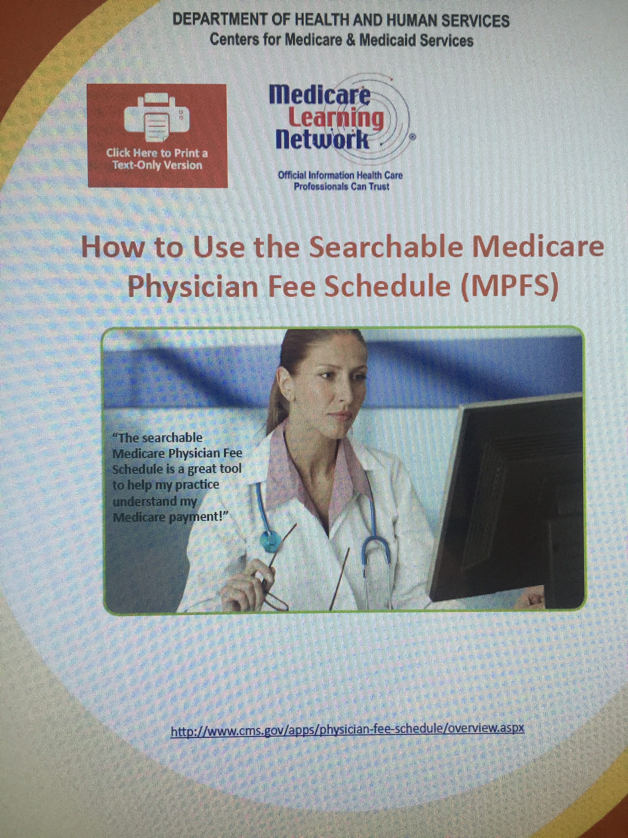
How to find Medicare Payment information
http://www.cms.gov/apps/physician-fee-schedule/overview.aspx
Notes:
I could give you a fish, but I would prefer to teach you to fish. This is how you find payment information for Medicare.

Slide 13
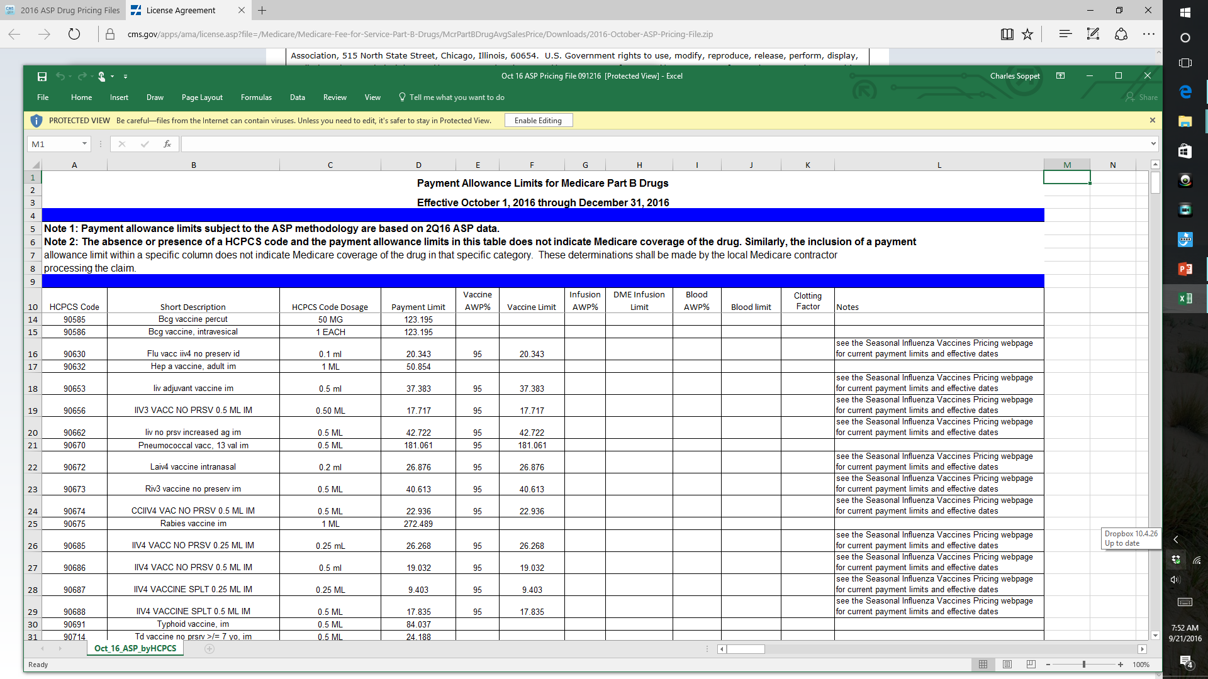
Payment for Vaccine component- Medicare
Notes:
This is payment for the vaccine component. You also receive a payment for the vaccine Administration, G0008, G0009, G0010. Also for commercial payors vaccine administration codes 90471 and 90472.

Slide 14
Documenting the Vaccine Administration
The Role of Quality Control in documentation
Notes:
Using the PDSA worksheet I introduced to you during the last webinar, which is duplicated on the next slide, helps you with your quality control, but also has a dual purpose of helping you, the CVO, keep up with costs and payments.

Slide 15
PDSA DAILY WORKSHEET FOR VACCINES
DAILY PLANNING WORKSHEET AND RECONCILIATION SHEET FOR IMMUNIZATION PDSA
6-Mar-16 | Monday
DATE | WEEKDAY
 |  |  | VACCINE TYPE
 | Influenza | PPS-23 | PCV-13 | Tdap | Td | Zostavax | Hep B | HPV | Hep A | Hib | Meningococcal
Mary Smith | ? | x | ? | x | n/a | x | x | n/a | n/a | n/a | n/a
John Doe
George Will
Babe Ruth
Ty Cobb
 |  |  |  |  |  |  |  |  |  |  | LEGEND
 |  |  |  |  |  |  |  |  |  |  | n/a=Not needed
 |  |  |  |  |  |  |  |  |  |  | x=previously given
 |  |  |  |  |  |  |  |  |  |  | ?= ask them today
 |  |  |  |  |  |  |  |  |  |  | D=declined today
 |  |  |  |  |  |  |  |  |  |  | checkmark=given today
Notes:
This is your quality control daily run sheet for your vaccines.

Slide 16


Completed PDSA daily run sheet
DAILY PLANNING WORKSHEET AND RECONCILIATION SHEET FOR IMMUNIZATION PDSA
20-Jan-17 | Friday
DATE | WEEKDAY
 | Influenza (iiv3) | PPS-23 | PCV-13 | TdaP | Td | Zostavax | Hep B | HPV | Hep A | Hib | Meningococcal
1) John Sartre | x | X (2005) | ? ✓ | x | x | x | x | n/a | n/a | n/a | n/a
2) F. Nietzsche | ?✓ | ?✓ | x (2014) | ? ✓ | ? n/a | x | n/a | n/a | n/a | n/a | n/a
3) Albert Camus | ?✓ | x | n/a | x (2012) | n/a | ? D | n/a | n/a | n/a | n/a | n/a
4) George Will | ? ✓ | x (2010) | x (2015) | x(2015) | n/a | ? ✓ | n/a | n/a | n/a | n/a | n/a
5) Mary Barnes | x | x (2000) |  | ? D | x | x | n/a | n/a | n/a | n/a | n/a
6) John Doe | x | x | ? | x (2010) | n/a | x | n/a | n/a | n/a | n/a | n/a
7) Ty Cobb | ? D | ? D | ? D | ? D | ? D | ? | ? D | n/a | ? D | ? n/a | ? n/a
8) Babe Ruth | x | ? | ?✓ | ? ✓ | x | x | x | n/a | n/a | n/a | n/a
9) A. C. Doyle | ? ✓ | x (2013) | x(2012) | x2012 | n/a | n/a | n/a | x | n/a | x (2012) | x(2012)
10) James Smith | ? ✓ | ?x (2010) | ?✓ | x (2013) | n/a | ? ✓ | n/a | n/a | n/a | n/a | n/a
Vaccine cost | $9.80 | $75.00 | $157 | $32 | $29 | $181 | $41 | $148 |  |  | $99/$98
Vaccine payment | $17.71 | $89.95 | $181.06 | $31.07 | $24.19 | varies by plan | $61.48 | n/a | $50.85 | n/a | LEGEND
Administration fee | $25.42 | $25.42 | $25.42 | $25.42 | $25.42 | $25.42 | $25.42 | n/a | $25.42 | n/a | n/a=Not needed
 |  |  |  |  |  |  |  |  |  |  | x=previously given
 |  |  |  |  |  |  |  |  |  |  | ?= ask them today
 |  |  |  |  |  |  |  |  |  |  | D=declined today
 |  |  |  |  |  |  |  |  |  |  | Checkmark ☑=given today
 |  |  |  |  |  |  |  |  |  |  | Prescription given=
Notes:
Here is an example of a completed “PDSA” run sheet at the end of a day for ten patients. (Typically you will have one of these sheets for morning session and one for afternoon session.) They are placed in your three ring binder as part of your QI program. For your patient “Ty Cobb” you will note that you have some work to do. You began by giving him a prescription for Zostavax to take to his pharmacy since he said he would “think about it”. You have reservations about whether he will receive that vaccine based upon his refusal to take other vaccines. In your next PDSA cycle you should amend your plan to include additional efforts to educate and influence patients like “Ty Cobb” to reconsider their choices in the face of new information and a new approach. Simply repeating the same approach over and over is not amending the plan, it is adopting the same plan for the next cycle. For “Ty Cobb” who is a retired marine, consider using a “culturally appropriate” explanatory sheet which would better allow him to understand the process and aim of immunization.
Note Traditional Medicare payment information at the bottom of the sheet. This reinforces to the staff that there are actual costs and potential revenues associated with each of these vaccines.

Slide 17






Generate an Insurance Claim
Notes:
So, this is an area of immunization which most physicians and nurses are not familiar. This is a simple introduction to the insurance claims process.

Slide 18
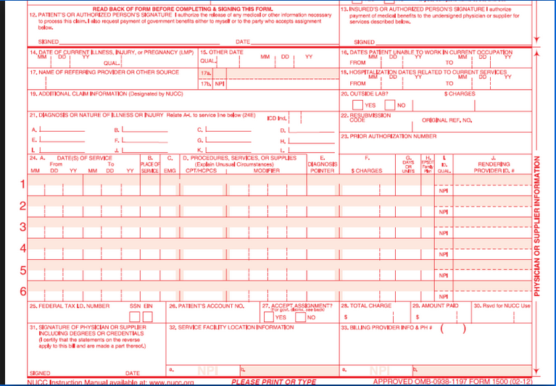
Form 1500
Box 21. Diagnosis code A. Should reflect the ICD 10 code describing the reason for the office visit. In this case the patient’s asthmatic condition
Box B. Should reflect the location where the service is provided. In this example 11 indicates the service was provided at an office
Box D. Procedures, Services, or Supplies. NCCI edits require a modifier 25 to recognize the office visit as a distinct service from the vaccine administration
The SK modifier can be used to indicate that the patient is considered high risk
Box F. Charges. Should reflect the HCP’s usual and customary charges
The reporting of the vaccines National drug code (NDC) may be required by some payers including Medicaid and TriCARE.
Notes:
This explains what goes where.

Slide 19
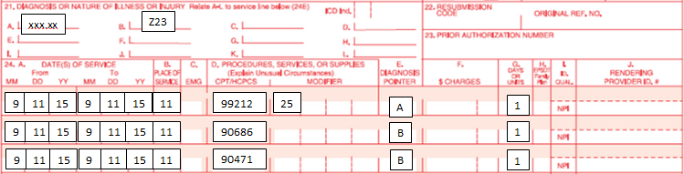
Filling out the Form
Notes:
The Medicare 1500 form.

Slide 20
Generate Reports
Why generate Reports ?
What reports to generate ?
How often to generate these reports ?
Notes:
Generating reports gives you the CVO and your boss the feedback you need to judge how well you are doing. There are three basic reports you need to generate. The first is a reconciliation of doses of each vaccine purchased and doses of each vaccine administered. I would recommend you do this monthly.
The second report is a reconciliation of total cost of each vaccine versus total revenue captured and I would recommend this also be created monthly.
The third report is a reconciliation of vaccination opportunities versus successes. I would recommend this report be generated weekly.

Slide 21
Using the Daily Run Sheet for Reporting
Formalizes Pre-visit immunization planning
Documents the “ask rate” at 100%
Documents the “Refusal Rate” easily
Can augment this with a “signature required” refusal form
Filled out contemporaneously by the nurse will double check documentation
Can be used to verify that the dose was given and check at end of day against vaccines documented as administered and charged in the Electronic Record
Keeping it allows for running count of progress (% of patients vaccinated)
Notes:
Utilizing the Run Sheet this way will help with QC on immunization administration and will also permit QC on the financial reporting. Serves as an audit against the billing and collections department collection rate and efficiency.

Slide 22
PDSA DAILY WORKSHEET FOR VACCINES
DAILY PLANNING WORKSHEET AND RECONCILIATION SHEET FOR IMMUNIZATION PDSA
6-Mar-16 | Monday
DATE | WEEKDAY
 |  |  | VACCINE TYPE
 | Influenza | PPS-23 | PCV-13 | Tdap | Td | Zostavax | Hep B | HPV | Hep A | Hib | Meningococcal
Mary Smith | ? | x | ? | x | n/a | x | x | n/a | n/a | n/a | n/a
John Doe
George Will
Babe Ruth
Ty Cobb
 |  |  |  |  |  |  |  |  |  |  | LEGEND
 |  |  |  |  |  |  |  |  |  |  | n/a=Not needed
 |  |  |  |  |  |  |  |  |  |  | x=previously given
 |  |  |  |  |  |  |  |  |  |  | ?= ask them today
 |  |  |  |  |  |  |  |  |  |  | D=declined today
 |  |  |  |  |  |  |  |  |  |  | checkmark=given today
Notes:
In Webinar One we introduced you to this low tech PDSA daily run sheet. Using the legend highlighted in yellow, this is where you document your pre visit planning for immunizations. You see demonstrated the pre-visit plan for Mary Smith. This patient has received PPS-23 in the past as well as Zostavax, Hepatits B and Tdap so these are noted with an “X”. We aren’t certain if this patient has received influenza or is yet eligible for Prevnar-13. (She received her PPS-23 in another locale so we need to ask her if she remembers the year she received it before we can decide if PCV-13 is appropriate yet). The other listed vaccines are not appropriate for her so they receive an “n/a” notation.

Slide 23
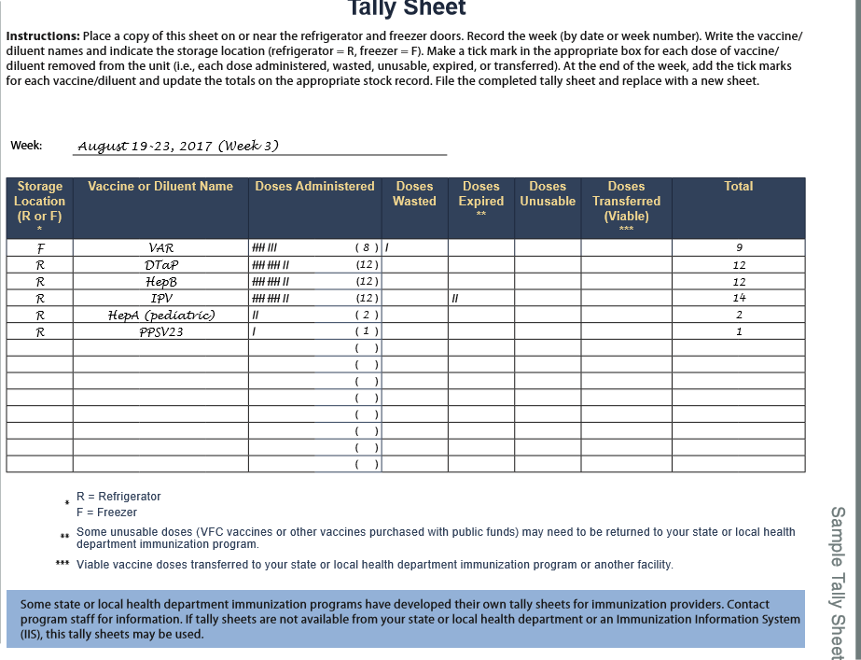
Doses Administered Tally sheet (daily)
Notes:
The completed PDSA daily run sheet will allow you to keep up with your daily inventory. The completed daily run sheets and this Tally sheet (which you recall we showed you how to retrieve from the CDC vaccine website) should be kept permanently in a 3 ring binder by the vaccine storage refrigerator and freezer. These are part of your audit record and will be used as you will see in the next Webinar to complete your end of the year reporting.

Slide 24
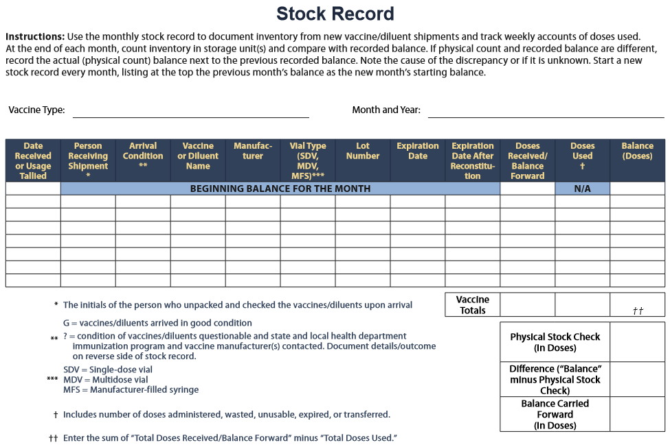
Inventory Control Report
Notes:
The Tally sheet will be used to keep up with your stock record.

Slide 25
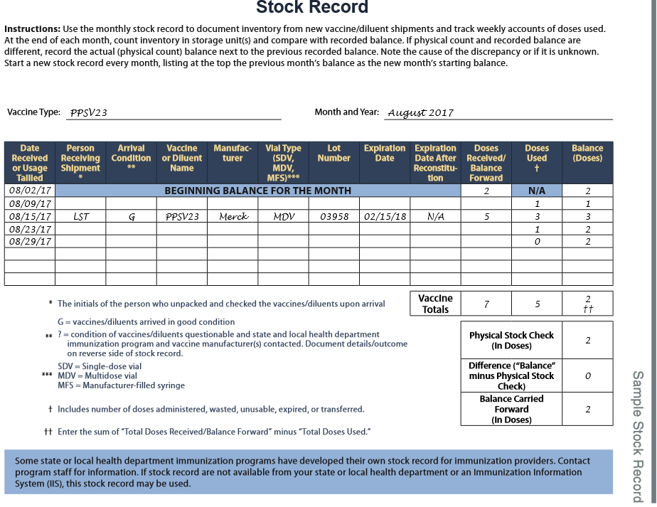
Stock Inventory Example
Notes:
And this is how you will do it. Again, you recall we showed you how to retrieve copies of this sheet from the CDC website in Webinar Two.

Slide 26
Audit the payment against the cost
DAILY PLANNING WORKSHEET AND RECONCILIATION SHEET FOR IMMUNIZATION PDSA
20-Jan-17 | Friday
DATE | WEEKDAY
 | Influenza (iiv3) | PPS-23 | PCV-13 | TdaP | Td | Zostavax | Hep B | HPV | Hep A | Hib | Meningococcal
1) John Sartre | x | X (2005) | ? ✓ | x | x | x | x | n/a | n/a | n/a | n/a
2) F. Nietzsche | ?✓ | ?✓ | x (2014) | ? ✓ | ? n/a | x | n/a | n/a | n/a | n/a | n/a
3) Albert Camus | ?✓ | x | n/a | x (2012) | n/a | ? D | n/a | n/a | n/a | n/a | n/a
4) George Will | ? ✓ | x (2010) | x (2015) | x(2015) | n/a | ? ✓ | n/a | n/a | n/a | n/a | n/a
5) Mary Barnes | x | x (2000) |  | ? D | x | x | n/a | n/a | n/a | n/a | n/a
6) John Doe | x | x | ? | x (2010) | n/a | x | n/a | n/a | n/a | n/a | n/a
7) Ty Cobb | ? D | ? D | ? D | ? D | ? D | ? | ? D | n/a | ? D | ? n/a | ? n/a
8) Babe Ruth | x | ? | ?✓ | ? ✓ | x | x | x | n/a | n/a | n/a | n/a
9) A. C. Doyle | ? ✓ | x (2013) | x(2012) | x2012 | n/a | n/a | n/a | x | n/a | x (2012) | x(2012)
10) James Smith | ? ✓ | ?x (2010) | ?✓ | x (2013) | n/a | ? ✓ | n/a | n/a | n/a | n/a | n/a
Vaccine cost | $9.80 | $75.00 | $157 | $32 | $29 | $181 | $41 | $148 |  |  | $99/$98
Vaccine payment | $17.71 | $89.95 | $181.06 | $31.07 | $24.19 | varies by plan | $61.48 | n/a | $50.85 | n/a | LEGEND
Administration fee | $25.42 | $25.42 | $25.42 | $25.42 | $25.42 | $25.42 | $25.42 | n/a | $25.42 | n/a | n/a=Not needed
 |  |  |  |  |  |  |  |  |  |  | x=previously given
 |  |  |  |  |  |  |  |  |  |  | ?= ask them today
 |  |  |  |  |  |  |  |  |  |  | D=declined today
 |  |  |  |  |  |  |  |  |  |  | Checkmark ☑=given today
 |  |  |  |  |  |  |  |  |  |  | Prescription given=
Notes:
Here is an example of a completed “PDSA” run sheet at the end of a day for ten patients. (Typically you will have one of these sheets for morning session and one for afternoon session.) They are placed in your three ring binder as part of your QI program. For your patient “Ty Cobb” you will note that you have some work to do. You began by giving him a prescription for Zostavax to take to his pharmacy since he said he would “think about it”. You have reservations about whether he will receive that vaccine based upon his refusal to take other vaccines. In your next PDSA cycle you should amend your plan to include additional efforts to educate and influence patients like “Ty Cobb” to reconsider their choices in the face of new information and a new approach. Simply repeating the same approach over and over is not amending the plan, it is adopting the same plan for the next cycle. For “Ty Cobb” who is a retired marine, consider using a “culturally appropriate” explanatory sheet which would better allow him to understand the process and aim of immunization.
Note Traditional Medicare payment information at the bottom of the sheet. This reinforces to the staff that there are actual costs and potential revenues associated with each of these vaccines.

Slide 27







Audit the payment against the cost
DAILY PLANNING WORKSHEET AND RECONCILIATION SHEET FOR IMMUNIZATION PDSA
20-Jan-17 | Friday
DATE | WEEKDAY
 | Influenza (iiv3) | PPS-23 | PCV-13 | TdaP | Td | Zostavax | Hep B | HPV | Hep A | Hib | Meningococcal
1) John Sartre | x | X (2005) | ? ✓ | x | x | x | x | n/a | n/a | n/a | n/a
2) F. Nietzsche | ?✓ | ?✓ | x (2014) | ? ✓ | ? n/a | x | n/a | n/a | n/a | n/a | n/a
3) Albert Camus | ?✓ | x | n/a | x (2012) | n/a | ? D | n/a | n/a | n/a | n/a | n/a
4) George Will | ? ✓ | x (2010) | x (2015) | x(2015) | n/a | ? ✓ | n/a | n/a | n/a | n/a | n/a
5) Mary Barnes | x | x (2000) |  | ? D | x | x | n/a | n/a | n/a | n/a | n/a
6) John Doe | x | x | ? | x (2010) | n/a | x | n/a | n/a | n/a | n/a | n/a
7) Ty Cobb | ? D | ? D | ? D | ? D | ? D | ? | ? D | n/a | ? D | ? n/a | ? n/a
8) Babe Ruth | x | ? | ?✓ | ? ✓ | x | x | x | n/a | n/a | n/a | n/a
9) A. C. Doyle | ? ✓ | x (2013) | x(2012) | x2012 | n/a | n/a | n/a | x | n/a | x (2012) | x(2012)
10) James Smith | ? ✓ | ?x (2010) | ?✓ | x (2013) | n/a | ? ✓ | n/a | n/a | n/a | n/a | n/a
Vaccine cost | $9.80 | $75.00 | $157 | $32 | $29 | $181 | $41 | $148 |  |  | $99/$98
Vaccine payment | $17.71 | $89.95 | $181.06 | $31.07 | $24.19 | varies by plan | $61.48 | n/a | $50.85 | n/a | LEGEND
Administration fee | $25.42 | $25.42 | $25.42 | $25.42 | $25.42 | $25.42 | $25.42 | n/a | $25.42 | n/a | n/a=Not needed
 |  |  |  |  |  |  |  |  |  |  | x=previously given
 |  |  |  |  |  |  |  |  |  |  | ?= ask them today
 |  |  |  |  |  |  |  |  |  |  | D=declined today
 |  |  |  |  |  |  |  |  |  |  | Checkmark ☑=given today
 |  |  |  |  |  |  |  |  |  |  | Prescription given=
Notes:
Having kept the PDSA run sheet in your 3 ring binder next to the vaccine storage refrigerator and freezer, you can retrieve each day’s sheet about three weeks later and obtain a payment list from your business office or practice manager. You mark in green those patients insured by Medicare who received vaccines and for whom you have received payments. You mark in a separate color (here in blue) those patients for whom you received payments from another insurer and the amounts received for those vaccines. You can then tally in the vertical column the total payments and total costs to make certain you are remaining profitable. This way you do not have to wait until the end of the year to find out whether you are losing money or making money and how much in each case. This is part of your financial PDSA cycle.

Slide 28
Measure the rates of immunization
DAILY PLANNING WORKSHEET AND RECONCILIATION SHEET FOR IMMUNIZATION PDSA
20-Jan-17 | Friday
DATE | WEEKDAY
 | Influenza (iiv3) | PPS-23 | PCV-13 | TdaP | Td | Zostavax | Hep B | HPV | Hep A | Hib | Meningococcal
1) John Sartre | x | X (2005) | ? ✓ | x | x | x | x | n/a | n/a | n/a | n/a
2) F. Nietzsche | ?✓ | ?✓ | x (2014) | ? ✓ | ? n/a | x | n/a | n/a | n/a | n/a | n/a
3) Albert Camus | ?✓ | x | n/a | x (2012) | n/a | ? D | n/a | n/a | n/a | n/a | n/a
4) George Will | ? ✓ | x (2010) | x (2015) | x(2015) | n/a | ? ✓ | n/a | n/a | n/a | n/a | n/a
5) Mary Barnes | x | x (2000) |  | ? D | x | x | n/a | n/a | n/a | n/a | n/a
6) John Doe | x | x | ? | x (2010) | n/a | x | n/a | n/a | n/a | n/a | n/a
7) Ty Cobb | ? D | ? D | ? D | ? D | ? D | ? | ? D | n/a | ? D | ? n/a | ? n/a
8) Babe Ruth | x | ? | ?✓ | ? ✓ | x | x | x | n/a | n/a | n/a | n/a
9) A. C. Doyle | ? ✓ | x (2013) | x(2012) | x2012 | n/a | n/a | n/a | x | n/a | x (2012) | x(2012)
10) James Smith | ? ✓ | ?x (2010) | ?✓ | x (2013) | n/a | ? ✓ | n/a | n/a | n/a | n/a | n/a
Vaccine cost | $9.80 | $75.00 | $157 | $32 | $29 | $181 | $41 | $148 |  |  | $99/$98
Vaccine payment | $17.71 | $89.95 | $181.06 | $31.07 | $24.19 | varies by plan | $61.48 | n/a | $50.85 | n/a | LEGEND
Administration fee | $25.42 | $25.42 | $25.42 | $25.42 | $25.42 | $25.42 | $25.42 | n/a | $25.42 | n/a | n/a=Not needed
 |  |  |  |  |  |  |  |  |  |  | x=previously given
 |  |  |  |  |  |  |  |  |  |  | ?= ask them today
 |  |  |  |  |  |  |  |  |  |  | D=declined today
 |  |  |  |  |  |  |  |  |  |  | Checkmark ☑=given today
 |  |  |  |  |  |  |  |  |  |  | Prescription given=
Notes:
This is a simple numeric fraction converted to percentage
The numerator consists of totaling all the “x” and check marks and N/A marks
The denominator consists of all marks
For example,
For Babe Ruth, the numerator is 9 and the denominator is 10 so the percentage given is 90%

Slide 29
Questions ? msoppet@Comcast.net

