Slide 1

I-Raise the Rates Tools for Improvement in Practice: Case Based Approach to Increasing Immunization in Your Practice
Robert H Hopkins, Jr., MD, FACP, FAAP
UAMS College of Medicine
Director Division of General Internal Medicine i-RAISE Immunization Champion Training
February 26-28, 2016
Key Largo, FL

Slide 2
Disclosures
I have no financial conflicts of interest
I have MAJOR nonfinancial conflicts
  I am a firm believer in adult immunization
  I am disturbed by our poor performance in this area
  I am confident that we can improve with better
    Knowledge
    Skills
    Determination
    Tools

Slide 3
Outline
Brief survey of current AI recommendations, rates
Case based review of Adult Immunization
  Identify challenges associated with specific vaccines
Plant seeds in you:
Because you are ‘fertile soil’ to grow improved adult immunization practice!!!
  Provider Recommendation & Patient Communication
  Reminder – Recall
  Chart/Provider Reminders
  Standing Orders
  Immunization Information Systems

Slide 6
Adult Vaccination Rates = POOR!
Data: NHIS 2014
Vaccine [Population]
Influenza | 2013 |  | 2014
Influenza – All Adults | 39.7 % |  | 43.2 %
[All] 19 – 49 years | 30.6 % |  | 31.5 %
[All] 50 – 64 years | 43.7 % |  | 47.7 %
> 65 years | 61.3 % |  | 71.5 %
HCW [19 – 64 years] | 65.4 % |  | 65.4 %
PPS23 & PCV13 | 2013 |  | 2014
High risk 19 – 49 years | 21.2 % |  | 20.3 %
> 65 years | 59.7 % |  | 61.3 %
Tetanus [19 – 49 years, received past 10 years] | 62.9 % |  | 62.6 %
Tetanus/Pertussis [19+, received in past 8 yrs] | 17.2 % |  | 20.1 %
Shingles [Zoster] age 60+ | 24.2 % |  | 27.9 %
Hepatitis B Vaccine [High risk 19 – 49 years] | 32.6 % |  | 32.2 %
HPV Vaccine [women 19-26/men 19-26, >1 dose] | 36.9 % | 8.0 % | 40.2 % | 8.2 %
MMWR Feb 5, 2016/ Vol 65(1).
Notes:
NHIS – National Interview Survey
NIS – National Flu Survey

Slide 7
Disparities and Adult Vaccination Rates
Data: NHIS 2014
Vaccine [Population] | Rate
Pneumococcal [>65 years]
All Adults | 61.3 %
Hispanic | 45.2 %
White | 64.7 %
Black | 49.8 %
Asian | 47.7 %
“…and, unfortunately, there are similar disparities for most adult vaccines. This is absolutely unacceptable in the United States in 2015!!”
-RHH, MD 2/15/2015
MMWR Feb 5, 2016/ Vol 65(1).
Notes:
Unlike childhood vaccination rates, we see large ethnic and racial disparities in adult vaccination rates.

Slide 8
Provider Recommendation:
Standards for Adult Immunization Practice
ALL providers should incorporate immunization needs assessment into every clinical encounter with strong recommendation.
ASSESS immunization status
RECOMMEND vaccines indicated, and strongly
ADMINISTER needed vaccines or REFER patients to a vaccine provider
4. DOCUMENT received vaccines
http://www.cdc.gov/vaccines/hcp/patient-ed/adults/for-practice/standards/index.html

Slide 9
CASE 1: Jane Smith
42 year-old teacher at local high school with asthma since childhood presents for follow up. Is using her controller and needs reliever about once a month in fall, winter and spring. Nurse ‘flagged chart’ because she refused recommended vaccines— ‘I don’t need them, those are for sick people…’
How do you respond to Jane’s comment??
What vaccines would you recommend?

Slide 10
Jane Smith: Answers
STRONG recommendation to vaccinate
Recommend:
  Influenza Asthma is high-risk condition
  PPSV23 Asthma is intermediate-risk
  Tdap Routine adult, once*, then resume Td
*In pregnant women recommend Tdap every pregnancy→ for infant protection

Slide 11
Provider Recommendation
NONCONFRONTATIONAL
  Recognize and turn motivations to positives
  Avoid pejorative/emotional reaction
SUPPORTIVE
  Data not highly effective in leading to behavior change
  Personal anecdotes, stories can be useful
  Conviction without judging is critical

Slide 12
Provider recommendation 1:
Anti-Vaccine 5-Point Response
RISK REDUCTION
  High risk patients may not understand this
VALUE to INDIVIDUAL
  Cost of illness in work loss/effectiveness
  Cost of treatment of illness
VALUE to FAMILY/Community
  Not there -or not at best- to care for family
LOW COST
  ACA Mandated first dollar coverage [Not M’Care, MCD]
SAFETY of vaccines

Slide 13
Provider recommendation 2:
SHARE More Information (If Needed)
Share reasons why the recommended vaccines are right for the patient
  given age, health status, lifestyle, job, or other risk factors.
Highlight your own experiences with vaccination to reinforce benefits
Address patient questions and any concerns about vaccines,
  include side effects, safety, effectiveness in plain, understandable language
Remind patients many vaccine-preventable diseases are common in the U.S. and can be serious for them.
Explain the potential costs of getting VPDs, including serious health effects, time lost (e.g. missing work or family obligations), and financial costs.

Slide 14
Provider Recommendation Translates Into
Higher Vaccination Rates
(Even for Patients With Negative Attitudes)
Vaccination Rate (%)
*High-risk patients were those ages 65 and older or those having heart disease, lung disease, diabetes, or other serious illness.
Nichol KL, et al. J Gen Intern Med. 1996;11(11):673-677.

Slide 15

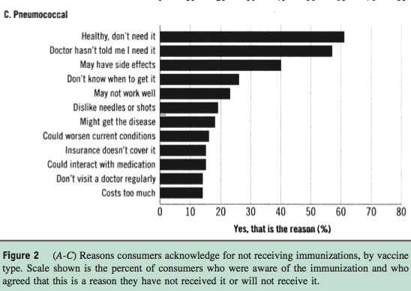

Slide 16
Provider recommendation 3:
Patients Who Aren’t Ready to Decide…
Emphasize the ‘benefits of getting vaccinated today’
Provide education
  Materials
  Trusted websites
  Community partners [Pharmacy, Health Department, AARP,…]
Document the conversation in the record
Set a plan for deferred vaccines
  And send reminders about needed vaccines
Continue the conversation at the next visit.
  For those who choose not to [be vaccinated]…

Slide 17
Reminder – Recall
Strategy to remind patients that vaccines are due (reminder) or late (recall)
Can be delivered via various methods (telephone, letter, email, text) and include educational materials
Usually targeted by patient demographics
  Disease: asthmatic, diabetes, cancer, HIV/AIDS,…
  Risk Factors: smokers
  Age group: 18-19/College, 65+
Increase vaccination coverage ~ 12 – 20%
Guide to Community Preventive Services http://www.thecommunityguide.org/vaccines/clientreminder.html
Notes:
Here are some possible questions you may receive from the audience:
What time of year do you start projects like these?
What staff makes the patient lists for the QI project?
What are the EHR considerations such as basic reporting functions of patient records?

Slide 18
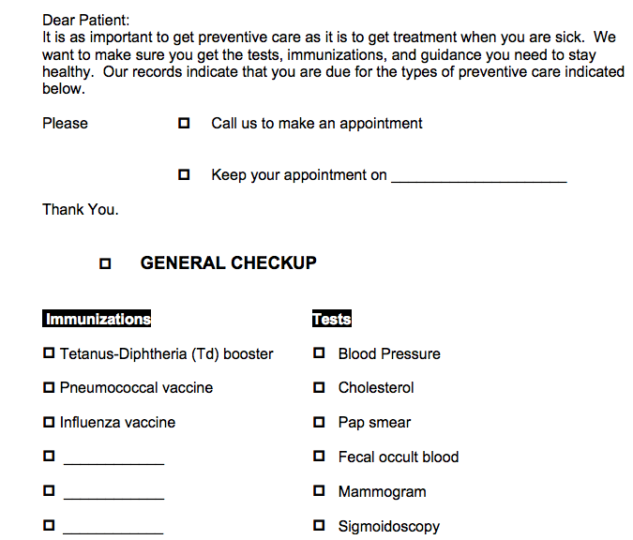
NO EMR: Sample Reminder Notice
Notes:
This is an example reminder notice and if you use this strategy, modify to meet your practice/patient needs.

Slide 19
Patient Reminder/Questionnaires: Assess Status, Patient Reminder… In clinic or send out via patient portal.
UAMS Adult immunization Clinic Screening Questionnaire NAME ____________________ Birthdate ___/___/19___ PCP _________________
Please complete this questionnaire to help our staff help better protect you and all of our patients from vaccine-preventable diseases!
-UAMS Center for Primary Care Staff
1. Do you have an allergy to any vaccine, to eggs or to gelatin? O No O Yes
2. If you need additional vaccines, would you be willing to receive them today with your flu vaccination? O No O Yes
If no, may we forward this questionnaire to your PCP? O No O Yes
3. Do you have any chronic health conditions, including any previous tissue or organ transplants? O No O Yes
If yes, please list here:______________________________________________________________________________________
4. Are you taking any medication [now or within the last month] which lowers the function of your immune system? O No O Yes
Examples would include: Chemotherapy, prednisone, medications to treat lupus or rheumatoid arthritis, medications to prevent transplant
rejection, medications to treat colitis or Crohns. If yes, please list here:_______________________________________________
5. Have you had [or are your doctors planning] surgery to remove your spleen? O No O Yes
6. Have you had any of the following: brain or spine surgery with placement of a shunt, brain or spine surgery which has resulted in a
spinal fluid leak, or cochlear implant surgery? O No O Yes
7. Have you ever had an adult tetanus and whooping cough (pertussis) vaccination? O No O Yes
8. Was your last tetanus vaccination given within the last 10 years? O No O Yes
If yes, what year was this given? __________
9. Have you received a 'pneumonia [or Pneumococcal] vaccine’ in your adult life? O No O Yes
If yes, what year was this given? __________
10. Have you ever had any of the following diseases or vaccinations against these diseases?
Chicken Pox: O No O Yes
Measles: O No O Yes
Mumps: O No O Yes
11. Have you ever had a Shingles (Zoster) vaccine? O No O Yes
12. Have you ever had Hepatitis B or Hepatitis A vaccination [or both]? O No O Yes Hepatitis B O Yes Hepatitis A
13. Did you receive an influenza vaccine last year? O No O Yes
If yes, where did you receive this immunization? ________________________
RHH, MD AI Screening Questionnaire 2014
NOTE: For this to be most useful, support with additional tools for patients, registration and vaccinating staff [e.g. guideline, standing order, access]

Slide 20
CASE 2: Bill Jones
54 year old man with diabetes and severe chronic kidney disease [CKD5] here for follow up. He has been adherent to medications and has lost a few # since last visit. On kidney transplant list for severe CKD. He received influenza vaccine and Tdap from health department this past fall. Nurse ‘flagged chart’- he Zoster vaccine [and will consider others] but nurse concerned - he does not qualify based on standing order…
Resources used for improvement?
What vaccines do you recommend?
What about the Zoster question?

Slide 21
Bill Jones: Answers
Resources:
  TOOLS TEAMWORK REMINDER STANDING ORDERS
Recommend:
  PCV13 ESRD is highest-risk condition
    Followed by PPSV23 in 8+ weeks
  HBV DM < 60 yrs. is high-risk condition
  ESRD is high-risk condition [High Dose vax]
  [Likely NO] Zoster recommended by ACIP at 60+
    FDA approved at 50+
    Can give, ‘one shot’ vax, likely this will require $$ out of pocket as not ACIP indicated..

Slide 22
Chart/Provider Reminders
Alert providers that patient(s) are due for vaccines
Methods:
  EMR Alerts
  Pre-visit chart review
Engage team in use of reminders in concert with SO
Expect results!
  Shown to increase vaccination 12 – 16% overall
  EHR based: can result in up to 50% increase in flu and pneumococcal vaccinations
http://archinte.jamanetwork.com/article.aspx?articleid=1105941
http://www.thecommunityguide.org/vaccines/providerreminder.html
Notes:
If there are questions on who will remind the provider, explain it could be the medical assistant, nurse, or a reminder in the EHR depending on clinic workflow.

Slide 23
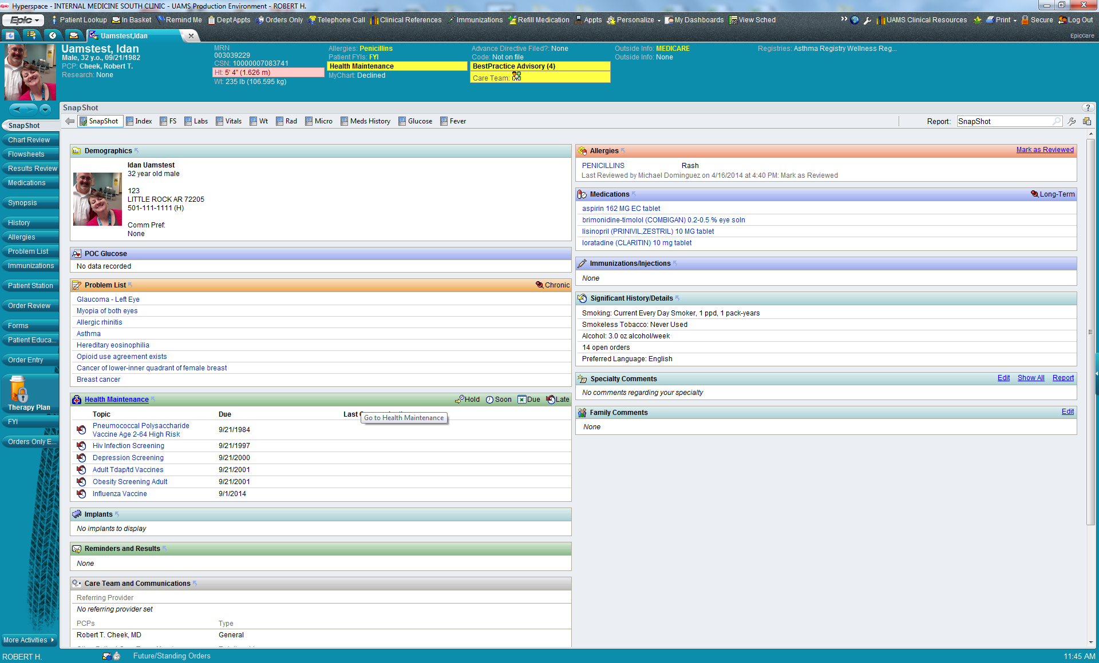
Provider Reminder: Vax Indications
Mr. Test has not received [none doc. in EMR] any immunizations!!
He is deficient in many ‘Health Maintenance’ elements, including no vaccinations

Slide 24
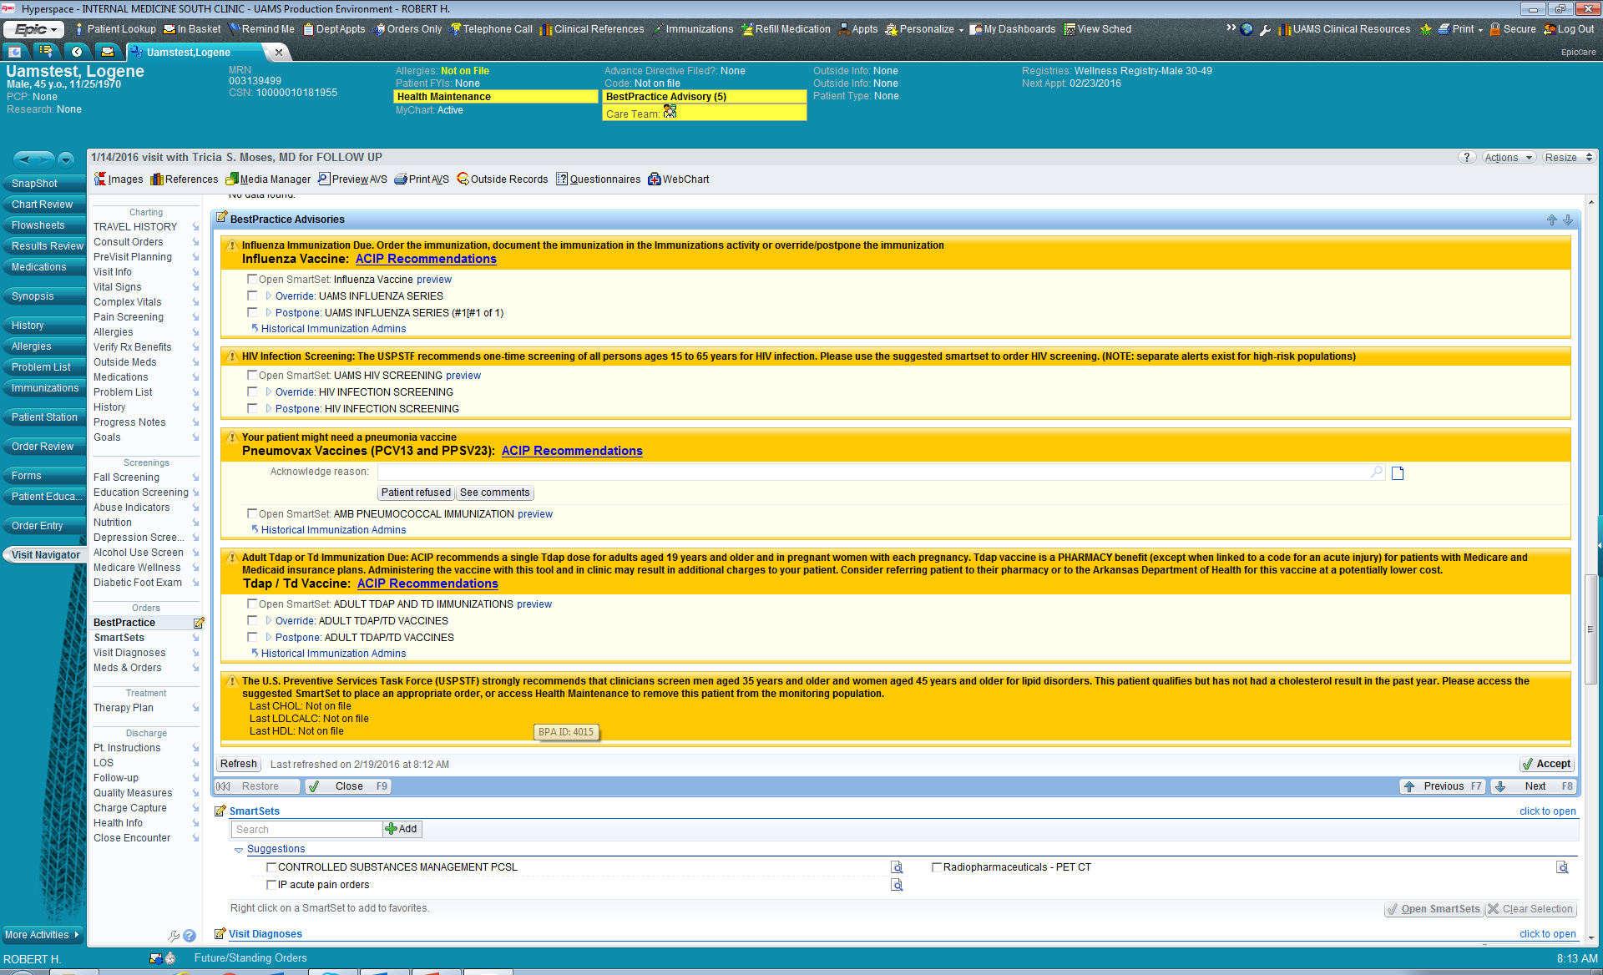
2
2
1
2
3

Slide 25
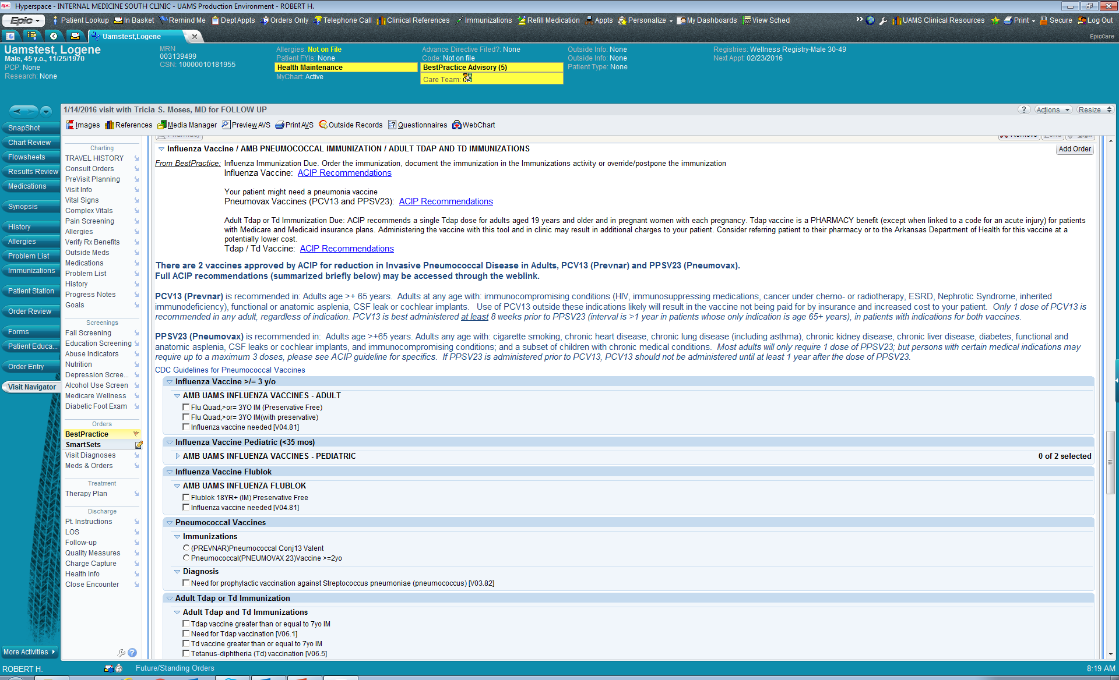
Select vaccines you wish to order [EMR associates with Preventive imm codes]
Click ‘sign’ button to activate

Slide 26
Standing Orders Protocol (SOPs)
Strategy to avoid missed opportunities in vaccination by allowing non – physician providers to administer vaccines without direct physician involvement
Recommended by many groups, including:
  Advisory Committee on Immunization Practices (ACIP)
  U.S. Community Preventive Services Task Force
Endorsed by CMS for vaccines since 2002
Resources:
http://www.standingorders.org/
http://www.immunize.org/standing-orders/

Slide 27
SOP Procedure
Recommend vaccination
  “Your doctor strongly recommends [flu] vaccine and wants you to have it – may I give it to you?”
Screen for contraindications and precautions
Provide appropriate Vaccine Information Statement (VIS)
Vaccine administration procedure
Vaccine documentation procedure

Slide 28
Standing Order Example: Influenza UAMS
UAMS Standing Order: Tdap. AU: RHH, MD. 10/2014. Accessed 2/18/2015

Slide 29
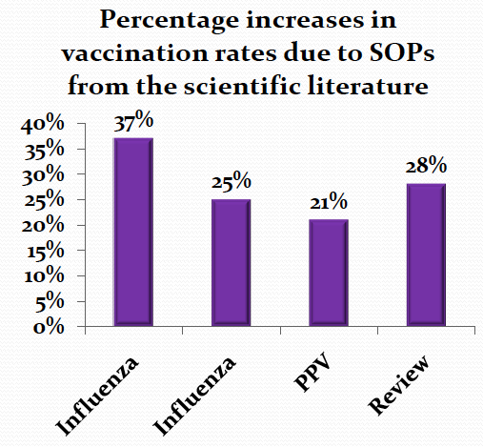
Standing Orders Protocols Effectiveness
Pharmacotherapy2007;27:729-733
Journal of American Geriatric Society2005;53:1008-1010
American Journal of Kidney Diseases2009;54:6-9
American Journal of Preventive Medicine2000;18(1S):92-6

Slide 30
CASE 3: Johnny Boudreaux
76 year-old man transferred today from the regional trauma center to the rehab center for which you are the Medical Director following severe ortho injuries in MVA.
On intake assessment you note Influenza vaccination documented in transfer summary but there is no record of any other immunizations… He does not know what vaccines he has received.
How might you obtain this information?
What vaccines would you recommend for Mr. B today?

Slide 31
Johnny Boudreaux: Answers
Information:
  Family? PCP? Pharmacy? State Registry?
Immunizations Today:
  PCV13 Single dose in all adults 65+
    PPSV23 DELAY: Recommend IN 12 months [CMS]
  Zoster Adults 60+
  Tdap Would be surprising to not get this in
  trauma care but stranger things have happened..

Slide 32
Immunization Information Systems (IIS):
State Lifespan Registries
IIS (registries) are confidential, population-based, computerized databases that record all immunization doses administered by participating providers in a given area
  IISs have robust vaccinations records for children, but remain underdeveloped or used for adults
Due to the mobility of the U.S. population, IISs will be critical to easily access complete vaccine histories
  Multiple vaccine providers and locations for adults
Interoperability and data sharing between state IISs are needed
        http://www.cdc.gov/vaccines/programs/iis/contacts-registry-staff.html
Notes:
The CDC has a contact list of state IIS staff: http://www.cdc.gov/vaccines/programs/iis/contacts-registry-staff.html

Slide 33
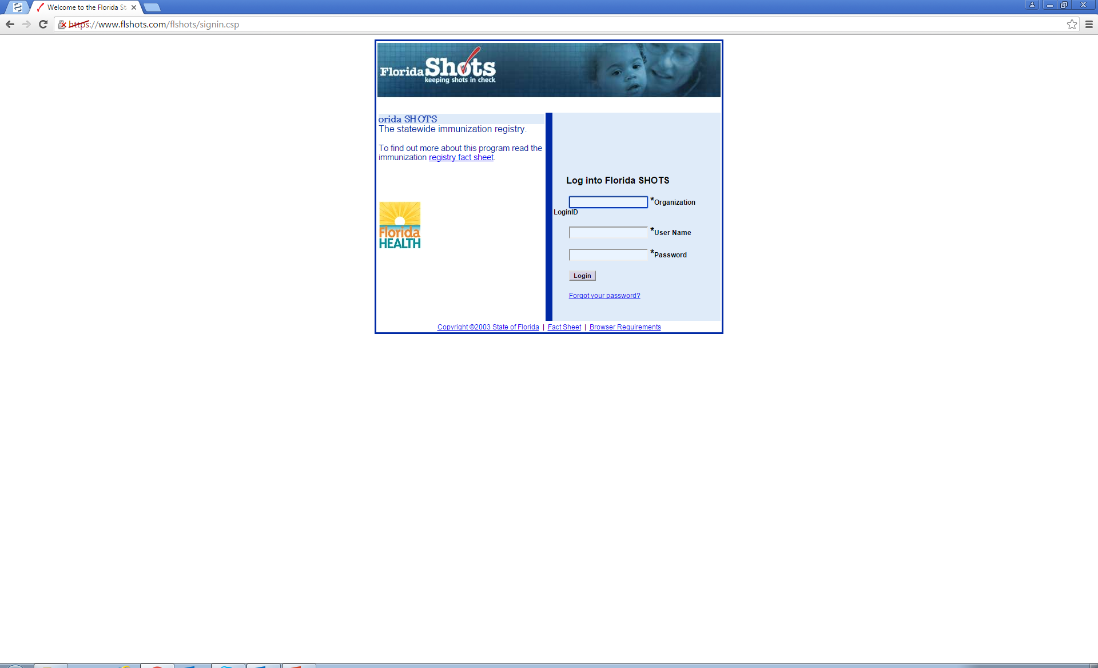
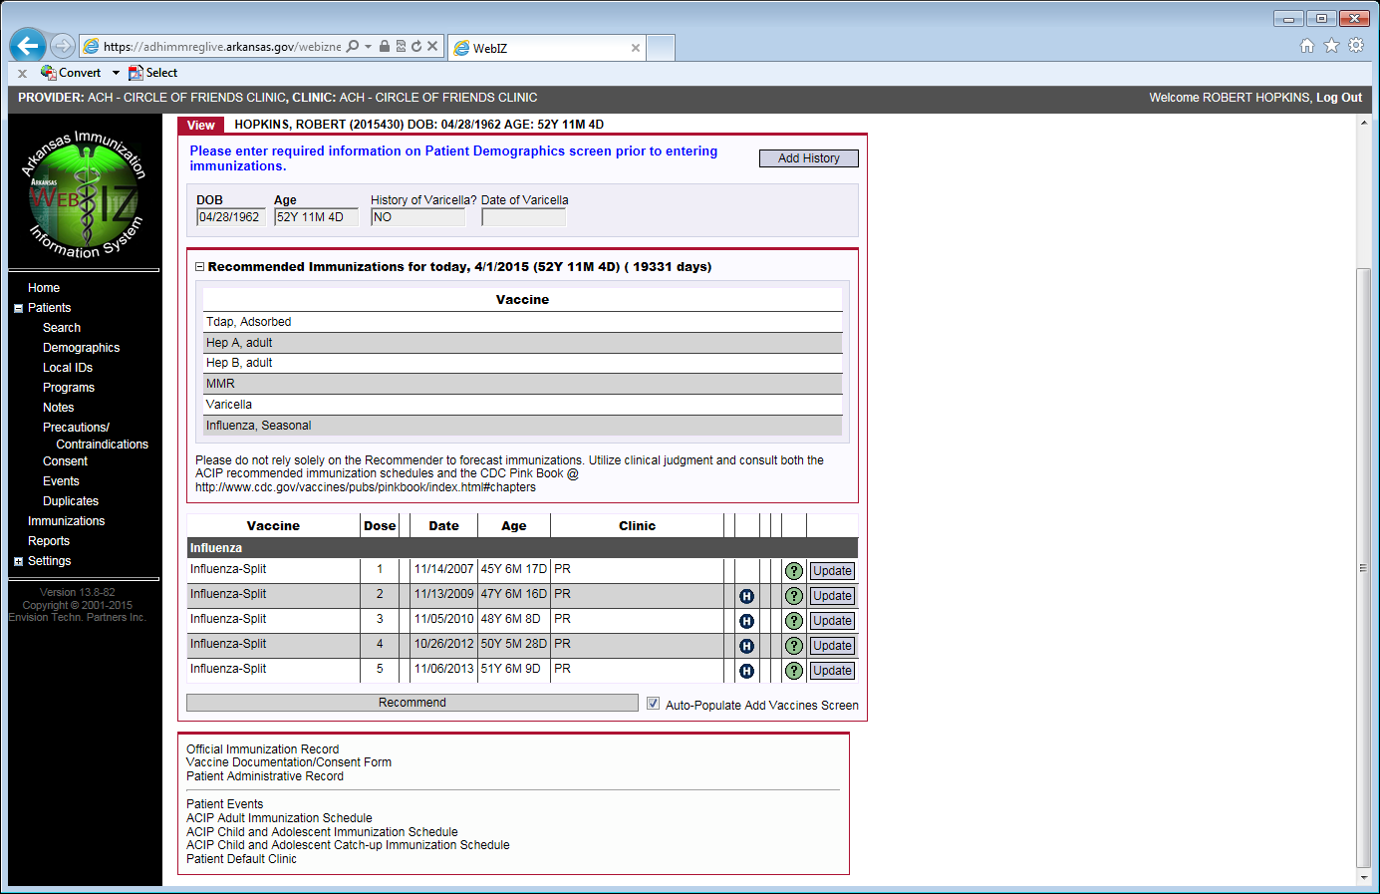
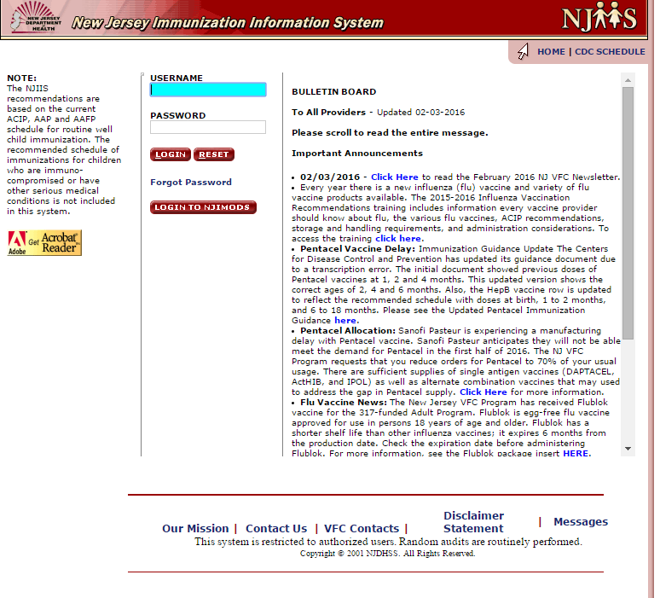
State Registry Snapshots: AR WebIZ, Florida Shots, and NJIS

Slide 34
IIS and Meaningful Use
Stage 2: Core Measure 16 – Submit electronic data to immunization registries
  Objective: Capability to submit electronic data to immunization registries or immunization information systems […]
  Measure: Successful ongoing submission of electronic immunization data from certified EMR to immunization registry or immunization information system for the entire EHR reporting period.
    Unidirectional feed is required from your EMR
    Bidirectional better but more problematic…
http://www.cms.gov/Regulations-and-Guidance/Legislation/EHRIncentivePrograms/downloads/Stage2_EPCore_16_ImmunizationRegistriesDataSubmission.pdf

Slide 35
CASE 4: Systems, QI Starter
You have done a quick audit of 30 randomly selected patient charts in your clinic panel and see that only 40% of your patients received influenza vaccine and had it documented in the EMR in the 2014 – 15 season.
  What elements can you identify that might play into this low vaccination rate?
  What simple intervention could be implemented to address this issue?
  What other team members do you want to engage in this project to improve your likelihood of success?

Slide 36
QI Starter: Some Potential Answers
Problems:
  Is there a systematic vaccination process in place?
  Is vaccination ‘ad lib’ or actively encouraged?
  Process to document vaccines elsewhere, refusal?
  Are all vaccine doses being recorded?
  Is the team knowledgeable and engaged?
Intervention: Education, Process, Outreach
  App, In-service, Post schedule/reminders
Team: 1= Identify Champion
  Clinic admin/leaders, all providers must at least agree
  Registration, Nurses, MA, others?

Slide 37
QI: PDSA Cycling
Plan
Design a process change: Identify gap in care, champions and stakeholders, process for change (with measurable outcome and timeframe)
Do
Put the process change into place
Study
Review the data
Act
Abandon, adapt, adopt, or repeat again

Slide 38
Where to start with Immunization QIP?
Identify a champion
Choose a specific focus/target:
  One vaccine
  One age group
  One disease state
Assess the status of that target
  Rate in a sample population
  Impact on the practice
Assess the knowledge and concerns of your team

Slide 39
Example QI Projects
Strategy Utilized | Vaccine | Population | Details
Patient Communication | Hepatitis B | Diabetics | Generate list of all diabetic patients and at next visit, recommend vaccination against Hepatitis B
Reminder – Recall | Influenza | All adults | At the start of flu season, send patient communication to remind patients to receive vaccine. After 2 months, identify patients not yet vaccinated and resend reminder
Chart Reminder | HPV | Female patients 19 – 26 & Male patients 19 – 21 | Query EHR to identify eligible patients who have not received HPV vaccine. Program an alert in patient charts to discuss and administer vaccine at next visit
Standing Orders | Tdap | Pregnant women, 27 – 36 weeks gestation | For each pregnant patient, have nursing staff offer and administer vaccine with appropriate documentation
Immunization Information Systems | Pneumo | Patients over 65 | For each visit with elderly patients, transmit pneumo vaccination status to IIS

Slide 40
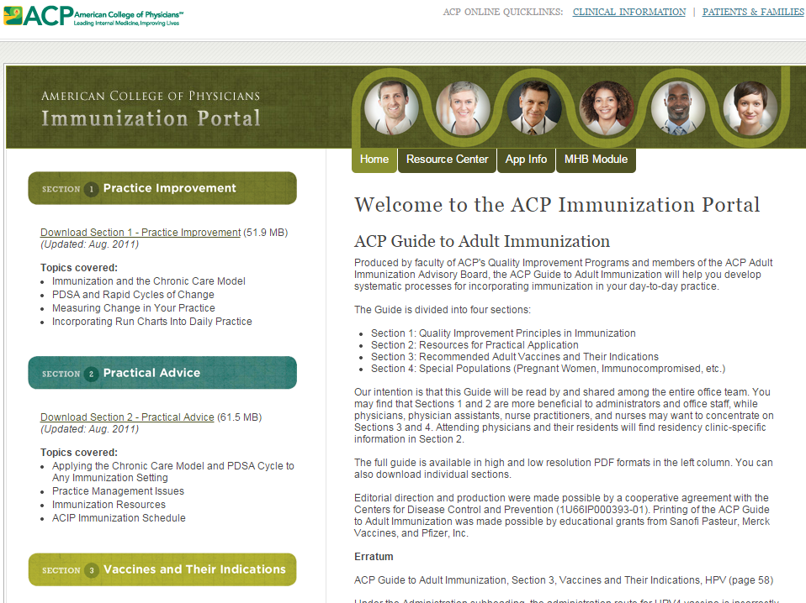
http://immunization.acponline.org/

Slide 41
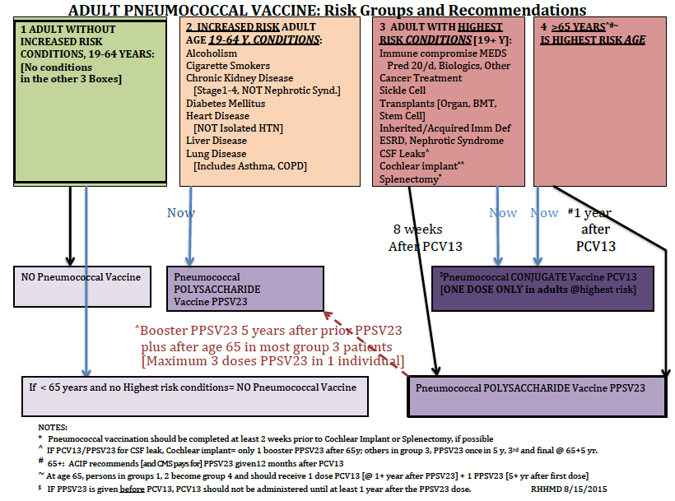
Pneumococcal Flow Sheet: ACIP Indications

Slide 42
Tdap QIP 1
Is there a problem?
Analyze the problem
Look for solutions
  Quick wins
  PDSA Candidates
Build a team
Start P-D-S-A
Assess results
Next cycle(s)
  Same problem
  Move to a new issue

Slide 43
Tdap QIP 2

Slide 44
Tdap QIP 3
And multiple other cycles could/should follow until rates are sustained at goal!
Then we turn the team’s attention to the next target!

Slide 45
Flu QIP: Starter Set

Slide 46
UAMS Vaccine Clinic QIP
Goal: Raise Influenza rates in OPC patients to > 50% [from ~43%]
  Clinic admin variable
    despite SO, posters, Educ. Outreach, 100% Employee vax
Plan: Flu Vax [+ Pneumo] clinic adjacent to OP Lab
  Oct 15-Jan 1. 1 REG, 1 LPN. SO + RN/MD backup
Do: Clinic, PR across OPC
Study: 1307 doses Influenza, 270 doses PCV/PPS
  14-15 4800 doses admin in OPC
  15-16 ____ doses admin in OPC [4400 doses by 11/12]
  Some vaccinating clinics referred and did not vax…
Act: Planning for 2016-17 season…

Slide 47
Additional Resources
ACP Guide to Adult Immunization http://immunization.acponline.org/
CDC Patient Education Materials http://www.cdc.gov/vaccines/hcp/patient-ed/adults/index.html
Adult Vaccinations Resource Library http://www.immunize.org/adult-vaccination/resources.asp
What Works to Increase Adult Vaccination Rates http://www2a.cdc.gov/vaccines/ed/whatworks/index.html
Quick Guide to Adult Vaccine Messaging http://www.izsummitpartners.org/wp-content/uploads/2014/05/AdultVaccineMessaging.pdf

