Slide 1
High Value Hospitalization
2023 • Presentation 4 of 5
Notes:
Welcome participants, introduce speaker, and identify the reason for this discussion: The primary goal of this curriculum is to provide trainees with the tools they need to become leaders in eliminating health care waste. This presentation will explore opportunities to provide high value care throughout various stages of hospitalization.

Slide 2
Essential Questions
How do charges differ for hospital care and outpatient services?
How can delayed diagnosis and diagnostic errors increase the cost of hospitalization?
Do different types of discharge locations have different associated out-of-pocket costs?
How can we optimize medication reconciliation during care transitions?
Notes:
Think about these essential questions related to the learning objectives for this session:
Compare charges for hospital care and outpatient services
Explain how delayed diagnosis and diagnostic errors increase cost by extending hospitalizations and increasing morbidity and mortality
Recognize the out-of-pocket costs associated with different types of hospital discharge locations
Optimize medication reconciliation as a key component of safe care transitions

Slide 3
Hospital Care vs. Outpatient Services
Notes:
Before deciding whether to hospitalize a patient, consider the differences in charges for hospital care and outpatient services and the best ways to use resources to support high value care.

Slide 4
Five Steps Toward High Value Care
1
Understand the benefits, harms, and relative costs of the interventions
Decrease or eliminate interventions that provide no benefits and/or may be harmful
3
Choose interventions and care settings to maximize benefits, minimize harms, and reduce costs
5
Customize a care plan that incorporates patient values and concerns
Identify system-level opportunities to improve outcomes, minimize harms, and reduce waste
2
4
Notes:
When comparing hospital care and outpatient services, remember the 5 steps toward high value care. First consider the relative cost of each intervention and then choose interventions and care settings that maximize benefits, minimize harms, and reduce costs.

Slide 5
Mr. Johnson’s Costs for Outpatient Care
Outpatient care for acute exacerbation of COPD
Service | Charge
Video visit | $116
Follow-up clinic visit | $295
Complete blood count | $46
Basic metabolic panel | $23
Five days of prednisone | $14
Total: | $494
Notes:
Recall the case of Mr. Johnson, the 68-year-old man who was treated for acute exacerbation of COPD. Here are the potential charges for his outpatient care, adding up to just under $500. Do any of these charges surprise you?

Slide 6
Mr. Johnson’s Costs for Hospital Care
Hospital care for acute exacerbation of COPD
Service | Charge
Two-night hospitalization | $6,702
Complete blood count | $92
Basic metabolic panel | $46
Chest radiography | $60
Emergency department fee | $1,287
Three days of prednisone at discharge | $14
Total: | $8,201
Notes:
Now consider the potential charges for Mr. Johnson’s hospital care, totaling over $8000. Do any of these charges surprise you?

Slide 7
Comparing Outpatient and Hospital Charges
Outpatient care for acute exacerbation of COPD
Hospital care for acute exacerbation of COPD
Service | Charge
Video visit | $116
Follow-up clinic visit | $295
Complete blood count | $46
Basic metabolic panel | $23
Five days of prednisone | $14
Total: | $494
Service | Charge
Two-night hospitalization | $6,702
Complete blood count | $92
Basic metabolic panel | $46
Chest radiography | $60
Emergency department fee | $1,287
Three days of prednisone at discharge | $14
Total: | $8,201
Direct admission avoids emergency department fees.
Notes:
Compare the charges that Mr. Johnson would incur in the hospital versus as an outpatient. There are other care options that have their own financial considerations. Observation has lower costs overall, but higher out-of-pocket costs for the patient. Direct admission cuts out emergency department costs.

Slide 8
Admission Decision
What factors should you consider when deciding whether to hospitalize Mr. Johnson? Would you hospitalize him or not?
What role, if any, does cost play in your decision?
Notes:
We are focusing on comparative charges here because very few of us were trained to incorporate cost concerns into hospitalization decisions. In groups of 2-4, discuss the costs and other factors involved in Mr. Johnson’s case and decide as a group whether you would admit him.

Slide 9
Diagnostic Error
Notes:
After the initial hospitalization decision, delayed diagnosis and diagnostic errors in the management stage can lead to increased costs such as extended hospitalizations and increasing morbidity and mortality. Let’s revisit Mr. Johnson’s case.

Slide 10
Delayed diagnosis
Mr. Johnson was admitted for acute exacerbation of COPD and subsequently improved. However, 2 days after discharge, he returns with the same symptoms that initially brought him to the hospital.
His exam is notable for improved wheezing but persistent increased work of breathing. He is readmitted for persistent acute exacerbation of COPD.
One day later, Mr. Johnson develops worsening dyspnea, pleuritic chest pain, and a new 2-L oxygen requirement. CT pulmonary embolism (PE) protocol shows a new segmental PE, and Mr. Johnson is started on apixaban.
What factors led to the delay in PE diagnosis in this case? Did any biases contribute to the missed diagnosis?
Notes:
Ask the group to think of what factors led to the delay in PE diagnosis in this case. Did any biases contribute to the missed diagnosis?

Slide 11
Types of Diagnostic Error
⛔ No-Fault
🧠 Cognitive
🏥 Systems-Based
Silent disease
Atypical presentation
Mimics common disease
Patient unable to report
Faulty data collection or interpretation
Flawed reasoning process
Incomplete knowledge
Organizational/ cultural
Flawed policy or procedure
Inadequate resources
Communication error
Workload
Notes:
There are 3 categories of diagnostic error: no-fault, cognitive, and systems-based. Cognitive errors account for 10%-20% of errors and are more common, more expensive, and more harmful than any other category of error. Cognitive errors extend hospitalizations, lead to readmissions, and create morbidity and mortality. They also have very complex causes, including faulty knowledge, biased thinking, and systems issues.

Slide 12
Diagnostic Error Discussion
Have you experienced an error in diagnosis that led to patient harm?
What could have been done differently to prevent the error from occurring?
Was the error no-fault, cognitive, or systems-based?
Notes:
Ask the group to discuss their experiences with diagnostic error in small groups of 2 or 3. Ask each group to consider the diagnostic reasoning processes involved and how things might have been done differently. Individual groups can then briefly share with the larger group.

Slide 13
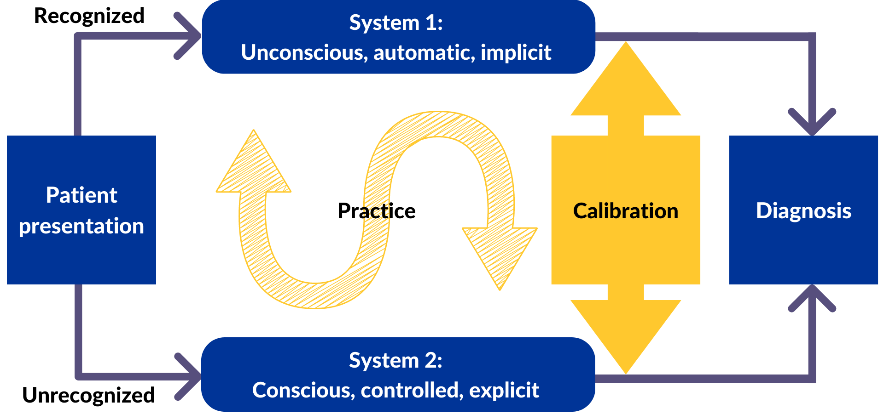
Diagnostic Reasoning
If system 2 cannot perform its regulatory function, diagnostic reasoning is prone to error.
Notes:
Recall the diagnostic reasoning process. System 1 gives us speed and is almost always accurate. However, it can be prone to bias. System 2 allows us to carefully weigh evidence and think logically but slows us down way too much if used all the time. When you are tired or stressed, system 2 cannot perform this regulatory function and error will ensue.

Slide 14
Cognitive Biases in the Clinical Reasoning Process
Anchoring Bias
Availability Bias
Confirmation Bias
Diagnostic Momentum
Notes:
Errors can also be associated with cognitive bias and its influence on your diagnostic decision making. Cognitive bias is a systemic, subconscious error in thinking that influences interpretation of information and affects decision making. Common cognitive biases in the clinical reasoning process include anchoring bias, confirmation bias, availability bias, and diagnostic momentum.
Anchoring bias: tendency to anchor on a particular piece of information
Confirmation bias: tendency to search for evidence to confirm the suspected diagnosis
Availability bias: tendency to consider recently encountered diagnoses because they come to mind more easily
Diagnostic momentum: tendency to consider a newly made diagnosis as fact, not fluid

Slide 15
Cognitive Debiasing Strategies
Diagnostic timeout
Metacognition
Decrease reliance on memory
Simulation
Accountability and feedback
Notes:
How can we guard against common cognitive biases in practice? There are several strategies to combat cognitive bias, all with the goal of slowing down the clinical reasoning process. These cognitive debiasing strategies include the following:
Metacognition: an awareness and understanding of one’s own thought process, including potential errors and biases
Diagnostic timeout: stop to reflect on the diagnosis. Consider probability and different perspectives.
Decrease reliance on memory, make tasks easier where possible, and alleviate time pressures
Get outside feedback and encourage accountability
Improve pattern recognition through simulation

Slide 16
Hospital Discharge
Notes:
Out-of-pocket costs associated with discharge vary depending on the discharge location. Let’s look at the options for hospital discharge for a patient like Mr. Johnson.

Slide 17
Discharge Options for Mr. Johnson
Assisted Living
Skilled RNs (IVs), PT/OT visits, home health aide
Skilled Nursing Facility
Daily skilled RN needs; direct supervision of RN, PT, OT; average length of stay: 13 days
Long-term Acute Care Hospital
Multiple skilled RN needs; direct supervision of RN, PT, OT; advanced need: ventilator wean, HFNC
💲💲💲💲💲
Continue Inpatient
All services available
💲💲💲💲
💲💲💲
💲💲
💲
Home
Skilled RN (IVs)
Over the next 24 hours, Mr. Johnson’s breathing improves, and he is weaned off oxygen.
On hospital day 3, he is ready for discharge. He lives with his husband and elderly mother-in-law in a 3rd floor walk-up unit.
Notes:
Mr. Johnson’s breathing improves and by hospital day 3, he is ready for discharge. Mr. Johnson lives with his husband and elderly mother-in-law in a third-floor walk-up apartment. Let’s look at the multiple options for patient discharge, each with varying costs and services. Moving from least expensive to most expensive in terms of out-of-pocket costs for the patient, the options include home, assisted living, a skilled nursing facility, a long-term acute care hospital, or continuing inpatient services.

Slide 18
Discharge Options Discussion
Which discharge option for Mr. Johnson finds the best balance between patient services and out-of-pocket cost?
Does the patient meet the criteria for each level of care? Can he access the services he needs?
Notes:
Recall that Mr. Johnson lives with his husband and elderly mother in a third-floor walk-up apartment.
Have residents discuss the questions about with a peer or in a group.

Slide 19
Medication Reconciliation
Notes:
Optimizing the medication reconciliation process is also a key component of safe care transitions.

Slide 20
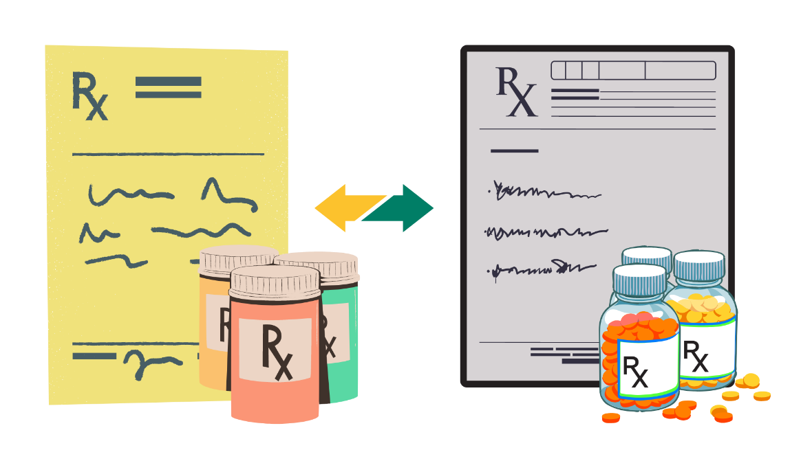
Medication reconciliation is the process of identifying the most accurate list of all medications that the patient is taking.
Important medication details to capture include:
Name
Dosage
Frequency
Route
Compare the medical record to an external list of medications obtained from the patient, hospital, or other provider.
Notes:
A thorough medication reconciliation is an important part of discharge; however, inadequate reconciliation can lead to harm and error. Be sure to capture the name, dosage, frequency, and route of all medications that the patient is taking.

Slide 21
Medication Reconciliation Discussion
Discuss a personal experience in which you saw a patient affected by an inadequate medication reconciliation.
Notes:
Have the residents take 5-10 minutes to discuss the prompt above.

Slide 22
Group Exercise
Design a new initiative to reduce discharge medication lists for your unit.
Include interventions and strategies to implement it.
Notes:
Have your groups take 10-15 minutes to design a new procedure for medication reconciliation and report back to the larger group.
Here are some suggestions you can offer if groups are having trouble:
Compare admission regimen to discharge regimen
Document a rationale for every medication change and a reason for every medication you are prescribing
Discontinue any medications that are no longer indicated
Indicate the remaining duration of any short-term medications
Prescribe generic medications whenever possible
Try to prescribe medications on the patient’s insurance formulary
Double check the patient’s medication allergies
Make sure medications are dose adjusted for renal or hepatic function
Communicate the new list to the patient, family, and the clinician who will be following up with the patient

Slide 23
Summary
Inpatient charges are usually higher than outpatient charges. Use the inpatient setting only when necessary.
Delays in diagnosis and diagnostic errors add hospital days, lead to readmissions, and increase morbidity and mortality.
Different discharge scenarios have very different out-of-pocket costs for individual patients. Consider these as you plan for safe discharge.
Thorough medication reconciliation should be performed at every outpatient visit and before every hospital discharge.
Notes:
Remember to always choose care settings that maximize benefits, minimize harms, and reduce costs.

Slide 24
Next Steps
Take the survey!
Complete the post-learning survey using the QR code.
Check out the references and resources for more info on eliminating health care waste.
Choose what you’d like to learn next at ACPOnline.org/HVCC and complete the prework cases for that unit.

