Slide 1
Eliminating Health Care Waste and Over-Ordering of Tests
2023 • Presentation 1 of 5
Notes:
Welcome participants, introduce speaker, and identify the reason for this discussion: The primary goal of this curriculum is to provide trainees with the tools they need to become leaders in eliminating health care waste. In today’s session, we will define value in health care, look at how our health care dollars are spent, and examine ways to deliver high value care to patients by discussing example cases on appropriate testing and imaging.

Slide 2
Essential Questions
What is value in health care?
Why is high value care important to patients, clinicians, and society?
How can we best deliver high value care to patients?
What clinical reasoning tools can assist in management of diagnostic uncertainty?
Notes:
Here are a few essential questions to consider when thinking about eliminating health care waste. The goals of our discussion today are to:
Define value in health care and the role of trainees in identifying value
Articulate the importance of high value care to patients, clinicians, and society
Explain the ACP model for delivering high value care to patients
Discuss the cost implications of several common clinical scenarios and the evidence-based guidelines for appropriate diagnosis and treatment
Identify clinical reasoning tools to assist in management of diagnostic uncertainty

Slide 3
What is value in health care and how can we deliver it to patients?
Notes:
What is value in health care and how can we deliver it to patients? The value of a service depends on clinical indication and the patient’s values, and no one wants to cut care that benefits patients and helps improve outcomes. Practicing high value care can help us address this challenge.

Slide 4
The Challenge: Thoughtfully order tests and studies that align with the patient’s goals and values while avoiding overtreatment and low value care.
Notes:
Isn’t this why we chose Internal Medicine? For the diagnostic process, the evidence, and solving a puzzle? This is an opportunity to go back to our roots and practice what we teach—that is, take a good history, perform and interpret an evidence-based physical examination, and thoughtfully order tests and studies that are in line with the patient’s goals and values.

Slide 5
Five Steps Toward High Value Care
1
Understand the benefits, harms, and relative costs of the interventions
Decrease or eliminate interventions that provide no benefits and/or may be harmful
3
Choose interventions and care settings to maximize benefits, minimize harms, and reduce costs
5
Customize a care plan that incorporates patient values and concerns
Identify system-level opportunities to improve outcomes, minimize harms, and reduce waste
2
4
Notes:
On the surface avoiding overtreatment and low value care makes sense and sounds simple, but what does it mean at the bedside when you are evaluating a real patient? How do you make the right decisions for individual patients? These five steps outline one approach to providing high value care. Let’s look at the first two steps in the context of an example case on appropriate testing.

Slide 6
Case 1: Appropriate Testing
Ms. Gray has an indwelling urinary catheter and presented with fever, cough, and malaise. Her daughter, who recently visited, now has COVID-19.
A urinalysis was significant for few bacteria, positive leukocyte esterase, negative nitrites. Urine culture grew >100,000 CFU/mL E. Coli.
After being prescribed a course of trimethoprim-sulfamethoxazole, Ms. Gray developed a severe drug reaction and was admitted to the hospital for treatment of Stevens-Johnson syndrome.
Notes:
Recall the case of Ms. Gray, a 69-year-old woman who presents to clinic for a 2-week posthospitalization follow-up for heart failure exacerbation and reports a 2-day history of fever, cough, sore throat, and malaise. During her hospitalization, she had urinary retention and an indwelling urinary catheter was placed. She has a follow-up appointment with a urologist next week. Her daughter was recently diagnosed with COVID-19.
Chest radiography revealed no acute cardiopulmonary abnormalities. COVID antigen testing was positive for COVID-19. Urinalysis was significant for few bacteria, positive leukocyte esterase, and negative nitrites. Urine culture grew >100,000 CFU/mL E. coli.
She was prescribed a course of trimethoprim-sulfamethoxazole and treated with supportive care for COVID-19. Her sore throat, fever, and cough resolved after 4 days, but she developed a severe drug reaction after 6 days of antibiotic therapy and presented to the ED where she was found to have Stevens-Johnson syndrome. She admitted to the hospital for 7 days for treatment of SJS

Slide 7
What are the costs associated with Ms. Gray’s care?
1
Understand the benefits, harms, and relative costs of the interventions
Initial Episode of Care
COVID testing: $82
CXR: $53
UA and culture: $100
7 days of antibiotics: $10
Downstream 📈
Hospitalization: $$$
Unnecessary suffering, anxiety, lost days of work for patient and her family
Notes:
First let’s look at the costs associated with Ms. Gray’s care. Consider both the initial episode of care and the downstream costs such as future hospitalization.
(Estimates courtesy of the Healthcare Blue Book)

Slide 8
How can we decrease or eliminate interventions that provide no benefits and/or may be harmful?
Decrease or eliminate interventions that provide no benefits and/or may be harmful
2
IDSA guidelines do not recommend screening for or treating asymptomatic bacteriuria in patients with an indwelling urinary catheter.
Consider the actions you will take based on the result and the harms that may result from unnecessary treatment.
Notes:
Ms. Gray lacked urinary symptoms and had a clear alternative diagnosis. Testing for bacteriuria in this patient with an indwelling urinary catheter who does not have symptoms of cystitis is unlikely to provide significant clinical benefit. These are examples of step 2 of the 5 steps toward high value care.

Slide 9
Group Discussion on Over-Ordering of Diagnostic Tests
Share a case where you feel like you over-ordered diagnostic testing.
What were common factors driving over-ordering in these cases?
Notes:
Ask participants to share their experiences with the larger group. Some common answers might include:
Consultant recommendations
Not wanting to be unprepared for rounds
Defensive medicine, not wanting to miss a diagnosis

Slide 10
Value in Health Care
Notes:
Introduce the value equation and ask the group to apply it an example from the group discussion. Emphasize that cost and value are not interchangeable. Tell participants that they will be asked to return to this equation throughout the curriculum.

Slide 11
Where are our health care dollars wasted?
💸 💸 💸
Notes:
From October 2000 to October 2022, the cost for medical care in the U.S. rose by 110.1% while the costs for all goods and services rose 71.3%. Medication pricing failures is the second largest source of estimated waste at $169.7 billion a year. Billing and coding waste is the largest single source of estimated waste at $248 billion per year. While U.S. health care spending is higher than what other high-income countries spend, the U.S. has lower overall health system performance.

Slide 12
Annual Cost Estimates in $US Billions by Waste Domain
Notes:
This chart shows the annual cost estimates by waste domain. In the domain of failure of care delivery, there is a lack of adoption of preventive care practices (obesity, vaccines, diabetes, hypertension) that accounts for an estimated $88.6 to $111.1 billion of waste annually. Overtreatment like low-value medication use, low-value screening, testing, or procedures, and overuse of end-of-life care represents an estimated $75.7 to $101.2 billion of annual waste.

Slide 13
Low-Value Services
Lab Testing
PSA > 70
25(OH) Vitamin D
Imaging
Frequent DEXA screening
Imaging for headache, syncope, LBP, uncomplicated rhinosinusitis
Prescription Drugs
Cardiopulmonary and Neurologic Testing
Procedures
Antipsychotics in dementia
Opiates for LBP
Antibiotics for URI and ear infections
Preop ECG, CXR, PFTs, stress testing, TTE in low- risk patients
EEG for headache
Vertebroplasty for osteoporotic fracture
Injections for LBP
Feeding tubes in dementia
Preop lab testing
Cardiac catheterization in low-risk patients
Notes:
A 2021 study on low value care measured 41 types of low-value services grouped into 6 general categories. Examples are listed in each category. In the Lab Testing category, PSA testing in men over age 70 may not be the costliest test on this list; however, one study estimated that testing costs account for just 2% of the life-time costs of PSA screening. In the Imaging category, one study reviewed >3000 DEXA scans and found that almost half were completed on patients less than 65 years old and 15% were repeated in the same patients within a 2-year period, which suggests inappropriate ordering according to the USPSTF guidelines. It’s probably no surprise that there are multiple other imaging studies on this list.
CXR = chest radiography; DEXA = dual-energy absorptiometry; ECG = electrocardiography; EEG = electroencephalography; LBP = low back pain; PFT = pulmonary function test; PSA = prostate-specific antigen; TTE = transeosphageal echocardiography; URI = upper respiratory infection.

Slide 14
Characteristics of Systems Delivering Low Value Care
Smaller proportion of PCPs
No major teaching hospital
Larger proportion of nonwhite patients
Located in the South or West
Serving areas with higher health care spending
Notes:
This same study aimed to identify characteristics of health care systems that deliver more low value care than others. It measured 41 low-value services for 556 health systems serving over 11 million Medicare beneficiaries. They found those characteristics associated with more low value care were the following (listed).

Slide 15
Medicare Beneficiaries Affected by Low-Value Services (2021)
Notes:
All told, using 2021 claims data, some modest improvement was noted from the 2009 study when 42% of Medicare beneficiaries received low value services, but 36% of Medicare beneficiaries are still affected, which shows we are making some progress, but we all have some work to do.

Slide 16
Why Do Residents Over-Order Tests?
Knowledge/Cognitive
Discomfort with diagnostic uncertainty
Lack of knowledge of costs and harms
No training in weighing benefit relative to cost/harm
Desire to be complete
Process
Preemptive ordering, rushing
Unnecessary duplication of tests
Ease of access to services while inpatient
Culture
Duplicating role-modeled behavior
Faculty demand
Defensive medicine
Patient requests
Notes:
As we see, over-testing is a large category of low value care. So, why do residents over-order tests? The reasons can be cognitive, procedural, or cultural.
Ask the group to think of some common reasons in each category shown above and then show the examples in each text box.

Slide 17
Defining and Managing Diagnostic Uncertainty
“subjective perception of an inability to provide an accurate explanation of the patient's health problem”
1. Assess patient
If low confidence, pursue further testing
If high confidence, initiate treatment
2. Formulate initial diagnostic hypothesis
Notes:
Diagnostic uncertainty is difficult to define. One definition is a subjective perception of an inability to provide an accurate explanation of the patient’s health problem. As clinicians, we often encounter complex situations in practice that lead to a great deal of uncertainty. This uncertainty can affect our decision-making process. Here is one process for managing diagnostic uncertainty in our clinical reasoning and determining when testing is appropriate.

Slide 18
Uncertainty Increases Resource Use
Increased physician anxiety due to uncertainty
Concerns about disclosing uncertainty to patients
Higher charges
Notes:
Increased physician anxiety can be due to uncertainty and further complicated by concerns about disclosing uncertainty to patients, which can then translate into higher charges.

Slide 19
Strategy Brainstorming Discussion
Brainstorm one individual-level and one systems-level strategy to handle uncertainty.
Notes:
Ask the group to brainstorm individual-level and systems-level strategies to handle uncertainty. After a few minutes, ask for volunteers to share with the larger group.

Slide 20
Case 2: Appropriate Imaging
Mr. Fox presents with worsening headache symptoms over the past month.
Patient initially undergoes conservative management and is told to follow up in 1 month or sooner if symptoms worsen.
Mr. Fox subsequently presents to the emergency department 2 weeks later with new-onset right hemibody weakness.
MRI of brain with or without contrast is performed and indicates 3-cm tumor in the left frontal lobe.
Patient is admitted to the hospital and undergoes tumor resection. Pathology indicates glioblastoma multiforme.
Should the MRI have been ordered at the first visit?
Notes:
Let’s continue with the case of Mr. Fox, a 42-year-old man with a history of hypertension and chronic headaches, who presents for worsening headache symptoms over the past month. Review the case details and ask the group if an initial MRI would have been appropriate.
Provide feedback to the group stressing the importance of clinical history to guide decision making. The decision to order an MRI in a younger man with headaches isn’t necessarily clear-cut.
Guide the discussion by asking questions such as, “What would make you more likely to order imaging versus less likely?” And give feedback such as “intermittent headaches with photophobia that are slightly worse than his previous migraines” versus “headache that is steadily worsening every morning” versus “patient taking his final exams in college and has had similar episodes in the past.” Emphasize that high-value decisions can sometimes be extremely patient- and history-specific, and before ordering expensive testing like MRIs, the clinician should really think about why this study is indicated.

Slide 21
High Cost ≠ Low Value
High-cost interventions may provide good value if highly beneficial.
Low-cost interventions may have little or no value if they provide little benefit or increase downstream costs.
Notes:
Remember that high cost doesn’t always indicate low value and low cost doesn’t always indicate high value. In this case, an MRI’s high cost did not mean it was low value.

Slide 22
Group Discussion
Can you think of other examples of high cost ≠ low value?
Can you think of other examples of low cost ≠ high value?
Notes:
Pose the following questions as an individual reflection or for a group discussion, if time allows. Possible responses could be:
ICD for selected patients with heart failure and low EF
Screening colonoscopy
BNP measurement in patient with clear heart failure
Annual Pap smears in an average-risk woman

Slide 23
Case 3: Low Back Pain
Mrs. Nii is a 54-year-old teacher with diabetes, hypertension, and hypothyroidism. She presents to urgent care with low back pain that started 2 weeks ago.
She does not recall any inciting factors, but the pain is so severe that she has had to take the past couple days off work. She tried acetaminophen, which didn’t help.
On examination, she has some tenderness to the paraspinal muscles, as well as a normal neurologic exam and negative straight leg raise.
You offer supportive care and reassurance, but Mrs. Nii asks for an MRI because she is worried that she could have a slipped disc and need surgery.
What Would You Do Next?
Notes:
Let’s look at another case to determine what imaging would be appropriate.

Slide 24
ACR Appropriateness Criteria® - Low Back Pain
Variant 1: Acute low back pain with or without radiculopathy. No red flags. No prior management. Initial imaging.
Imaging Test | Appropriateness | Radiation Exposure
Radiography lumbar spine | Usually Not Appropriate | ☢☢☢
MRI lumbar spine with IV contrast | Usually Not Appropriate | ⚪
MRI lumbar spine without and with IV contrast | Usually Not Appropriate | ⚪
MRI lumbar spine without IV contrast | Usually Not Appropriate | ⚪
Bone scan whole body with SPECT or SPECT/CT complete spine | Usually Not Appropriate | ☢☢☢
CT lumbar spine with IV contrast | Usually Not Appropriate | ☢☢☢
CT lumbar spine without IV contrast | Usually Not Appropriate | ☢☢☢
Discography and post-discography CT lumbar spine | Usually Not Appropriate | ☢☢☢
CT lumbar spine without and with IV contrast | Usually Not Appropriate | ☢☢☢☢
CT myelography lumbar spine | Usually Not Appropriate | ☢☢☢☢
FDG-PET/CT whole body | Usually Not Appropriate | ☢☢☢☢
Notes:
I think we all know that the MRI is not the right answer here. If you were considering imaging and weren’t sure which test would be appropriate, you could look the American College of Radiology Appropriateness Criteria, which would show you the following table, which is not surprising.

Slide 25
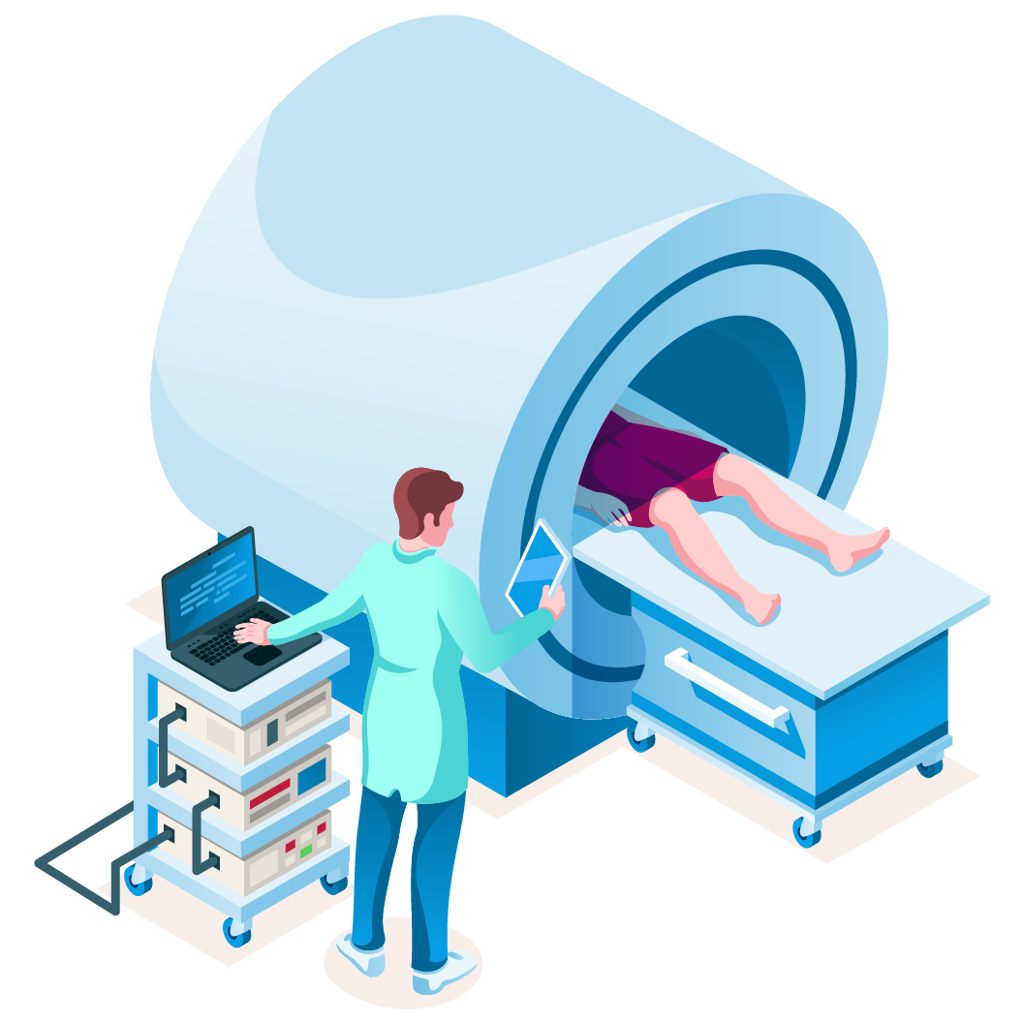
Factors Influencing Unneeded Lumbar Spine MRI Orders for Acute, Uncomplicated Low-Back Pain
Why are MRIs often ordered for low back pain?
Specialty care requirements
Patient belief that imaging adds value
Patient pressure on clinician
Time constraints
Notes:
MRIs are often ordered for evaluation of low back pain. Sometimes this is because the specialists we refer patients to request it in advance of the visit, or we want to reassure patients who believe that imaging adds value to their care and who pressure us to order it. Sometimes it is easier to order the study that the patient asks for rather than to explain why it may not only be unhelpful but may be harmful.
What would be some other possible downstream costs or harms for the patient if you ordered her the MRI like she requests?

Slide 26
Costs of Unneeded Lumbar Spine MRI Orders for Acute, Uncomplicated Low-Back Pain
What are the costs of unnecessary MRIs for LBP?
$300 million per year in unnecessary lower spine MRIs
Anxiety
Unnecessary procedures
Belief in presence of disease
Notes:
The costs of unnecessary MRIs for lower back pain are high, both financially and in terms of incidental findings: $300 million per year in unnecessary lower spine MRIs. Incidental findings can result in anxiety, belief in presence of disease, and unnecessary procedures—such as vertebroplasty or injections for lower back pain—that may increase the risk of adverse effects.

Slide 27
Mrs. Nii
Mrs. Nii agreed to try conservative care with heat, NSAIDs, and the exercises that you recommended and to call you if her symptoms do not improve or if they worsened.
She returned to the clinic 1 month later for a routine follow-up of her diabetes and had some minor residual pain that was improving daily.
Notes:
In this case, more conservative care helped Mrs. Nii feel better without potentially harmful tests or unnecessary treatments.

Slide 28
Summary
Here's what you can do to address the urgent, multibillion-dollar problem of health care waste:
Carefully weigh costs (including downstream costs), harms, and benefits
Order only interventions that add value to a patient's care
Reduce diagnostic uncertainty through appropriate use of evidence-based guidelines and decision-support tools
Support system-level high value care interventions
Notes:
Health care waste is an urgent, multibillion-dollar problem. Every clinician must carefully weigh costs (including charges and downstream costs), harms, and benefits and order only those interventions that add value to a patient’s care. Diagnostic uncertainly is a major driver of waste. Appropriate use of evidence-based guidelines and decision-support tools aid in the practice of high value care. System-level interventions to support high value decision making are critical.

Slide 29
Next Steps
Take the survey!
Complete the post-learning survey using the QR code.
Check out the references and resources for more info on eliminating health care waste.
Choose what you’d like to learn next at ACPOnline.org/HVCC and complete the pre-work cases for that unit.

