Slide 1
Overcoming Barriers to High Value Care
2018• Presentation 5 of 6

Slide 2
Learning Objectives
Describe the barriers to high value care in clinical practice and explore ways to overcome these barriers
Weigh the efficacy and safety of medical interventions to avoid inappropriate use and harm
Practice negotiating a care plan with patients that incorporates their values and addresses their concerns
Explain the importance of local culture in your practice decisions

Slide 3
Large Group Activity
Turn to the person sitting next to you and draft a quick list of potential barriers to delivery of high-value care to patients
Consider barriers at the individual provider level and at the systems level

Slide 4
Potential Barriers to High Value Care
System Level | Individual Provider Level
Lack of guidelines (sometimes from lack of evidence) | Poor familiarity with guidelines
Time pressure (emphasis on shorter visits/LOS, productivity) | Lack of time to explain to patients, patient expectations
Lack of centrally available information on prior tests | Discomfort with diagnostic uncertainty
Local culture | Lack of appreciation of harms, lack of knowledge of costs
Defensive medicine

Slide 5
Barrier: Defensive Medicine
“Defensive medicine occurs when doctors order tests, procedures, or visits… primarily to reduce their exposure to malpractice liability.”
(Congressional OTA 1994)
Defensive medicine is very common: 93% of physicians in Pennsylvania report practicing defensive medicine¹
Notes:
Ask residents: Raise your hand if you have ever practiced defensive medicine or seen it practiced

Slide 6
Does NOT Protect Against Malpractice²
Barrier: Defensive Medicine
Malpractice claims can be arbitrary and hard to prevent: 40% of malpractice claims do not involve medical errors
More care is not better care, as tests and treatments have associated harms that may lead to malpractice
Lack of follow up of abnormal test results often leads to malpractice litigation—don’t order the test if you don’t plan on following it up and acting on the results

Slide 7
Barrier: Defensive Medicine³
Listen
Document
Communicate
Listen to patient concerns, express empathy
Listen for patient understanding after you communicate risks and benefits of medical decisions
Careful documentation of your decision making process is key; consider making available to patients
Primary factor in patient’s decision to pursue claim is lack of adequate communication, reporting
Consider system-wide disclosure policy (evidence-based)
Notes:
Transition: Now that we’ve discussed the first barrier, let’s talk about the next one, Responding to Patient Requests.

Slide 8
Case: Patient Request
Chief complaint: “I need to know if I have lung cancer.”
53-year-old woman presents for an annual physical. Her 60-year-old best friend was recently diagnosed with stage IV lung cancer. The patient is concerned that she is also at risk.
She has a 25 pack-year smoking history, and quit at age 37
She read about CT for lung cancer screening online, and requests you order a scan today. She specifically requests a high-resolution CT scan, because she read that it is better at detecting small spots.

Slide 9
Case: Patient Request
Do you think a low-dose screening CT scan is appropriate in this patient?
Would you order one? Why or why not?
What are some barriers you expect to encounter (from both physician and patient perspectives) if you decide not to order?
Notes:
Photo credit: Creative commons

Slide 10
Case: Patient Request

Slide 11
Barrier: Patient Expectations
Patients often think that more testing is better
Physicians have legitimate concerns about patient satisfaction, which may be tied to reimbursement
Patients want a clear diagnosis, shared decision-making, acknowledgment that their symptoms are real and concerns are valid, and reassurance
Effective communication contributes more to patient satisfaction than the specific management plan

Slide 12
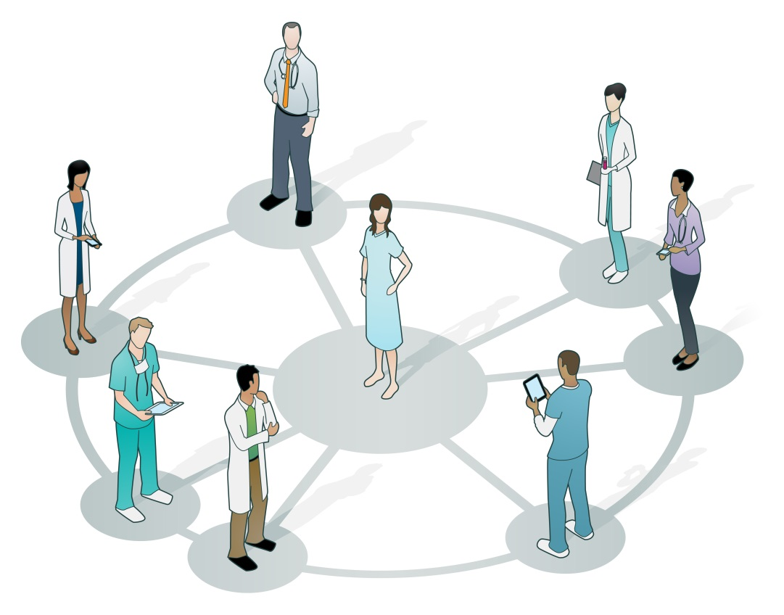
Barrier: Patient Expectations
What are some principles of patient-centered discussions?
How do you approach these issues with patients?
Notes:
Ask the group- what are some of the principles of patient-centered discussions? How would you approach issues like this with a patient?
Photo credit: http://www.forces4quality.org

Slide 13
Tool: HVC Conversation Guide
Set up an effective conversation with patients
Explain in plain language why requested tests are unnecessary
Customize the plan to match patients’ values
Screen for logistic and financial barriers to care
Notes:
Hand out the HVC Conversation Guide in preparation for the attendees to apply it to the next case

Slide 14
Case: Patient Expectations
Chief complaint: “I need antibiotics”
A 35-year-old man presents to clinic, asking for antibiotics
Reports sinus congestion and headache for three days
Says he has always received antibiotics for sinus infections in the past
When you explain that he does not need antibiotics at this time, he becomes upset, stating “I can’t wait for things to get worse, I need to take care of this now.”
Notes:
Photo credit: www.umalert.com

Slide 15
Case: Patient Expectations
The Conflict
Patient had multiple experiences in the past where he received antibiotics for the same complaints
However, you know that avoidance of antibiotics for acute sinusitis is a Choosing Wisely initiative from multiple professional societies^{5,6,7}
Notes:
http://www.choosingwisely.org/societies/american-college-of-emergency-physicians/

Slide 16
Case: Patient Expectations
Discuss in your small groups:
How would you resolve the conflict between what the patient wants and what you feel is medically indicated?
Practice using the HVC Conversation Guide
How much should you accommodate patient wishes for treatments with little or no prospect of benefit and the possibility of harm?

Slide 17
What Did You Decide to Do?
Report Back
Prescribe the antibiotics
No antibiotics, provide education and reassurance
Notes:
Have the small groups vote.

Slide 18
Case: Local Culture
You are an intern on the general medicine service. You admit a patient for C. difficile colitis, confirmed by PCR and seen on admission CT abdomen. On hospital day 3, the patient has worsening abdominal pain and distension. Her abdominal exam has worsened and is now tense with rebound tenderness, and urine output has dropped off precipitously.
You are concerned that the patient has developed an acute abdomen. You call the surgery resident and ask for a consult for “worsening c. diff, concern for perforation.”
She says, “Order a CT and we will see her later this afternoon.”
You don’t think that is appropriate….

Slide 19
Case: Local Culture
In your small groups, discuss:
What went wrong? Think about both your perspective and that of the surgery resident.
How could you better frame a question for the consultant?

Slide 20
Case: Local Culture
The High Value Care Consult:
Be specific: what question do you want them to answer?
What are you concerned about? How concerned are you?
If you want them to do something, ask directly.
Include important relevant information (exam/history)
“Speak the same language” via risk stratification tools and subspecialty guidelines when able
Suggest a time frame: Emergent/urgent/routine?
If they ask for testing, ask what the testing is looking for
Notes:
Give information on worsening clinical symptoms
Include your physical exam findings and key laboratory data
Can the patient be seen later? Or is this an urgent consult?
Do you feel this patient may need to go to the OR today?

Slide 21
Case: Local Culture
You call the surgery team back and relay the concerning physical exam findings, and your concern that the patient may need to be taken to the OR today. You ask if the surgery team could meet you at the bedside to assess the patient together.
The surgical team meets you at the bedside, evaluates the patient, and decide to take the patient to the OR urgently, without further imaging.

Slide 22
Barrier: Local Culture
Local Culture: What is the problem?
The art of medicine often outweighs the evidence (the majority of our patients would be excluded from clinical trials)
System 1 (pattern recognition) goes unchecked by System 2 (deliberate reasoning) under certain conditions (time pressure, work intensity, psychological stress)
Deeply ingrained; difficult to change (but not impossible)
Notes:
Jin, et al. evaluated the rate of blood transfusions in cardiac surgeries within a health care system
The variance of red blood cell transfusions among hospitals (0.82) was more than double that among surgeons in the same hospital (0.32)
The hospital a surgeon practiced at was more powerful than an individual surgeon’s preference

Slide 23
Barrier: Hidden Curriculum
Hidden Curriculum: What is it?
Non-verbal messages transmitted “on the job” through practices, habits, and hierarchy
Actions of senior physicians (often unspoken) influence the behavior of students, regardless of what is formally taught
In medical school, students are taught that the history and physical exam are key to diagnosis; however, some consultants request imaging before evaluating a patient at the bedside
Fear of disapproval outweighs fear of uncertainty
Notes:
Applying to the case example:
Waiting for imaging may delay treatment of a life threatening disease
In our current culture fear of uncertainty and fear of disapproval BOTH drive over-testing and over-treatment

Slide 24
Barrier: Culture/Hidden Curriculum
Come back to your small groups:
Brainstorm ideas for how to address local culture and hidden curriculum issues in your hospital system
Notes:
Applying to the case example:
Waiting for imaging may delay treatment of a life threatening disease

Slide 25
Barrier: Culture/Hidden Curriculum
Potential Solutions
Make best available evidence accessible to augment decision making
Use comparative data to identify practice variation and motivate clinicians to change
Identify respected clinical experts to support practice change (opinion leaders)
Unfreeze, Change, Freeze⁸
High Power/ Influence
Satisfy
Engage
Monitor
Inform
High
Involvement
Different Strategies for Different Stakeholders⁹
Notes:
Grant, C et. al. QI 105: Leading Quality Improvement. Cambridge, Massachusetts: Institute for Healthcare Improvement; 2016. Available on www.IHI.org. Accessed on 11/20/2017
Lewin’s Stages of change
Unfreeze: loosen attachments to current practice, share external research
Change
Freezing: lock in new way

Slide 26
Summary
Key barriers to high value care include defensive medicine, addressing patient expectations, and local culture
Good communication with patients and proper documentation are the best ways to defend your medical decisions
Take time to negotiate a care plan with patients that incorporates their values and addresses their concerns
Local culture affects your practice decisions; be clear in your consult questions in order to get the best answer for your patients

Slide 27
References
Studdert DM, Mello MM, Sage WM, et al. Defensive medicine among high-risk specialist physicians in a volatile malpractice environment. JAMA. 2005 Jun 1;293(21):2609-17. [PMID: 15928282]
Studdert DM, Mello MM, Gawande AA, et al. Claims, errors, and compensation payments in medical malpractice litigation. N Engl J Med. 2006 May 11;354(19):2024-33. [PMID: 16687715]
Gallagher TH, Studdert DM, Levinson W. Disclosing harmful medical errors to patients. N Engl J Med. 2007 Jun 28;356(26):2713-9. [PMID: 17596606]
American College of Chest Physician and American Thoracic Society. Five Things Physicians and Patients Should Question. Philadelphia, PA: Choosing Wisely; 2013. Available from: http://www.choosingwisely.org/societies/american-college-of-chest-physicians-and-american-thoracic-society Accessed 11/20/2017
American College of Emergency Physicians. Ten Things Physicians and Patients Should Question. Philadelphia, PA: Choosing Wisely; 2013. Available from: http://www.choosingwisely.org/societies/american-college-of-emergency-physicians Accessed 11/20/2017
American Academy of Family Physicians. Fifteen Things Physicians and Patients Should Question. Philadelphia, PA: Choosing Wisely; 2012. Available from: http://www.choosingwisely.org/societies/american-academy-of-family-physicians. Accessed 11/20/2017
American Academy of Allergy, Asthma, and Immunology. Ten Things Physicians and Patients Should Question. Philadelphia, PA: Choosing Wisely; 2012. Available from: http://www.choosingwisely.org/societies/american-academy-of-allergy-asthma-immunology/. Accessed 11/20/2017
Lewin, K. Frontiers in Group Dynamics: Concept, Method and Reality in Social Science; Social Equilibria and Social Change. Human Relations. June 1947. 1: 5–41. doi:10.1177/001872674700100103.
Grant, C et. al. QI 105: Leading Quality Improvement. Cambridge, Massachusetts: Institute for Healthcare Improvement; 2016. Available on www.IHI.org. Accessed on 11/20/2017

