Slide 1
High Value Diagnostic Testing and Screening
2018• Presentation 3 of 6

Slide 2
Learning Objectives
Review the concepts of sensitivity, specificity, and predictive value and their application to high value care decision-making
Practice applying these concepts to support high value care decisions when considering diagnostic and screening tests
Explore the benefits and harms (including costs) of routine screening
Develop an approach to customize screening recommendations to an individual patient and his/her unique risk factors, values, and concerns
Notes:
Needed in order to interpret diagnostic tests and especially screening.

Slide 3
Case: Biostatistics Review
You are in charge of your hospital’s rapid response team. You are working with the IT team to develop a tool to identify patients with sepsis, who are at high risk for decompensation and transfer to the ICU
The IT team asks if you are looking for a sensitive or a specific predictive tool
With your small group, define the following terms and decide which features you value for your sepsis tool:
Sensitivity, specificity
Positive predictive value, negative predictive value
Notes:
Needed in order to interpret diagnostic tests and especially screening.

Slide 4
Biostatistics Review: Definitions¹
Sensitivity | Ability to detect people who have disease
Specificity | Ability to detect people who do not have disease
Positive Predictive Value (PPV) | Likelihood that a person with a positive test result truly has disease
Negative Predictive Value (NPV) | Likelihood that a person with a negative test result truly does not have disease
Notes:
Needed in order to interpret diagnostic tests and especially screening.

Slide 5
Biostatistics Review: Definitions
Test Cutoff
Health
Disease
Notes:
For the more visual learners

Slide 6
Biostatistics Review: Definitions
 | Disease Present | Disease Absent
Test Positive | True Positive | False Positive
Test Negative | False Negative | True Negative
Sensitivity = $\frac{True Positive}{True Positive+False Negative}$ “Be sensitive to those who have disease” “SenSitivity = Screening”
Notes:
Very sensitive tests required in situations where consequences of false negative would be very bad (screening donated blood for HIV)

Slide 7
Specificity = $\frac{True Negative}{True Negative+False Positive}$ “Negative people get specific” “SpeCificity = Confirmation”
Biostatistics Review: Definitions
 | Disease Present | Disease Absent
Test Positive | True Positive | False Positive
Test Negative | False Negative | True Negative
Notes:
Needed in situations where false positive would be very bad (i.e. cancer)

Slide 8
PPV= $\frac{True Positive}{True Positive+False Positive}$
Biostatistics Review: Definitions
 | Disease Present | Disease Absent
Test Positive | True Positive | False Positive
Test Negative | False Negative | True Negative
Notes:
True positive /true + false

Slide 9
Biostatistics Review: Definitions
 | Disease Present | Disease Absent
Test Positive | True Positive | False Positive
Test Negative | False Negative | True Negative
NPV= $\frac{True Negative}{True Negative+False Negative}$

Slide 10
Diagnostic Reasoning Process²
Recognized
System 1
Calibration
Practice
Patient Presentation
Diagnosis
System 2
Unrecognized
Notes:
System 1 gives us speed, and is almost always accurate. However, can be prone to bias.
System 2 allows us to carefully weigh evidence and think logically, however would slow us down way too much.
Both systems need to be functioning to practice medicine.
The calibration or toggling between the systems is the most important component.
Normally, if system 1 is wrong (perhaps a bias is influencing your diagnostic decision), if a component of the patient presentation isn't fitting well, System 2 will toggle on and take over.
If you are tired, pressed for time, stressed, system 2 cannot perform this regulatory function and error will ensue.

Slide 11
Diagnostic Reasoning Process
Pretest Probability
Diagnostic Test
Post test
Probability
Disease Prevalence
Sensitivity, Specificity
PPV, NPV
Notes:
We start by creating a pretest probability (usually based on disease prevalence), then decide on the appropriate diagnostic test (based on which one maximizes sensitivity and specificity), which leads to our posttest probability.

Slide 12
Diagnostic Reasoning Process
Role of Diagnostic Testing
To reduce uncertainty regarding a specific patient’s diagnosis
Generally most appropriate for patients you feel have an intermediate (10%-90%) pretest probability of a disease
Test characteristics (such as likelihood ratios) should be considered before ordering a test to help determine whether a given test would significantly alter your post test probability and change your management
Notes:
Emphasize that unique pt presentations/symptoms and the pt demographics are essential to formulating clinical judgment regarding the pretest probability of a specific disease.
Should be applied in a sequential fashion until clinician’s can reach a “threshold” after which our posttest probability is high enough that we are confident that a patient either has or does not have a disease

Slide 13
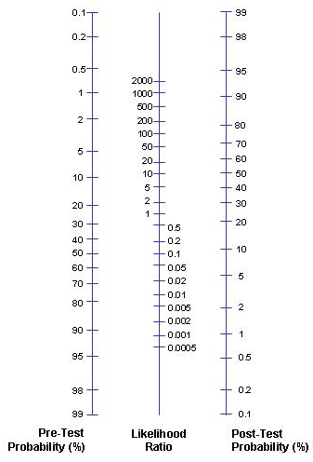
Diagnostic Reasoning Process
Likelihood Ratios (LR):
Use the estimated pretest probability of disease as an anchor on the left side of the graph
Draw a straight line through the known likelihood ratio, either (+) or (-)
Where this line intersects the graph on the right represents the post test probability of disease
Notes:
A LR ratio of 2 increases post-test probability by approximately 15%, a LR of 5 increases post-test probability by approximately 30% and a LR of 10 increases the post-test probability by approximately 45%.

Slide 14
Diagnostic Reasoning Process
Likelihood ratios for common exam maneuvers and diagnostic tests
Homan’s sign for DVT | LR (+) 1.1
Nuchal rigidity for meningitis | LR (+) 3
Fluid wave for ascites | LR (+) 5.0
Mammogram for breast cancer | LR (+) 8.7 LR (-) 1.4
ST elevation for acute MI | LR (+) 11.2
CT head for acute intracranial bleed | LR (+) 23.8 LR (-) 0.05
Valgus laxity for MCL injury | LR (+) 146.6
Notes:
Ask learners to guess the LR for the following common exam maneuvers and tests. Click to reveal the answers.

Slide 15
Diagnostic Reasoning Process
Pretest Probability
Diagnostic Test
Post test
Probability
Likelihood Ratio
Disease Prevalence
Sensitivity, Specificity

Slide 16
Case: Diagnostic Reasoning
Break into 3 small groups
Each group will work through a different case of a patient with possible heart failure exacerbation
Focus on the diagnostic process:
Estimate the pretest probability of disease in your patient
Evaluate how BNP would influence your post test probability of disease and assess whether this would be helpful in your patient
All three groups must answer the question: Is a BNP a high value test for your patient? Why or why not?

Slide 17
High Value Screening
Role of Screening Tests:
To detect asymptomatic and early-stage disease
Should be highly sensitive and highly specific to pick up most cases of true disease and avoid false positives
Targeted toward populations with a higher disease prevalence (high positive predictive value)
Should be relatively safe and cost-effective
Should screen for diseases in which early identification and treatment have been demonstrated to improve clinical outcomes
Notes:
Goal is for high sensitivity and specificity, but there is no free lunch so usually sacrifice one at the expense of the other

Slide 18
High Value Screening: Harms
Small Group Activity:
Discuss the potential harms associated with screening tests
Share a story about a patient you believe was harmed from screening
Notes:
Goal is for high sensitivity and specificity, but there is no free lunch so usually sacrifice one at the expense of the other

Slide 19
High Value Screening: Harms
False positive results
Because primary goal of screening = find disease → maximize sensitivity at cost of specificity → false positives
Can lead to incorrect labeling, inconvenience, expense, and physical harm in follow-up tests
Notes:
As mentioned before, no free lunch.

Slide 20
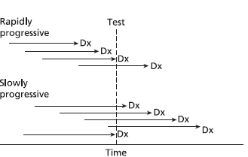
High Value Screening: Harms
Lead-Time Bias: Make diagnosis of disease but no mortality benefit
Length-Time Bias: “Overdiagnosis” and “Pseudo-disease”
Notes:
Lead time bias-Survival determined by time from diagnosis to death. With screening, can increase survival time, even though patient ends up dying at the exact same time they would have without the test. Seems like they lived longer, but actually just knew about disease longer
“Overdiagnosis”: Will finding a disease help the patient? Some diseases are so slow growing, or may even regress. Therefore they may not cause any trouble and in fact may not be a “disease” at all. This is an example of “length-time bias”. Cancer incidence increases with earlier screening. How do we know which ones will be invasive, and which will not be a problem? By nature, screening tests tend to pick up cancers that are more indolent and have better prognosis

Slide 21
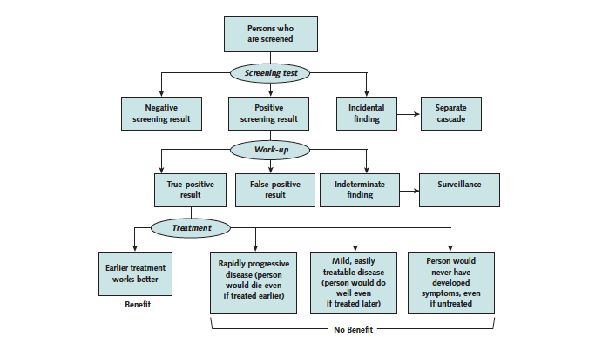
Screening Cascade⁴
High Value Screening

Slide 22
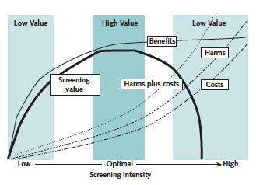
Value Framework⁴
High Value Screening

Slide 23
Cases: High Value Screening
Screening Value Cases
Discuss the following screening cases, and use handout to guide your decisions:
45-year-old woman asking about ovarian cancer screening
68-year-old man, up to date on colonoscopy, requesting FOBT screening
70-year-old woman, with ESRD on HD for 10 years, asking about yearly mammography

Slide 24
High Value Screening: Tips
Screen less frequently
Don’t screen patients with a life expectancy less than 10 years
Discuss potential downstream testing with patient before ordering initial screening test
Use higher threshold for positive result
Understand basic test characteristics and limitations as well as an individual patient’s goals and values
Notes:
Bullet point two: As many as 50% of people over 75 report physician recommends continued screening
10% of women with advanced non-breast cancer underwent mammography, 15% of men with advanced non-prostate cancer underwent PSA testing
Bullet point three: Make sure patient would consider transrectal biopsy before ordering PSA

Slide 25
Cost Effectiveness⁵
Quality-Adjusted Life Years (QALYs)
QALYs (quality-adjusted life-year) incorporate an estimate of the quantity of life gained by an intervention, coupled with a more subjective assessment of the quality of that life affected by the intervention
Historically, payers have considered any intervention that has a cost-effectiveness ratio of <$100K per QALY as acceptable
Notes:
Should also take into account cost-effectiveness

Slide 26
Cost Effectiveness
Cost-Effectiveness | Treatments, Testing^{6,7,8}
Cost-Saving (ratio < 0) | Aspirin for at-risk patients Childhood immunizations
0 to $13,999 / QALY | Chlamydia screening Colorectal screening for all adults > 50 years old
$14,000- $34,999 / QALY | Cervical cancer screening Hypertension screening
>$35,000/ QALY | Mammography Lung cancer screening
Notes:
IOM Roundtable on Evidence Based Medicine: Lowering costs and improving outcomes
EXAMPLES OF relative cost-effectiveness of different preventive measures.
Colonoscopy for avg risk patients costs $1000-3000 but provides a 20-30% absolute mortality reduction (USPSTF grade A)
Mammography for avg risk women ages 40-49 prevents only one death for every 1000 women screened annually for 10 yrs (USPSTF grade B)
**notably the mortality benefit of screening mammography increases with age owing to the higher incidence of breast cancer in older women

Slide 27
Summary
Diagnostic tests should only be used if the result is likely to significantly affect certainty of a disease and change management
Goals of screening are to detect treatable, asymptomatic, and early stage disease
Limitations (lack of sensitivity/specificity) and cost-effectiveness of screening tests, as well as patients’ goals, should be taken into account
Recommendations are not prescriptive, but rather the beginning of an open dialogue with patients to create (as a team) a prioritized plan of preventive health maintenance

Slide 28
References
Glaser AN. High-Yield Biostatistics. 3rd ed. Philadelphia: Lippincott Williams and Wilkins; 2004
Croskerry P. A Universal Model of Diagnostic Reasoning. Academic Medicine. 2009;84(8):1022
McGee S. Evidence-Based Physical Diagnosis. Philadelphia: Elsevier Saunders; 2012
Harris RP, Wilt TJ, Qaseem A; High Value Care Task Force of the American College of Physicians. A value framework for cancer screening: advice for high-value care from the American College of Physicians. Ann Intern Med. 2015 May 19; 162:712-7. [PMID: 25984846]
Owens, D, Qaseem A, Chou R, Shekelle P; Clinical Guidelines Committee of the American College of Physicians. High-value, cost-conscious health care: concepts for clinicians to evaluate the benefits, harms, and costs of medical interventions. Ann Intern Med. 2011 Feb 1;154(3):174-80. [PMID: 21282697]
Cohen JT, Neumann PJ, Cohen JT, Neumann PJ, Weinstein MC. Does preventive care save money? Health economics and the presidential candidates. N Engl J Med. 2008 Feb 14;358(7):661-3. [PMID: 18272889]
Institute of Medicine. The Healthcare Imperative: Lowering Costs and Improving Outcomes: Workshop Series Summary. Washington DC: National Academics Press; 2010
Pinsky, Paul F. Cost-effectiveness of CT screening in the National Lung Screening Trial. New Engl J Med. 2015 Jan 22;372(4):387

