Slide 1
High Value Quality Improvement
2015-2016 • Presentation 6 of 6

Slide 2
Learning Objectives
Define QI and its role in high value care
Explain the rationale for engaging in HVC QI projects
Explore one commonly used model for quality improvement
Review high value care project ideas
Select a quality improvement project focused on a high value care theme
Promote a high value care institutional culture
Notes:
HVC Themes
Reducing waste in the system (unnecessary testing and treatment or inappropriate setting of care)
Minimizing harms (radiation exposure, medication side effects)
Improving patient care through communication (incorporating patient values and concerns into care plans and/or improved communication with referring providers)

Slide 3
Steps Toward High Value Care¹
Step one: Understand the benefits, harms, and relative costs of the interventions that you are considering
Step two: Decrease or eliminate the use of interventions that provide no benefits and/or may be harmful
Step three: Choose interventions and care settings that maximize benefits, minimize harms, and reduce costs (using comparative-effectiveness and cost-effectiveness data)
Step four: Customize a care plan with the patient that incorporates their values and addresses their concerns
Step five: Identify system-level opportunities to improve outcomes, minimize harms, and reduce health care waste
Notes:
Review the framework and point out the QI presentation was a chance to practice step five

Slide 4
What is Quality Improvement?²
Focuses on the attempt to change a specific aspect of a field that has been identified as needing improvement
Works to gain insight into the function of a system and then change that system for the better (i.e., systems and processes)
Focuses on patients (or clients), teams, and data

Slide 5
Why is this important?
HVC QI is an opportunity for you to:
Affect the quality, safety, and efficiency of care at your institution
Improve patient-centered care
Work collaboratively with quality and safety officers, finance, and other health system leaders
Learn and practice leadership skills
Publish or present your results

Slide 6
QI Success in Other Industries³
Army Air Corps held a competition in 1935 for the rights to contract with them for a long-range bomber plane.
The favorite, a Boeing plane, crashed during competition due to “pilot error” because the new plane was much more complex than a standard plane – it was deemed “too much airplane for one man to fly.”
Army engineers gave the contract to another airline, but trialed a few of the Boeing planes with the implementation of a checklist for take-off to simplify the plane’s complexity.
With the checklist, not a single crash occurred over 1.8 million miles flown. The Army made a large-scale purchase of the plane and dubbed it the B17.
Adapted from Atul Gawande’s Checklist Manifesto

Slide 7
QI Success in Medicine⁴
Physician at Johns Hopkins, Dr. Peter Pronovost, noticed central line infections were spiking in his ICU and around the country
He mapped out the procedure process and noted that there were five simple steps physicians could take to prevent infections when inserting a central line
He implemented a simple checklist to ensure standardization of sterile procedure during insertion
In the pilot study, rates of central line infections in Michigan ICUs went from 3 per 1000 down to essentially 0, with a decrease in infection rates of 66% in the first 3 months of the study
Hospitals involved in the study saved nearly $175 million in costs and more than 1500 lives

Slide 8
QI Models
PDSA (Plan, Do, Study, Act)
Lean model: based on time and cost efficiency and what the customer wants
Six Sigma: measurement-based strategy that operates through DMAIC (examines existing processes) and DMADV (creates new processes)
Lean Six Sigma principles made famous by Toyota and their “Kaizen” practices
Notes:
There are lots of models – choose what you use in your institution
Doesn’t matter which one you use, we will provide 2 examples

Slide 9
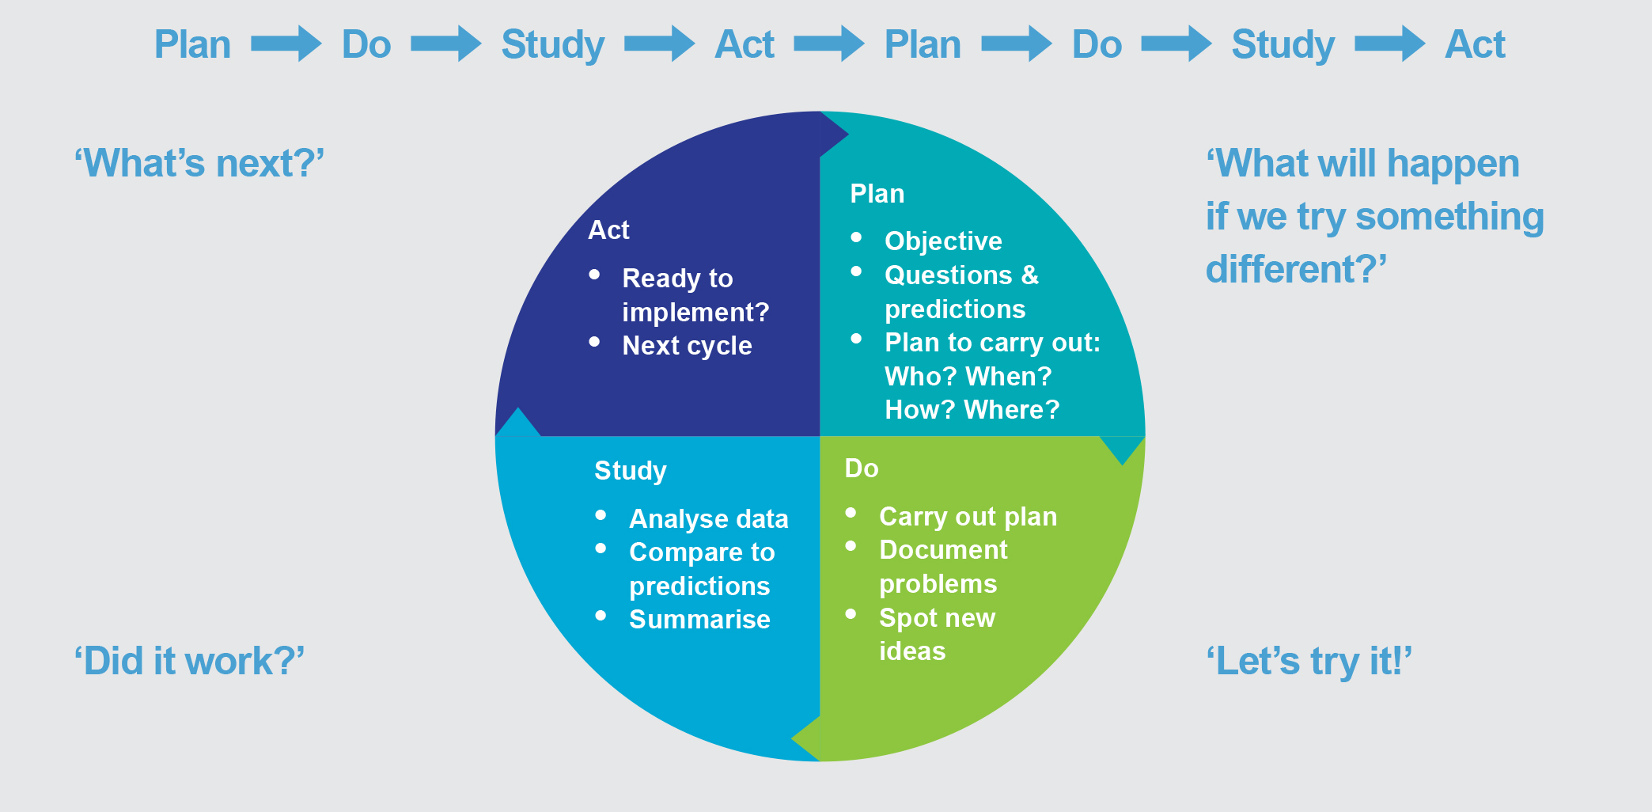
Langley G, Moen R, Nolan K, et al. The Improvement Guide: A Practical Approach to Enhancing Organizational Performance. Wiley, 2009.

Slide 10
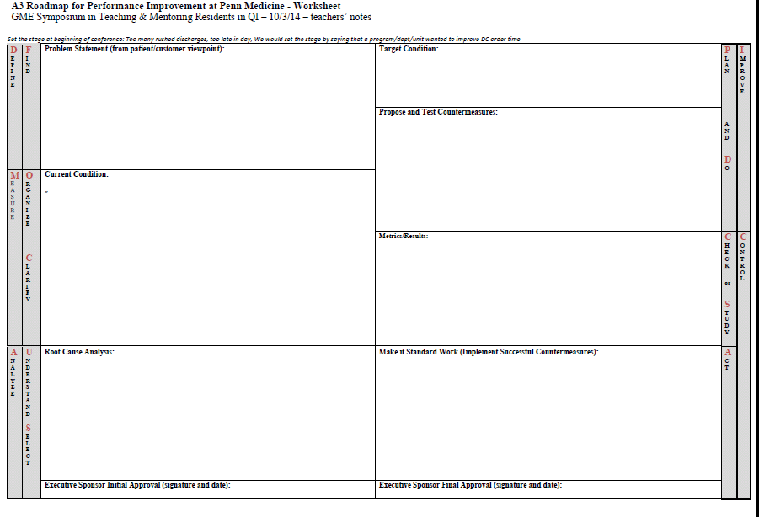
Sample QI Framework: A3 Roadmap
Problem Statement
Target / Aim
Propose and test Countermeasure
Current Condition
Metrics
Implement successful Countermeasures
Root Causes

Slide 11
Small Group Activity: HVC QI Project Ideas
HVC themes: reducing waste, minimizing harm, improving communication
Choosing Wisely lists http://www.choosingwisely.org/clinician-lists/
MKSAP Choosing Wisely Recommendations by specialty https://hvc.acponline.org/clinrec_mksap.html
Notes:
Either print lists or allow residents to look at on-line lists
Brainstorm project ideas; could bring this back to the prior talk and encourage participants to consider areas in your institution where local culture supercedes evidence

Slide 12
Reduce Unnecessary Preoperative Testing
Internal Medicine resident at NYU involved in a collaborative project between medicine, cardiology, and anesthesiology
Goal: to decrease use of unnecessary pre-op cardiac testing for average-risk patients undergoing low-risk procedures
Current condition step (chart review) identified pre-colonoscopy testing as a major contributor
Root cause analysis underway…

Slide 13
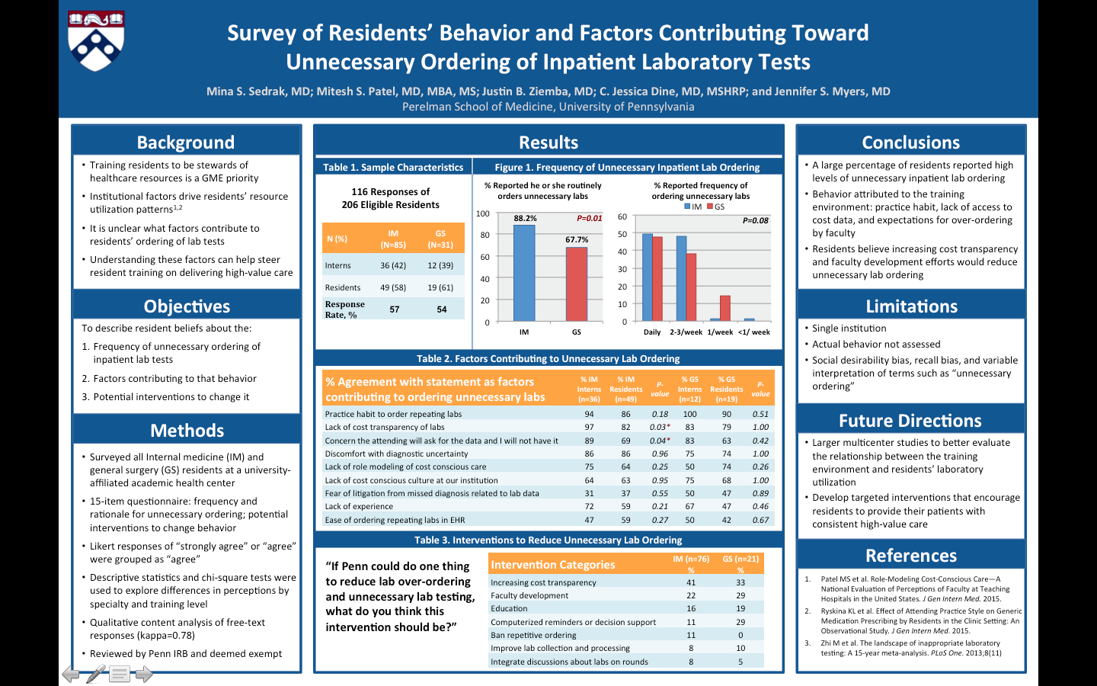

Slide 14
Improving Follow-up among Patients Living with HIV
Goal: to improve retention in care, increase ART use, and achieve viral suppression in patients with uncontrolled HIV infection
Tried to accomplish this by identifying patients with detectable VL who did not have a scheduled follow-up, and contacting them to make an appointment
Results showed that many patients did not have follow-up, and those who did had seen a social worker within the last year
After intervention, 61% scheduled for follow-up, with 15% showing improved clinical outcomes after follow-up
Conclusion: more intensive outreach involving social work and clinicians is needed in this subset of patients, and automatic social work intervention at appointments for patients with a history of being lost to follow-up

Slide 15
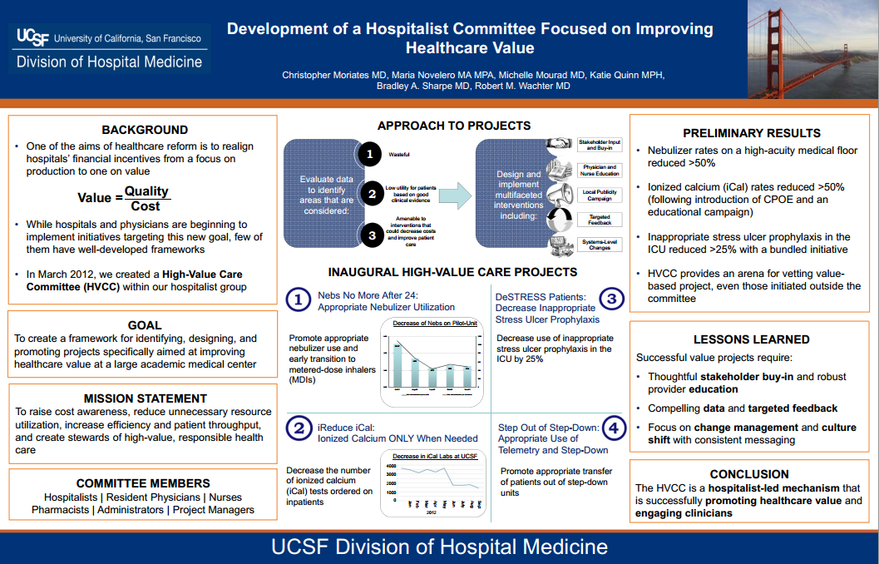

Slide 16
Next Steps
Identify stakeholders
Build a team and assign roles
Define the problem and the aim of the project with input from key stakeholders
Clarify timeline for projects and mentorship plan

Slide 17
QI Resources
Quality Improvement Curriculum Aids
Road Map for QI: This collaborative product from the AMA, IHI, and CMS introduces the basic framework of quality improvement to physicians. http://www.mjainmd.com/medicine/roadmap_for_quality_improvement.pdf
HVC QI Project Report: Worksheet to help guide residents through their quality improvement project and to stimulate post-project reflection and lessons learned
Trinity Health Curriculum on QI from MedEd Portal: This curriculum includes a QI Series Planner, Facilitator’s Guide and Improvement Workbook for residents. The complete curriculum is available at MedEd Portal “QI Training Series.”

Slide 18
References
Owens DK, Qaseem A, Chou R, Shekelle P; Clinical Guidelines Committee of the American College of Physicians. High-value, cost-conscious health care: concepts for clinicians to evaluate the benefits, harms, and costs of medical interventions. Ann Intern Med. 2011 Feb 1;154(3):174-80. [PMID: 21282697]
Massoud MR. Advances in Quality Improvement: Principles and Framework. Quality Assurance Project, QA Brief. Spring 2001.
Gawande, Atul. The Checklist Manifesto: How to Get Things Right. New York: Metropolitan Books, 2010.
Pronovost P, Needham D, Berenholtz S, et al. An intervention to decrease catheter-related bloodstream infections in the ICU. N Engl J Med. 2006 Dec 28;355(26):2725-32. [PMID: 17192537]
Landon BE, Hicks LS, O'Malley AJ, et al. Improving the management of chronic disease at community health centers. N Engl J Med. 2007 Mar 1;356(9):921-34. [PMID: 17329699]
Djuricich AM, Ciccarelli M, Swigonski NL. A continuous quality improvement curriculum for residents: addressing core competency, improving systems. Acad Med. 2004 Oct;79(10 Suppl):S65-7. [PMID: 15383393]
Holmboe ES, Prince L, Green M. Teaching and improving quality of care in a primary care internal medicine residency clinic. Acad Med. 2005 Jun;80(6):571-7. [PMID: 15917362]
Shojania KG, McDonald KM, Wachter RM, Owens DK, eds. Closing the Quality Gap: A Critical Analysis of Quality Improvement Strategies (Vol. 1: Series Overview and Methodology). Rockville, MD: Agency for Healthcare Research and Quality (US); 2004 Aug. [PMID: 20734525]
Notes:
? Resources

