Slide 1
High Value Hospitalization
2018 • Presentation 4 of 6

Slide 2
Learning Objectives
Compare charges for inpatient and outpatient services
Appreciate how delayed diagnosis and diagnostic errors increase cost by extending hospitalizations and increasing morbidity/mortality
Recognize the out-of-pocket costs associated with different types of hospital discharge
Optimize medication reconciliation as a key component of safe care transitions

Slide 3
Pre-hospital
Admission Decision
Management
Avoiding Diagnostic Errors
Discharge
Discharge Decision
Medication Reconciliation
Appropriate Use of Resources

Slide 4
Case: Initial Presentation
Mr. J is a 68-year-old man with history of controlled HTN, who presents to clinic today complaining of fever, right lower extremity pain and redness
T 38.5ºC, BP 130/75, HR 100, RR 18, O2 sat 98% on RA
He appears comfortable at rest. Exam is notable for tender RLE with erythema, warmth and edema extending from ankle to mid calf with no obvious portal of entry

Slide 5
Case: Admission Decision
Discuss in your groups whether you want to manage this patient as an outpatient or recommend admission to the hospital
What lab results, exam findings, patient factors would influence your decision?
What system-level interventions could you consider to improve recognition and management of patients with cellulitis?
Notes:
Labs: leukocytosis with left shift, elevated creatinine, elevated CRP, low bicarb, elevated CPK
Exam: malaise, fevers, chills, toxicity, lymphangitic spread (streaking), circumferential, pain out of proportion to exam

Slide 6
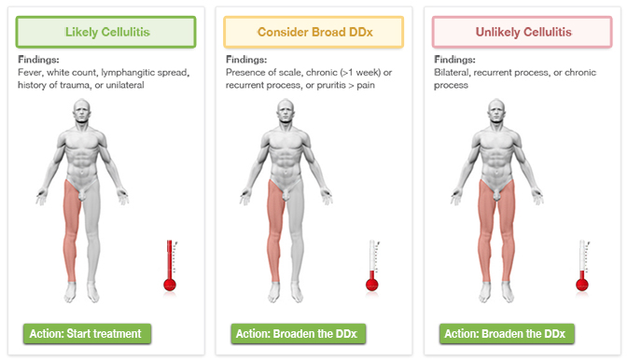
Case: Quality Initiatives
Visual support tools¹: recognition of condition, appropriate risk stratification
Notes:
Gogniat P, Papier A, Schneider S. Quality initiative focuses on cellulitis and the problem of diagnostic error. May 24, 2017. https://www.psqh.com/news/quality-initiative-focuses-on-cellulitis-and-the-problem-of-diagnostic-error/. Accessed 11/20/17.
https://www.psqh.com/news/quality-initiative-focuses-on-cellulitis-and-the-problem-of-diagnostic-error/

Slide 7
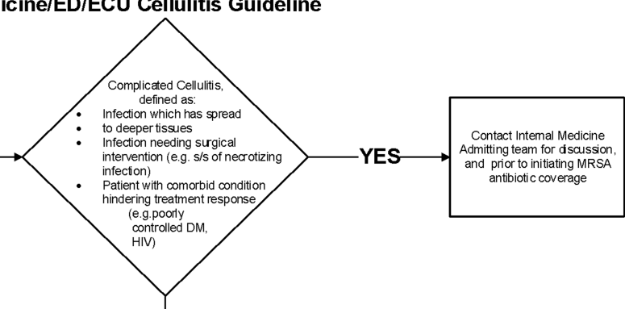
Case: Quality Initiatives
a
Clinical decision pathways imbedded into EHR^{2,3}: appropriate risk stratification and management
Notes:
Yarbrough PM, Kukhareva PV, Spivak ES, Hopkins C, Kawamoto K, Evidence‐Based Care for Cellulitis. J. Hosp. Med 2015;12;780-786. doi:10.1002/jhm.2433
Burgess, M. J., Enzler, M. J., Kashiwagi, D. T., Selby, A. J., Sohail, M. R., Daniels, P. R., ... Baddour, L. D. (2016). Clinical study of an online tool for standardizing hospital care. Journal for Healthcare Quality, 38(6), 359-369.

Slide 8
Case: Admission Decision
Discuss the relative cost implications, financial and nonfinancial, of each of the following care setting options:
Outpatient with close follow up
ED → observation
ED → admission
Direct admission
What role, if any, does or should cost play in your decision process?
Notes:
Inpatient charges are usually much higher than outpatient charges for the same tests/procedures.
Consider decision support tools to assist in appropriate decisions regarding inpatient admission.
Use of the ER raises charges substantially.
If stable patients in the clinic require admission, consider direct admission when appropriate.

Slide 9
Case: Charge Comparison
Outpatient | Inpatient (2 night stay)
CBC: $21 | CBC: $129
BMP: $23 | BMP: $214
CRP: $34 | CRP: $137
--- | Blood cultures $200
5 days cephalexin: $11 | 3 days cephalexin at discharge: $11
Follow up phone call: $0 | ER charge: $4,405
Follow up clinic visit: $222 | 2 night hospitalization: $6,000
Total = $2,588 | Total = $11, 096
Observation | Direct Admit
Higher out-of-pocket cost to patient | Avoid ED charges
Notes:
Prices from Healthcare blue book (Pennsylvania)
Is there anything in this charge comparison that surprised you?

Slide 10
Pre-hospital
Admission Decision
Appropriate Use of Resources
Management
Avoiding Diagnostic Errors
Discharge
Discharge Decision
Medication Reconciliation

Slide 11
Case: Continued
Mr. J was admitted for cellulitis and responded well to antibiotics
Two days after discharge, he returns complaining of RLE pain and swelling, denies fevers at home
T 36ºC, BP 110/60, HR 105, RR 18, O2 sat 98% on RA
Exam notable for RLE edema to knee, moderate tenderness and erythema
Re-admitted for recurrent cellulitis

Slide 12
Case: Continued
One day later, Mr. J developed acute onset of dyspnea, pleuritic chest pain, and a new 2 liter oxygen requirement
CT PE protocol showed a new segmental PE, and LE doppler ultrasound confirmed acute clot in the RLE
He is started on treatment dose enoxaparin

Slide 13
Case: Diagnostic Error
Discuss the factors that led to delay in PE diagnosis in this case
Did any biases contribute to the missed diagnosis?
Have you experienced an error in diagnosis that led to patient harm?
Why did this error occur?
Notes:
Use CDR handout

Slide 14
Case: Diagnostic Error
Diagnostic Error
No-Fault
Cognitive
Silent disease
Atypical presentation
Mimics common disease
Patient obstructs, unable to report
Faulty data collection or interpretation
Systems-based
Organizational/Culture
Flawed policy or procedure
Inadequate resources
Communication error
Workload
Flawed reasoning process
Incomplete knowledge
10-20% of all errors⁴
More common, expensive and harmful⁵
Notes:
Cognitive errors account for 10-20% of all errors² and are more common, more expensive and more harmful than any other category of error³
Extend hospitalizations, lead to readmissions, and create morbidity and mortality
Have very complex causes⁴
Result from faulty knowledge, biased thinking, and/or systems issues

Slide 15
Case: Diagnostic Reasoning⁶
Recognized
System 1
Calibration
Practice
Patient Presentation
Diagnosis
System 2
Unrecognized
Notes:
System 1 gives us speed, and is almost always accurate. However, can be prone to bias.
System 2 allows us to carefully weigh evidence and think logically, however would slow us down way too much.
Both systems need to be functioning to practice medicine.
The calibration or toggling between the systems is the most important component.
Normally, if system 1 is wrong (perhaps a bias is influencing your diagnostic decision), if a component of the patient presentation isn't fitting well, System 2 will toggle on and take over.
If you are tired, pressed for time, hungry, stressed, system 2 cannot perform this regulatory function and error will ensue.

Slide 16
Case: Cognitive Biases⁷
Anchoring: Fixated on a single feature of a case
Confirmation Bias: failing to seek disconfirming evidence against initial impression
Disregard/fail to notice patient is afebrile, WBC normalized
Availability Bias: diagnoses that come to mind faster assumed more likely
Notes:
It’s not important to be able to memorize these terms but it is important to understand and guard against these common cognitive biases in practice.

Slide 17
Case: Cognitive Error Strategies⁷
Develop insight/awareness of thinking process, diagnostic errors and biases, probability
Metacognition
Cognitive forcing strategies (diagnostic timeout, through EHR)
Decrease reliance on memory, make tasks easier, alleviate time pressure
Simulation (improve pattern recognition)
Accountability, feedback

Slide 18
Pre-hospital
Admission Decision
Management
Avoiding Diagnostic Errors
Discharge
Discharge Decision
Medication Reconciliation
Appropriate Use of Resources

Slide 19
Case: Continued
Blood cultures from the first day of his initial hospitalization come back positive for methicillin-resistant Staphylococcus aureus
Multiple blood cultures from the current admission were negative
TTE shows no evidence of endocarditis
A PICC line is placed for a 6 week course of IV vancomycin
On hospital day 6 he is improved and is deemed ready for discharge
He lives with his husband and elderly mother-in-law in a third-floor walk up apartment

Slide 20
Case: Discharge Options
Discuss discharge options for this patient
Does the patient meet criteria for each level of care? Can he access the services he needs?
Rank the options from least expensive to most expensive (out-of-pocket for the patient)

Slide 21
Discharge to… | Services | Cost
Home | Skilled RN (IVs) PT/OT visits Home health aide | $
Assisted Living | Skilled RN (IVs) PT/OT visits Home health aide | $$
Skilled Nursing Facility | Daily skilled RN needs Direct supervision of RN, PT/OT Average LOS 13 days | $$$
Long Term Acute Care Hospital | Multiple skilled RN needs Direct supervision of RN, PT/OT Advanced need: vent wean, HFNC | $$$$
Continue inpatient | All services available | $$$$$

Slide 22
Case: Medication Reconciliation
At discharge, the healthcare provider used the electronic medical record to carry forward all of Mr. J’s hospital medications to the discharge medication list
What are potential sources of error, harm, or waste that may ensue?
Discuss a personal experience where you saw a patient affected by an inadequate medication reconciliation

Slide 23
Case: Medication Reconciliation
You are tapped to head a new initiative to reduce errors on discharge medication lists for your unit
Discuss potential interventions or strategies you might implement
Notes:
Here are some in the event they do not come up with any:
Compare admission regimen to discharge regimen
Have a rationale for every medication change and a reason for every medication you are prescribing
Discontinue any medications that are no longer indicated
Indicate the remaining duration of any short term medications
Prescribe generic medications whenever possible
Try to prescribe medications on the patient’s insurance formulary
Double check the patient’s medication allergies
Make sure medications are dose adjusted renal or hepatic function
Communicate the new list to the patient, family and the clinician who will be following up the patient

Slide 24
Case: Medication Reconciliation⁸
Collaborative Medication Management Module
Assessment of your own system’s current state
Educational content on creating collaborative environment
Evidence-based strategies to promote collaborative medication management
Guide to patient, physician, system barriers
Case study for practice
Notes:
American College of Physicians, Practice Advisor 2.0. Improving Clinical Care: Collaborative Medication Management Module. Updated 7/18/2017. Available at: http://www.practiceadvisor.org/Modules/improving-clinical-care/collaborative-medication-management. Accessed 12/20/17

Slide 25
Summary
Inpatient charges are usually > outpatient charges; use the inpatient setting only when necessary
Delays in diagnosis and diagnostic errors add hospital days, lead to readmissions, and ↑ morbidity and mortality
Different discharge scenarios have very different out-of-pocket costs for individual patients; consider these as you plan for safe discharge
Thorough medication reconciliation should be performed at every outpatient visit and prior to every hospital discharge

Slide 26
References
Gogniat P, Papier A, Schneider S. Quality initiative focuses on cellulitis and the problem of diagnostic error. May 24, 2017. https://www.psqh.com/news/quality-initiative-focuses-on-cellulitis-and-the-problem-of-diagnostic-error Accessed 11/20/17
Yarbrough PM, Kukhareva PV, Spivak ES, Hopkins C, Kawamoto K, Evidence‐Based Care for Cellulitis. J.
Hosp. Med 2015;12;780-786. doi:10.1002/jhm.2433
Burgess, M. J., Enzler, M. J., Kashiwagi, D. T., Selby, A. J., Sohail, M. R., Daniels, P. R., ... Baddour, L. D. (2016). Clinical study of an online tool for standardizing hospital care. Journal for Healthcare Quality, 38(6), 359-369.
Graber ML, Wachter RM, Cassel CK. Bringing diagnosis into the quality and safety equations. JAMA. 2012 Sep 26;308(12):1211-2. [PMID: 23011708]
Saber Tehrani AS, Lee H, Mathews SC, et al. 25-Year summary of US malpractice claims for diagnostic errors 1986-2010: an analysis from the National Practitioner Data Bank. BMJ Qual Saf. 2013 Aug;22(8):672-80.[PMID: 236 10443]
Croskerry P. A Universal Model of Diagnostic Reasoning. Academic Medicine. 2009;84(8):1022
Croskerry P. The importance of cognitive errors in diagnosis and strategies to minimize them. Academic Medicine. 2003;78:775-780
American College of Physicians, Practice Advisor 2.0. Improving Clinical Care: Collaborative Medication Management Module. Updated 7/18/2011. Available at: http://www.practiceadvisor.org/Modules/improving-clinical-care/collaborative-medication-management Accessed 12/20/17

