Slide 1
Eliminating Healthcare Waste and Overordering of Tests
2015 - 2016 • Presentation 1 of 7

Slide 2
Learning Objectives
Define and recognize the importance of high value care.
Introduce a simple five-step model for delivering high value care.
Discuss the cost implications of several common clinical scenarios and the evidence-based guidelines for appropriate diagnosis and treatment.
Identify clinical reasoning tools to assist in management of uncertainty.

Slide 3
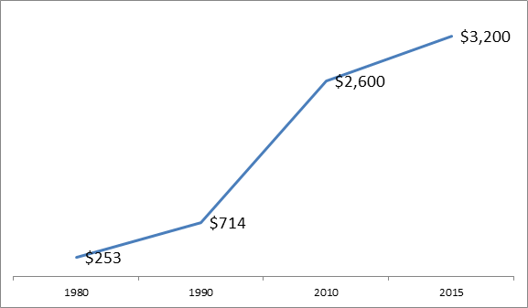
Why Worry About Cost Now?
Health Care Costs in the US in Billions of Dollars
*30% of these costs are wasted care (around $765 billion in 2009)

Slide 4
What is the problem?¹
Since 1970, healthcare spending is rising 2.4% faster than GDP.
Estimated $765 billion of “healthcare waste” annually.
Physicians responsible for 87% of wasteful spending.
Physicians must lead in addressing these problems – and we are! (Choosing Wisely campaign)
Trainees (YOU) must be at the front lines.
Notes:
The New England Healthcare Institute (NEHI) has defined waste in healthcare as “Healthcare spending that can be eliminated without reducing the quality of care.”

Slide 5
Estimated Sources of Excess Costs in Health Care (2009)²
Unnecessary Services
$210 Billion
Excessive Administration Costs
$190 Billion
Prices That Are Too High
$105 Billion
Fraud
$75 Billion
Inefficient Service Delivery
$130 Billion
Missed Prevention
$55 Billion
IOM 2010
Notes:
Category Sources
Unnecessary Services Overuse, unnecessary higher-cost services
Inefficiently Delivered Services Mistakes, care fragmentation
Unnecessary use of higher-cost providers
Operational inefficiencies at care delivery sites
Excess Administrative Costs Insurance paperwork costs beyond benchmarks
Insurers’ administrative inefficiencies
Inefficiencies due to care documentation requirements
Prices That Are Too High Service prices and product prices beyond competitive benchmarks
Missed Prevention Opportunities Primary and secondary
Fraud All sources—payers, clinicians, patients

Slide 6
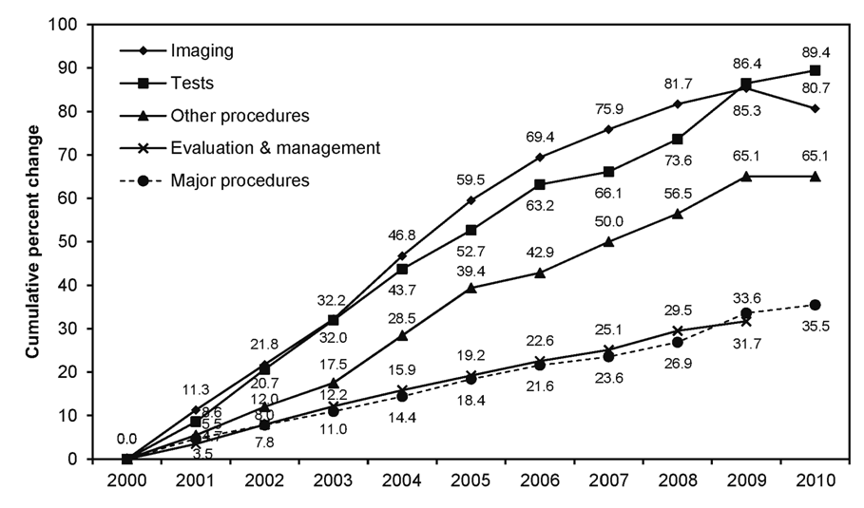
Ordering more services³…
Tests
Imaging
Two areas of greatest expenditures and most rapid growth: imaging and tests

Slide 7
Why do Residents Over-Order Tests?
Duplicating role modeled behavior
Desire to be complete
Pre-emptive ordering/rushing an evaluation/unnecessary duplication of tests
Discomfort with diagnostic uncertainty
Curiosity
Lack of knowledge of the costs and harms
Defensive medicine
Patient requests
Faculty demand
No training in weighing benefit relative to cost and harm
Ease of access to services when patient is hospitalized

Slide 8
Steps Toward High Value Care⁴
Step one: Understand the benefits, harms, and relative costs of the interventions that you are considering.
Step two: Decrease or eliminate the use of interventions that provide no benefits and/or may be harmful.
Step three: Choose interventions and care settings that maximize benefits, minimize harms, and reduce costs (using comparative-effectiveness and cost-effectiveness data).
Step four: Customize a care plan with the patient that incorporates their values and addresses their concerns .
Step five: Identify system level opportunities to improve outcomes, minimize harms, and reduce healthcare waste.

Slide 9
Case #1
Ms. B is 57 year-old woman presenting to the ED with chest pain.
She has a history of recurrent UTIs; she denies dysuria or urinary frequency.
Afebrile
WBC count 5.5
Should she have a routine urinalysis and urine culture?
Notes:
Ask the Group: How would a UA and culture change her management?

Slide 10
Case #1
How would you manage this patient?
Additional testing?
Treatment?
Do your recommendations change if she has an indwelling Foley catheter?

Slide 11
Step 1: Understand the benefits, harms, and costs of diagnostic testing
How much do you think the following cost:
Urinalysis?
Urine culture?
7 days of oral ciprofloxacin?
What are the potential downstream “costs”?
Notes:
Cost here means what is being billed (charges), will not go into detail re: patient’s expenses based on insurance coverage, etc.

Slide 12
Case #1: Follow Up
Urinalysis: cloudy, 11-50 WBC, 11-50 RBC, 2+ bacteria
Urine culture: >100,000 E. coli
Ms. B was discharged to complete 7 days of oral ciprofloxacin.
She returned 10 days later with fever, abdominal pain and diarrhea.
Stool Clostridium difficile assay was positive.
She was intolerant to metronidazole and was switched to oral vancomycin x 10 days.

Slide 13
Case #1: Approximate Charges
Initial episode of care:
Urinalysis $94
Urine culture $94
Ciprofloxacin 500 mg po bid x 7 days $23
Downstream:
C. difficile PCR assay $38
Metronidazole x 10 days $36
Vancomycin po x 10 days $2,284
Illness and lost days of work due to C. difficile colitis

Slide 14
Steps Toward High Value, Cost-Conscious Care⁴
Step one: Understand the benefits, harms, and relative costs of the interventions that you are considering.
Step two: Decrease or eliminate the use of interventions that provide no benefits and/or may be harmful.
Step three: Choose interventions and care settings that maximize benefits, minimize harms, and reduce costs (using comparative-effectiveness and cost-effectiveness data).
Step four: Customize a care plan with the patient that incorporates their values and addresses their concerns.
Step five: Identify system level opportunities to improve outcomes, minimize harms, and reduce healthcare waste.

Slide 15
Step 2: Decrease or eliminate care that provides no benefit and/or may be harmful.
Notes:
Briefly introduce the Choosing Wisely campaign: An initiative of the ABIM. Goal is to promote dialogue between pts and doctors regarding care that is
Evidence-based 2) Necessary 3) Non-redundant 4) Not harmful. For each subspecialty society, lists of 5 things to question were created.

Slide 16
Step 2: Decrease or eliminate care that provides no benefit and/or may be harmful.

Slide 17
Diagnostic Uncertainty
How do you handle uncertainty?
Does uncertainty prompt you to order potentially unnecessary tests and treatments?

Slide 18
Uncertainty Increases Resource Use⁵
“We show that increased physician anxiety due to uncertainty and increased concern about disclosing uncertainty to patients translate into higher charges.”
“Even after adjusting for multiple confounders, each standard deviation of change in several uncertainty scales corresponded to a change of mean charges of between 5% and 17%.”
Allison J, Kiefe A, Cook E, et al. The association of physician attitudes about uncertainty and risk taking with resource use in a Medicare HMO. Med Decis Making 1998 18: 320

Slide 19
Diagnostic Uncertainty
What tools are available to help you handle diagnostic or therapeutic uncertainty?
Specialty-specific validated clinical decision support tools
Specialist, attending and colleague group input
Clinical observation of the patient/close follow up

Slide 20
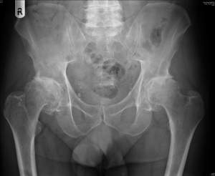
Case #2
Mr. M is a 75 year-old man with OA presenting with acute-on-chronic right hip pain. He slipped out of bed this morning and is now unable to bear weight on his right leg.
Exam is notable only for moderate tenderness over the right hip.
Hip and pelvis x-rays were negative for fracture.
Should he have further imaging? Which type?
Notes:
Photo Source: http://www.sanger.ac.uk/about/press/2011/110825.html
How good is the x-ray? (from https://acsearch.acr.org/docs/3082587/Narrative/)
The initial imaging study for acute hip pain in low-energy trauma is the radiograph. However, radiographs have been shown to have limited sensitivity [9-14]. In one series, magnetic resonance imaging (MRI) revealed fractures in 37% of patients who had negative radiographs for proximal femur fracture [15]. A more recent study demonstrated false-negative and -positive radiographic findings, which led the authors to conclude their study demonstrated “poor sensitivity and specificity of radiography of the proximal femur and pelvis in emergency department evaluation of patients with pain or suspected trauma around these structures [16].” In a recently published 10-year retrospective study, MRI showed fractures in 83 of 98 patients with negative radiographs [17]. Ultimately, radiographs alone cannot exclude fracture in older patients. There is no current data on the sensitivity and specificity of radiography in the younger patient population; therefore, clinicians are suggested to proceed with caution.

Slide 21
Clinical Decision Support Tools
American College of Radiology: Appropriateness Criteria
http://www.acr.org/Quality-Safety/Appropriateness-Criteria

Slide 22
ACR Appropriateness Criteria: Acute Hip Pain – Suspected Fracture

Slide 23
Case #2: Follow Up
CT pelvis was performed and was nondiagnostic.
Pain persisted and he remained unable to bear weight.
MRI was obtained and revealed a nondisplaced femoral fracture in the setting of severe osteoarthritis.
Patient underwent nonemergent repair of the fracture.
Notes:
In a more recent, larger study, 129 patients (whose average age was 65) received both CT and MRI for pelvic and proximal femoral insufficiency fractures. MRI demonstrated 99% sensitivity, when compared to 69% for CT, in detecting all pelvic and proximal femoral fractures when using a clinical reference standard augmented by follow- up imaging. With respect to proximal femoral fractures specifically, only 70% were detected by CT and 90% by MRI [22]. Interestingly, radiographs visualized only 15% of fractures diagnosed on MRI and 21% on CT. A similar study to the Cabarrus et al study evaluated CT and MRI head to head in detecting pelvic fractures in patients whose average age was 74 years. The study demonstrated fracture detection rates of 96% for MRI and 77% for CT when compared to a clinical reference standard [43].

Slide 24
Case #2: Approximate Charges
This hospitalization:
Downstream:
Femur x-ray: $700
Pelvis x-ray: $800
CT hip/pelvis: $3000
MRI hip: $4000
4 nights in the hospital: $12,000
Femur fracture repair: $12, 415
Delay in therapy, leading to increased morbidity/mortality
Radiation exposure
Notes:
Actual charges

Slide 25
MRI in this case: High Cost ≠ Low Value
Remember that High Cost ≠ Low Value and likewise Low Cost ≠ High Value.
High-cost interventions may provide good value because they are highly beneficial (ICD for selected patients with heart failure and low EF, screening colonoscopy).
Low-cost interventions may have little or no value if they provide little benefit or increase downstream costs (BNP measurement in patient with clear heart failure, annual Pap smears in an average-risk woman).

Slide 26
Clinical Case #3: Syncope
Mr. P., a 42 year-old man with hypertension treated with HCTZ, presents to the emergency department after passing out. He was outside working in his garden on a hot afternoon when he started to feel ill and then suddenly lost consciousness. His wife witnessed the event and noticed that he fell to the ground and was unresponsive for about 10 seconds. He did not hit his head. He then woke up and returned to his baseline mental status.
T 37.5ºC BP 110/70, HR 95, RR 12, 0₂ sat 98% on ambient air
Exam notable for: dry mucus membranes, no cardiac murmurs, normal neurologic exam

Slide 27
Step 1: Benefits, harms, costs Evaluation and Management of Syncope
What is your workup for a patient with syncope?
Which labs or initial studies do you want to order?
What are the benefits, harms, and costs of each test or intervention?
Notes:
At this time, have the residents use the worksheet table provided for common tests ordered in the evaluation of syncope and work in small groups to think through benefits, harms, and costs (both direct and indirect) of each

Slide 28
Patient Presentation—Update
Mr. P. was admitted for 2 days during which time:
ECG was normal; TTE was also obtained and revealed mild LVH
Head CT revealed no abnormalities.
Carotid duplex ultrasound revealed 10-50% stenosis, bilaterally.
Lab evaluation with CBC, BMP, troponin were all within normal limits.
He was monitored on telemetry, which revealed occasional PVCs.
He was given 1 liter of normal saline and discharged on hospital day 2.

Slide 29
Case #3: Approximate Charges*
1 night on telemetry $7,000
Physician fees (per day): $200
Consulting physician fee (per day): $300
Electrolyte panel: $175
Daily x 2 = $350
CBC: $170
Daily x 2 = $340
CXR: $500
Head CT: $3,000
TTE: $3,000
Carotid duplex ultrasound: $1,900
ER visit level 3 (moderate severity): $2,300
IV fluid bolus: $150
*Charges from CA Chargemaster website and patient bills; actual charges vary by institution
Notes:
CA Chargemaster: http://www.oshpd.ca.gov/chargemaster/

Slide 30
Approximate Costs—continued
What is the total charge for this patient’s 2-day admission?
Approximately $19,000
In addition to financial costs, what are some harms and potential downstream costs of this patient’s management?
Examples: Repeated phlebotomy, IV catheter-related phlebitis or infection, days of work lost, etc.
Notes:
Have participants discuss some of the other harms they identified in their table

Slide 31
Discussion
When does a patient with syncope require a limited workup versus an extensive evaluation?
When does a patient with syncope require inpatient admission?
Key: When managing a patient with syncope, risk stratify your patient to assist in the decision to admit or treat as an outpatient.
Notes:
Make sure to highlight the value of a detailed history and physical exam.

Slide 32
San Francisco Syncope Rule⁶
C - History of congestive heart failure
H - Hematocrit < 30%
E - Abnormal ECG
S - Shortness of breath
S - Triage systolic blood pressure < 90
A patient with any of the above measures →high risk for a serious outcome such as death, myocardial infarction, arrhythmia, pulmonary embolism, stroke, subarachnoid hemorrhage, significant hemorrhage, or any condition causing a return Emergency Department visit and hospitalization for a related event.

Slide 33
Limitations of Decision Rules
Only apply to the population where they were tested.
SF syncope rule: single medical center
Should be used in addition to but not in place of good clinical judgment
Use at the same step in the workup where they were studied.
SF syncope rule: used only AFTER obvious life-threatening causes of syncope had been ruled out; thus, this aid should not be used in the initial syncope evaluation
Decision rules for high-risk conditions must have a high sensitivity so you don't miss them and send the patient home.
SF syncope rule: the lower end of the CI for sensitivity is 90%, so if it were strictly applied, you could send up to 10% of patients with high risk syncope home

Slide 34
Step 2: Decrease or eliminate care that provides no benefit and/or may be harmful.

Slide 35
Step 2: Decrease or eliminate care that provides no benefit and/or may be harmful.

Slide 36
Summary
Healthcare waste is a multibillion dollar problem.
Every provider must carefully weigh costs (including charges and downstream costs), harms, and benefits and order only those interventions that add value to a patient’s care.
Acknowledge the role of diagnostic uncertainty.
Use evidence-based guidelines and decision support tools to aid in the practice of high value care.

Slide 37
References
Sager A, Socolar D. Health Costs Absorb One-Quarter of Economic Growth, 2000-2005. Boston: Health Reform Program, Boston University School of Public Health; 2005.
TheHealthcare Imperative: Lowering Costs and Improving Outcomes — Workshop Series Summary. The Institute of Medicine Web site. http://iom.nationalacademies.org/Reports/2011/The-Healthcare-Imperative-Lowering-Costs-and-Improving-Outcomes.aspx?_ga=1.219462233.1572788654.1438188089. Published February 24, 2011. Accessed December 15, 2015.
Medicare Payment Advisory Commission. A Data Book: Healthcare Spending and the Medicare Program; 2012.
Adapted from Owens, D, Qaseem A, Chou R, Shekelle P; Clinical Guidelines Committee of the American College of Physicians. High-value, cost-conscious health care: concepts for clinicians to evaluate the benefits, harms, and costs of medical interventions. Ann Intern Med. 2011 Feb 1;154(3):174-80. [PMID: 21282697]
Allison J, Kiefe C, Cook E, Gerrity M, Oray E, Centor R. The association of physician attitudes about uncertainty and risk taking with resource use in a Medicare HMO. Med Decis Making 1998 18:320. [PMID: 9679997]
Quinn J, McDermott D, Stiell I, Kohn M, Wells G. Prospective validation of the
San Francisco Syncope Rule to predict patients with serious outcomes. Ann Emerg
Med. 2006 May;47(5):448-54. [PMID: 16631985]

