Slide 1

Connecting Care
Ensuring Quality Referrals and Effective Care Coordination
the Medical Neighborhood
The Why, What & How of
High Value Care Coordination
& Action Step 1
ACP SAN special project
for implementing
High Value Care Coordination
Carol Greenlee MD FACP & Beth Neuhalfen

Slide 2
As you listen…
Think about what the current state for referrals is for the practices & clinics you work with and how you can help them begin to look at & improve their referral processes to….
  Reduce chaos & frustration in the clinic
  Improve satisfaction & outcomes for patients
  Reduce waste & unnecessary resource use
  Reduce wait times & improve access
Consider the need to optimize the ability to work across & between practices to connect & share care in order to be effective in alternative payment arrangements / APMs

Slide 3

Outline
Why: The need for better coordinated & connected care
What: The critical elements for a high value referral experience
How: Action steps to get practices moving from disconnected to connected care
Working together is BETTER …for everyone

Slide 4
Scope - Over 100 Million Referrals per Year
Specialty referrals are common - up to 70% of patients are referred to specialists in a year
  Among the elderly, an average of 2 new referrals are made yearly
Approximately 1 out of 3 office visits leads to a referral
Most referrals are from primary care to specialty care
  Self-referral by patients to specialty care appears to increase when access to timely primary care is limited
Notes:
"Closing the Loop: A Guide to Safer Ambulatory Referrals in the EHR Era,"
(Forrest et al. 2001).

Slide 5

Pain Points
S
a
t
i
s
f
a
c
t
i
o
n
Referral Process
A
c
c
e
s
s
Often Creates:
Chaos
Extra burden
Frustration
Confusion
Waste
Delay

Slide 6

“No Satisfaction” with existing Referral Processes
Chaos (inefficiencies)
Lack of communication
Isolation
In a survey of clinicians, 92% responded that they could improve their referral management practices.
  “If 92% of clinicians insisted they needed improved sterilization processes, you can bet organizations would take steps to correct them!”
Increased Burden
Job Dissatisfaction
Burnout
Change is the Answer
Notes:
Research from Kyruus

Slide 7

…80% of burnout is related to organizational factors AMA
  aspects of the workplace(how chaotic the workplace is) and
  organizational culture variables (cohesion, values, trust, communication and emphasis on quality vs. productivity)

Slide 8
Dissatisfaction
Satisfaction
  When a practice exhibits chaos, it often predicts adverse outcomes for physicians and their patients
Taming practice chaos
  Physician satisfaction was significantly improved with workplaces that were less chaotic.
What reduces chaos & drives satisfaction?
  Interventions aimed at
    workflow redesign
    improving communication between provider groups
Health Affairs Oct 2017
Notes:
Health Affairs 36; No 10, 2017: 1808-1814 (Linzer, Mark; Sinsky, Christine et al) Joy In Medical Practice: Clinician Satisfaction In The Healthy Work Place Trial

Slide 9
The Ideal State – Efficient & Effective
The ideal referral involves:
minimal wait time & efficient use of resources
Referral accuracy: ensures that the referral is:
  medically necessary
  directed to the correct specialty
  complete with relevant history and workup
  aligned with patient goals
  defined to appropriately meet the needs of the patient
Notes:
NEJM Catalyst: Can eConsults Save Medicaid?
Article · August 1, 2018
Carlos Reines, MBA, Laura Miller, MD, J. Nwando Olayiwola, MD, MPH, Christina Li, MBA & Ella Schwartz, MPAff
RubiconMD
Community Health Center Network

Slide 10
The Ideal State – Efficient & Effective
Timely Appointment scheduling:
  the referral request is generated, received, reviewed & appropriately scheduled in a timely manner
  the referral appointment with the subspecialist/specialist is successfully completed within a few days of the referral request
Accountable Information exchange:
  the primary care practice & the specialty care practice communicate directly, both before and after the patient sees the subspecialist/specialist
  any information relevant to that patient’s care is transferred between them & the patient/care giver
Notes:
NEJM Catalyst: Can eConsults Save Medicaid?
Article · August 1, 2018
Carlos Reines, MBA, Laura Miller, MD, J. Nwando Olayiwola, MD, MPH, Christina Li, MBA & Ella Schwartz, MPAff
RubiconMD
Community Health Center Network

Slide 11
The Current State – Wait Times
Average wait time for new patient appointment:
  24.1 days (32.2 days for a dermatologist)
    based on the Merritt Hawkins 2017 survey (a 30% increase from 18.5 days in 2014)
Not the experience for many systems and communities:
  One system had wait times of 11 months for gastroenterology, 10 months for nephrology and 7 months for endocrinology
  One community had an average wait time for a new specialty care appointment of 19 weeks (> 4 months) –
    with 30% waiting >6 months and 6% waiting > 1 year

Slide 12
Effects of Delay
Worsening of referred condition
  Use of more medication & ED services
  Treatable conditions no longer treatable
  Higher mortality rates
Need to repeat testing due to delay (outdated results)
  38% of all patients; 50% if waited > 6 months
Patient reported aspects (while waiting):
  50% worried about undiagnosed condition
  30% had symptoms interfere with activities
  24% had to miss work or school

Slide 13
The Current State – Efficient use of Resources
~8% of referrals are inappropriate (43/Specialty Care clinician/year)
  To the wrong specialty
  Not medically necessary
Of the patients incorrectly referred to the wrong specialty
  63% are re-referred to more clinically suitable physicians
    Costing an estimated $1.9 billion in lost wages and unnecessary co-pays annually
    37% are not re-referred, putting quality patient care at risk
Notes:
Kyruus Physician Referral Report http://bit.ly/1vPaI9t.

Slide 14
Case 1 (“wasted days & wasted nights”)
Oops!
Referral was for suspected Lupus , she needs a Rheumatology consult, I’m an Endocrinologist….
Now a 5 month wait….
28 year old female had routine consultation appt booked by her PCP front office staff with cc/o “fatigue”
No records sent
3 month wait

Slide 15
The Current State – Efficient use of Resources
60-70% of specialty care clinicians do not have the needed information for the referral at the time of the referral appointment
Resulting in "Low value referral appointments” (minimal benefit/cost (time, effort, dollars))
  Delay in care
  Additional appointments (backlog access for others)
  Increased (unnecessary) testing, work and workforce needs

Slide 16

Case 2 (“Playing Charades”)
70 year old woman from 2 hours away, doesn’t know why she was referred
No records
Only voice mail at referring practice
What to do?
Glipizide, metformin, Levothyroxine on med list
Discussed diabetes and thyroid
Ordered A1c and TSH
Oops!
  A1c and TSH results done 2 weeks prior were identical to those just done
  Referral was for evaluation of a left adrenal mass noted on abdominal CT

Slide 17
The Current State – Referral Scheduling
Up to 50% of referrals are never completed
  Never scheduled
    Missing information, process errors, communication failures
  Cancellations
  No Shows
In one system 84% of referrals were not completed
Poor referral tracking leads to inappropriate re-referrals, inefficient care, worse patient satisfaction, and malpractice lawsuits
  20% of malpractice claims for diagnosis error involve referral communication deficits
Notes:
According to ReferralMD,; (Gandhi et al. 2006).

Slide 18
Case 3 (“too little, too late”)
20 year old male comes in with parents asking for help with drug & alcohol use disorder
Referral sent to Behavioral Health
Behavioral Health has policy that patient must call himself to schedule appointment
Oops!
After 5 weeks with no appointment patient was hospitalized with severe head trauma after a roll-over accident while driving under the influence …

Slide 19
The Current State – Information Exchange
Surveys show 50% of referring clinicians were dissatisfied with timeliness of specialist feedback and desired more feedback from specialists
  ~50% of primary care clinicians don’t know if patient was ever seen by specialty care following referral request
  25-50% of primary care have no information back by several weeks after patient’s referral appointment
Information is often inadequate even when successfully transferred in a timely manner.
  28% of primary care & 43% of specialty care report information they do receive is not helpful

Slide 20

Case 4 (“Where’s the Beef?”)
  59 yo man with T2DM, HTN, Hyperlipidemia & Obesity
referred to cardiology with unexplained shortness of breath with the question “is this due to ischemic coronary artery disease?”
28 page note from cardiologist
  only ICD codes for impression
  no indication of
    what the cardiologist thinks or is going to do
    what s/he recommends the PCP do
    what s/he told the patient to do…
  More questions than answers

Slide 21
The Current State – Information Exchange (communication)
PCPs and specialists rarely discuss the preferred role for specialty care and who will be responsible for what aspects of care
In up to 26% of referrals, there is disagreement or misunderstanding of management plans between referring clinicians and subspecialists/specialists
  A survey found that 26% of patients reported receiving conflicting information from different providers
Notes:
Blendon et al. 2003
O’Malley and Cunningham 2009.

Slide 22

Case 5 (“What’s the Point?”)
30 year old female with depression, T1DM, and epilepsy
Sent to Behavioral Health clinician (BH) with request to “evaluate depression”
No records from PCP or neurologist
Past history of care with psychiatrist
BH clinician evaluates the patient and sets up a care plan but the PCP continues to treat the depression
BH clinician confused why she was asked to evaluate for depression or role in helping to co-manage

Slide 23
The Current State – Information Exchange (communication)
Frequent misunderstandings about the role of the specialist (single cognitive consultation vs ongoing co-management), contribute to large number of specialty care follow up visits (including patients with stable conditions who do not need to see specialists routinely)
  ~ 50% of specialty care visits are for follow-up specialty care, often “routine check-up”
    Limits access for higher acuity new patients & established patients with acute issues
Notes:
Blendon et al. 2003
O’Malley and Cunningham 2009.

Slide 24
“Stuck” in Specialty Care –
Need for Role Definition
Notes:
Among Referred Patients, Type of Work Done by Specialists in the US (Data are from the 2002-2004 NAMCS)

Slide 25

Current State – Disconnected Care
IOM 2001 Crossing the Quality Chasm
“A highly fragmented delivery system” …physician groups, hospitals, and other health care organizations [behavioral health] operate as silos
a “non-system”
disconnected care

Slide 26
Consequences of Disconnected Care
Waste, Safety & Satisfaction issues
  Misdiagnosis
  Delayed diagnosis and treatment
  Duplicated & unnecessary tests
  Duplication of services
  Additional visits
  Access backlog / workforce needs
  Confusion, errors
  Increased stress, burden, dissatisfaction
  Not very patient centered
  Not very cost effective
  Not very satisfying & extra work on the back end

Slide 27


We need a System instead of Silos
“Once we get to interoperability….”

Slide 28
Case 6 (“TMI-Overload”)
74 year old woman with cognitive impairment from Skilled Nursing Facility brought in by transport person
No records except MAR
SNF physician on the road
Look in the HIE….
94 pages of reports
Diabetes
Pituitary mass
Osteoporosis
But what’s the question?

Slide 29
Shared EHR does not solve all the referral/ care coordination problems
Care Coordination requires:
Information sharing (can even be done without EMR)
  Adequate
  Pertinent
Communication
  With patient & family and the medical home team
  With extended care team (e.g., clinical question)
Collaboration/Working Together (mindset – culture)
  Standardization & expectations of referral procedures
  Clarity in roles and responsibilities
Patient-centered approach (common goal - meeting patient needs)
  Contextual care: considering patient’s needs & circumstances
  Shared goals and decision making

Slide 30
Outline
Why: The need for better coordinated & connected care
What: The critical elements for a high value referral experience
How: Action steps to get practices moving from disconnected to connected care
Working together is BETTER …for everyone

Slide 31

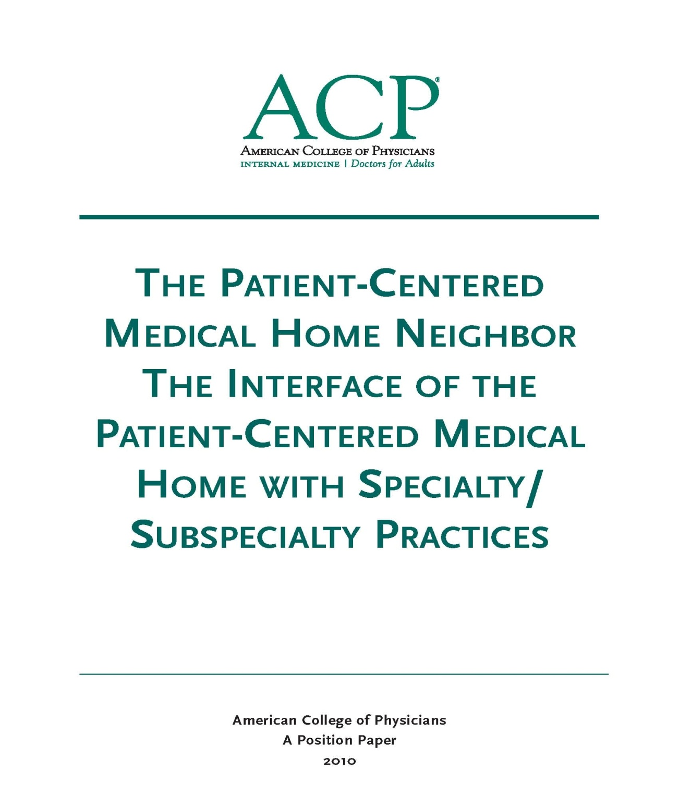
The Medical Neighborhood
October 2010
Medical Neighbor defined:
Communicates, collaborates & integrates
Appropriate & timely consultations
Effective flow of information
Responsible co-managing
Patient-centered care
Support primary care-medical home as hub of care
2010

Slide 32
We need a system for care coordination
The “Medical Neighborhood”
  An approach to care coordination
    It’s about working together better
    Promotes connected care wherever that care may be needed
High Value Care Coordination Tool Kit
  Defining what is needed & expected for high value referrals and care coordination
Notes:
The MN is not a place, it is an approach to how we work together to connect the care for patients where ever that care may take them

Slide 33

Patient-Centered Connected Care- the patient’s medical neighborhood
The Patient is the center of care
Primary Care is the
necessary hub of care
Specialty/ancillary care is an extension of care
  Helping with care to meet patient needs

Slide 34

What do you need to connect the care?
High Value Care Coordination
  Information Sharing
  Communication
  Collaboration
Start with a
High Value Referral Process
Notes:
So how do you get the care to be connected…we need

Slide 35

Steps toward the Ideal State
Referral critical elements & processes that provide high value (good benefit/cost):
High value referral request
  Prepared patient – participating partner in their care
  Clinical question / detailed reason for referral
  Pertinent supporting data
Pre-consultation requests & reviews
Defined scheduling protocol
Referral Tracking – closing the loop
Defined roles for specialty care
  Graduation/Hand-back to primary care
High value referral response

Slide 36
A Prepared Patient helps reduce
Incomplete & Inappropriate Referrals
Patient as partner in care
  Patient included in the process
  The patient’s needs & goals considered
Patient understand role of specialist and who to call for what
Pre-visit patient education regarding
    The referral condition and/or
    The type of and role of the specialist
    Info on the specialty practice (parking, contact info, other logistics)*
Appropriate (patient-centered) “handoff”
  Specialty practice alerted of any special needs of the patient
  Appropriate specialist at appropriate time to meet the patient’s needs
  Appropriate preparation with testing or therapeutic trials prior to referral
Notes:
The pt needs to be part of pt centered care

Slide 37
A Clinical Question is core to
Referral Accuracy & Information Exchange
“eyes” “gallbladder” “diabetes”
68 year old female with intermittent double vision. Is ophthalmopathy assessment the correct starting point?
39 year old female with severe RUQ pain, abnormal US and known diabetes, does she need surgery?
20 yo female with T1DM since age 8 on insulin pump therapy, transferring from pediatric to adult care

Slide 38
Appropriate (pertinent) Supporting Data for Referral Accuracy & Information Exchange
Pertinent (not data dump)
Adequate (reduce duplication)
To allow the specialty practice to
  determine if the referral is to the appropriate specialty
  effectively triage urgency
  effectively address the referral (enough info to do something at the initial visit)

Slide 39
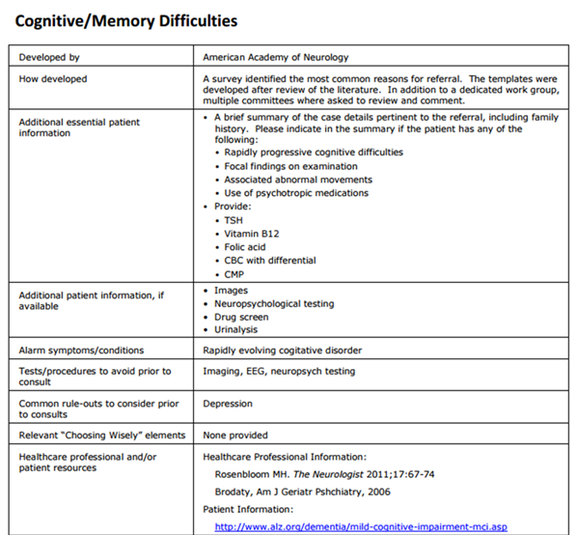
The requesting practice needs to know - what is pertinent…
Establish referral guidelines (Pertinent Data Sets)
Define:
  Information needed
  Testing needed
  Therapeutic trials
  What not to do
  Alarm signs & symptoms
    Urgency

Slide 40

A Key Element for Referral Accuracy:
Pre-consultation Request & Review
  Intended to expedite/prioritize care
  Pre-visit Request for Advice
    Does the patient need a referral
    Which specialty is most appropriate
    Recommendations for what preparation or when to refer
    Wait times for BH and approach to take in the interim
  Pre-visit Review of all Referrals
    Is the clinical question clear
    Is the necessary data attached
    Triage urgency (risk stratify the patient’s referral needs)
  Urgent Cases
    Expedite care
    Improved hand-offs with less delay and improved safety

Slide 41
  Define the Protocol for Making Appointments to improve Referral Scheduling & Completion
What is the expected protocol?:
  The patient will call to schedule an appointment
    Need parameters & process for handling if patient does not call
  The specialty practice should contact the patient
    Allows for Pre-visit assessment/referral disposition
    Allows for tracking of referrals / accountability

Slide 42
Referral Tracking to “Close the Loop” helps
Reduce Incomplete Referrals & Improve Outcomes
Referral request sent, logged & tracked
Referral request received and reviewed
  Referral accepted with confirmation of appointment date sent back to referring practitioner
  Referral declined due to inappropriate referral (wrong specialist, etc) and referring practice notified
  Patient defers making appt or cannot be reached and referring practice notified
Referral response sent (must address clinical question/reason for referral)
  Referral Note sent to referring clinician and PCP in timely manner
  Notification of No Show or Cancellation (with reason, if known)
Referrals made from one specialty to another (e.g. secondary referrals) include notification of the patient’s primary care clinician

Slide 43
Define the specialty role (referral type) to most appropriately meet patient needs
___Medical Consultation: Evaluate and advise with recommendations for management and send back to me
___Procedural Consultation: Specialist to confirm need for and perform requested procedure if deemed appropriate.
___Shared Care Co-management: I prefer to share the care for the referred condition (PCP lead, first call)
___Principal Care Co-management: Please assume principal care for the referred condition: (Specialist assumes care, first call)
___ Complete transfer of care(e.g. Pediatric to Adult Care transition) Please assume full responsibility for the care of this patient

Slide 44


Open up Access through “Graduation”
Patients with minor or resolved issues
  Especially if based on new approach, those issues could have been handled by pre- or virtual (e-) consultation
Patients who were referred with an unstable condition that are now stable and are appropriate for management by their primary care team
Patients for whom additional specialty testing and treatment are no longer indicated (e.g. appropriate for move to end-of-life care with palliative care or hospice)
Roles are fluid based on changes in the patient or the condition
Notes:
Patients often get ‘stuck” in specialty care and that contributes to reduced access: can graduate to shared care or back to management by PCP

Slide 45

A High Value Referral Response is
Critical for Information Exchange & Continuity
Answer the clinical question/address the reason for referral-Summary (include some thought process)
Agree with or Recommend type of referral / role of specialist
Confirm existing, new or changed diagnoses; include “ruled out”
Medication /Equipment changes
Testing results, testing pending, scheduled or recommended (including how/who to order)
Procedures completed, scheduled or recommend
Education completed, scheduled or recommended
Any “secondary” referrals made (confer with and/or copy PCP on all)
Any recommended services or actions to be done by the PCP/PCMH
Follow up scheduled or recommended
Clear indication of
What the specialist is going to do
What the patient is instructed to do
What the referring physician needs to do & when
Easy to find & refer to in the response note

Slide 46
Wait Times for Specialty Appointments at SFGH: before & after Improving the Referral Process
Courtesy
E. Murphy SFGH

Slide 47

A referral is part of taking care of the patient…meeting the needs of the patient
Collaboration is Critical
How do you get to collaboration ?

Slide 48

Make an Agreement….
Care Coordination Agreement
(Collaborative Care Agreement/Care Compacts)
An invitation to work together better
Provides a platform that everyone agrees to work from:
  Standardized Definitions
  Agreed upon expectations regarding communication and clinical responsibilities.
Can be formal or informal
Internal practice policies and procedures should be aligned to support the agreement
Notes:
How you handle the referral in your practice plays a critical role in successfully connecting care, it goes beyond the agreement, it operationalizing the agreement

Slide 49
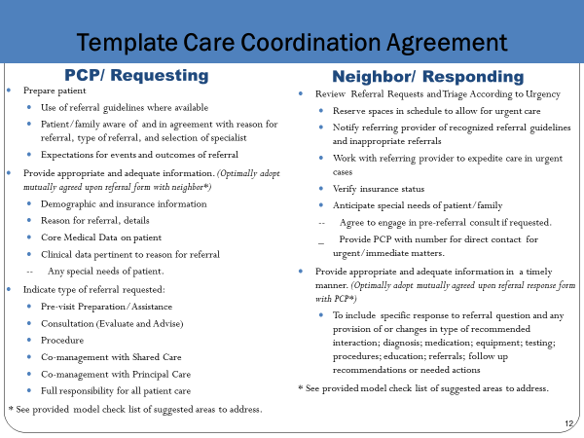
What’s in the Care Compact ?
(start with the basics)
Critical elements of the referral request
Critical elements of the referral response
Protocol for scheduling appointments
Closing the Loop-referral tracking protocol
Notes:
Agree to xxxx

Slide 50
Apply to All Referral Situations
Primary Care to Specialty Care (Behavioral Health, Radiology, Pathology and Hospital Medicine)
Specialty to Specialty
Specialty to Primary Care
Emergency Dept to Primary or Specialty Care
Ancillary & other services (Diabetes Ed, Physical Therapy, Nutrition, etc.)
Agree to work together in the care of mutual patients

Slide 51
Outline
Why: The need for better coordinated & connected care
What: The critical elements for a high value referral experience
How: Action steps to get practices moving from disconnected to connected care
Working together is BETTER …for everyone

Slide 52

The ACP SAN
High Value Care Coordination curriculum
Action Steps to Connected Care
Look at the practice’s internal referral process (“get your own house in order”)
Ensure the specialty practice gets what is needed for a high value referral
Ensure the others (patients, the requesting practice and any secondary care) get what they need
Develop Care Coordination Agreement(s) (compact) with appropriate referring practice(s)

Slide 53

Action Steps to Connected Care
Look at your internal referral process (get your own house in order)
  Perform a Walk-through / Process Map of the referral process within the practice
    Identify any gaps in critical elements
    Develop an Improvement Plan to close the gaps
  Define who the team members are for the practice referral process
  Initiate a Policy & Procedures document for your practice team’s internal referral process (will be a work in progress)

Slide 54

To have connected care between practices, need to have connected care within practices
We often have silos within our silos
Need to develop Patient-centered team care (entire staff) around the referral process
  Make it part of taking care of the patient
  Work as a team to design improvements, test and implement
Intentional internal processes (Policy & Procedures)
Track the referrals and the process

Slide 55

Start with One Step at a time….
Get your own “house” in order
  Start with a Process Map
    Make it a team approach
    Look for gaps (“opportunities”)in the referral process

Slide 56
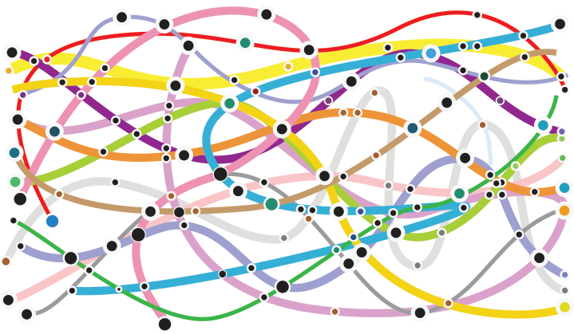






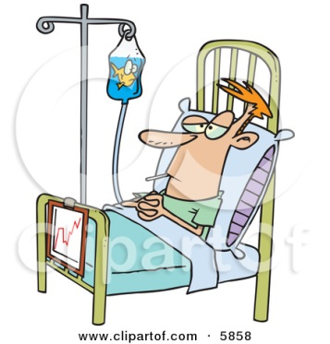
Process Map (Mess)

Slide 57
Tips to Help with Internal Referral Process
Process Map
Requesting a Referral
Responding to a Referral
Process Start and End
  Start = Decision to refer
  End = Referral reconciled
Referral reconciled means:
  Referral response received and recommendations are incorporated into the patient’s care in partnership with patient OR
  Referral incomplete and next steps have been made in partnership with patient
Process Start and End
  Start = Receipt of referral request
  End = Referral Response sent
Referral Response can be :
  Redirection to more appropriate specialist
  Referral not needed or Answer to simple question without appointment
  Notice of No Show or Cancel
  Completed Referral with note

Slide 58
Tips to Help with Internal Referral-Process Process Map
Map your process “as is”
  resist the tendency to “fix” as you map
Include those who actually “do” this process
  Not just the office manager or administrator
  Different people may vary in how they do the job
With complex processes such as this one, consider multiple passes, allow time to revisit & tweak
  Include:
    Who: Include handoff details, Patient involvement
    What: Time parameters? Documentation and notification parameters?
Notes:
Not very effective to have the OM put down what thinks is happening, have the people who do it as part of the process mapping

Slide 59
Develop a P&P (Policy & Procedures)
Set a practice policy for referrals
    Example primary care policy: “Our policy is to provide standardized referrals with a clear reason or question stated and attach the appropriate information so that our patients get the care they need efficiently, effectively and safely”
    Example subspecialty/specialty policy: “Our policy is to provide high value, patient-centered referrals appropriate to the needs of the patient”
Design the Procedures the way you want it to work
    See if it works
    Make improvements/changes as needed to get it working well

Slide 60
www.acponline.org/hvcc-training
Primary care checklist for referral process assessment and critical elements
Subspecialty/specialty care checklist for referral process assessment and critical elements
ACP SAN HVCC policy examples for referral process
Sample policy & procedures for referral content

Slide 61

Take a minute …
What is the Current State for your practices?
  What are wait times for referrals to specialty care?
    Time from receipt of referral request until appointment booked
    Time from booked until patient seen
  How many inappropriate referrals?
  How often are they “closing-the-loop” on referrals (what %)?
  How often does SC/BH know the reason for referral & have the supporting data at the time of the referral appointment?
  What are No Show & Cancellation rates for referrals?

Slide 62
Leave in action….
Perform a process map of the internal referral processes of the practice (what is their current state?)
  Identify gaps in “Critical Elements”
    Subsequent Action Steps will provide assistance with filling gaps
Identify needed team members, roles & responsibilities for your practice referral process
Initiate or review current policy & procedure document (to be developed and tweaked over time as practices progress through the additional action steps & as procedures are tried & adjusted in the practice)

