Slide 1

Connecting Care
Ensuring Quality Referrals and Effective Care Coordination
the Medical Neighborhood
Establish Pre-consultation Processes
& “Close-the-Loop” Referral Tracking
ACP SAN special project
for implementing
High Value Care Coordination
Carol Greenlee MD FACP & Beth Neuhalfen

Slide 2
The Ideal State – Efficient & Effective
The ideal referral involves:
minimal wait time & efficient use of resources
Referral accuracy: ensures that the referral is:
  medically necessary
  directed to the correct specialty
  complete with relevant history and workup
  aligned with patient goals
  defined to appropriately meet the needs of the patient
Notes:
NEJM Catalyst: Can eConsults Save Medicaid?
Article · August 1, 2018
Carlos Reines, MBA, Laura Miller, MD, J. Nwando Olayiwola, MD, MPH, Christina Li, MBA & Ella Schwartz, MPAff
RubiconMD
Community Health Center Network

Slide 3
The Ideal State – Efficient & Effective
Timely Appointment scheduling:
  the referral request is generated, received, reviewed & appropriately scheduled in a timely manner
  the referral appointment with the subspecialist/specialist is successfully completed within a few days of the referral request
Accountable Information exchange:
  the primary care practice & the specialty care practice communicate directly, both before and after the patient sees the subspecialist/specialist
  any information relevant to that patient’s care is transferred between them & the patient/care giver
Notes:
NEJM Catalyst: Can eConsults Save Medicaid?
Article · August 1, 2018
Carlos Reines, MBA, Laura Miller, MD, J. Nwando Olayiwola, MD, MPH, Christina Li, MBA & Ella Schwartz, MPAff
RubiconMD
Community Health Center Network

Slide 4
The Current State – Wait Times
Average wait time for new patient appointment:
  24.1 days (32.2 days for a dermatologist)
    based on the Merritt Hawkins 2017 survey (a 30% increase from 18.5 days in 2014)
Not the experience for many systems and communities:
  One system had wait times of 11 months for gastroenterology, 10 months for nephrology and 7 months for endocrinology
  One community had an average wait time for a new specialty care appointment of 19 weeks (> 4 months) –
    with 30% waiting >6 months and 6% waiting > 1 year
Notes:
One system reported an average of 5 weeks from receipt of the referral request to contacting the patient to schedule

Slide 5
Effects of Delay
Worsening of referred condition
  Use of more medication & ED services
  Treatable conditions no longer treatable
  Higher mortality rates
Need to repeat testing due to delay (outdated results)
  38% of all patients; 50% if waited > 6 months
Patient reported aspects (while waiting):
  50% worried about undiagnosed condition
  30% had symptoms interfere with activities
  24% had to miss work or school

Slide 6
The Current State – Efficient use of Resources
~8% of referrals are inappropriate (43/Specialty Care clinician/year)
  To the wrong specialty
  Not medically necessary
Of the patients incorrectly referred to the wrong specialty
  63% are re-referred to more clinically suitable physicians
    Costing an estimated $1.9 billion in lost wages and unnecessary co-pays annually
    37% are not re-referred, putting quality patient care at risk
Notes:
Kyruus Physician Referral Report http://bit.ly/1vPaI9t.

Slide 7
The Current State – Efficient use of Resources
60-70% of specialty care clinicians do not have the needed information for the referral at the time of the referral appointment
Resulting in "Low value referral appointments” (minimal benefit/cost (time, effort, dollars))
  Delay in care
  Increased (unnecessary) testing, work and workforce needs
  Additional appointments (backlog access for others)

Slide 8
The Current State – Referral Scheduling
Up to 50% of referrals are never completed
  Never scheduled
    Missing information, process errors, communication failures
  Cancellations
  No Shows
In one system 84% of referrals were not completed
Poor referral tracking leads to inappropriate re-referrals, inefficient care, worse patient satisfaction, and malpractice lawsuits
  20% of malpractice claims for diagnosis error involve referral communication deficits
Notes:
According to ReferralMD,; (Gandhi et al. 2006).

Slide 9

Critical Elements for a High Value Referral
Moving to Ideal State
High value referral request
  Patient-centered -prepared patient – participating partner in their care
  Clinical question / detailed reason for referral
  Pertinent supporting data
Pre-consultation requests & reviews
Defined scheduling protocol
Referral Tracking – closing the loop
Defined roles for specialty care
  Graduation/Hand-back to primary care
High value referral response

Slide 10
Background elements for Pre-consultation
Establishing Referral Criteria / Guidelines - improve the accuracy, effectiveness & efficiency of referrals
Timing of the referral request and appointment
  urgency or priority for scheduling expectations - urgent, intermediate/move up and routine (“risk stratification of the referral needs”)
Supporting data needed for the particular referral condition
  “pertinent data sets” / referral guidelines for referral conditions

Slide 11

A large specialty clinic…
Patients are booked on an “as come” (first call, first booked) basis
If patient is urgent & requesting clinician is concerned, s/he calls the specialist who tries to work(squeeze, cram) the patient in over lunch break …

Slide 12
Prioritize / Risk Stratify the Referral Needs
What is the Urgency or Priority for the referred condition:
Specialty Care practice - determine urgency of referral needs for commonly referred conditions or patient types
Create list of Urgent-Intermediate-Routine conditions
For use by the specialty care practice referral care team & to share with requesting practices to help guide
  does not need to be all inclusive- this is a guide to assist with team care & the referral process – a starting point
  can be modified based on individual patient context
  Include: “if not sure, ask”
Need to have a way to schedule in accordance with urgency
  Urgent slots built into the schedule; role of the on-call clinician or APP

Slide 13
Examples from my practice:
Urgent conditions
Move Up (Intermediate)
Pregnancy & diabetes
Pregnancy & thyroid
Hyperthyroidism
New thyroid cancer
New onset T1DM
DM with frequent/severe hypoglycemia
New dx Addison’s disease
Pituitary mass with vision loss
Diabetes out of control
Hypercalcemia
Pituitary
Adrenal
PCOS
Weight gain
Low T
Hypothyroid not feeling well
Routine

Slide 14
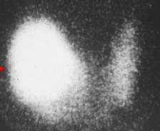
“Backwards” care Inappropriate Care
Two Cases from an Academic Medical Center
Patient comes for “uncontrolled” T2DM,
no A1C available (did not have POC A1C at AMC)
spent visit discussing insulin
subsequent A1C 7.1%
called patient to tell her to ignore everything we talked about and just adjust current oral regimen
Patient drove 3 hours for appointment to get FNA of thyroid nodule ,
no TSH available
Patient insisted the biopsy be done that day
  biopsy done
  TSH obtained
found to have suppressed TSH due to “hot” nodule (FNA not indicated)
Information Void – Value Void
Low Value Care (No Benefit/ Cost)

Slide 15
Supporting Data (Pertinent Data Set) for the referred condition
Pertinent to the clinical question or reason for referral (not data dump)
Adequate enough to address the issues (reduce duplication)
To allow the specialty practice to
  determine if the referral is to the appropriate specialty
  effectively triage urgency
  effectively address the referral (enough info to do something)

Slide 16
Parameters for Pertinent Data Sets
The Pertinent Data Set / referral guideline should not create a significant burden for the requesting physician or practice
  Should be a “minimal data set” for the condition
  Process can be iterative –
    use of pre-consultation process with pre-visit assistance to ask for more information or addition testing or therapeutic trial when indicated and appropriate based on individual case

Slide 17
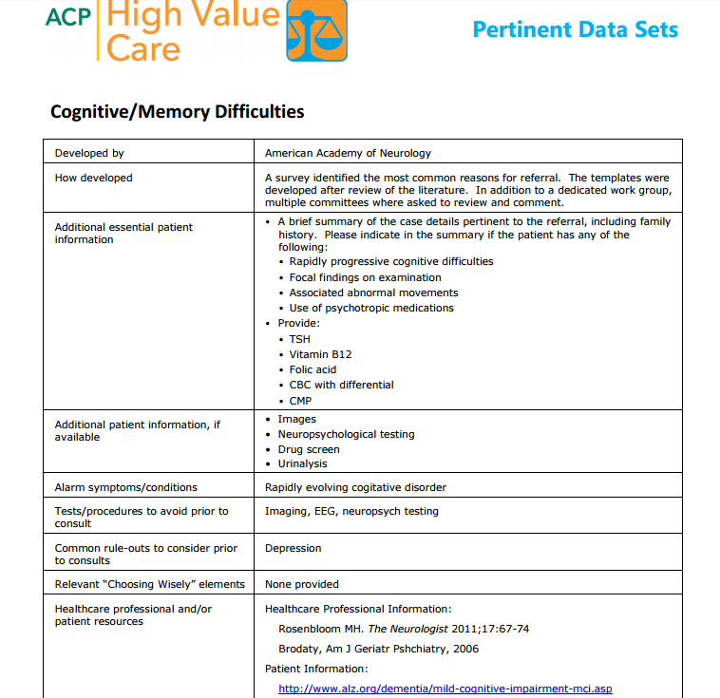



Slide 18
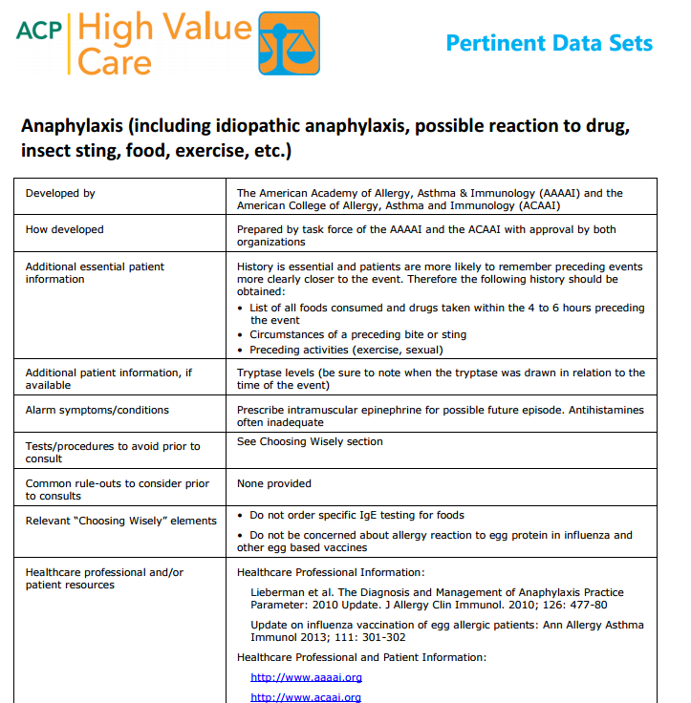

Slide 19
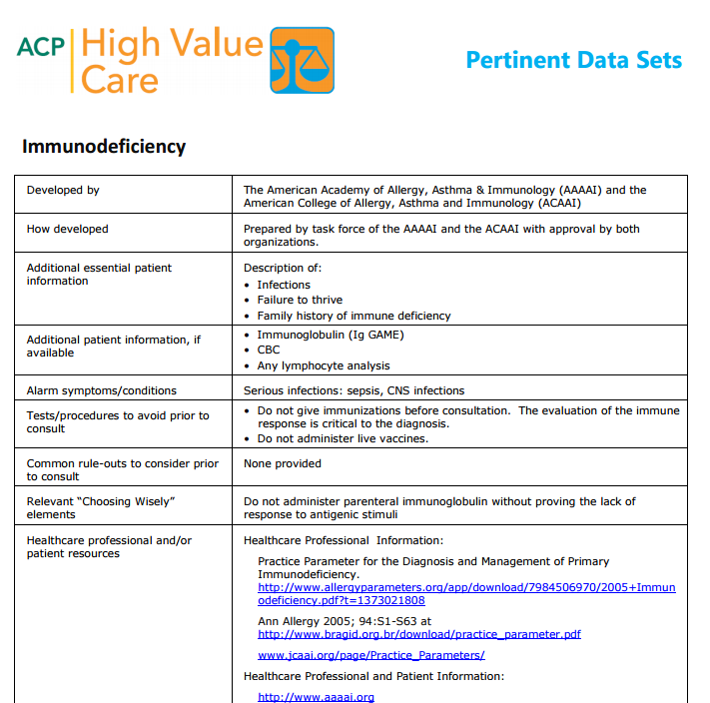

Slide 20
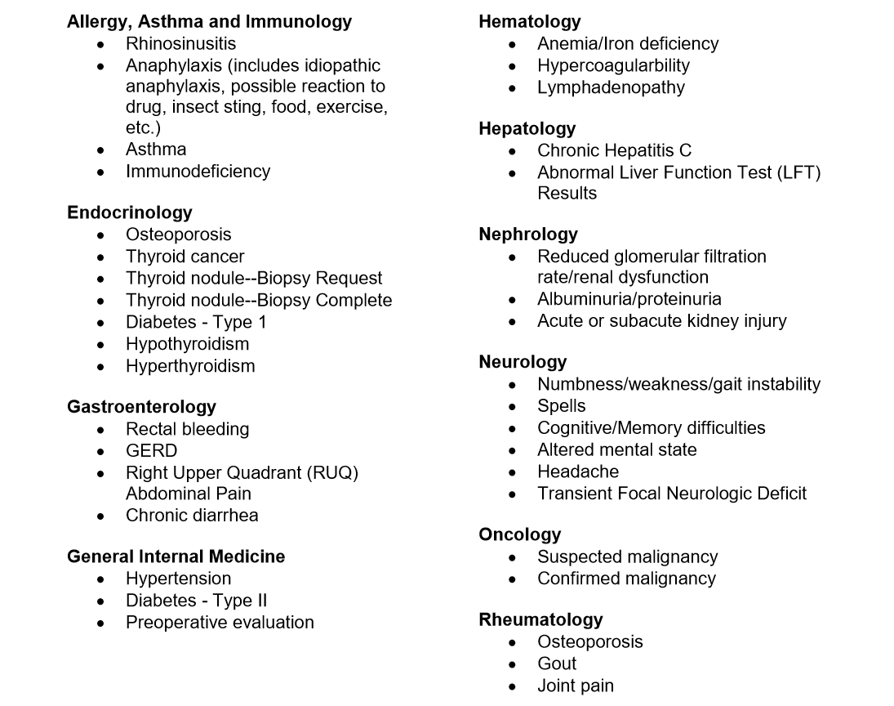
Available Pertinent Data Sets

Slide 21
Now as you listen - consider Pre-consultation Exchange & Referral Tracking…
Think about how investing in a Pre-consultation (pre-visit request and/or review and assistance)
  could improve access & value of referrals
  could help make the referral process more patient-centered & at the same time save time & effort (resources) for the practice.
Think about how to ensure collaborative referral tracking to ensure closing-the-loop on all referral requests

Slide 22

Antithesis of High Value Coordinated Care:
Common scenario #1:
  60 yo woman was referred to surgeon Dr. Z by another specialist for a procedure. After a 3 month wait for the appointment, Surgeon Z. read her records as he walked in the room saying “I don’t do that procedure. You will need to go to XXX Clinic to get that done”.
  Waste:
    Delay: Progression of condition, harm
    Non-value-added appointment for all in involved

Slide 23

Antithesis of High Value Coordinated Care:
Common scenario #2:
  70 year old woman does not know why she was referred, PCP staff just told her to make appt, no records, only get into voice mail at PCP office
  Waste:
    Resources (duplicated testing, visit costs, time)
    Access “jammed up” (delay of care…downstream effects)

Slide 24

Pre-consultation to the rescue !

Slide 25
Pre-consultation Exchange
Intended to expedite the timeliness & appropriateness of referrals & to prioritize care
Provide pre-visit review and/or advice
Clarify need for a referral
  Answer clinical question without necessity of a formal specialty visit (“do I need to do anything about this?”)
Better prepare patient for specialty assessment
  Utilize referral guidelines / referral criteria
Identify & Assist with urgent referrals
Notes:
Often the requesting clinician is unsure if anything needs to be done and without a way to ask, just sends a referral

Slide 26
What is Pre-consultation?
A request for pre-visit advice and/ or assistance
  Should not require in-depth analysis of the case
    Can result in no need for further assessment or management
    Can “evolve” into an e-consult or face-to-face appointment
A process of pre-visit review
  To ensure appropriateness of the referral
  To ensure adequacy of the referral information
  To provide advice or assistance as needed for preparation for the referral appointment and interim care
    Additional testing
    Therapeutic trial
    Interim care to stabilize while waiting for specialty care

Slide 27
Pre-consultation Request for Pre-visit Advice and/or Assistance
Pre-visit preparation or assistance can take place before any type of formal referral & can include:
  request for guidance regarding whether referral is to appropriate specialty care practice and/or is medically necessary
  Request for guidance on the urgency of the referral
  Request for guidance for pre-visit work-up.
  Through these interactions, patient care is optimized and cooperation & an educational process around that care occurs between the practices –

Slide 28
I am referring this patient for:
___Pre-consultation/ pre-visit assistance/preparation
___Medical Consultation: Evaluate and advise with recommendations for management and send back to me
___Procedural Consultation: Specialist to confirm need for and perform requested procedure if deemed appropriate.
___Co-management: I prefer to share the care for the referred condition (PCP lead, first call)
___Co-management: Please assume principal care for the referred condition: (Specialist assumes care, first call)
___Please assume full responsibility for the care of this patient (Complete transfer of care)

Slide 29
Examples of Pre-consultation requests:
Are these slightly abnormal thyroid function studies of concern? Do they need further evaluation?
  If so, what additional testing do you want before the appointment
For referral to Nephrology for new patient evaluation for renal dysfunction, patient has had an Abdominal CT scan,
  Does patient still need Renal US before you will schedule?
Receive referral request with photo of skin lesion asking “how soon do you need to see this patient?” to “rule out melanoma”
  Review by dermatology identifies it as benign (e.g. seborrheic keratosis); requesting practice notified & patient receives reassurance (no dermatology appointment needed)

Slide 30
Response to a Pre-consultation Request
Clinician involvement is critical
Can indicate
  No need for further assessment or treatment (reassure)
  Need for a different specialty type (redirect)
  Need for additional testing or therapeutic trial prior to referral (prepare)
  Need for formal face-to-face appointment (prioritize- “risk stratify”)
    Urgency of appointment
    Suitable issue amenable to recommendations per “e-consult” (virtual consultation clinician-to-clinician)
Can send response by faxed note (or even phone call) if shared or interoperable EMR is not available (document in record)

Slide 31
Pre-consultation Review (“working the referral”)
Recommended for all referral requests
Review prior to scheduling patient
  To ensure appropriate referral
  Determine urgency of the referral
  Ensure adequate information for high value referral
Can be a team process (with clinician oversight & availability)
  Use of referral request checklist
  Use of lists of urgent-intermediate-routine conditions
  Use of referral guidelines/ pertinent data sets
  Clinician review of outlier or complex cases *
Notes:
* Some care teams have a more senior physician as reviewer for practice or clinic, some have APP, some of admin staff do part (ensure there is contact info, clinical question, supporting data, etc.) with clinician doing final review once info gathered, unless urgent

Slide 32
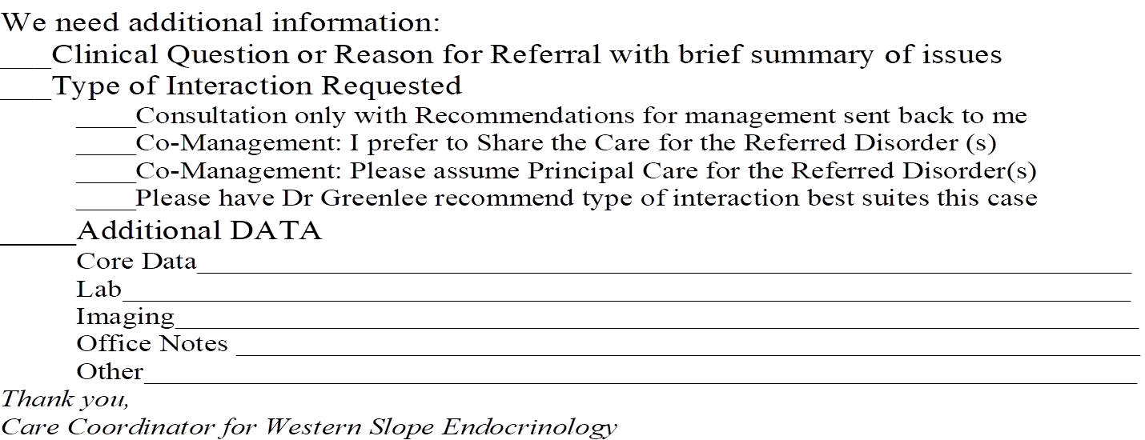
How do you request missing information?
Phone call to requesting practice
Forms (paper or EHR)
Tracking system to ensure receive
It’s worth the investment in
time & effort up front to
prevent the chaos & disruption
and back-end mess & burden

Slide 33
Recommendations for “Neighborly” Response to Pre-consultation Request or Review
“It appears this patient was referred for Lupus and would benefit more from referral to Rheumatology rather than Endocrinology. However, if there are endocrine issues that I failed to recognize and that need to be addressed, please let me know and we will schedule …otherwise we will defer scheduling at this time…” (redirect)
“It appears that this referral is regarding a 4 mm thyroid nodule noted on thyroid ultrasound. Current ATA thyroid nodule guidelines indicate that no further evaluation is needed. If there are additional concerns that I missed, please let me know…otherwise, we will defer scheduling at this time” (consider “here is what the current guideline states [copy &paste]”) (reassure)
Consider a call to clarify (and to build the relationship and the process)
Avoid “deferred”, “not appropriate”, “reject”

Slide 34
Pre-consultation/ Pre-visit Review
Check-list
Identify if referral is to appropriate specialty
  If referred condition is better managed by a different specialty(redirect):
    what process do you use to redirect the referral?
    Who notifies the patient?
Identify if referral appointment is medically necessary (indicated)
  If further evaluation or management is not indicated
    Explain why not indicated (reassure) (e.g. “thyroid nodule guidelines…”)
    Answer simple question that does not require formal consultation (e.g. “This is c/w a seborrheic keratosis &does not require any treatment”)
    Who notifies & explains to (reassures) the patient?
    What if patient still wants face-to-face appointment?
Need to know that referring practice has process for handling – suggest using direct contact until pre-consultation processes mutually engaged

Slide 35
Pre-consultation/ Pre-visit Review
Check-list
Are the referral request elements complete?
  Is the clinical question (or reason for referral) clear?
  Is there adequate & pertinent supporting data (pertinent date set)?
  Is the Core Medical Data set included?
What is the urgency (priority - risk stratification) of the referral needs?
  Is the patient able to be scheduled according to those needs?

Slide 36
Pre-consultation/ Pre-visit Review
Improves value of appointment for patients
Creates more time for interaction with the patient around the reason for referral or the clinical question
Improves resource utilization by both requesting & responding practices & the patient
Reduces stress and increases cooperation around caring for the patient
Improves access
Improves safety
Reduces waste

Slide 37
Antithesis of High Value Coordinated Care:
Common scenario #1:
  60 yo woman was referred to surgeon Dr. Z by another specialist for a procedure. After a 3 month wait for the appointment, Surgeon Z. read her records as he walked in the room saying “I don’t do that procedure. You will need to go to XXX Clinic to get that done”.
This patient (and clinician) would have benefited from a
Pre-consultation Request “Do you do this procedure?”
Or at least a Pre-consultation review to catch the inappropriate referral

Slide 38
Antithesis of High Value Coordinated Care:
Common scenario #2:
  70 year old woman does not know why she was referred, PCP staff just told her to make appt, no records, only get into voice mail at PCP office
This patient (and clinician) would have benefited from a Pre-consultation Review to request the missing clinical question and supporting data

Slide 39
Wait Times for Specialty Appointments at SFGH: before & after Pre- & E-consultations
Courtesy
E. Murphy SFGH
Notes:
Required components of a good referral process, including a clinical question

Slide 40
Reduction in Unnecessary Care & Costs
One system improved their referral process with estimated savings of $300 to $800 per referral from such factors as avoiding unnecessary specialist referrals and a 45% reduction in duplicative testing.
My practice reduced inappropriate referrals into my practice from ~20% to 0% using pre-consultation and care coordination agreements & improved (reduced) wait time by over 2 months

Slide 41

Put it into action….
For Primary Care
  Consider a Pre-consultation Request for patients they need guidance on preparation for referral or if not sure about need for referral, type of specialty or timing
  What mechanisms will your system use for this?
For Specialty Care
  As they develop their Pre-consultation Review process
    Use the Referral Request checklist
    Use the urgency / priority lists
    Use the Pertinent Data Sets / Referral guidelines
  How do you incorporate the referral guidelines into the EHR & the referral process?

Slide 42

Open Loop – Open Ended
53 year old man had skin lesion resected by PCP
  Pathology showed melanoma
  Referred to Dermatology for the needed further management
  Patient was No Show for Dermatology appointment
  …and neither clinician was aware…
Notes:
Patient could have been unclear for reason, thought already resected why need to see derm; could be fearful, could have co-pay/cost concerns, could have had car trouble, could have forgotten

Slide 43
REASONS FOR NO-SHOWS
Overscheduling/forgetting about appointment
Feeling that condition has worsened and opting to go to the emergency room instead
Not understanding why appointment is necessary
A limited relationship with their physician making them less concerned about skipping an appointment
A language barrier that causes them to misunderstand when appointment is scheduled
Socio-economic factors
Worries about receiving bad news and hoping to avoid the situation
Some patients may simply feel better and not need the appointment, but fail to notify the office.
Annals of Family Medicine
Usually not defiance or
being a contrarian

Slide 44
Referral Tracking “Closing the Loop”
Referral request received and reviewed – referring practitioner notified, continued:
  Referral declined due to inappropriate referral (wrong specialist, further assessment &/or management not indicated )
    How is this communicated to the requesting practice?
      Who sends referral request to the appropriate specialty
    How is this communicated to the patient ?
  Patient defers making appt or cannot be reached
    If unable to contact patient, confirm correct contact information
    Establish time frame for notifying requesting practice based on urgency of the referred condition

Slide 45
Referral Tracking “Closing the Loop”
Referral response sent -
  Referral Note (report) sent to requesting clinician &/or PCP
    Ensure Addresses clinic question or reason for referral
    Sent in timely manner (usually considered within 1 week of visit)
    Process for notifying requesting practice and/or PCP of test results that come back after the referral response note sent
  Notification of No Show or Cancellation
    If patient cancelled, include reason for cancellation if known
    Notice of NO SHOW and any policy on rescheduling

Slide 47
Establish Policy & Procedure for “No Show”
& Cancelled Referral Appointments
Patient “No Shows” for referral appointment/ procedure or cancels without rescheduling …
  What is expected now? Who contacts the patient?
  Should Specialty Care keep trying to reschedule?
    What is the SC “No Show” policy (fees, limits)?
  Example of a FQHC-PC practice policy
    Requests notification by SC practice if their patients cancel or “No Show”
    They then contact/ see patient to determine reason & next steps

Slide 48
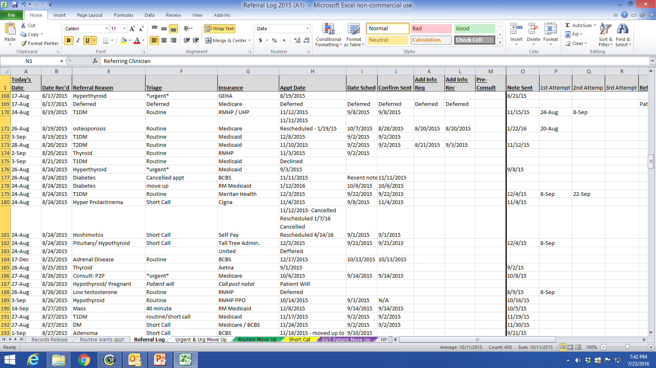
Close the Loop Referral Tracking

Slide 49
Close the Loop Referral Tracking

Slide 50
Triage (Risk Stratification) and Tracking
Urgent
Move up
Routine
Short Call

Slide 51
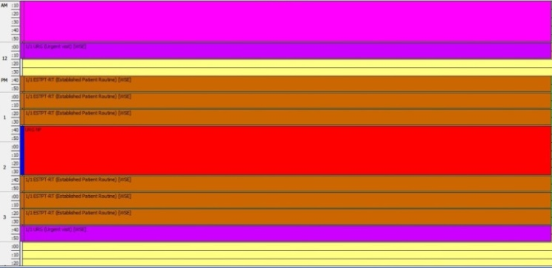
Schedule Based on the Referral Needs
Specialty care practices need to have a mechanism to schedule patients in accordance with their referral needs / risk status
  Reserved Urgent spots (“work the referral; work the schedule”)
  On-call clinician to see patients with urgent referral needs
  Other options
Urgent

Slide 52
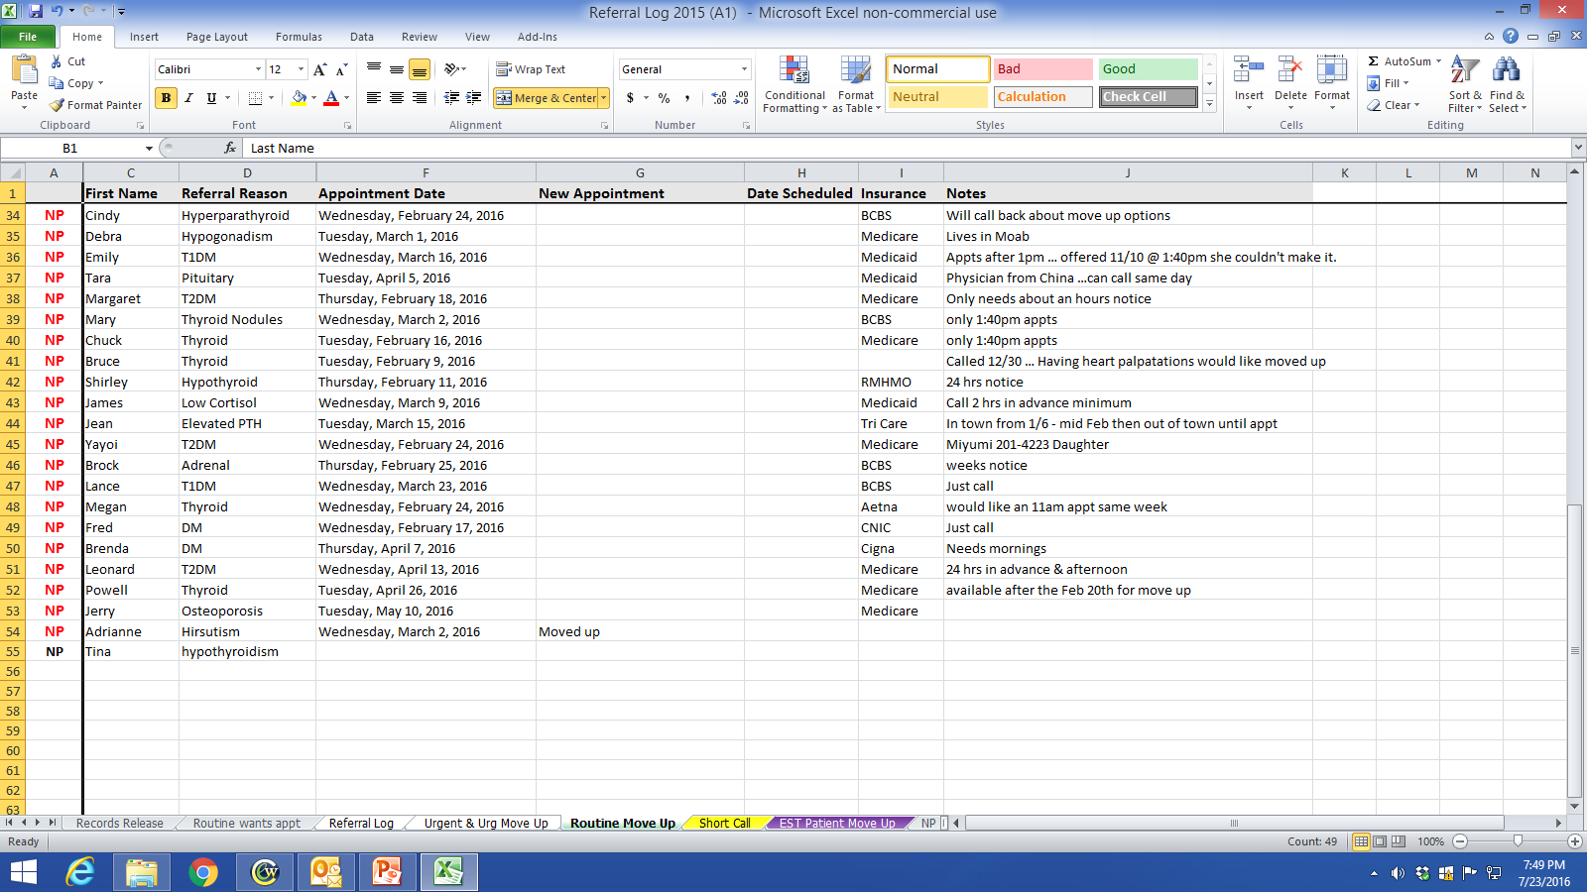
Working the Schedule
91% of patients would come on short notice if contacted
Notes:
Study out of UK showed that 91% of patients would come on short notice / cancellation if given the opportunity & called(texted, emailed)

Slide 53
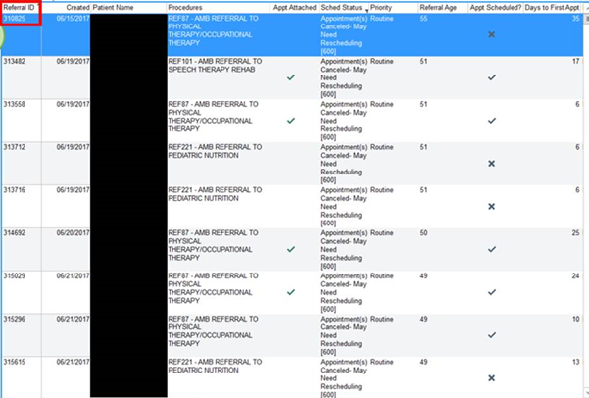
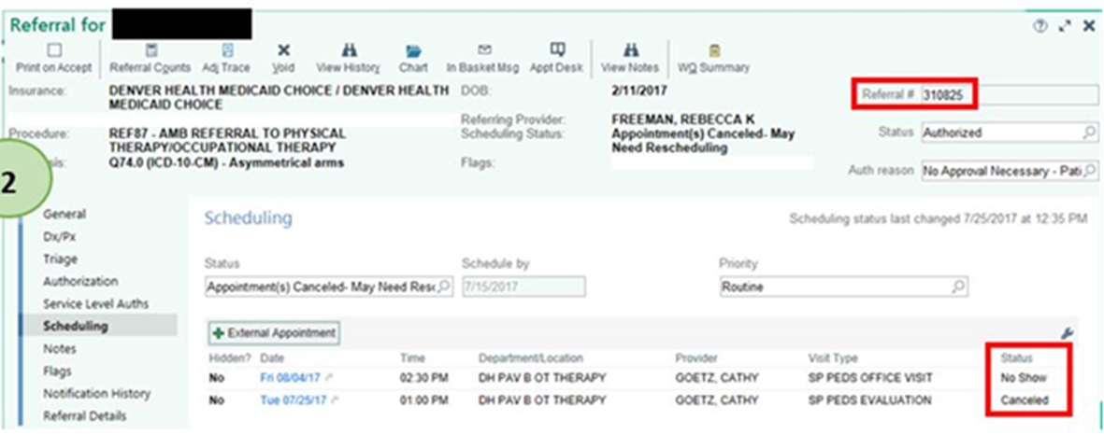
Referral Tracking at Denver Health (EPIC)
Notes:
DH through epic reports is able to work the queue daily in reconciling appointments made, cancellations that need to be rescheduled, and no-show appointments that may need a navigator to call the patient to ensure there aren’t any barriers to attending the appointment. The clinic sending the referral is responsible for tracking their patient referrals….from the time of referral initiation to close the loop. Each patient is accounted for in the referral process. In this example the scheduling status shows what needs to happen with the patient and the care team can take action in providing a high valued referral.

Slide 54
Referral Tracking “Closing the Loop”
Self-referred patient
Referral request received and reviewed
  Handle c/w practice policy
  Clarify reason for referral / clinical question
  Ensure appropriate specialty
  Attempt to get records in advance
Referral response sent -
  Referral Note (report) sent to PCP and appropriate other clinicians (unless patient has strong objections despite reassurance)

Slide 55
Put it in action….
Identify team member(s) for the role & responsibility of closing-the-loop for referral requests to & from the practice
Determine how the practice will track the close-the-loop process
  Create any needed forms for the close-the-loop process
  Can it be part of the EHR?
Make it part of the referral process for the practice
What are the policies around no-show & cancelled appointments?

Slide 56
Leave in action….
Specialty Care Practices:
  Create lists of conditions that are usually urgent, intermediate (move-up) or routine in priority (i.e. how urgent is the referral?)
    Ensure the practice has capacity to schedule & see patients based on the urgency needs
  Develop Pertinent Data Set / referral guidelines for at least one (1-4) conditions commonly referred to your practice (may use the Pertinent Data Sets on the ACP High Value Care website if applicable)
  Develop a Pre-consultation review process & a process for Pre-consultation requests
  Put in place a close-the-loop tracking process

Slide 57
Leave in action….
Primary Care Practices:
  Utilize urgency guides created by specialty care practices to help direct timing of referral request
    Provide direct contact (call) with the specialty care clinician regarding urgent cases
  Utilize Pertinent Data Sets / referral guidelines to help ensure high value referral requests for your patients(may use the Pertinent Data Sets on the ACP High Value Care website if applicable)
  Utilize Pre-consultation request when need clarity regarding the referral request
  Put in place a close-the-loop tracking process

Slide 58
www.acponline.org/hvcc-training
Supporting Materials
HVCC Checklist for Developing Pertinent Data Sets / Referral Guidelines
Pertinent Data Sets developed by specialty societies
HVCC Pre-consultation Review Checklist
Referral Tracking examples

Slide 59
Check list for Pertinent Data Sets/ Referral Guidelines
For a condition or set of conditions:
Essential Information (pertinent & adequate)
Additional Information to send if already done (available) but don’t need to do
Tests or procedures to avoid
Alarm symptoms, signs, conditions (urgency)
Common ‘rule-outs’ to consider before referral
Relevant Choosing Wisely elements
Resources for Health Care Professionals
Resources for Patients

