Slide 1
Connecting Care Ensuring Quality Referrals and Effective Care Coordination
the Medical Neighborhood
Action Items
for Improving the Referral Process for UCONN
ACP SAN special project
for implementing
High Value Care Coordination
Carol Greenlee MD FACP & Beth Neuhalfen

Slide 2
What is Needed ….
A system-wide care coordination agreement – implemented & utilized to improve care of patients and reduce chaos & frustration in the system (and improve safety & reduce costs)
What do we need to get there?
How do we get there?
First steps---

Slide 3
What is a Care Coordination Agreement?
An invitation to work together better:
Platform that everyone agrees to work from:
Standardized definitions
Agreed upon expectations regarding communication and clinical responsibilities.
Also called Care Coordination Compact or Collaborative Care Agreement / Compact

Slide 4
Getting to a System-Wide Agreement
Agree to a standardized referral process:
Suggested approaches to getting there
Committee of Medical Neighborhood (HVCC) champions
Reps from different stakeholders (SC & PC clinicians, clinical & administrative staff, patient/caregiver, central scheduling, IT (EPIC))
Sequential roll-out with Dyads
E.g. PC and Orthopedics; PC and Cardiology, etc. (Dyads)
Often includes referral guidelines, e-consultations
Then expand to other clinics

Slide 5
Getting Started
Decide what to include in the Care Coordination Agreement
Start with basics (elements of good referral process)
Include critical issues that need to be addressed
Have a conversation
“we really enjoy seeing your patients/we so appreciate your help with our patients…it would help us if…” or
“we want to be sure you are getting what you need…”
Decide on forms
Serves as checklist, helps with team care around referral

Slide 6
What really matters …
Relationships – working together
Cultural mindset of “in it together” vs separate silos
Truly connecting care for the patient
Willingness to improve the processes needed to improve the referral experience
Coming to agreement
Doing what is needed to enact the necessary processes

Slide 7
Basics that Benefit
Having a conversation
Defining needs
Many misperceptions
Benefit of discussing issues/working together
“Forms” (“Formal” Agreement)
Defines the elements (reference, enduring, modifiable)
Reinforces/encourages completeness (“compliance”)
“Hard stop” for clinical questions
“Patient informed” check box
Enhances tracking & team roles

Slide 8
What is Included in the Care Compact ? (start with the basics)
Preparation of the patient / pre-consultation
Type of referral /role of the specialist
Provide a clinical question with all referrals
Core data set to accompany all referral.
Pertinent supporting data for the referral
Communication protocol (direct contact for urgent referral)
Critical elements of the referral response
Answer the clinical question, provide rationale, include test results, etc.
Protocol for making appointments
“Closing the Loop” protocol
.

Slide 9
Requests & Offers (Requirements) For a More Effective Process
Requesting Practice
Specialty Care/Responding
A prepared patient
Include any special considerations with the referral request
A clinical question or detailed reason for referral
Supporting information – pertinent data
Core medical data
Contact number (backline, care coordinator etc.)
No Show/Cancellation policy – f/u with patient
Mechanism for Pre-consultation request
Specialty Care practice info for “one pager” for patient
Referral guidelines (Pertinent Data Set) for specific conditions
Agreement to Preview Referral Request
Schedule by urgency
Close the loop – referral tracking notifications & referral response notes sent to PC & Requesting practice

Slide 10
Get Agreement on Common Approach to Referral Requests
A prepared patient
Include any special considerations/ patient needs with the referral request & patient goals
Right Specialty at the Right Time w the Right Information
Define the Role in Care requested of Specialty Care
A clinical question or detailed reason for referral
Supporting information for the reason for referral – pertinent data
Core medical data – agreed-upon elements
Mechanism for sending the Referral Request
Contact number (backline, care coordinator etc.)
No Show (& cancellation) policy – f/u w patients

Slide 11
Get Agreements for Specialty Care - Responding to a Referral Request
Info for “One Pager” for patient
Referral guidelines for specific conditions (what info is needed with referral requests)
Mechanism for pre-consultation request (if not sure whether referral is needed, best specialty type or what info to send)
Perform a pre-view of referral requests (to ensure high value)
Ensure referral appropriate & necessary info received
Referral Response to every referral request with critical elements included & easy to find location in note
Close the loop
Notify when scheduled or if unable to schedule
Notify of No Show or Cancellation
Referral response notes sent back in timely manner

Slide 12
Template for “One Pager” for Patient about the Referral - Reduce the Unknowns
Patient name_________ Referred on________
Reason for Referral:____________________ Patient Goal____________
Type of referral(role requested of specialty care)*: (recommend have options to be circled)
To: Practice name/ physician name(s) - Practice address & phone
Info about practice: including link to website for additional info
Role Requested of you -the Patient/Caregiver: Wait to be contacted, what to do if... ..
Appointment scheduling: will SC practice call, time frame to expect, etc.
Visit preparation: Previsit forms, who /what to bring, fasting for test, etc.
What to expect: what care team members involved, time allotment, etc.
Directions: (bus & train routes & stops; parking & costs; door entrance, elevator bank, floor, etc.)
Notes:
Form can be created by Specialty Care practice with all the info on one page (and link to website if available); PC practice can fill in for patient the reason for referral, and circle the type of referral requested

Slide 13
High Value Referral Response
Answer the clinical question/address the reason for referral
Summary or Synopsis (include thought process, rationale)
Agree with or Recommend type of referral / role of specialist
Confirm existing, new or changed diagnoses; include “ruled out”
Medication /Equipment changes
Testing results, testing pending, scheduled or recommended (including how/who to order)
Procedures completed, scheduled or recommend
Education completed, scheduled or recommended
Any “secondary” referrals made (confer with and/or copy PCP on all)
Any recommended services or actions to be done by the PCMH
Follow up scheduled or recommended

Slide 14
Referral Response: Critical Elements
Answer the clinical question/ address the reason for referral
Summary or Synopsis (include thought process, rationale)
Clear indication of the plan for diagnostic evaluation &/or the treatment
What is the specialist going to do
What is the patient instructed to do
What does the referring physician need to do & w hen
What follow up is needed and with whom

Slide 15
High Value Referral Response
Make the referral response easy for the referring practice to review & utilize ( “user friendly” )
Do not want to contribute to “data dump” problem (send multiple page report where the referring physician cannot easily access critical information)
Set up protocol with referring clinician/team that critical elements will be placed in a specific part of or location in the referral response report e.g. under “Assessment and Plan”
Sign note with A&P at top of note

Slide 16
REASONS FOR NO-SHOWS
Delay – long wait time
Too many unknowns
“Cold-feet”/intimidation
Lack of transportation
Lack of money for travel
Fear
Condition or costs
Inconvenient time/date
Usually not defiance or
being a contrarian
Be Curious Not Furious

Slide 17
Referral Tracking “Closing the Loop”
Referral request sent, logged & tracked
Referral request received and reviewed – referring practitioner notified:
Referral accepted with confirmation of appointment date & time (note if patient on a move up list)
If request is a secondary referral, include PCP in notification (e.g. patient referred by endocrinology, GI, cardiology to surgery)
Notify if appointment is moved up or re-scheduled
Ask for additional information if missing critical items or special request to aid & expedite assessment or management
Need process to track to ensure that all missing/ special request information is received

Slide 18
Referral Tracking “Closing the Loop”
Referral request received and reviewed – referring practitioner notified, continued:
Referral declined due to inappropriate referral (wrong specialist, further assessment &/or management not indicated )
How is this communicated to the requesting practice?
Who sends referral request to the appropriate specialty
How is this communicated to the patient ?
Patient defers making appt or cannot be reached
If unable to contact patient, confirm correct contact information
Establish time frame for notifying requesting practice based on urgency of the referred condition

Slide 19
Referral Tracking “Closing the Loop”
Referral response sent -
Referral Note (report) sent to requesting clinician &/or PCP
Ensure Addresses clinic question or reason for referral
Sent in timely manner (usually considered within 1 week of visit)
Process for notifying requesting practice and/or PCP of test results that come back after the referral response note sent
Notification of No Show or Cancellation
If patient cancelled, include reason for cancellation if known
Notice of NO SHOW and any policy on rescheduling
Establish a policy & procedure for handling No Show (or cancel w/o rescheduling) for referral appt
Notes:
Since the requesting clinician/PC has a relationship w the patient, usually best for them to f/u w patient on NO SHOW or cancellation w/o rescheduling – sometimes patient has made appointment w SC clinician elsewhere based on a recommendation from family/friend (and PC needs to get copy of that referral response) or just forgot to go, appointment time conflict, etc.

Slide 20
Referral Tracking “Closing the Loop”
Self-referred patient
Self-referral request received and reviewed by SC
Handle c/w practice policy
Clarify reason for referral / clinical question
Ensure appropriate specialty
Attempt to get records in advance
Referral response sent -
Referral Note (report) sent to PCP and appropriate other clinicians (unless patient has strong objections despite reassurance)

Slide 21
Consider Step-wise Agreement Priorities
Basics:
The Referral Request checklist elements
The Referral Response checklist elements
Close the loop referral tracking
Consider developing Referral Guidelines
List of urgent-intermediate-routine referral conditions
Pertinent data sets / referral guidelines for specific conditions
Add in once you get the process operational:
Define the role in care provided by Specialty Care
Agreement on how to handle secondary diagnoses
Specifications on making secondary referrals
Consider virtual “e- consults” (clinician to clinician recommendations)

Slide 22
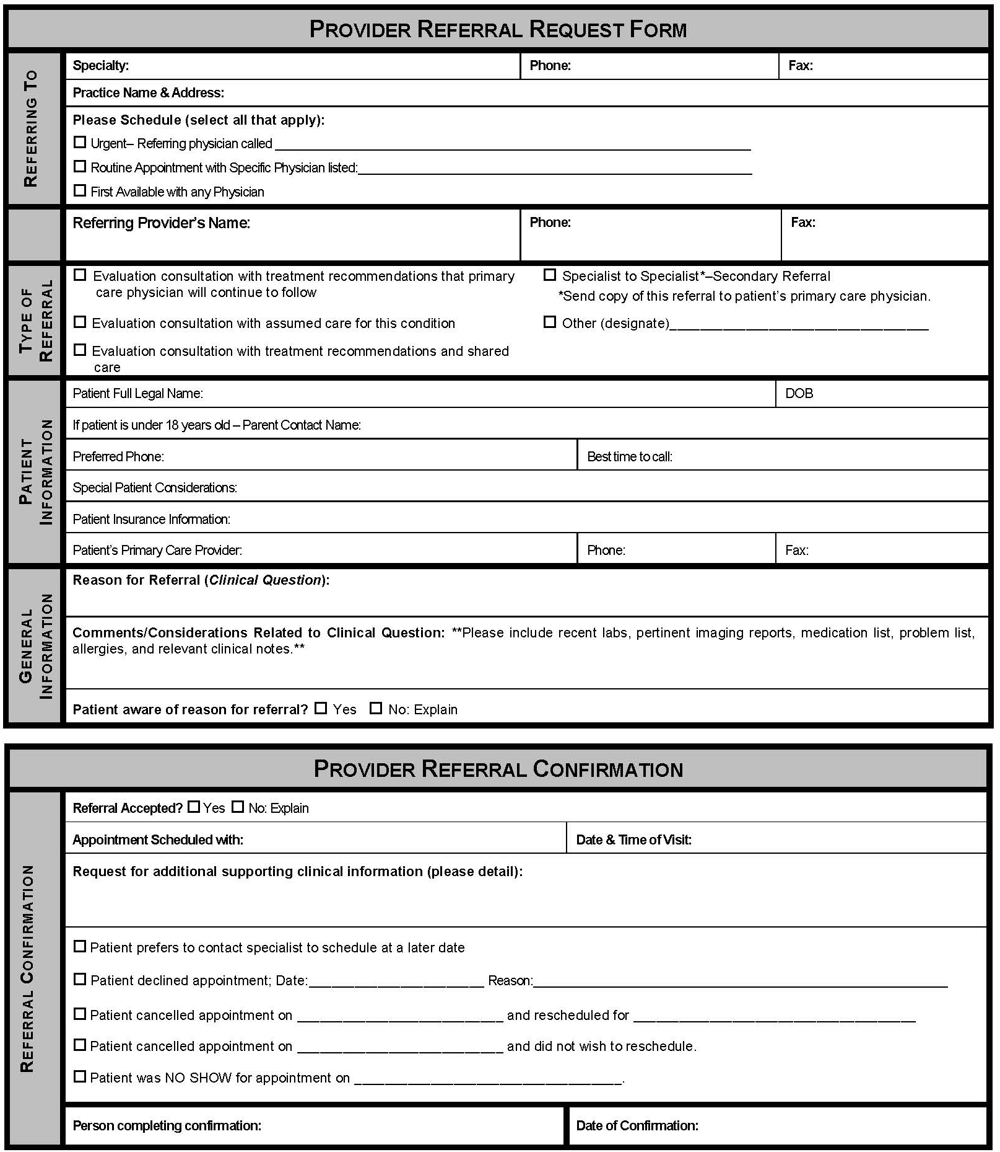
Example of System-wide CCA for IPA (Independent Physicians Association)
Focus on Referral Process :
Referral Request
Clinical question
Supporting data
Prepared Patient
Referral Response
Address clinical question
Referral Tracking
Confirmation of appointment or decline (redirect) referral
Notification of No Show or Cancellation

Slide 23
What is Needed – Next Steps….
Need to get each clinic’s “own house” in order?
Need for patient-centered team-based care
Are the clinicians on-board?
Are you ready to begin work on a common approach to the referral process (care coordination agreement)?
Which approach do you prefer?
Champions committee or Pilot Practice Dyad roll-out

Slide 24
Put it in action….
How will you track referrals?
Suggestions:
Identify team member(s) for the role & responsibility of closing-the-loop for referral requests to & from the practice
Create any needed forms for the close-the-loop process – (how will SC notify PC / the Requesting practice)
Determine how the practice will track the close-the-loop process – set up in EPIC
Make it part of the referral process for the practice

Slide 25
First steps to a more patient-centered referral process ….
Help the primary care practice identify how they can include the patient’s goal(s) in the referral request
Encourage Specialty Care practices to develop a “one pager” on their practice for the requesting practice to provide to patients when the referral is made
Consider having practice do a patient experience survey about the referral process or patient input on the practice’s referral process & share with care team

Slide 26
Materials for Action Step 4
Sample & Model Templates for Care Coordination Agreements / Compacts
www.acponline.org/hvcc-training

Slide 27
Template Care Coordination Agreement
PCP / Requesting
Neighbor / Responding
Prepare patient
Use of referral guidelines where available
Patient/family aware of and in agreement with reason for referral, type of referral, and selection of specialist
Expectations for events and outcomes of referral
Provide appropriate and adequate information*
Demographic and insurance information
Reason for referral, details
Core Medical Data on patient
Clinical data pertinent to reason for referral
-- Any special needs of patient.
Indicate type of referral requested:
Pre-visit Preparation/Assistance
Consultation (Evaluate and Advise)
Procedure
Co-management with Shared Care
Co-management with Principal Care
Full responsibility for all patient care
* See provided model check list of suggested areas to address.
Review Referral Requests and Triage According to Urgency
Reserve spaces in schedule to allow for urgent care
Notify referring provider of recognized referral guidelines and inappropriate referrals
Work with referring provider to expedite care in urgent cases
Verify insurance status
Anticipate special needs of patient/family
-- Agree to engage in pre-referral consult if requested.
_ Provide PCP with number for direct contact for urgent/immediate matters.
Provide appropriate and adequate information in a timely manner*
To include specific response to referral question; verify type role; any changes to diagnosis; medication; equipment; testing; procedures; education; referrals; follow up recommendations or needed actions
* See provided model check list of suggested areas to address.
12

