Slide 1

Connecting Care
Ensuring Quality Referrals and Effective Care Coordination
the Medical Neighborhood
Action Step # 4:
Create a Care Coordination Agreement
ACP SAN special project
for implementing
High Value Care Coordination
Carol Greenlee MD FACP & Beth Neuhalfen

Slide 2

The ACP SAN
High Value Care Coordination curriculum
Action Steps to Connected Care
Look at your internal referral process (get your own house in order)
Ensure the specialty practice gets what is needed for a high value referral
Ensure the others (patients, the requesting practice and any secondary care) get what they need
Develop Care Coordination Agreement(s) (compact) with appropriate referring practice(s)

Slide 3

As you listen…
Think about developing a care coordination agreement
  What do you need & want in a care coordination agreement to improve the referral process for
    Patients/caregivers – more patient-centered
    Clinicians and practices
    Reducing waste and improving cost effectiveness
  How this agreement might improve access to care

Slide 4



Putting it all together-Connecting Care
Building the bridge
abutments –getting your
own house in order
Securing the
connecting pieces:
the referral request
the referral response
Establishing the bridge: a Care Coordination Agreement for the
Referral process

Slide 5

Ideally & Ultimately…
Patient-Centered High Value Care Coordination would be standard of care…
… with every clinical team doing what is needed to coordinate, connect and share the care for
our patients whenever and wherever
that care may take them

Slide 6



To help us get there…
Care Coordination Agreements provide
A starting point
And
A roadmap

Slide 7
What is a Care Coordination Agreement?
An invitation to work together better:
Platform that everyone agrees to work from:
  Standardized definitions
  Agreed upon expectations regarding communication and clinical responsibilities.
Can be formal or informal
Also called Care Coordination Compact or Collaborative Care Agreement / Compact

Slide 8

Models for Establishing Agreements
“One-on-One” Compacts with selected medical neighbors
  PCP practice with specialist / specialty to specialty
  ACO with a specialty
  One Organization (system) with another Organization (system)
System-wide adoption (all players within system)
  Closed or integrated systems (VA, ACO, IPA, AMC)
  Multi-specialty networks (everyone on same page)
Unilateral approach
  Medical Center / Organization /Specialty Practice (“This is how we agree to work with those who refer to our center/ organization/ practice or those who we refer to and this is what we would like from you ”)

Slide 9
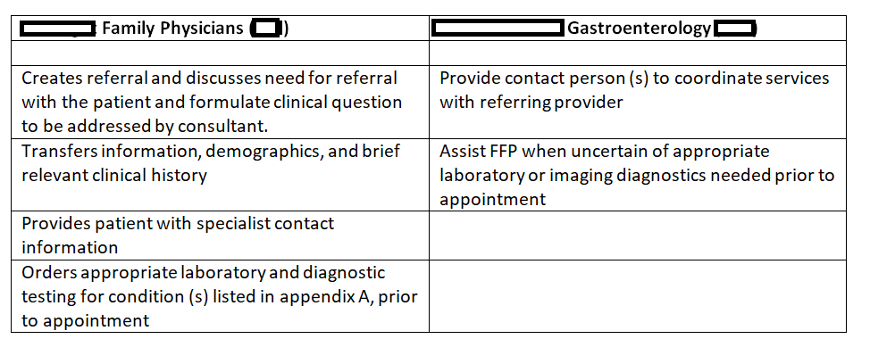
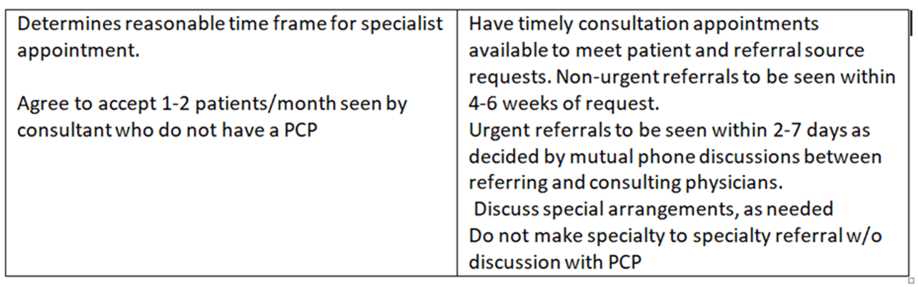
Example of Formal 1-on-1 CCA
(PCP with Specialty)

Slide 10
Example of Informal 1-on-1 CCA
(Specialty to Specialty)
Endocrinology with Endocrine Surgeon
  Work closely together for surgical cases involving parathyroid/thyroid/adrenal issues
  Evolved & continuously evolving understanding of information, communication & collaboration needs
    Clear clinical questions/ reason for referral
    Detailed summary / discussions-calls
    Defined expectations around roles & responsibilities
    Defined expectations around shared information, communication and care collaboration
Notes:
Even though informal (no shared document between them), likely still benefit from keeping check list

Slide 11
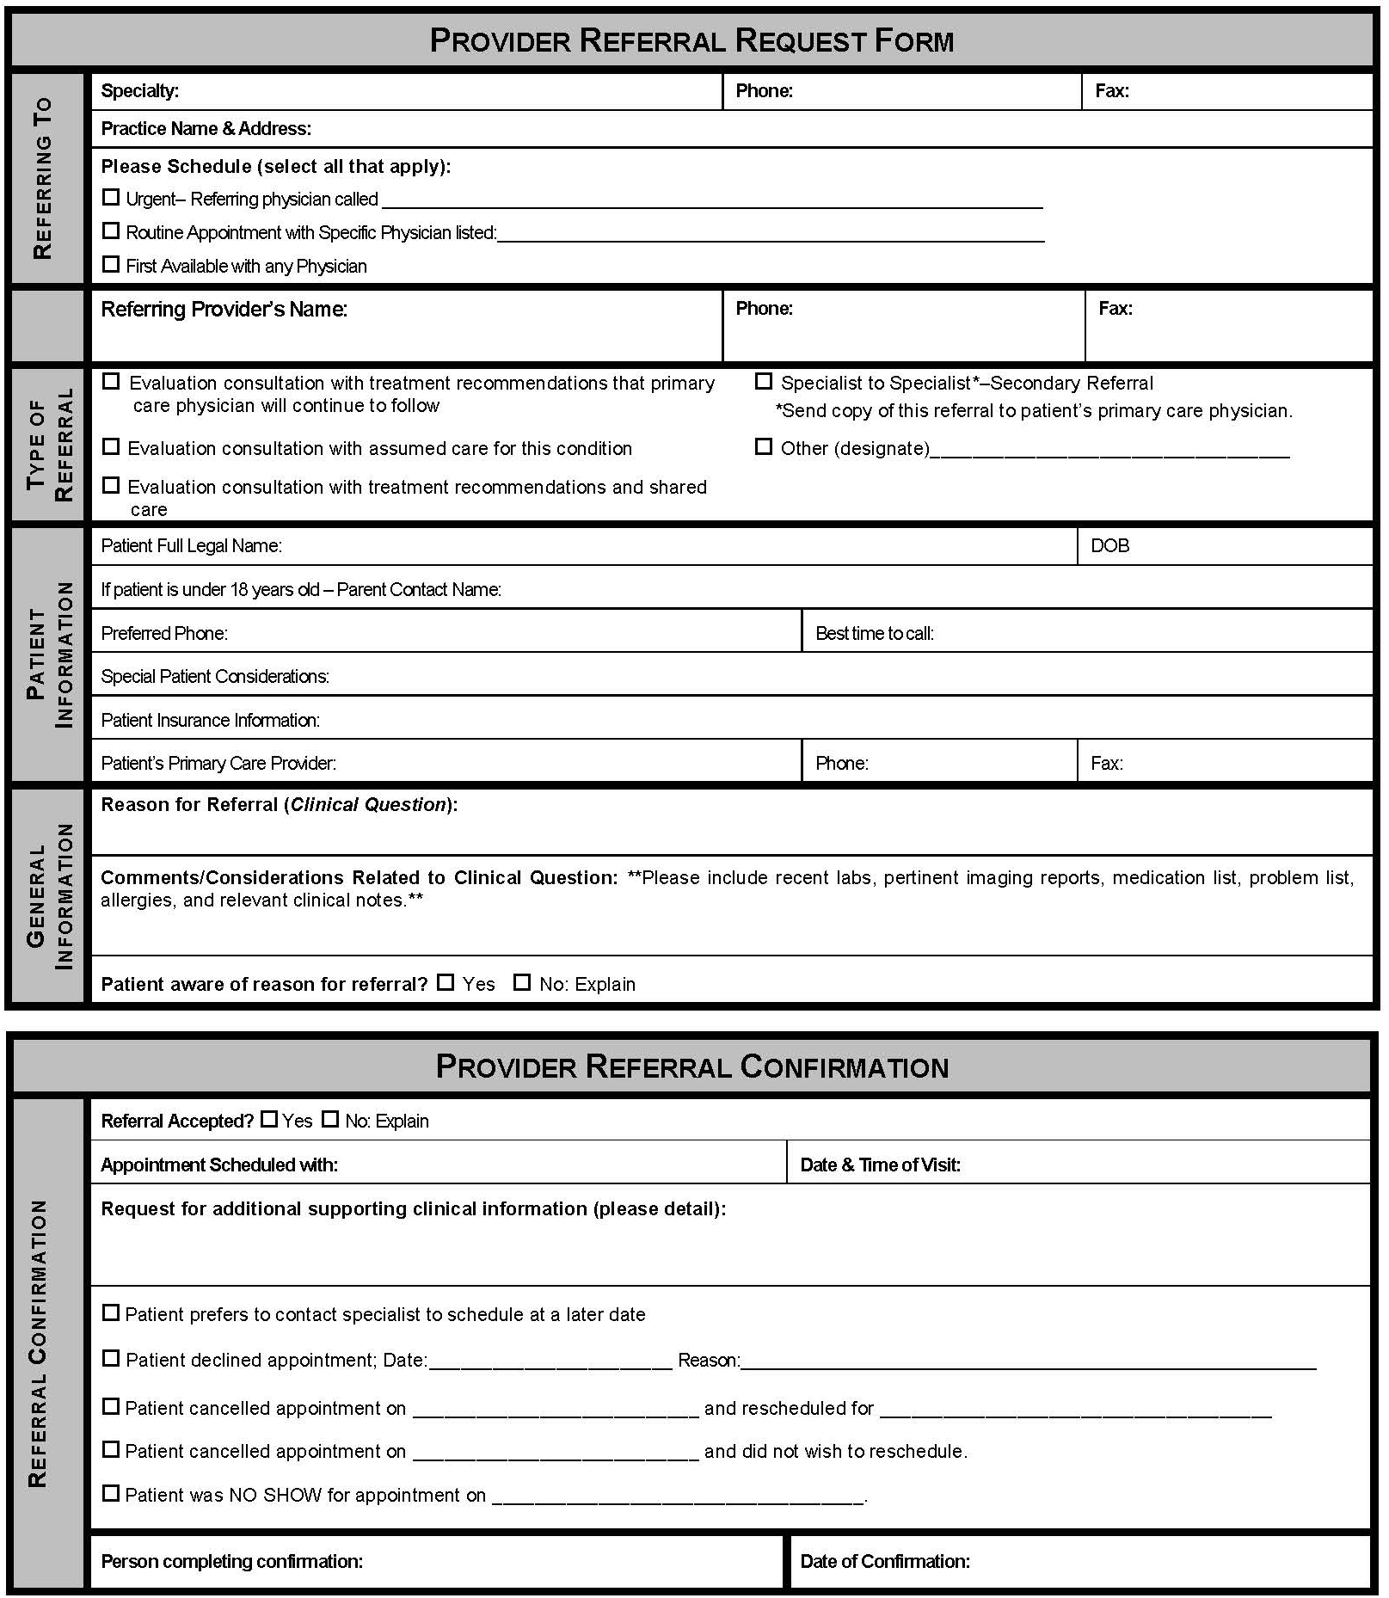
Example of System-wide CCA for IPA
(Independent Physicians Association)
    Focus on Referral Process :
    Referral Request
      Clinical question
      Supporting data
    Prepared Patient
    Referral Response
      Address clinical question
    Referral Tracking
    Confirmation of appointment or decline (redirect) referral
    Notification of No Show or Cancellation

Slide 12
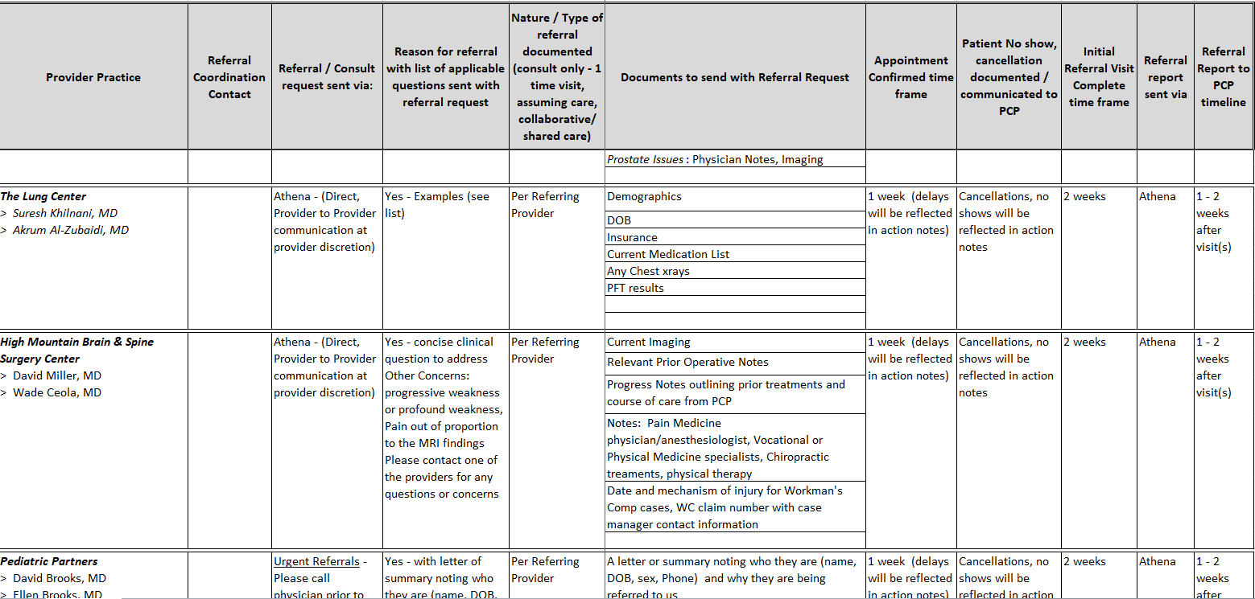

Example of System-wide CCA for Employed Multi-Specialty Physicians group

Slide 13
Wide Specialty Referral Base
Most specialists have a wide geographic referral base
Large institutions & Academic Medical Centers
  Many, if not most, referrals come from outside the “system” or institution
  Consider a Unilateral Care Coordination Agreement
  Provide your requests & offers

Slide 14
Example of Unilateral CCA
PLEASE SHARE THIS WITH YOUR PHYSICIANS AND ADVANCED PRACTICE PROVIDERS
We want to provide you with value-added and appropriate assistance with your ENDOCRINOLOGY referrals. Please note the requested information. Feel free to use your own referral form but please do include as much of the information as possible to help us expedite your patient’s referral.
Providing a summary of the issues necessitating referral or a clinical question will help us ensure that we address the appropriate concerns and also will help us triage the referral.
Every referral request is reviewed by the staff and our physician upon receipt.
We may ask that you do some additional testing prior to referral to prevent delay or to further define the process for your patient.
We want to be sure that you and your patient get the advice and assistance to care that is requested. We are working to align our referral response to meet those aims. We will do our best to tie into any CARE PLAN that has been established for the patient and to outline any endocrine care plan or action plan items. As we all know, this is a work in progress for all of us and please feel free to let us know if there are additional items or a different format that would be of more help to you in coordinating the care of our common patients.
Sincerely and Thank You,
Carol Greenlee MD and the staff of Western Slope Endocrinology

Slide 15
Western Slope Endocrinology Referral Form (“CCA”)
WSE’s Offers …
We will call the patient to schedule the appointment if appropriate and will notify you of the appointment date and time.
We will also notify you if we determine that the referral is not appropriate for our practice or if we are unable to schedule the patient.
We will send a referral response note usually within 2-3 days of seeing the patient. We most often send this by fax from our EMR.

Slide 16
Demographics
Full Legal Name: _______________________________________________DOB: ______________________
Home Phone: _____________________ Cell: _____________________ Work: ________________________
Referring Provider: ____________________________________________ Phone: _____________________
Referral Information
Clinical Question or Reason for referral (summary is helpful):
Type of Referral requested:
___Medical Consultation: Evaluate and advise with recommendations for management sent back to me
___Co-management: I prefer to share the care for the referred condition (PCP lead)
___Co-management: Please assume principal care for the referred condition (Specialist assumes care)
___Have Specialist determine which is most appropriate after their assessment of the patient
Is this routine____ or urgent____? ⁭
If urgent please indicate why and consider calling Dr. Greenlee to help us expedite care.
Is the patient aware that they have been referred to us and why? ___________________
Are there any special needs such as issues with mental competence, language or physical issues?
Is the patient the contact person? ______ If not, who is? __________________________________
Please include clinical data that is pertinent to the referral:
The patient’s core medical information (Demographics, Medication list, Allergy list, Problem list, etc)
Labs
Radiology reports
Clinical notes
Any additional medical history that is useful
If you have a CARE PLAN on this patient, please attach
WSE’s
Requests

Slide 17
Referral Specific Unilateral CCA
Wrap it into the referral request (spell it out)
38 yo female with suppressed TSH confirmed on repeat testing along with elevated fT4 (see attached), please evaluate for cause of hyperthyroidism and help with selection of most appropriate treatment option
Patient is in care management, she has unreliable phone & transportation services, please contact her care manager Ginger Rogers at 123-456-7890 for help with scheduling any tests or imaging
Please contact us before any secondary referrals
  Patient is under controlled substance agreement
  She is in CO Medicaid Prime plan (Value Based-Shared Savings plan)

Slide 18


Who to Make an Agreement With?
Practices you work with frequently
Practices you need “more” from
  PCP needing timely referral response notes
  Specialty group needing more than ICD code with referrals
  PCP needing colonoscopy reports from GI group
  Surgeon needing pre-op prep assistance
Practices you need “less” from
  Chart dump with referrals
  40-page referral response notes (with every order, etc. in it) with no helpful information included or easily found
Notes:
Bigger ROI if reach out to work with practices that you are not getting those things that you need

Slide 19

Getting Started
Decide what to include in the Care Coordination Agreement
  Start with basics (elements of good referral process)
  Include critical issues that need to be addressed
Have a conversation
  “we really enjoy seeing your patients/we so appreciate your help with our patients…it would help us if…” or
  “we want to be sure you are getting what you need…”
Decide on forms
  Serves as checklist, helps with team care around referral

Slide 20

What really matters …
Relationships – working together
  Cultural mindset of “in it together” vs separate silos
    Truly connecting care for the patient
Willingness to improve the processes needed to improve the referral experience
  Coming to agreement
Doing what is needed to enact the necessary processes

Slide 21


Basics that Benefit
Having a conversation
  Defining needs
    Many misperceptions
  Benefit of discussing issues/working together – cohesion
    Need clinician involvement
“Forms”- “Formal” Agreement
  Defines the elements (reference, enduring, modifiable)
  Reinforces/encourages completeness (“compliance”)
    “Hard stop” for clinical questions
    “Patient informed” check box
    Enhances tracking & team roles
Notes:
It is the coming together, the relationship building, the agreement and willingness to use processes to work together better that really matters – otherwise the agreement is just a piece of paper --- should not be just sent to another practice with request/demand “sign this” – should be doable by both parties and benefit both parties as week as patients/caregivers

Slide 22
What is Included in the Care Compact ? (start with the basics)
Preparation of the patient / pre-consultation
Type of referral /role of the specialist
Provide a clinical question with all referrals
Core data set to accompany all referral.
Pertinent supporting data for the referral
Communication protocol
Critical elements of the referral response
Protocol for making appointments
“Closing the Loop” protocol
.

Slide 23





One-on-One Care Compacts with Everyone
→ Too Much to Manage by both SC & PC
Overload & Frustration…
Notes:
Benefit of having a common approach, standardized – helps prevent overwhelming our cognitive load capacity

Slide 24
Take a minute …
Some of you already have or are in process on some form of formal or informal care coordination or referral agreements with another practice now …
Would you consider establishing a system-wide referral agreement
  Agree on the elements to be included with every referral request & referral response
    Specific referral guidelines (pertinent data) for specific conditions/specialty care needs
  Close-the-Loop Referral Tracking

Slide 25
Get Internal Agreement on Common Approach to Referral Process
How to go forward?
  Champions committee – multi-stakeholder reps (PC& SC clinicians, clinical & administrative staff, patient/caregiver reps)
    Develop & Implement system-wide approach
      Ensure internal capabilities for doing the required processes*
    Outreach to major additional practices
  Pilot-practices approach (multi-stakeholder involvement)
    Develop & Implement pilot approach within 1-3 practice dyads (GI – PC; Derm- PC; Urology - PC)
      Troubleshoot the internal necessary processes*
    Spread to other practices

Slide 26
Requests & Offers
For a More Effective Process
Requesting Practice
Specialty Care/Responding
A prepared patient
Include any special considerations with the referral request
A clinical question or detailed reason for referral
Supporting information – pertinent data
Core medical data
Contact number (backline, care coordinator etc.)
No Show/Cancellation policy – f/u with patient
Mechanism for Pre-consultation request
Specialty Care practice info for “one pager” for patient
Referral guidelines (Pertinent Data Set) for specific conditions
Agreement to Preview Referral Request
  Schedule by urgency
Close the loop – referral tracking notifications & referral response notes sent to PC & Requesting practice

Slide 27
Get Agreement on Common Approach to Referral Requests
A prepared patient
  Include any special considerations/ patient needs with the referral request & patient goals
  Right Specialty at the Right Time w the Right Information
Define the Role in Care requested of Specialty Care
A clinical question or detailed reason for referral
Supporting information for the reason for referral – pertinent data
Core medical data – agreed-upon elements
Mechanism for sending the Referral Request
Contact number (backline, care coordinator etc.)
No Show (& cancellation) policy – f/u w patients

Slide 28
Get Agreements for Specialty Care - Responding to a Referral Request
Info for “One Pager” for patient
Referral guidelines for specific conditions (what info is needed with referral requests)
Mechanism for pre-consultation request (if not sure whether referral is needed, best specialty type or what info to send)
Perform a pre-view of referral requests (to ensure high value)
  Ensure referral appropriate & necessary info received
Referral Response to every referral request with critical elements included & easy to find location in note
Close the loop
  Notify when scheduled or if unable to schedule
  Notify of No Show or Cancellation
  Referral response notes sent back in timely manner

Slide 29

Consider Step-wise Agreement Priorities
Basics:
The Referral Request checklist elements
  Scheduling protocol
  Close the loop referral tracking
The Referral Response checklist elements
Referral Guidelines
  List of urgent-intermediate-routine referral conditions
  Pertinent data sets / referral guidelines for specific conditions
Add in once you get the process operational:
Define the role in care provided by Specialty Care
Agreement on how to handle secondary diagnoses
Specifications on making secondary referrals
Consider virtual “e- consults” (clinician to clinician recommendations)

Slide 30
As you listen …
Think about access to specialty care
  Recognize how having care coordination agreements and improving the referral process can improve access to specialty care
  Think about which patients might be able to “graduate” from management of a condition by specialty care back to primary care opening up specialty care access (& reducing care fragmentation)

Slide 31

Defining “Access” to Health Care
Defined by IOM in 1993:
Access to health care = having "the timely use of personal health services to achieve the best health outcomes"

Slide 32
Timeliness
The health care system's ability to provide health care quickly after a need is recognized.
Measures of timeliness include:
  Availability of appointments and care for illness or injury when it is needed
  Time spent waiting
The delay in time between identifying a need for a specific test or treatment and actually receiving those services can negatively impact health and costs of care.

Slide 33

Some issues with “Access” to Health Care
IOM 2001 Crossing the Quality Chasm
“A highly fragmented delivery system…[with] long waiting times and delays…”

Slide 34
Wait Times for Specialty Appointments at SFGH: before & after Improving the Referral Process
Courtesy
E. Murphy SFGH

Slide 35
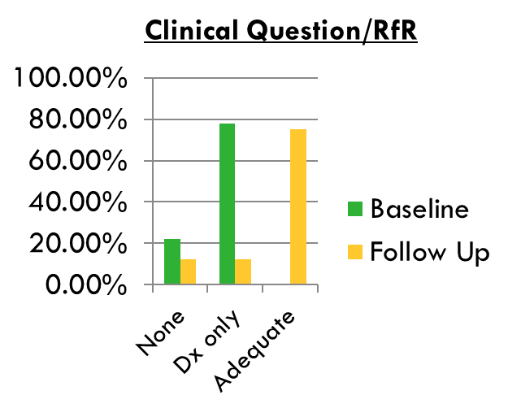
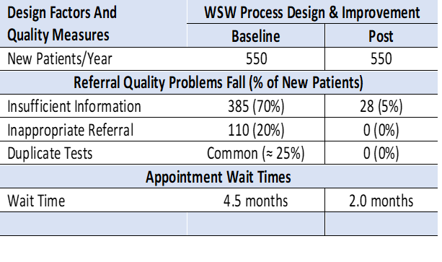
Small, Rural Specialty Care Practice
Three infrastructure elements
  Care coordination agreements (CCA) with referring practices (shared expectations)
  Pre-consultation review of all referral requests and communication with referring practices prior to referral
  Referral tracking and triage throughout the process

Slide 36
Take a minute …
Just by improving the referral process(including pre-consultation/pre-visit request & review) for high value referrals - can improve access
What other opportunities are there to open up access for patients needing specialty expertise and care?

Slide 37
Among Referred Patients, Type of Work Done by Specialists in the US (Data are from the 2002-2004 NAMCS)
Notes:
About 50% of appointments for SC are for “routine follow up” – many of which are for patients w stable conditions that could be managed by PC, this limits appointment spaces for sicker patients or new patients

Slide 38


Opening Access through “Graduation”
A study showed at least 20% of patients in an academic specialty care clinic had both their PC & SC clinicians agree that they could return to PC management of the referred condition
  Patients with minor or resolved issues
  Patients who were referred with an unstable condition that are now stable and are appropriate for management by their primary care team
Roles are fluid based on changes in the patient or the condition
Notes:
Patients often get ‘stuck” in specialty care and that contributes to reduced access: can graduate to shared care or back to management by PCP

Slide 39
Communicating Preference
It is preferable for the primary care team to indicate their intention regarding the role of specialty care and their desire or lack of desire to resume management of the referred condition as part of the initial referral request.
I am referring the patient for:
___Principal Care Co-management: Please assume principal care for the referred condition: (Specialist assumes lead for care of the disorder, first call for the disorder)
  __I prefer to resume management of this condition once stable
  __I prefer that you assume ongoing co-management of this condition

Slide 40

Consider ….
To Help Improve Access:
Monitor wait time for routine new patient appointments or follow up appointments to your practice or clinic (3rd next-available)
Develop a mechanism for Pre-visit (“pre-consultation”) request & review to sort out referrals that are inappropriate & to be sure adequate info at time of referral appointment (high value)
Consider which patients / conditions are suitable for transition back to primary care management

Slide 41
Intent of this curriculum …
Evaluate your current state for referrals and find the opportunities to improve your referral processes in order to….
  Reduce chaos & frustration in the clinic
  Reduce waste & unnecessary resource use
  Reduce wait times & improve access
  Improve satisfaction & outcomes for patients

Slide 42
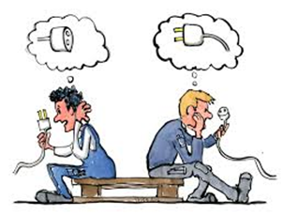

Current State → Opportunities
A more Patient-centered approach
  Confusion & chaos – patient takes the brunt of impact
  Fragmented care, burden of care – unnecessary SC referral appointments (role for PC & SC) & follow-up
  Wait time – delay in care
Wasted resources (time, efforts, workforce) in the referral process – need to work together to solve
Missing communication – coordination
  Silos within silos – clinicians MIA
    The referral process should be part of taking care of the patient not a siloed process in & of itself
  Missing internal & external collaborative approach
Notes:
Addressing these current state opportunities will not only be better for patients but will be better for you – there is a lot of time and staff resource spent now that could be reduced by working together to better share info about the referral / closing the loop steps

Slide 43

Leave in action….
Develop a Care Coordination Agreement
  Work together toward a system-wide agreement
    Its about the patient - working together to connect care for the patient
  Develop expectations & agreement on the
    Elements to be included in a Referral Request & Referral Response for all referrals
    Close-the-Loop Referral Tracking
  Have a plan & timeline for Implementation - follow through
Track improvements in metrics such as access (wait times), close-the-loop, no show/cancel w/o rescheduling rates, etc.

Slide 44
What is Needed – Next Steps….
Is your own house in order?
  What processes still require troubleshooting or redesigning?
  Are your clinicians on-board?
Are you ready to begin work on a common approach to the referral process (care coordination agreement)?
  Which approach do you prefer?
    Champions committee or Pilot Practice Dyad roll-out

Slide 45
Materials for Action Step 4
Sample & Model Templates for Care Coordination Agreements / Compacts
www.acponline.org/hvcc-training

Slide 46
Template Care Coordination Agreement
PCP / Requesting
Neighbor / Responding
Prepare patient
  Use of referral guidelines where available
  Patient/family aware of and in agreement with reason for referral, type of referral, and selection of specialist
  Expectations for events and outcomes of referral
Provide appropriate and adequate information*
  Demographic and insurance information
  Reason for referral, details
  Core Medical Data on patient
  Clinical data pertinent to reason for referral
  -- Any special needs of patient.
Indicate type of referral requested:
  Pre-visit Preparation/Assistance
  Consultation (Evaluate and Advise)
  Procedure
  Co-management with Shared Care
  Co-management with Principal Care
  Full responsibility for all patient care
* See provided model check list of suggested areas to address.
Review Referral Requests and Triage According to Urgency
  Reserve spaces in schedule to allow for urgent care
  Notify referring provider of recognized referral guidelines and inappropriate referrals
  Work with referring provider to expedite care in urgent cases
  Verify insurance status
  Anticipate special needs of patient/family
  -- Agree to engage in pre-referral consult if requested.
  _ Provide PCP with number for direct contact for urgent/immediate matters.
Provide appropriate and adequate information in a timely manner*
  To include specific response to referral question; verify type role; any changes to diagnosis; medication; equipment; testing; procedures; education; referrals; follow up recommendations or needed actions
* See provided model check list of suggested areas to address.
12

Slide 47
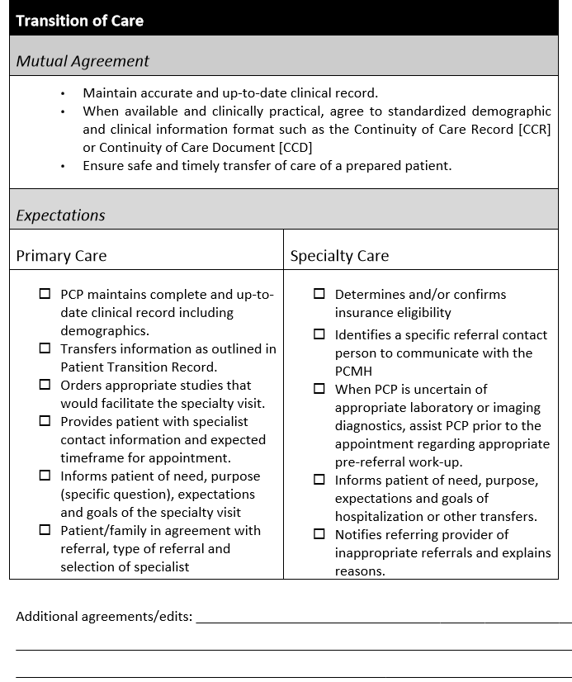
Example Guide for Care Coordination Agreement
The Mutual Agreement section of the tables reflect the core elements of the PCMH
and Medical Neighborhood
and outline expectations from
both primary care and
specialty care providers.

