Slide 1
Connecting Care Ensuring Quality Referrals and Effective Care Coordination
the Medical Neighborhood
Action Step #2 Segment 1
The Referral Request
ACP SAN special project
for implementing
High Value Care Coordination
Carol Greenlee MD FACP

Slide 2
As you listen…
Think about what is needed with a referral request to provide the most appropriate care for the referred patient including
Appropriate urgency of the referral appointment
Addressing the referral problem & patient’s goals
Reducing waste or unnecessary resource use for the patient, the practice and the health care system

Slide 3
The Typical Referral Request
Patient in exam room with cc/o “fatigue” (or “lungs” or “heart” or “anemia” or “pain”…)
Not sure what testing was done or treatments tried before referral
Asked front desk staff to call the referring practice to get records faxed/sent…

Slide 4
Surveys show this scenario is all too common
68% of specialists reported receiving no information from the primary care provider prior to referral visits;… and if they received info… 43% of specialists were dissatisfied with the information they received Gandi et. al. J Gen. Int. Med. 2000
Only 34.8% of specialist received notification of a patient's history and reason for consultation before the referral appointment (65.2% did not) O’Malley, AS, Reschovsky JD. Arch Intern Med. 2011;171(1):56-65
In Colorado, 37% of specialists receive necessary information (63% do not) Systems of Care survey, Colorado Medical Society
This is not good for the patient
Not good for the clinician or practice
Not good for the system

Slide 5
Check list for a high value Referral Request
Patient Demographics & Scheduling Information
Referral Information
Patient’s Core Data Set
Care Coordination/Referral Tracking

Slide 6
Patient Demographics & Scheduling Information
Name, demographics, contact info, surrogates
Special considerations (impaired hearing, vision, cognition, etc..)
Insurance information
Referring clinician/practice name, contact info (including direct contact for urgent matters)
Indicate that patient/surrogate understands and agrees with the purpose of (and type of) referral
Indicate whether
Patient should call to schedule
Specialty practice should contact the patient

Slide 7
Patient Demographics and Scheduling Information
Name, demographics, contact info, surrogates
Special considerations (impaired hearing, vision, cognition, etc..)
Insurance information
Referring clinician/practice name, contact info (including direct contact for urgent matters)
Indicate that patient/surrogate understands and agrees with the purpose of (and type of) referral
Educational material for patient (on disorder or specialty)
Indicate whether
Patient should call to schedule
Specialty practice should contact the patient

Slide 8
Prepared Patient
Patient aware of and in agreement with referral with appropriate expectations
Consideration of what matters to the patient
Patient specific goals
Reading material for patient prior to appointment (explaining type of specialist or information on referral concerns)
Alert specialty practice of any special needs (impaired vision, hearing, cognition, care giver status, etc.)
Use of Referral Guidelines (specific to the patient)
Appropriate specialist at appropriate time
Appropriate testing or therapeutic trials prior to referral
Patient understand role of specialist and who to call for what
For more on the “prepared patient”
See Action Step 3
21
Notes:
The pt needs to be part of pt centered care

Slide 9
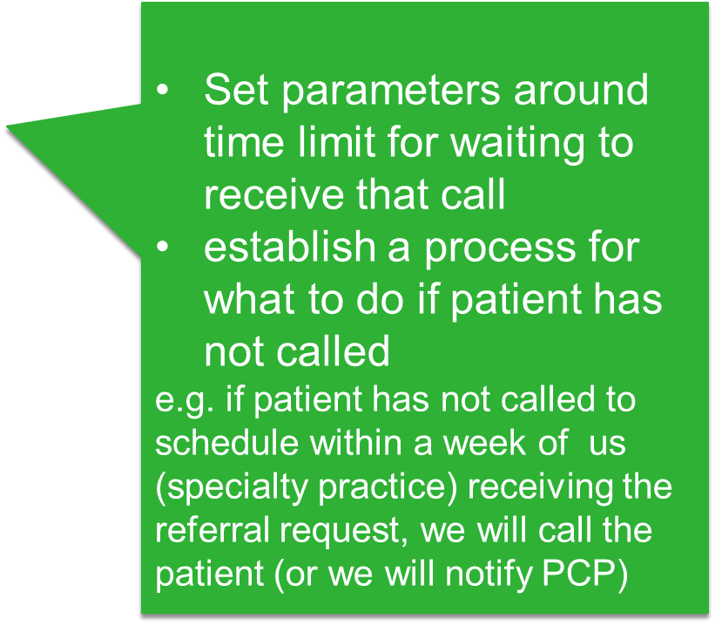
Define the protocol for making appointments
the expected protocol:
the patient will call to schedule an appointment
the specialty practice should contact the patient
Allows for Pre-visit assessment/referral disposition
Allows for tracking of referrals / accountability

Slide 10
Referral Information
What is the specific clinical question (reason for referral)
A brief Summary of case details pertinent to the referral, include relevant co-morbidities (alarm signs or symptoms)
Urgency (referral status or referral priority)
Referral Type (anticipated, pending specialist’s evaluation) (Referral Definition or Role in care requested of the specialist)
Pertinent data set: Clinical information directly relevant to the specific referral question (office notes, test results, etc.) (Supporting data for the referral)

Slide 11
Provide a Clinical Question (or summary of reason for referral) with all referrals
“eyes” “gallbladder” “diabetes”
68 year old female with intermittent double vision. Is ophthalmopathy assessment the correct starting point?
39 year old female with severe RUQ pain, abnormal US and known diabetes, does she need surgery?
20 yo female with T1DM since age 8 on insulin pump therapy, transferring from pediatric to adult care

Slide 12
Summary of Case pertinent to the referral
Clinical question or reason for referral & summary: & “
Help introduce the patient’s story
“Please help determine which next treatment option is best suited for a 62 yo first grade teacher who has had diabetes for past 10 years. She was allergic to SU; had diarrhea with metformin, edema with Pioglitazone and is now on Long Acting insulin 60 units once daily with widely fluctuating glucose levels and A1c of 10.2%. She is reluctant to check her BG or take injections during the work day due to working with children and the demands of a school teacher.” ( note: this also “turns the patient into a person”)

Slide 13
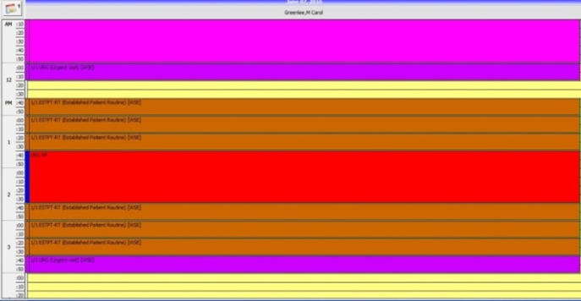
What is the Urgency : (Referral status)
__Urgent (local definition; often appointment within 1-2 days)
Recommend direct communication
Minimally provide written justification for urgency
__Intermediate (subacute, move up )
__Routine
Expectation for scheduling
in accordance with urgency

Slide 14
Referral Type (what is the suggested role of the specialist)
____ Pre-visit Advice / Pre-consultation
____ Non Face-to-Face (e-) consultation
____ Consultation (Evaluate and Advise, with the goal of managing the problem remaining with the referring clinician)
____ Procedural Consultation
____Co-Management with Shared Care (Referring clinician (e.g. PCP) maintains first call for the referral disorder)
____ Co-Management with Principal Care (Referred to subspecialist/specialist assumes first call for the referral disorder)
____ Please assume Full Responsibility for Complete Transfer of all Patient Care (e.g .Pediatric to Adult care transition)

Slide 15
Pre-visit Advice / Pre-consultation
Intended to expedite/prioritize care
Previsit Advice
Does the patient need a referral
Which specialty is most appropriate
Recommendations for what preparation or when to refer
Previsit Review
Is the clinical question clear
Is the necessary data attached
Triage urgency (risk stratify the patient’s referral needs)
Urgent Cases
Expedite care
Improved hand-offs with less delay and improved safety
More on setting up Pre-consultation
processes in part 3 of this action step #2 on ensuring you get what you need

Slide 16
Formal Consultation
Cognitive consultation (advice)
To obtain specialist’s opinion on a patient’s diagnosis, abnormal lab or imaging study result(s), treatment or prognosis
Limited to one or a few visits that focus on answering a discrete question.
e-Consultation: provide advice/recommendations without an office visit (clinician to clinician)
Procedural consultation
To obtain a technical procedure for diagnostic, therapeutic or palliative purposes
Include detailed report back to referring physician
Examples: Colonoscopy, Bone Marrow Biopsy, MRSA infection with recurrent carbuncles

Slide 17
Non-Face-to-Face Consultation including e-Consultations
Reduce unnecessary specialty visits
Streamline patient care decisions
Key Elements
Answer clinical question, and tailor to specific patient characteristics
Non-binding…convert eConsult to standard visit if too complex
Compensated time and effort
Exchange records and responses
Documentation: “Based on the information I received, I recommend…”

Slide 18
E-consult Dermatology (“tele-derm”) examples:
A straight forward problem that can be addressed so the referring provider is able to treat or re-assure the patient without a subsequent appointment to Dermatology. Examples:
a skin eruption with which the referring clinician may not be familiar but which dermatology clinician recognizes (e.g. nummular eczema)
able to provide adequate suggestions for treatment; the patient is started on the correct treatment and responds, a visit to Dermatology is avoided
a patient with a rash the referring clinician thinks is pityriasis rosea but wants reassurance for the diagnosis.
Dermatology concurs with the assessment but also recommends they obtain serology for syphilis. The test is negative and the rash resolves; a visit to Dermatology is avoided.

Slide 19
Co-Management (ONGOING management of a patient’s medical condition)
Shared Care for the disease
(PCP responsible for Elements of Care, takes ‘first call’)
Principal care for the disease.
(Specialist responsible for Elements of Care for that disorder or set of disorders, takes ‘first call’ for the disorder)
Principal care of the patient for a consuming illness for a limited period of time
(specialist serves as first contact but patient maintains PCP as medical home/ hub of care)

Slide 20
Co-Management Oncology examples:
Shared Care for the Disease
CLL
Principal Care of the Disease
Ductal carcinoma in situ (non-invasive breast cancer – DCIS)
Principal Care of the Patient
Metastatic colon cancer with adjuvant chemotherapy
More on the types of referrals & specialty roles
In the video-podcast -
Care Coordination:
Establishing Roles in the Medical Neighborhood
25
Notes:
Oncology examples of comanagement

Slide 21
Pertinent Data Set (supporting data ) for the referred conditions
Pertinent (not data dump)
Adequate (reduce duplication)
To allow the specialty practice to
determine if the referral is to the appropriate specialty
effectively triage urgency
effectively address the referral (enough info to do something)

Slide 22
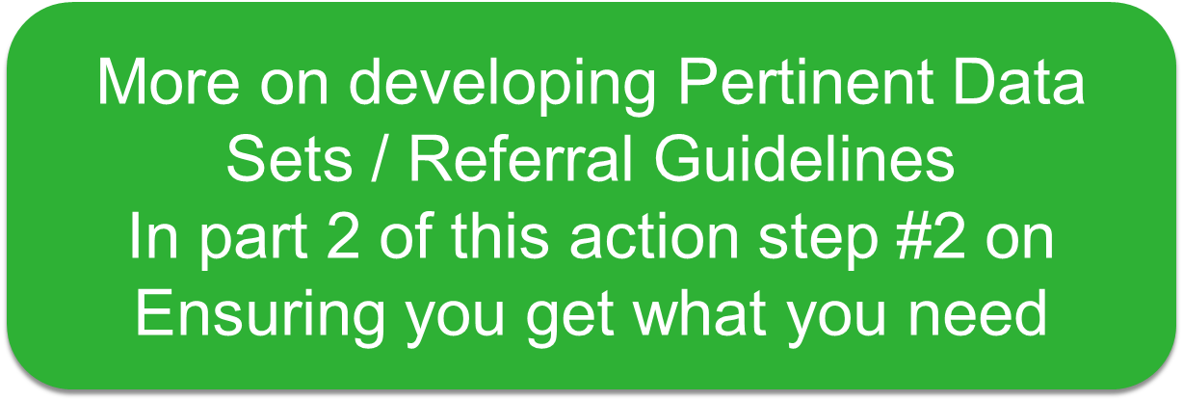

Slide 23
Patient’s Core (general) Data Set
Active problem list
Past medical and surgical history
Medication list
Medical allergies
Preventive care (e.g., vaccines and diagnostic tests)
Family history
Habits/social history
List of providers (care team) (other specialists caring for patient).
Advance directive;
Overall current care plan and goals of care
Also Need Shared Information on:
Global Risk Stratification
Is patient in Care Management or working with Behavioral Health services
How are SDoH needs being met (e.g. transportation services)
Is the Patient under a Pain Contract or Controlled Substance Agreement

Slide 24
Referral Tracking “Closing the Loop” protocol
Track what you requested:
Deferred
F/u with patient or redirect referral
Confirmed appointment
No Show / Cancellation notice
Referral Response note & results
Referral request sent
Referral request received and reviewed
Referral accepted with confirmation of appointment date sent back to referring practitioner
Referral declined due to inappropriate referral (wrong specialist, etc) and referring practice notified
Patient defers making appt or cannot be reached and referring practice notified
Referral response sent (must address clinical question/reason for referral)
Referral Note sent to referring clinician and PCP in timely manner
Notification of No Show or Cancellation (with reason, if known)
More on Referral Tracking in Action Step 3

Slide 25
The Referral Request
Whenever a patient is referred to another clinician or service:
Primary Care to Specialty Care (including Radiology, Pathology and Hospital Medicine)
Specialty to Specialty (“Secondary Referrals”)
Specialty to Primary Care
Primary or Specialty Care to Ancillary & other services (Diabetes Ed, Physical Therapy, Nutrition, etc..)
Agree to supply what is needed for High Value Care

Slide 26
Ideal: “Synoptic” Referral Request
Clinical question or reason for referral: “Please help determine which next treatment option is best suited for a 62 yo first grade teacher who has had diabetes for past 10 years. She was allergic to SU; had diarrhea with metformin, edema with Pioglitazone and is now on Long Acting insulin 60 units once daily with widely fluctuating glucose levels and A1c of 10.2%. She is reluctant to check her BG or take injections during the work day due to working with children and the demands of school teacher.”
Urgency: intermediate
Type of Referral: Shared co-management
Core Data: attached
Pertinent Data: lab flow sheet attached
Patient considerations: Please call after 3 PM due to work hours
Contact for more info: back line number is 123-456-8901

Slide 27
Leave in action….
Use the Referral Request checklist to ensure you are getting what you need from others (as part of your Pre-consultation review)
When/if you send “secondary referrals”, use the Referral Request checklist to ensure you provide the needed information with the referral you request
The Referral Request checklist will be part of the Care Coordination Agreement that you will develop

