Slide 1
Connecting Care Ensuring Quality Referrals and Effective Care Coordination
the Medical Neighborhood
Action Segment #1
Get Your Own House in Order
ACP SAN special project
for implementing
High Value Care Coordination
Carol Greenlee MD FACP & Beth Neuhalfen

Slide 2
Pain Points
REFERRALS
Often Create:
Chaos
Extra burden
Frustration
Confusion
Waste

Slide 3
As you listen…
Think about what actions you can take in your practice to eliminate the chaos & extra burden and improve the referral process and care coordination
For patients
For the practice itself (your staff & clinicians)
For reducing waste or unnecessary resource use

Slide 4
Outline
Why: The need for better coordinated & connected care
What: Recommendations and best practices for high value care coordination based on physician derived & developed principles and tool kits
How: Action steps to get you moving from disconnected to connected care
Working together is BETTER …for everyone

Slide 5
Case 1 (“Playing Charades”)
70 year old woman from town 2 hours away, doesn’t know why she was referred
No records
Only voice mail at referring practice
Glipizide, metformin, Levothyroxine on med list
Discussed diabetes and thyroid
Ordered A1c and TSH
Oops!
A1c and TSH results done 2 weeks prior were identical
Left adrenal mass on abdominal CT
Waste & back-end burden (mess)for everyone

Slide 6
Case 2 (“Wasted days & Wasted nights”)
28 year old female had routine consultation appointment booked by her PCP front office staff with cc/o “fatigue”
No records sent
3 month wait
Oops!
She has lupus and needed rheumatology consult, I’m an endocrinologist….
Now a 5 month wait….
Waste & no “benefit”
for anyone

Slide 7
Case 3 (“Where’s the Beef?”)
59 yo man with T2DM, HTN, Hyperlipidemia & Obesity
referred to cardiology with unexplained DOE & question “is this ischemic?”
28 page note from the cardiologist
only ICD codes for impression
no indication of what the cardiologist thinks or is going to do or
what s/he recommends the PCP do or
what s/he told the patient to do…
More questions than answers
Safety concerns

Slide 8
Scenarios like these are not uncommon
60-70% of specialists reported receiving no information
25-50% of primary care providers received no information
~50% did not even know if their patient ever saw the specialist
28 % of primary care and 43% of specialists are dissatisfied with the information they receive
8% of referrals are inappropriate (wrong specialist or are unnecessary) (average 43 referrals /specialist/year)

Slide 9
IOM 2001 (Crossing the Quality Chasm): “A highly fragmented delivery system”
[with]…“ poorly designed care processes characterized by unnecessary duplication of services and long waiting times and delays…
…physician groups, hospitals, and other health care organizations operate as silos,
often providing care without … complete information”
a ‘non-system’

Slide 10
The answer is not in trying harder…..
“…the effective remedy is not to browbeat the health care workforce by asking them to try harder ….
Poor designs set the workforce up to fail, regardless of how hard they try.
If we want safer, higher-quality care, we will need to have redesigned systems of care…[and]… ongoing tracking to assess progress…”

Slide 11
Directions to a New Model
Acute care model
Staccato care
ER model
Physician centered
Physician carries the load & responsibility
Staff supports physician
Silos of care
Separated care providers
Disconnected care
Chronic Care Model
Care that is Comprehensive, continuous & coordinated
Patient-Centered Team Care
Shared accountability for what is best for the patient
System of Care
Connected, coordinated care
The Right Care at the Right Time in the Right Place

Slide 12
It’s about finding a better way…..
It’s not about doing more…
It is about doing it in a new way
transformation:
a thorough or dramatic change

Slide 13
Primary Drivers for Transformation of Health Care Delivery
Design care & care delivery to be person & family centered
Use data to continuously drive & ensure better care, better health & smarter spending…and discovery of new & better ways of delivering care
Ensure financial viability of practices while reducing burden & increasing joy, to keep practices open for business & serving the people in their communities

Slide 14
The Move to Value Based Payment…intended to drive the move to value based care
Your payments will reflect the “Value” of the care you provide
Value = Quality (Benefit)/Cost
Goal = “get the most for the money”
Get the best patient outcomes for the best cost
Ensure patients get care that benefits them (improves outcome) = higher quality
Reduce care that adds cost without adding benefit (or that may potentially cause harm) = lower costs

Slide 15
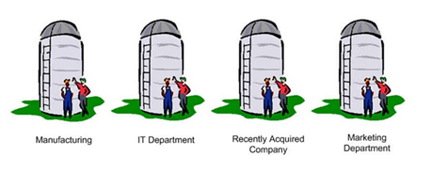
With a few exceptions, most practice in a silo, part of disconnected care
Silo Care / Disconnected Care is:
Not very patient centered
Not very cost effective
Not very satisfying & often burdensome on the back end

Slide 16
From Disconnected Care → High Value, Connected Care
Start with the END in mind:
Goal of Care Coordination: Ensure appropriate care for the individual
Uncoordinated care leads to inappropriate care: Duplicated testing / Unnecessary care
Wrong disorders addressed
Unmet needs
Conflicts with goals and comorbidities
Wasted patient time; wasted clinician time
Excessive burden on both patients & practices
Notes:
ALLYSON

Slide 17
From Disconnected Care → High Value, Connected Care
Start with the END in mind:
Goal of Care Coordination: To Benefit the Patient
Ensure appropriate, continuous connected care
Enhance the Quality of Care (6 domains)
Patient Centered Care
Safety
Effectiveness
Efficiency
Timeliness
Equity
Notes:
ALLYSON

Slide 18
From Disconnected Care → High Value, Connected Care
Start with the END in mind:
Goal of Care Coordination: To Benefit the Physician and Clinical Team
Working together/Cooperation
Increase effectiveness and safety
Increase satisfaction
Reduce stress, chaos and burden
Increase connectedness and part in the bigger picture
More enjoyment (JOY) in the work
…Connecting the Care, Sharing the Care
Notes:
ALLYSON

Slide 19
Care Coordination
Needs to be intentional
Needs a systematic approach
Needs to be part of taking care of the patient, not an afterthought
We need a SYSTEM instead of SILOS

Slide 20
We need a System instead of Silos
“Once we get to interoperability….”

Slide 21
Case 4 (“TMI-Overload”)
74 year old woman with cognitive impairment from Skilled Nursing Facility brought in by transport person
No records except MAR
SNF physician on the road
Look in the HIE….
94 pages of reports
Diabetes
Pituitary mass
Osteoporosis
But what’s the question?

Slide 22
Shared EHR does not solve all the referral/ care coordination problems
Care Coordination requires:
Information sharing (can even be done without EMR)
Adequate
Pertinent
Communication
With patient & family and the medical home team
With Extended Care team (e.g., clinical question)
Collaboration/Working Together
Standardization & expectations of referral procedures
Clarity in roles and responsibilities
Patient-centered approach
Contextual care: considering patient’s needs & circumstances
Shared goals and decision making

Slide 23
We need a SYSTEM for Communication, Collaboration & Care Coordination…..
Notes:
We need that system, we need a grid for c and cc

Slide 24
Outline
Why: The need for better coordinated & connected care
What: Recommendations and best practices for high value care coordination based on physician derived & developed principles and tool kits
How: Action steps to get you moving from disconnected to connected care
Working together is BETTER …for everyone

Slide 25
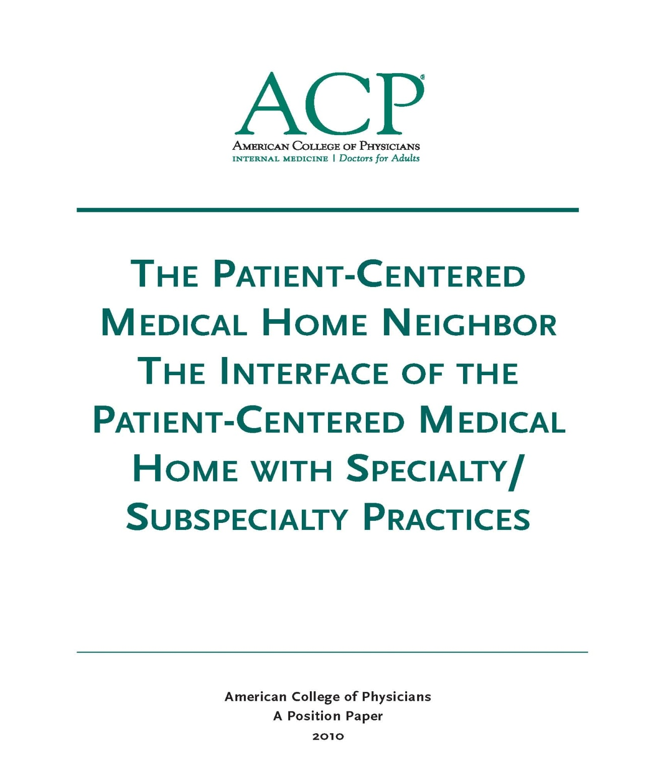
Care Coordination Best Practices and Tools
High Value Care Coordination Tool Kit
Designed & Tested by Practicing Clinicians
Specialty, Subspecialty and Primary Care
Along with Patient & Family Advocacy Organizations

Slide 26
The Medical Neighborhood October 2010
Medical Neighbor defined:
Communicates, collaborates & integrates
Appropriate & timely consultations
Effective flow of information
Responsible co-managing
Patient-centered care
Support medical home as hub of care
2010

Slide 27
Anticipated roles to meet patient needs
Pre-consultation/ pre-visit assistance
Medical Consultation
E-consult (virtual clinician-to-clinician)
Procedural Consultation
Shared Care Co-management
virtual co-management
Principal Co-management

Slide 28
Pre-visit Advice / Pre-consultation
Intended to expedite/prioritize care
Previsit Advice
Does the patient need a referral
Which specialty is most appropriate
Recommendations for what preparation or when to refer
Previsit Review
Is the clinical question clear
Is the necessary data attached
Triage urgency (risk stratify the patient’s referral needs)
Urgent Cases
Expedite care
Improved hand-offs with less delay and improved safety

Slide 29
Take a minute …
How can defining the type of referral (role of the specialist) add to the value of the care ?
How can that role be communicated so that the patient as well as all involved clinicians are aware ?
How could having a “pre-consultation” process improve things for both the patient and the involved practices ?

Slide 30
We need a system for care coordination
High Value Care Coordination
Defining what is needed & expected for high value referrals and care coordination
The “Medical Neighborhood”
An approach to care coordination
It’s about working together better
Promotes connected care where ever that care may be needed

Slide 31
Patient-Centered Connected Care- the patient’s medical neighborhood
The Patient is the center of care
Primary Care is the
necessary hub of care
Specialty/ancillary care is an extension of care
Helping with care to meet patient needs

Slide 32
What do you need to connect the care?
High Value Care Coordination
Information Sharing
Communication
Collaboration
Start with Check Lists for:
High Value Referral Request
High Value Referral Response

Slide 33
Expectations for High Value Referrals
Referral Request
Referral Response
Prepared Patient
Type of referral
Clinical question
Urgency
Core Data Set
Pertinent Data set
Answer the clinical question
What the specialist is going to do
What the patient is instructed to do
What does the referring physician need to do & when
What follow up is needed & with whom

Slide 34
Prepared Patient
Patient as partner in care
Patient included in the process
The patient’s needs & goals considered
Patient understands role of specialist and who to call for what
Pre-visit patient education regarding
referral condition and/or
type and role of specialist
Appropriate (patient-centered) “handoff”
Specialty practice alerted of any special needs of the patient
Appropriate specialist at appropriate time to meet the patient’s needs
Appropriate preparation with testing or therapeutic trials prior to referral
Notes:
The pt needs to be part of pt centered care

Slide 35
Take a minute …
How often are the patients prepared for the referral now (from perspective of both the requesting or receiving practices…and the patients)?
How do you ensure that the patient’s goals are considered ?

Slide 36
A referral is part of taking care of the patient…meeting the needs of the patient
Collaboration is Critical
How do you get to collaboration ?

Slide 37
Make an Agreement….
Care Coordination Agreement
(Collaborative Care Agreement/Care Compacts)
Platform that everyone agrees to work from:
Standardized Definitions
Agreed upon expectations regarding communication and clinical responsibilities.
Can be formal or informal
Your policies and procedures should be aligned to support the agreement

Slide 38
What’s in the Care Compact ? (start with the basics)
Critical elements of the referral request
Critical elements of the referral response
Protocol for making appointments
“Closing the Loop” referral tracking protocol

Slide 39
Define the protocol for making appointments
Expected protocol:
Patient will call to schedule an appointment
Specialty practice should contact the patient
Allows for Pre-visit assessment/referral disposition
Allows for tracking of referrals / accountability

Slide 40
Referral Tracking “Closing the Loop” protocol
Referral request sent
Referral request received and reviewed
Referral accepted with confirmation of appointment date sent back to referring practitioner
Referral declined due to inappropriate referral (wrong specialist, etc) and referring practice notified
Patient defers making appt or cannot be reached and referring practice notified
Referral response sent (must address clinical question/reason for referral)
Referral Note sent to referring clinician and PCP in timely manner
Notification of No Show or Cancellation (with reason, if known)
Referrals made from one specialty to another (e.g. secondary referrals) include notification of the patient’s primary care clinician

Slide 41
Template Care Coordination Agreement
PCP/ Requesting
Neighbor/ Responding
Prepare patient
Use of referral guidelines where available
Patient/family aware of and in agreement with reason for referral, type of referral, and selection of specialist
Expectations for events and outcomes of referral
Provide appropriate and adequate information. (Optimally adopt mutually agreed upon referral form with neighbor*)
Demographic and insurance information
Reason for referral, details
Core Medical Data on patient
Clinical data pertinent to reason for referral
-- Any special needs of patient.
Indicate type of referral requested:
Pre-visit Preparation/Assistance
Consultation (Evaluate and Advise)
Procedure
Co-management with Shared Care
Co-management with Principal Care
Full responsibility for all patient care
* See provided model check list of suggested areas to address.
Review Referral Requests and Triage According to Urgency
Reserve spaces in schedule to allow for urgent care
Notify referring provider of recognized referral guidelines and inappropriate referrals
Work with referring provider to expedite care in urgent cases
Verify insurance status
Anticipate special needs of patient/family
-- Agree to engage in pre-referral consult if requested.
_ Provide PCP with number for direct contact for urgent/immediate matters.
Provide appropriate and adequate information in a timely manner. (Optimally adopt mutually agreed upon referral response form with PCP*)
To include specific response to referral question and any provision of or changes in type of recommended interaction; diagnosis; medication; equipment; testing; procedures; education; referrals; follow up recommendations or needed actions
* See provided model check list of suggested areas to address.
12

Slide 42
Template Care Coordination Agreement
PCP/ Requesting
Neighbor/ Responding
Indication of urgency - Direct contact with specialist for urgent cases
Provide Neighbor with number for direct contact for additional information or urgent matters
Needs to be answered by responsible contact Review secondary diagnoses or suggested referrals identified by Neighbor/specialist.
If co-managing with Neighbor, provide them with any changes in patient’s clinical status relevant to the condition being addressed by the Neighbor.
Contact the patient, if deemed appropriate, when notified by Neighbor of failure to keep appointment.
Indicate acceptance of referral category or suggest alternate option and reasoning for change.
Refer follow-up of any secondary diagnoses (additional disorders identified or suspected) back to the PCP for handling unless directly related to the referred problem.
If secondary diagnosis is followed up by Neighbor, notify PCP.
Information regarding any secondary referrals made by Neighbor needs to be communicated to PCP.
Notify Referring Provider of No Shows and Cancellations.
If patient is self-referred or referred by another specialist/Neighbor, the PCP provider needs to be copied on the referral response upon obtaining appropriate patient permission.
13

Slide 43
Take a minute …
How would having care coordination agreements make your life easier ?
Which practice or practices would you most like to work out a care coordination or referral agreement ?

Slide 44
Apply to All Referral Situations
Primary Care to Specialty Care (Radiology, Pathology and Hospital Medicine)
Specialty to Specialty
Specialty to Primary Care
Ancillary & other services (Diabetes Ed, Physical Therapy, Nutrition, etc.)
Agree to work together in the care of mutual patients

Slide 45
Outline
Why: The need for better coordinated & connected care
What: Recommendations and best practices for high value care coordination based on physician derived & developed principles and tool kits
How: Action steps to get you moving from disconnected to connected care
Working together is BETTER …for everyone

Slide 46
The ACP Support & Alignment Network High Value Care Coordination pilot project
Action Steps to Connected Care
Look at your internal referral process (get your own house in order)
Ensure you get what you need for a high value referral
Ensure the others gets what they need
Develop Care Coordination Agreement(s) (compact) with appropriate referring practice(s)

Slide 47
Action Steps to Connected Care
Look at your internal referral process (get your own house in order)
Perform a Walk-through / Process Map of the referral process within the practice
Identify any gaps in critical elements
Develop an Improvement Plan to close the gaps
Define who the team members are for the practice referral process
Develop a Policy & Procedures document for your practice team’s internal referral process (will be a work in progress)

Slide 48
It matters what you connect with…..
True Tales from the Trenches
“We had to fax the same records to the specialist 6 times”
“ I referred the patient for a shoulder injury but received a note back about his old knee injury”
“We sent the records, the front desk received the records but the specialist (physician) never saw them and had no idea why the patient was referred/prior work up
“the specialist said they didn’t have time to look at the records my PCP sent”
“we have no idea if the patient was ever seen or not”

Slide 49
Connecting with Chaos is Less Effective
Supporting data
Requesting more data
Referral by fax
Cancellations
Received confirmation
Electronic referrals
No shows
Is there a clinical question?
The referral request sent

Slide 50
To have connected care between practices, need to have connected care within practices
We often have silos within our silos
Need to develop Patient-centered team care (entire staff) around the referral process
Make it part of taking care of the patient
Work as a team to design improvements, test and implement
Intentional internal processes (Policy & Procedures)
Track the referrals and the process

Slide 51
Start with One Step at a time….
Get your own “house” in order
Do a Process Map
Make it a team approach
Look for gaps(“opportunities”)in the referral process
Develop a P&P (policy & procedures)
Think continuous improvement

Slide 52
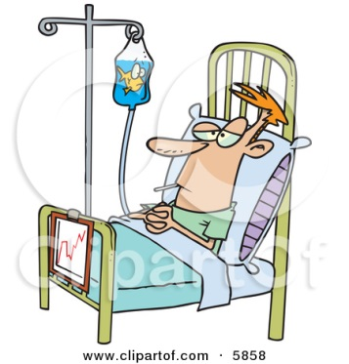
Process Map (Mess)

Slide 53
Tips to Help you Process Map
Process Start and End
Start = Decision to refer
End = Referral reconciled
Referral reconciled means:
Referral response received and recommendations are incorporated into the patient’s care in partnership with patient OR
Referral incomplete and next steps have been made in partnership with patient
Process Start and End
Start = Receipt of referral request
End = Referral Response sent
Referral Response can be :
Redirection to more appropriate specialist
Referral not needed or Answer to simple question without appointment
Notice of No Show or Cancel
Completed Referral with note

Slide 54
Tips to Help you Process Map
Map your process “as is”
Include those who actually “do” this process
With complex processes such as this one, consider multiple passes:
Who? Include handoff details
What?
Time parameters?
Documentation and notification parameters?
Patient involvement?

Slide 55
Commonly Encountered Issues
Different people may vary in how they do the job
There will likely be gaps in your process – resist the tendency to “fix” as you map
Standard parameters and policies may not exist
After mapping, staff become more aware of process flows. Allow for at least 3 days to “tweak”

Slide 56
Develop a P&P (Policy & Procedures)
Set a practice policy for referrals
Example primary care policy: “Our policy is to provide standardized referrals with a clear reason or question stated and attach the appropriate information so that our patients get the care they need efficiently, effectively and safely”
Example specialty policy: “Our policy is to provide high value, patient-centered referrals appropriate to the needs of the patient”
Design the Procedures the way you want it to work
See if it works
Make improvements/changes as needed to get it working well

Slide 57
Leave in action….
Perform a referral process walk-through (Process Map)
Identify gaps in “Critical Elements”
Subsequent Action Steps will provide assistance with filling gaps
Identify needed team members, roles & responsibilities
Develop a Policy & Procedure document (can be added to & tweaked as progress through the additional steps)

Slide 58
END

Slide 59
Process Mapping

Slide 60
Brief Process Mapping Demo

