Slide 1
Connecting Care Ensuring Quality Referrals and Effective Care Coordination
the Medical Neighborhood
Action Step #1
Get Your Own House in Order
ACP SAN special project
for implementing
High Value Care Coordination
Carol Greenlee MD FACP

Slide 2
Pain Points
REFERRALS
Often Create:
Chaos
Extra burden
Frustration
Confusion
Waste

Slide 3
As you listen…
Think about what actions you can take in your practice to eliminate the chaos & extra burden and improve the referral process and care coordination
For your patients
For the practice itself (for your staff & clinicians)
For reducing waste or unnecessary resource use

Slide 4
Outline
Why: The need for better coordinated & connected care
What: Recommendations and best practices for high value care coordination based on physician derived & developed principles and tool kits
How: Action steps to get you moving from disconnected to connected care
Working together is BETTER …for everyone

Slide 5
Case 1 (“Playing Charades”)
70 year old woman from town 2 hours away, doesn’t know why she was referred
No records
Only voice mail at referring practice
What to do?
What I did:
Glipizide, metformin, Levothyroxine on med list
Discussed diabetes and thyroid
Ordered A1c and TSH
Oops!
A1c and TSH results done 2 weeks prior were identical
Left adrenal mass on abdominal CT
60-70% of specialists reported receiving no information on referred patients
43% of specialists dissatisfied with the information they do receive

Slide 6
Case 2 (“wasted days & wasted nights”)
28 year old female had routine consultation appt booked with us by her PCP front office staff with cc/o “fatigue”
No records sent
3 month wait
Oops!
Referral was for suspected Lupus , she needed a Rheumatology consult, I’m an Endocrinologist….
Now a 5 month wait….
8% of Referrals are Inappropriate – to the wrong specialty or not necessary
(average 43 per specialist per year)

Slide 7
Case 3 (“Where’s the Beef?”)
59 yo man with T2DM, HTN, Hyperlipidemia & Obesity
referred to cardiology with unexplained DOE & question “is this ischemic?”
28 page note from the cardiologist
only ICD codes for impression
no indication of what the cardiologist thinks or is going to do or
what s/he recommends the PCP do or
what s/he told the patient to do…
25-50% of Primary Care clinicians
receive no information back after the referral appointment
~50% don’t know if patient ever saw the specialist
28% are dissatisfied with the information they do receive
More questions than answers

Slide 8
IOM 2001 Crossing the Quality Chasm “A highly fragmented delivery system”
[with]…“ poorly designed care processes characterized by unnecessary duplication of services and long waiting times and delays…
…physician groups, hospitals, and other health care organizations operate as silos,
often providing care without … complete information”
a ‘non-system’
disconnected care

Slide 9
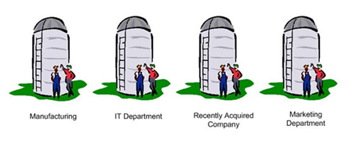
With a few exceptions, most practice in a silo, part of disconnected care
Silo Care / Disconnected Care is:
Not very patient centered
Not very cost effective
Not very satisfying & often burdensome on the back end

Slide 10
From Disconnected Care → High Value, Connected Care
Start with the END in mind:
Goal of Care Coordination: Ensure appropriate care for the individual
Uncoordinated care leads to inappropriate care: Duplicated testing / Unnecessary care
Wrong disorders addressed
Unmet needs
Conflicts with goals and comorbidities
Wasted patient time; wasted clinician time
Excessive burden on both patients & practices
Notes:
ALLYSON

Slide 11
From Disconnected Care → High Value, Connected Care
Start with the END in mind:
Goal of Care Coordination: To Benefit the Patient
Ensure appropriate, continuous connected care
Enhance the Quality of Care (6 domains)
Patient Centered Care
Safety
Effectiveness
Efficiency
Timeliness
Equity
Notes:
ALLYSON

Slide 12
From Disconnected Care → High Value, Connected Care
Start with the END in mind:
Goal of Care Coordination: To Benefit the Physician and Clinical Team
Working together/Cooperation
Increase effectiveness and safety
Increase satisfaction
Reduce stress, chaos and burden
Increase connectedness and part in the bigger picture
More enjoyment (JOY) in the work
…Connecting the Care, Sharing the Care
Notes:
ALLYSON

Slide 13
Care Coordination
Needs to be intentional
Needs a systematic approach
Needs to be part of taking care of the patient, not an afterthought
We need a SYSTEM instead of SILOS

Slide 14
We need a System instead of Silos
“Once we get to interoperability….”

Slide 15
Case 4 (“TMI-Overload”)
74 year old woman with cognitive impairment from Skilled Nursing Facility brought in by transport person
No records except MAR
SNF physician on the road
Look in the HIE….
94 pages of reports
Diabetes
Pituitary mass
Osteoporosis
But what’s the question?

Slide 16
Shared EHR does not solve all the referral/ care coordination problems
Care Coordination requires:
Information sharing (can even be done without EMR)
Adequate
Pertinent
Communication
With patient & family and the medical home team
With extended care team (e.g., clinical question)
Collaboration/Working Together
Standardization & expectations of referral procedures
Clarity in roles and responsibilities
Patient-centered approach
Contextual care: considering patient’s needs & circumstances
Shared goals and decision making

Slide 17
We need a SYSTEM for Communication, Collaboration & Care Coordination…..
Notes:
We need that system, we need a grid for c and cc

Slide 18
Outline
Why: The need for better coordinated & connected care
What: Recommendations and best practices for high value care coordination based on physician derived & developed principles and tool kits
How: Action steps to get you moving from disconnected to connected care
Working together is BETTER …for everyone

Slide 19
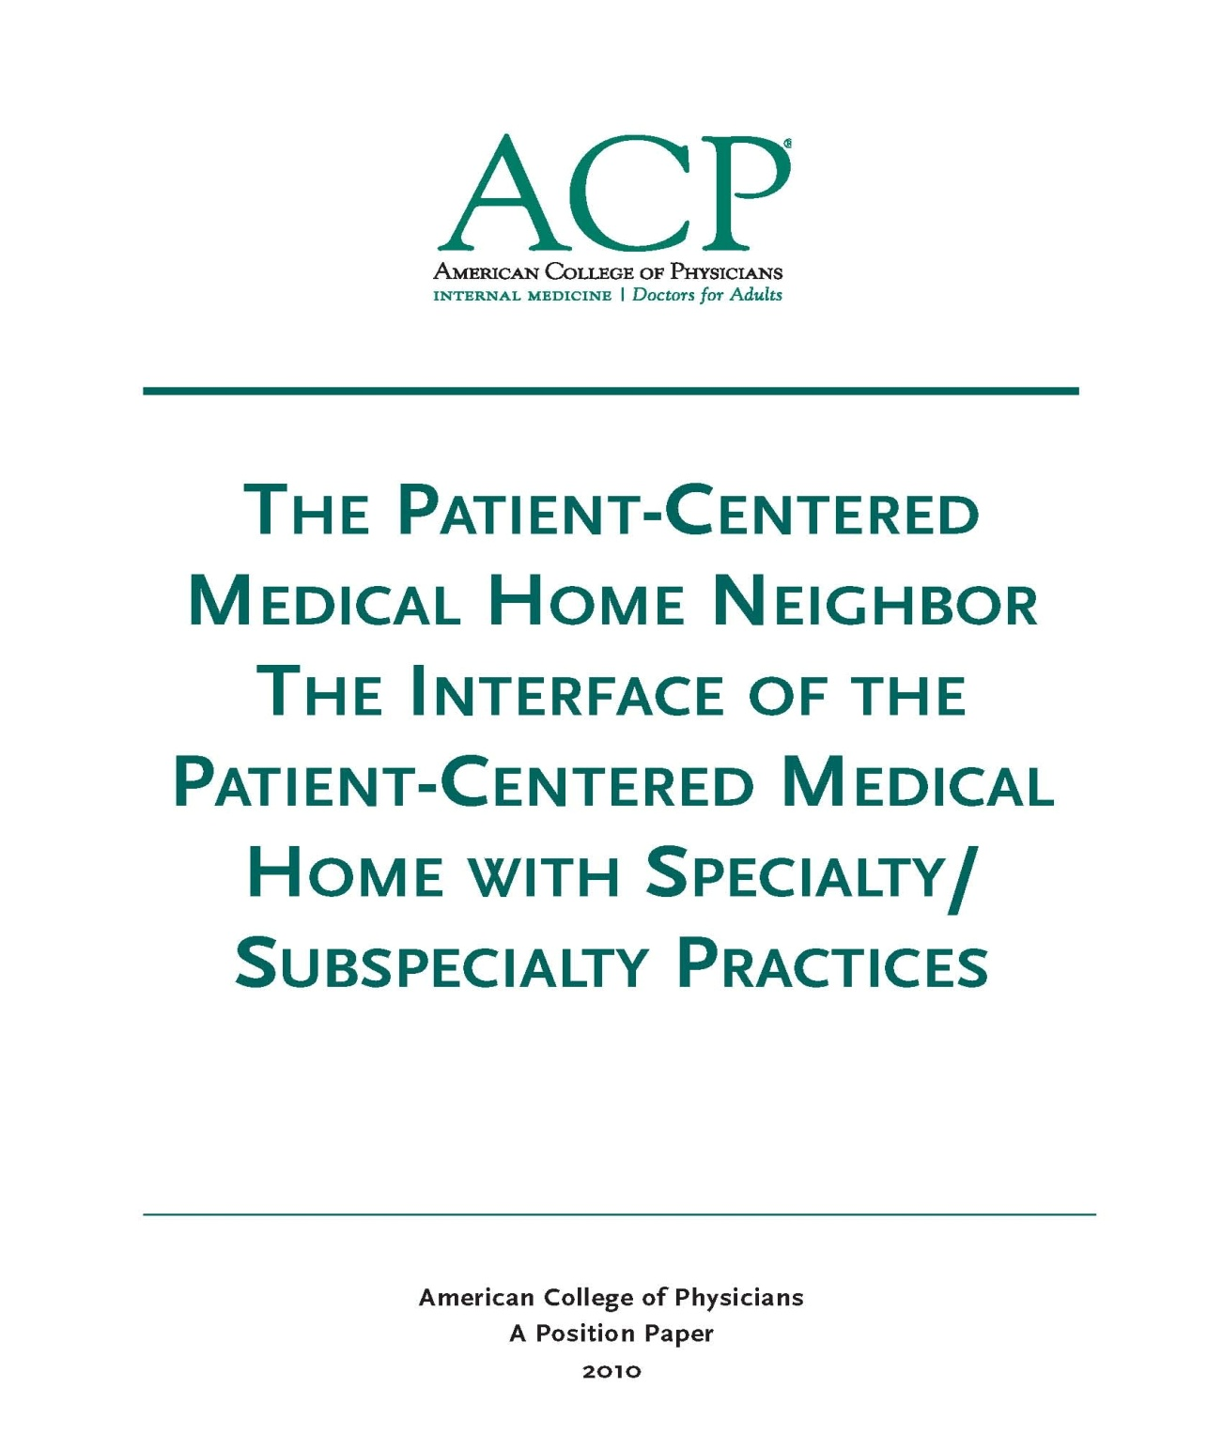
Care Coordination Best Practices and Tools
High Value Care Coordination Tool Kit
Designed & Tested by Practicing Clinicians
Specialty, Subspecialty and Primary Care
Along with Patient & Family Advocacy Organizations

Slide 20
The Medical Neighborhood October 2010
Medical Neighbor defined:
Communicates, collaborates & integrates
Appropriate & timely consultations
Effective flow of information
Responsible co-managing
Patient-centered care
Support medical home as hub of care
2010

Slide 21
Anticipated roles to meet patient needs
Pre-consultation/ pre-visit assistance
Cognitive Consultation
E-consult (virtual clinician-to-clinician)
Procedural Consultation
Shared care Co-management
virtual co-management
Principal Co-management

Slide 22
Pre-visit Advice / Pre-consultation
Intended to expedite/prioritize care
Previsit Advice
Does the patient need a referral
Which specialty is most appropriate
Recommendations for what preparation or when to refer
Previsit Review
Is the clinical question clear
Is the necessary data attached
Triage urgency (risk stratify the patient’s referral needs)
Urgent Cases
Expedite care
Improved hand-offs with less delay and improved safety

Slide 23
Take a minute …
How can defining the type of referral (role of the specialist) add to the value of the care ?
How can that role be communicated so that the patient as well as all involved clinicians are aware ?
How could having a “pre-consultation” process improve things for both the patient and the involved practices ?

Slide 24
We need a system for care coordination
High Value Care Coordination
Defining what is needed & expected for high value referrals and care coordination
The “Medical Neighborhood”
An approach to care coordination
It’s about working together better
Promotes connected care wherever that care may be needed

Slide 25
Patient-Centered Connected Care- The Patient’s Medical Neighborhood
The Patient is the center of care
Primary Care is the
necessary hub of care
Specialty/ancillary care is an extension of care
Helping with care to meet patient needs

Slide 26
What do you need to connect the care?
High Value Care Coordination
Information Sharing
Communication
Collaboration
Start with Check Lists for:
High Value Referral Request
High Value Referral Response
Notes:
So how do you get the care to be connected…we need

Slide 27
Expectations for High Value Referrals
Referral Request
Referral Response
Prepared Patient
Type of referral
Clinical question
Urgency
Core Data Set
Pertinent Data set
Answer the clinical question
What the specialist is going to do
What the patient is instructed to do
What does the referring physician need to do & when
What follow up is needed & with whom

Slide 28
Prepared Patient
Patient as partner in care
Patient included in the process
The patient’s needs & goals considered
Patient understand role of specialist and who to call for what
Pre-visit patient education regarding
the referral condition and/or
the type of and role of the specialist
Appropriate (patient-centered) “handoff”
Specialty practice alerted of any special needs of the patient
Appropriate specialist at appropriate time to meet the patient’s needs
Appropriate preparation with testing or therapeutic trials prior to referral
Notes:
The pt needs to be part of pt centered care

Slide 29
Take a minute …
How often are the patients prepared for the referral now (from perspective of both the requesting or receiving practices…and the patients)?
How do you ensure that the patient’s goals considered ?

Slide 30
A referral is part of taking care of the patient…meeting the needs of the patient
Collaboration is Critical
How do you get to collaboration ?

Slide 31
Make an Agreement….
Care Coordination Agreement
(Collaborative Care Agreement/Care Compacts)
Platform that everyone agrees to work from:
Standardized Definitions
Agreed upon expectations regarding communication and clinical responsibilities.
Can be formal or informal
Your policies and procedures should be aligned to support the agreement

Slide 32
What’s in the Care Compact ? (start with the basics)
Critical elements of the referral request
Critical elements of the referral response
Protocol for making appointments
“Closing the Loop” referral tracking protocol

Slide 33
Define the protocol for making appointments
the expected protocol:
the patient will call to schedule an appointment
the specialty practice should contact the patient
Allows for Pre-visit assessment/referral disposition
Allows for tracking of referrals / accountability

Slide 34
Referral Tracking “Closing the Loop” protocol
Referral request sent
Referral request received and reviewed
Referral accepted with confirmation of appointment date sent back to referring practitioner
Referral declined due to inappropriate referral (wrong specialist, etc) and referring practice notified
Patient defers making appt or cannot be reached and referring practice notified
Referral response sent (must address clinical question/reason for referral)
Referral Note sent to referring clinician and PCP in timely manner
Notification of No Show or Cancellation (with reason, if known)
Referrals made from one specialty to another (e.g. secondary referrals) include notification of the patient’s primary care clinician

Slide 35
Template Care Coordination Agreement
PCP/ Requesting
Neighbor/ Responding
Prepare patient
Use of referral guidelines where available
Patient/family aware of and in agreement with reason for referral, type of referral, and selection of specialist
Expectations for events and outcomes of referral
Provide appropriate and adequate information. (Optimally adopt mutually agreed upon referral form with neighbor*)
Demographic and insurance information
Reason for referral, details
Core Medical Data on patient
Clinical data pertinent to reason for referral
-- Any special needs of patient.
Indicate type of referral requested:
Pre-visit Preparation/Assistance
Consultation (Evaluate and Advise)
Procedure
Co-management with Shared Care
Co-management with Principal Care
Full responsibility for all patient care
* See provided model check list of suggested areas to address.
Review Referral Requests and Triage According to Urgency
Reserve spaces in schedule to allow for urgent care
Notify referring provider of recognized referral guidelines and inappropriate referrals
Work with referring provider to expedite care in urgent cases
Verify insurance status
Anticipate special needs of patient/family
-- Agree to engage in pre-referral consult if requested.
_ Provide PCP with number for direct contact for urgent/immediate matters.
Provide appropriate and adequate information in a timely manner. (Optimally adopt mutually agreed upon referral response form with PCP*)
To include specific response to referral question and any provision of or changes in type of recommended interaction; diagnosis; medication; equipment; testing; procedures; education; referrals; follow up recommendations or needed actions
* See provided model check list of suggested areas to address.
12

Slide 36
Take a minute …
How would having care coordination agreements make your life easier ?
Which practice or practices would you most like to work out a care coordination or referral agreement ?

Slide 37
Apply to All Referral Situations
Primary Care to Specialty Care (Radiology, Pathology and Hospital Medicine)
Specialty to Specialty
Specialty to Primary Care
Ancillary & other services (Diabetes Ed, Physical Therapy, Nutrition, etc.)
Agree to work together in the care of mutual patients

Slide 38
Outline
Why: The need for better coordinated & connected care
What: Recommendations and best practices for high value care coordination based on physician derived & developed principles and tool kits
How: Action steps to get you moving from disconnected to connected care
Working together is BETTER …for everyone

Slide 39
The ACP Support & Alignment Network High Value Care Coordination pilot project
Action Steps to Connected Care
Look at your internal referral process (get your own house in order)
Ensure you get what you need for a high value referral
Ensure the others gets what they need
Develop Care Coordination Agreement(s) (compact) with appropriate referring practice(s)

Slide 40
Action Steps to Connected Care
Look at your internal referral process (get your own house in order)
Perform a Walk-through / Process Map of the referral process within the practice
Identify any gaps in critical elements
Develop an Improvement Plan to close the gaps
Define who the team members are for the practice referral process
Develop a Policy & Procedures document for your practice team’s internal referral process (will be a work in progress)

Slide 41
It matters what you connect with…..
True Tales from the Trenches
“We had to fax the same records to the specialist 6 times”
“ I referred the patient for a shoulder injury but received a note back about his old knee injury”
“We sent the records, the front desk received the records but the specialist (physician) never saw them and had no idea why the patient was referred/prior work up
“The specialist said they didn’t have time to look at the records my PCP sent”
“We have no idea if the patient was ever seen or not”

Slide 42
To have connected care between practices, need to have connected care within practices
We often have silos within our silos
Need to develop Patient-centered team care (entire staff) around the referral process
Make it part of taking care of the patient
Work as a team to design improvements, test and implement
Intentional internal processes (Policy & Procedures)
Track the referrals and the process

Slide 43
Start with One Step at a time….
Get your own “house” in order
Start with a Process Map
Make it a team approach
Look for gaps (“opportunities”)in the referral process

Slide 44
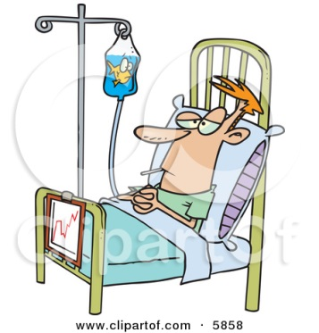
Process Map (Mess)

Slide 45
Tips to Help you Process Map
Requesting a Referral
Responding to a Referral
Process Start and End
Start = Decision to refer
End = Referral reconciled
Referral reconciled means:
Referral response received and recommendations are incorporated into the patient’s care in partnership with patient OR
Referral incomplete and next steps have been made in partnership with patient
Process Start and End
Start = Receipt of referral request
End = Referral Response sent
Referral Response can be :
Redirection to more appropriate specialist
Referral not needed or Answer to simple question without appointment
Notice of No Show or Cancel
Completed Referral with note

Slide 46
Tips to Help you Process Map
Map your process “as is”
resist the tendency to “fix” as you map
Include those who actually “do” this process
Different people may vary in how they do the job
With complex processes such as this one, consider multiple passes, allow time to revisit & tweak
Include:
Who? Include handoff details, Patient involvement
What? Time parameters? Documentation and notification parameters?

Slide 47
Develop a P&P (Policy & Procedures)
Set a practice policy for referrals
Example primary care policy: “Our policy is to provide standardized referrals with a clear reason or question stated and attach the appropriate information so that our patients get the care they need efficiently, effectively and safely”
Example specialty policy: “Our policy is to provide high value, patient-centered referrals appropriate to the needs of the patient”
Design the Procedures the way you want it to work
See if it works
Make improvements/changes as needed to get it working well

Slide 48
Leave in action….
Perform a referral process walk-through (Process Map)
Identify gaps in “Critical Elements”
Subsequent Action Steps will provide assistance with filling gaps
Identify needed team members, roles & responsibilities for your practice referral process
Develop a Policy & Procedure document (can be added to & tweaked as progress through the additional steps)

Slide 49
For Additional Information
Forms and other material relevant to this training can be found at:
www.acponline.org\hvcc-training

