Slide 1
Connecting Care Ensuring Quality Referrals and Effective Care Coordination
the Medical Neighborhood
Action Step #2:
Ensure you get what you need for a high value referral
ACP SAN special project
for implementing
High Value Care Coordination
Carol Greenlee MD FACP

Slide 2
Action Steps to Connected Care
Look at your internal referral process (get your own house in order)
Ensure you get what you need for a high value referral
Ensure others get what they need
Develop Care Coordination Agreement(s) (compact) with appropriate referring practice(s)
Three (3) Action Items to Establish:
Basic Elements of a Referral Request
Referral Criteria/ Guidelines
Risk Stratify Urgency
Pertinent Data Set (Referral Guidelines)

Slide 3
1st Define the Basic Elements of the Referral Request
Check list for a high value Referral Request
Patient Demographics & Scheduling Information
Referral Information
Patient’s Core Data Set
Care Coordination/Referral Tracking

Slide 4
Referral Information
What is the specific clinical question (reason for referral)
A brief Summary of case details pertinent to the referral, include relevant co-morbidities (alarm signs or symptoms)
Urgency (referral status or referral priority)
Referral Type (anticipated, pending specialist’s evaluation) (Referral Definition or Role in care requested of the specialist)
Pertinent data set: Clinical information directly relevant to the specific referral question (office notes, test results, etc.) (Supporting data for the referral)

Slide 5
2nd Establish Referral Criteria / Guidelines
Timing of the referral request and appointment
urgency or priority for scheduling expectations - urgent, intermediate/move up and routine (“risk stratification of the referral needs”)
Supporting data needed for the particular referral condition
“pertinent data sets” / referral guidelines for referral conditions

Slide 6
Action Steps to Connected Care
Look at your internal referral process (get your own house in order)
Ensure you get what you need for a high value referral
Ensure others get what they need
Develop Care Coordination Agreement(s) (compact) with appropriate referring practice(s)
Three (3) Action Items to Establish:
Basic Elements of a Referral Request
Referral Criteria/ Guidelines
Risk Stratify Urgency
Pertinent Data Set (Referral Guidelines)
Pre-consultation/ Pre-visit review process

Slide 7
Connecting Care Ensuring Quality Referrals and Effective Care Coordination
the Medical Neighborhood
Delmarva Webinar 3 (action step 2, segment 3)
Establish a Pre-consultation Process
ACP SAN special project
for implementing
High Value Care Coordination
Carol Greenlee MD FACP

Slide 8
As you listen…
Think about how investing in a Pre-consultation (Pre-visit review and assistance) process could
make the referral process more patient-centered
at the same time save time & effort (resources) for the practice.
Think about how you can “re-organize” for a Pre-consultation process with pre-visit preparation & assistance to replace chaos at time of appointment & the back-end burden

Slide 9
Antithesis of High Value Coordinated Care:
Common scenario #1:
60 yo woman was referred to surgeon Dr. Z by another specialist for a procedure. After a 3 month wait for the appointment, Surgeon Z. read her records as he walked in the room saying “I don’t do that procedure. You will need to go to XXX Clinic to get that done”.
Waste:
Delay: Progression of condition, harm
Non-value-added appointment for all in involved

Slide 10
Antithesis of High Value Coordinated Care:
Common scenario #2:
70 year old woman does not know why she was referred, PCP staff just told her to make appt, no records, only get into voice mail at PCP office
Waste:
Resources (duplicated testing, visit costs, time)
Access “jammed up” (delay of care…downstream effects)

Slide 11
Pre-consultation to the rescue !

Slide 12
What is Pre-consultation?
A request for pre-visit advice and/ or assistance
Should not require in-depth analysis of the case
Can result in no need for further assessment or management
Can “evolve” into an e-consult or face-to-face appointment
A process of pre-visit review
To ensure appropriateness of the referral
To ensure adequacy of the referral information
To provide advice or assistance as needed for preparation for the referral appointment and interim care
Additional testing
Therapeutic trial
Interim care to stabilize while waiting for specialty care

Slide 13
Pre-consultation Request for Pre-visit Advice and/or Assistance
Pre-visit preparation or assistance can take place before any type of formal referral & can include:
request for guidance regarding whether referral is appropriate and/or necessary
Request for guidance on the urgency of the referral
Request for guidance for pre-visit work-up.
Through these interactions, patient care is optimized and cooperation & an educational process around that care occurs between the practices –

Slide 14
I am referring this patient for:
___Pre-consultation/ pre-visit assistance/preparation
___Medical Consultation: Evaluate and advise with recommendations for management and send back to me
___Procedural Consultation: Specialist to confirm need for and perform requested procedure if deemed appropriate.
___Co-management: I prefer to share the care for the referred condition (PCP lead, first call)
___Co-management: Please assume principal care for the referred condition: (Specialist assumes care, first call)
___Please assume full responsibility for the care of this patient (Complete transfer of care)

Slide 15
Examples of Pre-consultation requests:
Are these slightly abnormal thyroid function studies of concern? Do they need further evaluation?
If so, what additional testing do you want before the appointment
For referral to Nephrology for new patient evaluation for renal dysfunction, patient has had an Abdominal CT scan,
Does patient still need Renal US before you will schedule?
Receive photo of skin lesion with referral “rule out melanoma”
Review by dermatology identifies it as benign (e.g. seborrheic keratosis); requesting practice notified & patient receives reassurance (no dermatology appointment needed)

Slide 16
Response to a Pre-consultation Request
Clinician involvement is critical
Can indicate
No need for further assessment or treatment
Need for a different specialty type
Need for additional testing or therapeutic trial prior to referral
Need for formal referral appointment
Simple issues amenable to recommendations per “e-consult” (virtual consultation clinician-to-clinician)
Can send response by faxed note (or even phone call) if shared or interoperable EMR is not available

Slide 17
Pre-consultation Review (“working the referral”)
Recommended for all referral requests
Review prior to scheduling patient
To ensure appropriate referral
Determine urgency of the referral
Ensure adequate information for high value referral
Can be a team process (with clinician oversight & availability)
Use of referral request checklist
Use of lists of urgent-intermediate-routine conditions
Use of referral guidelines/ pertinent data sets
Clinician review of outlier or complex cases

Slide 18
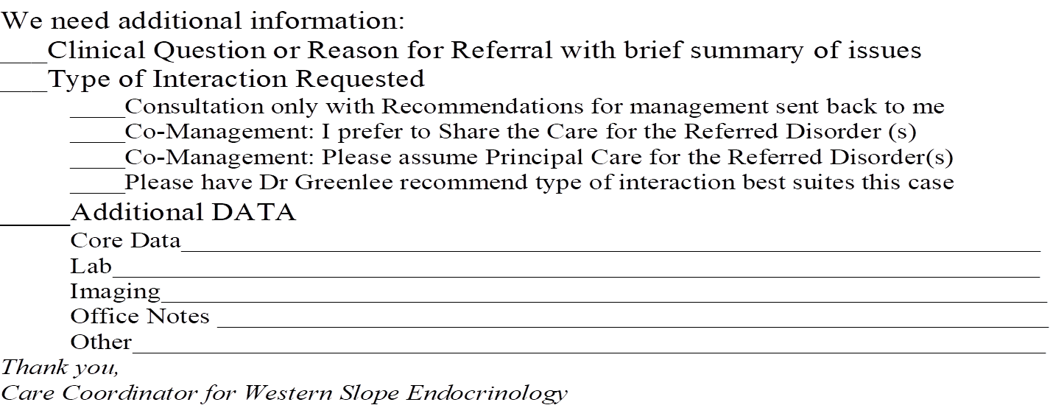
How do you request missing information?
Phone call to requesting practice
Forms
Tracking system to ensure receive
It’s worth the investment in
time & effort up front to
prevent the chaos & disruption
and back-end mess & burden

Slide 19
Pre-consultation/ Pre-visit Review Check-list
Identify if referral is to appropriate specialty
If referred condition is better managed by a different specialty:
what process do you use to redirect the referral?
Who notifies the patient?
Identify if referral appointment is needed (indicated)
If further evaluation or management is not indicated
Explain why not indicated (e.g. thyroid nodule guidelines or ….)
Answer simple question that does not require formal consultation (e.g. “this does not require any treatment”)
Who notifies & explains to patient?
Need to know that referring practice has process for handling

Slide 20
Pre-consultation/ Pre-visit Review Check-list
Are the referral request elements complete?
Is the clinical question clear
Is there adequate & pertinent supporting data (pertinent date set)
Is the Core Medical Data set included
What is the urgency (risk stratification) of the referral needs?
Is the patient scheduled according to those needs

Slide 21
Pre-consultation/ Pre-visit Review
Improves value of appointment for patients
Creates more time for interaction with the patient around the reason for referral or the clinical question
Improves resource utilization by both requesting & responding practices
Reduces stress and increases cooperation around caring for the patient
Improves access
Improves safety
Reduces waste

Slide 22
Antithesis of High Value Coordinated Care:
Common scenario #1:
60 yo woman was referred to surgeon Dr. Z by another specialist for a procedure. After a 3 month wait for the appointment, Surgeon Z. read her records as he walked in the room saying “I don’t do that procedure. You will need to go to XXX Clinic to get that done”.
This patient (and clinician) would have benefited from a
Pre-consultation Request “Do you do this procedure?”
Or at least a Pre-consultation review to catch the inappropriate referral

Slide 23
Antithesis of High Value Coordinated Care:
Common scenario #2:
70 year old woman does not know why she was referred, PCP staff just told her to make appt, no records, only get into voice mail at PCP office
This patient (and clinician) would have benefited from a Pre-consultation Review to request the missing clinical question and supporting data

Slide 24
Put it into action….
For Primary Care
Consider a Pre-consultation Request for patients you need guidance on preparation for referral or if not sure about need for referral, type of specialty or timing
For Specialty Care
As you develop your Pre-consultation review process
Use the Referral Request checklist
Use the urgency / priority lists
Use the Pertinent Data Sets / Referral guidelines

Slide 25
Leave in action….
For Primary Care
Use Pre-consultation Requests to ensure high value referral requests
For Specialty Care
Develop a Pre-consultation process & checklist
For responding to Pre-consultation Requests
For doing Pre-consultation Reviews of all referral requests

Slide 26
www.acponline.org/hvcc-training
Pre-consultation Review process checklist

