Slide 1
I Cannot Be What I Cannot See: Time To Unleash A JEDI Healthcare Environment
Darilyn V. Moyer MD, MACP, FRCP, FIDSA, FAMWA, FEFIM
EVP/CEO American College of Physicians

Slide 2


Slide 3


Slide 4
Disclosures
I am a full time employee at the American College of Physicians
I am an Adjunct Professor of Medicine at the Lewis Katz School of Medicine at Temple University
I have no financial or IP conflicts to disclose
Many thanks to my physician colleagues and society/organizational staff for sharing content used in this presentation

Slide 5
Educational Objectives
Review data germane to women in medicine including compensation and advancement
Define specific obstacles to achieving equity at the micro and macro level
Describe potential actionable interventions to work towards achieving equity at the micro and macro levels, not just for women, but for all underrepresented groups in healthcare

Slide 6

Not A Zero Sum Game…

Slide 7
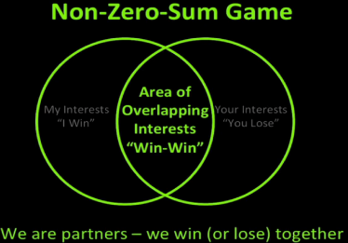
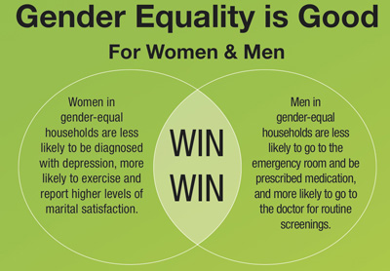
Gender Equity
Improves
Productivity
Creativity
Communication
Employment
Job satisfaction
Work engagement
Policy development

Slide 8
Dr. Carlos del Rio on the Need For Men To Get Engaged…
"Over the past 40 years medical schools have achieved gender parity at the student level, but women physicians continue to remain underrepresented in the higher ranks of academic medicine and in healthcare leadership positions. Today women represent an unaccountably small proportion of full professors, department chairs, and deans. Shattering this glass ceiling is an urgent priority and we cannot expect women to do it by themselves. As men we need to work side-by-side with women colleagues pushing for gender equity. This is not only the right thing to do it is also the smart thing to do."
Carlos del Rio, MD, FIDSA, Distinguished Professor for Emory Clinical and Academic Affairs at Grady, Professor of Medicine, Executive Associate Dean for Emory at Grady, Emory University School of Medicine, Professor of Global Health and Epidemiology, Rollins School of Public Health

Slide 9
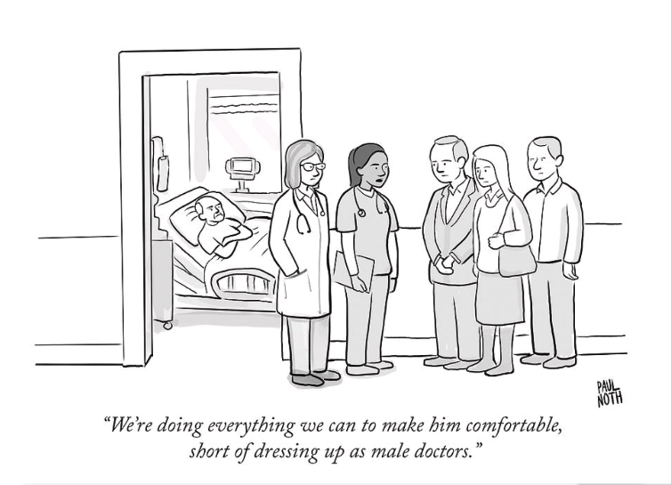
By Paul North
The New Yorker

Slide 10
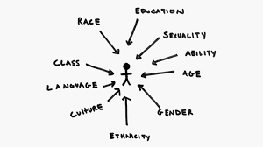
The Crowded Intersection…

Slide 11
After Controlling For All Possible Factors…

Slide 12
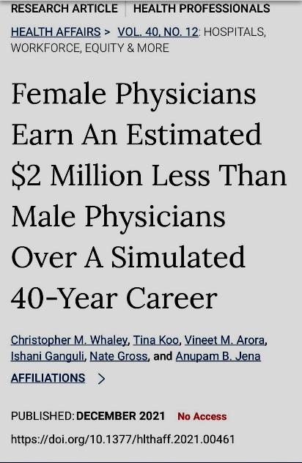

Slide 13
Compensation Disparities By Gender In Internal Medicine, Read et al, Annals of Internal Medicine, 11/18
Married/Partnered vs. Not Married/Partnered: The salary for men was $50,000 higher than for women when physicians were married/partnered, and $52,500 higher when physicians were not married/partnered.
Currently Married or Partnered | Women (n = 120) | Men (n = 254)
Yes | 82% | 92%
Median salary (IQR), $ | 200,000 (169,500 – 250,000) | 250,000 (200,000 – 300,000)
No | 18% | 8%
Median salary (IQR), $ | 197,500 (165,750 – 223,250) | 250,000 (206,250 – 315,000)

Slide 14
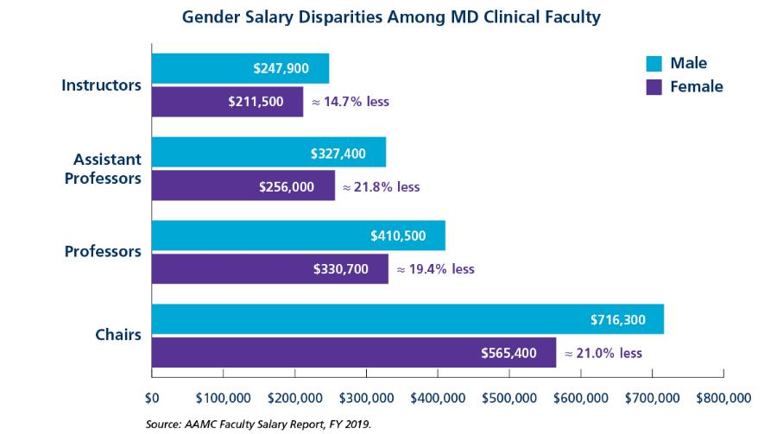
2019 AAMC Faculty Salary Data

Slide 15
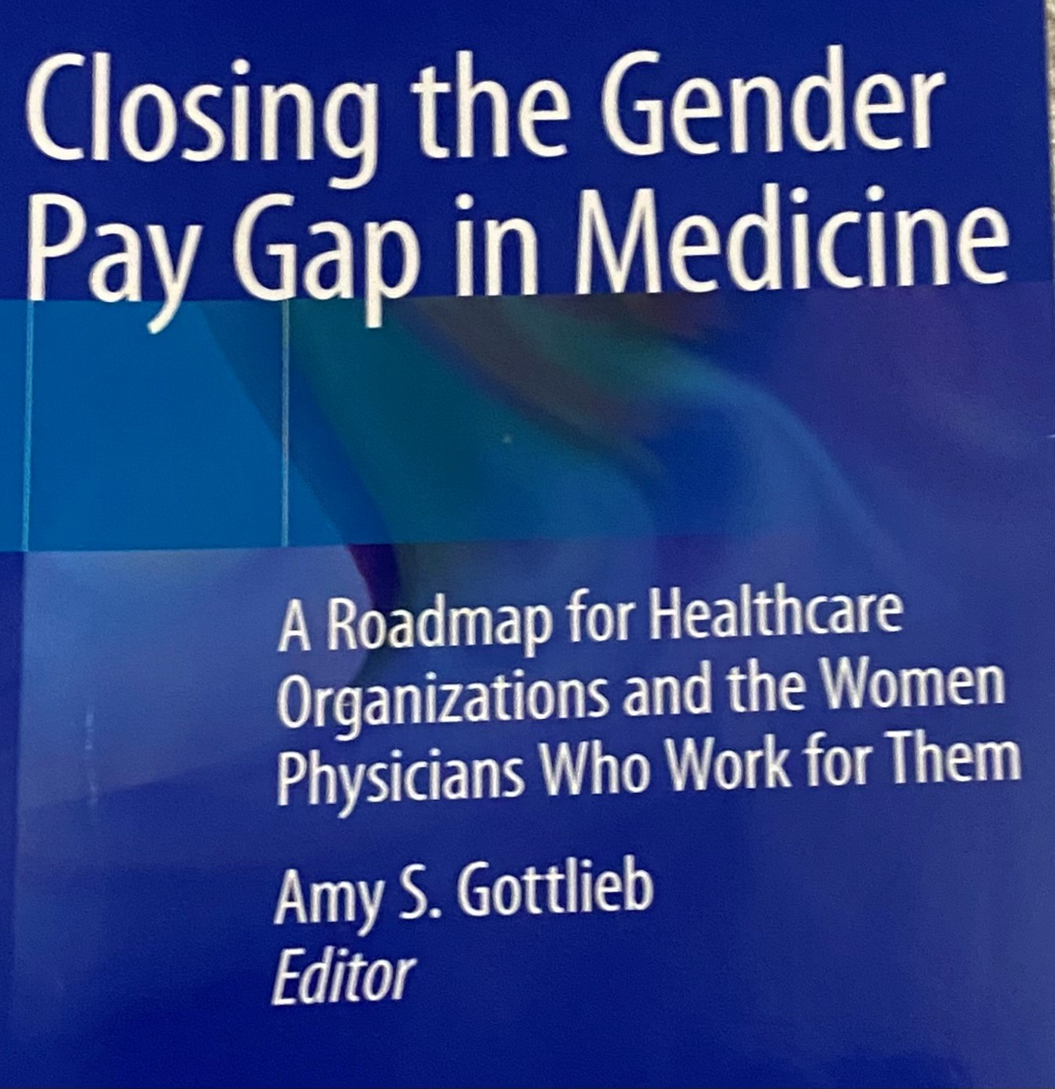

Slide 16
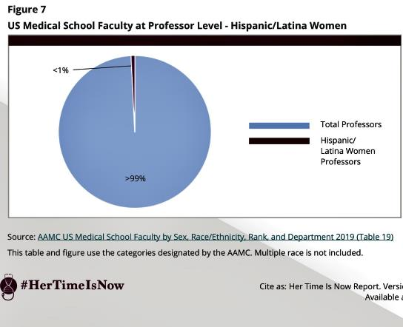
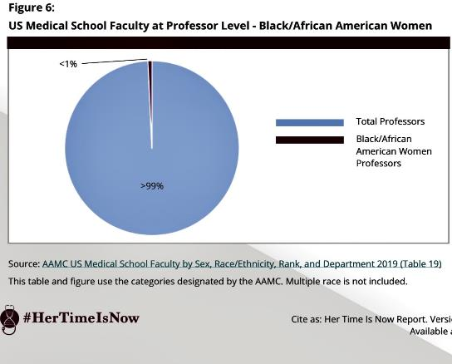
The Inexorable Zero of US Medical School Faculty- #HerTimeIsNow, Julie Silver, 9/20, www.hertimeisnow.org

Slide 17
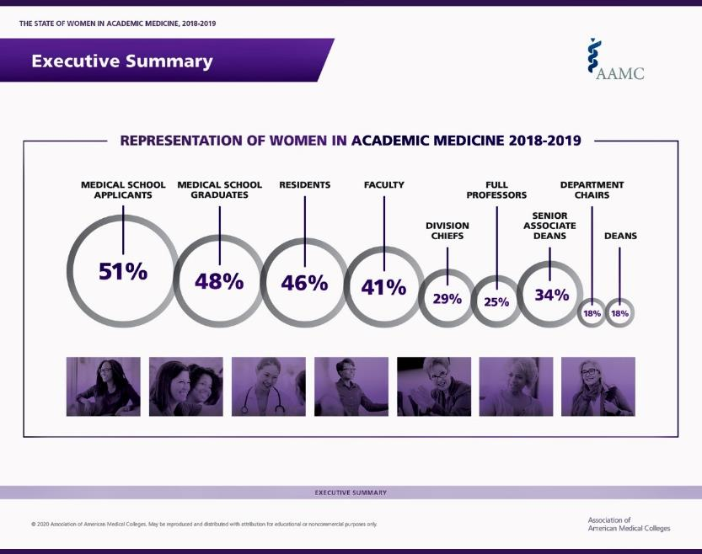

Slide 18
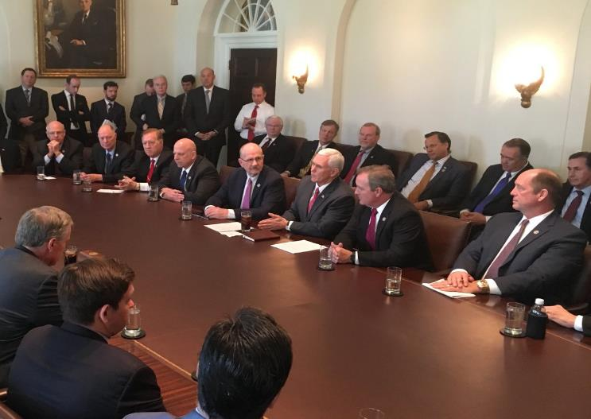
Where Are The Women and Non-White Folks?

Slide 19


Slide 20
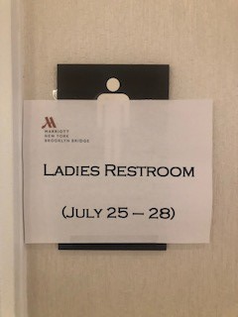

Slide 21
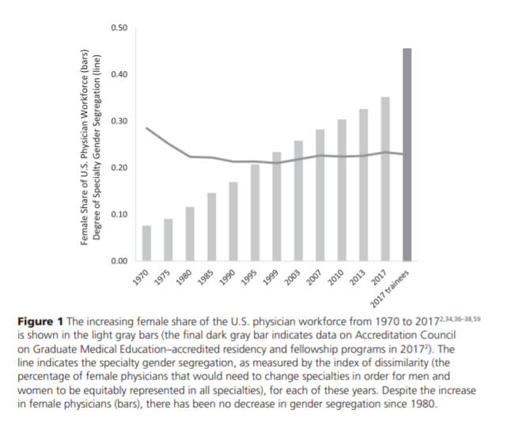
Occupational Gender Segregation- While number of women physicians increased, gender segregation unchanged
“Trainees continue to distribute into the specialties in ways that reinforce, rather than mitigate, pre-existing gender imbalances”
Elaine Pelley, Molly Carnes: Academic Medicine, Vol. 95, No. 10 / October 2020

Slide 22
#HerTimeIsNow 2020: Dr. Quinn Capers states…
Academic medicine should be a meritocracy. It isn't. Even if we ignore the preliminary data that, in some circumstances, women physicians have been shown to outperform men in terms of following evidence-based guidelines, there is no rational explanation for why so many brilliant women are underpaid and underpromoted in academia. When institutional bias and racism are layered on top of gender disparities, it becomes a feat of heroic proportions for women of color to advance to the highest levels of medicine. Cities are burning, and the world is crying out for an end to racism and oppression on any basis. Academic medicine can heed this call by dismantling processes that frustrate her ability to thrive, grow, and lead. For the sake of our patients, #HerTimeIsNow."

Slide 23
A Strong Signal On Quality of Care of Women and URiM Physicians
Women and URiM physicians are more likely to follow EBM Clinical Guidelines and provide care for underserved patients
Women physicians are more likely to provide patient-centered communication and health counseling, compared to male physicians
Patients with female practitioners were more likely to receive guideline-recommended treatment for heart failure and diabetes, and may have better clinical outcomes
Compared with majority group physicians, URiM physicians are more likely to care for the underserved, Medicaid, and poor patients
URM patients are more likely to consent to both preventive and health services if the recommending physician is also a URM
Wallis, et al,JAMA Surg 12/21- Disparate outcomes for female patients with male vs. female surgeons in post-op outcomes, complications, death

Slide 24
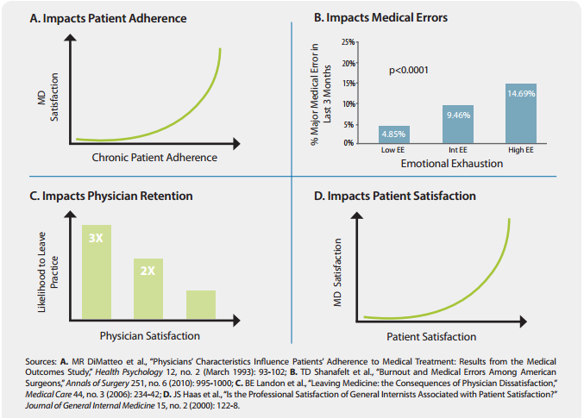

Slide 25
Covid-related Work Stress and Work intentions in a Sample of U.S. HCPs, Linzer et al, MayoClinicProc, 12/21
Survey of HCPs 7/1-12/31/20
20,665 respondents (response rate 34%) at 124 U.S. institutions surveyed for fear of viral exposure or transmission, COVID-19erelated anxiety or depression, work overload, burnout, and intentions to reduce hours or leave their jobs
Intention to reduce hours was highest among nurses (33.7%; n=776), physicians (31.4%; n=2914), and advanced practice providers (APPs; 28.9%; n=608) while lowest among clerical staff (13.6%; n=242) and administrators (6.8%; n=50)
Approximately 1 in 3 physicians, APPs, and nurses surveyed intend to reduce work hours. One in 5 physicians and 2 in 5 nurses intend to leave their practice altogether
Reducing burnout and improving a sense of feeling valued may allow health care organizations to better maintain their workforce

Slide 26
Linzer, et al, continued
Burnout in physicians is associated with higher rates of intention to reduce clinical effort, leave current practice, or leave medicine altogether
Longitudinal studies have found that burnout among physicians is associated with 1.5 to 2 times the likelihood of leaving an organization within 2 years
It is estimated that turnover and reduced clinical hours due to physician burnout in the United States cost $4.6 billion annually
Nurses with symptoms of burnout have been found to have greater absenteeism and poor work performance
Stressful work environments and burnout are among the top reasons nurses give for leaving their jobs

Slide 27
Gendered Expectations: Do They Contribute To High Burnout Among Female Physicians?
Female physicians have more female patients, and more patients with social complexity
Up to a 60% excess in burnout in female vs. male physicians
Differing expectations in empathy, listening time, decisiveness which have implications for patient evaluations
Possible solutions- adjusting for patient gender in compensation plans, education, co-locating behavioral medicine specialists, adjusting visit times
Ganguli et al, NEJM, 10/20, showed female PCPs generated less revenue than male colleagues due to lower visit volume, yet spent more time in direct patient care per visit, per day, and per year
- Linzer et al, JGIM online, 2/18

Slide 28
If You Build It, Will They Show Up?
A Case Study From CV Fellowship At Duke

Slide 29
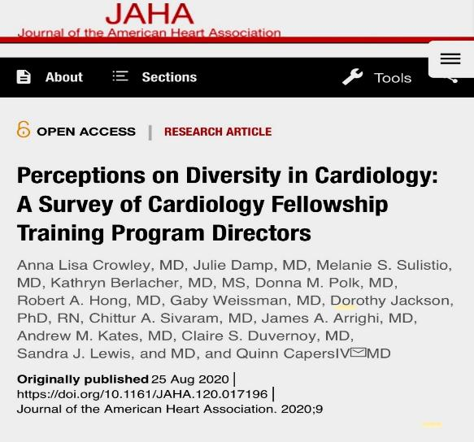
I Cannot Be What I Cannot See…

Slide 30
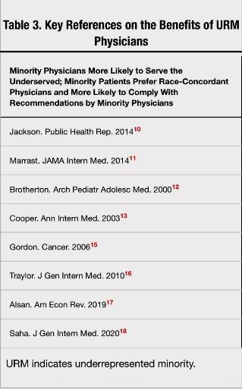
It’s About the Patients…How Patient-Physician Racial and/or Gender Congruity Leads To Better Outcomes

Slide 31
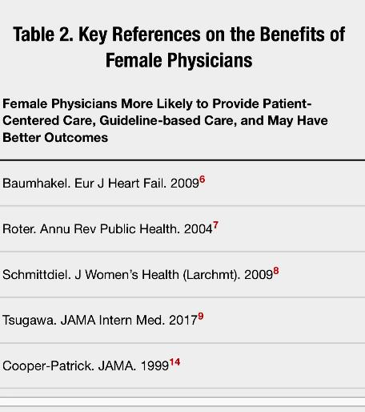
It’s About the Patients…How Patient-Physician Racial and/or Gender Congruity Leads To Better Outcomes

Slide 32
In Order To Know Where You Need To Go…Know Where You Are:
In 2015, 6% of Cardiology Fellows self IDed as URiM, 11.6% in 2018
In the 2015 U.S. population, 17.6% Hispanic, 13.3% black, 1.2% Native American
12 question survey by the ACC CV Training Committee, administered in 2016
110/193 programs represented: 84% said URiM were underrepresented at their institution

Slide 33
Capers et al, JAHA, 8/2020
69% believed that the following statement was true: “Diversity is the driver of excellence in the healthcare setting”, 31% are uncertain or do not believe the statement
63% chose “our program is diverse already so diversity does not need to be increased”
37% want to increase diversity, but only 6% listed “diversity” as a top 3 priority when creating fellowship rank lists, and < ½ had a plan to increase diversity
Clinical skills/acumen, ability to “fit in/team player”, research productivity are the top 3 priorities of CV fellowship ranking

Slide 34
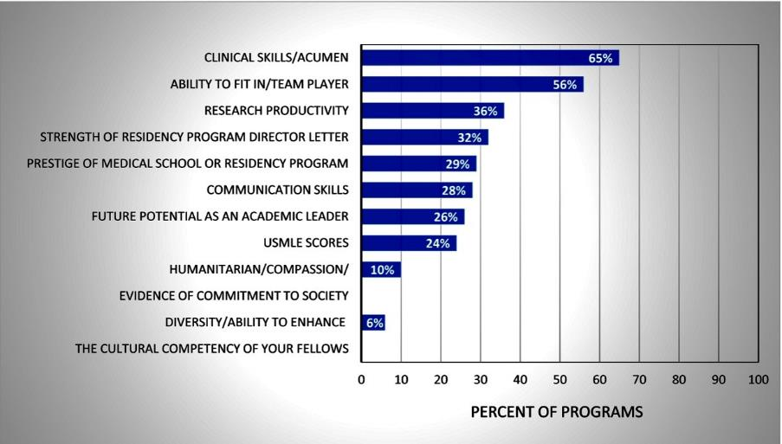
Survey of CV Training Programs-Fellowship Ranking Criteria

Slide 35
So How Do We Get To A Better Place? GME Example from Duke
Evaluation of Women and UREG Representation in a General Cardiology Fellowship After a Systematic Recruitment Initiative, Rymer et al, JAMA Network Open, 1/21
Multipronged initiative 2015-19 that started with a CV Fellowship Diversity and Inclusivity TF which drafted recommendations including fellowship recruiting committee reorg, changes to fellowship applicant screening process, interview day, applicant ranking process, and post match interventions
5 Domains- Diversity as a priority, seeking out candidates, implementing inclusive recruitment practices, investing in trainee success, building the pathway/pipeline
Post intervention, 25% increase in applications, interviewed applicants went from 20% to 35% women, 14% to 20% UREG
Matriculated fellows (5 yr mean) went from 27% to 54% women, 6% to 33% UREG, and overall women and/or UREG, 28% to 67% with no significant changes nationally during intervention period

Slide 36
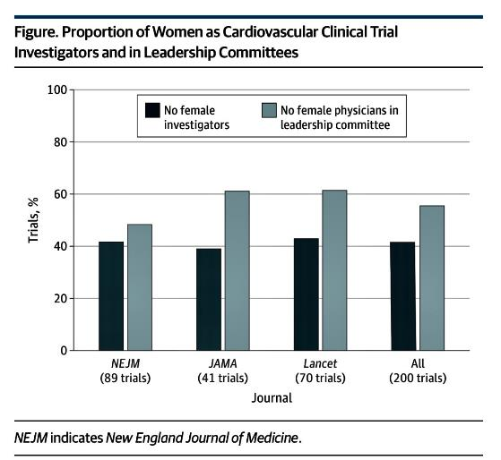
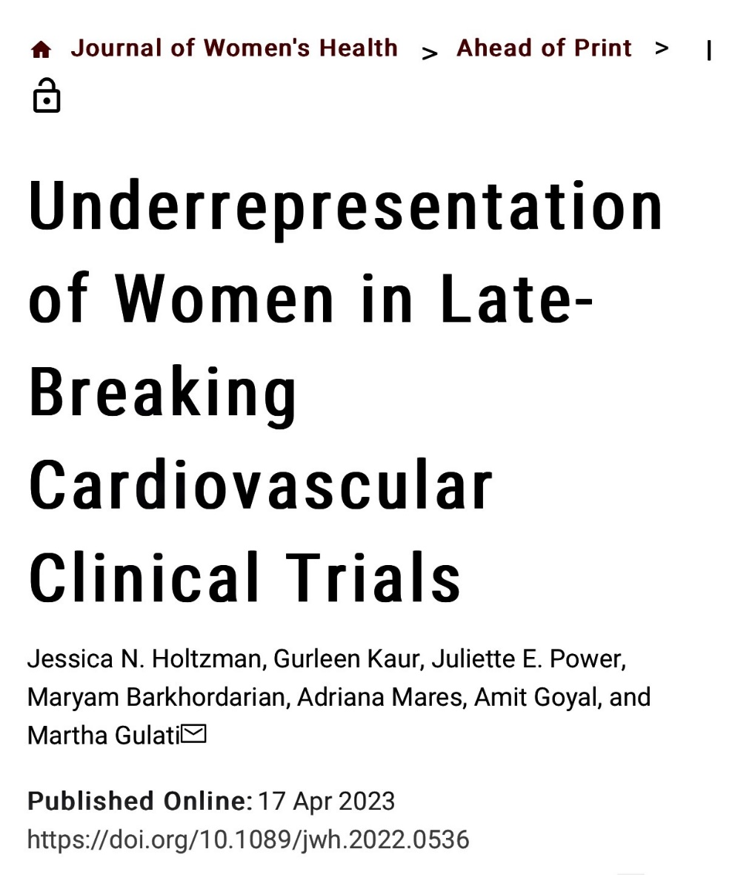
I Cannot Be What I Cannot See…Silver, Walsh, Cho et al, JAMA IM 8/20

Slide 37
Building Bridges Over Troubled Pathways For URiM Groups… Campbell et al JAMA Network Open 8/20
Blacks comprise ~13% of the U.S. popn only 5% of physicians and < 7% of recent med school grads
4/13 HB Med Schools remained open after 1910 Flexner report
Extrapolation of data from schools that remained open
5 of the closed med schools might have collectively provided training to an additional 35.5K graduates by 2019, ~29% increase in black physicians in 2019
None of the 30 new medical schools opened since 2000 and associated with AAMC were located at HBCUs, and none specifically focused on health disparities
Cherokee Nation and Oklahoma State University established the OSU School of Osteopathic Medicine at the Cherokee Nation
Physicians from HB med schools disproportionately pursued clinical practice, research, and advocacy that target the needs of medically underserved communities
Need to review all opportunities including education beginning in preschool, access to SES resources/reduction of debt burden, address coaching, mentorship, sponsorship opportunities

Slide 38
On The Important Role of Medical Societies and Academic Journals…
For too long, the leadership of women in medicine has been limited by structural barriers. The partnership of institutions, medical societies, and academic journals will be a pivotal step in ensuring systematic change that addresses gender equity within the full context of diversity, equity, and inclusion."
Eliza Lo Chin, MD, MPH, FACP, FAMWA, Executive Director, American Medical Women's Association

Slide 39
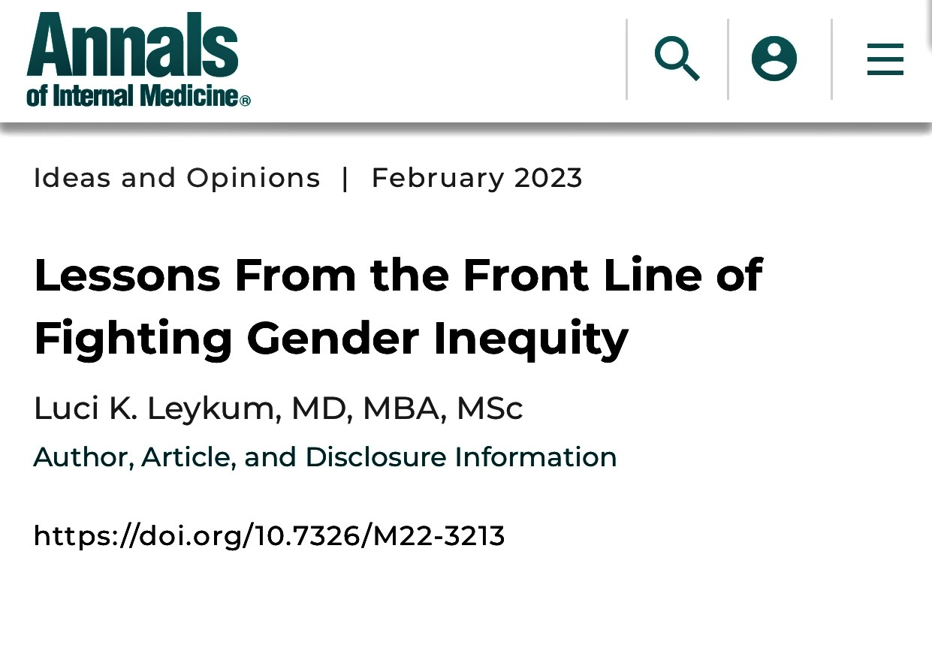
ACP’s Journal Annals of Internal Medicine Leads The Way ….
Editor In Chief- Dr. Christine Laine
Deputy Editors- 3 women FTEs, 1.5 FTE men
Associate Editors- 7 Women, 13 men
Annals Editorial Board- 8 women, 7 men
Publication Committee- 9 women, 8 men

Slide 40

I Grew Up Poor and a First Generation College Graduate…

Slide 41
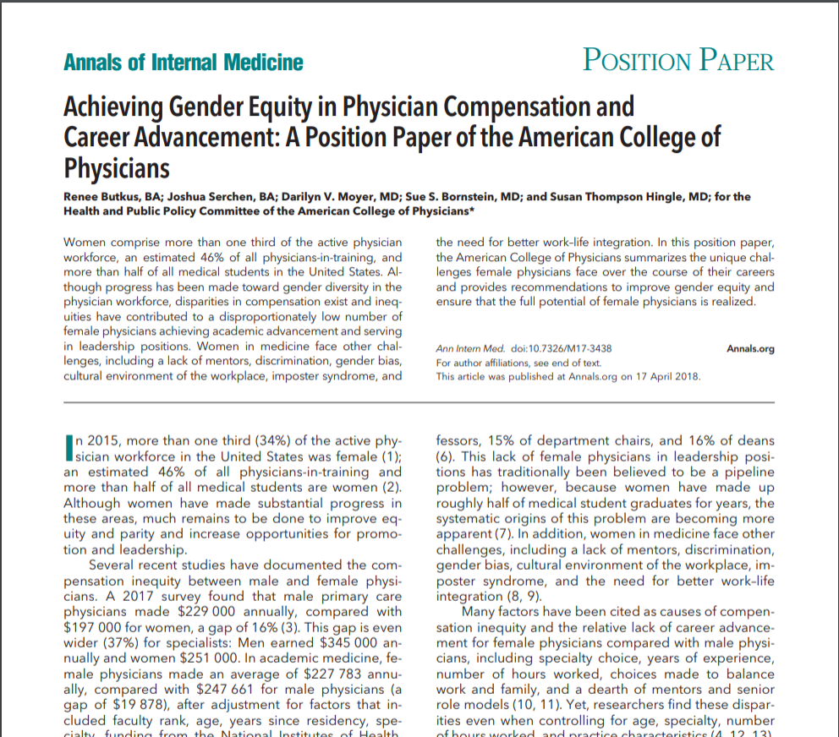

Slide 42
Achieving Gender Equity in Physician Compensation and Career Advancement
Physician compensation
Family and medical leave
Leadership development
Unconscious bias training
Research on gender inequity
Oppose harassment, discrimination, and retaliation
Butkus R, Serchen J, Moyer DV, Bornstein SS, Hingle ST, for the Health and Public Policy Committee of the American College of Physicians. Achieving Gender Equity in Physician Compensation and Career Advancement: A Position Paper of the American College of Physicians. Ann Intern Med. ;168:721–723. doi: 10.7326/M17-3438

Slide 43
ACP Issues Organizational Commitment to be Anti-Racist, Diverse, Equitable, and Inclusive
ACP made an organizational commitment to being an anti-racist organization dedicated to policy, advocacy and action to confront and eliminate racism, racial disparities, discrimination, bias and inequities in health and health care and within its own organization.
ACP strives to embody a diverse, inclusive and equitable organization that facilitates effective and respectful interaction among individuals who hold a broad range of views, and respect, empathy and understanding of others.
ACP is studying, listening, and developing evidence-based solutions to create an equitable and inclusive organizational culture, and to guide its interactions with members, staff, and others.
Visit ACP’s Diversity, Equity and Inclusion page at: https://www.acponline.org/dei
Notes:
Through these updates, ACP hopes to reinforce its intent to welcome, consider, and respect the many diverse voices of internal medicine and its subspecialties. In addition, the updated Core Values emphasize that ACP's actions will reflect its embrace of diversity and inclusion to foster engagement, belonging, and respect, resulting in facilitation of a just and equitable culture.

Slide 44

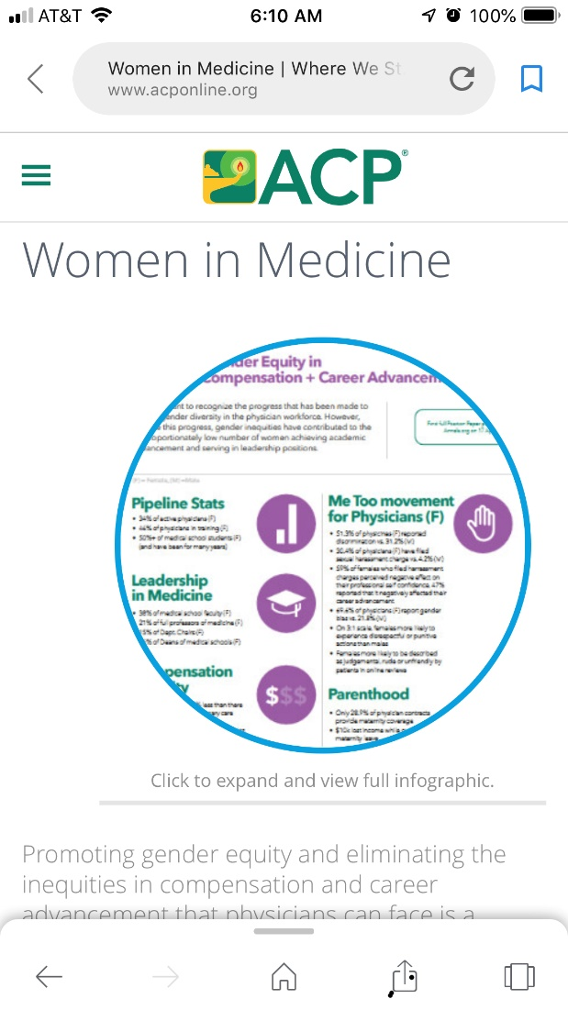
Free Resources To Make ACP Policy Live…

Slide 45
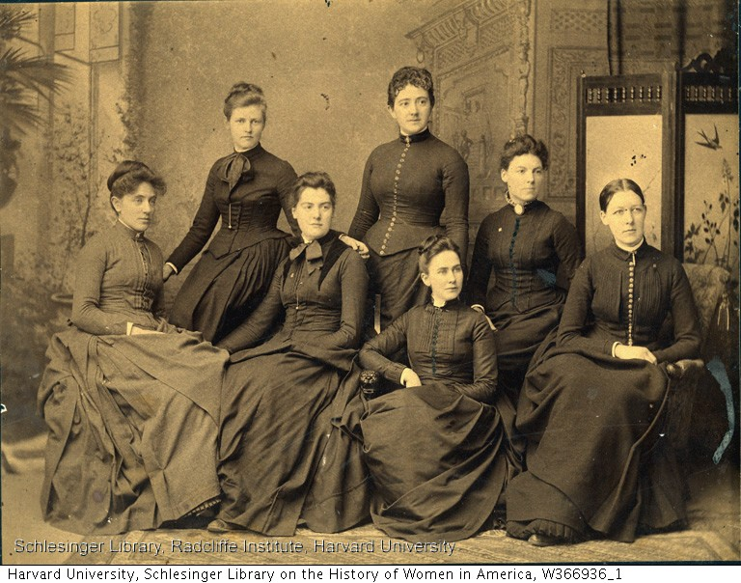
WIM: Membership in Medical Societies
By the end of the 19th century, the number of women physicians grew to almost 9,000
Women physicians were excluded from memberships in medical organizations so they formed their own
Thirty local women physician societies emerged around the country between 1870 and 1915 – when both the American Women’s Medical Association and the American College of Physicians were formed
By 1937, there were 57 women physician members in ACP

Slide 46
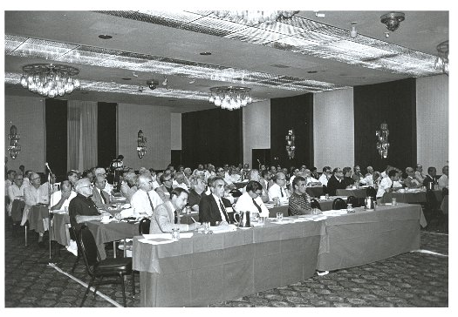
1982 ACP Board of Governors

Slide 47
Gender Identity – Full Board of Governors
Men
Women
Unknown

Slide 48
 | ACP’s history of women “firsts”
1920 | Anna Weld MD, FACP – one of the first 3 women elected to Fellowship
1972 | Helen Taussig MD, MACP – first female MACP
1979 | Harriet Dustan MD, MACP – first woman elected to the BOR
1984 | Helen Smitt MD, MACP – chair subcommittee on Women Physicians
1989 | Linda Hawes-Clever MD, MACP – first woman to chair BOG
1996 | Christine Cassel MD, MACP – first female ACP President, followed by Sandra Fryhofer, MD, MACP (2000), Sara Walker, MD, MACP (2002), Lynne Kirk, MD, MACP (2006), Virginia Hood MBBS, MACP (2011), Molly Cooke, MD, MACP (2013), Ana Maria Lopez (2019), Jacqueline Fincher 202
2003 | Mary Herald MD, MACP – first woman to Chair BOR, followed by Donna Sweet, MD, MACP (2005), Phyllis Guze, MD, MACP (2012), Tanveer Mir, MD, MACP (2015), Susan Hingle, MD, FACP (2017), Heather Gantzer, MACP (2019), Sue Bornstein, MACP (2022)
2007 | Jane F. Desforges Distinguished Teacher Award – first award named for a woman (Jane Desforges, MD, MACP was the first woman recipient of the award in 1988)
2009 | Christine Laine, MD, MPH, FACP – first solo female Editor-in-Chief of Annals of Internal Medicine
2011 | Virginia Hood MBBS, MACP – first IMG woman President
2016 | Darilyn Moyer MD, MACP – first woman CEO/EVP
Notes:
At the first meeting, Helen Smitt was asked by a committee member to get him a cup of coffee, assuming she was staff. This subcommittee morphed into the committee on underrepresented groups by 1986 at the suggestion of Dr. Mary Herald a member of the committee
Dr. Smitt also became a member of the BOR in 1991 and the first woman to chair The Joint Commission.
Dr. Chrisitne Cassel in 1996 was first woman President and there have been just 6 so far so there is room for you all. It took longer for the BOR to see the light with Dr. Mary Herald becoming the first woman Chair in 2003, 24 years after Dr. Dustan was the first woman elected to the BOR and just 14 years ago.
First IMG President was Charles Martin from Montreal in 1928 and there were 2 other Canadians in 1933 (Meakins) and 1955 (

Slide 49
Mentoring Monday: How Gender Diversity In The Boardroom Can Boost Philly’s Economy, F Hossain, Phila Business Journal, 3/17
Overwhelming data that companies on S&P 500 and Russell 3000 with more women on Boards outperform other organizations
80% of HCPs in Philly are women, < 20% of HC institution CEOs are women, < 25% hospital/health system Boards are women
“Leaky pipelines and sluggish middles”
Governance rules matter- BoardSource-70% on nonprofit boards are self-sustaining and/or closed, less than 1/5 CEOs believed they had the right board members
“Womenomics for Philadelphia’s Sustainable Prosperity”

Slide 50
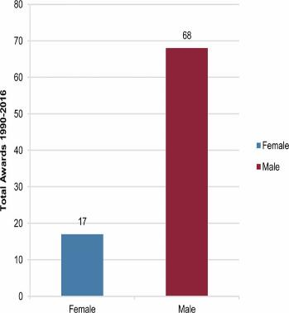
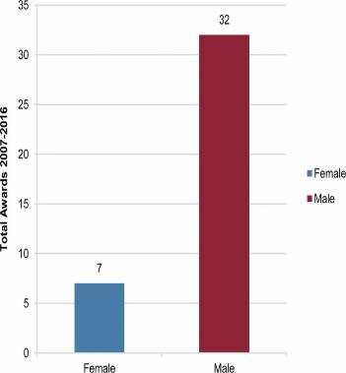
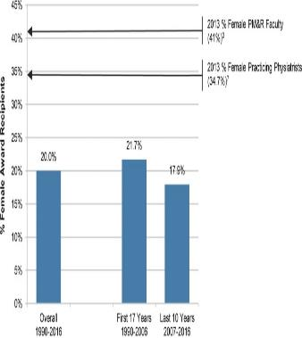
Women Physicians Are Underrepresented in Recognition Awards
Julie Silver et al Am J Phys Med Rehabil. 2018 Jan; 97(1): 34–40.

Slide 51
Seismic Shift in ACP Masterships and Awards for Women- A Case in Deliberate Practice
From 2007-2014, < 10 women/year were nominated for MACP
In 2007-8, 4/80 MACP nominees were women, all were selected (9% of all MACPs)
In 2019-20, 27/87 MACP nominees were women, 18/27 were selected (2/3rd vs. 1/3rd), representing 33.3% of MACPs
In 2007-15 < 15 women/year nominated for ACP ~ 22-25 Awards, 26 nominated in 2019-20
In 2019-20, 8/26 or 31% of women nominated for ACP awards were selected, vs. 36% of overall group
In 20-21, 32% of MACPs and 22% of Awardees are women

Slide 52
23-24 ACP Board of Regents Composition
16/25 Women
10/25 POC
4/25 IMG
6/25 under age 52
1/25 Openly LGBTQ
Marked geographic and practice setting diversity

Slide 53
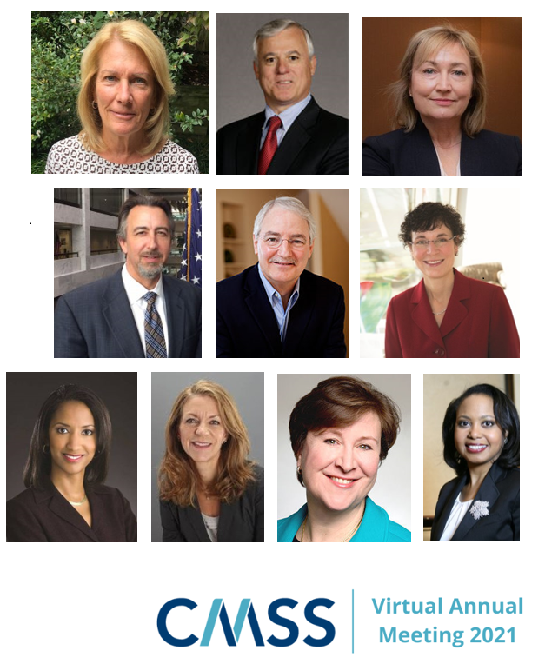
CMSS BOD 2022

Slide 54
The Solution = Systematic Process + Metrics
Examine gender data through the lens of an organization’s mission, values, and ethical code of conduct.
Report the results transparently to all stakeholders.
Investigate causes of disparities.
Implement strategies to address disparities.
Track outcomes and adjust strategies as needed.
Report/publish results
- Be Ethical, Julie Silver, 2018, sheleadshealthcare.com

Slide 55
Metrics For All Leaders
Compensation at all levels and across all domains
Hiring and/or promotion at all levels and across all domains
Executive and departmental leadership
Board representation- and inclusion on impactful committees/initiatives
Newsletter, website, and press release content
Promotional materials

Slide 56
Metrics For All Leaders
Introductions (e.g., biased language)
Space allocations (e.g., office, laboratory, clinic, reception)
Supplies (e.g., office, equipment, research)
Financial allocation (i.e., size of budget)
Financial control (i.e., independence in decision-making)
Financial priority (e.g., President’s reception versus women’s task force)

Slide 57
Metrics For All Leaders
Assistant allocation (administrative, clinical, research) and other personnel support
Assistant type (e.g., full-time equivalent, shared with others)
Consultant budget (e.g., attorneys, accountants, advisors)
Training opportunities/programs (e.g., type, participants, directors, faculty, speakers)
Mentors/Mentees (e.g., assignments, success in publishing, satisfaction with relationship)
Amount of financial support going to organizations and businesses with a demonstrable track record of workforce equity and inequity (e.g., medical societies)
Formal complaints of harassment or mistreatment
Workplace culture surveys

Slide 58

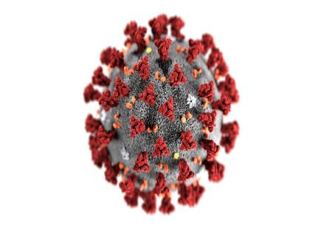

Equity In the Time Of COVID…

Slide 59
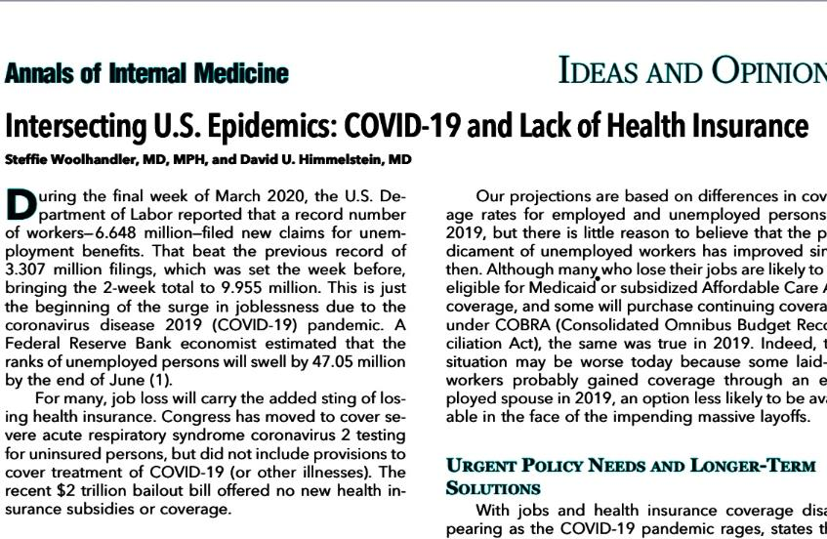

Slide 60
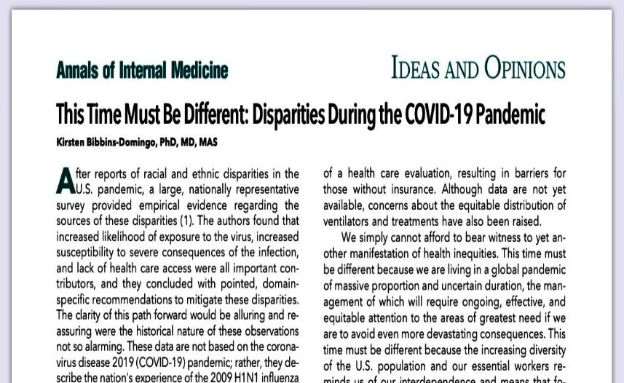

Slide 61
Covid Conundrum: A Prescription For Inequities
Disproportionate impact on marginalized populations, essential workers, healthcare professionals (HCPs)
75% of HCPs infected with Covid are women
Women physicians disproportionately working in communities hardest hit by Covid (both domain of practice and geography)
Santhosh, Jain et al, “The Third Shift”, JWomensHealth, 2020- promotions and career advancement tied to clinical revenue and grants
Disproportionate role of women in med ed realm increased workload (conversion to virtual curriculum, etc)

Slide 62
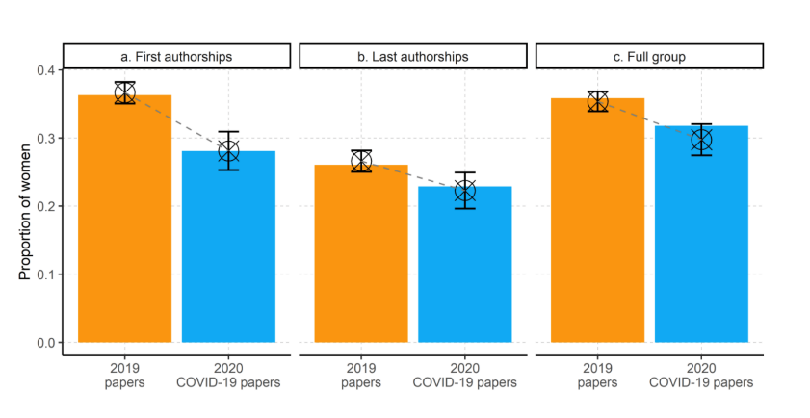
Is Covid-19 Amplifying the Authorship Gender Gap in the Medical Literature?
Andersen et al, arXiv, May 2020

Slide 63
Fewer Projects Now… Viglione, Nature, May 2020

Slide 64
Experiences of a Health System’s Faculty, Staff, and Trainees’ Career Development, Work Culture, and Childcare Needs During the Covid-19 Pandemic, Delaney et al, JAMANetworkOpen, 4/2021
U of Utah survey of all faculty, staff, trainees in 8/2020, with 27,200 participants (~18% participation rate)
Mean age 40 years, 75% respondents women, 86% white/European descent, , 11% Latina/latino, 6% Asian or Asian-American
51% had clinical responsibilities, 66% non-physician staff, 16% faculty, 13% trainees
Half of parents reported that parenting and managing virtual education were stressors
21% considered leaving the workforce,30% considered reducing hours
60% of trainees and 55% of faculty perceived decreased productivity, and about half were worried about Covid-19 impacting career development
Health systems must develop effective strategies to support their employees… but how?

Slide 65
Can We Fill The Glass With Covid Activities? Arora, WIM Webinar- Covid and Gender Equity
Promotion/ tenure clock stops and shifts
Credit for clinical, educational, service, media/advocacy, social media, research
Bridge funding
Facilitate group work dynamics
Capitalize on full on spotlight on inequities

Slide 66
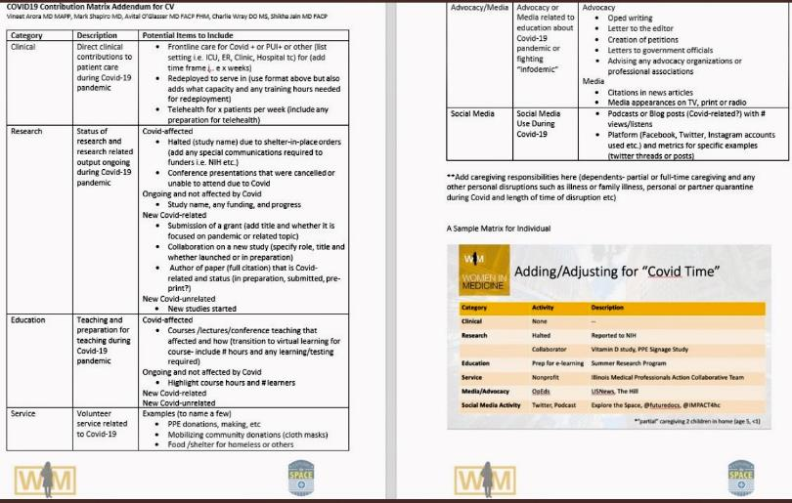
Documenting Academic Progress In The Time of Covid-Arora et al, WIM Summit Webinar 2020, JHM, 2021

Slide 67
Minding The Gap: Organizational Strategies to Promote Gender Equity During the COVID-19 Pandemic, Gottlieb et al, JGIM 10/20
Academic productivity
Capture Covid-19 contributions
Encourage inclusion of women on research teams and ensure sponsorship for COVID-19 research funding opportunities
Allow cancelled scholarly activities to be listed on CV
Ensure women are included in decision-making
Develop promotion structures that recognize Covid-19 teaching, clinical care leadership, administration and teaching
Extend promotion deadlines

Slide 68
Minding The Gap: Organizational Strategies to Promote Gender Equity During the COVID-19 Pandemic, Gottlieb et al, JGIM 10/20
Compensation and Professional Effort
Standardize how professional effort is calculated in 3 mission areas of education, research, and clinical care
Conduct total compensation audits and capture professional effort related to non-clinical activities
Evaluate and transparently share data, and provide forums for discussion and feedback BEFORE implementation
Ensure that women physicians participate in organizational decision-making around changes to total compensation during and after the pandemic
In the setting of pay freezes/salary reductions, consider pay equity in calculations
Consider awarding stipends to those redeployed to COVID-19 work

Slide 69
Minding The Gap: Organizational Strategies to Promote Gender Equity During the COVID-19 Pandemic, Gottlieb et al, JGIM 10/20
Career development
Capitalize on medical society and medical organization programming
Maintain institutional funding streams for programming that support women’s career advancement and leadership development
Widely publicize organizational leadership opportunities
Ensure that women have strong representation on promotion and search committees

Slide 70
Minding The Gap: Organizational Strategies to Promote Gender Equity During the COVID-19 Pandemic, Gottlieb et al, JGIM 10/20
Family support
Alternate/flex work schedules
Partner with local businesses to offer subsidize/bulk discounts for self and family care needs
Develop and promote efforts at varied institutional levels to vet and pool dependent care providers for sharing
Collaborate with local organizations such as childcare providers, to create or reopen care centers for children of essential workers

Slide 71
Does Career “Flexibility” Exist?
UC system has had flexible policies (family/ childbearing leaves, stop the tenure clock active service modifications) since 1988 but only 6.7% of women and 0% of men have used these policies
1/3rd of those < 50 years old wanted to use but did not make the request
Concerns about burdening colleagues, perceptions that they were not committed combined with an unsupportive culture, career damage, limiting future opportunities, and face time bias
Flexibility should be mutually beneficial and result in superior outcomes for all parties
- Howell, AcadMed, 8/17

Slide 72
What We Know…
Women (and URiM/UREG) are recruited, evaluated, advanced, promoted, mentored, sponsored and compensated differently than those in majority power holding groups (UME, GME, practicing physicians, and patient satisfaction data)
Data around women conference introductions, speaking time, interruptions, appropriation of comments/contributions of women is quite concerning
Despite NASEM requirements that AAMC affiliated hospitals/healthcare orgs maintain a clearly written bill of rights and responsibilities communicating a zero-tolerance policy for sexual harassment towards HCPs, 0/55 contained NASEM recommended specific language against patient perpetuated sexual harassment or abuse (Vigilanti et al, JAMA Network Open, 9/20)
Emerging data around increasing prevalence of personal attacks and sexual harassment of physicians on Social Media(SoMe), with women reporting significantly more online sexual harassment than men 16.4 vs. 1.5% (Pendergrast et al, JAMA Network Open 1/21)- www.impact4hc.com

Slide 73
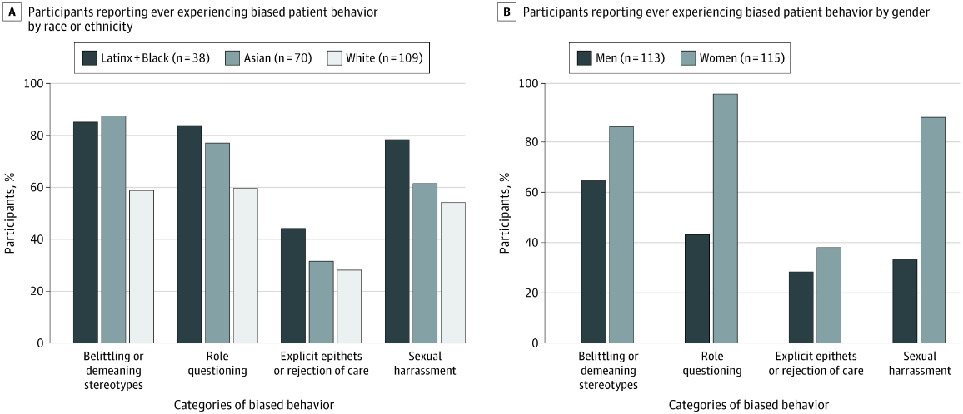
Resident Physician Experiences With and Responses to Biased Patients Shalila S. de Bourmont, et al, JAMA Network Open, 11/20

Slide 74
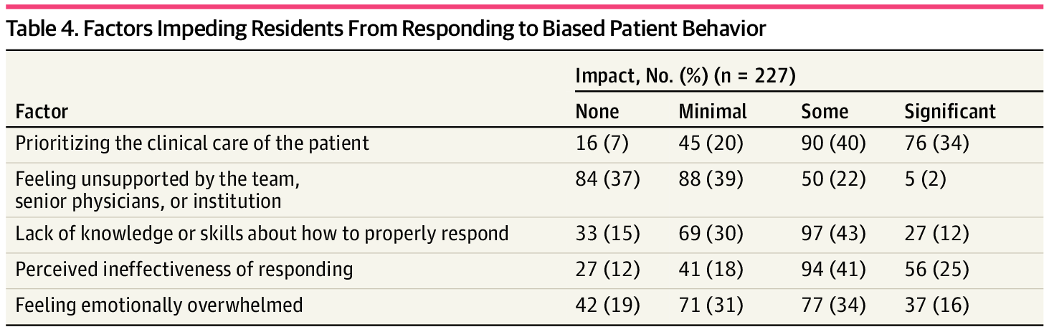

Slide 75
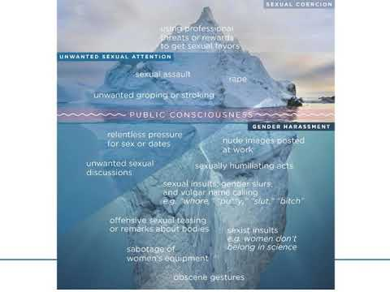
What Lies Beneath- The Catastrophic Iceberg

Slide 76
How Deep Does The Iceberg Go?
Medscape Sexual Harassment 2018 online survey
6235 HCPs-3711 practicing physicians, 1007 nurses,440 physician trainees, 286 NPs, 791 Pas who responded in March-April 2018
12% female physicians, 4% male physicians reported unwanted sexual behavior, only 405 of the harassing behaviors were reported
Amongst harassers, ~1/2 were physicians, 37% were in a superior organizational position, 20% in an equal or peer role, 37% in a subordinate role
30% of med students experienced unwanted advancements in a 2018 survey
11% of nurses, NPs, PAs reported sexual harassment in a 3 year period and 12% reported electronic harassment
More than 50% of victims chose to remain silent, less than 25% of incidents reported were investigated

Slide 77
#MedToo: A Large Scale Examination of the Incidence and Impact of Sexual Harassment of Physicians and Other Faculty at an AHC, Jagsi et al, JWomensHlth, 2020
20 min online survey administered to all faculty at U of Michigan Medical School for at least 1 year
26% response rate, 82.5% of women and 65% of men reported at least 1 episode of SH from insiders in the past year, 64% of women and 44% of men reported harassment from patients and patients’ families
Increased experiences of harassment were independently associated with lower mental health, job satisfaction, sense of safety at work, and increased turnover intentions

Slide 78
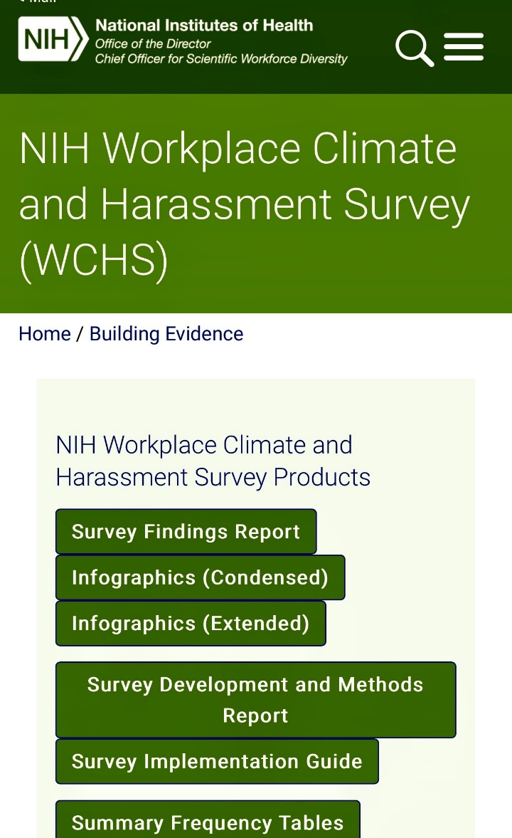
Environmental Survey Design, Survey Administration, and Acting on Results Are Key…..Valentine et al, AcadMed, 3/2022

Slide 79
Characteristics of Faculty Accused of Academic Sexual Misconduct In The Biomedical and Health Sciences
Characterized faculty accused of sexual misconduct resulting in institutional or legal actions that proved or supported guilt at U.S. higher educational institutions in biomedical/health services
Authors performed internet searches of Misconduct database (https://academic-sexual-misconduct-database.org) and top 500 search results were reviewed 11/18-4/19
Authors abstracted characteristics of alleged perpetrators, their targets, and outcomes by “Assault”, “Harassment”, “Consensual Relationships”, “Exploitation”

Slide 80
Characteristics of Faculty Accused of Academic Sexual Misconduct In The Biomedical and Health Sciences
Identified 125 faculty sexual misconducts in 1982-2019 affecting at least 1668 targets
34% in U.S. News and World Report top 50 rated colleges/universities
98% perpetrators male, and 92% of targets were only females
72% of perpetrators targeted subordinates
19% targeted clinical trainees
51% Full Professors, 17% Department Chairs/Directors/Deans
30% committed sexual assault, 56% sexual harassment
49% resigned/retired, 21% terminated, 9% sanctioned by funding sources or boards governing clinical practice

Slide 81
Characteristics of Faculty Accused of Academic Sexual Misconduct In The Biomedical and Health Sciences
50 accused faculty remained in academia, 60% remained at same institution, 40% at a different institution
6/50 terminated by 1st institution, 15/50 resigned or retired
Domains: 40 Research, 34 Medical, 30 Psychology, 6 Dental, 4 Nursing,11 “Other”
Limitations- lack of transparency/standardized database and reporting expectations
-Espinoza, Hsiehchen, JAMA,4/21/20

Slide 82
Addressing Sexual Harassment: An Institutional Approach, Noseworthy et al, MayoClinicProceedings, 4/2020
Beyond reporting and developing systems to address sexual harassment, institutions must have a systematic method to thoroughly investigate allegations of sexual harassment
Impose fair and consistent corrective actions when allegations are substantiated
Develop a culture intolerant of sexually harassing behavior
In 2 years from late 2017-2019, 153 allegations, ~60% of investigations were substantiated, 30% of the accused were physicians or scientists
Outline a 10 step institutional approach to sexual harassment allegations

Slide 83
Implementation of an Online Reporting System to Identify Unprofessional Behaviors and Mistreatment Directed at Trainees at an Academic Medical Center- Leitman et al, 12/22, JAMA Open
Pool of ~ 4200 students, trainees, graduate students, postdoctoral fellows filed 196 reports 2019-2021 in Mt. Sinai online reporting system
Nearly 90% of the reports described unprofessional interactions, and over 60% described behavior from faculty, AAMC definition of mistreatment was used
Under 1% of the 2,900 faculty members who interact with trainees accounted for half of the reports describing unprofessional behavior
The most common reported behaviors were related to public embarrassment or humiliation (54.9%),offensive remarks related to gender, sexual orientation, national origin, race, color, or religion (32.9%), denial of opportunities like training or rewards on the basis of membership in a protected group (9.2%)

Slide 84
Implementation of an Online Reporting System to Identify Unprofessional Behaviors and Mistreatment Directed at Trainees at an Academic Medical Center- Leitman et al, 12/22, JAMA Open
The vast majority of the reports (94%) were handled by a discussion with the subject. Ten reports were escalated to a written warning or change in duties, and 14 reported faculty were referred for a physician wellness evaluation
Residents and fellows were the most frequent reporters, at 55.5% of all reports
Complaints were directed at faculty in 61.3% of cases and residents and fellows in 13.9%
The majority of negative feedback was centered around just 20 faculty members
Leading up to the implementation of the new tool, a group of stakeholder representatives met for 12 months and designed the feedback form and protocol for triaging reports, providing feedback, disclosing aggregate data publicly, and addressing problems via remediation, formal investigation, or disciplinary action.

Slide 85
"Some institutions may think they don't have a problem with trainee mistreatment -- but this goes to show that if you make it easier to hear about bad behavior, you'll hear about it."

Slide 86
Role Of U.S. Healthcare Accreditation, Credentialing, Licensing, and Rating Organizations
AAMC’s commitment to DEI and gender equity- GWIMS and now CWAMS- www.aamc.org, www.cwams.org
ACGME 2019 Common Program Requirements and CLER requirements around DEI and training environments free of harassment and discrimination- www.acgme.org
The Joint Commission’s commitment to quality and safety of patient care - www.jointcommission.org
Roles of state licensing and health boards
Role of healthcare institutional rating systems
Role of other credentialing organizations

Slide 87
ACGME CPRs 2019
Section I.C. discusses diverse/inclusive aims –”The program, in partnership with its Sponsoring Institution, must engage in practices that focus on mission-driven, ongoing, systematic recruitment and retention of a diverse and inclusive workforce of residents, fellows (if present), faculty members, senior administrative staff members, and other relevant members of its academic community. (Core)”
Section I.D.2.includes the requirement for lactation facilities and disabilities accommodation- “clean and private facilities for lactation that have refrigeration capabilities, with proximity appropriate for safe patient care; (Core)” and “accommodations for residents with disabilities consistent with the Sponsoring Institution’s policy. (Core)”

Slide 88
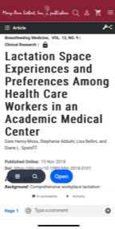
Championing A Cause…Bellini et al, Jwomen’sHealth,2018

Slide 89
ACGME CPRs 2019
Section VI. has a strong introduction about the learning/working environment with specific details in VI.C on wellbeing-”evaluating workplace safety data and addressing the safety of residents and faculty members; (Core)
Background and Intent: This requirement emphasizes the responsibility shared by the Sponsoring Institution and its programs to gather information and utilize systems that monitor and enhance resident and faculty member safety, including physical safety. Issues to be addressed include, but are not limited to, monitoring of workplace injuries, physical or emotional violence, vehicle collisions, and emotional well-being after adverse events”

Slide 90
ACGME CLER 2019
Professionalism Finding 1
In many clinical learning environments, graduate medical education and executive leadership expressed intolerance for behaviors that are considered unprofessional. Across some clinical learning environments, residents, fellows, and clinical staff described witnessing or experiencing incidents of disrespectful or disruptive behavior on the part of attending physicians, residents, fellows, nurses, or other clinical staff. These findings ranged from descriptions of isolated incidents to reports of disrespectful behavior that was persistent or chronic in nature.

Slide 91
Joint Commission
LD.03.01.01 EP 5: Leaders create and implement a process for managing behaviors that undermine a culture of safety.
EC.02.01.01 EP 1: The hospital implements its process to identify safety and security risks associated with the environment of care that could affect patients, staff, and other people coming to the hospital's facilities. Note: Risks are identified from internal sources such as ongoing monitoring of the environment, results of root cause analyses, results of proactive risk assessments of high-risk processes, and from credible external sources such as Sentinel Event Alerts.
EC.02.01.01 EP 3: The hospital takes action to minimize or eliminate identified safety and security risks in the physical environment.

Slide 92
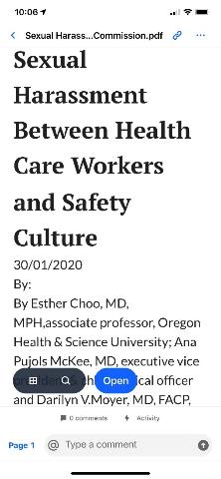
Safety and Quality Are Inextricably Linked With An Organization’s Culture

Slide 93
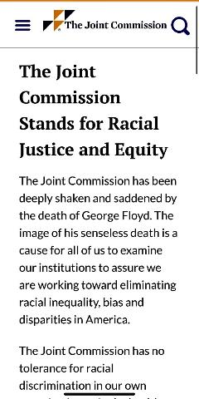
Putting Teeth Into Racial Justice and Equity

Slide 94
Dr. Quentin Youmans… “Allyship Is No Longer An Option”
“Ensuring gender equity must be a goal for all of us in medicine, not solely a select few. This requires that we all lend both our voices and our influence in support of women colleagues when we see or hear of inequities. Allyship can no longer be an option, but an imperative.”
Quentin R. Youmans, MD Fellow, Cardiovascular Disease Northwestern University Feinberg School of Medicine

Slide 95
7 Tips For Men Who Want To Support Equality
Challenge the likability penalty
Evaluate performance fairly
Give women credit
Get the most out of meetings
Share the office housework
Make work work for parents
Mentor women and offer equal access
www.leanin.org

Slide 96
Top Ten Catalyzers To Get To A JEDI Healthcare Environment And Become An Antiracist Organization
Perform foundational work- review your organization’s mission, vision, and goals with a JEDI and anti-racist lens, modify accordingly, discuss and publicize the elevator story widely
Review your policies and procedures for governance of your organization to remove explicit and implicit bias in all recruitment, retention, appointment, promotion, leadership, educational, and advancement processes
Ensure that your organization has JEDI, anti-harassment and discrimination policies (including those for patients/family members/visitors) and accessible mechanisms for activation of processes to enforce these policies. Get granular
Establish a body for ensuring a JEDI/ anti-racist in your organization that is empowered, has teeth in education and enforcement, can actively intervene in a rapid response fashion with individual , group and allyship training, as well as have oversight with all governance and other germane policies relevant to establishing and maintaining a JEDI/Anti-racist environment
Review the allocation and prioritization of financial and other critical supporting resources to ensure that allocations prioritize creating/sustaining/augmenting a JEDI/anti-racist environment

Slide 97
Top Ten Catalyzers To Get To A JEDI Healthcare Environment And Become An Antiracist Organization
Institute deliberate practice in transparent data collection and review to assess your organization’s cultural environment, with a focus on safety, quality, JEDI and anti-racist principles, get specific and granular and avoid broad statements about harassment and discrimination
Review and actively track total compensation, recruitment, appointment, advancement, awards and leadership positions and benchmark to rank and file of your organization and patient characteristics (if applicable)
Transparently publicize your organization’s data regarding your review of data in total compensation, recruitment, appointment, advancement and leadership in your organization
Educate all in the organization regarding the benefits of a JEDI/anti-racist environment in terms of human and financial outcomes, safety and quality. Start with your organization’s Board
Review all local, regional, national licensing, accreditation, certification JEDI/anti-racist standards and ensure that your organization is adhering to them (eg AAMC, ACGME, Joint Commission, state/local licensing boards and health departments)

Slide 98
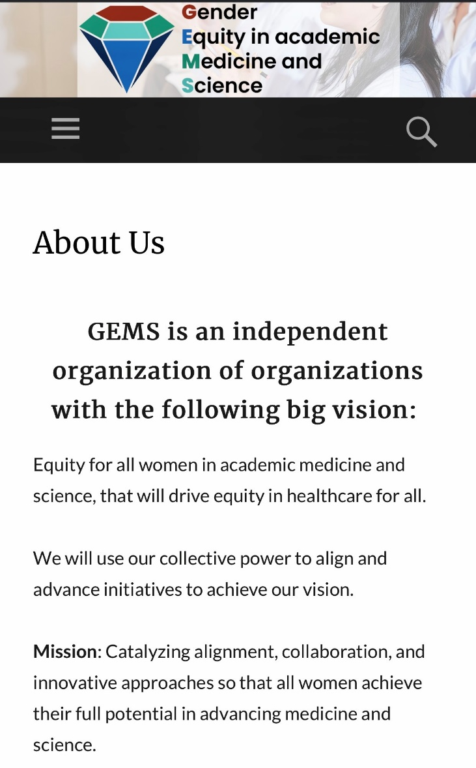
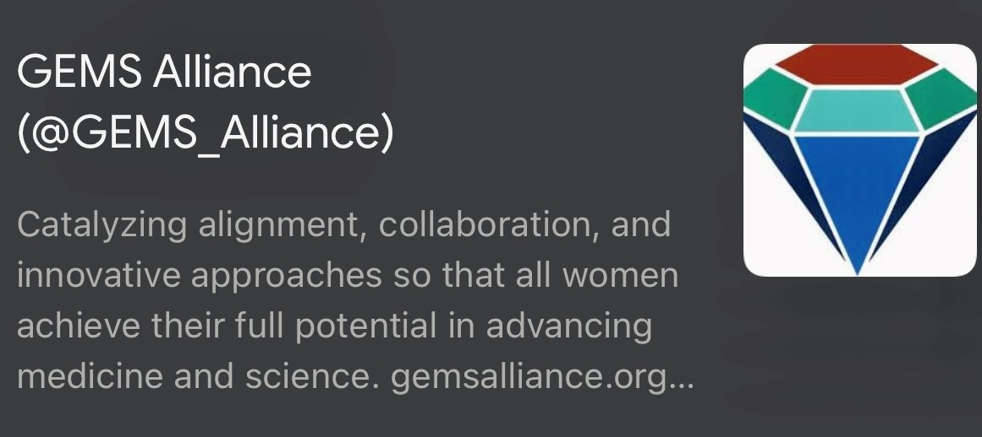
Encourage Your Academic Organizations To Join GEMS Alliance…

Slide 99
Free Resources To Make ACP Policy Live…

Slide 100
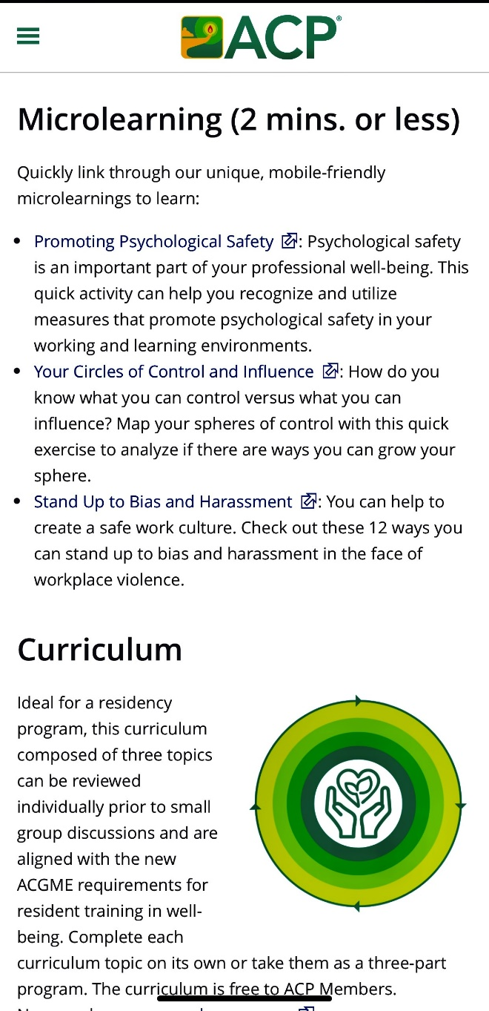
www.acponline.org/practiceresources/well-being

Slide 101
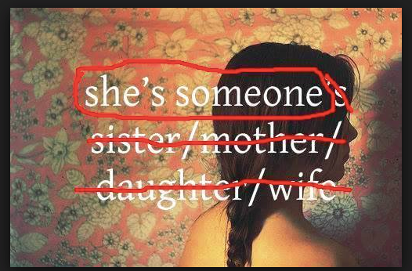

Slide 102

And May The Force Be With All Of You!

Slide 103


Slide 104

And Miles To Go Before We Sleep….

Slide 105

Thank you . . . Follow us @ACPinternists @ DarilynMoyer
…for your continued support of ACP and your commitment to internal medicine.

Slide 106
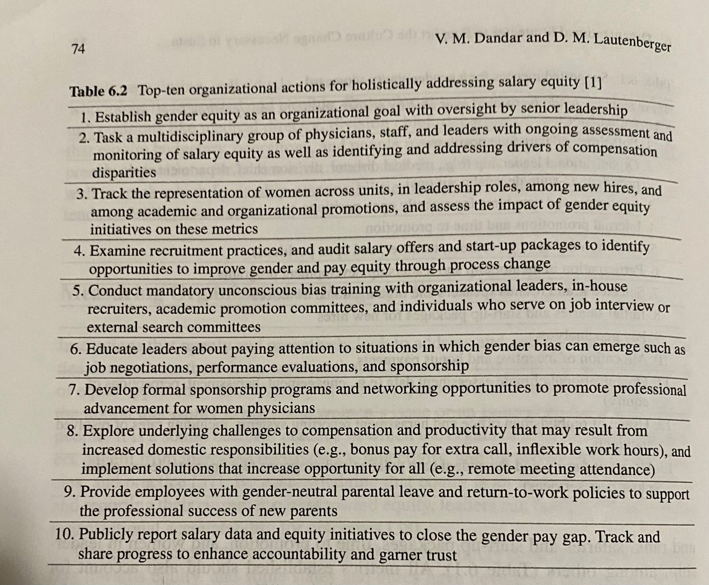
Gottlieb Book Table

Slide 107
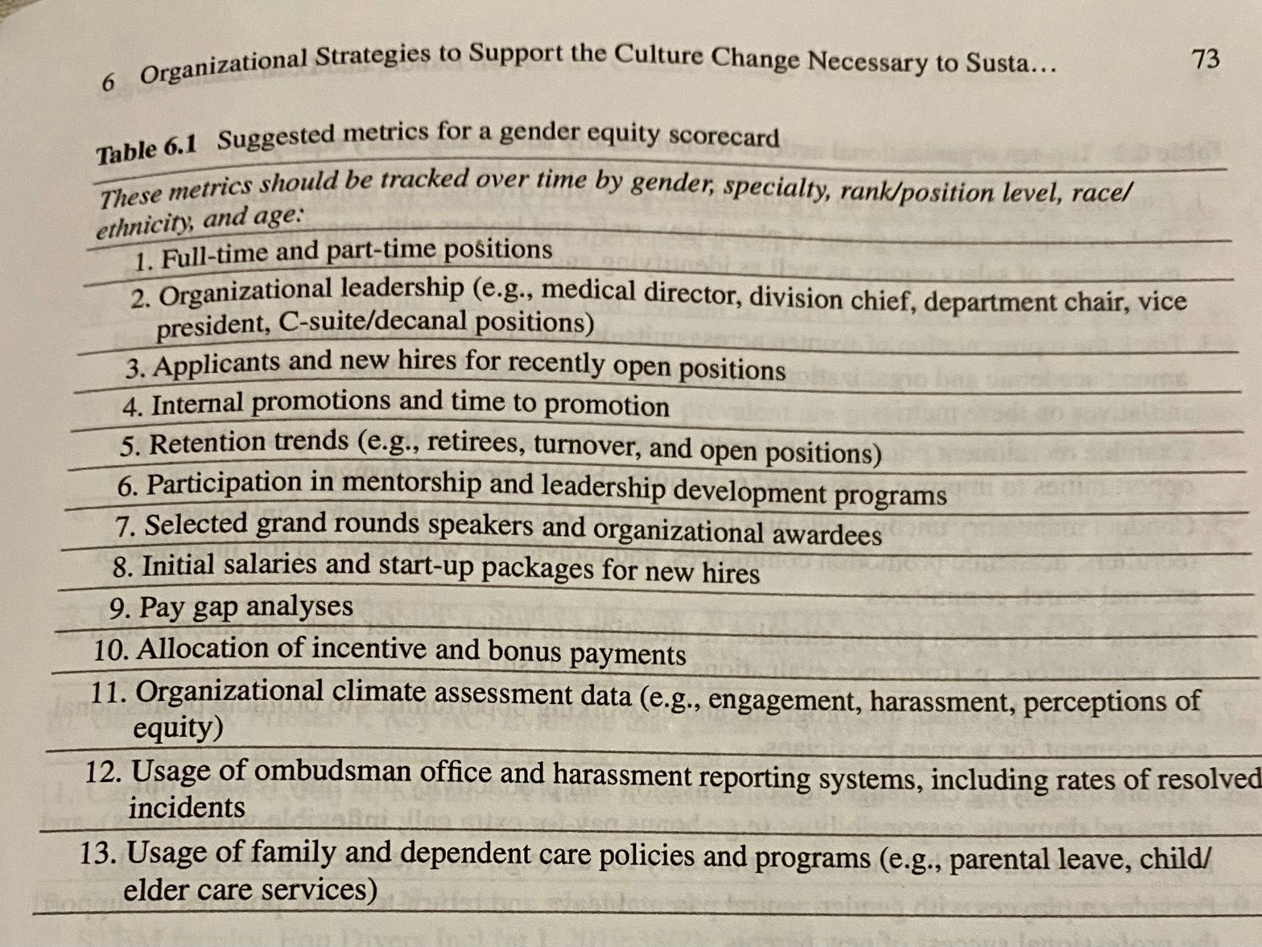
Gottlieb Book Table

