Slide 1
Women In Medicine: Creating A JEDI Healthcare System
Darilyn V. Moyer MD, FACP
EVP/CEO American College of Physicians

Slide 2


Slide 3


Slide 4
Disclosures
I am a full time employee at the American College of Physicians
I am an Adjunct Professor of Medicine at the Lewis Katz School of Medicine at Temple University
I have no financial or IP conflicts to disclose
Many thanks to my physician colleagues and society/organizational staff for sharing content used in this presentation

Slide 5
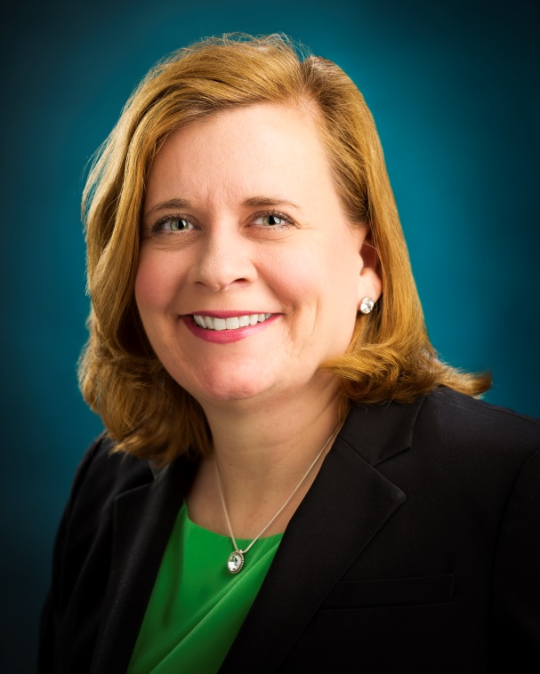
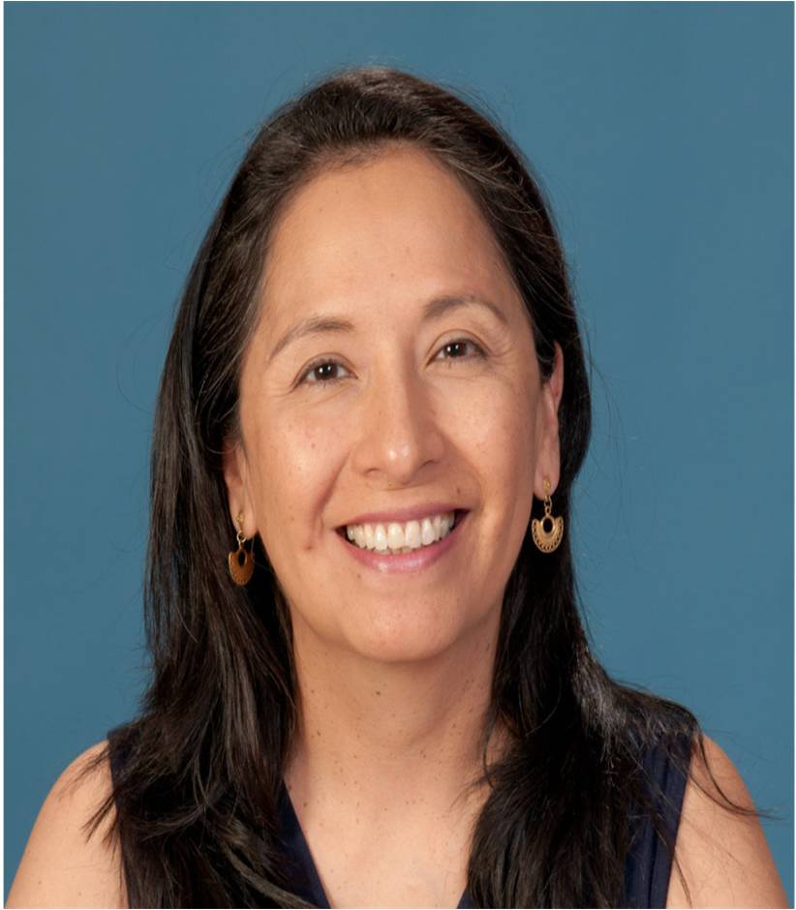
Women in ACP Leadership 2018-2019
Susan Thompson Hingle, MD, MACP
Past Chair, Board of Regents
Ana María López, MD, MPH, FACP
President

Slide 6
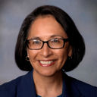
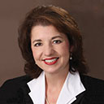
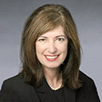
Women In ACP Leadership 2019-2020
Ana Maria Lopez, MD, MPH, MACP
Immediate Past President
Jacqueline Fincher, MD, MACP
President-elect
Heather Gantzer, MD, FACP
Chair-elect Board of Regents

Slide 7
Educational Objectives
Review data germane to women in medicine including compensation and advancement
Define specific obstacles to achieving equity at the micro and macro level
Describe potential actionable interventions to work towards achieving equity at the micro and macro levels

Slide 8

Not A Zero Sum Game…
Notes:
Pink Elephant symbolizes that this is an important subject we all need to work on together- our physician pipeline and patients are counting on it!
And we can’t continue to do business as usual as over 50% of the entering classes of med schools are women. Most of the newly minted physicians have partners who work outside of the home. We need to change inherent systemic structures that don’t allow us to maximize the potential of our increasingly diverse physician workforce.
A call out to all who are in positions to engage in these important actions and to move from unbiased passivity to activation and engagement

Slide 9
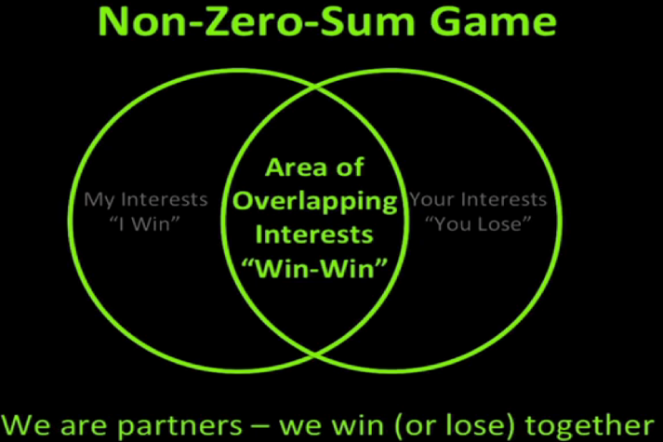
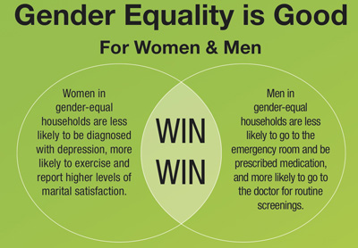
Gender Equity
Improves
  Productivity
  Creativity
  Communication
  Employment
  Job satisfaction
  Work engagement
  Policy development
Notes:
Bottom line is that more diverse organizations have better outcomes in multiple domains

Slide 10
Innovation, Diversity, and Market Growth
2015, McKinsey and Company-“Companies in the top quartile for racial and ethnic diversity are 35% more likely to have financial returns above their respective national industry medians.”
2014, Stephen Frost-“…discriminating against women, homosexuals, and disabled people is costing $64 billion dollars a year in the U.S. alone”
2013, Center for Talent and Innovation-Companies with inherent and acquired diversity
  70% more likely to capture a new market
  75% more likely for ideas to get to production
  158% more likely to understand their target population and innovate effectively

Slide 11
The Facts About Women In Business Leadership
When women lead, performance improves
Startups led by women are more likely to succeed, but VC funding challenging for women’s businesses
Innovative companies with more women in top management are more profitable
Companies with more gender diversity had more revenue, customers, market share and profits
“To break down barriers that hold women back it’s not enough spread awareness. If we don’t reinforce that people need-and want to- overcome their biases, we end up silently condoning the status quo”

Slide 12
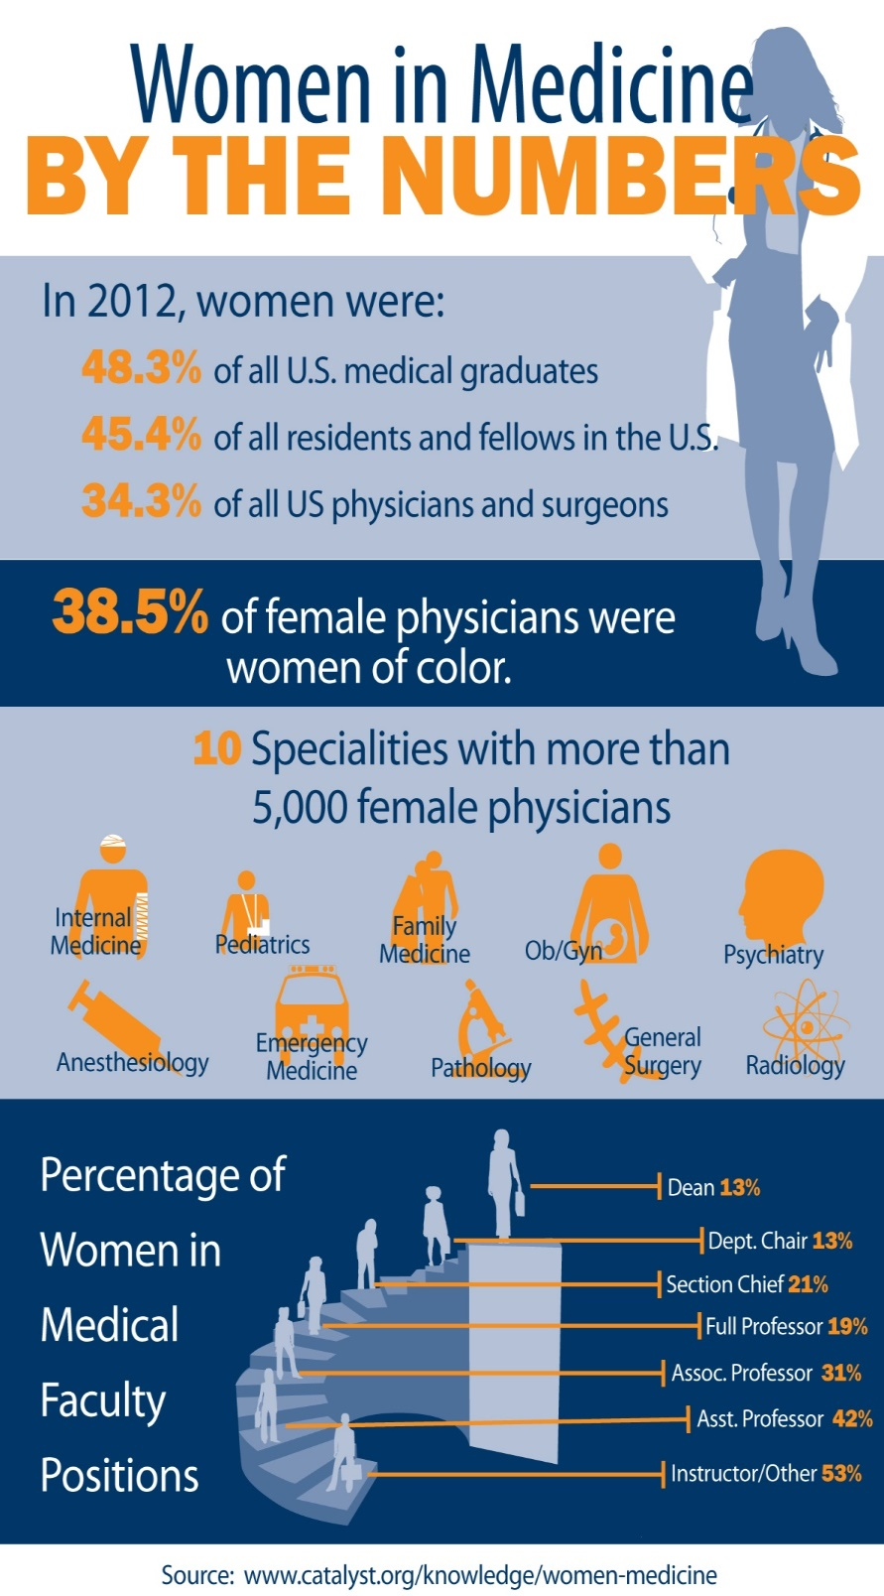
AAMC GWIMS database 2016

Slide 13
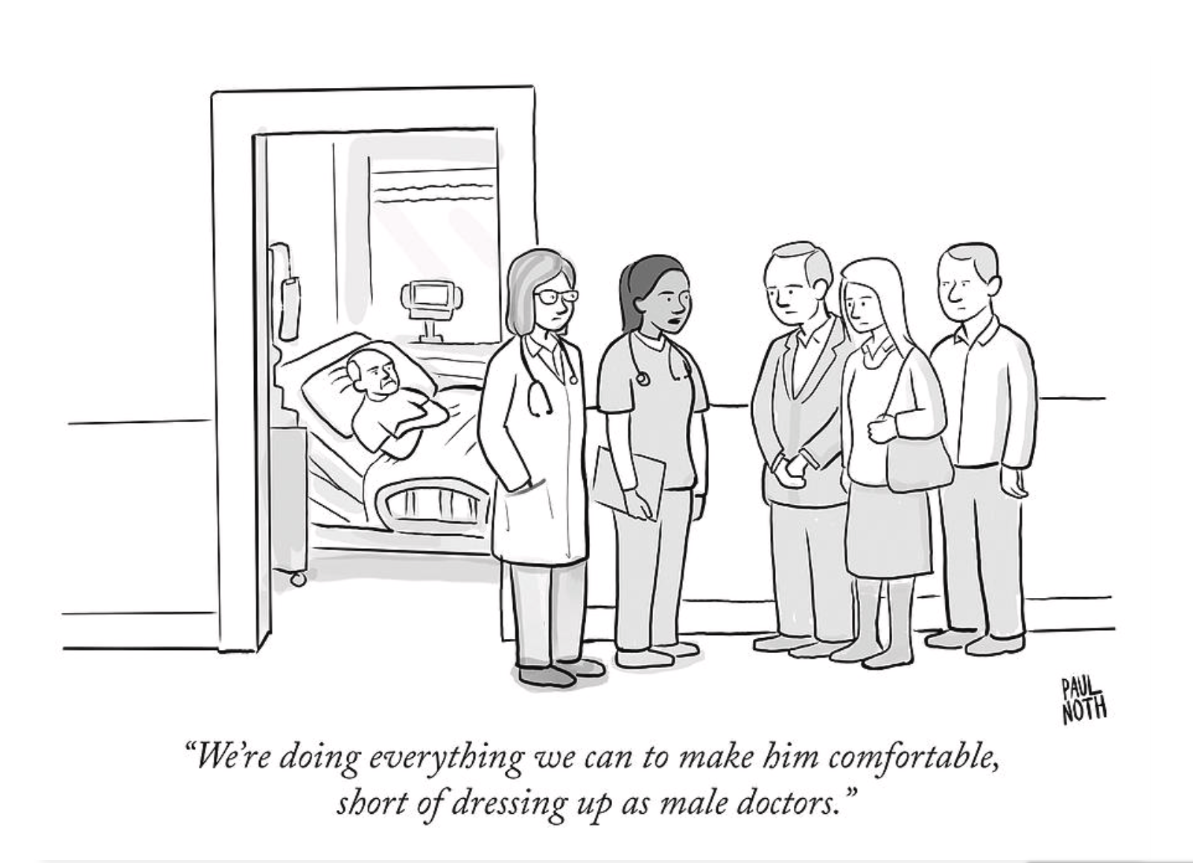
By Paul North
The New Yorker

Slide 14
ISSUES THAT MAY BE TIED TO WOMEN PHYSICIANS AND PROFESSIONAL DISTRESS
Imposter syndrome/stereotype perception
Gendered expectations/external demands
Sexual harassment/(un)conscious gender bias
Communication styles/interpersonal interactions
Notes:
More burnout in all underrepresented groups in healthcare

Slide 15
Gendered Expectations: Do They Contribute To High Burnout Among Female Physicians?
Female physicians have more female patients, and more patients with social complexity
Up to a 60% excess in burnout in female vs. male physicians
Differing expectations in empathy, listening time, decisiveness which have implications for patient evaluations
Possible solutions- adjusting for patient gender in compensation plans, education, co-locating behavioral medicine specialists, adjusting visit times
- Linzer et al, JGIM online, 2/18

Slide 16
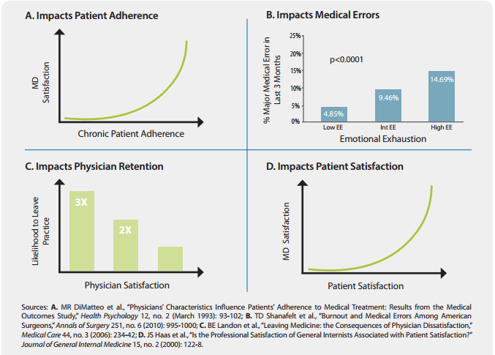
Source: California HealthCare Foundation
Notes:
Physician dissatisfaction has big consequences and a human and financial toll. We know that women and physicians serving vulnerable pt popns have higher rates of burnout

Slide 17
Assess- Confidence Gap and Valuation
Men overestimate their abilities and performance and women underestimate both
Men apply for jobs when they meet 60% of qualifications, women when they meet 100%
Men initiate salary negotiations 4X more often than women and when women do negotiate, they ask for 30% less money than men
-The Confidence Code, Katty Kay and Claire Shipman

Slide 18
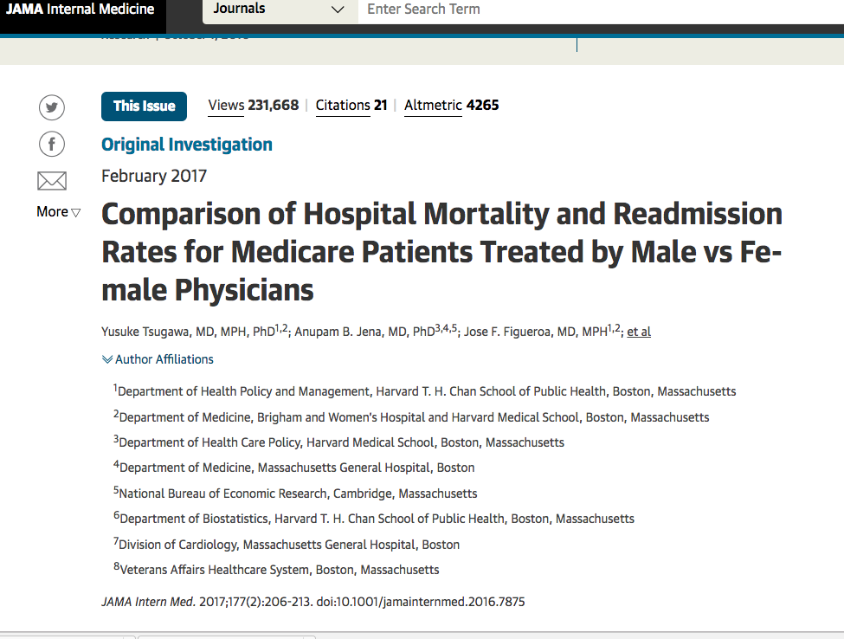
Notes:
http://jamanetwork.com/journals/jamainternalmedicine/article-abstract/2593255
Newer data in the surg literature for better outcomes for women surgeons whose pts were less likely to die within the next 30 days
Recent study of over 500K heart attack pts found that ANY pt treated by a female physician was more likely to survive, compared to those treated by a male physician. And strong evidence that the effect was particularly pronounced for female pts.

Slide 19
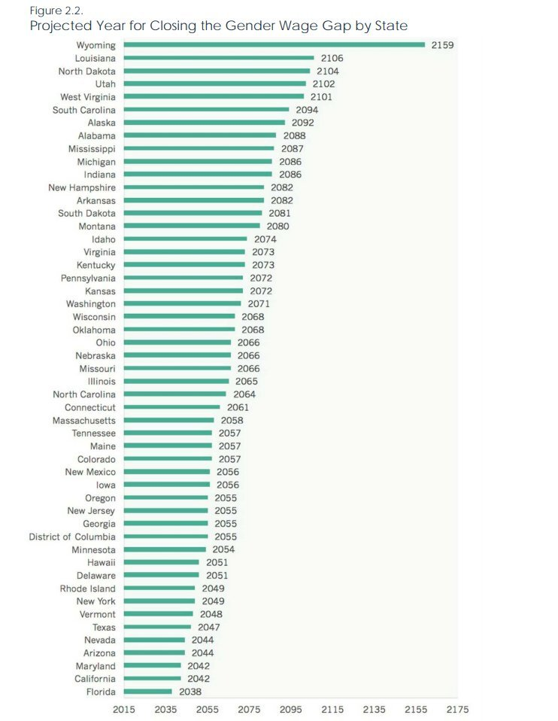
Institute for Women’s Policy Research
March 2017
Notes:
It’s 100 years since women got the vote (!(!(), please don’t let it be more than 100 years until we step up and do what’s right to fix this

Slide 20
“Dr. Paid Less”
“Dr. Paid Less”- on average, a $20,000 gap in salaries at med schools, unadjusted was ~$51,000
Full female Professors ($251K) made roughly the same amount as male Associate Professors ($247K)
At some schools, there was no gender pay gap
Also concerns of administrative burden/assistance, grants, lab space…
Call the question- “Am I in line with other members of the group?”
Barriers to reporting
Notes:
From Jena’s seminal 2016 study
Calling Lilly Ledbetter- US Supreme Court case against Goodyear tire- crucial decision-

Slide 21
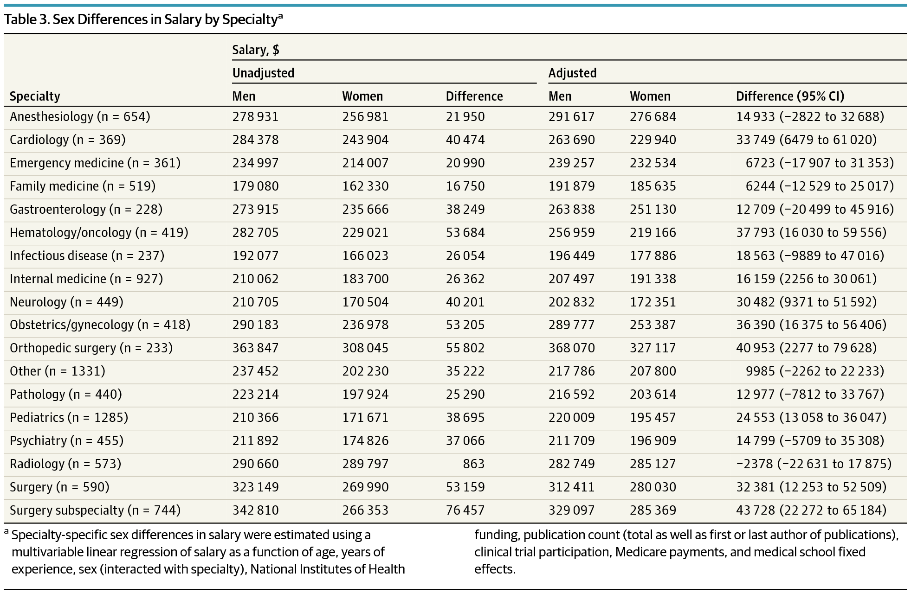

Slide 22

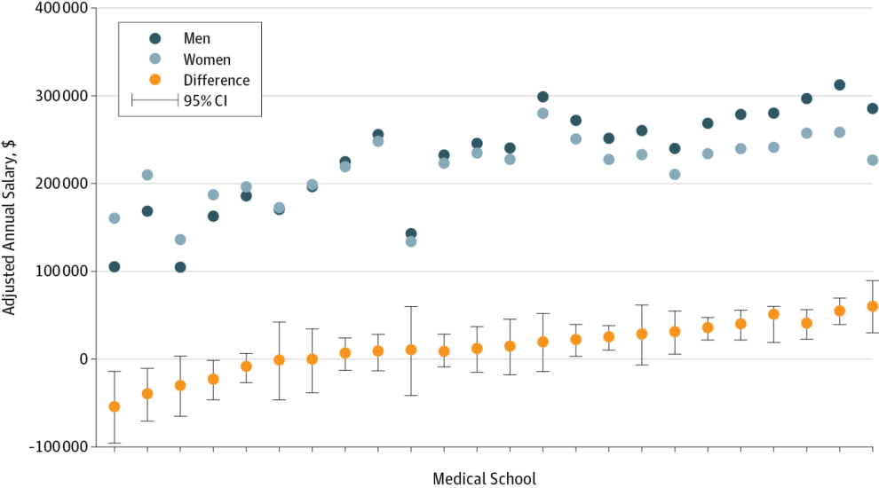
From: Sex Differences in Physician Salary in US Public Medical Schools
JAMA Intern Med. 2016;176(9):1294-1304. doi:10.1001/jamainternmed.2016.3284
Figure Legend:
Sex Differences in Salary According to Medical School School-specific sex differences in salary were estimated using a multivariable linear regression of salary as a function of age, years of experience, sex (interacted with school), National Institutes of Health funding, publication count (total as well as being first or last author on publications), clinical trial participation, and Medicare payments. See the Salary Data subsection of the Methods section for a list of the included schools. Limit lines indicate 95% CI.
Date of download: 9/9/2017
Copyright © 2016 American Medical Association. All rights reserved.

Slide 23
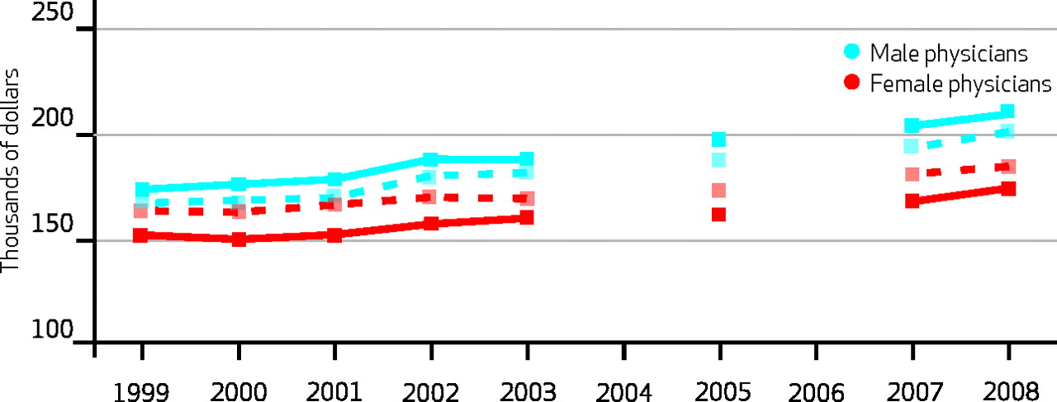

Physician Starting Salaries Over Time, Mean And Controlling For Observable Characteristics, By Gender, Selected Years 1999–2008.
Anthony T. Lo Sasso et al. Health Aff 2011;30:193-201
Notes:
Physician Starting Salaries Over Time, Mean And Controlling For Observable Characteristics, By Gender, Selected Years 1999–2008
This is crucial as initial salary predicts lifetime of wage earnings and could result in significant lost compensation over time

Slide 24
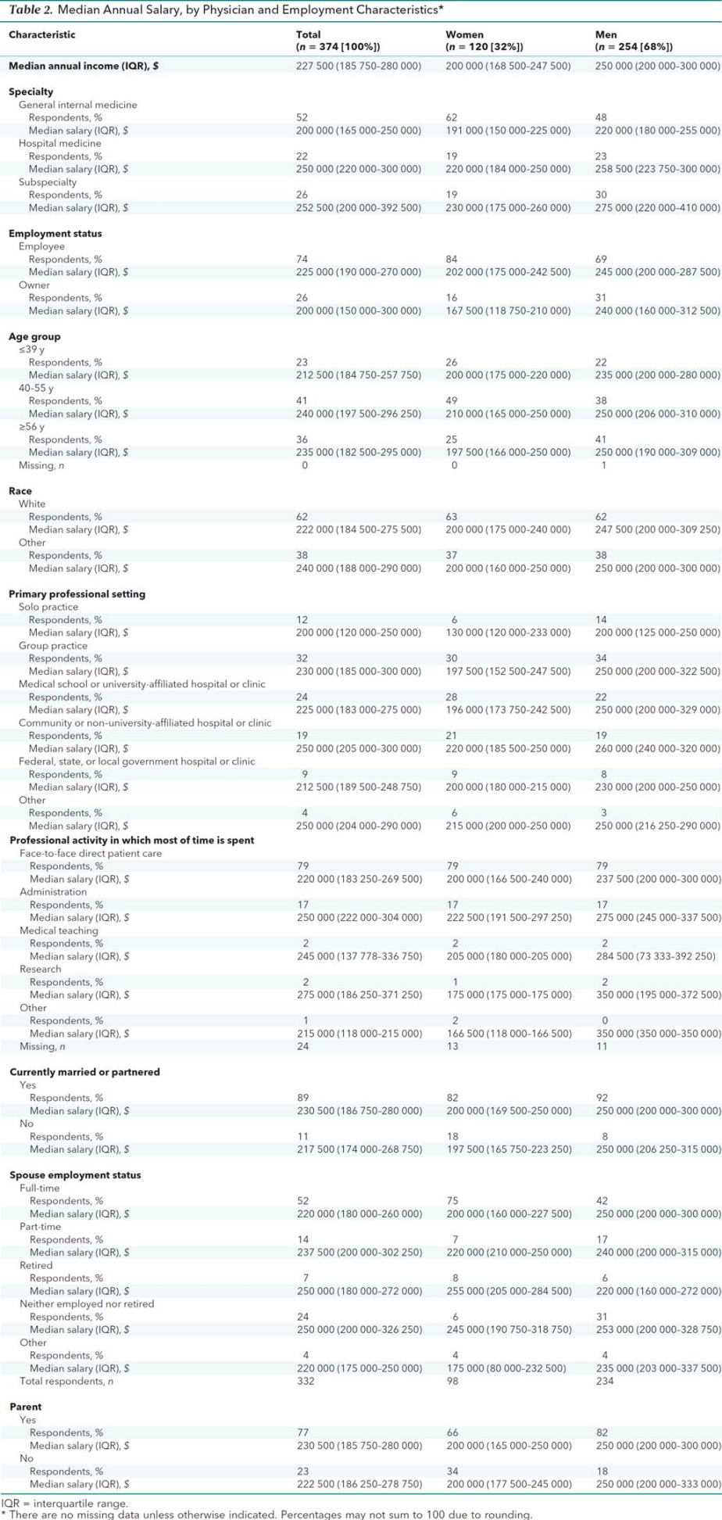
From: Compensation Disparities by Gender in Internal Medicine
Ann Intern Med. Published online August 07, 2018. doi:10.7326/M18-0693
Median annual income $227,500
Women $200,00
Men $250,000
Date of download: 10/15/2018
Notes:
ACP 2018 study

Slide 25
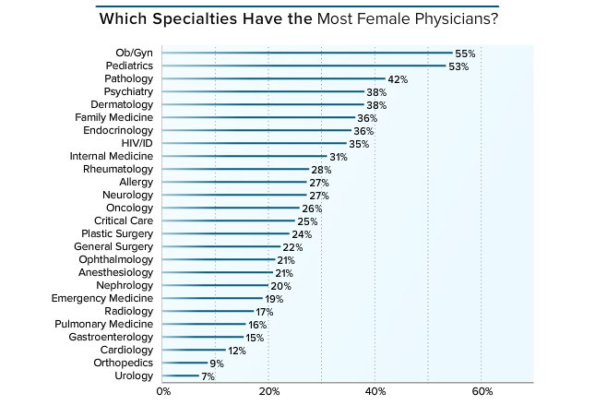
Notes:
Some specialties are > 50% women many approaching 50%

Slide 26


Slide 27
AAMC GWIMS database 2016

Slide 28
Medical schools are making modest progress in moving women physicians into positions of academic leadership
% Position Incumbents by Gender
2003-04
2013-14
Source: AAMC, “The State of Women in Academic Medicine, 2013-14”, https://members.aamc.org/eweb/upload/The%20State%20of%20Women%20in%20Academic%20Medicine%202013-2014%20FINAL.pdf
Notes:
Very little change in progression of female Asst Professors to Full Professors/Chairs/Deans in the decade from 2003-2004

Slide 29
The Decanal Divide: Women In Decanal Positions in US Medical Schools
9/16 study of US allopathic schools
22/149 deans/interim deans are women
Women most prevalent in positions focusing on medical education and least prevalent in those focused on strategy, finance, and government relations
54% (vs 44%) of decanal level administrators below the rank of dean if the institution was led by a woman dean or vice dean
-Schor, AcadMed, 8/17
Notes:
Women Deans tend to be cohorted in the “Caref\giver” positions such as Med Ed, Student Affairs,Admissions

Slide 30
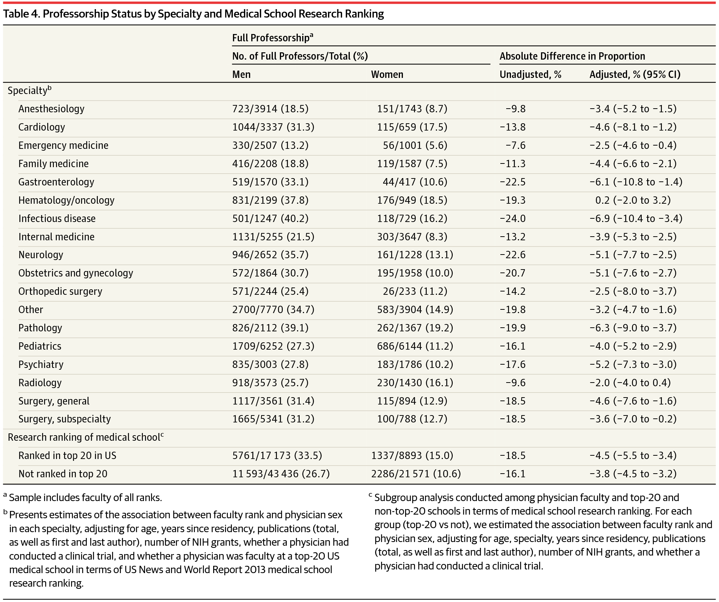
JAMA 2015
Notes:
Significant disparities across the board

Slide 31
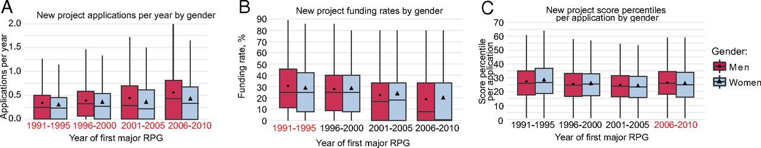

Boxplots of new project application volume, funding rates, and score percentiles, by gender and cohort.
Lisa A. Hechtman et al. PNAS doi:10.1073/pnas.1800615115
©2018 by National Academy of Sciences
Notes:
Boxplots of new project application volume, funding rates, and score percentiles, by gender and cohort. Markers indicate means; bars indicate medians. Red cohort labels indicate statistically significant gender differences (P ≤ 0.05, Wilcoxon rank-sum test, two-tailed). Outliers are not shown. (A) Women submitted slightly fewer new applications per year than men overall and within each cohort (1991–1995: women, n = 2,192; men, n = 5,539; W = 6,383,318, P < 0.001; 1996–2000: women, n = 2,436; men, n = 5,876; W = 7,802,511, P < 0.001; 2001–2005: women, n = 2,690; men, n = 6,068; W = 8,868,382, P < 0.001; 2006–2010: women, n = 3,342 men, n = 6,627; W = 11,865,699, P < 0.001). (B) While average funding rates were no different between the genders overall, women had a slightly lower funding rate in the 1991–1995 cohort (women, n = 1,551; men, n = 4,032; W = 3,235,387, P = 0.04). (C) While women and men’s average score percentiles were not statistically different overall, in the 2006–2010 cohort, women scored slightly better on average than men (women, n = 1,501; men, n = 3,175; W = 2,487,779, P = 0.02).

Slide 32
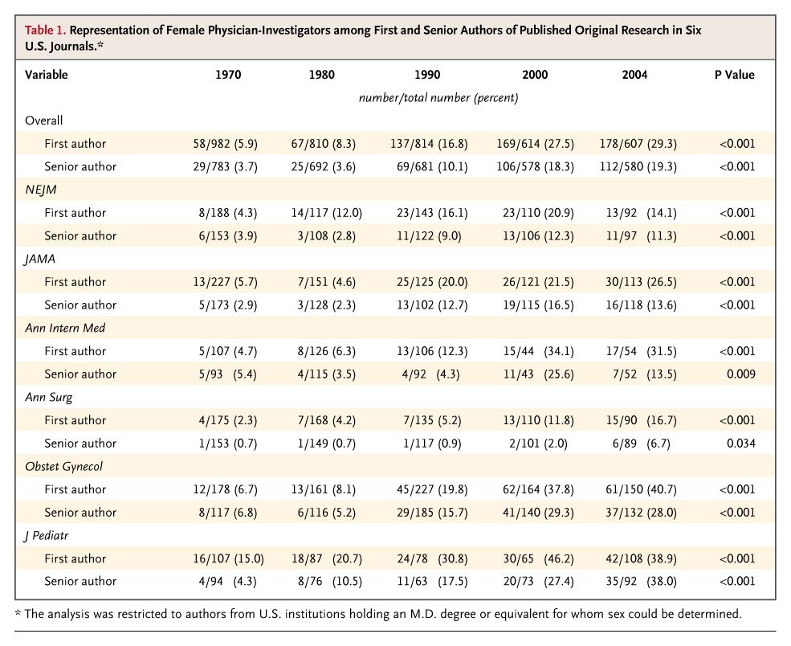
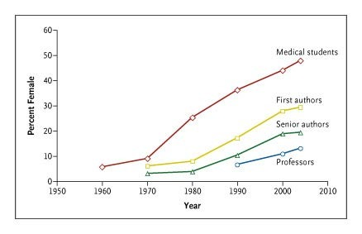
Gender and Authorship
Notes:
First and senior authorships lag far behind- tied into research funding issues

Slide 33
Editors and Editorial Boards
Editors
  10/63 women (16%)
Editorial Boards
  719/4112 women (17.5%)
            -Amrein et al Gender Medicine Volume 8, Issue 6, December 2011, Pages 378-387

Slide 34
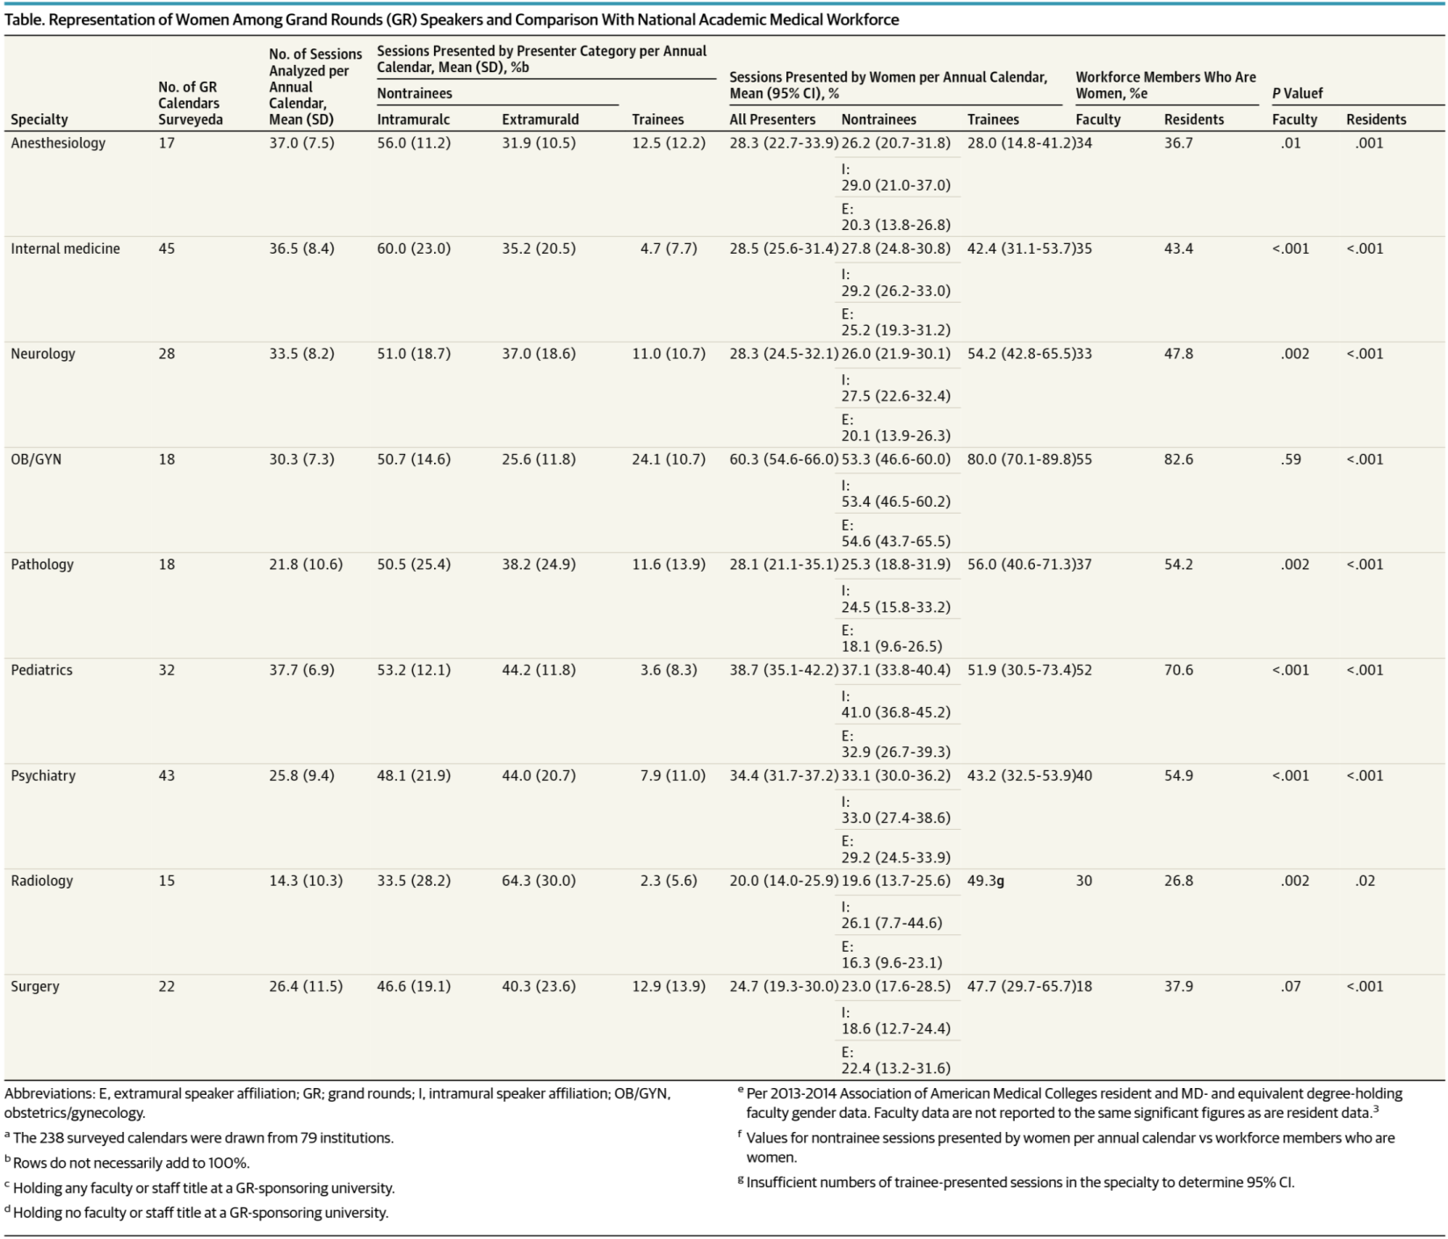
From: Representation of Women Among Academic Grand Rounds Speakers
JAMA Intern Med. 2017;177(5):722-724. doi:10.1001/jamainternmed.2016.9646
Date of download: 10/16/2018
Copyright 2017 American Medical Association. All Rights Reserved.
Notes:
Important to start to track your own data- quite revealing

Slide 35
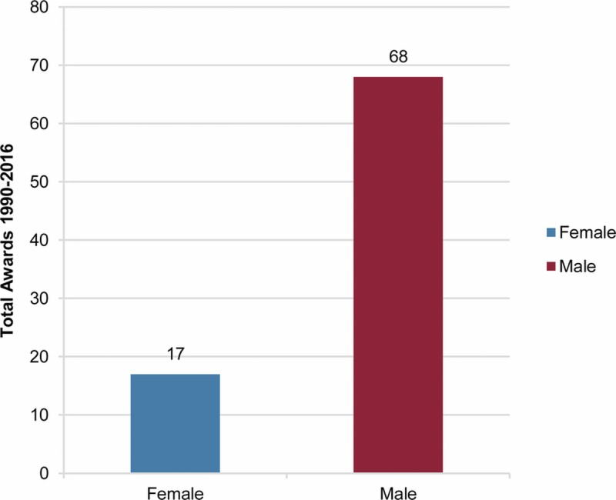
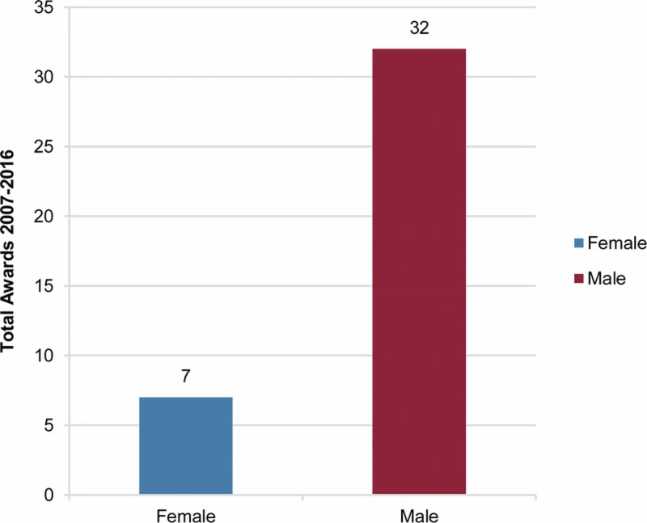
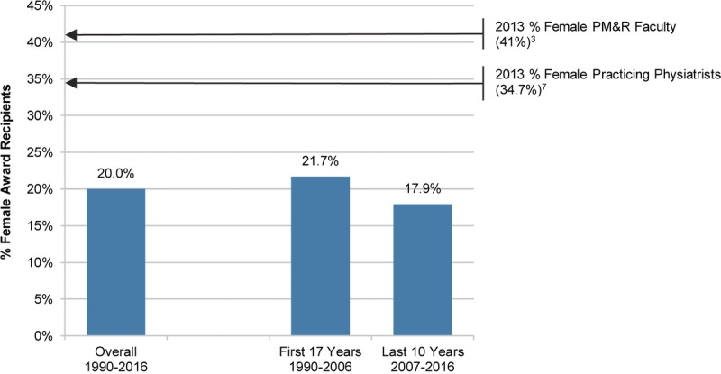
Women Physicians Are Underrepresented in Recognition Awards
Julie Silver et al Am J Phys Med Rehabil. 2018 Jan; 97(1): 34–40.

Slide 36
ACP National Awards
 | 2007-08 | 2008-09 | 2009-10 | 2010-11 | 2011-12 | 2012-13 | 2013-14 | 2014-15 | 2015-16 | 2016-17 | 2017-18
Women - Masters
Nominees | 4 | 4 | 5 | 5 | 8 | 5 | 8 | 15 | 17 | 23 | 27
Percentage of Total Nominees | 5.0% | 5.0% | 5.7% | 5.9% | 9.8% | 6.9% | 11.8% | 16.3% | 18.3% | 23.5% | 27.0%
Selected | 4 | 4 | 5 | 5 | 7 | 5 | 7 | 8 | 11 | 12 | 19
Percentage of Total Selected | 8.7% | 8.3% | 10.0% | 10.0% | 16.3% | 10.6% | 16.7% | 14.5% | 21.2% | 22.6% | 32.2%
Percentage of Those Nominated in Subset Selected | 100.0% | 100.0% | 100.0% | 100.0% | 87.5% | 100.0% | 87.5% | 53.3% | 64.7% | 52.2% | 70.4%
Women - Awardees
Nominees | 12 | 13 | 10 | 10 | 8 | 9 | 9 | 8 | 14 | 17 | 17
Percentage of Total Nominees | 20.3% | 20.3% | 14.9% | 14.9% | 15.1% | 20.9% | 30.0% | 16.7% | 22.2% | 20.2% | 21.5%
Selected | 3 | 6 | 3 | 5 | 4 | 3 | 5 | 4 | 6 | 5 | 5
Percentage of Total Selected | 18.8% | 35.3% | 16.7% | 26.3% | 21.1% | 15.8% | 29.4% | 22.2% | 30.0% | 22.7% | 23.8%
Percentage of Those Nominated in Subset Selected | 25.0% | 46.2% | 30.0% | 50.0% | 50.0% | 33.3% | 55.6% | 50.0% | 42.9% | 29.4% | 29.4%

Slide 37
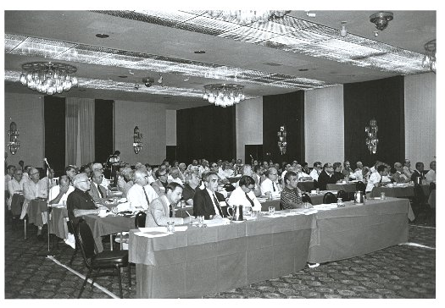
1982 Board of Governors

Slide 38
Professional Society
Boards of Trustees/Regents/Directors
Organization | Number of Women | Number of Men | Percentage of Women
AMA | 6 | 15 | 28.5%
ACP | 6 | 14 | 30%
ACS | 6 | 26 | 18.7%
ACOG | 13 | 17 | 43.3%
AAFP | 4 | 12 | 25%
AAP | 7 | 7 | 50%
APA | 12 | 10 | 54.5%
AAHPM | 10 | 8 | 55.5%
Notes:
Per survey data 64% of respondents to a survey were women.

Slide 39
Presidential Leadership of National Medical Professional Societies Over Decade 2007-2017
Society/Societies | % Women Presidents
AGS, APA | 50-60%
ASNR, SCCM | 40%
AACAP, ACEP, ASH, ASN, AAP, ATS, ACR, RSNA | 30%
ACP, AAFP,ACS, IDSA, AAO, AAOHNS, AAPM&R, ACPM, | 20%
AAAAI, ASA, AACE, ACG, ACOG, ASPS, ASTRO, SVS | 10%
CAP,AAD,SCAI,AANS, AAN, AAOS, AAPM, AATS, AUA, SIR | 0%

Slide 40
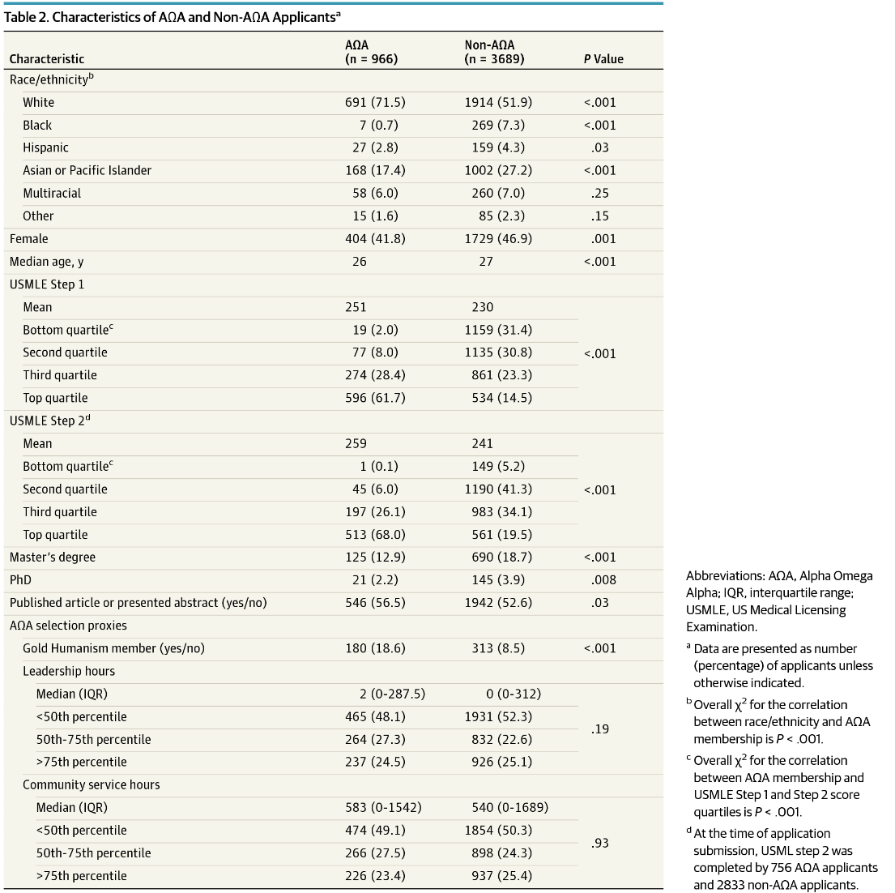
Boatright et al. Jama Internal
Medicine 2017; 177(5): 659-665

Slide 41
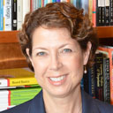
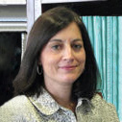
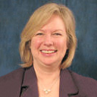
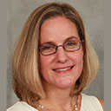
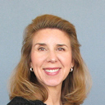
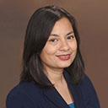
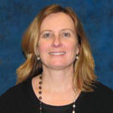
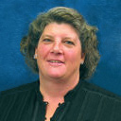
ACP Senior Staff
Davoren Chick,
Senior VP Medical Education
Christine Laine,
Senior VP/Editor in Chief, Annals of Internal Medicine
Shari Erickson,
Senior VP Governmental Affairs & Medical Practice
Diane Scott-Licther, Senior VP Publishing
Allison Ewing,
VP Public Relations & Marketing
Tabassum Salam,
VP Medical Education
Daisy Smith,
VP Clinical Program
Nancy Matthews, Senior Advisor, Business Development

Slide 42
Potential Macro Level Concerns-Culture And So Much More…
Total compensation-salary/stipends/bonuses, clinical/research administrative resources/support
Advancement
Global Evaluations
Structural overt and implicit bias
Workforce implications
Human toll and financial cost to organizations and systems

Slide 43
Lots Of Challenges…
Imposter syndrome/pygmalion effect
Lexicon of gender descriptors/stereotypes
Implicit bias- informing attitudes and decisions without rising to the level of consciousness
Time…
Confidence and concerns about active or passive retaliation
Identifying Coaches, Mentors, and Sponsors/Champions

Slide 44
The Facts About Women In Business Leadership
When women lead, performance improves
Startups led by women are more likely to succeed, but VC funding challenging for women’s businesses
Innovative companies with more women in top management are more profitable
Companies with more gender diversity had more revenue, customers, market share and profits
“To break down barriers that hold women back it’s not enough spread awareness. If we don’t reinforce that people need-and want to- overcome their biases, we end up silently condoning the status quo”

Slide 45
Micro/Individual Level Challenges
Socialized in a male-dominated society
Women underestimate their worth, are out of traditional loops, have fewer coaches/mentors/sponsors, and fold more readily
Pink elephants in the room- concepts of “scarcity”, “DIY Bootstraps”, “frenemies”
More susceptible to burnout
Uncertain how to react to structural inequities- compensation, advancement, evaluations, governance, processes
Concern for retaliation

Slide 46
Differentiating Coaches, Mentors, and Sponsors…
A Coach talks to you
A Mentor talks with you
A Sponsor talks about you- Sponsorship is public support for the advancement of someone with untapped leadership potential
-Travis et al, Sponsorship:A Path To The Academic C- suite for Women Faculty? AcadMed, 2/13

Slide 47
Words Matter-Is The Professor Bossy Or Brilliant?
Rate My Professor-Women are more likely to be described as nice, bossy, disorganized, helpful, annoying or playing favorites and men are likely to be described as a star, knowledgeable, awesome, or the best professor
Impact on evaluations including MSPEs, resident evaluations and code leadership, position descriptions and hiring
-Isaac et al, Acad Med, 2011
-Arora et al, JGME, 2017
-Carnes et al, Acad Med 2009,2015
-www.catalyst.org/biascorrect
Notes:
Rate My Professor from Northeastern U Professor Benjamin Schmidt, NYT 2/15
Issac study- text analysis of 297 MSPEs, only female students had “Family medicine” correlating with “standout” adjectives
Arora et al is a qualitative study PGY-3 EM resident evaluations “Gender Differences in Attending Physicians feedback” found that men received more consistent and women more discordant feedback. Autonomy was thought to be a leadership characteristic for men but not women. Women more likely to be characterized as “argumentative”.
Carnes et al included best practices to avoid job descriptions that prime the male gender (strong, charismatic, leader) and avoid male suffixes such as “Chairman” in job titles, work towards an applicant pool that has at least 25% women, do not ask about parenthood status.
Code leadership- 25 medical residents from 9 programs, no perceived differences in leadership effectiveness, code leadership=highly agentic, counternormative and stressful for female residents
“Agentic” specialties male dominated and correlated with higher “status” (procedures, higher rank, tenured)within specialties whereas communal specialties (Peds, GIM, Geri, FM) lower status and more education, service, lower rank and non-tenured

Slide 48
Does Career “Flexibility” Exist?
UC system has had flexible policies (family/ childbearing leaves, stop the tenure clock active service modifications) since 1988 but only 6.7% of women and 0% of men have used these policies
1/3rd of those < 50 years old wanted to use but did not make the request
Concerns about burdening colleagues, perceptions that they were not committed combined with an unsupportive culture, career damage, limiting future opportunities, and facetime bias
Flexibility should be mutually beneficial and result in superior outcomes for all parties
- Howell, AcadMed, 8/17

Slide 49
I Wish I Could Say That We Don’t Need Just To Be Better Negotiators…Who, When, What, Where, How
Understand what they want out of the negotiation- eg what’s the big picture, how are you compensated and what are the criteria for advancement?
Try to discover the party you are negotiating with learning and negotiation style, arm yourself with data, understand what you bring to the position
Get the facts- is my compensation and growth trajectory in line with other members of my group?
Play out scenarios and Practice…
What is your BATNA?
What is your documented follow up?

Slide 50

Time To Hit Reset

Slide 51
I/WE CAN With Deliberative Practice-
System Level Recommendations
Get expertise in understanding I CAN- Inclusiveness, Comprehensiveness, Accountability, Networking
Transparent assessment of baseline data and needs assessment-tell everyone how compensation and advancement is determined and demonstrate it
Actively address inclusiveness at every level of your institution and understand the cost to your organization in terms of productivity, PTSD, job satisfaction/commitment, health
Ensure comprehensive approaches and combine solutions- leadership, governance, system and grass roots (culture and informal system issues)
Measure the results and share with others
Notes:
Recent article (Arora, Choo, JGME 10/17)about how an institution addressed that their male trainees were getting more shoutouts regarding their scholarly work than women. They instituted a monthly publication that systematically reviewed all trainees recent scholarly work.
Others actively review their speaker lists to ensure they are achieving equity and getting equal podium time for all.

Slide 52
ACP Diversity and Inclusion Task Force:
A Case Study In Deliberative Practice
Convened in July 2017 to create a strategic plan to increase diversity and inclusion in ACP
Recommended establishing a Diversity and Inclusion Subcommittee of the Governance Committee to achieve the following goals:
  Provide a sustainable commitment to developing effective strategies to assure integration of diversity and inclusion across the College’s governance and membership that is adaptable to the changing environment and membership demographics
  Establish a dedicated body within the College’s governance structure with appropriate resources and staff support

Slide 53
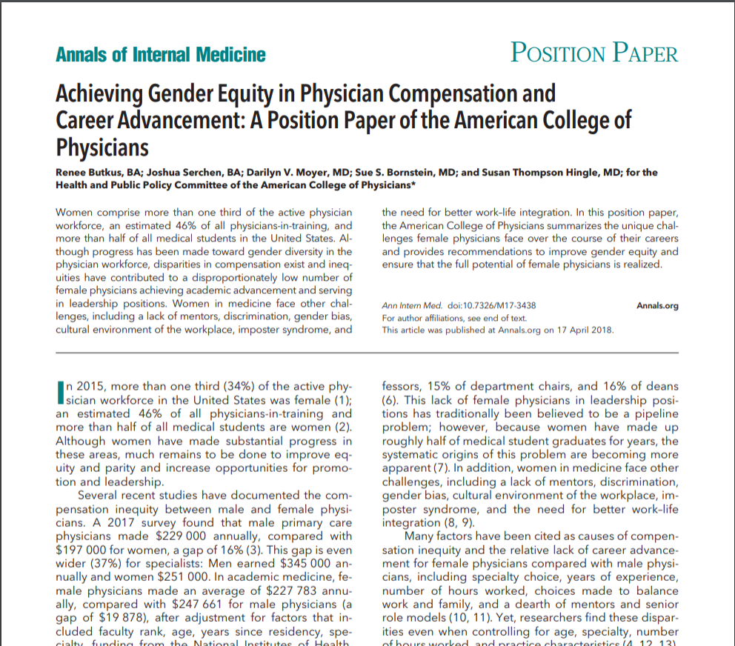

Slide 54
Achieving Gender Equity in Physician Compensation and Career Advancement
Physician compensation
Family and medical leave
Leadership development
Unconscious bias training
Research on gender inequity
Oppose harassment, discrimination, and retaliation
Butkus R, Serchen J, Moyer DV, Bornstein SS, Hingle ST, for the Health and Public Policy Committee of the American College of Physicians. Achieving Gender Equity in Physician Compensation and Career Advancement: A Position Paper of the American College of Physicians. Ann Intern Med. ;168:721–723. doi: 10.7326/M17-3438

Slide 55
I CAN MAP…
Mentor- find and be a mentor
Amplify- comments, accomplishments
Promote- sponsorship, propensities that defy biases, equitable power dynamics, candidacies, awards, named whatevers… no “women left on the rim”
Notes:
Amplification was used successfully in the Obama White House when initially West Wing women staffers were outnumbered by male staffers 2:1. They worked together to actively amplify each other in meetings and discuss other women’s accomplishments. By the end of the 8 year term, women in the West Wing outnumbered men 2:1

Slide 56
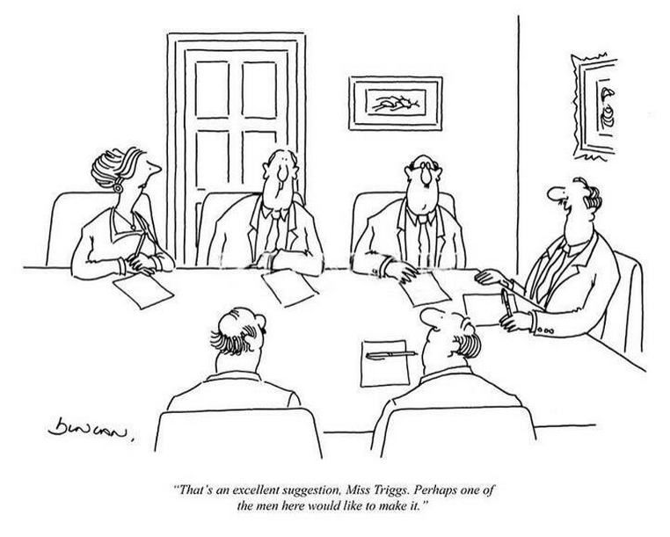

Slide 57
I CAN MAP CPR- Strategies For The Micro/Individual Level
HBR 5/17- “How To React To Biased Comments At Work”
The totality of micro aggressions can be “soul destroying” and need to be actively addressed
Concern that victims don’t want to accused of playing the diversity card
Power dynamic
Retaliation concerns
Seed the soil for improvement with CPR-Context, Pattern, Relationship considerations

Slide 58
Seed The Soil With CPR, Know Your Goal, Make It Safe
Content- egregious, subtle or somewhere in between
Pattern- multiple subtle occurrences- gather more data until a pattern emerges
Relationship- cumulative impact on trust

Slide 59
Know Your Goal…
Before you speak up, think about what to achieve- apology, punishment, improved relationship
State your take without being accusatory and describe what really happened- “ … and here’s what I heard you say and I’m not sure you understand how it came across”
Make it safe- acknowledge that everyone has unconscious biases

Slide 60
Everyone Should Address The Pink Elephants In The Room…
Scarcity bias
DIY “Pull Yourself Up By Your Bootstraps” bias
Pull everyone in with gratitude
Move to Meaningful Coaching, Mentorship and Sponsorship
Engage those in positions to affect change

Slide 61
Getting Mentors, Sponsors, Coaches…
Peek around the corners-find your “go to” people
Ask others for their stories
Be gender blind-encourage men in equitable mentoring
Look to younger folks and non-traditional peers
Don’t be afraid to show that you are human
Interventions are particularly effective when initiated by men in male dominated fields

Slide 62
And Opportunities…
Unleash a new lexicon-words matter
Learn how to address varied scenarios, negotiate, practice, address systemic issues and play them out
Shake off confirmation bias-walk down new hallways with others
Let implicit bias motivate you to educate
Be gracious and pull others up with you-it makes you more powerful
Listen to others and tell your story

Slide 63
Opportunities for Macro and Micro Levels…
Start the conversation with opportunities in challenges for your processes around hiring and advancement, appointments, awards, recognition, governance structure
Start somewhere/everywhere- local hospital, practice, academic healthcare network committee or group
Actively address wording for job descriptions/performance, a composition for the search committee, program planning committee, task force, speakers, panels, etc
Look for and develop benchmarking tools…and publicize/publish them

Slide 64
A Randomized Controlled Trial To Improve The Success of Women Assistant Professors
3 levels of intervention- development of WAPs, changes at the dept/division level through faculty-led task forces, engagement of institutional leaders (used Total Leadership Program)
Academic productivity and work-self efficacy improved over the 3 yr trial in both intervention and control groups in PhDs, not MDs
Avg work hrs/wk declined sig more for faculty in the intervention group (-3.8 vs. -1.4)
      Abbuhl et al, JWomen’s Health, 26, 2017. pp1-9

Slide 65
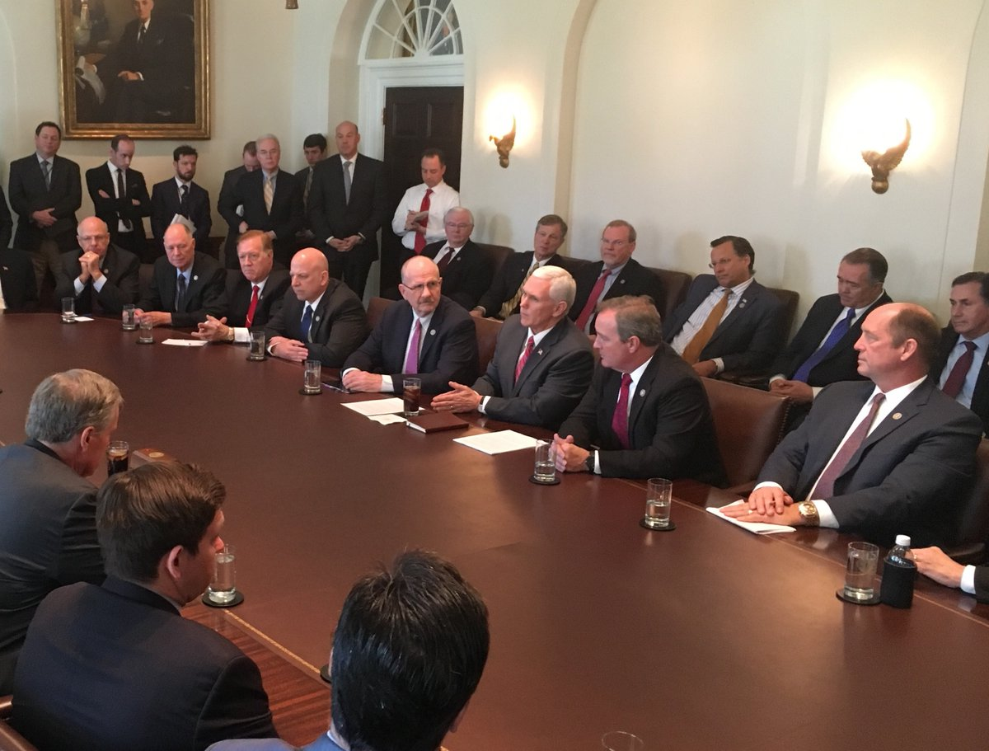
Where Are The Women?

Slide 66
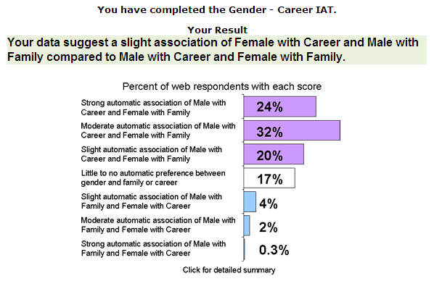
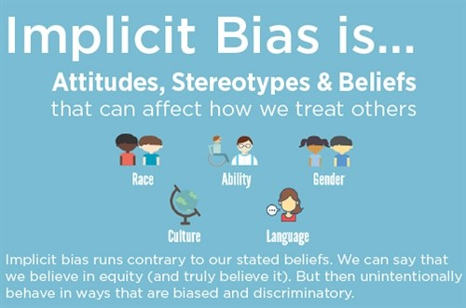
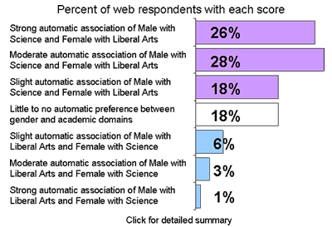
https://implicit.harvard.edu/implicit/

Slide 67
Begin With An End In Mind…
Need crucial conversations, transparency, tools, metrics, best practices
Need collaboration
How can this group be the change we want to see?

Slide 68
Top 10 Things You Can Do to Impact
Gender Equity in Medicine
Advocate: Advocate for family, maternity, and paternity leave. Caregiving, whether of children or of parents, still primarily falls on women. Advocate for education that supports whole-woman care, including contraception and family planning. Advocate for inclusion of more women in clinical trials. Advocate for institutional requirements for hiring and promotion that address and fix inequities. Advocate for equal gender representation on search committees and in applicants. Advocate for recognition of all types of work, including committees, task forces, and comprehensive, complex patient care, and advocate for payment for all work.
Amplify: Amplify the accomplishments of women. Give credit when it is due. Don’t take credit away from the woman who speaks up.
Celebrate, Honor, and Support: Celebrate positive examples and experiences. Celebrate differences. Honor female leaders by promoting them to positions of leadership within your professional community and nominate them for deserving acknowledgments and awards. Find allies with influence. Be an ally with influence. Believe in yourself and in other women. Support each other. Support choices that may not always validate our own.

Slide 69
4. Engage: Engage everyone, including leadership and men, to make gender equity a priority. Engage minority females to ensure we are looking out for all women—African American, Hispanic, Asian American/Native Hawaiian/Pacific Islander, and Native American women, as well as LGTBQ and those with disabilities— whose pay gap and leadership gap issues are worse. Demand prompt and non-retaliatory corrective actions in response to gender bias, harassment, or discrimination. Insist on gender pay equity.
5. Help: Offer to help. Be available. Offer opportunities. Help make connections. Write letters of support and recommendation that overcome gendered language and expectations. Teach negotiation skills. Help by urging women who are busy but uninvolved professionals to join organized medicine in this fight.
6. Measure: Make measurement a priority. Insist that institutions include markers to address leadership and pay gaps. Make sure these measurements include underrepresented minorities.
7. Mentor: Be a mentor and look for mentors.

Slide 70
8. Promote: Promote practices that push away biases and create more equity. Use gender-neutral language in position descriptions, conversations, evaluations, and promotion criteria. Promote diversity and inclusion for search committees, task forces, and standing committees. Promote gender inequity awareness at meetings by making it an agenda item.
9. Respect: Respect the person—regardless of gender, cultural, or other identity. Respect the role that the physician has in your organization and/or wants to have. Respect one’s ideology.
10. Share and Solicit: Share what makes you successful, share what you know. Share unwritten rules and unspoken knowledge. Solicit female role models to visit your institutions.
Advancing the Careers of Women: What ACP’s Female Leaders Think Annals Fresh Look Blog
Fatima Z. Syed, MD, MSc 9/26/2018

Slide 71
Organization | Sample Initiatives
University of Chicago | Senior leadership compensation review committee ensures objective comp for top 20 positions
City of Hope | Promoting data transparency on diversity and inclusion, including developing dashboards for FY19
Cleveland Clinic | Enterprise-wide performance management initiative for top 40 executives
Rush Health System | Women’s Leadership Council reviews annual HR benefits reviews and helps identify adverse effects
Advocate Aurora Health | Talent Review Board mandates a diverse slate of candidates and manages annual review process
Geisinger | “Women That Lead” employee resource group
Ohio State University | Implicit bias testing required for members of search committees and admissions committee
University of Pennsylvania Southern Illinois University School of Medicine | Culture Conducive to Women’s Academic Success survey (Westring et al. Acad Med. 2012 Nov; 87(11): 1622–1631.

Slide 72
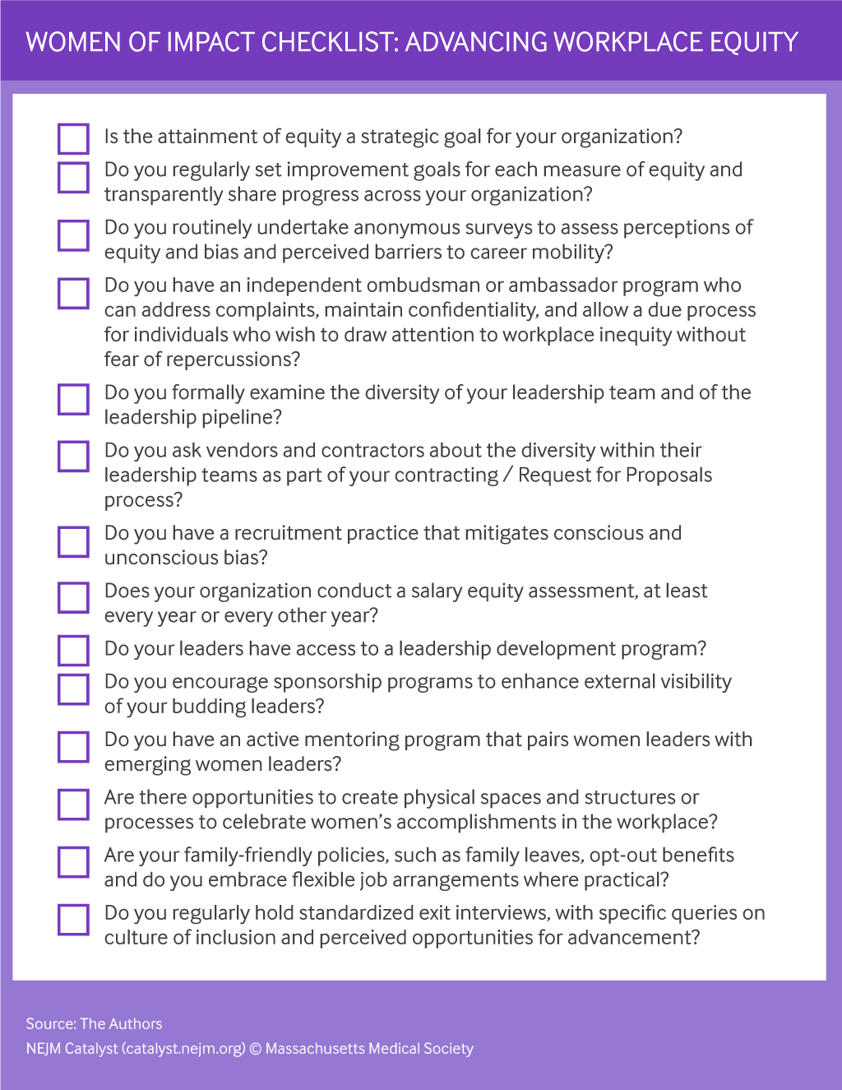

Slide 73


#HeForShe
HeForShe is a solidarity campaign for the advancement of gender equality, initiated by UN. Its goal is to achieve equality by encouraging both genders to partake as agents of change and take action against negative stereotypes and behaviors, faced by women.

Slide 74
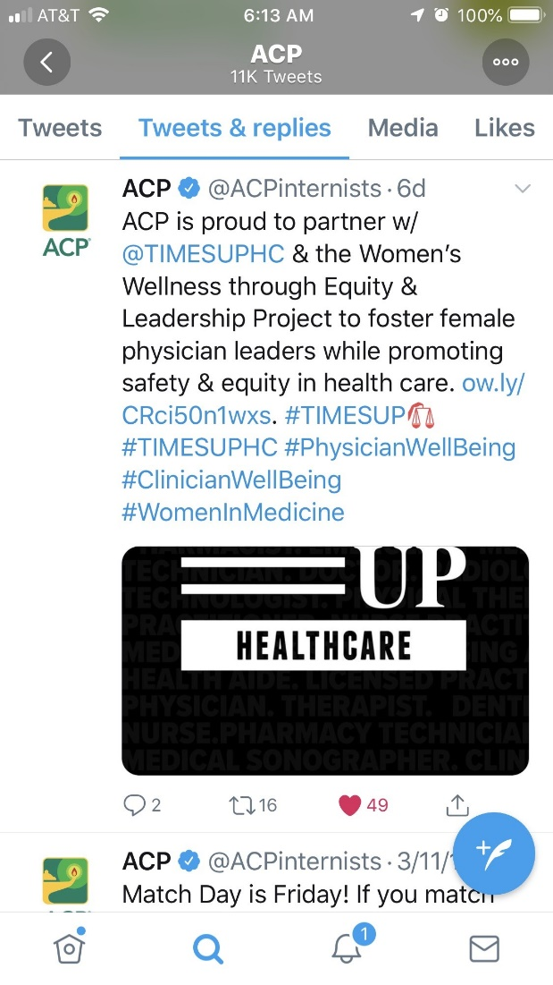
Times Up Is An Opportunity

Slide 75
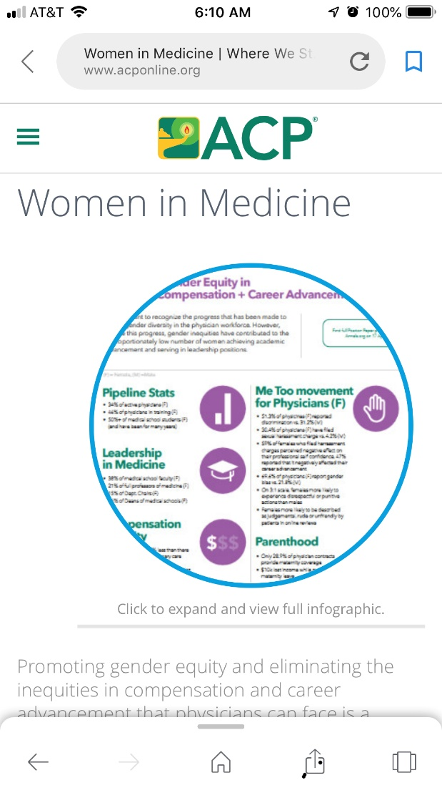

Slide 76
Remember to ASSERT Yourself
Assess- Confidence Gap and Valuation
Style- Know your and the other party’s leadership and negotiation style
Set the stage-use gender-based style in your favor
Engage- recognize factors that would truly engage the other party
Revisit- remember to recognize that there could be an opportunity to continue/revisit the negotiation
Tenacity and Thanks- use them and memorialize the negotiation(s)

Slide 77
7 Tips For Men Who Want To Support Equality
Challenge the likability penalty
Evaluate performance fairly
Give women credit
Get the most out of meetings
Share the office housework
Make work work for parents
Mentor women and offer equal access
                www.leanin.org

Slide 78
“In The Company Of Givers And Takers”
Adam Grant- HBR 2013
Givers, takers and matchers
Givers more assertive if acting as an agent on behalf of others
Majority of people are matchers- influenced by the work culture
Key is promoting a giving culture and an atmosphere of generosity toward each other
Notes:
Increasing data that the collaborative environment created by teams with more women results in more cooperative behavior in the OR, as documented by a recent study.

Slide 79
Adam Grant’s One Sentence Classroom Experiment…
Presented data to his classes regarding the underrepresentation of women in leadership roles and discussed the factors that held women back
During the next semester, there was no change in the % of female MBA students who applied for leadership positions on campus
The next year, he added one sentence asking people to do something about diversity in leadership, and saw that women applying for leadership increased by 65%

Slide 80


Slide 81
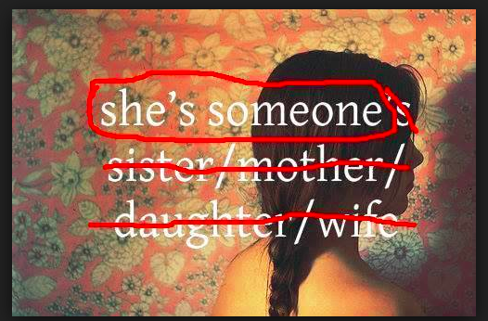

Slide 84


Slide 85


Slide 86
Additional Resources
www.acponline.org/wim
www.aamc.org
www.aauw.org

Slide 87
Get the Facts With Catalyst Reports www.catalyst.org
Catalyst reports expose the existence of stereotypes and bias, and the pernicious effect they have on opportunities for advancement for women, people of color, and others.
Women “Take Care,” Men “Take Charge”: Stereotyping of U.S. Business Leaders Exposed
Cascading Gender Biases, Compounding Effects: An Assessment of Talent Management Systems
The Double-Bind Dilemma For Women In Leadership: Damned If You Do, Doomed If You Don’t
The Myth Of The Ideal Worker: Does Doing All The Right Things Really Get Women Ahead?
Good Intentions, Imperfect Execution? Women Get Fewer Of The “Hot Jobs” Needed To Advance
Feeling Different: Being the “Other” in US Workplaces
The Day to Day Experiences of Workplace Inclusion and Exclusion

Slide 88
Case Studies

Slide 89
Position Statement One: Case Study
Challenge | Potential Solution
Dr. W is a third-year resident in internal medicine who is exploring her career options after residency. She is very interested in returning to her hometown to serve the indigent where she was raised. She knows that there is a dearth of African American physician role models so is excited to return home. As she is discussing her contract with a colleague who is also interested in working for the same clinic with identical experience and position description, she is made aware that her contract offer is 30% less than that of her white male colleague. | Recognizing Dr. W's valid concerns, Dr. W's potential new boss looks into it and finds out that she is correct. The offer is changed so that she is offered the same as her male colleague. In addition, he begins routinely and transparently providing deidentified data about compensation, stratified for rank and time in rank, for both new hires and current faculty. This is shared with every faculty member during the hiring and annual faculty review process.

Slide 90
Position Statement Three: Case Study
Challenge | Potential Solution
Dr. H is an early-career physician. After she and her husband adopt an infant son, she takes 6 weeks of family leave. Upon returning, she is informed that the leave was unpaid because institutional policy treats adoption as family leave, which is unpaid. Had the leave been maternity leave, it would have been paid. | Dr. H and Dr. L, a colleague from pediatrics who experienced the same challenge, work with their employer to change the policy. The policy now allows for 6 weeks of paid leave for maternity leave, which includes adoption of a child. They are continuing to work on changes that will expand it to a parental leave policy that includes fathers.
Medical specialty boards should be flexible in
their requirements for board eligibility in circumstances
when trainees took family or medical leave.

Slide 91
Position Statement Four: Case Study
Challenge | Potential Solution
Dr. J is a successful academic physician who has achieved the status of full professor and who serves as chair of the Department of Medicine as well as chair of the Board of Directors of a prominent national medical organization. Despite these remarkable accomplishments, she shies away from attention and often passes up opportunities for fear of being underqualified for the next step. She is concerned that a next step could be a glass cliff and does not want to worsen the cause for women in medicine by failing. | Dr. J believes that the best approach to her personal and organizational concerns will require multilevel interventions. She meets with her faculty development dean to review how other institutions have addressed the imposter syndrome and glass cliff barriers. They obtain information and actionable practices from other institutions and implement programs to improve the confidence, skills, and leadership qualities of individual faculty.
ACP supports the provision of programs in leadership
development, negotiation, and career development
for all physicians and physicians-in-training.

Slide 92
Position Statement Five: Case Study
ACP supports the provision of regular and recurring
implicit bias training by all organizations that employ
physicians. Organizational policies and procedures
should be implemented that address implicit bias.
Challenge | Potential Solution
Curious that the Department of Medicine Promotion and Tenure Committee has only 1 woman and 1 underrepresented minority, Dr. F, the new chair of the Department of Medicine, reviews promotion data for his department and finds that women and underrepresented minorities progress substantially more slowly than others. | After finding that women and underrepresented minorities progress substantially more slowly than others, Dr. F implements processes within the Department of Medicine that assure that each annual performance review of individual faculty members includes a discussion about promotion needs and timelines.

Slide 93
Position Statement Six: Case Study
Challenge | Potential Solution
Dr. T serves as the only woman department chair at an academic medical center. In addition to raising 3 children and caring for her aging mother, she is a well-known academic “triple threat” who maintains an active clinical practice, is an award-winning teacher and medical educator, and consistently secures NIH funding for her research on hypertension. The academic institution she works for has convened a search committee for its next dean. She is interested in becoming dean. Knowing the influence chairs can have, she is disappointed to learn that during an informal gathering that included many of the chairs, the chairs had not even considered her for the dean position because “they assumed she was too busy.” | Dr. K is the dean of a medical school and calls for a review of diversity and inclusion status and policies in the institution, including a baseline needs assessment, installation of a Diversity and Inclusion Task Force whose composition specifically weights underrepresented minority and female faculty to review the survey data, current status of formal and informal processes that feed the leadership pipeline, organizational changes from this actionable data, and accountable metrics to track progress in the leadership and advancement for all faculty.

Slide 94
Position Statement Seven: Case Study
Challenge | Potential Solution
Dr. G prides herself on being a highly sought-after internal medicine specialist because of the comprehensive, patient-centered care she provides to her patients. Many women patients seek care from her because she will take care of not only their medical problems but also their Pap smears and psychosocial issues. Her quality metrics and patient satisfaction ratings are the highest in her practice. During her annual performance review, she is notified that she will need to increase her productivity or take a pay cut because her RVUs are lower than those of her colleagues. She believes that this is due to the additional time she spends per patient visit. | Dr. G asks for her practice to consider tracking the additional gynecological and mental health care provided, as well as weighting quality metrics and patient satisfaction, for all members in her practice. She offers to work with her management and colleagues to find a compensation model that will acknowledge and incentivize these additional metrics. Her practice agrees because they want to retain physicians.
Further research is needed on the reasons for and effect of gender pay inequity and barriers to career
advancement and the best practices to close these gaps across all practice settings.

Slide 95
Example #1
A female faculty member who has just had a second child has served as an assistant clerkship director for several years with consistently positive reviews of her performance by all stakeholders. When the clerkship director announces their departure for a new position, the person in charge of choosing the new clerkship director does not consider her for the position because they thought she “already had her hands full” and didn’t want the faculty member to feel “conflicted”. How should the faculty member handle this?

Slide 96
Example #2
A 0.5 FTE primary care physician who has been in private practice for 10 years is negotiating with the organization that is acquiring practices for integration into a regional health care organization. The practice has actively promoted their commitment to preventive medicine, and this physician has been considered a poster child for care of the whole patient- including conducting comprehensive exams, actively addressing mental health/sociobehavioral issues, and performing female gynecologic examinations. In the course of analysis, the physician is told that due to their “low RVU production”, their compensation package in the new health system will be “adjusted accordingly”. The physician’s personal financial analysis indicates that the new compensation package does not cover costs for household expenses. How should this physician address this situation?

Slide 97
Example #3
A faculty member who is a 4 year Assistant Professor at their institution, discovers that another faculty member, in the same division, with the same amount of experience, time in rank, and job description, is compensated at a 15% higher rate. How does this faculty member address this situation?

