Slide 1

Well-being Resources: Promoting Well-being & Long-term Sustainability as You Advocate
Crissy Walter, MSOD
Sr. Associate, Well-being and Professional Fulfillment

Slide 2

Agenda
WBPF Resource Overview
  Advocacy and Guidance
  Ongoing Supports
  Career Lifespan Training and Resources
Questions

Slide 3
ACP Well-being and Professional Fulfillment
Part of an integrated adaptive system since 2017
Internal
Patients Before Paperwork Initiative Membership Programs (DE&I, WIM, IMPower, IMPact, Career and Prof. Development) Chapters & Activities Center for Ethics and Professionalism 15 ACP departments support the program #I.M. Proud
External
National Academy of Medicine Collaborative on Clinician Well-being and Resilience – founding member Collaborative for Healing and Renewal in Medicine (CHARM) National Physician Suicide Awareness American Medical Association-Behavioral Health Integration Emotional PPE Project Physician Support Line G6 (represent 590K+ Frontline Physicians)
Campaigns Impacting Internal and External Efforts
(#dontworryalone) National Physician Suicide Awareness Day I.M. Emotional Support Mental Health Awareness Day Health Workforce Well-being Day
Notes:
Note for Speaker: G6, is a group of Associations representing over 590,000 frontline physicians: American Academy of Family Physicians, the American Academy of Pediatrics, the American College of Obstetricians and Gynecologists, the American College of Physicians, the American Osteopathic Association, and the American Psychiatric Association

Slide 4
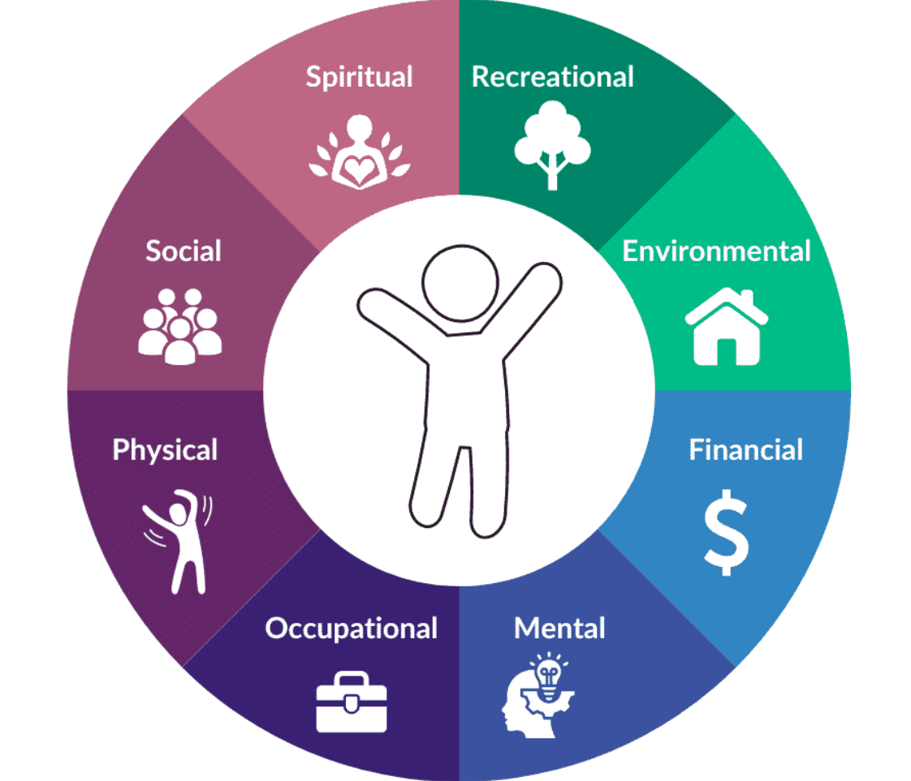
WBPF for I.M. Physician Career Lifespan
Tailored approach to fit each unique intersection
  WBPF Resource Themes :
  Advocacy and Guidance
  Ongoing Supports
  Career Lifespan Training and Resources
  Stages:
  Students: early normalization of help-seeking, identity formation support, resources intro.
  Early career: coaching, financial clarity, career navigation.
  Mid-career: leadership development, career pathways, community connection.
  Late career: transition planning, financial well-being, coaching, and legacy pathways.
  *One-size-fits-all solutions
  won’t work.*

Slide 5
Coordinated, Practical,
Career Spanning Resources

Slide 6
Advocacy and Ongoing Guidance

Slide 7
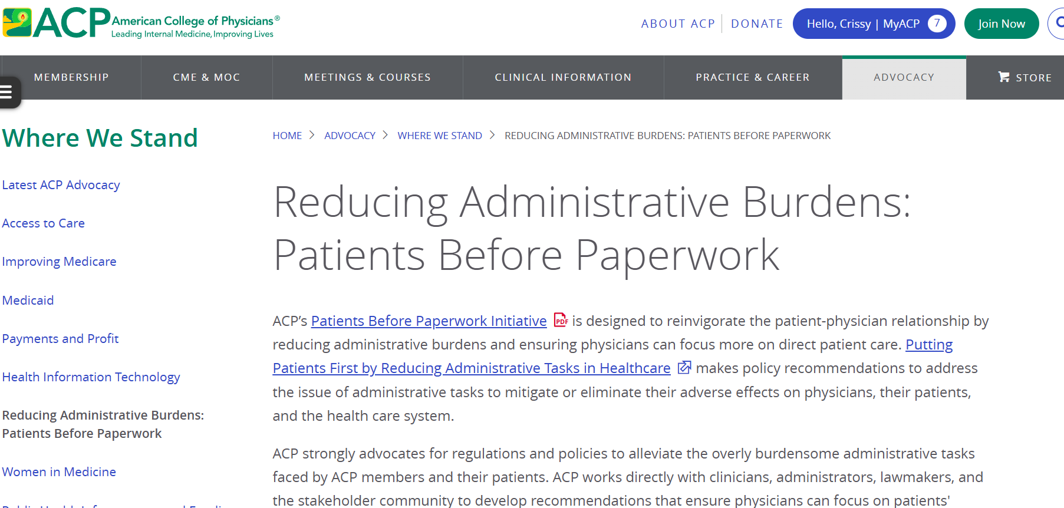
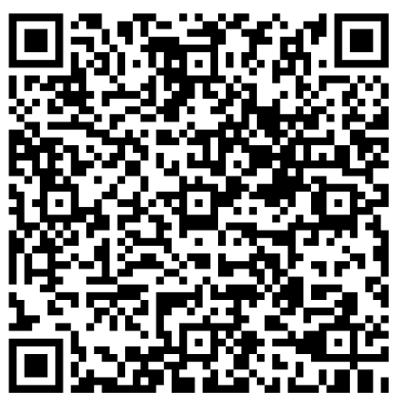
Advocacy: Patients Before Paperwork

Slide 8
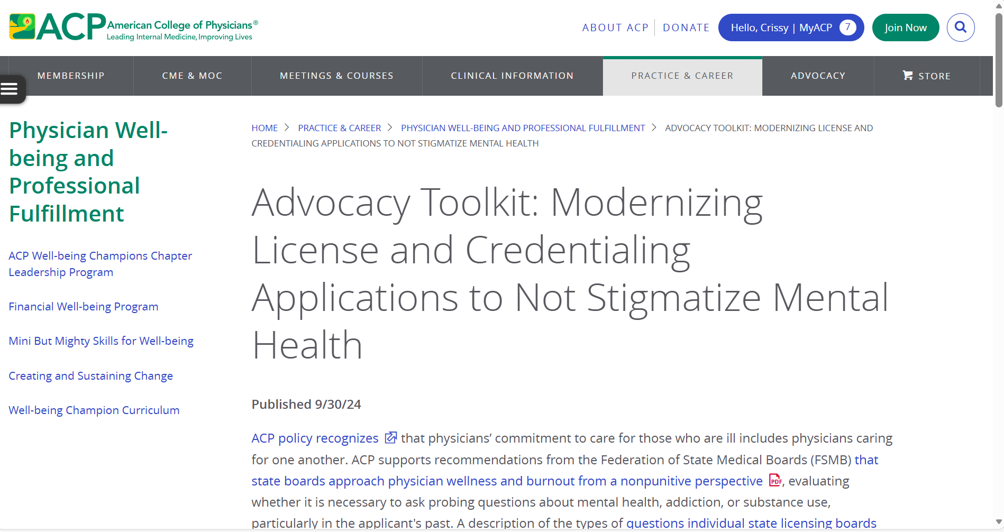
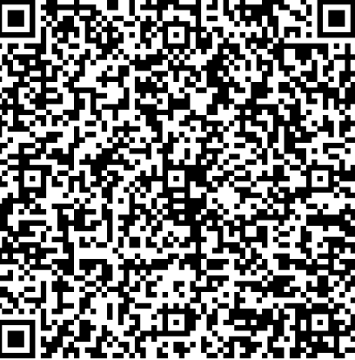
Advocacy Toolkit: Modernizing License and Credentialing Applications to Not Stigmatize Mental Health

Slide 9
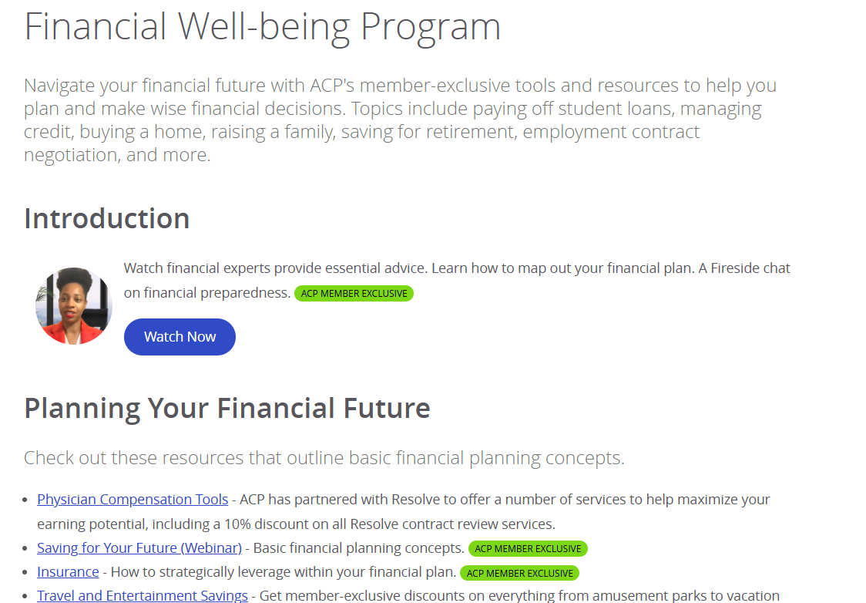
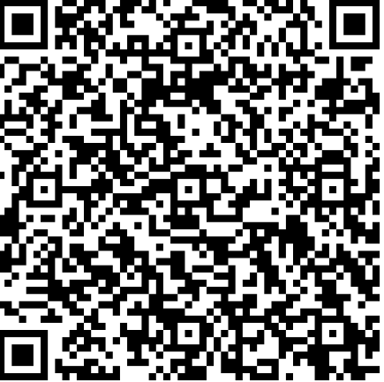
Financial Well-being Resources

Slide 10
Ongoing Supports
For: Systems, Communities, and Individuals

Slide 11

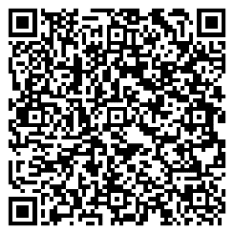
Physician Well-Being & Professional Fulfillment Resources
Equipping internal medicine physicians to foster well‑being and professional fulfillment
  Promotes individual, organization, and system-level well-being
  Multiple tools available
    I.M. Emotional Support and Resident Well-being Hubs
    Podcasts, TED Talks, blogs, apps, mini skills, and more
    CME opportunities
acponline.org/wellbeing

Slide 12

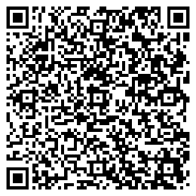
I.M. Emotional Support Hub & Video Series
Physicians: Take Care Of Yourselves, Too
Quick access to peer support and counseling resources
Physician Suicide: Awareness and Prevention Resources
Support resources for individuals and organizations
  Videos offering coping strategies
  CME-accredited well-being webinars
  Tips for stress management
  Tools for cultivating self-compassion
  And more
acponline.org/supporthub

Slide 13



Slide 14
Training, Curriculum, and Resources
For: Career Lifespan

Slide 15
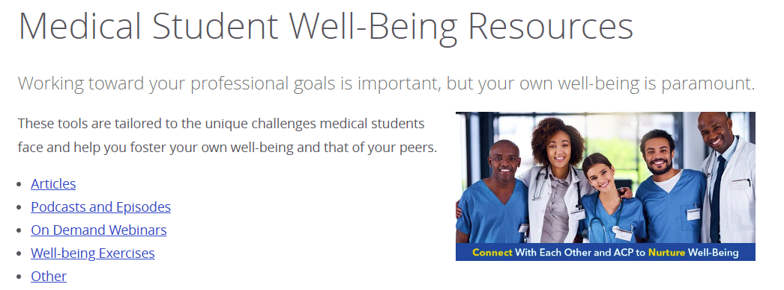
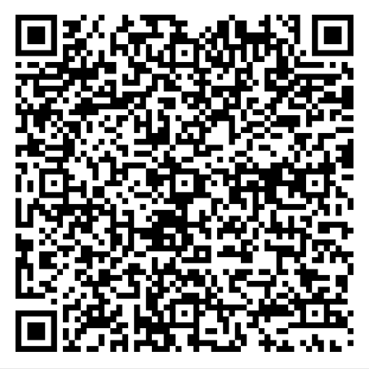
Medical Student Well-being Resources

Slide 16


Resident Well-being Learning Hub
Prioritize Resident Well-being
Aligned with the new ACGME requirements for resident training in well-being.
Curriculum sections can be taught individually or as a complete program.
Three multimedia online modules offer individual and organizational strategies to :
  foster well-being
  mitigate burnout, and
  promote the value of collaborative learning environments and positive social interaction
ACP Resident Well-being Hub
Notes:
ACP's New Resident Well-Being Curriculum is ideal for residency programs. Three online sections review strategies to foster well-being, mitigate burnout, and promote the value of collaborative learning environments and positive social interaction.
Aligned with the new ACGME requirements for resident training in well-being, the modules can be taught individually or as a complete program.

Slide 17
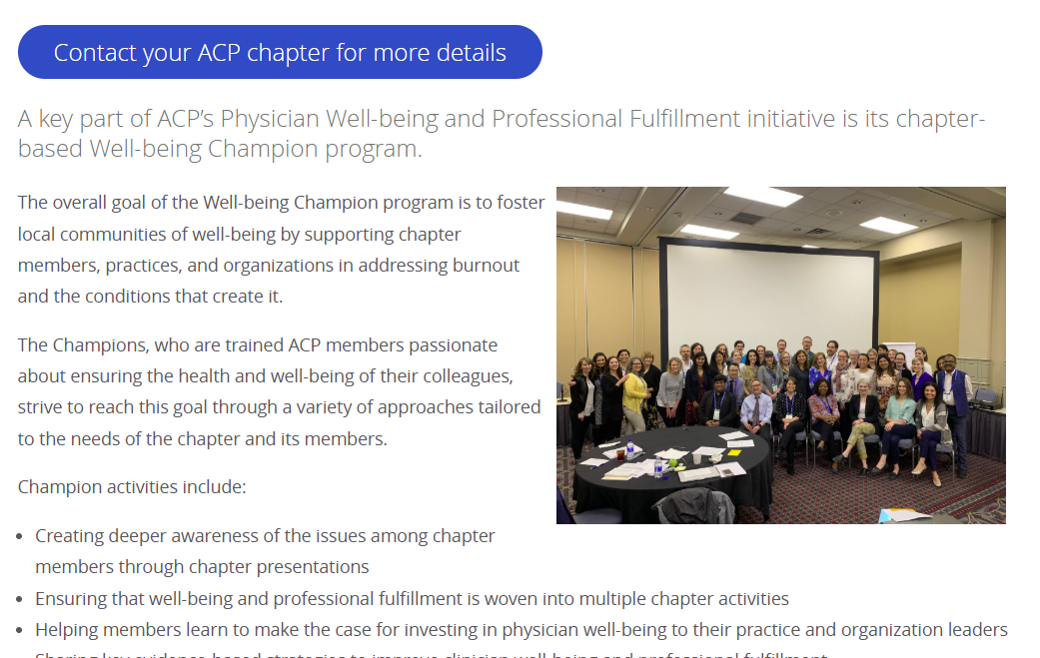
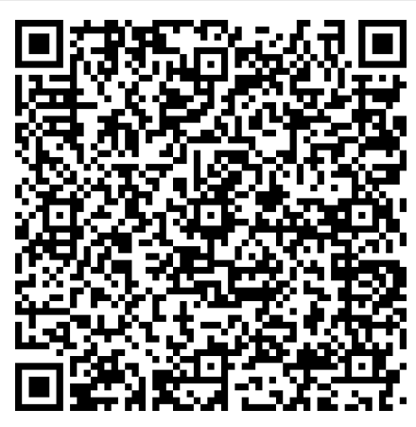
Well-Being Champion Chapter Leadership Development Program

Slide 18

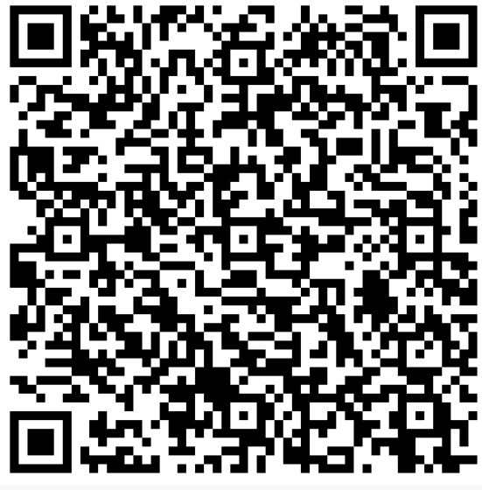
Well-being Champion Curriculum
Start a Domino Effect for Well-Being
Wherever you are in your life and career, you can be the force that sets the first domino in motion. ACP’s free, self-paced Well-being Champion Curriculum equips you with the knowledge and skills to start a chain reaction of support, connection, and care in your community.
*Free and Exclusive to ACP Members
*General Membership Rollout 3/18/26 on Health Workforce Well-Being Day
WBC Curriculum

Slide 19
Master a Well-being Skill During a Coffee Break

Slide 20


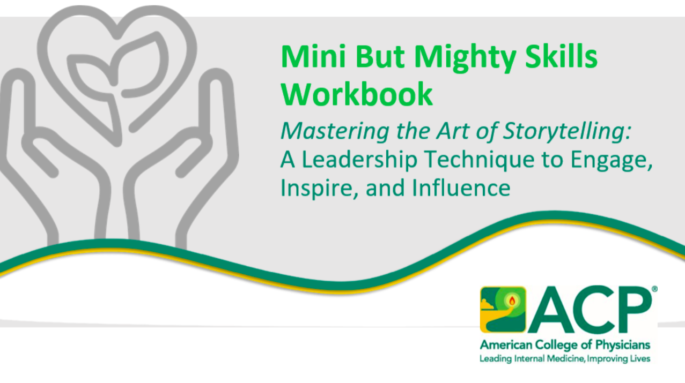
Mini But Mighty Skills (15 mins or less)
New! Mastering the Art of Storytelling: A Leadership Technique to Engage, Inspire, and Influence:
With engaging videos, real-world examples, and a reflective workbook, participants will learn to craft impactful stories that build trust, inspire action, and support well-being.
acponline.org/minibutmighty

Slide 21
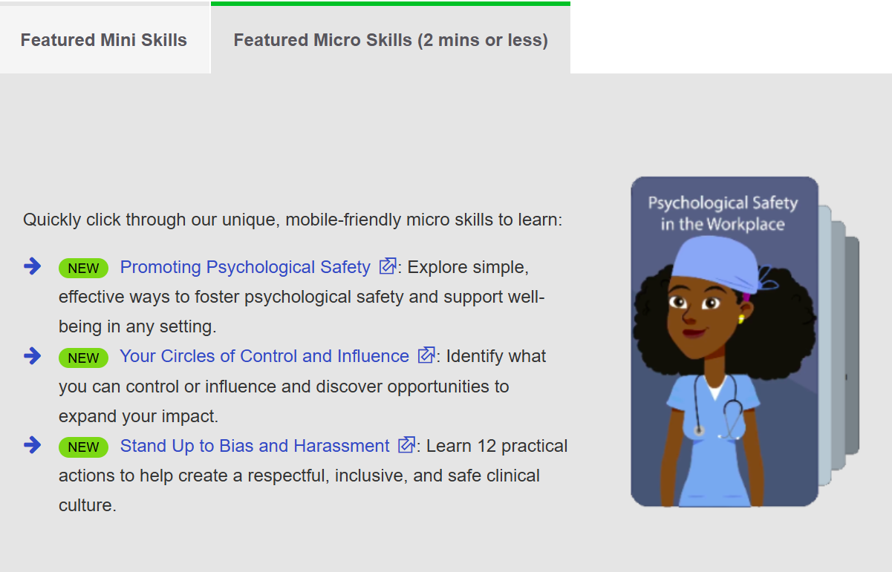
Micro But Mighty Skills (less than 2 mins)
acponline.org/minibutmighty

Slide 22
Systems and Team Well-being

Slide 23
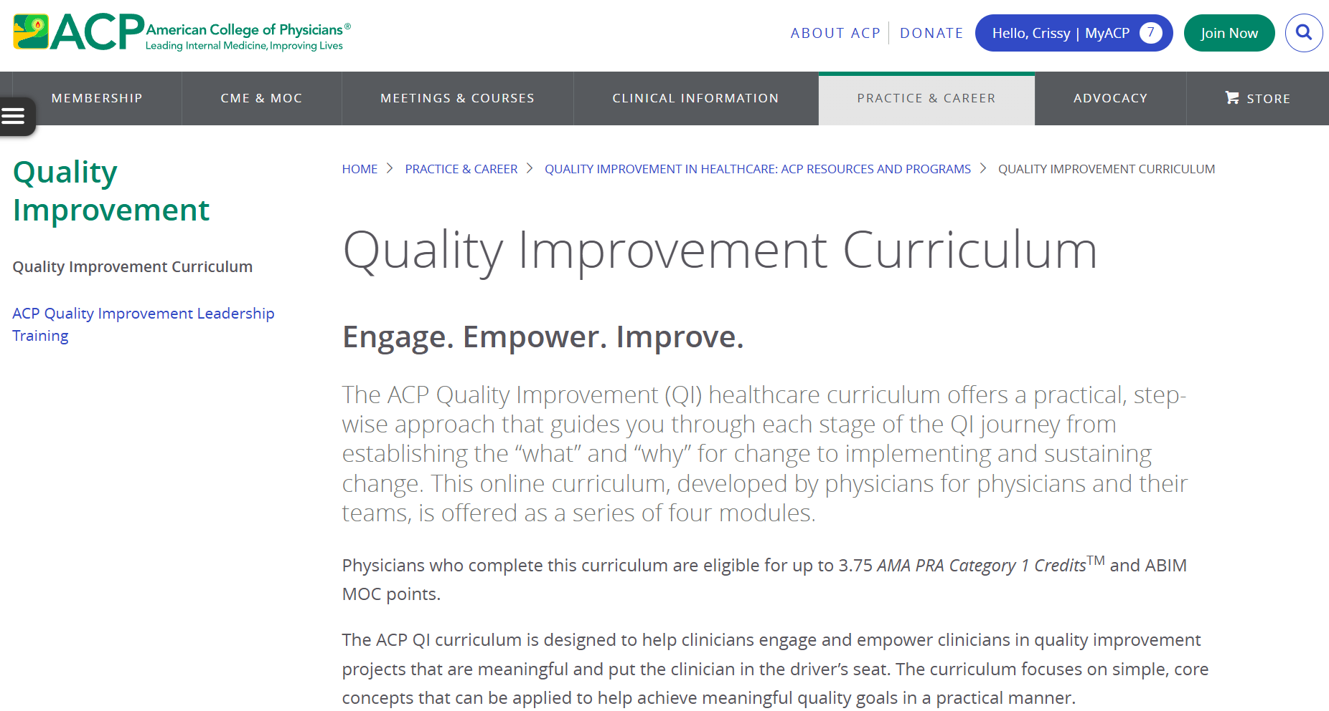
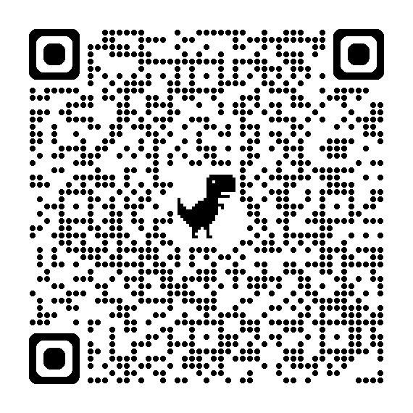
QI Curriculum

Slide 24
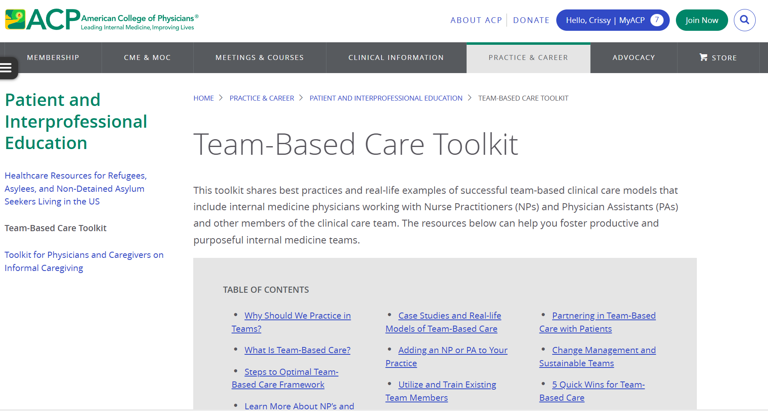
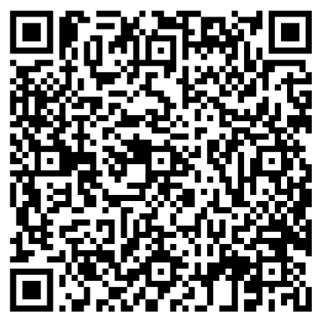
Team-Based Care Toolkit

Slide 25
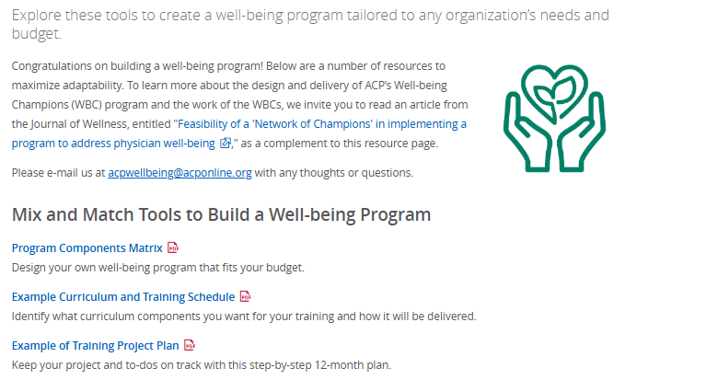
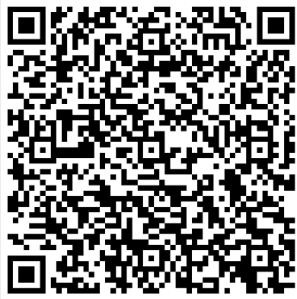
Design Your Own Well-being Program

Slide 26
Navigating What’s Next

Slide 27
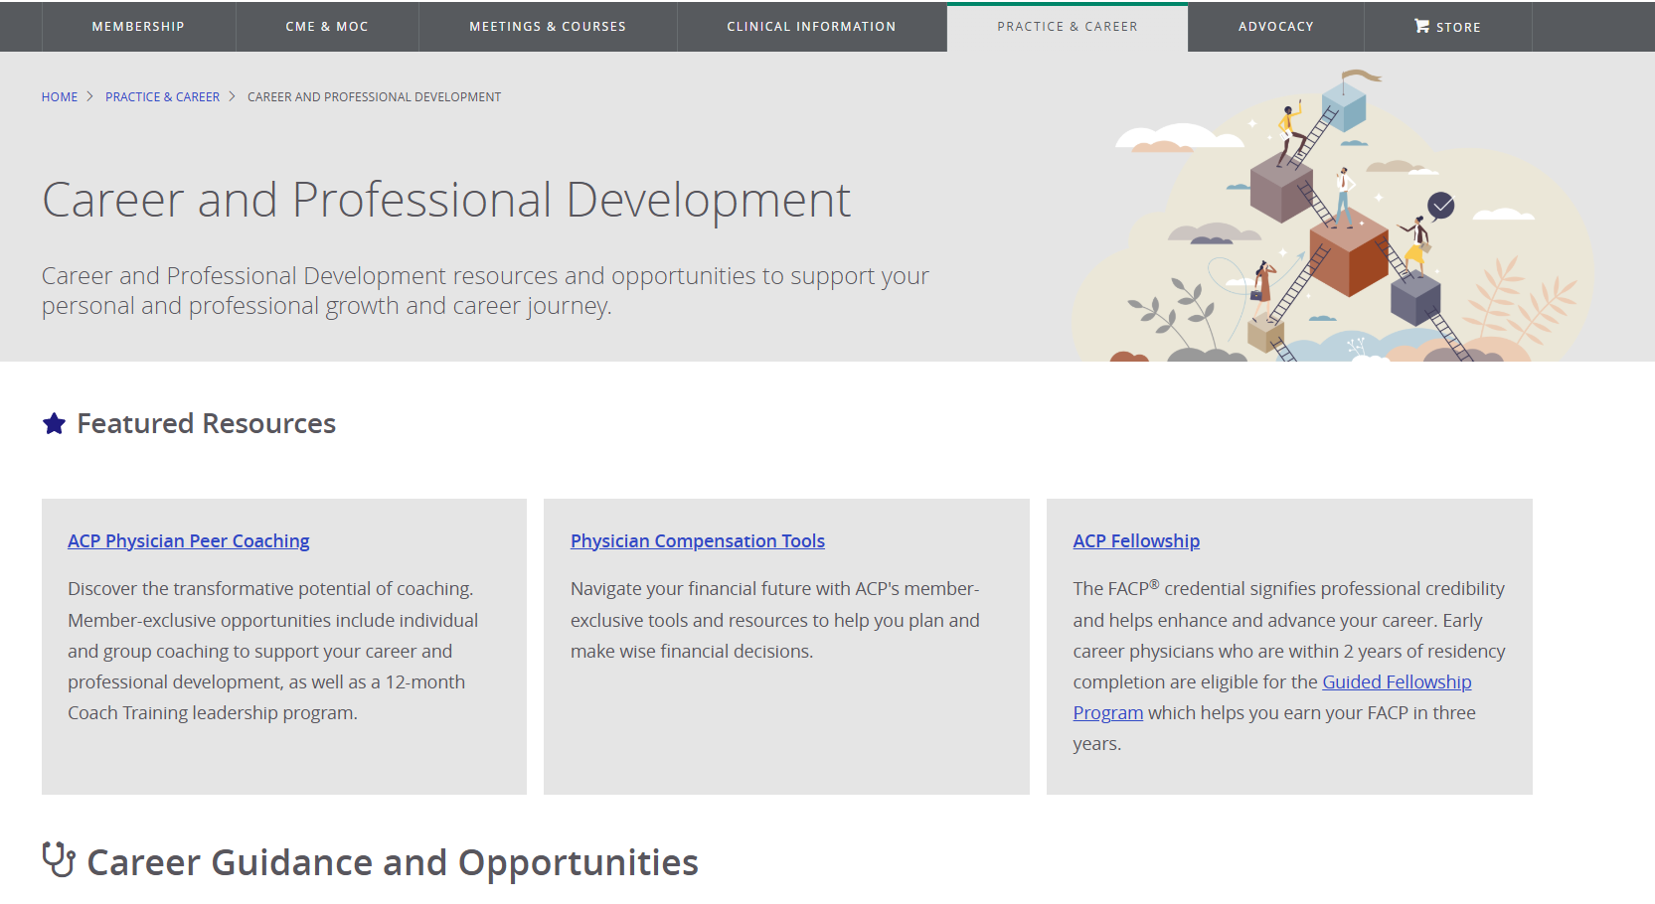
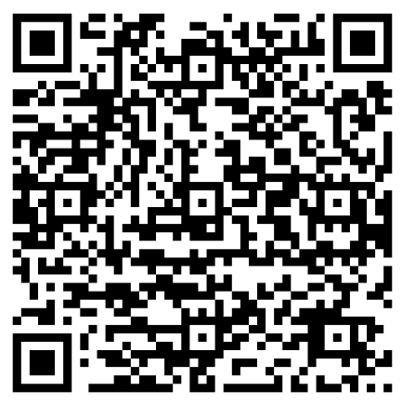
Career and Professional Development Virtual Center

Slide 28



Navigating Career Transitions
Connect. Transform. Achieve.
Connect with an ACP Peer Coach to navigate career transitions.
Explore core strengths, transform challenges into insight, and achieve meaningful momentum toward actionable outcomes.

Slide 29


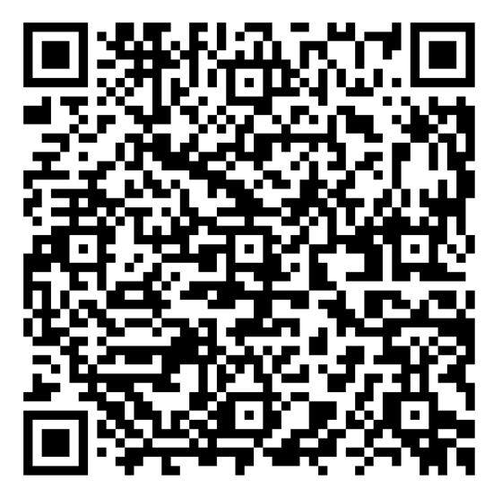
Access additional well-being resources
www.acponline.org/minibutmighty
www.acponline.org/wellbeing
www.acponline.org/supporthub

Slide 30

Questions and Discussion
Additional thoughts, e-mail:cwalter@acponline.org
Notes:
Input from PIPC to shaping WBPF 2.0

Slide 31
Thank You!

