Slide 1
Enhancing your Advocacy with ACP Resources Kory Stuer Associate, State Health Policy and Advocacy State Health Policy Webinar March 12, 2024

Slide 2
Resources Overview
For All ACP Members
Policy Compendium
State Health Policy Toolkits
Advocates for Internal Medicine (AIM) Network
Advocacy Assistance Request Form
For Chapter Leaders Only
State Health Policy Consultations
Grassroots Collaboration with ACP National
State Legislative Tracking
State Fact Sheets

Slide 3
Advocacy Resources for All ACP Members

Slide 4
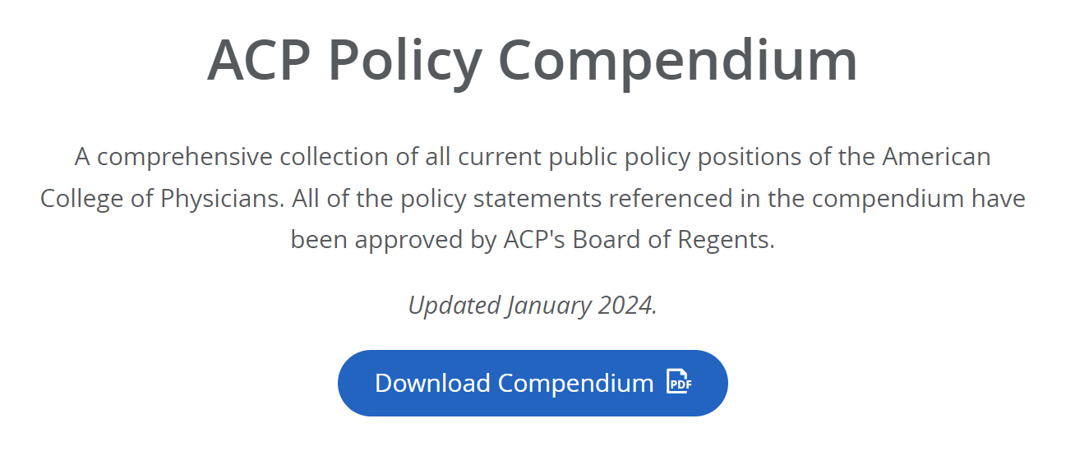
For all members – ACP Policy Compendium
Best first place to look to determine ACP policy on a given issue
Available on ACPOnline Advocacy Page – Where We Stand
Regularly updated to reflect latest College policy
See Compendium on ACPOnline:

Slide 5
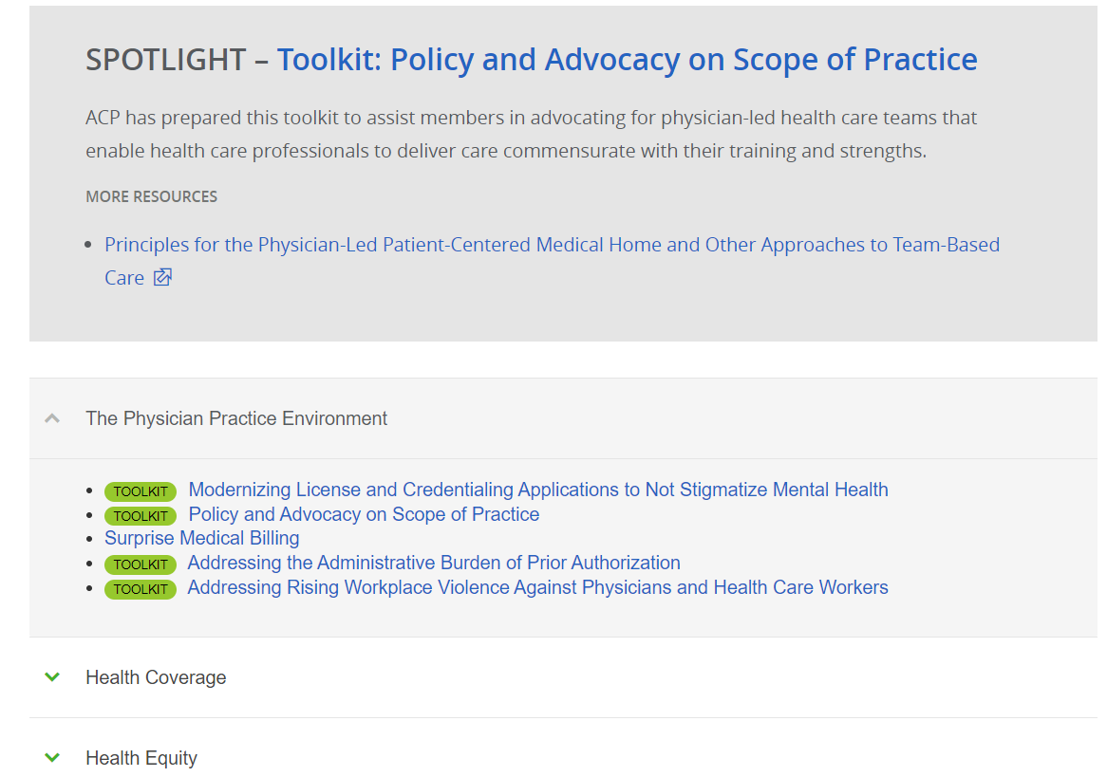
For all members – State Health Policy Toolkits
Available on ACPOnline Advocacy Page – State Health Policy
14 toolkits currently posted on variety of policy issues
See toolkits on ACPOnline

Slide 6
For all members – Advocates for Internal Medicine Network (AIMn)
Enroll in the Advocates for Internal Medicine Network
Join more than 15,000 colleagues in the AIMn program in advocating for the interests of internal medicine in Washington DC. By joining, you will receive legislative updates on key policy issues and engage in outreach to your federal lawmakers.
Visit ACP's Legislative Action Center (LAC):
In 2023, more than 1,100 advocates took action over 2,000 times, sending more than 5,100 total messages.

Slide 7
Current Federal AIMn Alerts
Visit ACP's Legislative Action Center (LAC):

Slide 8
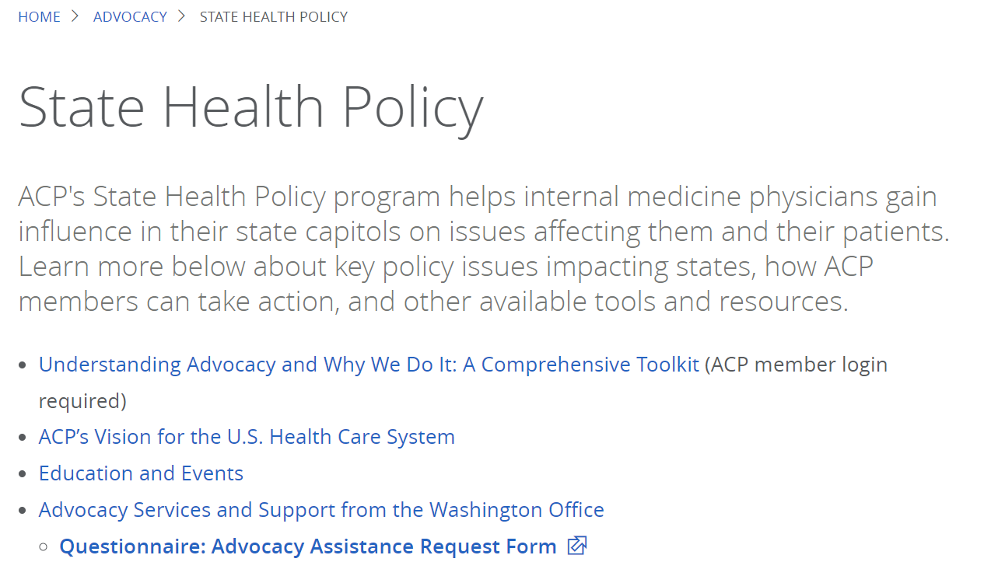
For all members – Advocacy Assistance Request Form
ACP State Health Policy Staff
Available on State Health Policy page on ACPOnline
Access the form on ACPOnline:

Slide 9
Advocacy Resources for Chapter Leaders

Slide 10
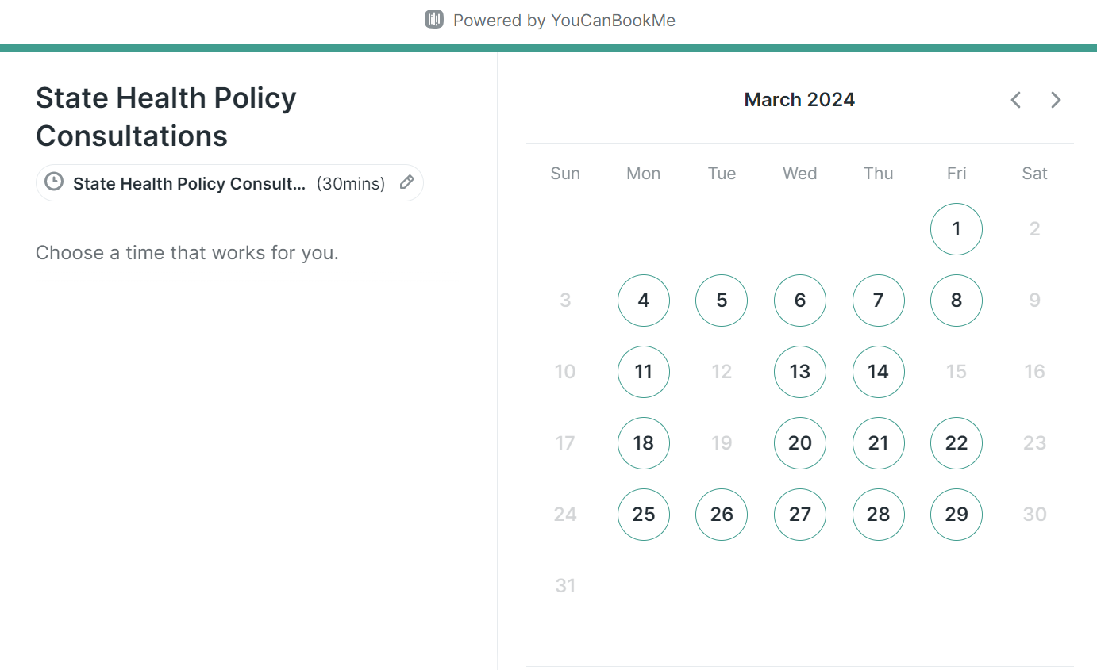
For Chapter Leaders – Consultations with State Health Policy Staff
ACP National's state health policy team is now available to be booked for consultations to discuss policy issues in your state, advocacy strategies, and more
More information on LeaderNet:

Slide 11
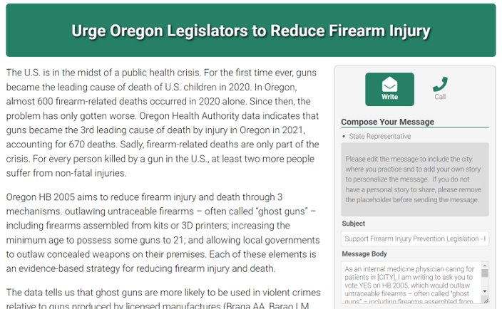
For Chapter Leaders – Grassroots Collaboration with ACP National
Chapter leaders can now request to use ACP's grassroots software to facilitate their members contacting elected officials about health policy issues in their state
More information on LeaderNet:

Slide 12
For Chapter Leaders – State Legislative Tracking
State Leg Tracking on LeaderNet:
ACP is tracking state legislation on:
Reproductive health
Scope of Practice
Prior Authorization
Firearm Injury Prevention
Gender-affirming Care

Slide 13
For Chapter Leaders – State Fact Sheets
Now available for 50 states + DC
Featuring key data points that can be used in your advocacy
Accompanying guidance document with additional information also posted on LeaderNet
State Fact Sheets on LeaderNet:

Slide 14
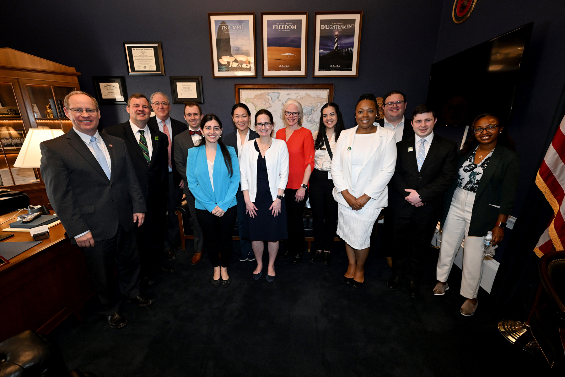
Leadership Day 2024 May 14-15 Westin Washington, DC Downtown

Slide 15
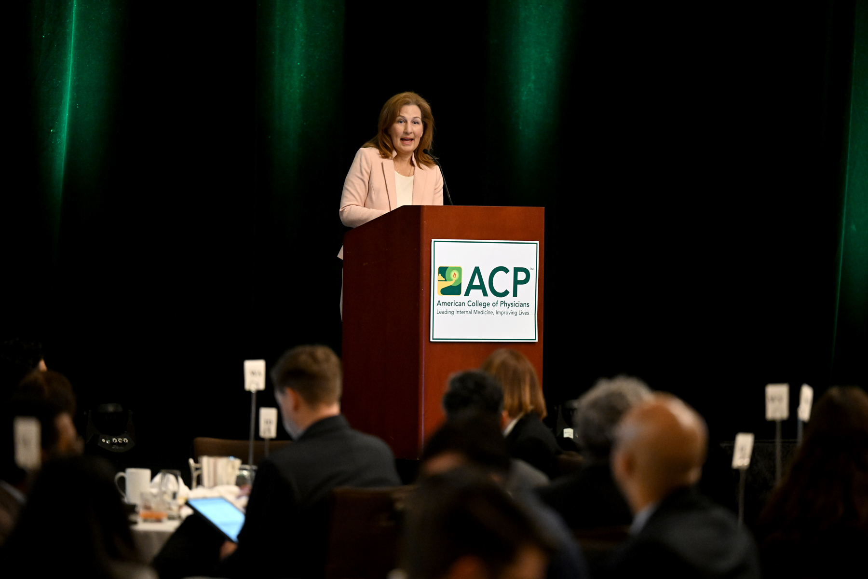
Leadership Day Reminders
Members interested in attending Leadership Day should contact their chapter before registering.
Registration Deadline: April 15
Hotel Room Block Deadline: April 15
Neubauer Award Nominations Deadline: March 25
Please contact Shuan Tomlinson with any questions about Leadership Day at stomlinson@acponline.org

