Slide 1
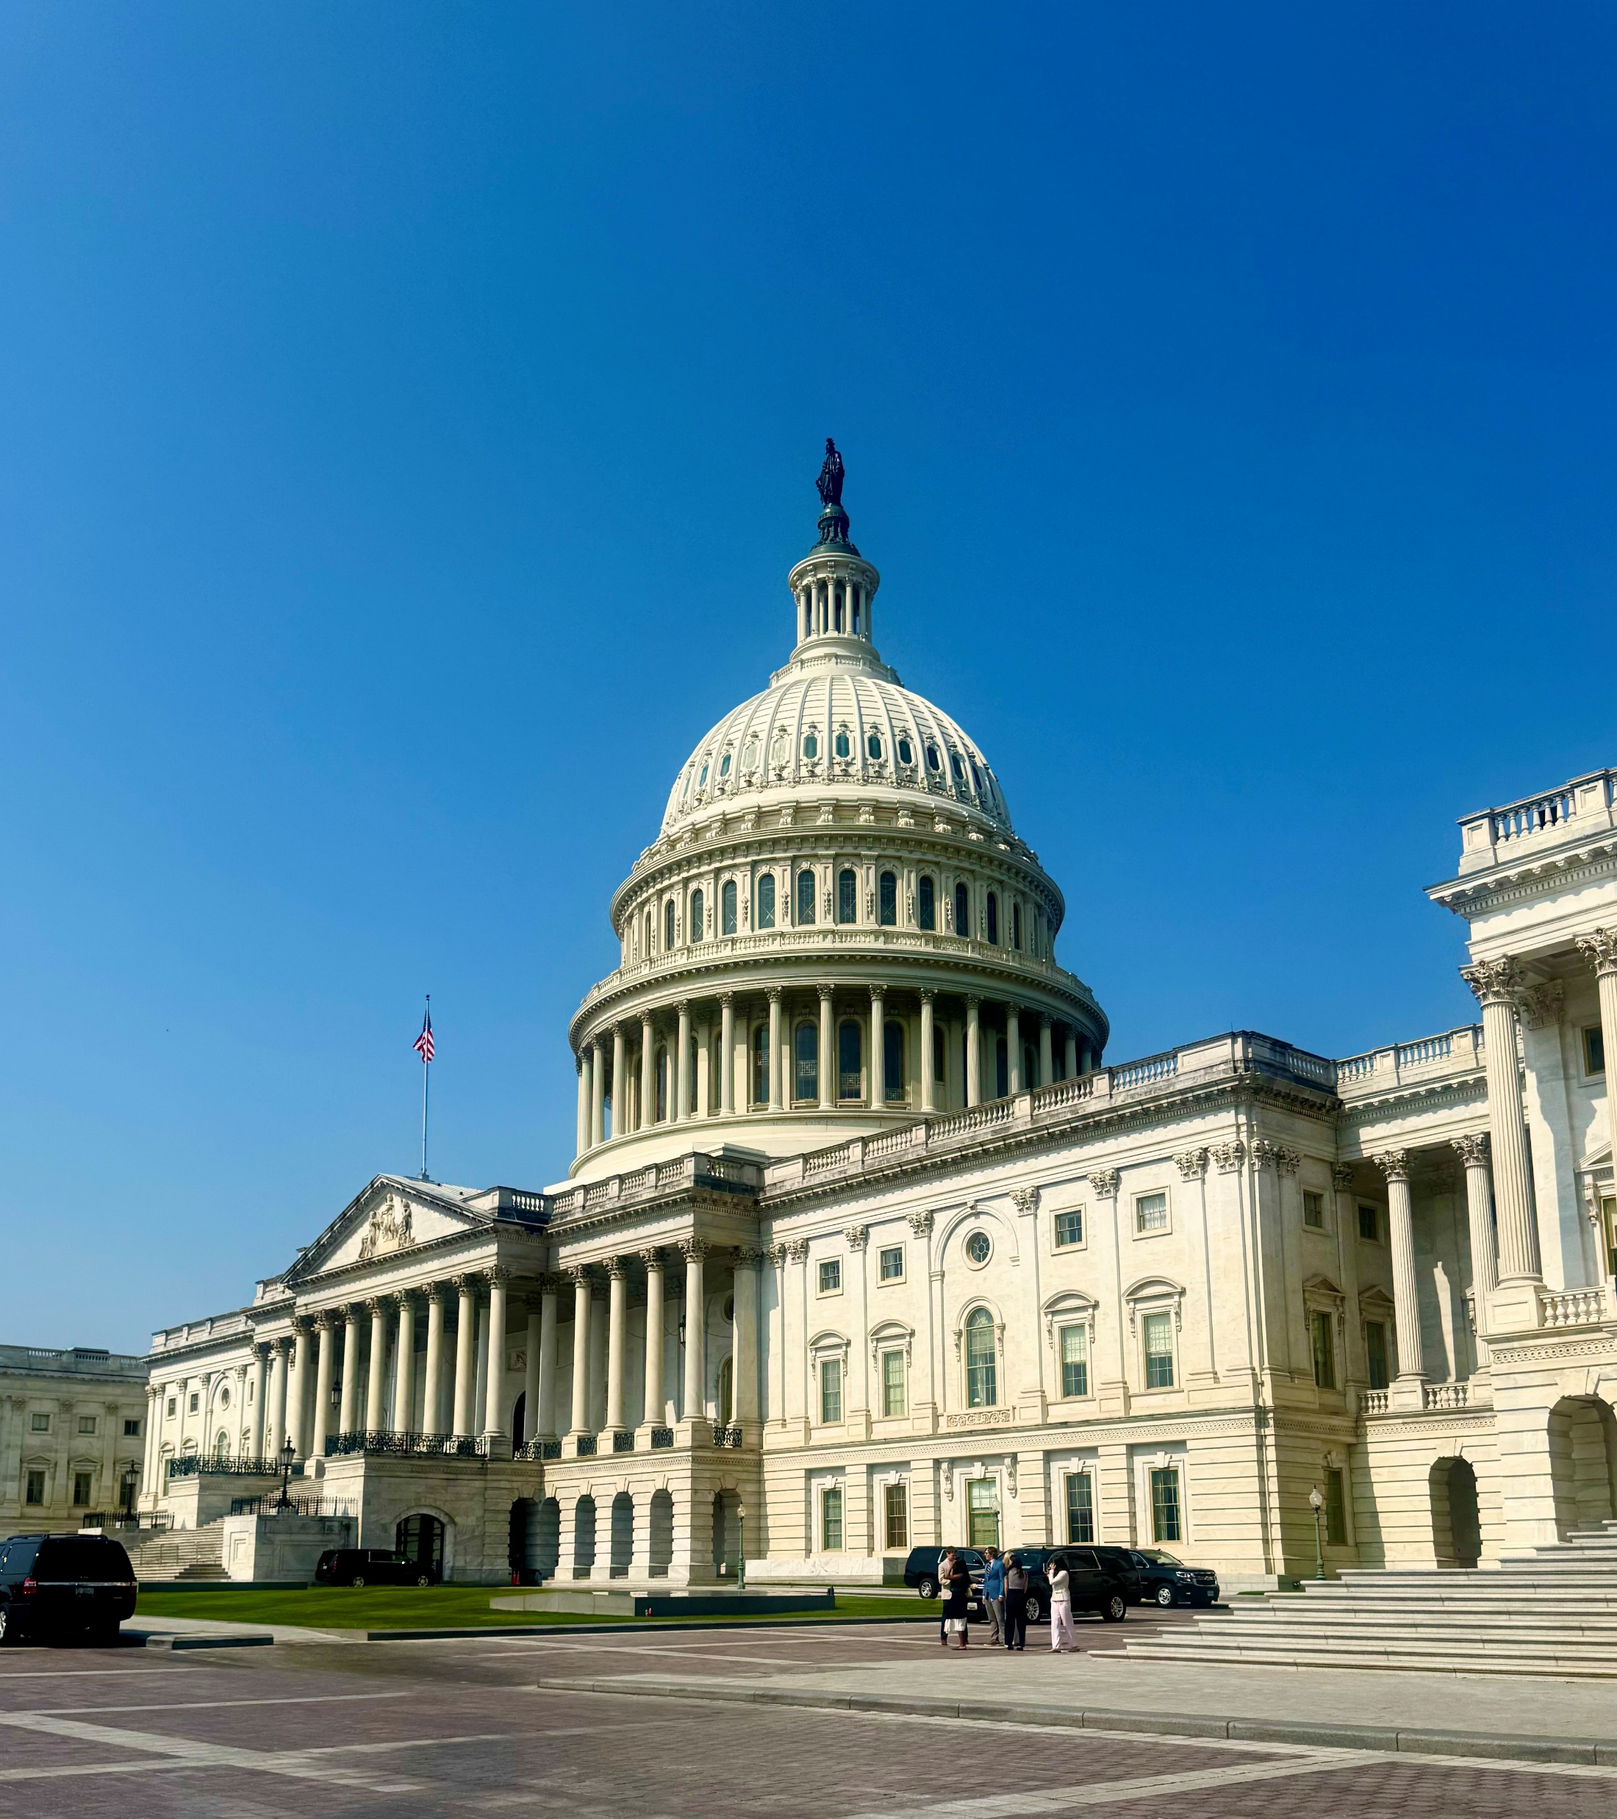
ACP’s Federal Advocacy Efforts on Vaccines
ACP is urging Congress to protect and strengthen our nation’s public health by supporting evidence-based guidance and research for immunizations, expanding access to safe and effective immunizations, and ensuring the public has reliable, accurate information to make informed decisions.
Education on the importance of evidence-based science and vaccines to protect public health
Expertise as internal medicine physicians and frontline health care workers
Constituent stories on the importance of access to vaccines

Slide 2
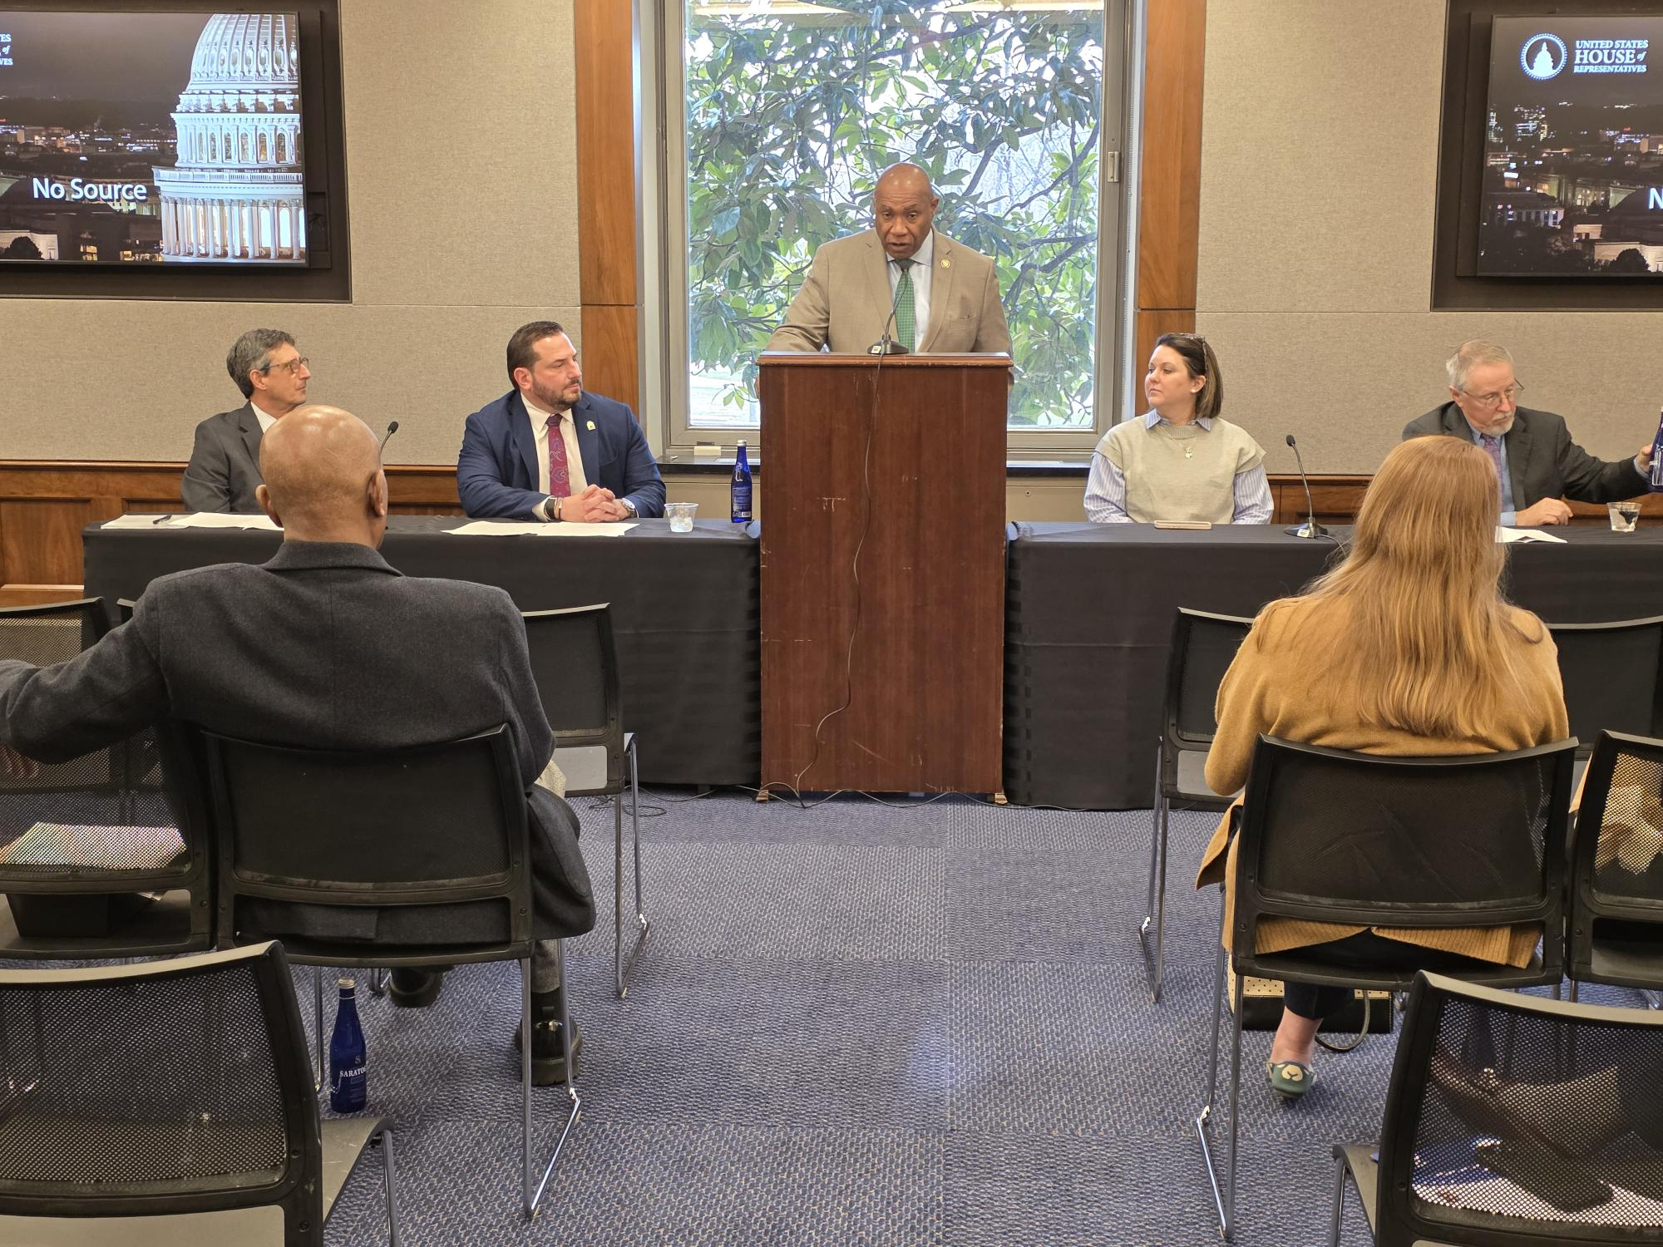
ACP Hosted a Hill Briefing on Vaccines on January 6, 2026
ACP President, Jason Goldman, MD MACP moderated a panel that briefed Hill Staffers on the importance of Vaccines.
Panelists included: Dr. Robert H. Hopkins, Jr., Medical Director of the National Foundation for Infectious Diseases; Dr. Leonard R. Friedland, Vice President, Director Scientific Affairs and Public Health, GSK Vaccines; and Danielle Romaguera, Mother and Patient Advocate (Vaccinate Your Family).
Rep. Dr. Herb Conaway, D-NJ, addressed the audience on the role of vaccines to public health.

Slide 3

Congressional Committees of Jurisdiction
Committees of Jurisdiction over vaccine policy:
Senate Health, Education, Labor and Pensions (HELP) Committee
Chair Dr. Bill Cassidy (R-LA), Ranking Member Bernie Sanders (I-VT)
Health Subcommittee Chair Dr. Roger Marshall (R-KS), Ranking Member Ed Markey (D-MA)
House Energy and Commerce (E&C) Committee
Chair Brett Guthrie (R-KY-02), Ranking Member Frank Pallone (D-NJ-06)
Health Subcommittee Chair Morgan Griffith (R-VA-09), Ranking Member Diana DeGette (D-CO-01)
Find & engage with your member of Congress by signing up for ACP’s Advocates for Internal Medicine Network

Slide 4
ACP-endorsed Legislation
The Family Vaccine Protection Act, H.R.3701, which would codify the role of the Centers for Disease Control and Prevention (CDC) Advisory Committee on Immunization Practices (ACIP), ensuring transparency and accountability in the United States’ review process for immunization recommendations.
The Protecting Free Vaccines Act, H.R.5448, which would ensure zero-cost sharing for certain immunizations, ensuring patients’ access to safe and effective preventative health care.
ACP Supports the Protecting Free Vaccines Act
The Vaccine Transportation Access Act, H.R.6839, which would establish a grant program for community organizations to address transportation barriers to help Americans get to their vaccine appointments.

Slide 5

Share Your Stories on Vaccines
Do you have stories on vaccines? Please share them with ACP’s Legislative Affairs Team!

Slide 6

Write to your Senators and Representatives
Join ACP’s Grassroots Campaign for the Family Vaccine Protection Act, H.R.3701

Slide 7
Write to your Senators and Representatives
Join ACP’s Grassroots Campaign for the Protecting Free Vaccines Act, S. 2857/H.R. 5448

