Slide 1
August Recess 2025
Grassroots Mobilization Challenge
Kory Stuer
Associate, State Health Policy & Advocacy

Slide 2
August Recess Issues Review
Extend Medicare Telehealth Flexibilities
Reauthorize & Fund National Health
Service Corps
Reauthorize & Fund Teaching Health Center Graduate Medical Education

Slide 3
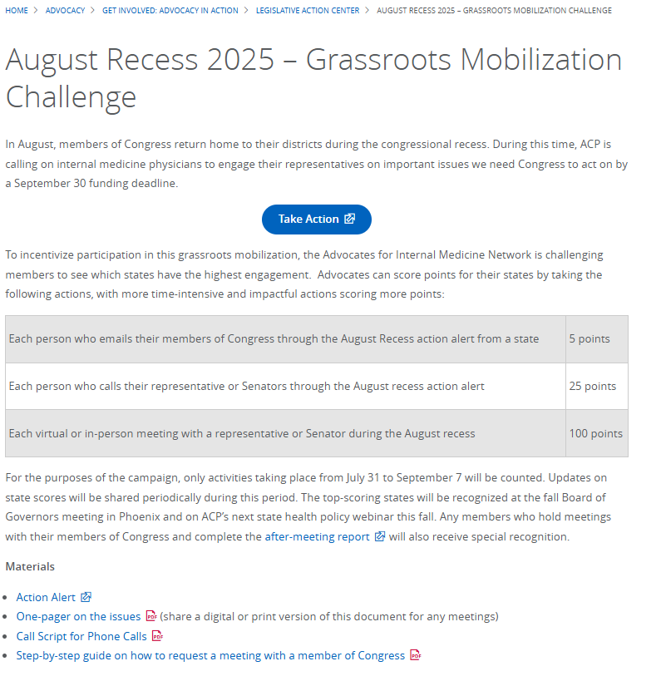
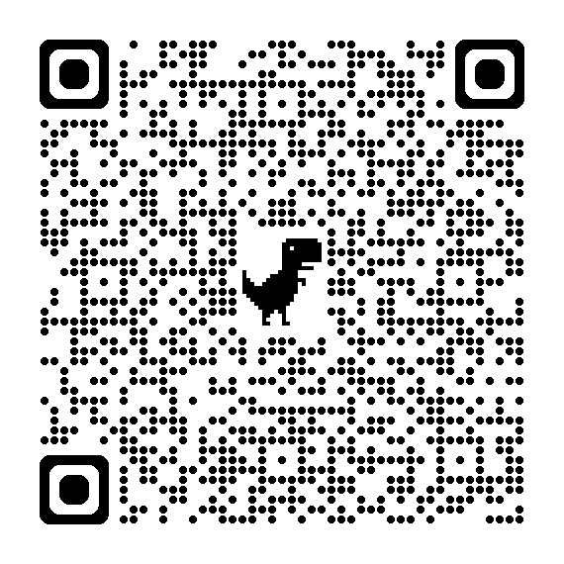
August Recess Grassroots Mobilization Challenge
Email, call, or meet with members of Congress
Score points for your state based on level of activity
Advocacy Resources
Action Alert
One-pager
Call script
Guide to requesting meetings

Slide 4
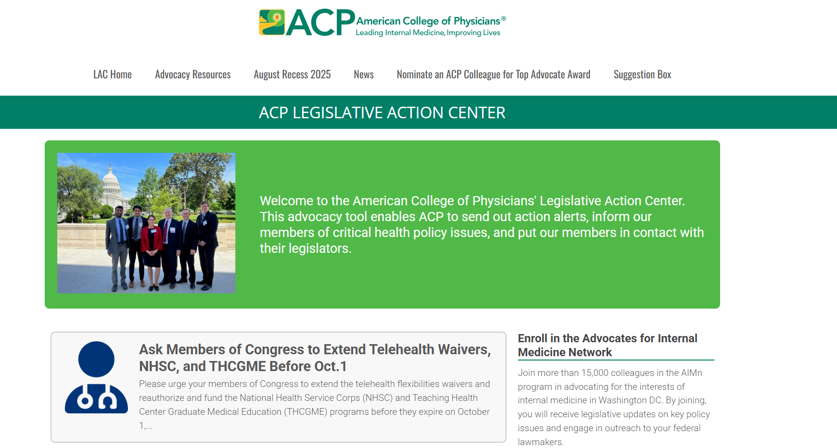
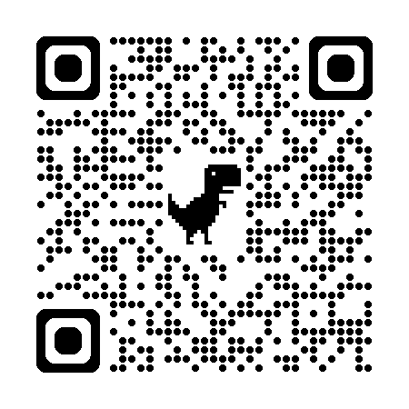
ACP Legislative Action Center – August Recess

Slide 5
ACP Legislative Action Center – August Recess

Slide 6
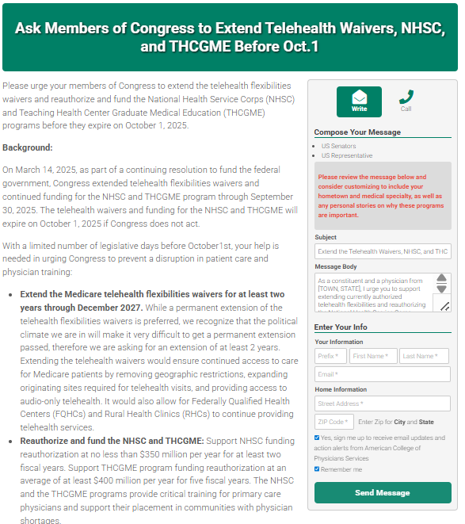
Grassroots Alert
Email and phone options available
Template #623 "August Recess 2025" available in the chapter portal to easily distribute the alert to your chapter
As always, consider personalizing your messages to make a bigger impact!

Slide 7
August Recess 2025 - Grassroots Challenge
For different advocacy actions taken from July 31 through September 7, you can score points for your state:
  5 points for every person who sends an email message through the action alert
  25 points for every person who calls their representatives through the action alert
  100 points for every meeting held with a member of Congress (and form filled out)
States with the highest engagement will be recognized at the fall Board of Governors meeting, in a broadcast to the Advocates for Internal Medicine Network, and on the next State Health Policy Webinar this fall, as well as all states that hold meetings with members of Congress

Slide 8
August Recess 2025 - Grassroots Challenge
More information and resources for the grassroots challenge are posted on ACP's Legislative Action Center:
  Action alert link
  One-pager describing the issues, for educating yourself or for sharing with Congressional offices after meeting
  Call script
  Step-by-step guide for requesting meetings with Congressional offices during recess
While we encourage all members to participate as fully as possible in the challenge, be sure to connect with your chapter if you are interested in requesting a meeting with a member of Congress.

Slide 9
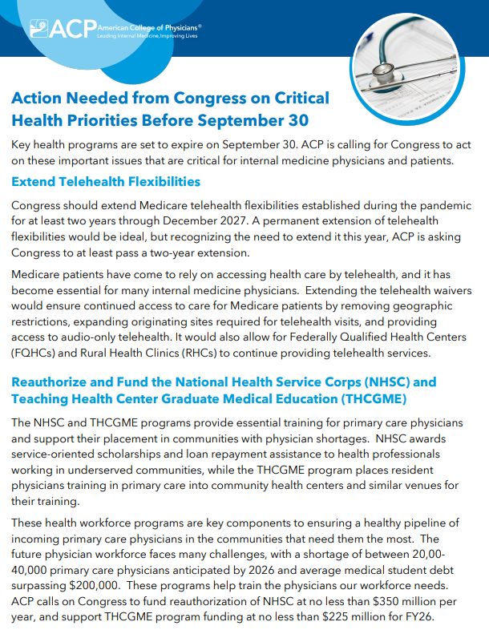
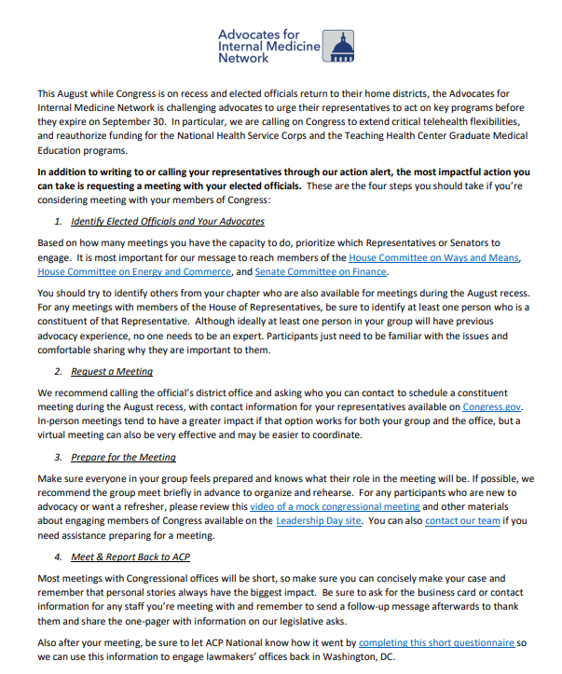

Slide 10
Questions?

