Slide 1
Understanding and Addressing Disparities and Discrimination in Health and Health Care
Josh Serchen
Associate, Health Policy, ACP

Slide 2
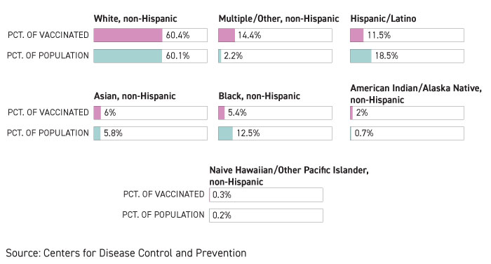
Disparities in Health and Health Care
Source: COVID Tracking Project, The Atlantic

Slide 3
A Comprehensive Policy Framework to Understand and Address Disparities and Discrimination in Health and Health Care
ACP believes in “good health care for all, poor health care for none”
Social determinants of health, racism and discrimination, economic and educational disadvantages, health care access and quality, individual behavior, and biology, affect a person's health
“We must recognize and confront the fact that many elements of U.S. society, some of which are intertwined and compounding, contribute to poorer health outcomes. If we accept that no one element of society is solely responsible for creating disparities, then any strategy to eliminate disparities that addresses any element independently of the others will fail to accomplish its goal.”

Slide 4
Understanding and Addressing Disparities and Discrimination In Education and in the Physician Workforce
Disparities in medical education and the health workforce
Implement policies to eliminate discrimination experienced by health care professionals
Respect and dignity; opportunities for leadership, mentorship, and advancement; interventions to prevent, report, and address incidents of harassment
Implement best practices in the recruitment, retention, and advancement of marginalized health professionals
Expand outreach programs, diversity/minority affairs offices, scholarships, and other financial aid programs to improve matriculation/graduation rates of minority medical students
Disparities in education at all levels
Sufficiently fund schools and implement best practices to strengthen educational quality and results
Replace biased and inequitable funding mechanisms built upon underlying structural factors like segregation and racial wealth gaps, which result in education resource disparities
Ensure equitable access to high-quality teachers, a rigorous evidence-based curriculum, extracurricular activities, and educational materials and opportunities

Slide 5
Understanding and Addressing Disparities and Discrimination Affecting the Health and Health Care of Persons and Populations at Highest Risk
Coverage, Quality, Access
Indigenous Health
Health Literacy
COVID-19
Maternal Mortality
single payer or public choice model
expand Medicaid eligibility
expand ACA insurance marketplace subsidies
increase number of health care professionals in underserved communities
equitably fund IHS/tribal health systems
interventions: evidence-based, culturally appropriate, community accepted, and respectful of traditional beliefs
social drivers, mental health, suicide interventions
interventions/ practice adaptations to accommodate patient cultural, informational, and linguistic needs
cover and reimburse translation services
supporting patient navigators
high-quality granular data
equitably distribute testing, treatment, vaccines, and other resources
stronger workplace protections
universal access to family and medical leave
access to comprehensive coverage across a woman’s lifespan
maternal mortality review committees
safety and quality improvement activities
doulas and patient navigators

Slide 6
Understanding and Addressing Disparities and Discrimination in Law Enforcement and Criminal Justice Affecting the Health of At-Risk Persons and Populations
Study, implement, and fund alternative models that deploy social workers and other mental health professionals specially trained in violence interruption, mediation, homelessness outreach, and mental health
Additional funding and resources should be invested in addressing socioeconomic factors that are associated with crime, such as unemployment, homelessness, education
Policies should be implemented to address the disproportional impact of incarceration on health at the personal, familial, and community levels for people of color, as well as disparities in rates of law enforcement interactions, incarceration, and severity in sentencing
Criminal justice law, policies, and practices, should be examined and studied for racial impact and overhauled if they result in unnecessary or disproportionate harm

Slide 7
Biden Administration Executive Actions
Executive Order On Advancing Racial Equity and Support for Underserved Communities Through the Federal Government
ACP: Consistent with ACP’s policies to address disparities in discrimination in health and health care, this executive order seeks to advance principles, policies, and approaches to achieving equity across the federal government, including requiring federal agencies to review agency programs and policies to assess systemic barriers in accessing benefits and opportunities for marginalized and underserved communities; consider whether new regulations may be needed to advance equity in these programs; and direct resources towards underserved communities.
Also as recommended by ACP, this Executive Order revokes Executive Order 13950 issued by the previous administration, which prohibited federal agencies and contractors from offering or supporting certain forms of implicit bias training.

Slide 8
Biden Administration Executive Actions
Executive Order on Ensuring an Equitable Pandemic Response and Recovery
ACP: The COVID-19 pandemic has disproportionately impacted communities of color. This executive order will advance ACP’s call for equitable support for those communities, and for addressing the social drivers of health that can exacerbate COVID-19.
Memorandum on Redressing Our Nation’s and the Federal Government’s History of Discriminatory Housing Practices and Policies
ACP: Today’s announcements from President Biden order the Department of Housing and Urban Development to work on inequality in housing. The interconnected nature of things like issues with housing and other social drivers of health, cause widespread and pervasive disparities.

Slide 9
Biden Administration Executive Actions
Memorandum on Tribal Consultation and Strengthening Nation-to-Nation Relationships
ACP: The actions direct agencies to respect tribal sovereignty, empower tribal self-determination, and strengthen relationships with American Indian and Alaska Native tribes. In a recent policy paper, ACP observed that public policy must acknowledge the long history of racism, discrimination, abuse, forced relocation, and other injustices experienced by Indigenous persons and commit to focused and culturally appropriate policies to address their present reality of injustice, disparities, and inequities.
Memorandum Condemning and Combating Racism, Xenophobia, and Intolerance Against Asian Americans and Pacific Islanders in the United States
ACP: The announcements also disavowed discrimination against and harassment of Asian Americans, which ACP condemned in a statement issued last March, based on reports of reports of harassment against individuals of Asian descent, including physicians and other clinicians. At this challenging time our focus should be on respecting the dignity of others. We cannot allow prejudice and discrimination to divide us.

Slide 10
Questions?
A Comprehensive Policy Framework to Understand and Address Disparities and Discrimination in Health and Health Care
Understanding and Addressing Disparities and Discrimination in Education and in the Physician Workforce
Understanding and Addressing Disparities and Discrimination Affecting the Health and Health Care of Persons and Populations at Highest Risk
Understanding and Addressing Disparities and Discrimination in Law Enforcement and Criminal Justice Affecting the Health of At-Risk Persons and Populations

