Slide 1
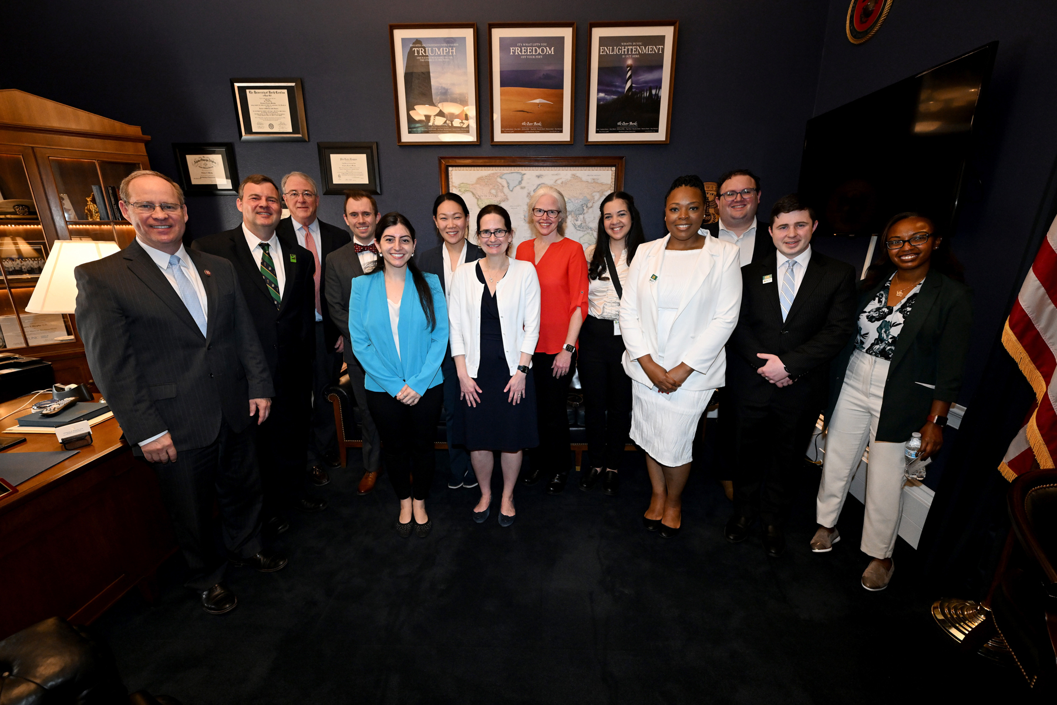
Leadership Day 2025
April 28-29
Westin Washington, DC Downtown

Slide 2


Submit a Breakout Session Proposal for Leadership Day
Lead your own session (with ACP staff support) or request a topic to be covered
  Story of a state-level advocacy win
  A deep dive on a key health policy topic
  Training on key advocacy skills
Medical students, resident/fellow members, early career physicians, and chapter advocacy leaders are especially encouraged to consider submitting a proposal
Proposals due by February 28
See LeaderNet for more information and to submit a proposal

Slide 3

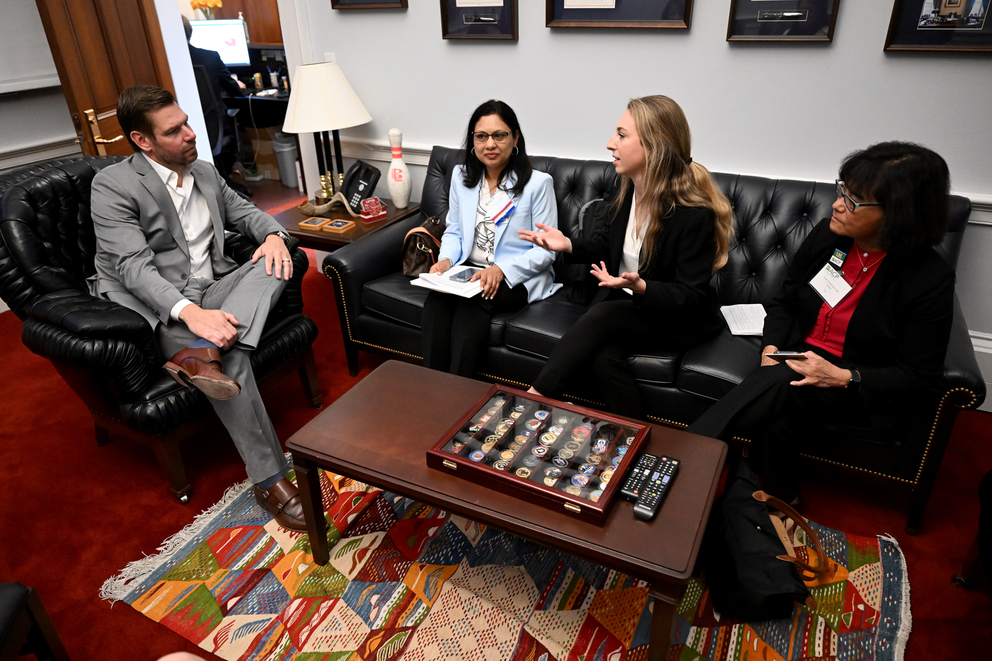
Leadership Day Reminders
Members interested in attending Leadership Day should contact their chapter before registering.
Registration Deadline: April 3
Hotel Room Block Deadline: April 10
Neubauer Award Nominations Deadline: March 3

Slide 4

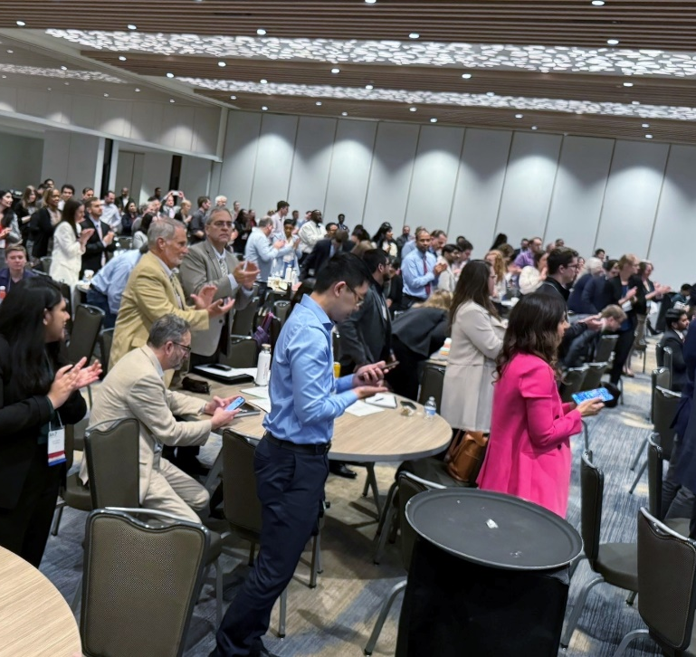
2024 Participation
480 Participants, including:
  227 physicians
  152 resident physicians
  75 medical students
  ACP and chapter staff
Notes:
DGAPP staff, chapter affairs staff, Communications, EO… (20+ ACP staff involved in event)

Slide 5
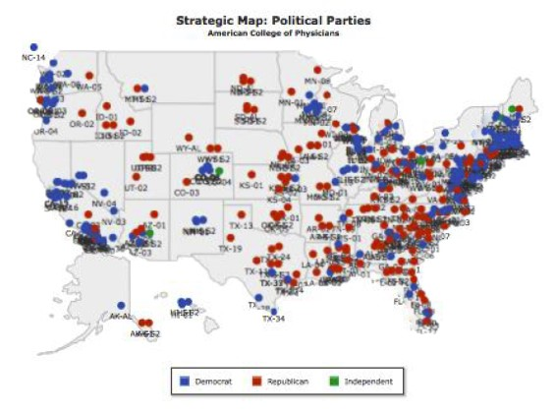
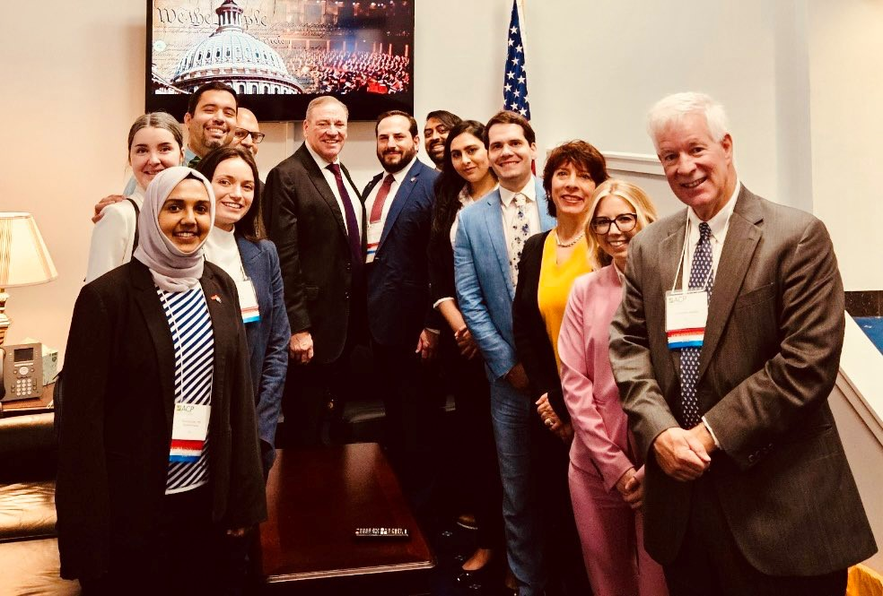
2024 Congressional Meetings
Participants from all 50 states and DC
369 congressional meetings
  269 House (61.8%), 100 Senate
30% with members of congress or senior staff
  83 member
  111 senior staff
61 non-constituent House meetings (22.6%)

Slide 6
Measuring Success
Building ACP and chapter advocacy capacity
Strengthening ACP member engagement and providing membership value
Cultivating relationships with lawmakers and advancing federal legislative priorities

Slide 7
2024 Leadership Day Legislative Asks
We are asking members of Congress to cosponsor the following bills:
H.R.2630/S. 652 - the Safe Step Act of 2023
H.R. 2389/S. 1302 - the Resident Physician Shortage Reduction Act of 2023
H.R. 6545 - the Physician Fee Schedule Update and Improvements Act

Slide 8
Cosponsorship of Leadership Day Legislation
2024 Leadership Day Legislative Ask Cosponsors
Bill | Cosponsors Before LD23 | Cosponsors a/o 6/30/23 | Change | % Change | Cosponsors a/o 5/13/24 | Cosponsors a/o 6/30/24 | Change since LD24 | % Change Since LD24
HR 2630: Safe Step Act | 29 | 66 | 37 | 127.6% | 194 | 217 | 23 | 11.9%
S 652 | 28 | 30 | 2 | 7.1% | 41 | 41 | 0 | 0.0%
HR 2389: Resident Physician Shortage Reduction Act | 76 | 125 | 49 | 64.5% | 175 | 182 | 7 | 4.0%
S 1302 | 4 | 4 | 0 | 0.0% | 7 | 7 | 0 | 0.0%
HR 6545: Physician Fee Schedule Improvements Act | -- | -- | -- | -- | 14 | 18 | 4 | 28.6%

Slide 9
2025 Leadership Day Participation
Increase member engagement, strengthen chapter advocacy, and increase the number of districts with constituents participating in Leadership Day.
Increase the number of congressional districts covered, not just the number of participants from a chapter.
Prioritize members of Congress in leadership and on committees with health care jurisdiction.
Ensure that participants are registered with the address where they are registered to vote.
Physicians should provide both their home and work addresses.
Students can use their permanent address, not just their school address.
Contact your chapter before registering for Leadership Day.

Slide 10
Important Leadership Day Dates
March 3: Neubauer Award Nominations
April 3: Registration Closes
April 10: Hotel Room Block Closes
Monday-Tuesday, Apr. 28-29: Leadership Day

