Slide 1
State Health Policy Webinar
Upcoming Advocacy Events and Resources
David Pugach, JD
Vice President, Governmental Affairs and Public Policy
November 19, 2024

Slide 2
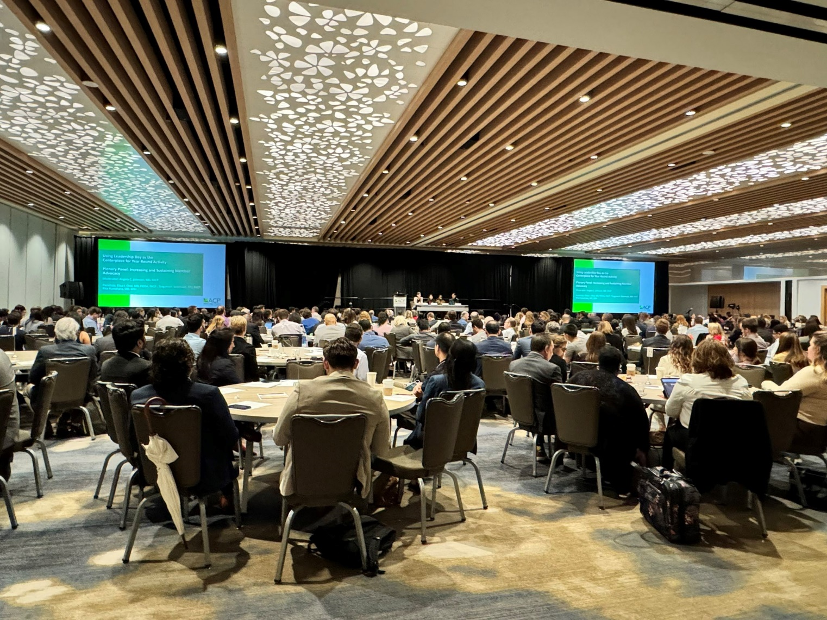
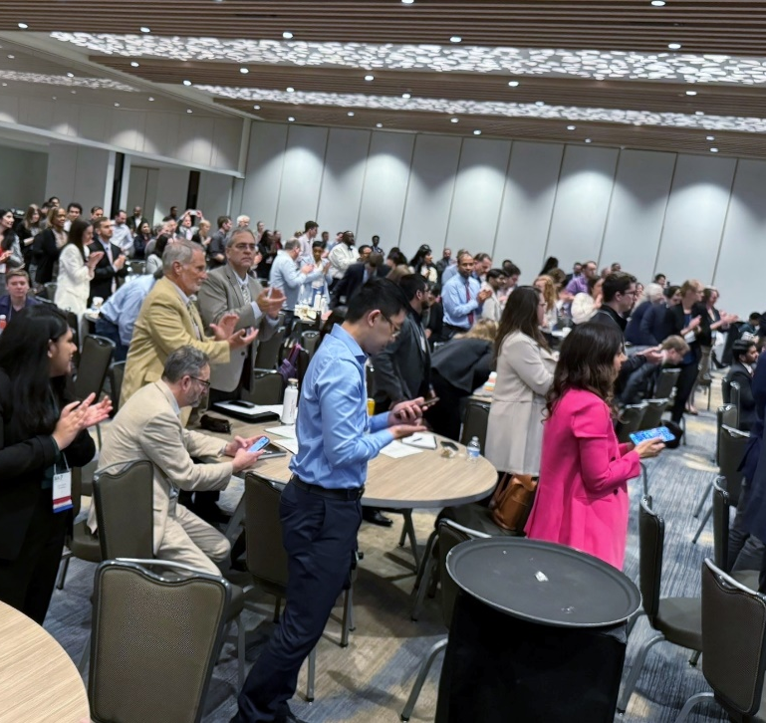
2024 Participation
480 Participants, including:
  227 physicians
  152 resident physicians
  75 medical students
  ACP and chapter staff
Notes:
DGAPP staff, chapter affairs staff, Communications, EO… (20+ ACP staff involved in event)

Slide 3
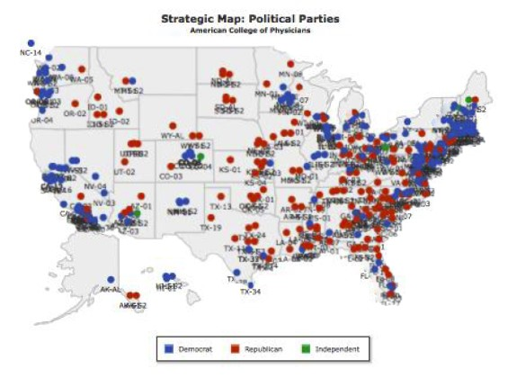
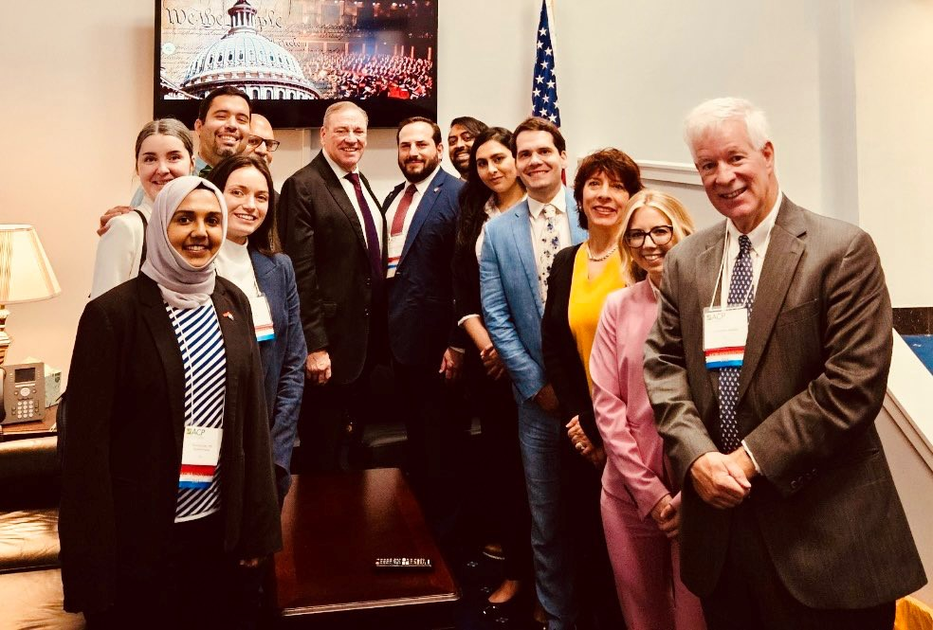
2024 Congressional Meetings
Participants from all 50 states and DC
369 congressional meetings
  269 House (61.8%), 100 Senate
30% with members of congress or senior staff
  83 member
  111 senior staff
61 non-constituent House meetings (22.6%)

Slide 4
Measuring Success
Building ACP and chapter advocacy capacity
Strengthening ACP member engagement and providing membership value
Cultivating relationships with lawmakers and advancing federal legislative priorities

Slide 5
2024 Leadership Day Legislative Asks
We are asking members of Congress to cosponsor the following bills:
H.R.2630/S. 652 - the Safe Step Act of 2023
H.R. 2389/S. 1302 - the Resident Physician Shortage Reduction Act of 2023
H.R. 6545 - the Physician Fee Schedule Update and Improvements Act

Slide 6
Cosponsorship of Leadership Day Legislation
2024 Leadership Day Legislative Ask Cosponsors
Bill | Cosponsors Before LD23 | Cosponsors a/o 6/30/23 | Change | % Change | Cosponsors a/o 5/13/24 | Cosponsors a/o 6/30/24 | Change since LD24 | % Change Since LD24
HR 2630: Safe Step Act | 29 | 66 | 37 | 127.6% | 194 | 217 | 23 | 11.9%
S 652 | 28 | 30 | 2 | 7.1% | 41 | 41 | 0 | 0.0%
HR 2389: Resident Physician Shortage Reduction Act | 76 | 125 | 49 | 64.5% | 175 | 182 | 7 | 4.0%
S 1302 | 4 | 4 | 0 | 0.0% | 7 | 7 | 0 | 0.0%
HR 6545: Physician Fee Schedule Improvements Act | -- | -- | -- | -- | 14 | 18 | 4 | 28.6%

Slide 7
2025 Leadership Day Participation
Increase member engagement, strengthen chapter advocacy, and increase the number of districts with constituents participating in Leadership Day.
Increase the number of congressional districts covered, not just the number of participants from a chapter.
Prioritize members of Congress in leadership and on committees with health care jurisdiction.
Ensure that participants are registered with the address where they are registered to vote.
Physicians should provide both their home and work addresses.
Students can use their permanent address, not just their school address.

Slide 8
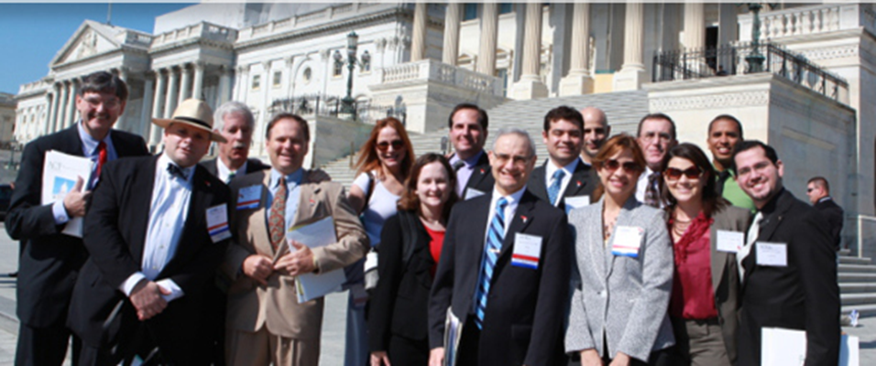
Save The Date
2025 Leadership Day
April 28-29, 2025 – Washington, DC

Slide 9
Upcoming Leadership Day Information
Information about travel scholarships will be sent from Chapter Activities staff to ACP chapters later this year
Registration and hotel information available in early January
Breakout sessions will be taking proposals this year; submission process opens in January

Slide 10
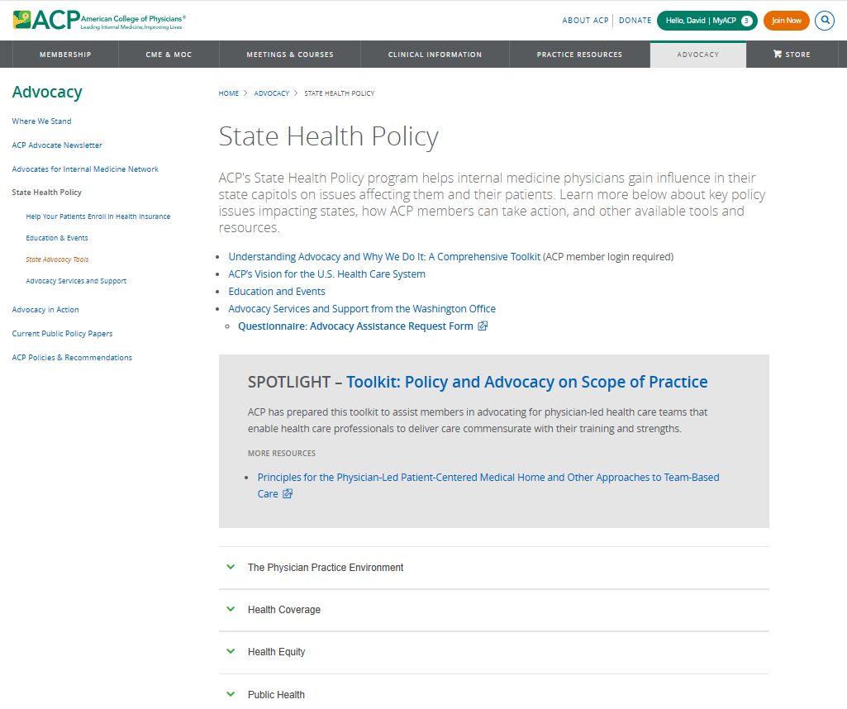

ACP State Health Policy Resources

Slide 11

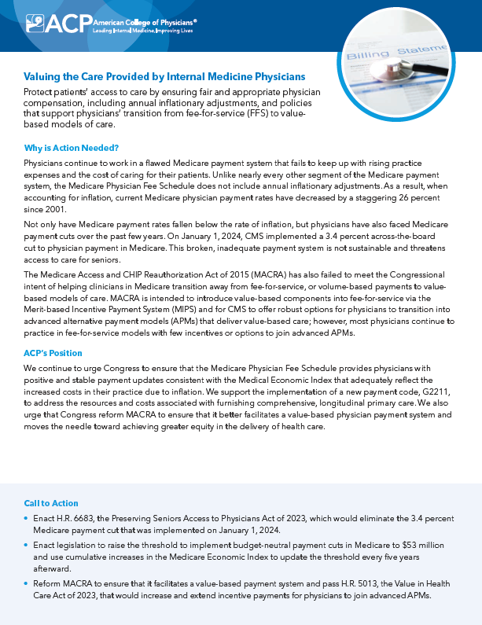

ACP Advocacy Priorities

Slide 12
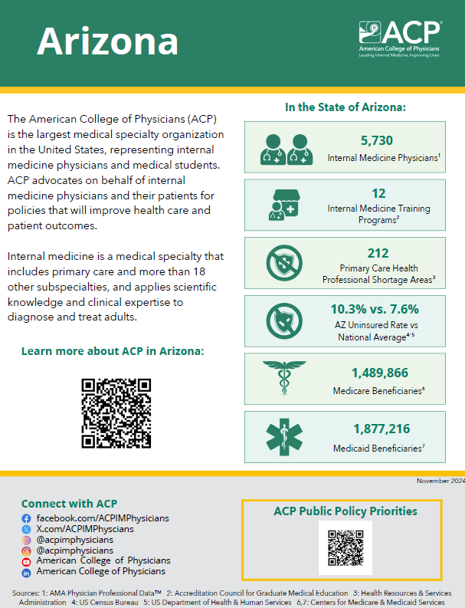
State Fact Sheets

Slide 13
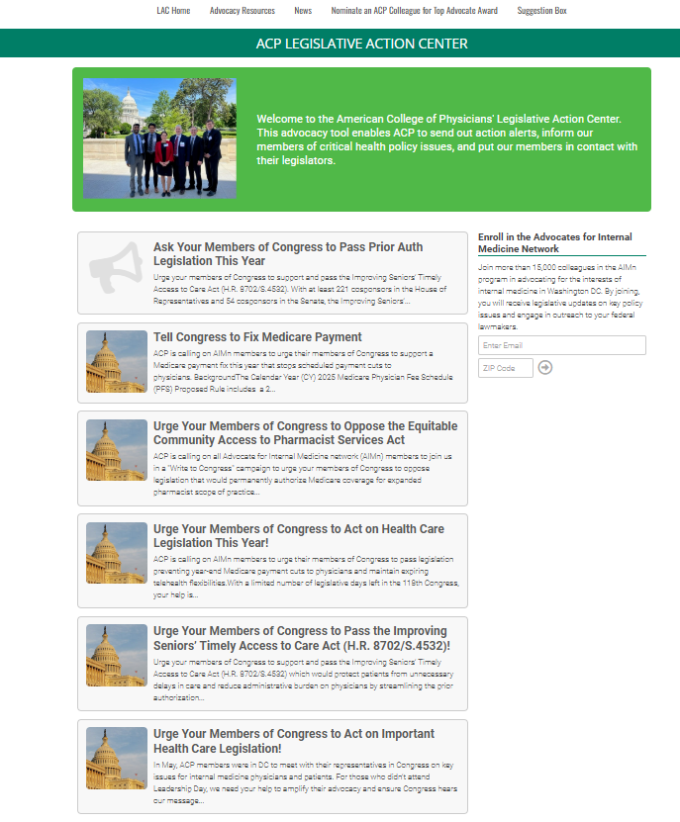

Contacting Your Lawmakers

