Slide 1
August Recess 2026
Grassroots Mobilization Challenge
David Pugach, JD
Vice President, Governmental Affairs and Public Policy

Slide 2
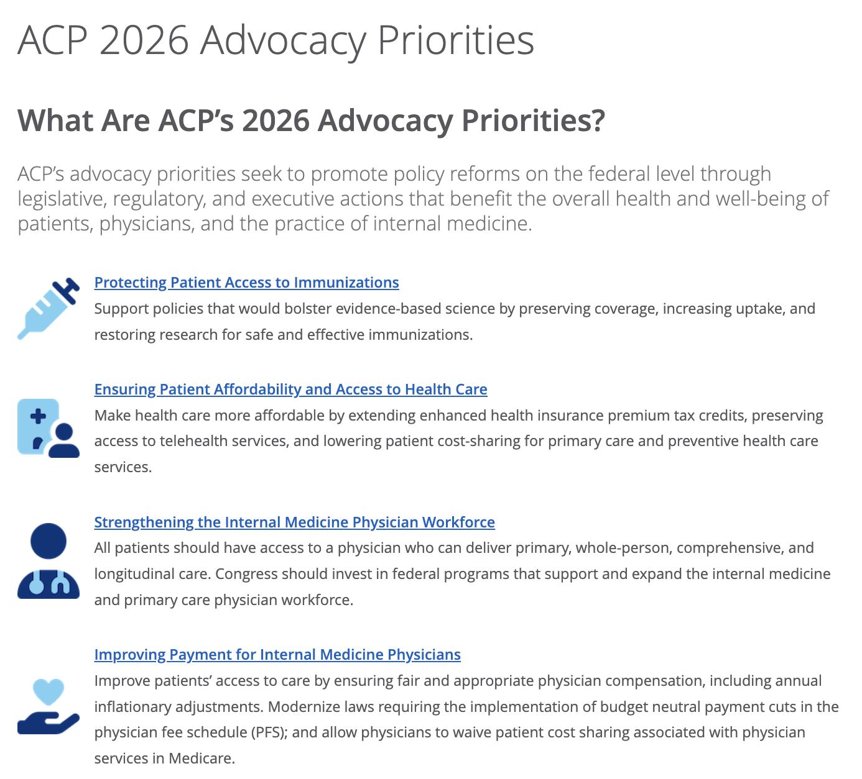
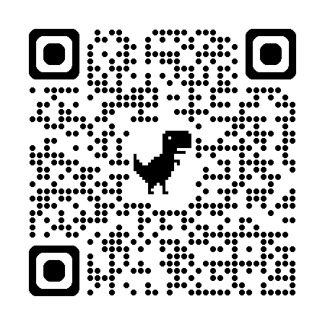

Slide 3
August Recess Issues Review
Protecting physician access to visa programs
H–1Bs for Physicians and the Healthcare Workforce Act, H.R. 7961
Strengthening and stabilizing Medicare payments
Patients First Act of 2026

Slide 4
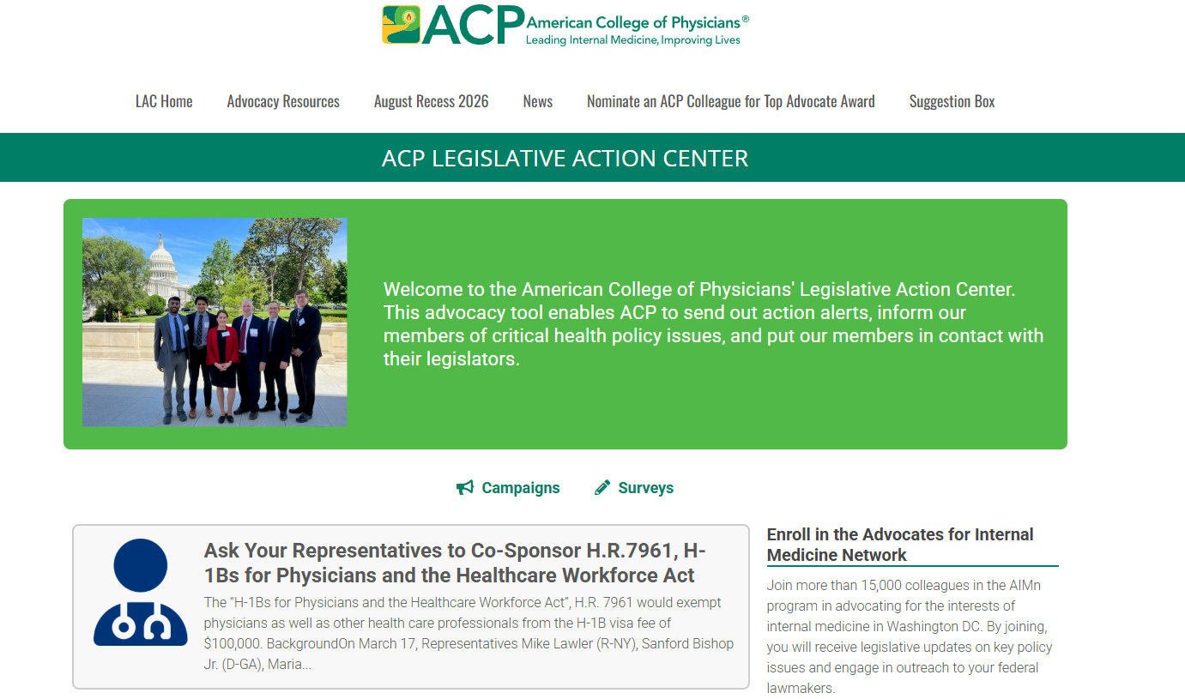
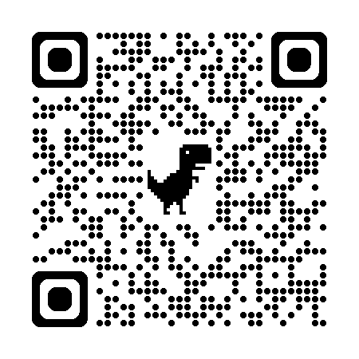
ACP Legislative Action Center – August Recess

Slide 5
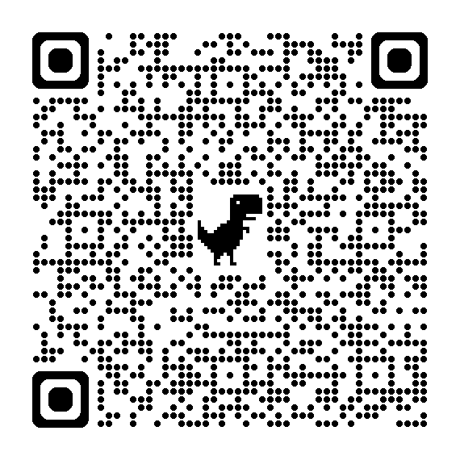
Resources: 2026 August Recess Grassroots Challenge
COMING SOON More information and resources for the grassroots challenge will be posted on ACP's Legislative Action Center in the coming weeks:
  Action alert link to send direct message to your members of Congress
  One-pager describing the issues, for educating yourself or for sharing with Congressional offices after meeting
  Call script to help guide any phone conversations
  Guide for requesting meetings with Congressional offices during recess
While we encourage all members to participate as fully as possible in the challenge, be sure to connect with your chapter if you are interested in requesting a meeting with a member of Congress.

Slide 6
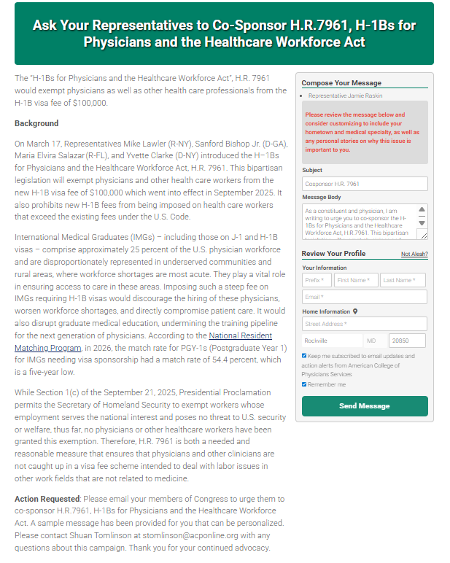
Grassroots Alert
Email and phone options available
COMING SOON Template "August Recess 2026" available in the chapter portal to easily distribute the alert to your chapter
As always, consider personalizing your messages to make a bigger impact!

Slide 7
Point System: 2026 August Recess Grassroots Challenge
For different advocacy actions taken from July 31 through September 13, you can score points for your state:
States with the highest engagement as well as states that hold meetings with members of Congress will be recognized at the fall Board of Governors meeting, in a broadcast to the Advocates for Internal Medicine Network, and on the next State Health Policy Webinar this fall.
5 points | Each person who emails their members of Congress through the August Recess action alert from a state
25 points | Each person who calls their representative or Senators through the August recess action alert
100 points | Each virtual or in-person meeting with a representative or Senator during the August recess

Slide 8
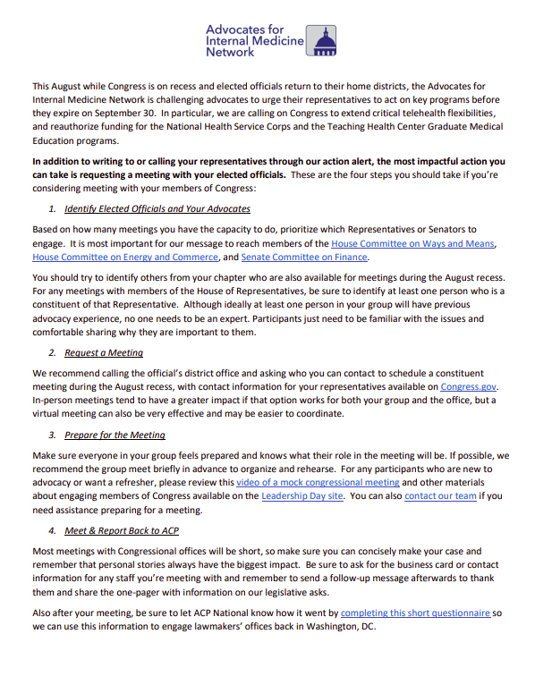
August Recess Grassroots Mobilization Challenge
Email, call, or meet with members of Congress
Score points for your state based on level of activity
Advocacy Resources COMING SOON
  Action Alert
  One-pager
  Call script
  Guide to requesting meetings

Slide 9
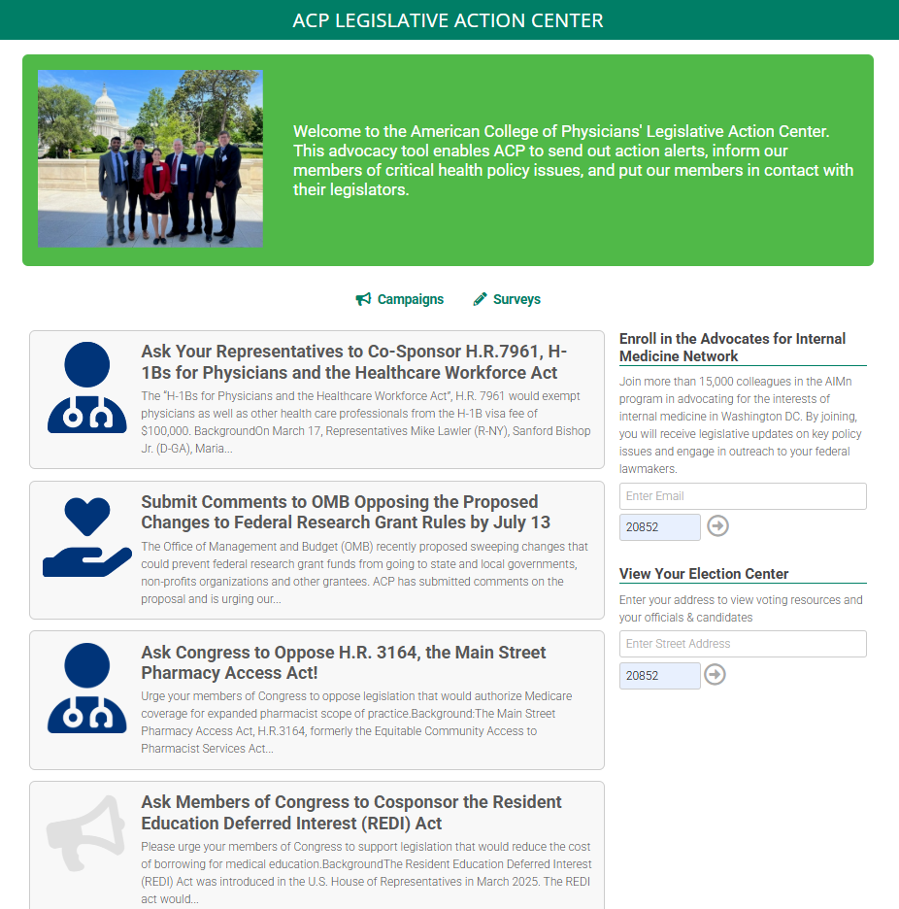
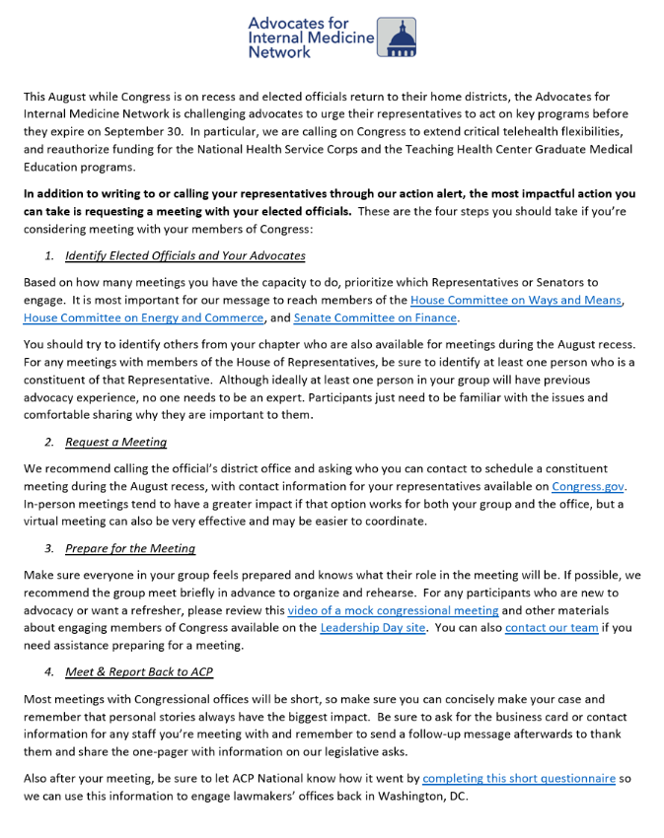

Slide 10
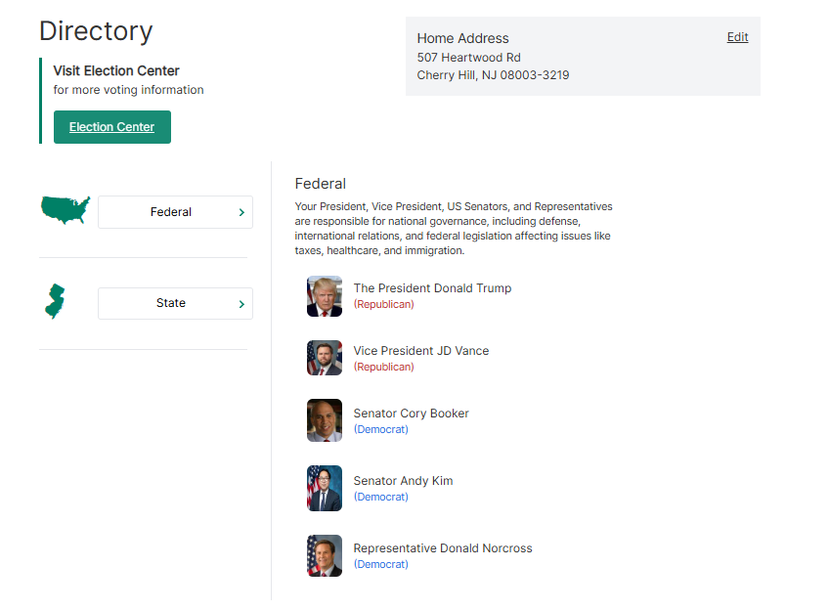
ACP Legislative Action Center Election Center

Slide 11
2025 Winners
1
California
California
California
2
Wisconsin
Wisconsin
Wisconsin
3
New York
New York
New York
4
Ohio
5
Pennsylvania

Slide 12
Questions?

