Slide 1
State Health Policy Webinar
Washington Update
David Pugach
Vice President, Governmental Affairs & Public Policy
March 5, 2026

Slide 2
FY26 Appropriations and Health Care Legislation
PRODUCER
National Journal Presentation Center

Slide 3
FY26 Appropriations and Health Policy Package
Federal government* being funded through September 30
Proposed cuts to public health agencies rejected
Funds physician workforce programs
Reauthorizes and extends Medicare policies impacting patient care and physician payment
Established new pharmacy benefit manager (PBM) reforms and transparency requirements
Enacts ACP-led appropriations report language

Slide 4
House Appropriations Report Language
Overestimating Utilization of New Codes in the Fee Schedule.— The Committee is concerned that CMS estimates for the utilization of a new code in the initial calendar year in the Medicare Physician Fee Schedule (MPFS) are inflated and exceed what is statutorily required… resulting in substantial resources being unnecessarily deducted from the physician fee schedule required by budget neutrality... the Committee directs GAO to study the extent to which CMS has overestimated the utilization of new fee schedule codes in each of the last ten years, including data on related reductions to the fee schedule for each of those years. The Committee directs GAO to provide a briefing on this study to the Committees on Appropriations, Energy and Commerce, and Ways and Means of the House of Representatives, and the Committee on Appropriations of the Senate, within 120 days of enactment of this Act with a report to follow.

Slide 5
Senate Appropriations Report Language
Physician Fee Schedule Codes.—… the Committee notes that CMS may overestimate or underestimate utilization, and therefore the overall cost of such changes, resulting in substantial adjustments to physician fee schedule payments required by budget neutrality. The Committee encourages GAO to study CMS estimates of the utilization of selected new fee schedule codes over the last 10 years, data on related adjustments to the fee schedule for these years, the effects of CMS utilization estimates relative to actual utilization figures on physician fee schedule payments and spending for those services, and other items determined appropriate by the Comptroller General.

Slide 6
Patient Access and Physician Payment Provisions
Medicare Telehealth Flexibilities: The Medicare telehealth flexibilities are extended through December 31st, 2027.
Extension of APM Incentive Payments: The Medicare APM bonus payments are extended through the 2026 performance period, with bonuses paid in 2028. The appropriations bill also extends flexibilities on meeting the qualifying professional threshold for the 2026 performance period, which also impacts payments in 2028.
Hospital at Home Waivers: The Medicare acute hospital care at home waiver program, which provides hospitals with the ability to qualify for Medicare waivers to treat their patients at home via telehealth, is extended through September 30th, 2030.

Slide 7
Workforce Provisions
Community Health Centers: $4.6 billion is provided for CHCs up until September 30th, 2026, and $1.15 billion is proposed to be appropriated from the period of October 1st, 2026 through December 31st, 2026.
National Health Service Corps (NHSC): Funding is extended through December 31st, 2026.
Teaching Health Center Graduate Medical Education (THCGME): Funding for the THCGME is extended through September 30th, 2029.

Slide 8
Ongoing and Outstanding Issues

Slide 9
2026 Congressional Calendar
■ Both chambers in session ■ House only in session ■ Senate only in session ■ Federal holiday
January
February
March
April
 |  |  |  | 1 | 2 | 3
4 | 5 | 6 | 7 | 8 | 9 | 10
11 | 12 | 13 | 14 | 15 | 16 | 17
18 | 19 | 20 | 21 | 22 | 23 | 24
25 | 26 | 27 | 28 | 29 | 30 | 31
1 | 2 | 4 | 4 | 5 | 6 | 7
8 | 9 | 10 | 11 | 12 | 13 | 14
15 | 16 | 17 | 18 | 19 | 20 | 21
22 | 23 | 24 | 25 | 26 | 27 | 28
1 | 2 | 3 | 4 | 5 | 6 | 7
8 | 9 | 10 | 11 | 12 | 13 | 14
15 | 16 | 17 | 18 | 19 | 20 | 21
22 | 23 | 24 | 25 | 26 | 27 | 28
29 | 30 | 31
 |  |  | 1 | 2 | 3 | 4
5 | 6 | 7 | 8 | 9 | 10 | 11
12 | 13 | 14 | 15 | 16 | 17 | 18
19 | 20 | 21 | 22 | 23 | 24 | 25
26 | 27 | 28 | 29 | 30
May
June
July
August
 |  |  |  |  | 1 | 2
3 | 4 | 5 | 6 | 7 | 8 | 9
10 | 11 | 12 | 13 | 14 | 15 | 16
17 | 18 | 19 | 20 | 21 | 22 | 23
24 | 25 | 26 | 27 | 28 | 29 | 30
31
 | 1 | 2 | 3 | 4 | 5 | 6
7 | 8 | 9 | 10 | 11 | 12 | 13
14 | 15 | 16 | 17 | 18 | 19 | 20
21 | 22 | 23 | 24 | 25 | 26 | 27
28 | 29 | 30
 |  |  | 1 | 2 | 3 | 4
5 | 6 | 7 | 8 | 9 | 10 | 11
12 | 13 | 14 | 15 | 16 | 17 | 18
19 | 20 | 21 | 22 | 23 | 24 | 25
26 | 27 | 28 | 29 | 30 | 31
 |  |  |  |  |  | 1
2 | 3 | 4 | 5 | 6 | 7 | 8
9 | 10 | 11 | 12 | 13 | 14 | 15
16 | 17 | 18 | 19 | 20 | 21 | 22
23 | 24 | 25 | 26 | 27 | 28 | 29
30 | 31
September
October
November
December
 |  | 1 | 2 | 3 | 4 | 5
6 | 7 | 8 | 9 | 10 | 11 | 12
13 | 14 | 15 | 16 | 17 | 18 | 19
20 | 21 | 22 | 23 | 24 | 25 | 26
27 | 28 | 29 | 30
 |  |  |  | 1 | 2 | 3
4 | 5 | 6 | 7 | 8 | 9 | 10
11 | 12 | 13 | 14 | 15 | 16 | 17
18 | 19 | 20 | 21 | 22 | 23 | 24
25 | 26 | 27 | 28 | 29 | 30 | 31
1 | 2 | 3 | 4 | 5 | 6 | 7
8 | 9 | 10 | 11 | 12 | 13 | 14
15 | 16 | 17 | 18 | 19 | 20 | 21
22 | 23 | 24 | 25 | 26 | 27 | 28
29 | 30
 |  | 1 | 2 | 3 | 4 | 5
6 | 7 | 8 | 9 | 10 | 11 | 12
13 | 14 | 15 | 16 | 17 | 18 | 19
20 | 21 | 22 | 23 | 24 | 25 | 26
27 | 28 | 29 | 30 | 31
Notes:
Sources:
“2026 Combined Congressional Calendar,” Rational360, December 23, 2025, https://rational360.com/2026-combined-congressional-calendar/

Slide 10
Legislative Deadlines
TOPIC | DEADLINE | DESCRIPTION
Expanded ACA tax credits | December 31, 2025 Expired | The Inflation Reduction Act extended expanded ACA subsidies for three years, lasting through 2025; both the subsidies and various IRA energy efficiency credits have expired and are yet to be renewed
FY2027 appropriations | September 30, 2026 | Congress has passed all but one appropriations bills for FY2026, funding discretionary governmental operations through September 30
Medicare Physician Payment Increase | December 31, 2026 | The temporary 2.5% Medicare physician payment increase expires, requiring congressional action to prevent reimbursement reductions
Debt ceiling reached | Estimated in 2027 | Congress increased the debt ceiling by $5T in the One Big Beautiful Bill Act in July 2025, but are estimated to hit the debt ceiling again some time in 2027
Notes:
Sources:
“Upcoming Congressional Fiscal Policy Deadlines,” Committee for a Responsible Federal Budget, October 14, 2025, https://www.crfb.org/blogs/upcoming-congressional-fiscal-policy-deadlines
“Expiration of the 2018 Farm Bill and Extension for 2025,” Congressional Research Service, December 26, 2024, https://crsreports.congress.gov/product/pdf/R/R47659

Slide 11
ACP Advocacy Priorities

Slide 12
How We Identify an Issue for Potential Prioritization
Needs of the Internal Medicine profession/ ACP members
Environmental Feasibility/ Opportunities for Action & Success
ACP Strategic Priorities

Slide 13
2025 ACP Policy & Advocacy Priorities
Physician Payment
Administrative Burden
Access to Care
Patient-Physician Relationship
IM Workforce
Digital Health
Prescription Drug Access
Public Health (including immunizations)
Scope of Practice
Notes:
Thank you, Dr. Opole.
Dr. Opole covered a subset of these priorities, including workforce physician payment, administrative burden, access to care, and public health, when discussing the letter to the Trump Administration Transition Team, as well as in the Action Alert that you all can take now.
In addition to these priorities, ACP is also continuing its focus on protecting the patient-physician relationship. This includes promoting policies such as ensuring access to reproductive health care, LGBTQ+ and gender-affirming care. These issues, as well as ACP’s priority of promoting physician-led, team-based care instead of expanding scope of practice for nonphysicians, have a strong state-based focus—and ACP has been and will continue to build out our support for our state chapters to engage in advocacy.
Another ACP priority area is supporting policies that will leverage digital health and artificial intelligence to improve patient care and reduce administrative burdens on physicians and their care teams and ensure that these tools are used appropriately to enhance patient health. We are also continuing to prioritize policies that improve prescription drug pricing and transparency, and increase access, affordability, and the availability of prescription drugs. This means we will continue to support Medicare drug price negotiation by CMS and are going to be calling on the new administration to continue these efforts as well.
These nine priorities are all critical for those of us in practice—TELL A PERSONALIZED STORY
I will now hand it over to Shari to further discuss the unfinished congressional business from 2024 and lessons learned from the first Trump administration about areas where we might have opportunities to make progress.

Slide 14
2026 Advocacy Priorities

Slide 15
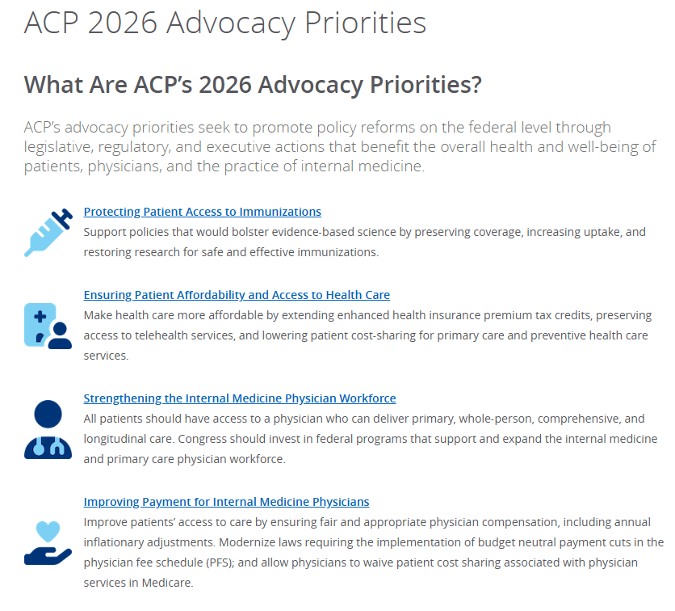


Slide 16

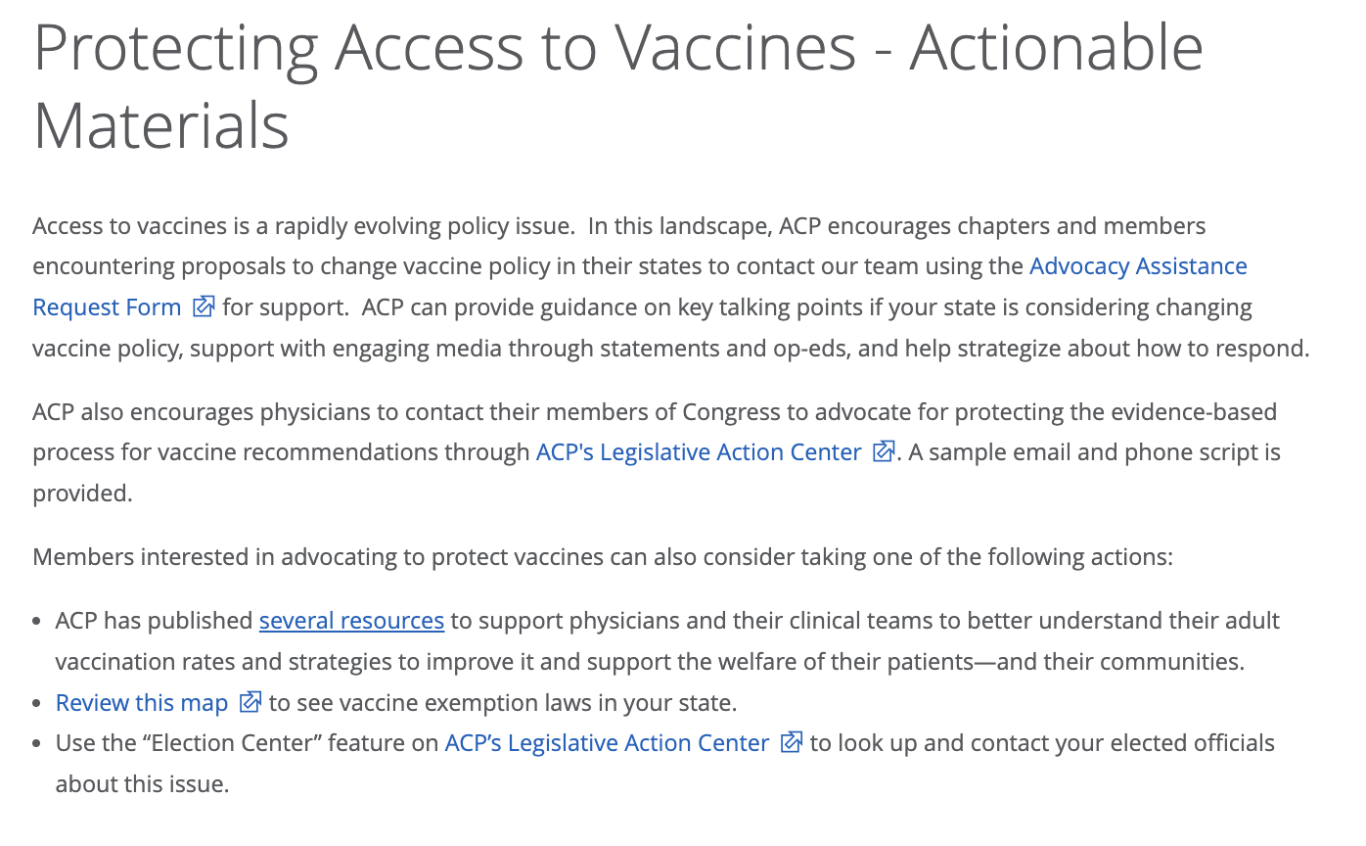
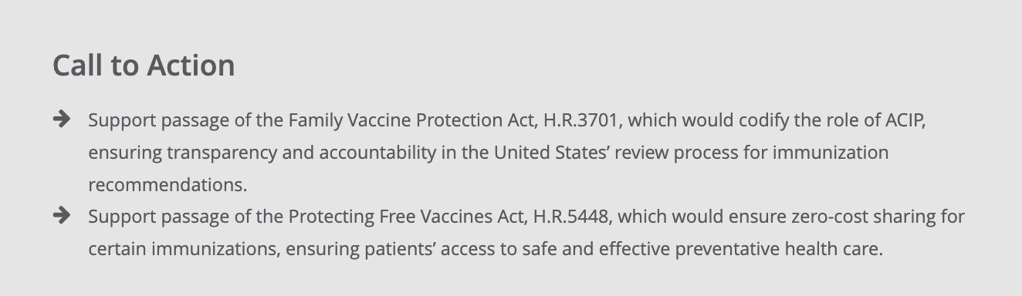
Protecting Patient Access to Immunizations

Slide 17
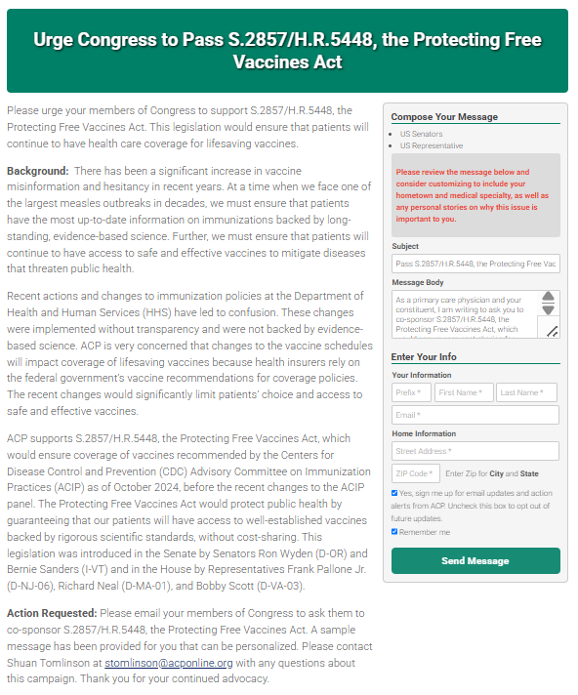

Protecting Access to Immunizations

Slide 18
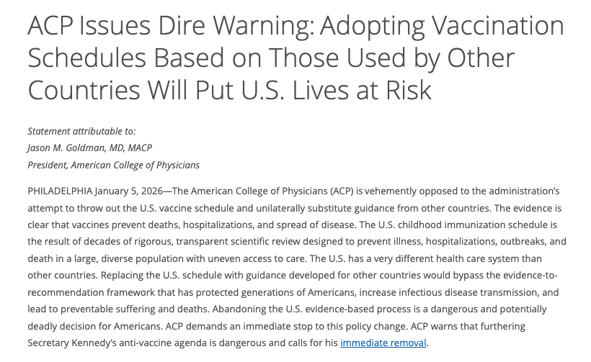

Slide 19
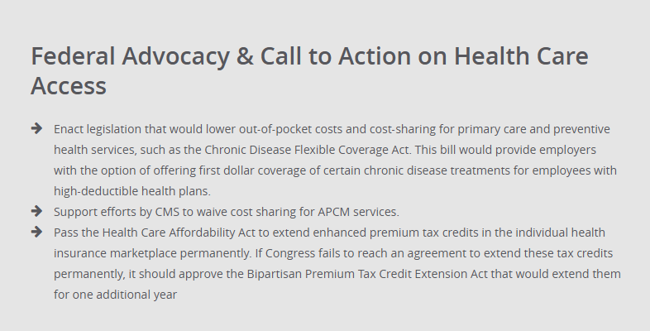
Ensuring Patient Affordability and Access to Health Care

Slide 20
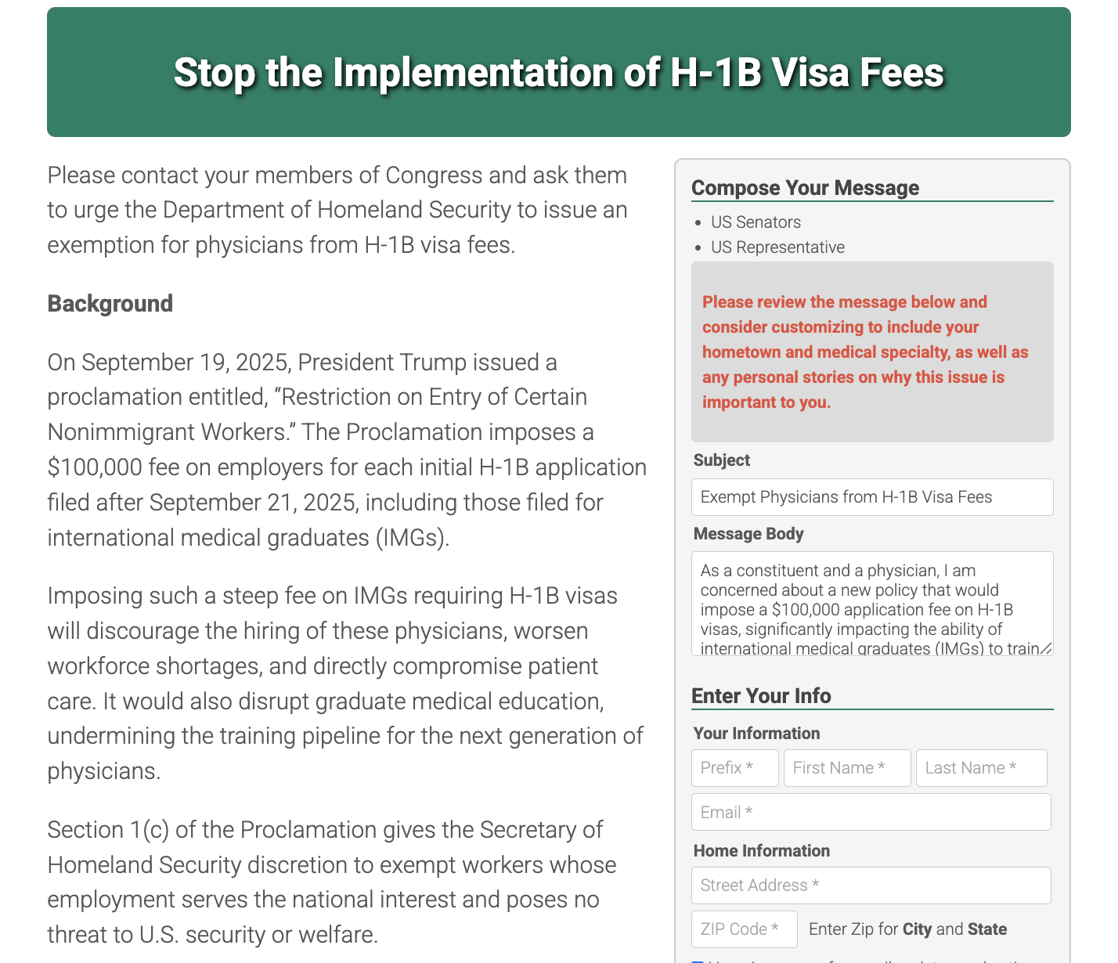

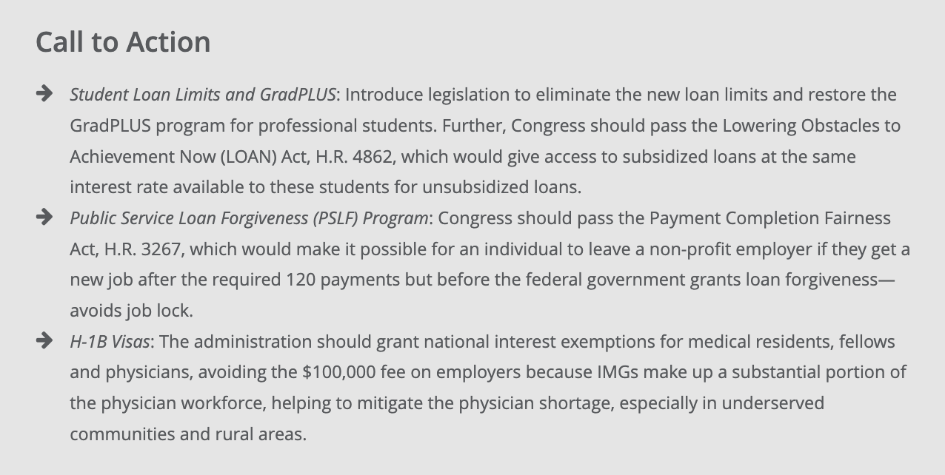
Strengthening the Internal Medicine Physician Workforce

Slide 21

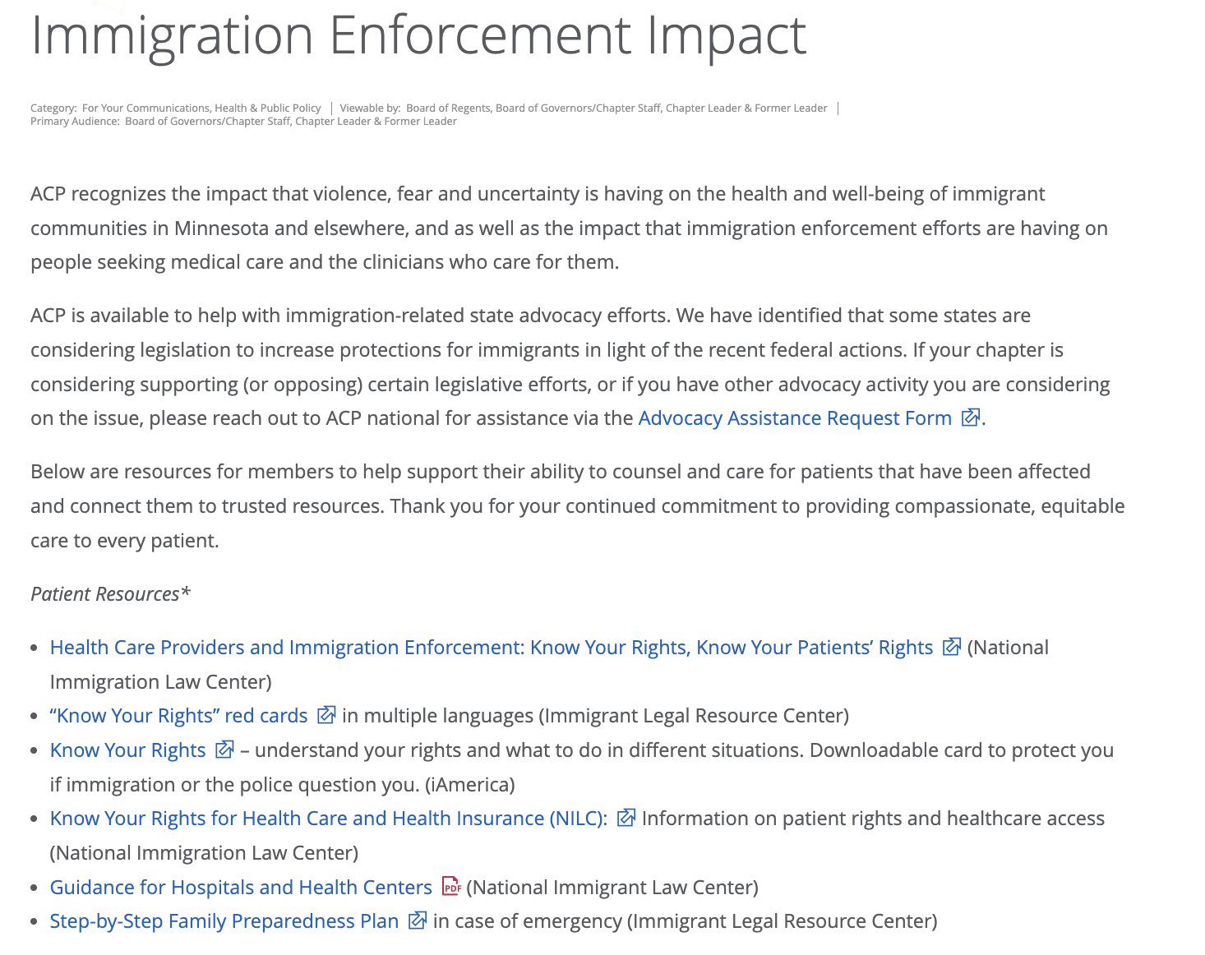

Slide 22
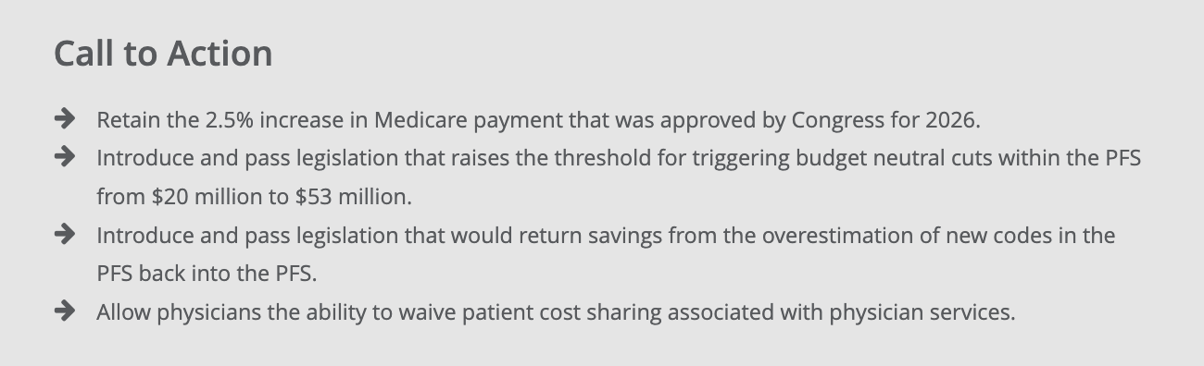
Improving Payment for Internal Medicine Physicians

Slide 23
Medicare PFS Efficiency Adjustment
2026 Medicare Physician Fee Schedule slightly reduces the value of certain procedural codes to account for technological advances that allow physicians who deliver procedure-based care more efficiently.
It has been more than a decade since codes have been reevaluated due to technological advances, improved workflows, and increased physician experience.
Surgical societies pushing legislation that would repeal the efficiency adjustment.
ACP pushing grassroots and lobbying against legislation.

Slide 24
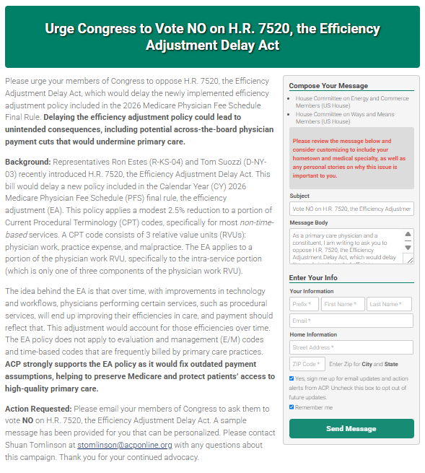

Efficiency Adjustment Grassroots Alert

Slide 25
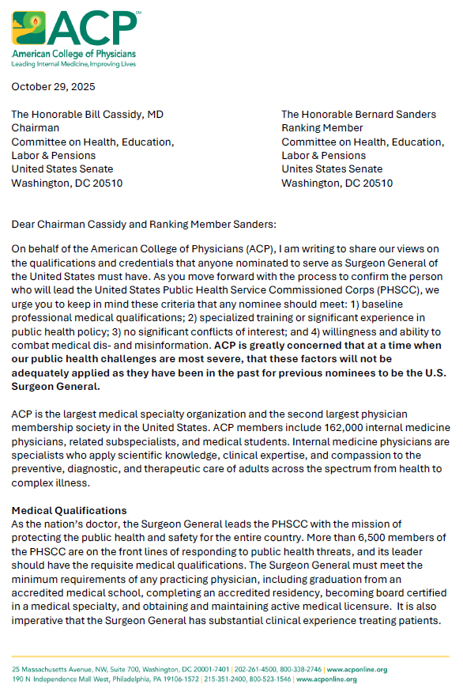
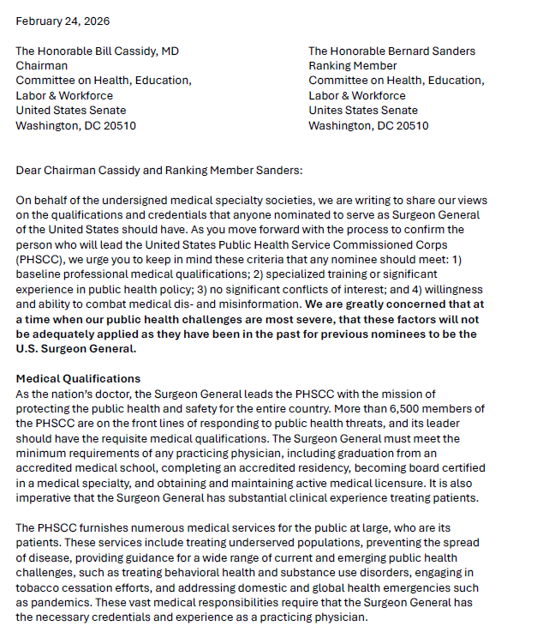
Surgeon General Nomination

Slide 26
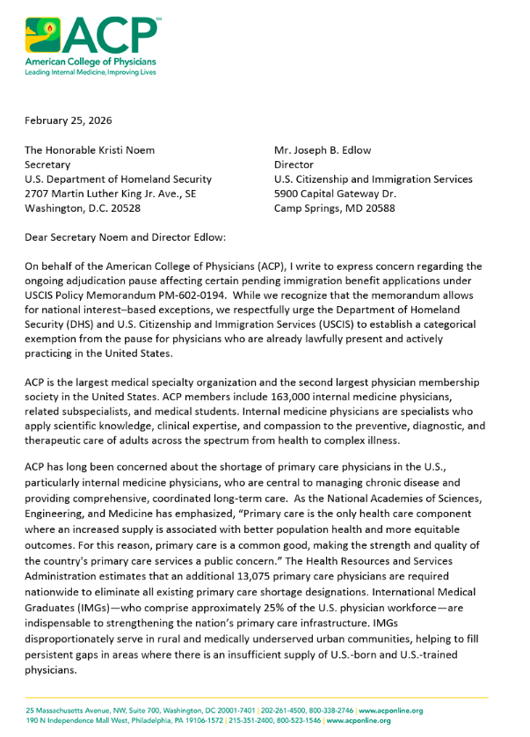

IMG Advocacy

Slide 27
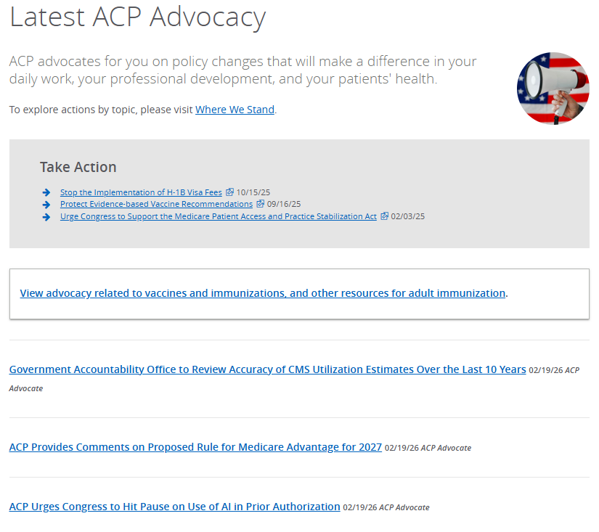
ACP Advocacy in Action

Slide 28
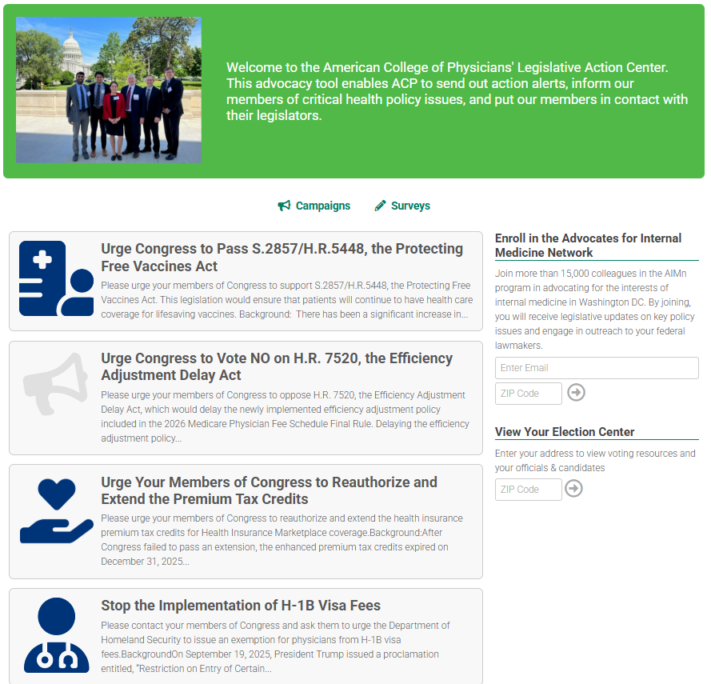

Grassroots Alerts

