Slide 1
2026 State Legislative Sessions & ACP Chapter Resources November 5, 2025
David Pugach, JD Vice President, Governmental Affairs and Public Policy

Slide 2
Overview
2025 Election Issues and State Health Policy Activity
State Legislative Activity
Grassroots and State Advocacy Resources
Leadership Day

Slide 3
2025 Election & State Health Policy

Slide 4





What Was on the ballot this year?
GOVERNOR RACES
New Jersey and Virginia elected new governors, with both states currently being held by term-limited incumbents, Glenn Youngkin (R-VA) and Phil Murphy (D-NJ)
In Virginia, former Rep. Abigail Spanberger (D) faced Lieutenant Governor Winsome Earle-Sears (R), while in New Jersey it was Rep. Mikie Sherrill (D-NJ-11) against Jack Ciattarelli (R)
MAYORS
Several high-profile mayoral races are occured in 2025, with races in New York City and Minneapolis generating the most media interest due to progressive candidates
STATE LEGISLATURES
In addition to voting for Governor, Virginia and New Jersey voted for their state legislature in 2025, with Democrats currently in control in both states
STATE SUPREME COURTS
Wisconsin and Pennsylvania held state Supreme Court elections
STATE BALLOT MEASURES
Six states voted on ballot measures, with California’s redistricting measure (Prop 50) holding the most national impact
SOURCE Ballotpedia, Cook Political Report with Amy Walter.
PRESENTATION CENTER 11/3/25
Notes:
Sources: “United States Senate elections, 2024,” Ballotpedia, accessed January 22, 2024, https://ballotpedia.org/United_States_Senate_elections,_2024
“Gubernatorial elections, 2024,” Ballotpedia, accessed January 22, 2024, https://ballotpedia.org/Gubernatorial_elections,_2024
“State legislative elections, 2024,” Ballotpedia, accessed January 22, 2024, https://ballotpedia.org/State_legislative_elections,_2024
Peter Nicholas, “President Joe Biden drops out of the 2024 presidential race,” NBC News, July 21, 2024, https://www.nbcnews.com/politics/2024-election/president-joe-biden-drops-2024-presidential-race-rcna159867

Slide 5







Six states had Ballot Measures
OVERVIEW
California
A ballot measure to pave the way for a new congressional district map for the 2026 midterms
Colorado
Ballot measure to fund the Healthy School Meals for All Program by retaining excess revenue and limiting certain tax deductions
Maine
Two measures were on the ballot: one addressing possible electoral rule changes and the second one focusing on gun safety
New York
Proposed ballot measure to preserve land within the Mount Van Hoevenberg Olympic Sports Complex
Texas
Texas State Legislature approved 17 ballot measures affecting policy associated with criminal justice, voting rights, and taxation
Washington
One ballot measure proposed to allow certain Trust Funds to be invested into the stock market
California’s Prop 50
Proposed by Governor Gavin Newsom ahead of 2026 Elections
Framed as a response to the Texas mid-cycle redistricting efforts
Would allow the state to use a new congressional district map for 2026-2030
Five Republican districts would shift towards being more Democratic
SOURCE Ballotpedia
PRESENTATION CENTER 11/3/25
Notes:
Sources:
“Voters in Six States Will Decide on 24 Statewide Ballot Measures on Nov. 4 - Ballotpedia News,” October 24, 2025, https://news.ballotpedia.org/2025/10/24/voters-in-six-states-will-decide-on-24-statewide-ballot-measures-on-nov-4/.
“California Proposition 50, Use of Legislative Congressional Redistricting Map Amendment (2025),” Ballotpedia, October 20, 2025, https://ballotpedia.org/California_Proposition_50,_Use_of_Legislative_Congressional_Redistricting_Map_Amendment_(2025).
“California 2025 Ballot Propositions,” Ballotpedia, accessed November 2,2025, https://ballotpedia.org/California_2025_ballot_propositions.
“Colorado 2025 Ballot Measures,” Ballotpedia, accessed November 2,2025, https://ballotpedia.org/Colorado_2025_ballot_measures.
“Maine 2025 Ballot Measures,” Ballotpedia, accessed November 2,2025, https://ballotpedia.org/Maine_2025_ballot_measures.
“New York 2025 Ballot Measures,” Ballotpedia, accessed November 2,2025, https://ballotpedia.org/New_York_2025_ballot_measures.
“Texas 2025 Ballot Measures,” Ballotpedia, accessed November 2,2025, https://ballotpedia.org/Texas_2025_ballot_measures.
“Washington 2025 Ballot Measures,” Ballotpedia, accessed November 2,2025, https://ballotpedia.org/Washington_2025_ballot_measures.

Slide 6





States Expanding Health Policy Authority as Federal Programs Face Uncertainty
The future of many healthcare programs remains uncertain
ACA’s uncertain future
ACA tax credits are set to expire in 2025 amid GOP resistance to an extension until the government shutdown is resolved. HHS issued regulations impacting ACA enrollment that faced legal pushback, but Kennedy v. Braidwood Management upheld the preventive services mandate
Limited drug pricing reform
Drug pricing regulation has relied on executive orders tightening oversight, accelerating generic approvals, and strengthening “most-favored nation” benchmarks. President Trump also struck a deal with Pfizer to tie Medicaid drug prices to the company’s lowest global rates
States are setting their own laws on prescription drugs and reinsurance
Innovative reinsurance models
The ACA approved waivers for 20 states to implement new insurance programs, with states such as MN, WI, and OR operating claims-cost reinsurance models
State coverage mandates
Some states enacted laws requiring insurers to cover specific services, providers, or populations; NJ and MA also mandate that residents maintain minimum coverage
Drug transparency laws
23 states passed drug transparency laws and 12 established Prescription Drug Affordability Boards (PDABs), several of which can set or review price caps
SOURCE The Hill, Reuters, KFF, Latham and Watkins, Politico, CMS, Alliant, Goodwin Law
PRESENTATION CENTER 10/9/25
Notes:
Sources:
Joseph Choi, “Why Congress is running out of time for an ObamaCare deal,” The Hill, October 5, 2025, https://thehill.com/policy/healthcare/5538167-congress-aca-tax-credit-increase/.
Diana Jones, “Democratic Attorneys General Sue to Block HHS Changes to ACA Health Insurance Marketplaces,” Reuters, July 17, 2025, https://www.reuters.com/legal/government/democratic-attorneys-general-sue-block-hhs-changes-aca-health-insurance-2025-07-17/.
Laurie Sobel, Lindsey Dawson, and Alina Salganicoff, “Kennedy V. Braidwood: The Supreme Court Upheld ACA Preventive Services but That’s Not the End of the Story,” KFF, August 9, 2025, https://www.kff.org/affordable-care-act/kennedy-v-braidwood-the-supreme-court-upheld-aca-preventive-services-but-thats-not-the-end-of-the-story/.
“Drug Pricing: FDA Considerations Under Recent Executive Orders and Congressional Bills,” Latham and Watkins, https://www.lw.com/en/insights/drug-pricing-fda-considerations-under-recent-executive-orders-and-congressional-bills.
David Lim, “Pfizer, Trump Strike Drug Pricing Deal,” POLITICO, September 30, 2025, https://www.politico.com/news/2025/09/30/pfizer-trump-strike-drug-pricing-deal-00587993.
“Section 1332: State Innovation Waivers,” CMS, accessed October 5,2025, https://www.cms.gov/marketplace/states/section-1332-state-innovation-waivers.
“State Individual Mandates (and other Group Health Plan Considerations),” Alliant, June 2025, https://alliant.com/media/3wepo5l2/state-individual-mandates.pdf
“State Drug Transparency Laws — 2025 Update,” Goodwin Law, June 2, 2025, https://www.goodwinlaw.com/en/insights/publications/2025/06/alerts-lifesciences-state-drug-transparency-laws?utm_source=chatgpt.com.
“Prescription Drug Affordability Review Boards — 2025 Update,” Goodwin Law, June 2, 2025, https://www.goodwinlaw.com/en/insights/publications/2025/06/alerts-lifesciences-prescription-drug-affordability-review-boards.

Slide 7
State Legislative Activity

Slide 8
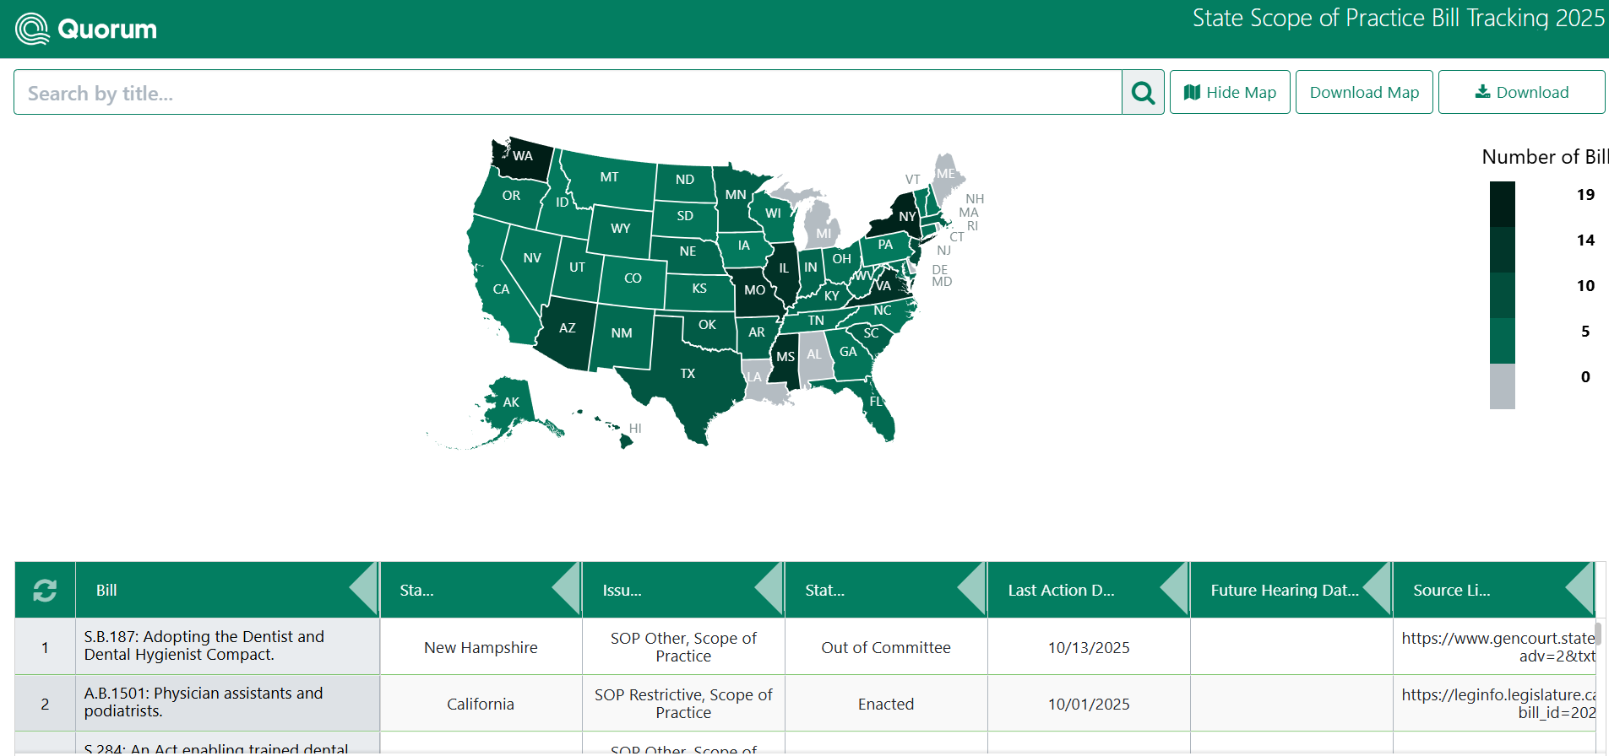
State Legislative Tracking
In 2025, ACP tracked state legislation on:
Scope of Practice
Prior Authorization
AI & Health
Firearm Injury Prevention
Reproductive Health

Slide 9

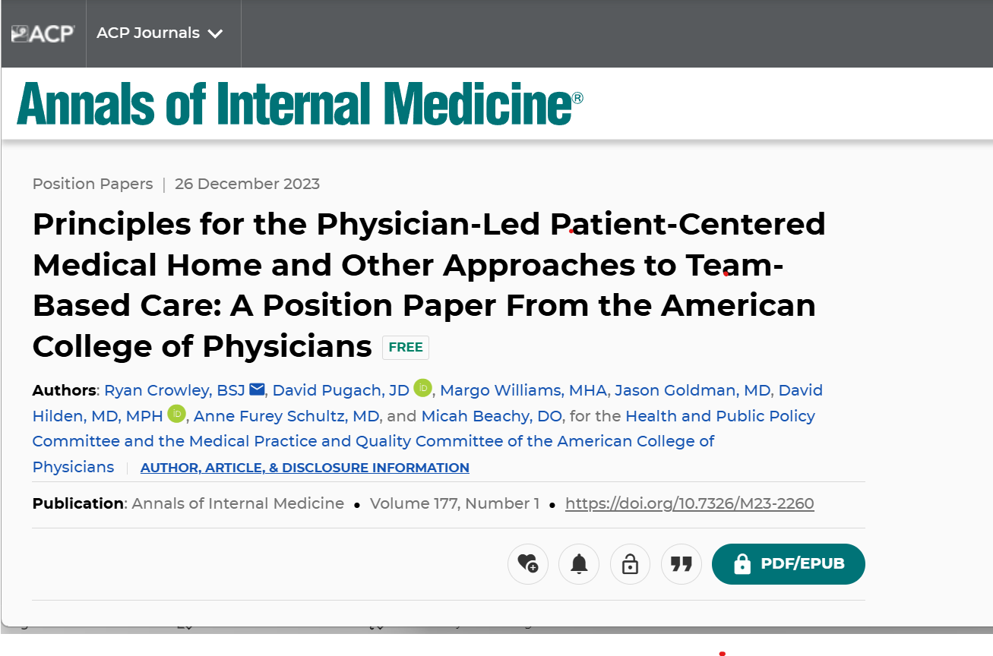
Scope of Practice Activity
249 scope bills were introduced in 2025.
More than 150 scope expansion bills were defeated this year that would have expand the scope of NPs, Nurse anesthetists, PAs, optometrists, pharmacists, psychologists, naturopaths, and podiatrists.

Slide 10
Grassroots and State Advocacy Resources

Slide 11
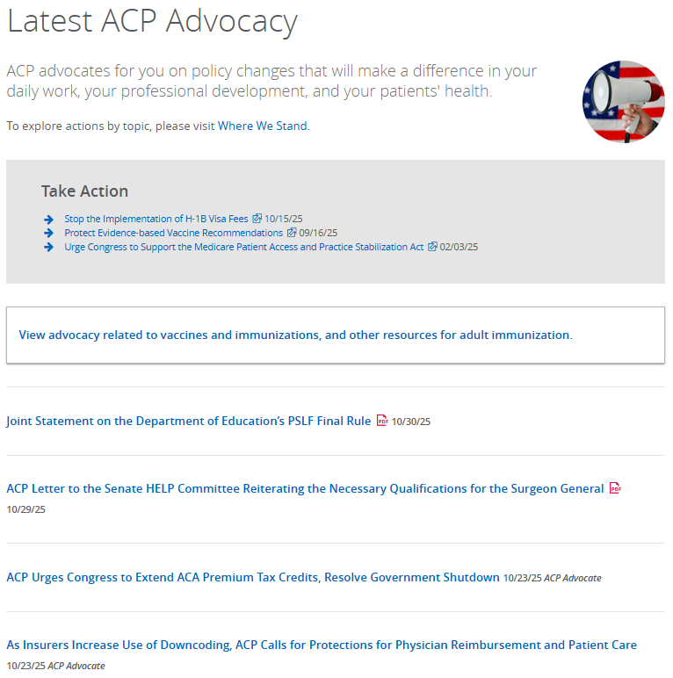


Slide 12
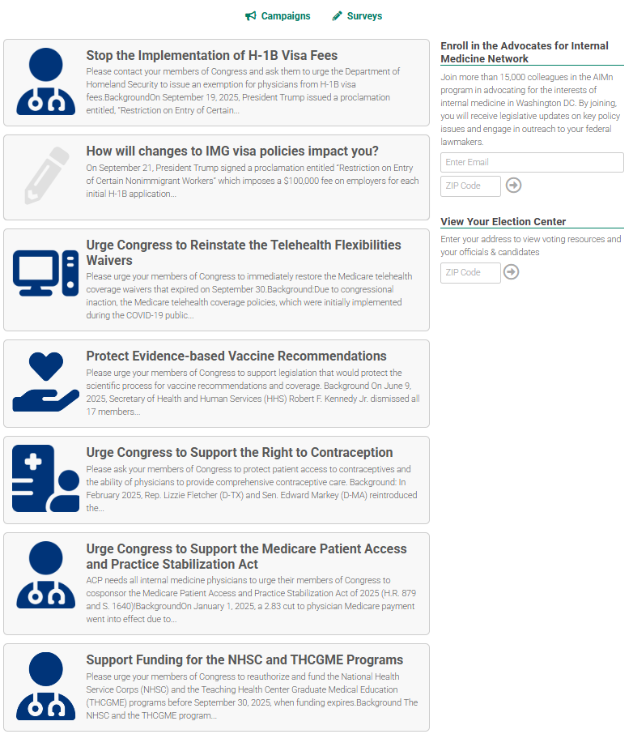

ACP Legislative Action Center

Slide 13
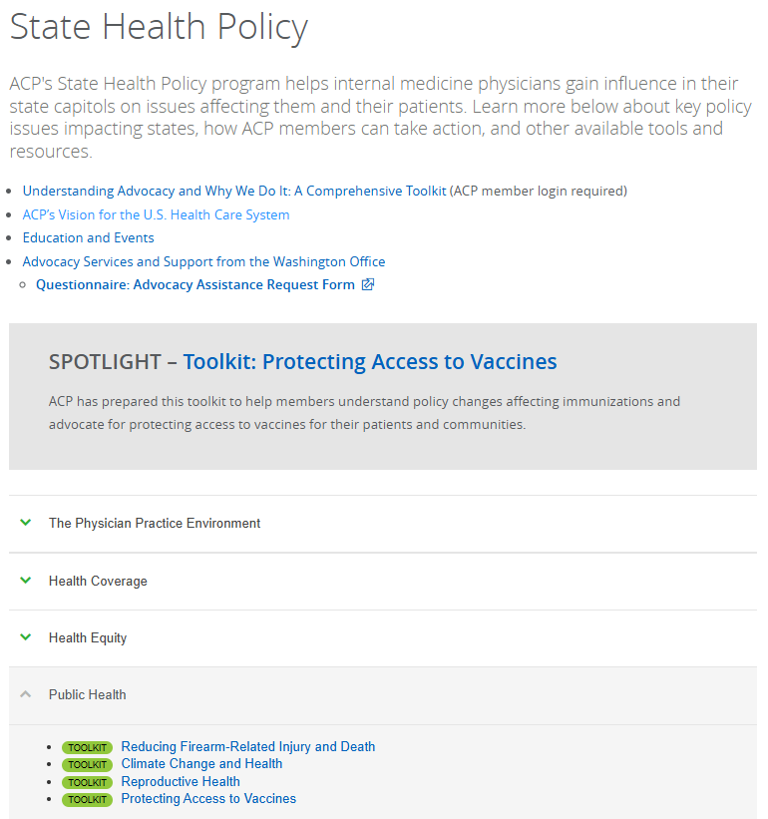


Slide 14


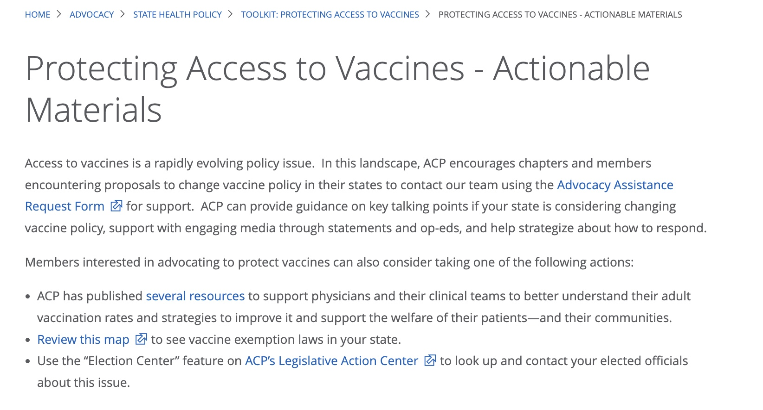
Toolkit Supporting Access to Vaccines

Slide 15
Leadership Day

Slide 16

2025 Leadership Day Participation
512 people registered
470 ACP members attended, including:
275 physician members
132 residents
67 medical students
Nearly 50 more physicians attended in 2025 than 2024

Slide 17
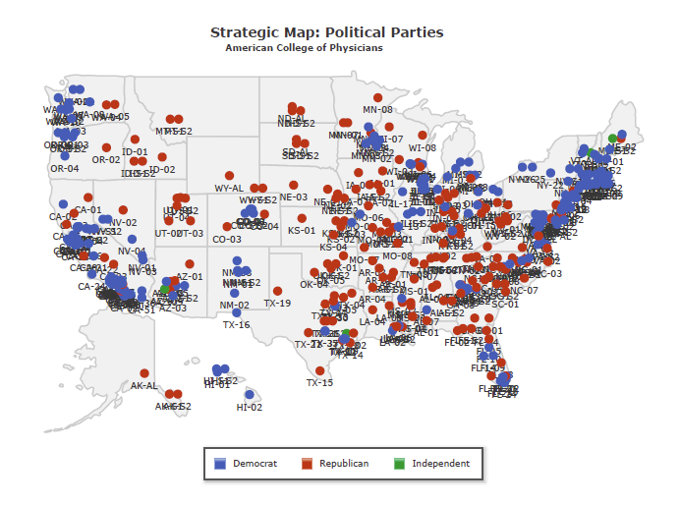
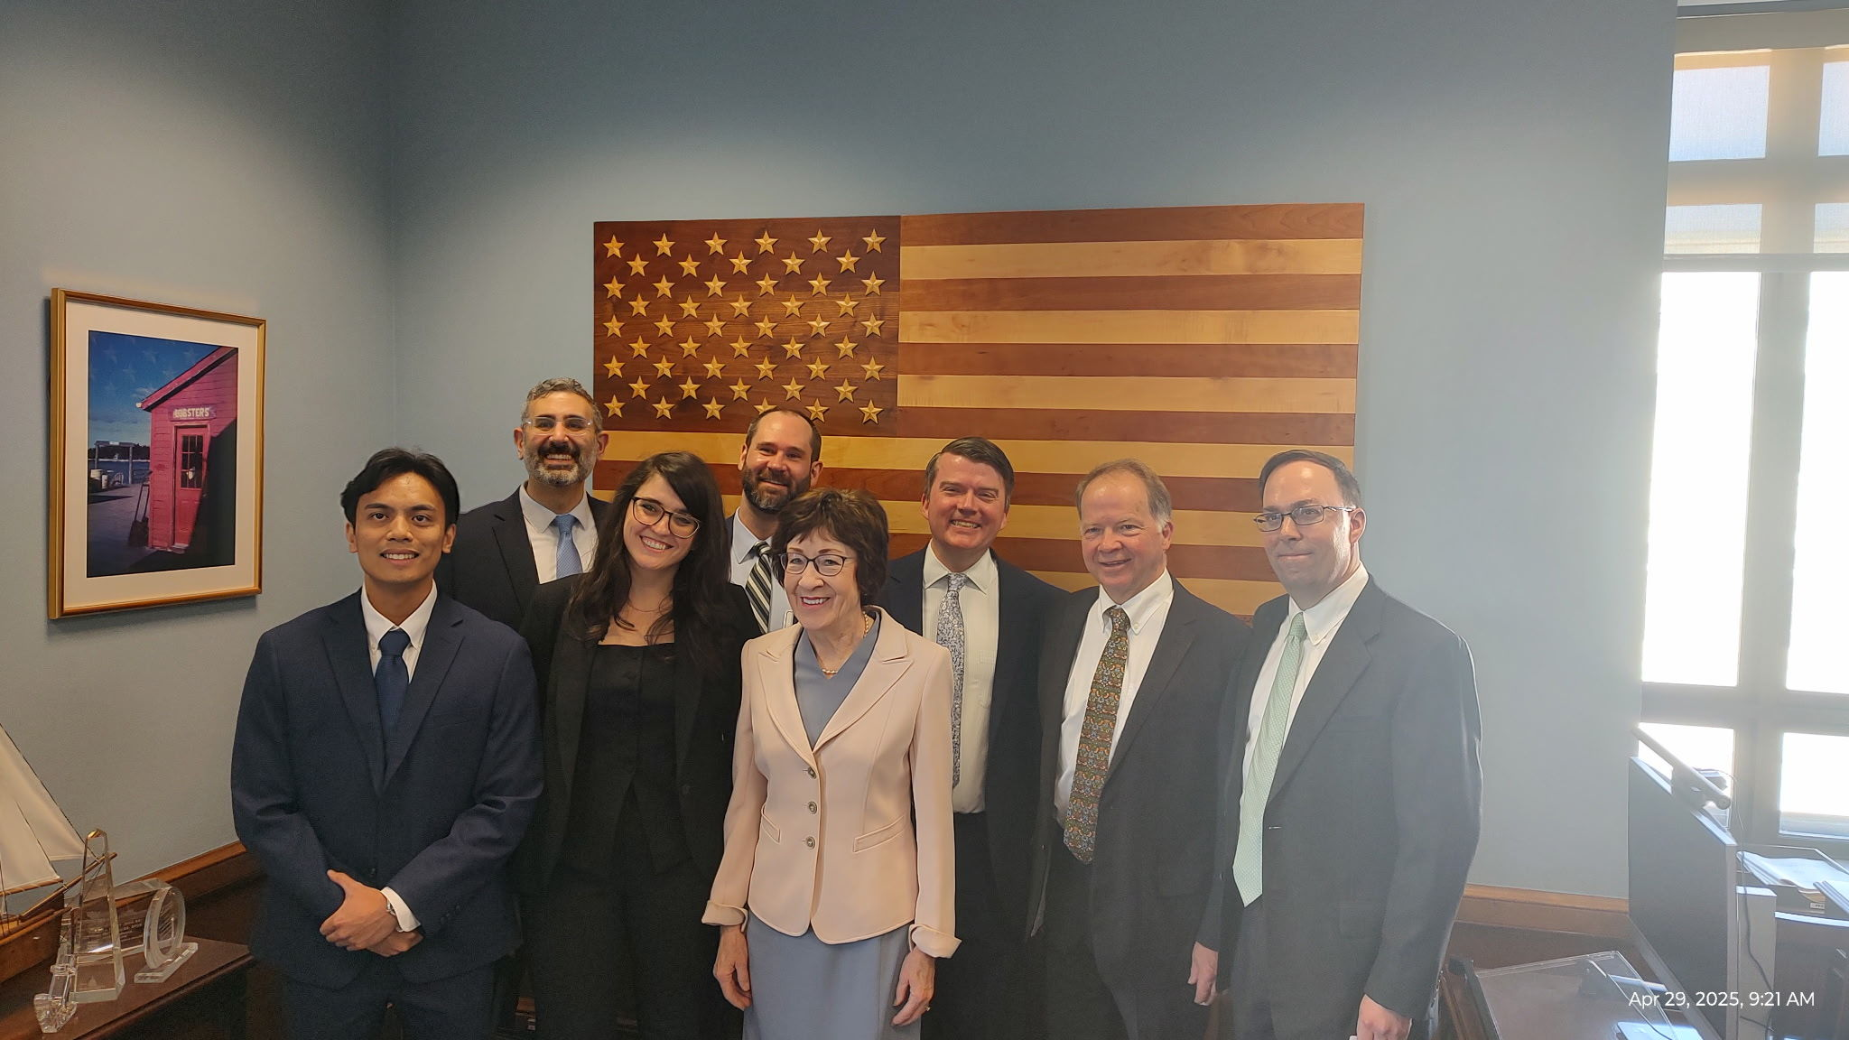
2025 Leadership Day
414 congressional meetings
50 states and DC
48% with members of congress or senior staff
73 member
132 senior staff
83 non-constituent meetings

Slide 18
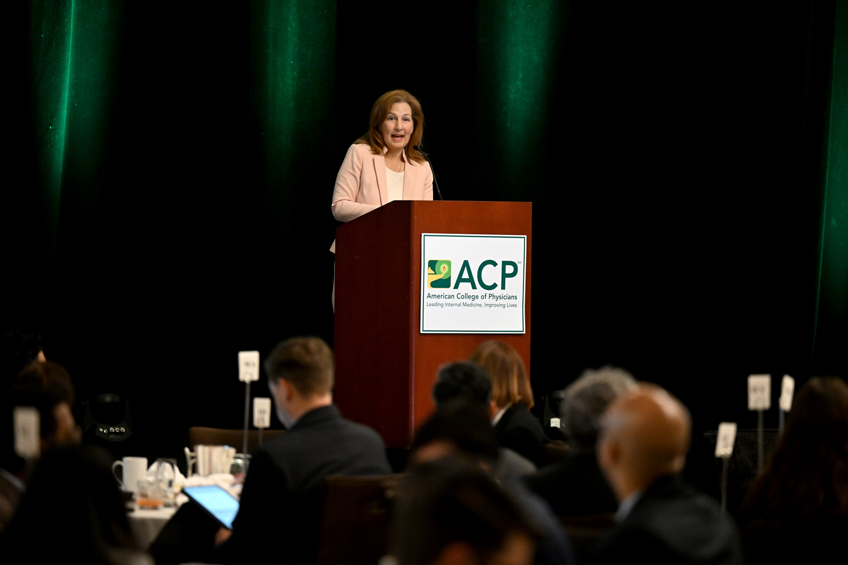
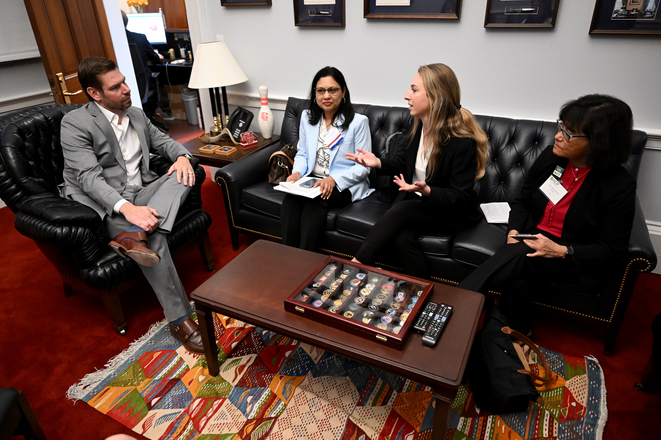
2026 Leadership Day
May 12-13 in Washington, DC
Registration will open in early January
If interested in participating, please contact your chapter

Slide 19
Questions

