Slide 1
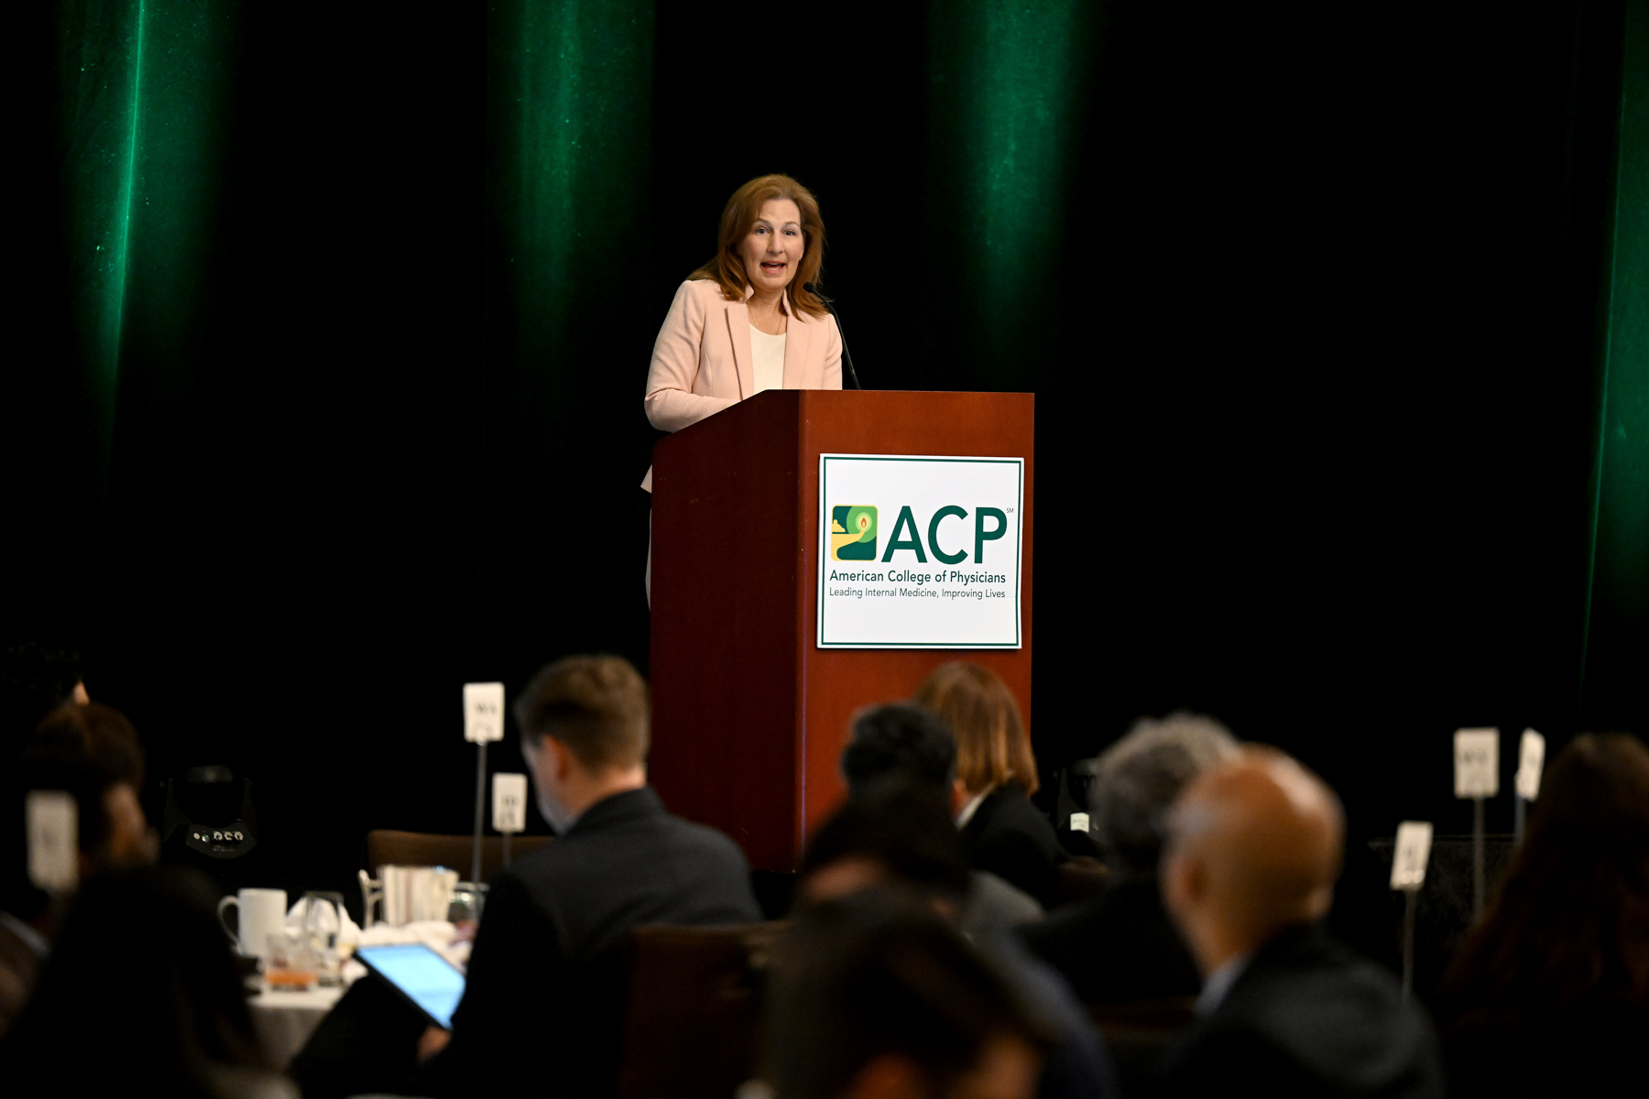
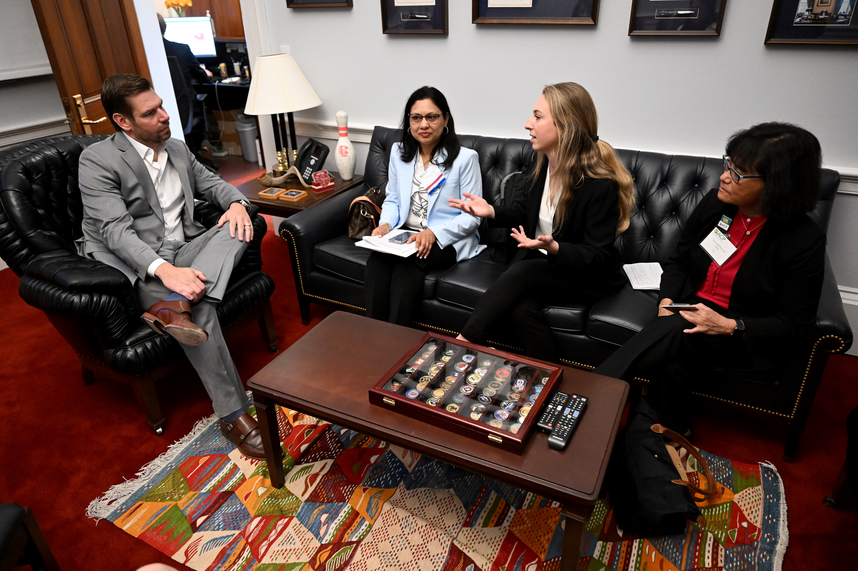

Leadership Day 2026
Tuesday, May 12 – Wednesday, May 13
The Westin Washington, DC Downtown Hotel (located at 999 9th Street, NW) -- Deadline April 20
Registration Now! Deadline April 24
Visit the Leadership Day Hub for more info. and resources

Slide 2
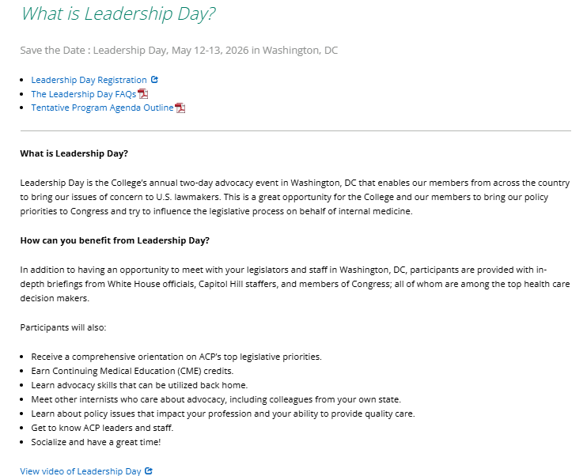


Slide 3
Constituent Visits and Personalized Outreach are Most Influential
INFLUENCE OF ADVOCACY STRATEGIES DIRECTED AT A MEMBER’S WASHINGTON OFFICE
■ A lot of positive influence ■ Some positive influence
*Asked of Chiefs of Staff, Communications Directors, Legislative Directors, Legislative Assistants
SOURCE Congressional Management Foundation.
PRESENTATION CENTER 2/13/25
Notes:
Sources:
“Citizen-Centric Advocacy: The Untapped Power of Constituent Engagement,” Congressional Management Foundation, 2017
http://www.congressfoundation.org/storage/documents/CMF_Pubs/cmf-citizen-centric-advocacy.pdf

Slide 4
Cosponsorship of Leadership Day Legislation
2023 & 2024 Leadership Day Legislative Ask Cosponsors
Bill | Cosponsors Before LD23 | Cosponsors a/o 6/30/23 | Change | % Change | Cosponsors a/o 5/13/24 | Cosponsors a/o 6/30/24 | Change | % Change
HR 2630: Safe Step Act | 29 | 66 | 37 | 127.6% | 194 | 217 | 23 | 11.9%
S 652 | 28 | 30 | 2 | 7.1% | 41 | 41 | 0 | 0.0%
HR 2389: Resident Physician Shortage Reduction Act | 76 | 125 | 49 | 64.5% | 175 | 182 | 7 | 4.0%
S 1302 | 4 | 4 | 0 | 0.0% | 7 | 7 | 0 | 0.0%
HR 6545: Physician Fee Schedule Improvements Act | -- | -- | -- | -- | 14 | 18 | 4 | 28.6%

Slide 5
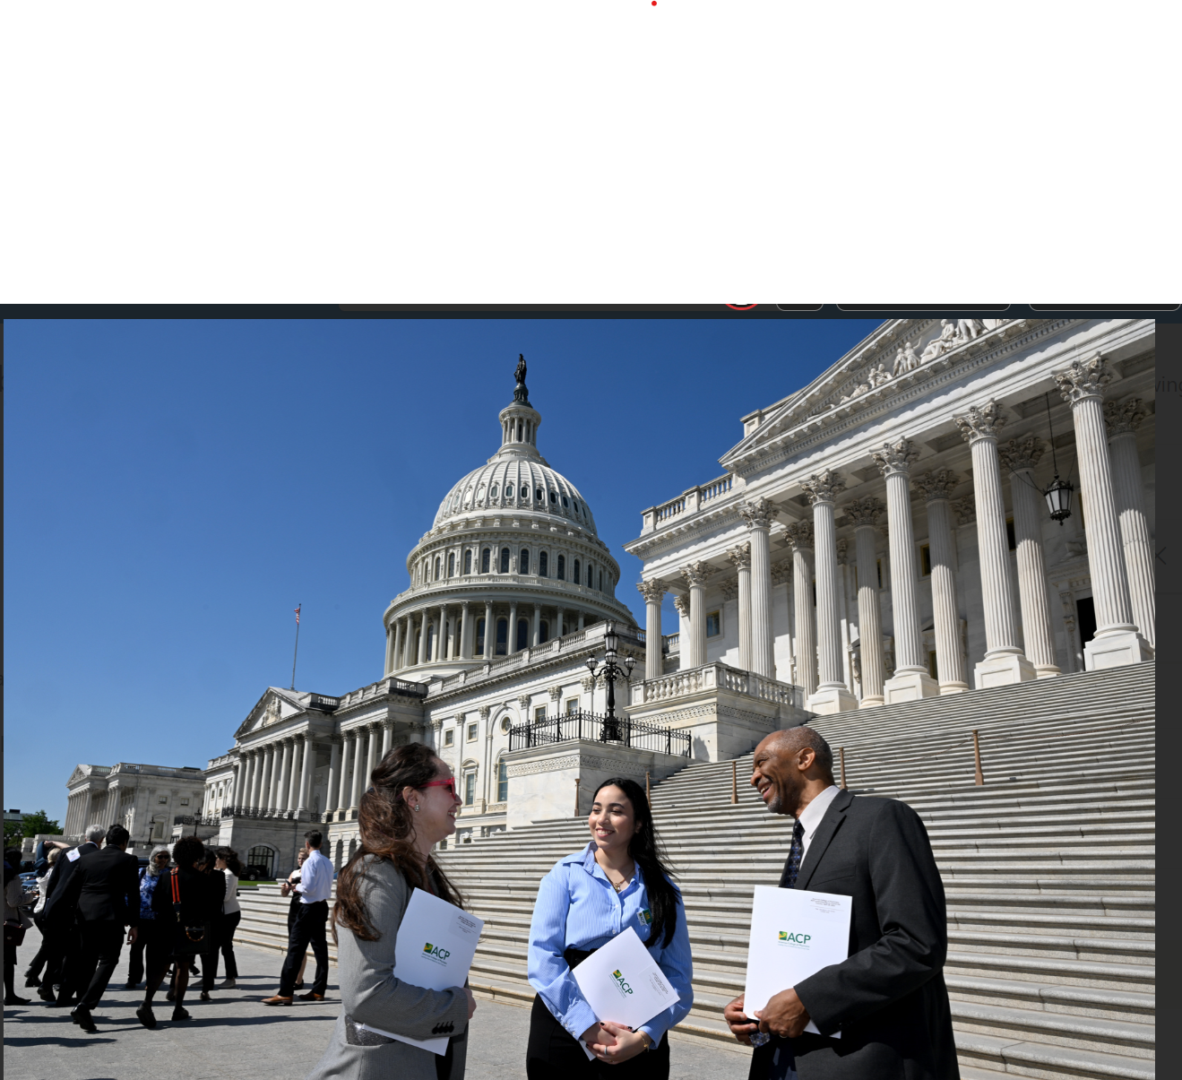
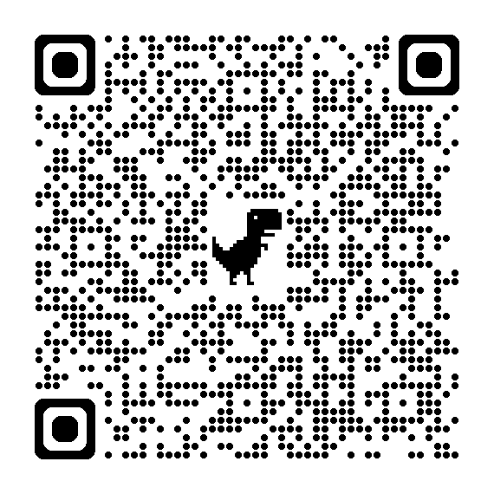
Leadership Day 2026
Richard Neubauer Advocate of the Year Award– Nominations due March 16!
Presented during Leadership Day on May 12.

